Slide 1
Chapter Fourteen
Consumer’s Surplus
消费者剩余

Slide 2
Structure
Money equivalent of utility gains to trade
Consumer’s surplus
Changes in consumer’s surplus
Compensating and equivalent variations
Producer’s surplus

Slide 3
Monetary Measures of Gains-to-Trade
You can buy as much gasoline as you wish at $1 per gallon once you enter the gasoline market.
Q: What is the most you would pay to enter the market?
A: You would pay up to the dollar value of the gains-to-trade you would enjoy once in the market.

Slide 4
Monetary Measures of Gains-to-Trade
How can such gains-to-trade be measured?
Three such measures are:
  Consumer’s Surplus
  Equivalent Variation （等价变换）, and
  Compensating Variation （补偿变换）.
Only in one special circumstance do these three measures coincide.

Slide 5
Reservation Price
Maximum willingness to pay for an additional unit of a good
Two goods: good 1 (x₁) and expenditure on others (x₂); p₂=1
By budget constraint (p₁x₁+x₂=m):
  If x₁=0, then x₂=m
  If x₁=1, then x₂=m-p₁
  If x₁=2, then x₂=m-2p₁
  If x₁=3, then x₂=m-3p₁

Slide 6
Reservation Price
Reservation price for the 1st unit (r₁)
u(0, m) = u(1, m-r₁)
r₁ is the dollar equivalent of the marginal utility of the 1st unit.
Reservation price for the 2nd unit (r₂)
u(1, m-r₂) = u(2, m-2r₂)
r₂ is the dollar equivalent of the marginal utility of the 2nd unit.
Reservation price for the 3rd unit (r₃)
u(2, m-2r₃) = u(2, m-3r₃)

Slide 7
$ Equivalent Utility Gains
Generally, if she already has n-1 gallons of gasoline then r_{n} denotes the most she will pay for an nth gallon.
  r_{n} is the dollar equivalent of the marginal utility of the nth gallon.

Slide 8
$ Equivalent Utility Gains
r₁ + … + r_{n} will be the dollar equivalent of the total change to utility from consuming n gallons of gasoline at a price of $0.

Slide 9
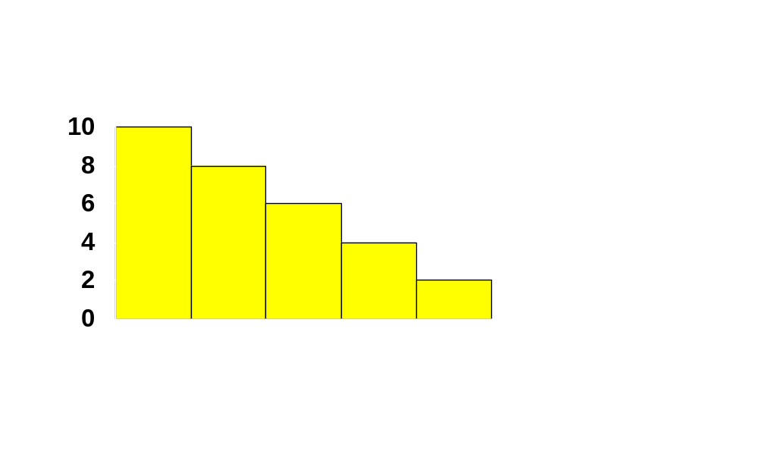
$ Equivalent Utility Gains
r₁
r₂
r₃
r₄
r₅
r₆
1
2
3
4
5
6

Slide 10
$ Equivalent Utility Gains
What is the monetary value of our consumer’s gain-to-trading in the gasoline market at a price of $p_{G}?

Slide 11
$ Equivalent Utility Gains
The dollar equivalent net utility gain for the 1st gallon is $(r₁ - p_{G})
and is $(r₂ - p_{G}) for the 2nd gallon,
and so on, so the dollar value of the gain-to-trade is
$(r₁ - p_{G}) + $(r₂ - p_{G}) + …
for as long as r_{n} - p_{G} > 0.

Slide 12
$ Equivalent Utility Gains
So r₁ + … + r_{n} - p_{G}n will be the dollar equivalent of the total change to utility from consuming n gallons of gasoline at a price of $p_{G} each.

Slide 13
$ Equivalent Utility Gains
r₁
r₂
r₃
r₄
p_{G}
r₅
r₆
1
2
3
4
5
6

Slide 14
$ Equivalent Utility Gains
r₁
r₂
r₃
r₄
p_{G}
r₅
r₆
1
2
3
4
5
6

Slide 15
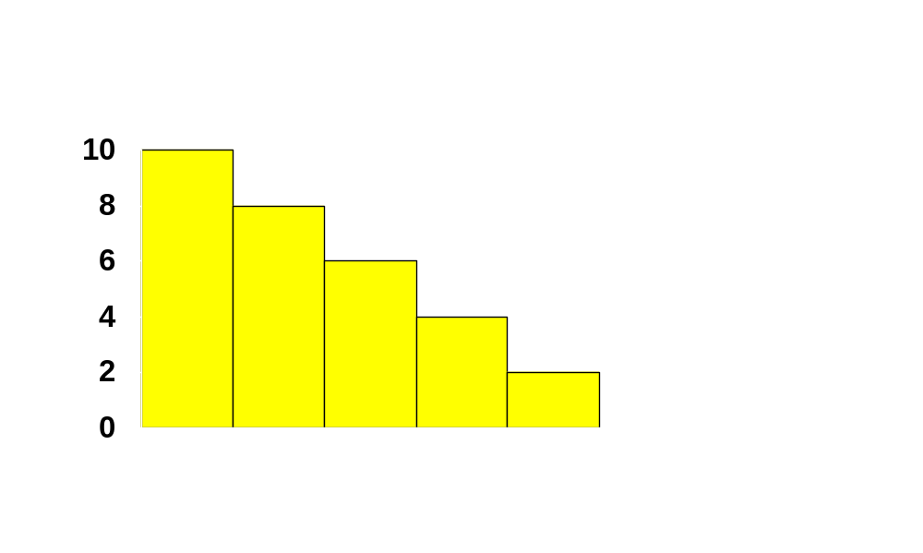
$ Equivalent Utility Gains
$ value of net utility gains-to-trade
r₁
r₂
r₃
r₄
p_{G}
r₅
r₆
1
2
3
4
5
6

Slide 16
$ Equivalent Utility Gains
If gasoline can be purchased in any quantity then ...

Slide 17
$ Equivalent Utility Gains
($) Res.
Prices
Reservation Price Curve for Gasoline
Gasoline

Slide 18
$ Equivalent Utility Gains
($) Res.
Prices
Reservation Price Curve for Gasoline
p_{G}
Gasoline

Slide 19
$ Equivalent Utility Gains
($) Res.
Prices
Reservation Price Curve for Gasoline
$ value of net utility gains-to-trade
p_{G}
Gasoline

Slide 20
Quasi-Linear Utility
U(x, y) = v(x) + y
Reservation prices for the first 3 units:
v(0)+m=v(1)+m- r₁ ⇒ r₁= v(1) - v(0)
v(1)+m- r₂=v(2)+m- 2r₂ ⇒ r₂= v(2) - v(1)
v(2)+m- 2r₃=v(3)+m- 3r₃ ⇒ r₃= v(3) - v(2)
r₁+r₂+r₃=v(3)-v(0)=v(3)
This is the gross benefit （毛收益）of consuming 3 units of good x.

Slide 21
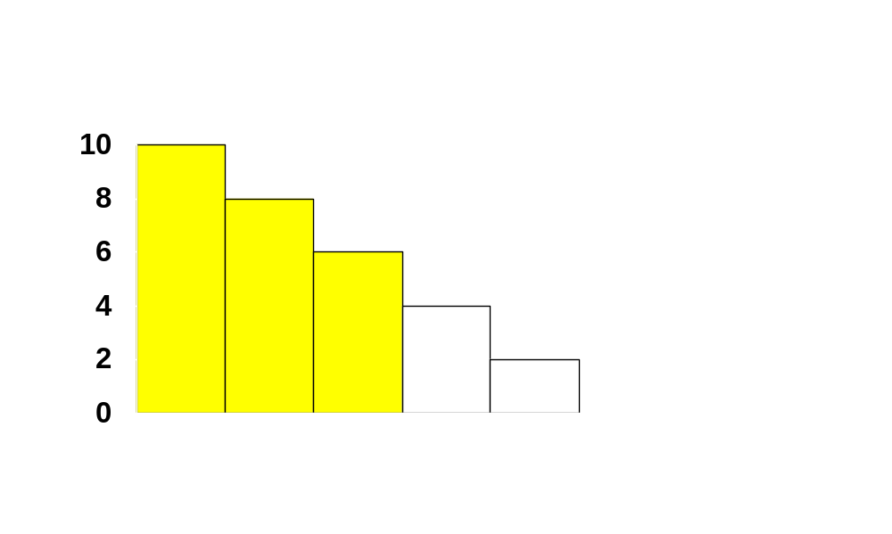
Quasi-Linear Utility
r₁
r₂
r₃
r₄
r₅
r₆
1
2
3
4
5
6

Slide 22
Quasi-Linear Utility
When x=3, y=m-3p,
U(3, m-3p)= v(3) + m-3p
If consume 0 good x, then y=m
U(0, m) = m
The net benefit of consuming x (gains-to-trade)
U(3, m-3p) – U(0, m) = v(3) - 3p
If n units of x then utility gain is
v(n) – pn
This is the net benefit （净收益）.

Slide 23
Quasi-Linear Utility
r₁
r₂
r₃
r₄
p
r₅
r₆
1
2
3
4
5
6

Slide 24
$ Equivalent Utility Gains
Unfortunately, estimating a consumer’s reservation-price curve is difficult,
so, as an approximation, we use the consumer’s ordinary demand curve.
This approximation gives the Consumer’s Surplus measure of net utility gain.

Slide 25
Consumer’s Surplus
A consumer’s reservation-price curve is not quite the same as her ordinary demand curve. Why not?
A reservation-price curve describes sequentially the values of successive single units of a commodity.
An ordinary demand curve describes the most that would be paid for q units of a commodity purchased simultaneously.

Slide 26
Consumer’s Surplus
But, if the consumer’s utility function is quasilinear in income then
  The reservation price curve is exactly the demand curve
  Consumer’s Surplus is an exact $ measure of gains-to-trade.
If income effects are small, then the approximation is good.

Slide 27


Consumer’s Surplus
The consumer’s utility function is
quasilinear in x_{2.}
Take p₂ = 1. Then the consumer’s
choice problem is to maximize
subject to

Slide 28
Consumer’s Surplus
The consumer’s utility function is
quasilinear in x_{2.}
Take p₂ = 1. Then the consumer’s
choice problem is to maximize
subject to

Slide 29
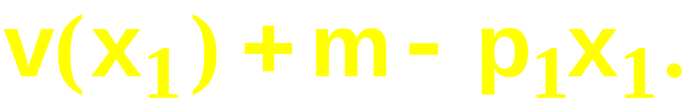
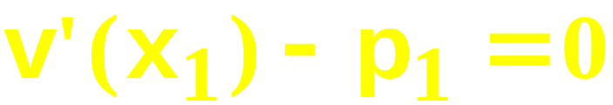

Consumer’s Surplus
That is, choose x₁ to maximize
The first-order condition is
That is,
This is the equation of the consumer’s
ordinary demand for commodity 1.

Slide 30
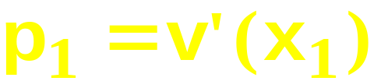
Consumer’s Surplus
p₁
Ordinary demand curve,
is exactly the consumer’s utility
gain from consuming x₁’
units of commodity 1.
CS

Slide 31
Interpreting Consumer’s Surplus
Net benefit of consuming n units of the good:
Compensation needed to give up consuming the product.

Slide 32
Change in Consumer’s Surplus
The change to a consumer’s total utility due to a change to p₁ is approximately the change in her Consumer’s Surplus.

Slide 33
Consumer’s Surplus
p₁
p₁(x₁), the inverse ordinary demand
curve for commodity 1

Slide 34
Consumer’s Surplus
p₁
p₁(x₁)
CS before

Slide 35
Consumer’s Surplus
p₁
p₁(x₁)
CS after

Slide 36
Consumer’s Surplus
p₁
p₁(x₁), inverse ordinary demand
curve for commodity 1.
Lost CS

Slide 37
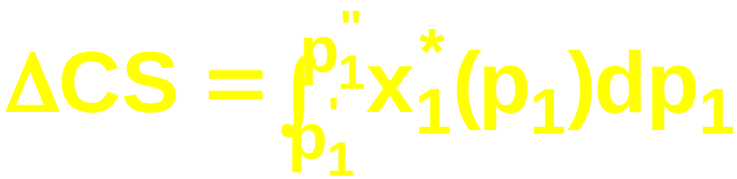
Consumer’s Surplus
x₁*(p₁), the consumer’s ordinary
demand curve for commodity 1.
measures the loss in
Consumer’s Surplus.
Lost
CS
p₁

Slide 38
Compensating Variation and Equivalent Variation
Two additional dollar measures of the total utility change caused by a price change are Compensating Variation and Equivalent Variation.

Slide 39
Compensating Variation
p₁ rises.
Q: What is the least extra income that, at the new prices, just restores the consumer’s original utility level?
A: The Compensating Variation.

Slide 40
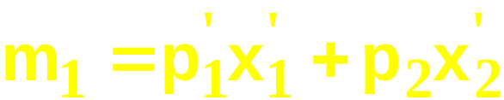
Compensating Variation
p₁=p₁’
p₂ is fixed.
x₂
u₁
x₁

Slide 41
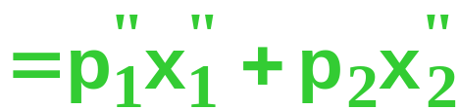
Compensating Variation
p₁=p₁’
p₁=p₁”
p₂ is fixed.
x₂
u₁
u₂
x₁

Slide 42
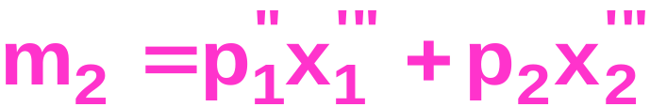
Compensating Variation
p₁=p₁’
p₁=p₁”
p₂ is fixed.
x₂
u₁
u₂
x₁

Slide 43
Compensating Variation
p₁=p₁’
p₁=p₁”
p₂ is fixed.
x₂
u₁
u₂
CV = m₂ - m₁.
x₁

Slide 44
Equivalent Variation
p₁ rises.
Q: What is the least extra income that, at the original prices, just restores the consumer’s original utility level?
A: The Equivalent Variation.

Slide 45
Equivalent Variation
p₁=p₁’
p₂ is fixed.
x₂
u₁
x₁

Slide 46
Equivalent Variation
p₁=p₁’
p₁=p₁”
p₂ is fixed.
x₂
u₁
u₂
x₁

Slide 47
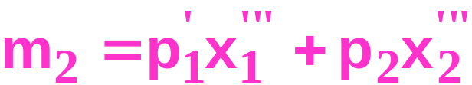
Equivalent Variation
p₁=p₁’
p₁=p₁”
p₂ is fixed.
x₂
u₁
u₂
x₁

Slide 48
Equivalent Variation
p₁=p₁’
p₁=p₁”
p₂ is fixed.
x₂
u₁
u₂
EV = m₁ - m₂.
x₁

Slide 49
Consumer’s Surplus, Compensating Variation and Equivalent Variation
When the consumer has quasilinear
utility,
CV = EV = ΔCS.
But, otherwise, we have:
In size, EV < ΔCS < CV.

Slide 50
Producer’s Surplus
Changes in a firm’s welfare can be measured in dollars much as for a consumer.

Slide 51
Producer’s Surplus
Output price (p)
Marginal Cost
y
(output units)

Slide 52
Producer’s Surplus
Output price (p)
Marginal Cost
y
(output units)

Slide 53
Producer’s Surplus
Output price (p)
Marginal Cost
Revenue
=
y
(output units)

Slide 54
Producer’s Surplus
Output price (p)
Marginal Cost
Variable Cost of producing
y’ units is the sum of the
marginal costs
y
(output units)

Slide 55
Producer’s Surplus
Output price (p)
Revenue less VC
is the Producer’s
Surplus.
Marginal Cost
Variable Cost of producing
y’ units is the sum of the
marginal costs
y
(output units)

