Slide 1
Chapter Fifteen
Market Demand
市场需求

Slide 2
Structure
From Individual to Market Demand Functions
Elasticities
Revenue and own-price elasticity of demand
Marginal revenue and price elasticity

Slide 3
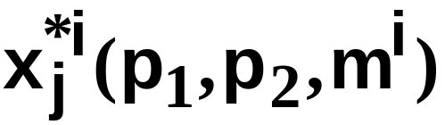
From Individual to Market Demand Functions
Think of an economy containing n consumers, denoted by i = 1, … ,n.
Consumer i’s ordinary demand function for commodity j is

Slide 4
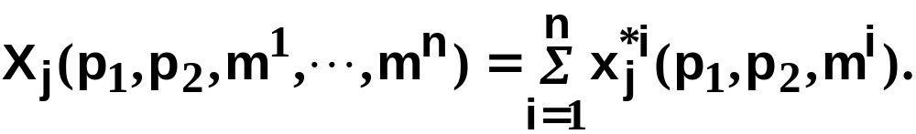
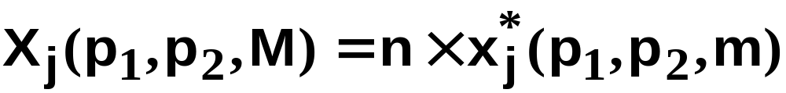
From Individual to Market Demand Functions
When all consumers are price-takers, the market demand function for commodity j is
If all consumers are identical then
where M = nm.

Slide 5
From Individual to Market Demand Functions
The market demand curve is the “horizontal sum” of the individual consumers’ demand curves.
E.g. suppose there are only two consumers; i = A,B.

Slide 6
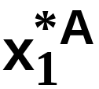
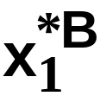
From Individual to Market Demand Functions
p₁
p₁
p₁’
p₁’
p₁”
p₁”
20
15

Slide 7
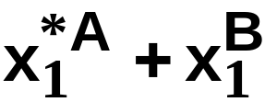
From Individual to Market Demand Functions
p₁
p₁
p₁’
p₁’
p₁”
p₁”
20
15
p₁
p₁’

Slide 8
From Individual to Market Demand Functions
p₁
p₁
p₁’
p₁’
p₁”
p₁”
20
15
p₁
p₁’
p₁”

Slide 9
From Individual to Market Demand Functions
p₁
p₁
p₁’
p₁’
p₁”
p₁”
20
15
p₁
p₁’
The “horizontal sum”
of the demand curves
of individuals A and B.
p₁”
35

Slide 10
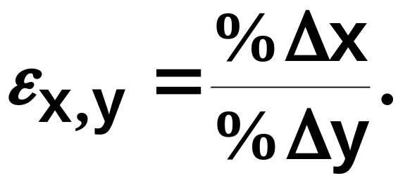
Elasticities （弹性）
Elasticity measures the “sensitivity” of one variable with respect to another.
The elasticity of variable X with respect to variable Y is

Slide 11
Economic Applications of Elasticity
Economists use elasticities to measure the sensitivity of
  quantity demanded of commodity i with respect to the price of commodity i (own-price elasticity of demand，需求的自价格弹性)
  demand for commodity i with respect to the price of commodity j (cross-price elasticity of demand，需求的交叉价格弹性).

Slide 12
Economic Applications of Elasticity
  demand for commodity i with respect to income (income elasticity of demand 需求的收入弹性)
  quantity supplied of commodity i with respect to the price of commodity i (own-price elasticity of supply 供给的自价格弹性)

Slide 13
Economic Applications of Elasticity
  quantity supplied of commodity i with respect to the wage rate (elasticity of supply with respect to the price of labor)
  and many, many others.

Slide 14
Own-Price Elasticity of Demand
Q: Why not use a demand curve’s slope to measure the sensitivity of quantity demanded to a change in a commodity’s own price?

Slide 15
Own-Price Elasticity of Demand
p₁
p₁
slope
= - 2
slope
= - 0.2
10
10
5
X₁*
50
X₁*
In which case is the quantity demanded
X₁* more sensitive to changes to p₁?

Slide 16
Own-Price Elasticity of Demand
p₁
p₁
slope
= - 2
slope
= - 0.2
10
10
5
X₁*
50
X₁*
In which case is the quantity demanded
X₁* more sensitive to changes to p₁?

Slide 17
Own-Price Elasticity of Demand
10-packs
Single Units
p₁
p₁
slope
= - 2
slope
= - 0.2
10
10
5
X₁*
50
X₁*
In which case is the quantity demanded
X₁* more sensitive to changes to p₁?

Slide 18
Own-Price Elasticity of Demand
10-packs
Single Units
p₁
p₁
slope
= - 2
slope
= - 0.2
10
10
5
X₁*
50
X₁*
In which case is the quantity demanded
X₁* more sensitive to changes to p₁?
It is the same in both cases.

Slide 19
Own-Price Elasticity of Demand
Q: Why not just use the slope of a demand curve to measure the sensitivity of quantity demanded to a change in a commodity’s own price?
A: Because the value of sensitivity then depends upon the (arbitrary) units of measurement used for quantity demanded.

Slide 20
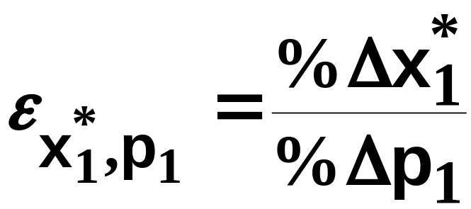
Own-Price Elasticity of Demand
is a ratio of percentages and so has no
units of measurement.
Hence own-price elasticity of demand is a sensitivity measure that is independent of units of measurement.

Slide 21
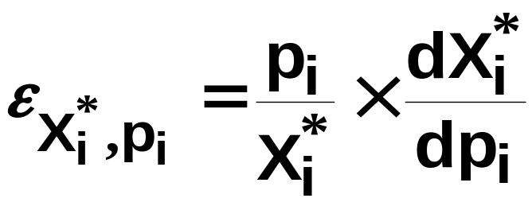
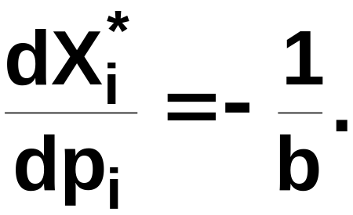
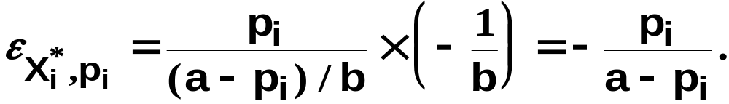
Point Own-Price Elasticity
E.g. Suppose p_{i} = a - bX_{i}.
Then X_{i} = (a-p_{i})/b and
Therefore,

Slide 22
Point Own-Price Elasticity
p_{i}
p_{i} = a - bX_{i}*
a
a/b
X_{i}*

Slide 23
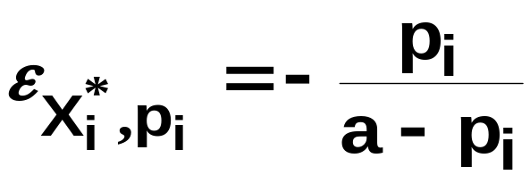
Point Own-Price Elasticity
p_{i}
p_{i} = a - bX_{i}*
a
a/b
X_{i}*

Slide 24

Point Own-Price Elasticity
p_{i}
p_{i} = a - bX_{i}*
a
a/b
X_{i}*

Slide 25

Point Own-Price Elasticity
p_{i}
p_{i} = a - bX_{i}*
a
a/b
X_{i}*

Slide 26
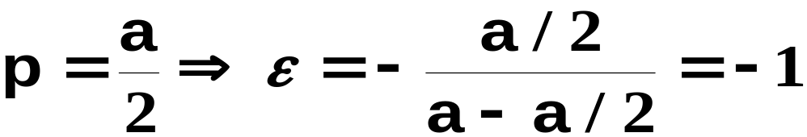
Point Own-Price Elasticity
p_{i}
p_{i} = a - bX_{i}*
a
a/b
X_{i}*

Slide 27

Point Own-Price Elasticity
p_{i}
p_{i} = a - bX_{i}*
a
a/2
a/2b
a/b
X_{i}*

Slide 28
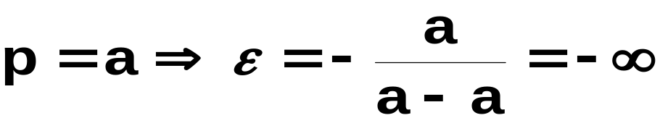
Point Own-Price Elasticity
p_{i}
p_{i} = a - bX_{i}*
a
a/2
a/2b
a/b
X_{i}*

Slide 29

Point Own-Price Elasticity
p_{i}
p_{i} = a - bX_{i}*
a
a/2
a/2b
a/b
X_{i}*

Slide 30
Point Own-Price Elasticity
p_{i}
p_{i} = a - bX_{i}*
a
own-price elastic （有弹性）
a/2
own-price inelastic （缺乏弹性）
a/2b
a/b
X_{i}*

Slide 31
Point Own-Price Elasticity
p_{i}
p_{i} = a - bX_{i}*
a
own-price elastic
(own-price unit elastic)
单位弹性
a/2
own-price inelastic
a/2b
a/b
X_{i}*

Slide 32
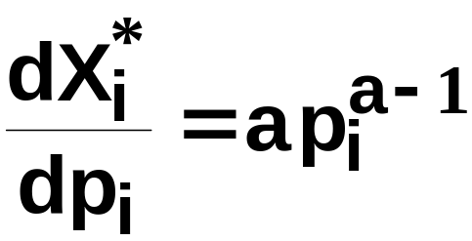
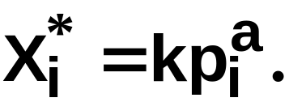
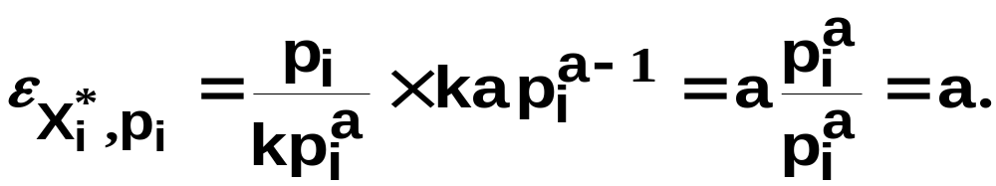
Point Own-Price Elasticity
E.g.
Then
so

Slide 33
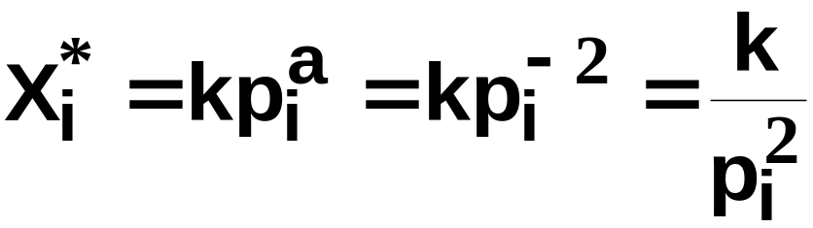

Point Own-Price Elasticity
p_{i}
everywhere along
the demand curve.
X_{i}*

Slide 34
Revenue and Own-Price Elasticity of Demand
If raising a commodity’s price causes little decrease in quantity demanded, then sellers’ revenues rise.
  Hence own-price inelastic demand causes sellers’ revenues to rise as price rises.
If raising a commodity’s price causes a large decrease in quantity demanded, then sellers’ revenues fall.
  Hence own-price elastic demand causes sellers’ revenues to fall as price rises.

Slide 35
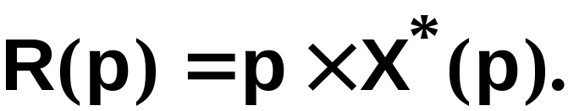
Revenue and Own-Price Elasticity of Demand
Sellers’ revenue is

Slide 36
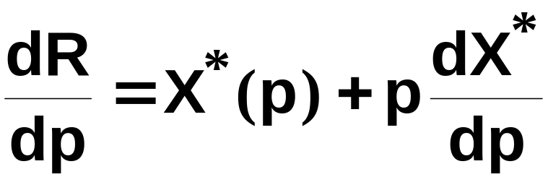
Revenue and Own-Price Elasticity of Demand
Sellers’ revenue is
So

Slide 37
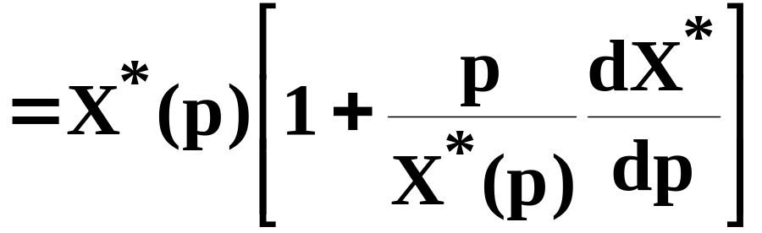
Revenue and Own-Price Elasticity of Demand
Sellers’ revenue is
So

Slide 38
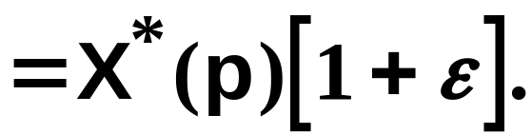
Revenue and Own-Price Elasticity of Demand
Sellers’ revenue is
So

Slide 39
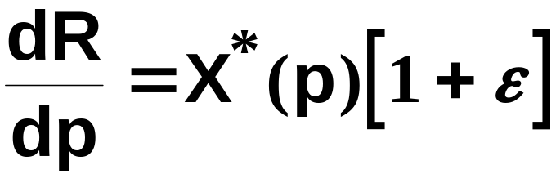
Revenue and Own-Price Elasticity of Demand

Slide 40
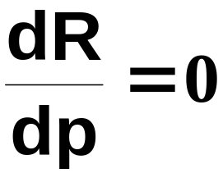

Revenue and Own-Price Elasticity of Demand
so if
then
and a change to price does not alter
sellers’ revenue.

Slide 41
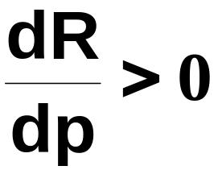

Revenue and Own-Price Elasticity of Demand
but if
then
and a price increase raises sellers’
revenue.

Slide 42
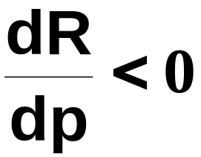

Revenue and Own-Price Elasticity of Demand
And if
then
and a price increase reduces sellers’
revenue.

Slide 43
Revenue and Own-Price Elasticity of Demand
In summary:
Own-price inelastic demand;
price rise causes rise in sellers’ revenue.
Own-price unit elastic demand;
price rise causes no change in sellers’
revenue.
Own-price elastic demand;
price rise causes fall in sellers’ revenue.

Slide 44
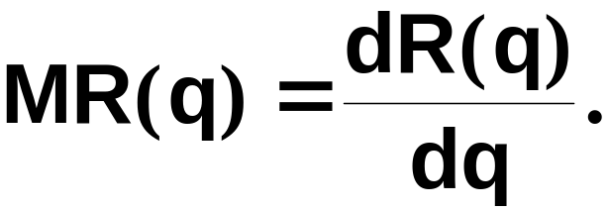
Marginal Revenue and Own-Price Elasticity of Demand
A seller’s marginal revenue is the rate at which revenue changes with the number of units sold by the seller.

Slide 45

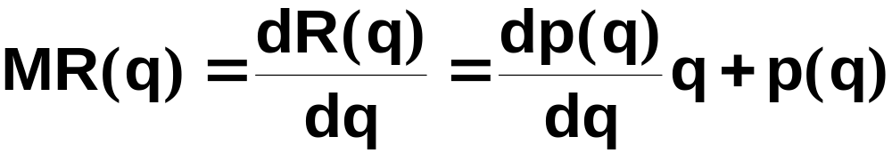
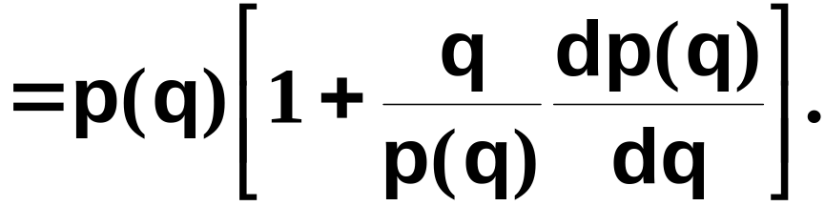
Marginal Revenue and Own-Price Elasticity of Demand
p(q) denotes the seller’s inverse demand function; i.e. the price at which the seller can sell q units. Then
so

Slide 46
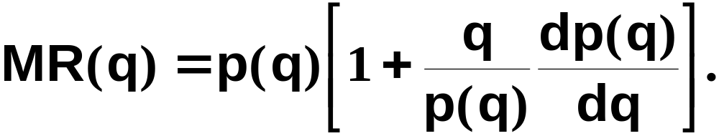
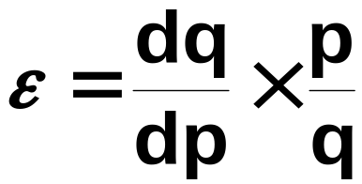
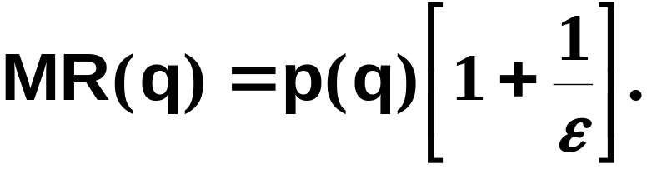
Marginal Revenue and Own-Price Elasticity of Demand
and
so

Slide 47
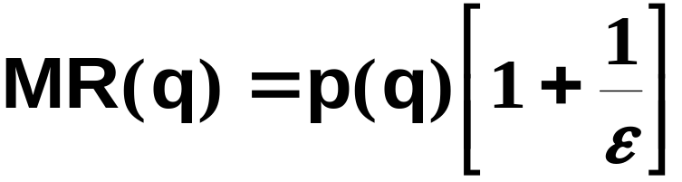
Marginal Revenue and Own-Price Elasticity of Demand
says that the rate
at which a seller’s revenue changes
with the number of units it sells
depends on the sensitivity of quantity
demanded to price; i.e., upon the
of the own-price elasticity of demand.

Slide 48
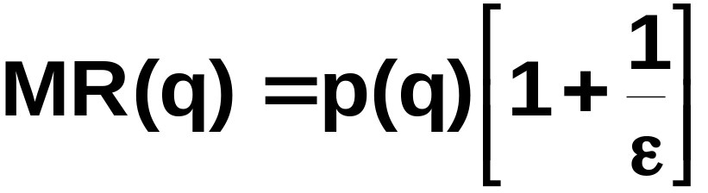






Marginal Revenue and Own-Price Elasticity of Demand
If
then
If
then
If
then

Slide 49
Marginal Revenue and Own-Price Elasticity of Demand
If
Selling one
more unit does not change the seller’s
revenue.
then
If
Selling one
more unit reduces the seller’s revenue.
then
If
then
Selling one
more unit raises the seller’s revenue.

Slide 50


Marginal Revenue and Own-Price Elasticity of Demand
An example with linear inverse demand.
Then
and

Slide 51


Marginal Revenue and Own-Price Elasticity of Demand
p
a
a/2b
a/b
q

Slide 52
Marginal Revenue and Own-Price Elasticity of Demand
p
a
$
a/2b
a/b
q
R(q)
q
a/2b
a/b

Slide 53
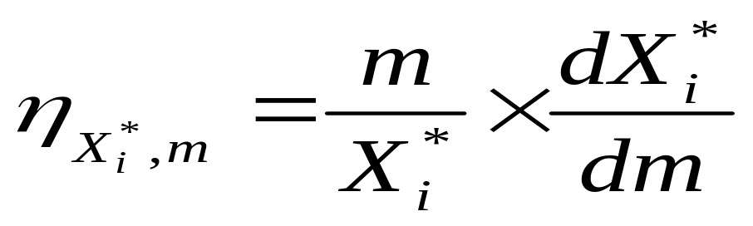
Income Elasticity
Normal good: η>0
Inferior good: η<0
Luxury good: η>1
Necessary good: 0<η<1

Slide 54
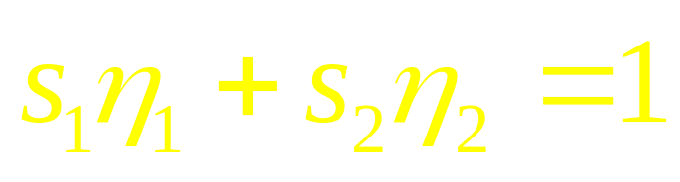
A Special Property
Weighted average of income elasticities of all goods is one with the weights being expenditure shares of the goods.
In the case of 2 goods,

