Slide 1
Chapter Nine
Buying and Selling
购买 和 销售

Slide 2
Structure
Endowments （禀赋）
Budget constraints with endowments
Net demands
  Price offer curve
Example: Labor supply
  Comparative statics
Slutsky equation revisited

Slide 3
Buying and Selling
Trade involves exchange -- when something is bought something else must be sold.
What will be bought? What will be sold?
Who will be a buyer? Who will be a seller?

Slide 4
Buying and Selling
And how are incomes generated?
How does the value of income depend upon commodity prices?
How can we put all this together to explain better how price changes affect demands?

Slide 5

Endowments
The list of resource units with which a consumer starts is his endowment （禀赋）.
A consumer’s endowment will be denoted by the vector (omega).

Slide 6

Endowments
E.g.
states that the consumer is endowed with 10 units of good 1 and 2 units of good 2.
What is the endowment’s value?
For which consumption bundles may it be exchanged?

Slide 7
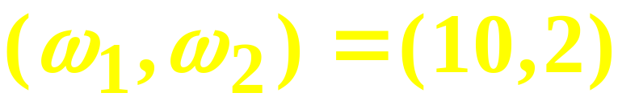
Endowments
p₁=2 and p₂=3 so the value of the endowment is
Q: For which consumption bundles may the endowment be exchanged?
A: For any bundle costing no more than the endowment’s value.

Slide 8
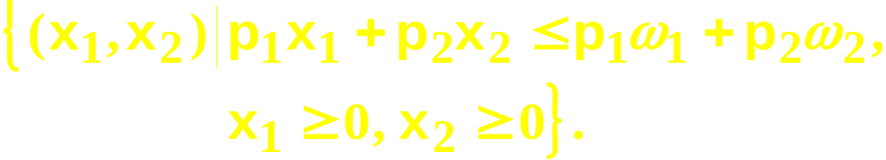
Budget Constraints Revisited
So, given p₁ and p₂, the budget constraint for a consumer with an endowment is
The budget set is

Slide 9

Budget Constraints Revisited
x₂
ω₂
ω₁
x₁

Slide 10

Budget Constraints Revisited
x₂
ω₂
Budget set
ω₁
x₁

Slide 11
Changing Endowments
x₂
Changing the endowment
(ω₁,ω₂ )
(ω₁ ’,ω₂ ’)
(ω₁ ”,ω₂ ”)
x₁

Slide 12
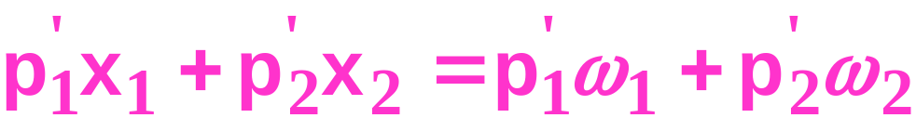
Changing Prices
x₂
Changing prices of the endowment
ω₂
ω₁
x₁

Slide 13
Changing Prices
x₂
ω₂
Budget set
ω₁
x₁

Slide 14
Changing Prices
The endowment point is always on
the budget constraint.
x₂
So price changes pivot the
constraint about the
endowment point.
ω₂
ω₁
x₁

Slide 15
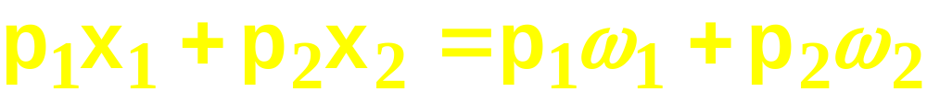
Net Demand
The constraint
is
That is, the sum of the values of a consumer’s net demands （净需求） is zero.

Slide 16
Net Demands
Suppose and p₁=2, p₂=3. Then the constraint is
If the consumer gross demands (毛需求）(x₁*,x₂*) = (7,4), then 3 good 1 units exchange for 2 good 2 units. Net demands are
x₁*- ω₁ = 7-10 = -3 and
x₂*- ω₂ = 4 - 2 = +2.

Slide 17
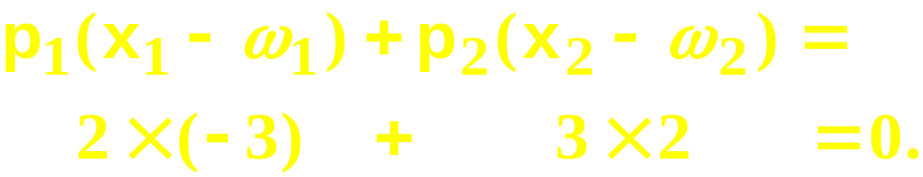
Net Demands
p₁=2, p₂=3, x₁*-ω₁ = -3 and x₂*-ω₂ = +2 so
The purchase of 2 extra good 2 units at
$3 each is funded by giving up 3 good 1
units at $2 each.

Slide 18
Net Demands at Different Prices
x₂
At prices (p₁,p₂) the consumer
sells units of good 1 to acquire
more units of good 2.
x₂*
ω₂
x₁*
ω₁
x₁
Net seller of good 1

Slide 19
Net Demands at Different Prices
x₂
At prices (p₁’,p₂’) the consumer
sells units of good 2 to acquire
more of good 1.
ω₂
x₂*
ω₁
x₁*
x₁
Net buyer of good 1

Slide 20
Net Demands at Different Prices
x₂
At prices (p₁”,p₂”) the consumer
consumes her endowment; net
demands are all zero.
x₂*=ω₂
x₁*=ω₁
x₁
Autarky

Slide 21
Offer Curve
x₂
Price-offer curve contains all the
utility-maximizing gross demands
for which the endowment
can be exchanged.
ω₂
ω₁
x₁

Slide 22
Net Demands
x₂
Price-offer curve
Sell good 1, buy good 2
ω₂
ω₁
x₁

Slide 23
Net Demands
x₂
Price-offer curve
Buy good 1, sell good 2
ω₂
ω₁
x₁

Slide 24
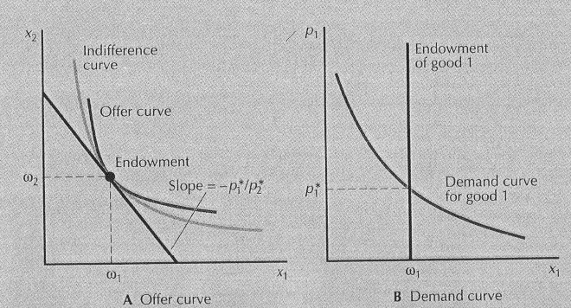

Slide 25
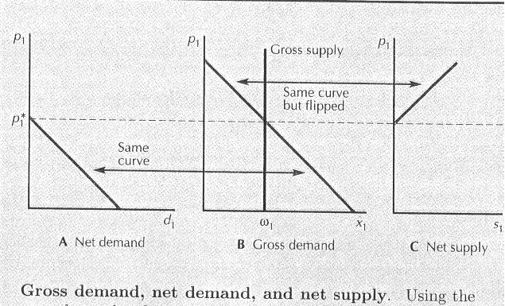

Slide 26
Some Results about Price Change
If a consumer is a net seller of a good, when the price of the good decreases, if she remains a supplier then the consumer is worse off.
If a consumer if a net buyer of a good, when the price decreases, the consumer will remain a buyer and be better off.

Slide 27
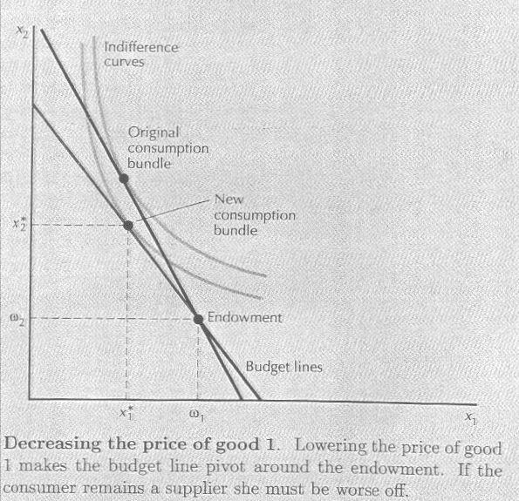

Slide 28
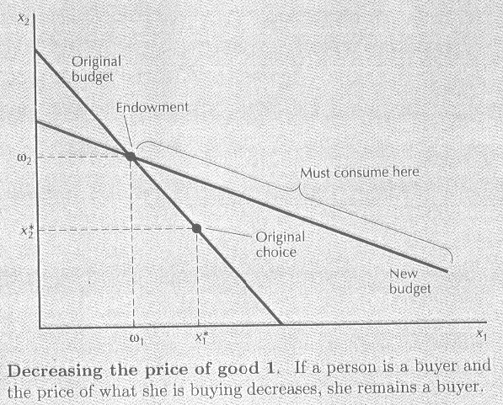

Slide 29
Labor Supply
A worker is endowed with $m of nonlabor income and R hours of time which can be used for labor or leisure. ω = (R, m).
Consumption good’s price is p_{c}.
w is the wage rate.
⎯
⎯

Slide 30


Labor Supply
The worker’s budget constraint is
where C, R denote gross demands for the consumption good and for leisure. That is
⎯
⎯
{
{
expenditure
endowment
value

Slide 31
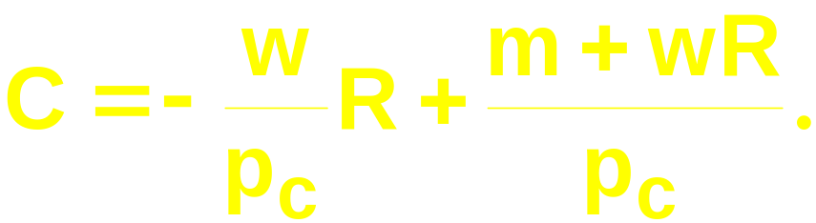
Labor Supply
⎯
rearranges to
⎯

Slide 32
Labor Supply
($)
C
m
endowment
⎯
R
R

Slide 33
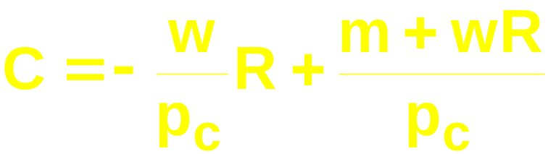
Labor Supply
C
⎯
m
endowment
⎯
R
R

Slide 34
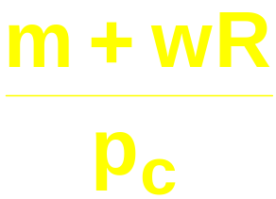
Labor Supply
C
⎯
⎯
m
endowment
⎯
R
R

Slide 35
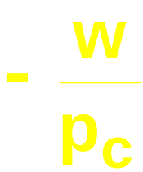
Labor Supply
C
⎯
⎯
slope = , the ‘real wage rate’
m
endowment
⎯
R
R

Slide 36
Labor Supply
C
⎯
⎯
C*
m
endowment
⎯
R
R*
R
leisure
demanded
labor
supplied

Slide 37
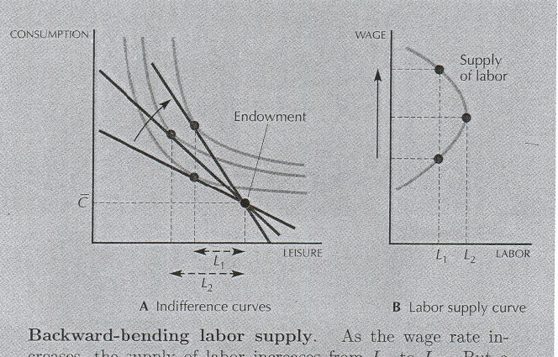
Labor Supply Curve

Slide 38
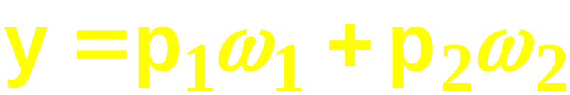
Slutsky’s Equation Revisited
Slutsky: changes to demands caused by a price change are the sum of
  a pure substitution effect, and
  an income effect.
This assumed that income y did not change as prices changed. But
does change with price. How does this modify Slutsky’s equation?

Slide 39
Slutsky’s Equation Revisited
A change in p₁ or p₂ changes
so there will be
an additional income effect, called the endowment income effect （禀赋收入效应）.
Slutsky’s decomposition will thus have three components
  a pure substitution effect
  an (ordinary) income effect, and
  an endowment income effect.

Slide 40
Slutsky’s Equation Revisited
x₂
Initial prices are (p₁’,p₂’).
x₂’
ω₂
x₁’
ω₁
x₁

Slide 41
Slutsky’s Equation Revisited
x₂
Initial prices are (p₁’,p₂’).
Final prices are (p₁”,p₂”).
x₂’
ω₂
x₂”
x₁’
ω₁
x₁”
x₁

Slide 42
Slutsky’s Equation Revisited
x₂
Initial prices are (p₁’,p₂’).
Final prices are (p₁”,p₂”).
How is the change in demand
from (x₁’,x₂’) to (x₁”,x₂”) explained?
x₂’
ω₂
x₂”
x₁’
ω₁
x₁”
x₁

Slide 43
Slutsky’s Equation Revisited
x₂
Initial prices are (p₁’,p₂’).
x₂’
ω₂
x₁’
ω₁
x₁

Slide 44
Slutsky’s Equation Revisited
x₂
Initial prices are (p₁’,p₂’).
Final prices are (p₁”,p₂”).
x₂’
ω₂
x₂”
x₁’
ω₁
x₁”
x₁

Slide 45
Slutsky’s Equation Revisited
x₂
⇒
Pure substitution effect
ω₂
ω₁
x₁

Slide 46
Slutsky’s Equation Revisited
x₂
⇒
Pure substitution effect
ω₂
ω₁
x₁

Slide 47
Slutsky’s Equation Revisited
x₂
⇒
Pure substitution effect
⇒
Ordinary income effect
ω₂
ω₁
x₁

Slide 48
Slutsky’s Equation Revisited
x₂
⇒
Pure substitution effect
⇒
Ordinary income effect
ω₂
ω₁
x₁

Slide 49
Slutsky’s Equation Revisited
x₂
⇒
Pure substitution effect
⇒
Ordinary income effect
⇒
Endowment income effect
ω₂
ω₁
x₁

Slide 50
Slutsky’s Equation Revisited
x₂
⇒
Pure substitution effect
⇒
Ordinary income effect
⇒
Endowment income effect
ω₂
ω₁
x₁

Slide 51
Slutsky’s Equation Revisited
Overall change in demand caused by a
change in price is the sum of:
(i) a pure substitution effect
(ii) an ordinary income effect
(iii) an endowment income effect

Slide 52
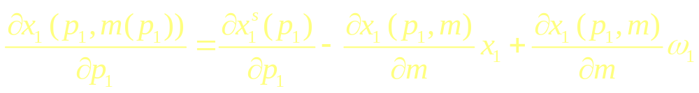
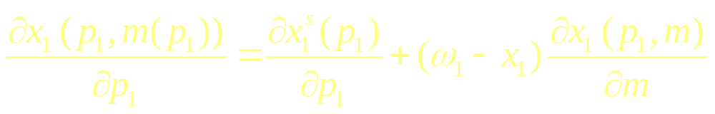
Slutsky Equation with Endowments
Or
(-)
(+)
(+)

