Slide 1
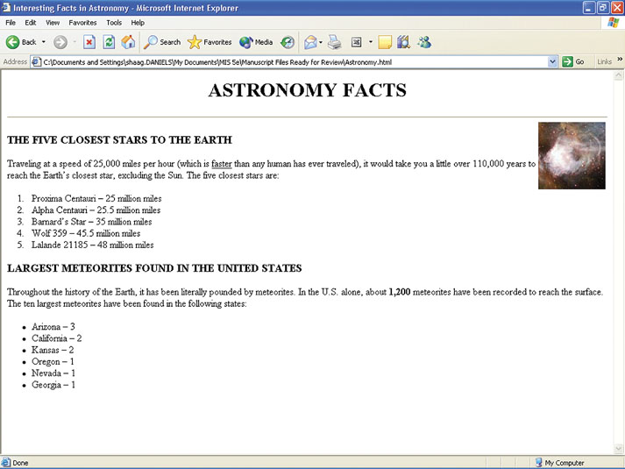
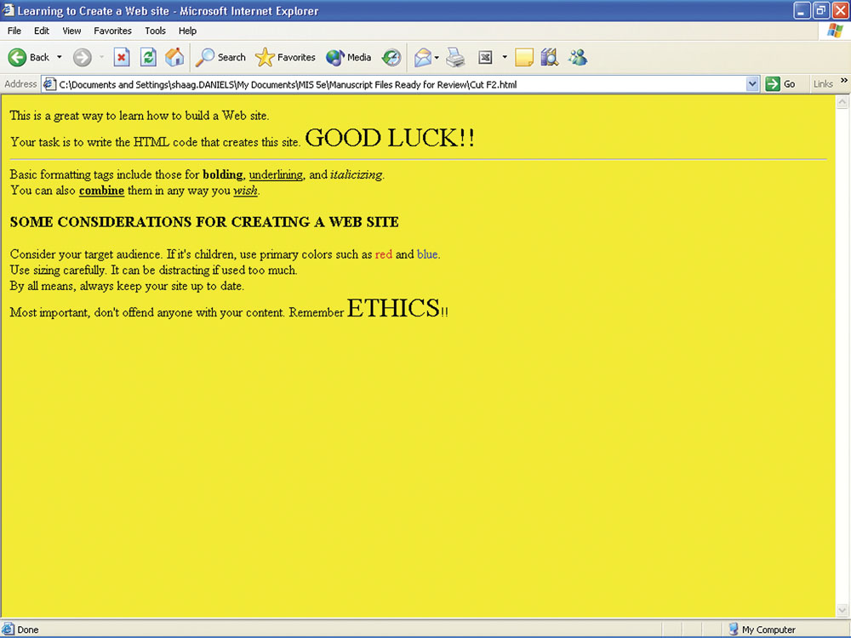
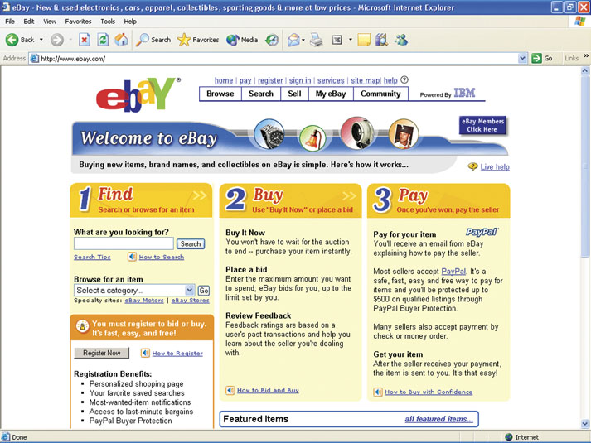
BUILDING A WEB PAGE WITH HTML
XLM
F

Slide 2
HYPERTEXT MARKUP LANGUAGE (HTML)
To create a Web site, you must create an HTML document
HTML document – file that contains your Web site content and the HTML formatting instructions
Web page is a view of an HTML document from within a Web browser
McGraw-Hill
© 2007 The McGraw-Hill Companies, Inc. All rights reserved.

Slide 3
Creating an HTML Document
Use any text editor
Our choice is Notepad
  Click on Start
  Point at All Programs
  Point at Accessories
  Click on Notepad
Create HTML document and save with htm or html extension
McGraw-Hill
© 2007 The McGraw-Hill Companies, Inc. All rights reserved.

Slide 4
Working Locally
For all to see, Web site must be in Web space
Web space – storage area where you keep your Web site
To view a local Web site in Internet Explorer
  Click on File and Open
  Click on Browser
  Choose folder and HTML document name
  Click on Open and OK
McGraw-Hill
© 2007 The McGraw-Hill Companies, Inc. All rights reserved.

Slide 5
HTML Document Sections
HTML tag – specifies the formatting and presentation of information in a Web site
Structure tags – HTML tags that set up the necessary sections
Two major sections in an HTML document
  Head section
  Body section
McGraw-Hill
© 2007 The McGraw-Hill Companies, Inc. All rights reserved.

Slide 6
HTML Tags
Usually are <tagname> and </tagname>
Entire HTML document
    <html>
    <head>
    </head>
    <body>
    </body>
    </html>
McGraw-Hill
© 2007 The McGraw-Hill Companies, Inc. All rights reserved.

Slide 7
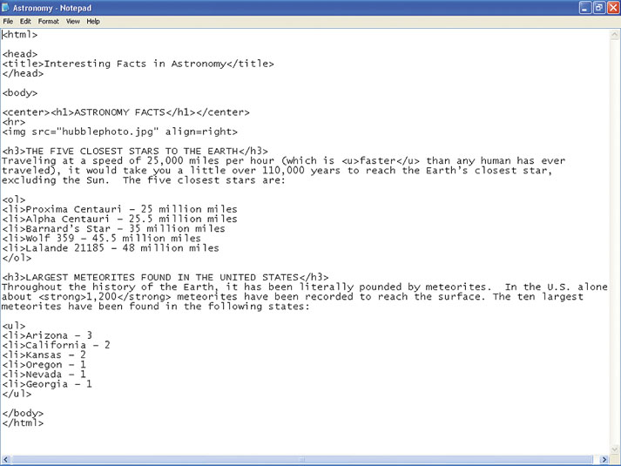
HTML Document
Body section
Structure tags
McGraw-Hill
© 2007 The McGraw-Hill Companies, Inc. All rights reserved.

Slide 8
Resulting Web Page
Image
Lists
McGraw-Hill
© 2007 The McGraw-Hill Companies, Inc. All rights reserved.

Slide 9
BASIC TEXT FORMATTING
Basic formatting tags – HTML tags that allow you specify formatting for text
Strong (bold) - <strong> and </strong>
Underline - <u> and </u>
Emphasis (italics) - <em> and </em>
Line break - <br>
Horizontal rule - <hr>
McGraw-Hill
© 2007 The McGraw-Hill Companies, Inc. All rights reserved.

Slide 10
CREATING HEADINGS
Heading tags – make certain information, such as titles, stand out
<hnumber> and </hnumber>, where number is from 1 to 6
<h1> and </h1> - largest
<h6> and </h6> - smallest
McGraw-Hill
© 2007 The McGraw-Hill Companies, Inc. All rights reserved.

Slide 11
ADJUSTING TEXT COLOR
Default text color is black, can be changed
<font color=“color name”> and </font>
Example
  I like the color <font color=“blue”>blue</font>.
  Reads as… I like the color blue.
McGraw-Hill
© 2007 The McGraw-Hill Companies, Inc. All rights reserved.

Slide 12
ADJUSTING TEXT SIZE
Default is usually 3; can be changed
<font size=“font size”> and </font>
Example
<font size=“10”>A</font>stronomy is fun
Reads as… Astronomy is fun.
McGraw-Hill
© 2007 The McGraw-Hill Companies, Inc. All rights reserved.

Slide 13
CHANGING BACKGROUND COLOR
Default is white; can be changed
<body bgcolor=“color name”> with no ending tag
Example
  <body bgcolor=“green”>
  Changes background color to green
McGraw-Hill
© 2007 The McGraw-Hill Companies, Inc. All rights reserved.

Slide 14
ADDING IMAGES
Images can be useful or worthless
To insert an image
  <img src=“filename.extension”>
Image file must be in Web space
Is usually jpg or gif format
Cannot use bmp file formats
McGraw-Hill
© 2007 The McGraw-Hill Companies, Inc. All rights reserved.

Slide 15
Adjusting Image Sizes
Can adjust image size with height and width parameters
Provide sizing in pixel count
Example
  <img src=“indy.jpg” height=100 width=100>
  Size would be approximately 1.5 inches square
McGraw-Hill
© 2007 The McGraw-Hill Companies, Inc. All rights reserved.

Slide 16
Adjusting Image Position
Can adjust location; default is left; use align parameter
align=“right” is right justified
<center><img src…></center> is centered
McGraw-Hill
© 2007 The McGraw-Hill Companies, Inc. All rights reserved.

Slide 17
USING A TEXTURED BACKGROUND
Can use an image as background
Browser will “tile” image to fill page
<body background=“filename.extension”>
File must be in Web space
McGraw-Hill
© 2007 The McGraw-Hill Companies, Inc. All rights reserved.

Slide 18
CREATING AND USING LISTS
Lists can be
  Numbered
  Unnumbered (bulleted)
Format is (for numbered)
  <ol>
  <li>list content
  <li>list content
  </ol>
McGraw-Hill
© 2007 The McGraw-Hill Companies, Inc. All rights reserved.

Slide 19
CREATING AND USING LISTS
For unnumbered or bulleted list, replace “o” with “u”
Format is (for unnumbered)
  <ul>
  <li>list content
  <li>list content
  </ul>
McGraw-Hill
© 2007 The McGraw-Hill Companies, Inc. All rights reserved.

Slide 20
ADDING LINKS TO A WEB SITE
Link (hyperlink) – clickable text or image that takes you to another site or page
Three types
  Links to other Web pages or sites
  Links to downloadable files
  Links to e-mail
McGraw-Hill
© 2007 The McGraw-Hill Companies, Inc. All rights reserved.

Slide 21
ADDING LINKS TO A WEB SITE
Format of a link tag is…
<a href=“address/filename”>screen text</a>
Example
  To provide a link to MTV’s Web site
  <a href=“www.mtv.com”>Visit MTV</a>
  Displays as Visit MTV
McGraw-Hill
© 2007 The McGraw-Hill Companies, Inc. All rights reserved.

Slide 22
ADDING LINKS TO A WEB SITE
For a downloadable file
Replace Web site address with file name
Example
  <a href=“workbook1.xls”>My Excel Workbook</a>
  Displays as My Excel Workbook
  Lets someone download your Excel workbook
McGraw-Hill
© 2007 The McGraw-Hill Companies, Inc. All rights reserved.

Slide 23
ADDING LINKS TO A WEB SITE
For a link to e-mail
Replace address/filename with mailto: and your e-mail address
Example
  <a href=“mailto:shaag@du.edu”>E-mail me</a>
  Displays as E-mail me
McGraw-Hill
© 2007 The McGraw-Hill Companies, Inc. All rights reserved.

