Slide 1
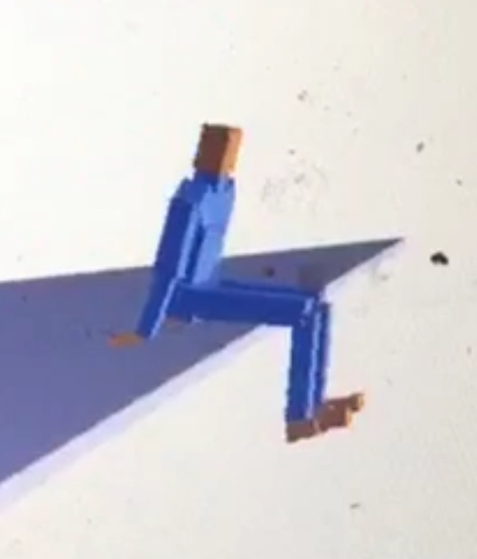
CS 7496 – Perfect 10
Determine state of platform
Scan mInputSensor image for particular pixel color
Time it is closest and farthest away to calculate speed
Give the character momentum
Added constraints on the shoulder and elbow
Applied torque to the thigh, shin, and hand
Calculate when to jump
Character has enough forward momentum
Platform is approaching
Dibyendu Mondal and Anna Greene

