Slide 1
Music Classification based on Genre
Team Members: Aditi Laddha - 130050026
Palak Jain - 130050031
Dibyendu Mondal - 130050046

Slide 2
Problem Statement
The aim of the project is to develop a music genre classifier. There are many genres into which songs may be classified, e.g. pop, rock, classical, metal etc. Gigabytes of music files are spread over the web. To automate searching and organizing the music files based on their genre is a challenging task. In this report, we present our approach to classify genres of music file based on their content and analysis on some inputs.

Slide 3
Outcomes of the project
We use our program on different kinds of input files for classifying the music files into pop, classical, metal, rock etc. Currently we classify the files into 2, 3 and 4 genres with greater than 80% accuracy.
We find the total error after every iteration on training the Neural Net.
We calculate the sensitivity of our model.
We calculate specificity of our model.

Slide 4
Screenshots
We have used 2 libraries: Pybrain and Neurolab.
Some outputs and errors for Pybrain are:

Slide 5
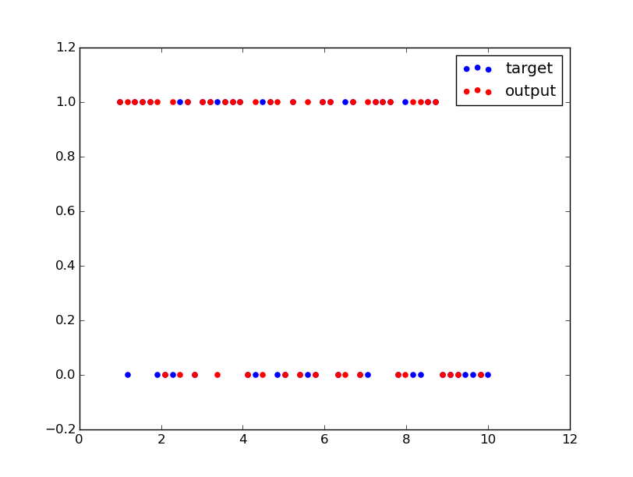
Rock-Pop Classification

Slide 6
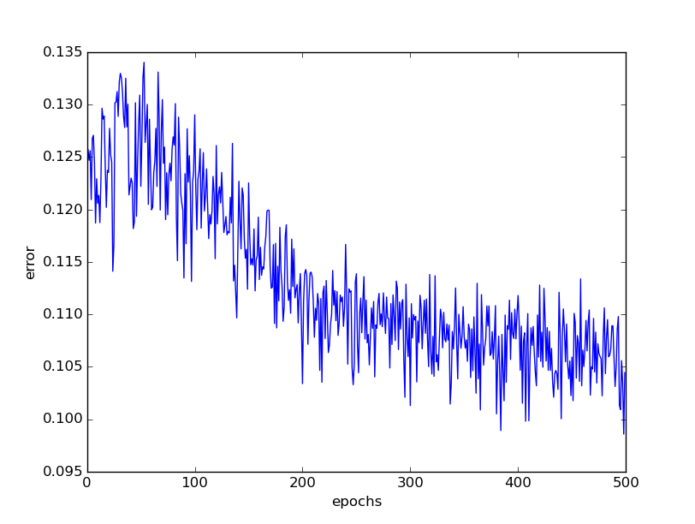
Rock-Pop training error

Slide 7
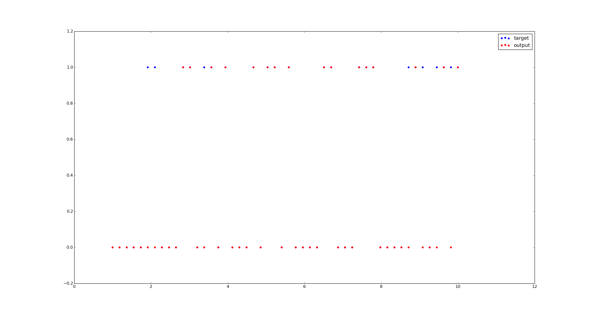
Rock-Classical Classification

Slide 8
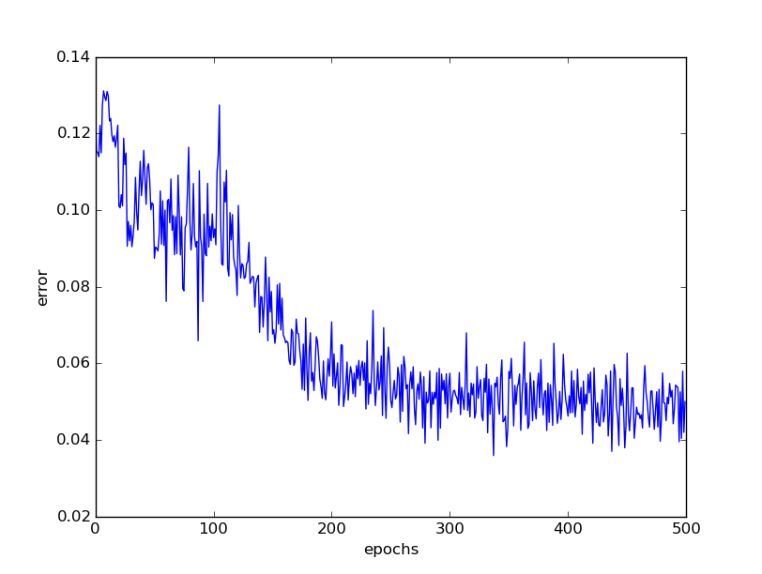
Rock-Classical training errors

Slide 9
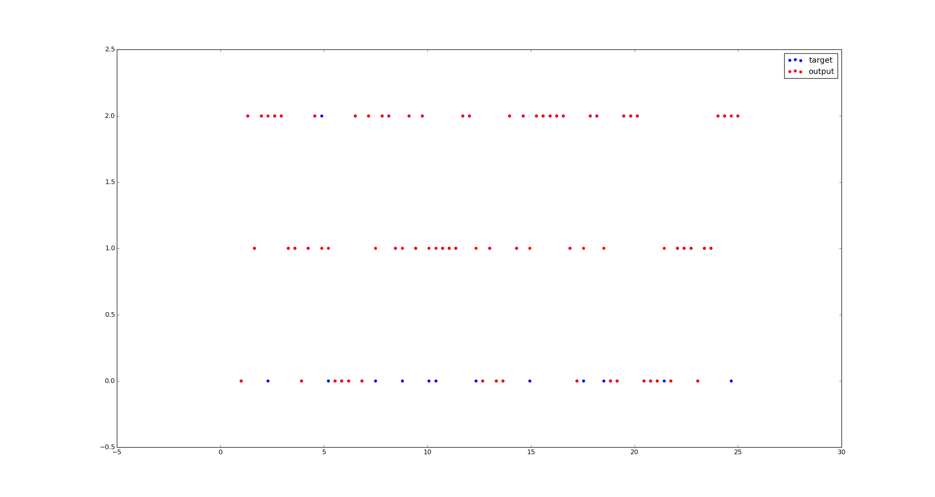
Pop-Classical-Metal Classification

Slide 10
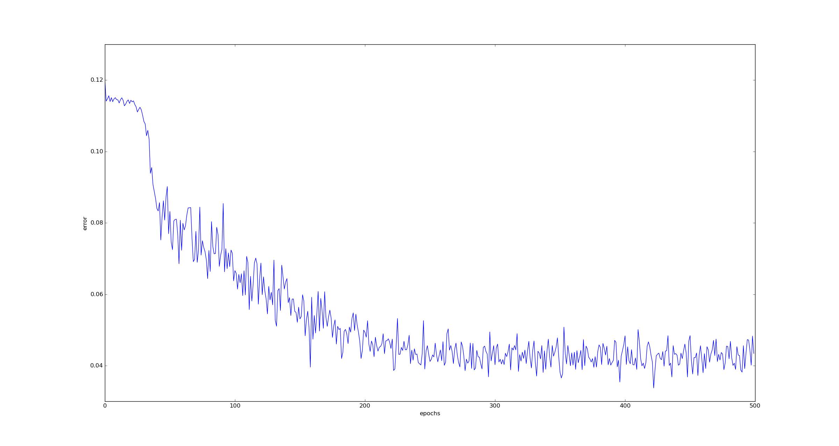
Pop-Classical-Metal training error

Slide 11
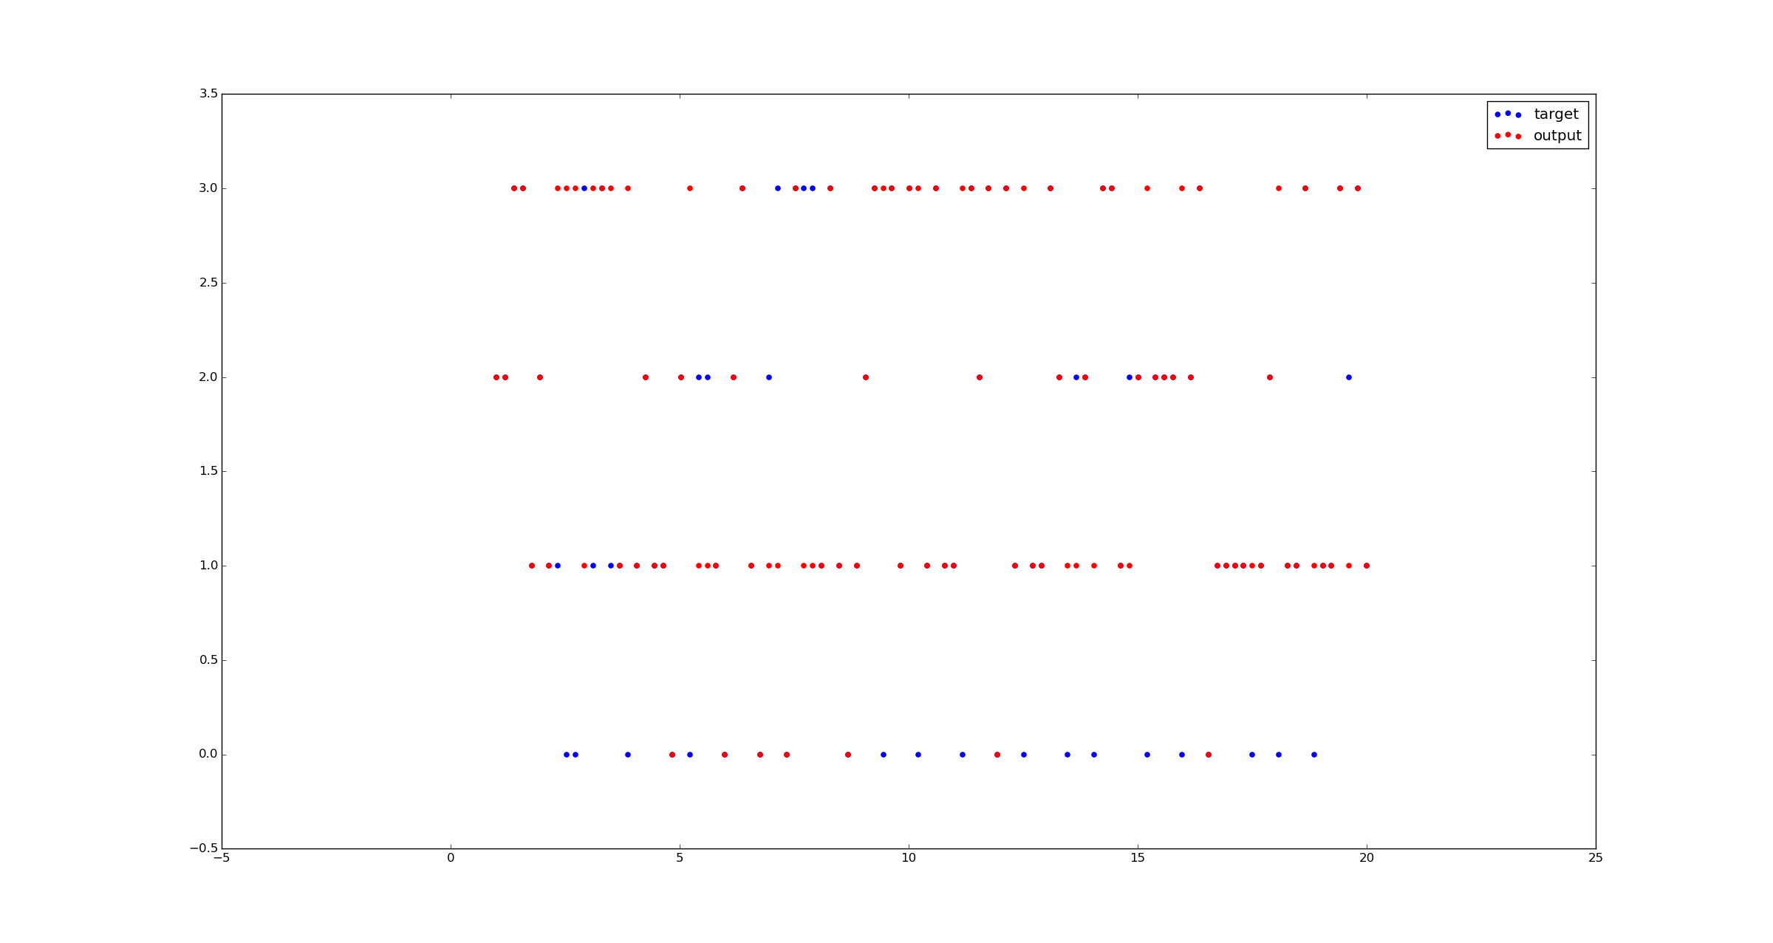
Pop-Classical-Metal-Blues Classification

Slide 12
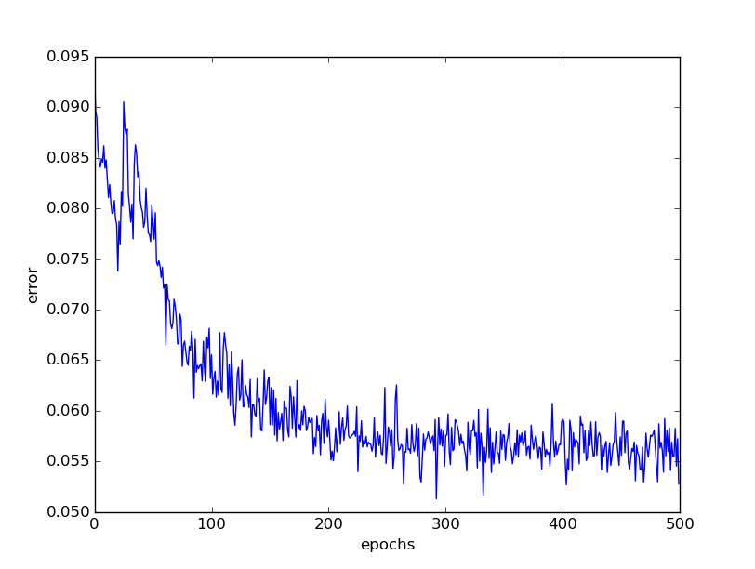
Pop-Classical-Metal-Blues training errors
Pop-Classical-Metal-Blues training error

Slide 13
Screenshots
Some outputs and errors for Neurolab are:

Slide 14
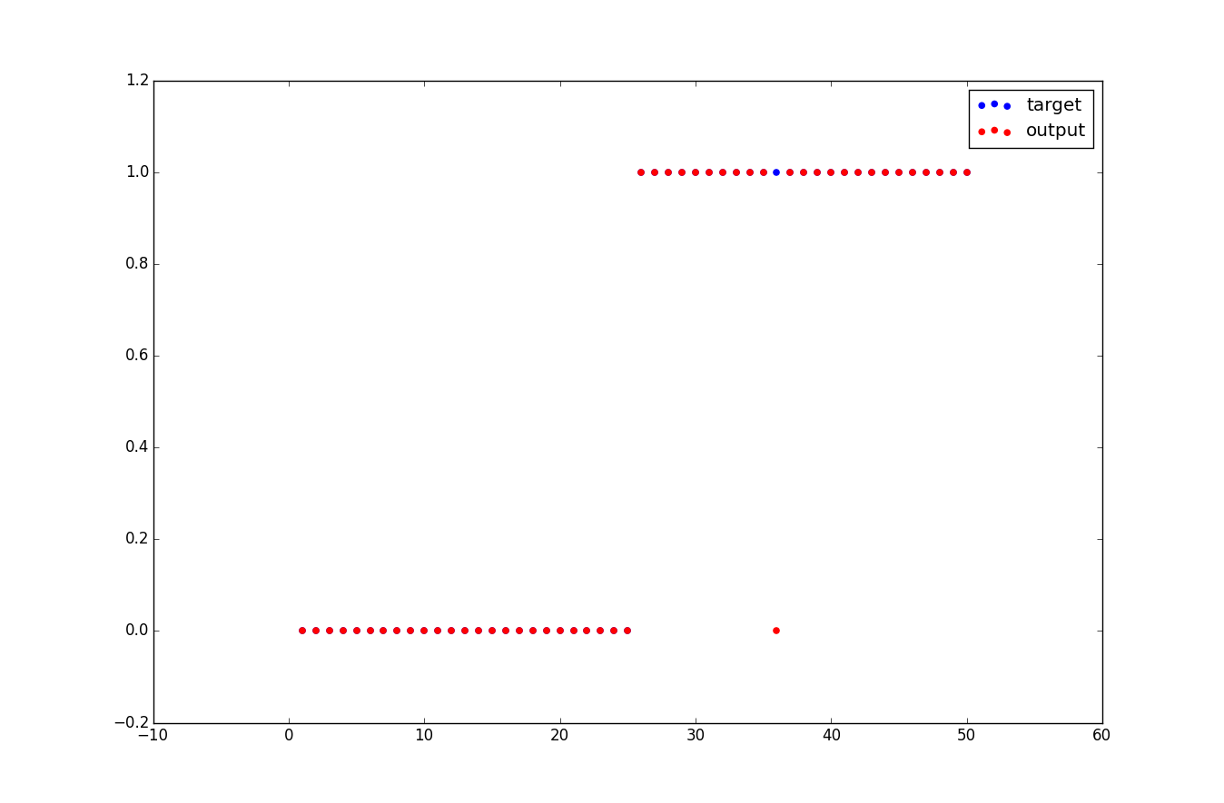
Pop-Classical Classification

Slide 15
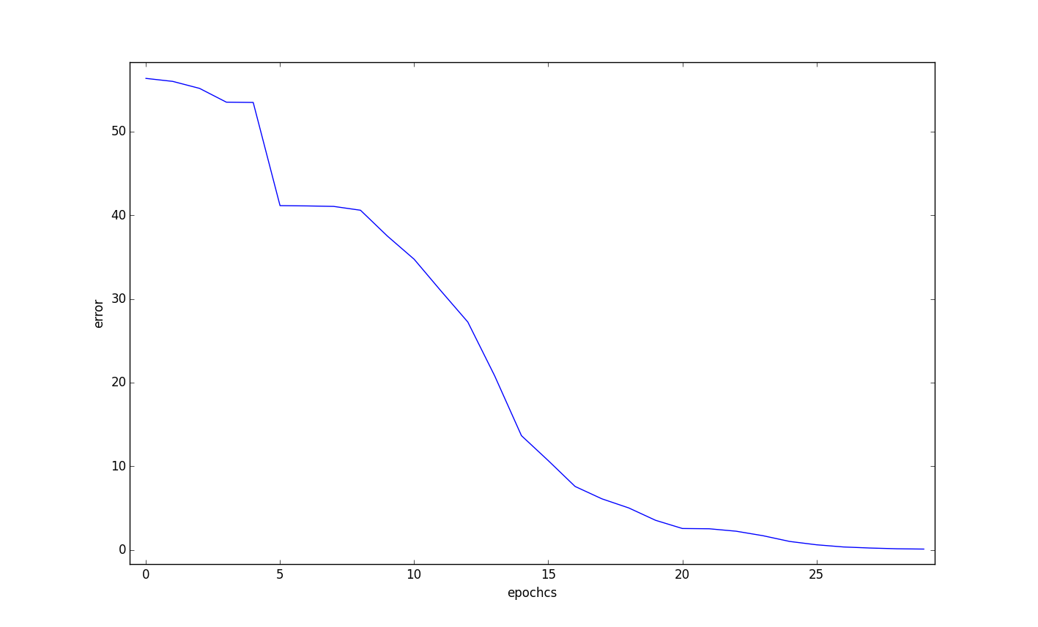
Pop-Classical training errors

Slide 16
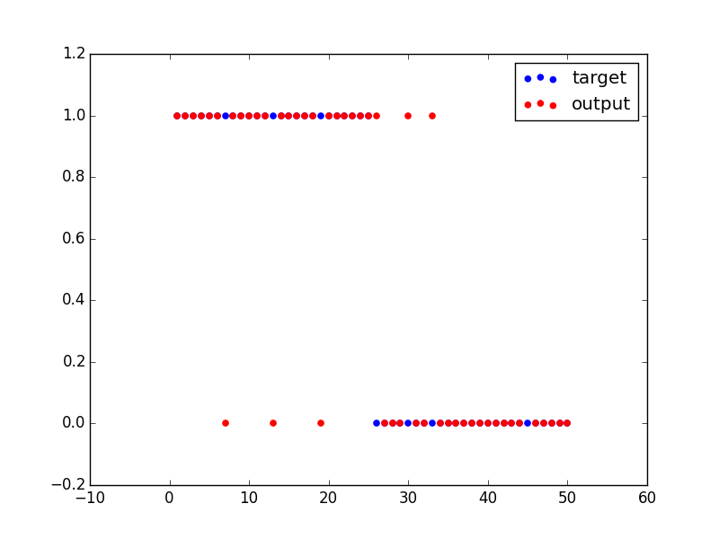
Rock-Pop Classification

Slide 17
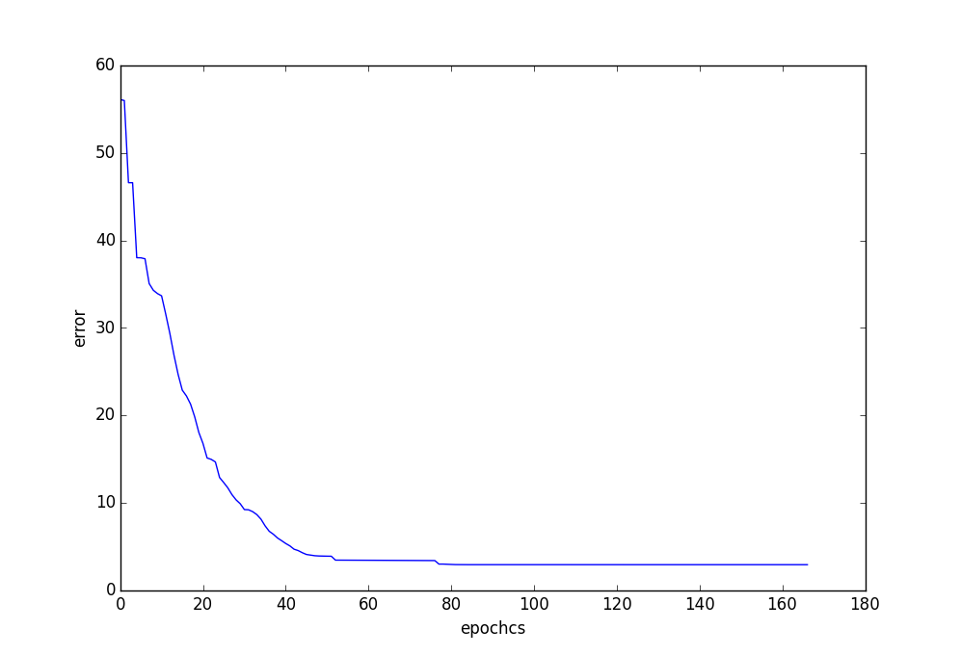
Rock-Pop training errors

Slide 18
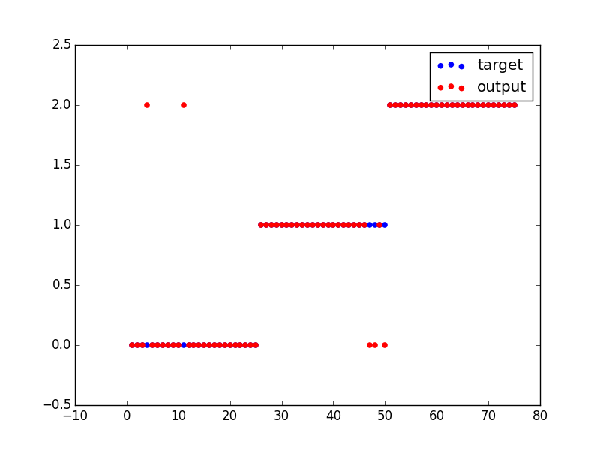
Pop-Metal-Classical Classification

Slide 19
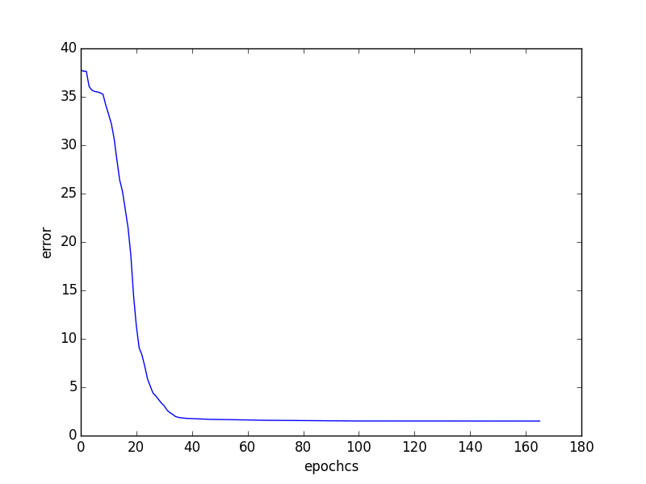
Pop-Metal-Classical training errors

Slide 20
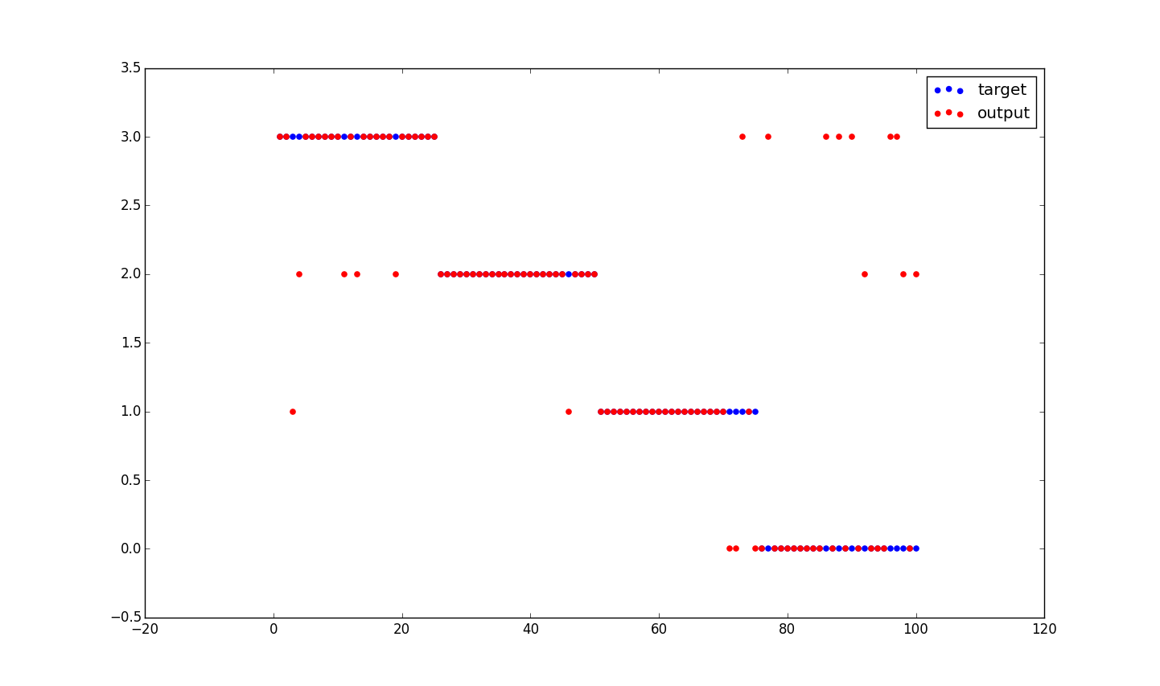
Pop-Classical-Metal-Blues Classification

Slide 21
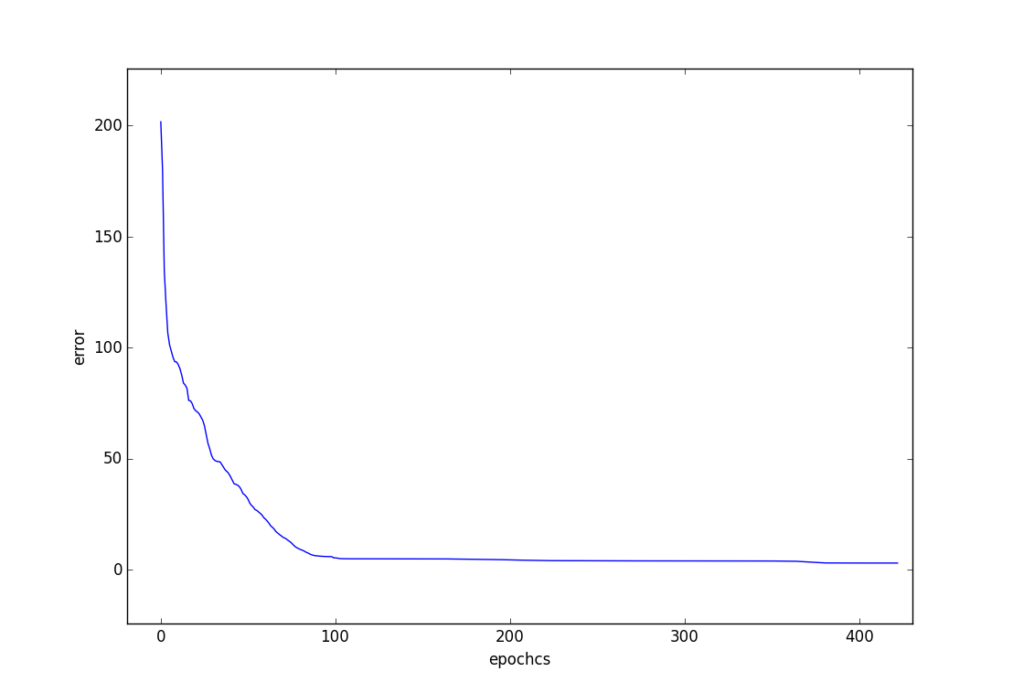
Pop-Classical-Metal-Blues training errors

Slide 22
Code Overview
We have used music files, taken from GTZAN database, and extracted some features. These were used as inputs to our Neural Network. We have used 2 libraries to build a Neural Network, train and test the data. One is Pybrain and the other is Neurolab. By building a Neural Network and training it with the inputs it gives total error at each iteration. On testing it on the test data, it predicts the output.

Slide 23
Features Used : MFCC
We have used 52 features representing Mel-Frequency Cepstral Coefficients (MFCC) as input. MFC is a representation of the short-term power spectrum of a sound, based on a linear cosine transform of a log power spectrum on a nonlinear mel scale of frequency. MFCC is typically believed to encode timbral information, since it represents short-duration musical textures. Our input feature vector comprises of means and variance of several FFT frames.

Slide 24
Neural Network Model
For each genre we have a set of 100 sound clips with 52 input features. Training data and test data are split into 3:1 proportion. We have 1 hidden layer consisting of 20(pybrain) /12(neurolab) nodes and 1 output node for each genre. Our performance is measured against the following metrics:
Training error
Sensitivity for each genre : tp/(tp+fn)
Specificity for each genre : tn/(fp+tn)

Slide 25
Results for classification (Pybrain)
4 genre : Pop | Classical | Metal | Blues
specificity [0.83870967, 0.94736842,, 0.9285714, 0.93939393939393945]
sensitivity [1.0, 0.67441860465116277, 1.0, 0.58823529411764708]
3 genre: Pop | Metal | Classical
specificity [0.80327868852459017, 1.0, 0.96153846153846156]
sensitivity [1.0, 0.65789473684210531, 0.95652173913043481]
2 genre : Pop | Metal
specificity [0.93548387096774188, 0.94736842105263153]
sensitivity [0.94736842105263153, 0.93548387096774188]

Slide 26
Results for classification (Neurolab)
4 genre : Pop | Classical | Metal | Blues
sensitivity : [0.9733333333333334, 1.0, 0.9866666666666667, 0.84]
specificity: [0.56, 0.88, 1.0, 0.96]
3 genre: Pop | Metal | Classical
specificity [0.94, 1.0, 0.96]
sensitivity [0.92, 0.88, 1.0]
2 genre : Pop | Metal
specificity [0.96, 1.0]
sensitivity [1.0, 0.96]

Slide 27
Contribution
All of us have contributed equally. (33.33% each)

Slide 28
Future Suggestions
We have used only 30 second long sound clips for classification. Future work can involve longer length music which can have many variation of attributes in a single song.
In our current work, we have used only four broad genre, namely, rock, pop, classical and rock. These genres are clearly separated from each other. Future work may involve classification involving
More number of genres
Genres which have subtle differences (eg. country soul and country blues)

Slide 29
Learning from the project
The backpropagation algorithm performance is hindered by local minimas. Sometimes bad random initialization leads to local minimas out of which there is no coming out, no matter for how many epochs we train.
Learning rate is important for the performance of backpropagation trainer.
Choosing correct features also affects performance. Too few features lead to incorrect classification. Too many features introduce redundancy and make training more difficult.
Size of the network is also crucial. A very large network may lead to overfitting whereas a very small network may not have enough computational power to compute complex functions.

