Slide 1

UART – Universal Asynchronous Receiver Transmitter
Presented by:
Aman Goel
Anmol Arora
Dibyendu Mondal
Karan Vaidya
Pranjal Khare

Slide 2
CONTENTS
Introduction to UART
Basics of Serial Communication -- RS-232
Basic block diagram of UART
Transmitter block of UART
Receiver block
Interfacing with PIC microcontroller
Programming of UART
Applications

Slide 3
INTRODUCTION TO UART
UART – Stands for Universal Asynchronous Receiver Transmitter
UART receives/sends data to microprocessor/microcontroller through data bus
UART consists of 2 main components – a transmitter and a receiver

Slide 4


WHY USE A UART?
A UART may be used when:
  High speed is not required
  An inexpensive communication link between two devices is required
UART communication is very cheap
  Single wire for each direction (plus ground wire)
    Asynchronous because no clock signal is transmitted
  Relatively simple hardware

Slide 5
BASICS OF SERIAL COMMUNICATION
Bit rate:
-Number of bits sent every second (BPS)
Baud rate:
-Number of symbols sent every second, where every symbol can represent more than one bit.
Ex. high-speed modems which use phase shifts to make every data transition period represent more than one bit.
-We can consider bit rate and baud rate to be the same thing.

Slide 6
TRANSMISSION REQUIREMENT
Before transmission begins, transmitter and receiver must agree on :
- Baud rate (75, 150, 300, 600, 19200, etc)
- Start Bit
- Stop Bit
- 8 Data Bits (for our design)
- Parity type (which is not implemented here)

Slide 7
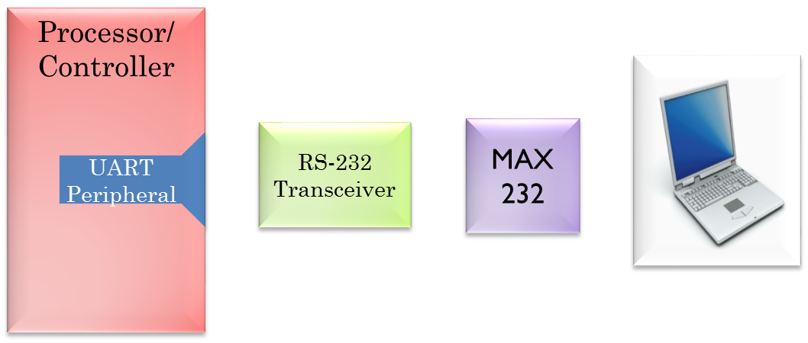
SERIAL COMMUNICATION BLOCK DIAGRAM
PC

Slide 8
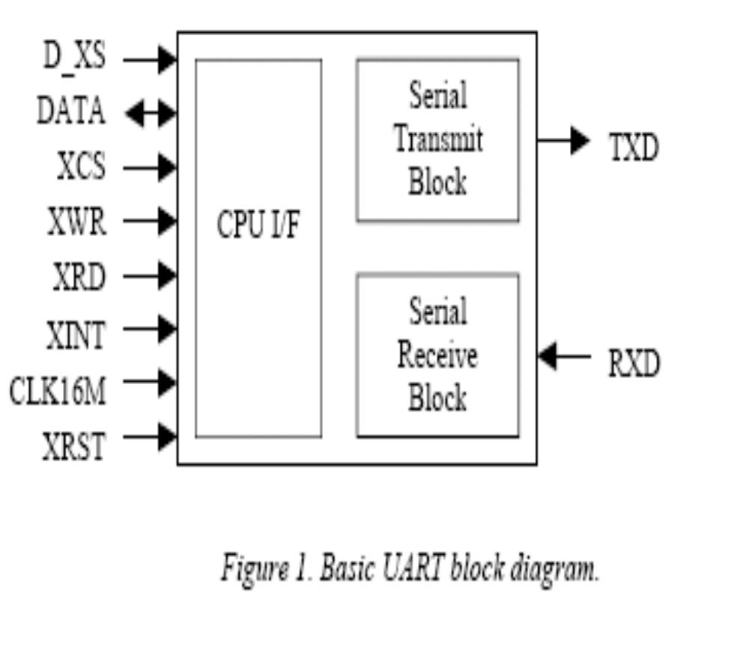
BASIC BLOCK DIAGRAM OF UART

Slide 9
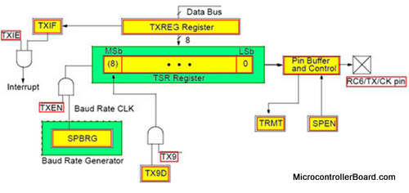
UART TRANSMITTER
Initially the transmitter is in the idle state
The user sets the data bits appropriately and presses the switch to transmit
The data is then transmitted to the receiver after appending appropriate start and stop bits

Slide 10
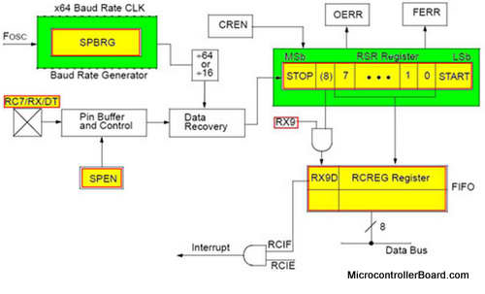
UART RECIEVER
The clock of the receiver is a multiple of the bit rate, in PIC 16f877A,it’s x16 or x64. So, each bit is transmitted/received in 16 clock cycle.
If the receiver detects a start bit for a period = bit period (16 clock cycles), then it waits for the period of half bit, and then sample the value on the RX pin and shift it in the receiving shift register.

Slide 11
RECEIVER CONTD.
Every received bit is sampled at the middle of the bit’s time period. After the detection of a START bit, eight or nine bits of serial data are shifted from the RX pin into the Receive Shift Register, one bit at a time.
After the last bit has been shifted in, the STOP bit is checked and the data is moved into the FIFO buffer.

Slide 12

UART CHARACTER TRANSMISSION
Below is a timing diagram for the transmission of a single byte
Uses a single wire for transmission
Each block represents a bit that can be a mark (logic ‘1) or space (logic ‘0’)
1 bit time
mark
space
Time

Slide 13
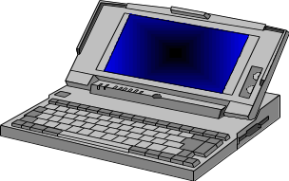
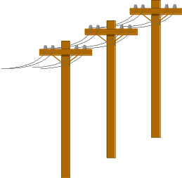
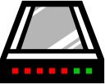

APPLICATIONS
Communication between distant computers
  Serializes data to be sent to modem
  De-serializes data received from modem
Serial
Cable
Phone
Line
Phone
Line
Modem
Serial
Cable
Modem

Slide 14
APPLICATIONS CONTD.
PC serial port is a UART!
  Serializes data to be sent over serial cable
  De-serializes received data
The UART is also responsible for baud rate generation.
This determines the speed at which data is transmitted and received. One baud is one bit per second (bps).
With modern UARTs, 230,400 baud can be achieved with a short cable length of a few feet.
Serial
Cable
Serial
Cable
Device
Serial
Port
Serial
Port

Slide 15
PROJECT TIMELINE
April Beginning: Team meeting to discuss the agenda of the project. There was confusion in the understanding of the project and so, we consulted TAs to understand the actual idea. The meeting ended with the conclusion that the team will proceed with UART
April second week: Team meeting to complete the transmitter code. Basic receiver code was also designed
April third week: Team meeting to complete the remaining receiver code. Test bench worked successfully

Slide 16
WORK DIVISION
Aman Goel and Anmol Arora worked mainly on transmitter
Dibyendu Mondal, Karan Vaidya and Pranjal Khare worked mainly on the receiver.
All the 5 of us worked to prepare this concluding presentation
The team members worked with dedication and devotion and the work division is fairly 20% for each of the team member

Slide 17
ACKNOWLEDGEMENTS
Aman Goel (130050041)
Anmol Arora (130050027)
Dibyendu Mondal (130050046)
Karan Vaidya (130050019)
Pranjal Khare (130050028)

Slide 18


