Slide 1
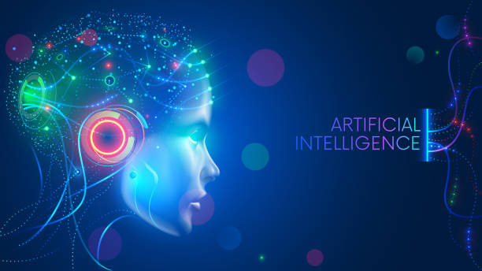

Slide 2
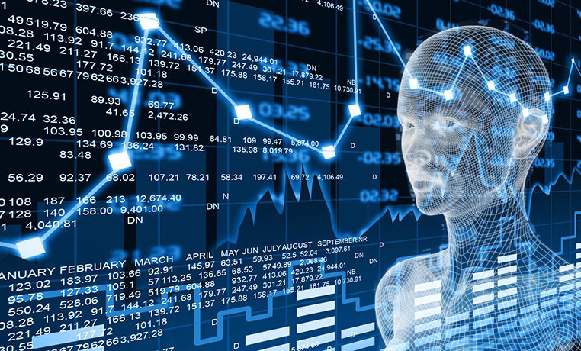
Welcome

Slide 3
Presentation On
Artificial Intelligence

Slide 4
What is Artificial Intelligence?
Artificial intelligence (AI) is wide-ranging branch of computer science concerned with building smart machines capable of performing tasks that typically require human intelligence. AI is an interdisciplinary science with multiple approaches, but advancements in machine learning and deep learning are creating a paradigm shift in virtually every sector of the tech industry.

Slide 5
Narrow Artificial Intelligence
Narrow AI is all around us and is easily the most successful realization of artificial intelligence to date. With its focus on performing specific tasks, Narrow AI has experienced numerous breakthroughs in the last decade that have had "significant societal benefits and have contributed to the economic vitality of the nation," according to "Preparing for the Future of Artificial Intelligence," a 2016 report released by the Obama Administration.
A few examples of Narrow AI include:
Google search
Image recognition software
Siri, Alexa and other personal assistants
Self-driving cars
IBM's Watson

Slide 6
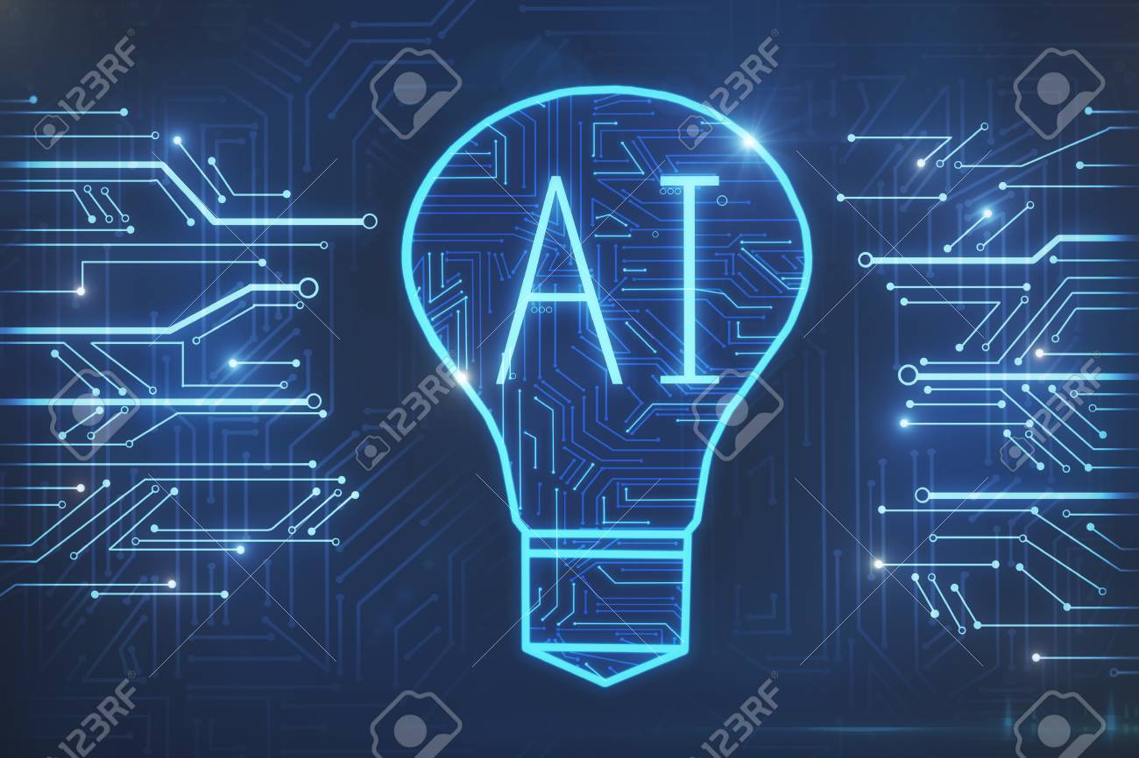
HOW IS AI USED?
Artificial intelligence generally falls under two broad categories:
Narrow AI: Sometimes referred to as "Weak AI," this kind of artificial intelligence operates within a limited context and is a simulation of human intelligence. Narrow AI is often focused on performing a single task extremely well and while these machines may seem intelligent, they are operating under far more constraints and limitations than even the most basic human intelligence.
Artificial General Intelligence (AGI): AGI, sometimes referred to as "Strong AI," is the kind of artificial intelligence we see in the movies, like the robots from Westworld or Data from Star Trek: The Next Generation. AGI is a machine with general intelligence and, much like a human being, it can apply that intelligence to solve any problem.

Slide 7

HISTORY OF AI
Intelligent robots and artificial beings first appeared in the ancient Greek myths of Antiquity. Aristotle's development of the syllogism and it's use of deductive reasoning was a key moment in mankind's quest to understand its own intelligence.
1963
John McCarthy starts the AI Lab at Stanford
1997
IBM's Deep Blue beats world chess champion Gary Kasparov
1972
The logic programming language PROLOG is created.
2008
Google makes breakthroughs in speech recognition and introduces the feature in its iPhone app
1991
U.S. forces deploy DART, an automated logistics planning and scheduling tool, during the Gulf War.
2011
IBM's Watson trounces the competition on Jeopardy!.

Slide 8
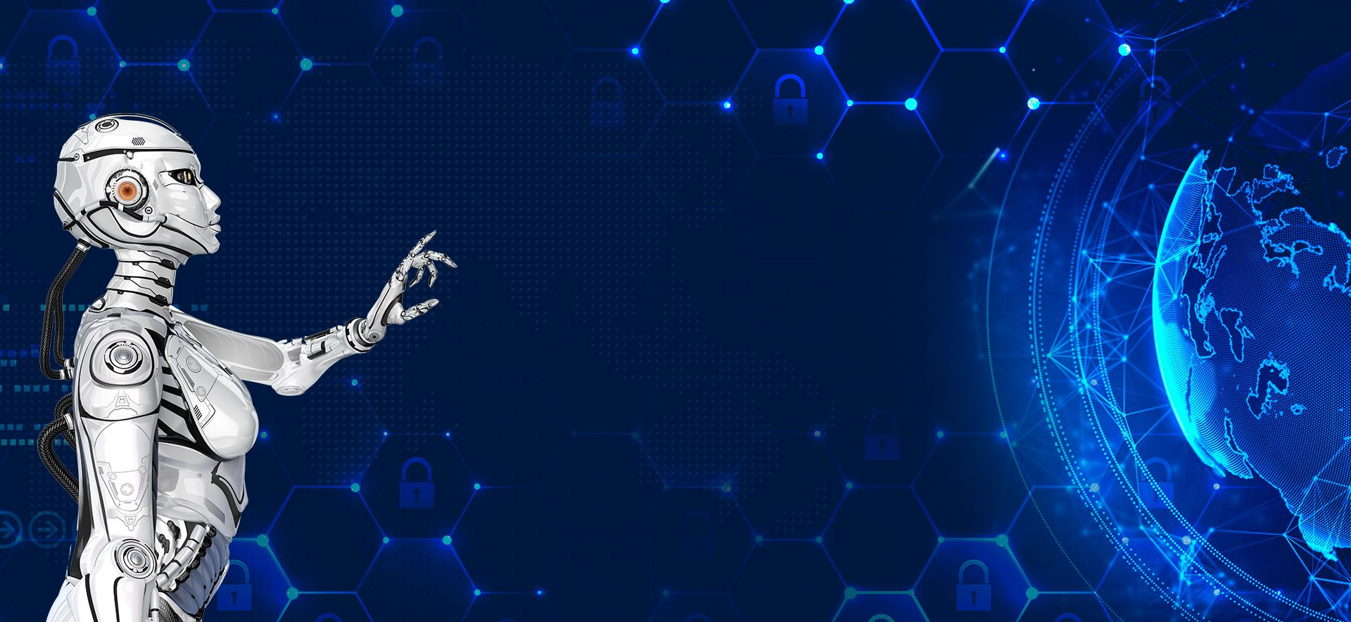
ARTIFICIAL INTELLIGENCE EXAMPLES
Smart assistants (like Siri and Alexa)
Disease mapping and prediction tools
Manufacturing and drone robots
Optimized, personalized healthcare treatment recommendations
Conversational bots for marketing and customer service
Robo-advisors for stock trading
Spam filters on email
Social media monitoring tools for dangerous content or false news
Song or TV show recommendations from Spotify and Netflix

Slide 9
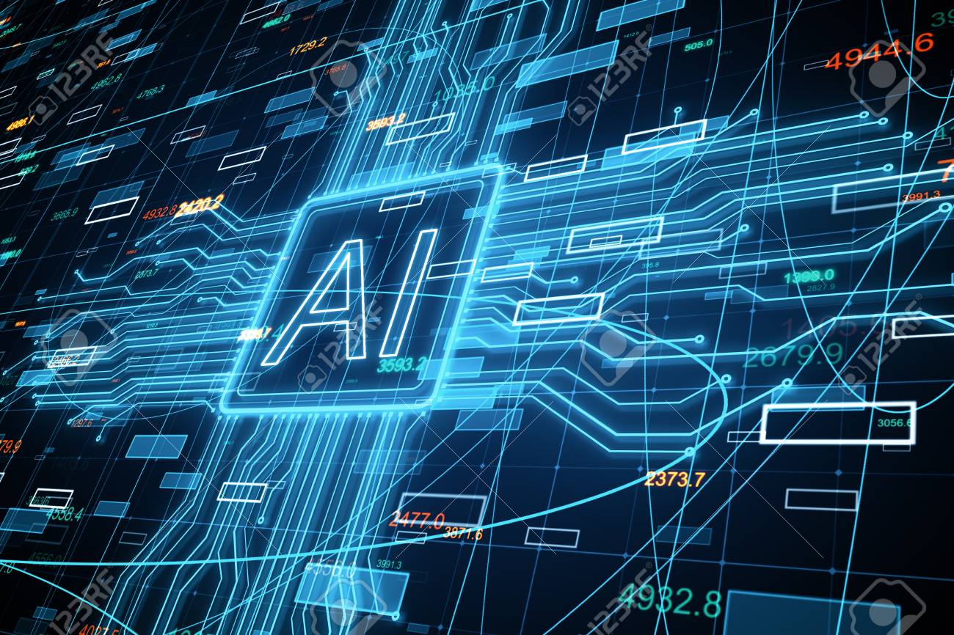
Understanding Artificial Intelligence (AI)
When most people hear the term artificial intelligence, the first thing they usually think of is robots. That's because big-budget films and novels weave stories about human-like machines that wreak havoc on Earth. But nothing could be further from the truth. Artificial intelligence is based on the principle that human intelligence can be defined in a way that a machine can easily mimic it and execute tasks, from the most simple to those that are even more complex. The goals of artificial intelligence include learning, reasoning, and perception.

Slide 10
Do you any question?

Slide 11
‘’’’’’’’’’’’’’’’’’’’’’’’’’’’’’’’’’’’’’’’’’’’
THANK YOU

