Slide 1
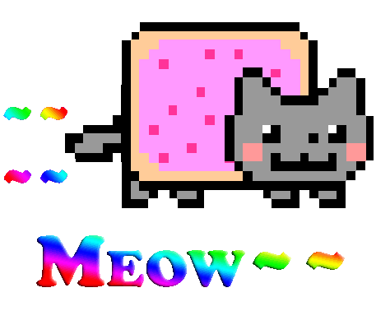
The simplest API ever for your implementation of the HTTP Server Zia. Vote for us, and you will not have to change anything in your server code. It's so generic, so simple, so concise... that I turned into a cat. Meow~

Slide 2
Differentes etape du traitement d’une requete

