Slide 1
CMSC 350 Data Structures and Analysis
Week 7 Priority Queues and Graph Representations and Properties

Slide 2
Complete Binary Tree
A complete binary tree is a binary tree with the following property
All levels are full except the bottom
On the bottom level all leaves are to the left of all missing nodes
Shape of a complete tree

Slide 3
Heap
Heap order property (max-heap)
The value in all nodes except the root must be less than or equal to the value in its parent
A heap is a complete binary tree that has the heap order property
A heap is a partially sorted data structure
A heap can be easily stored in an array using a level-order enumeration

Slide 4
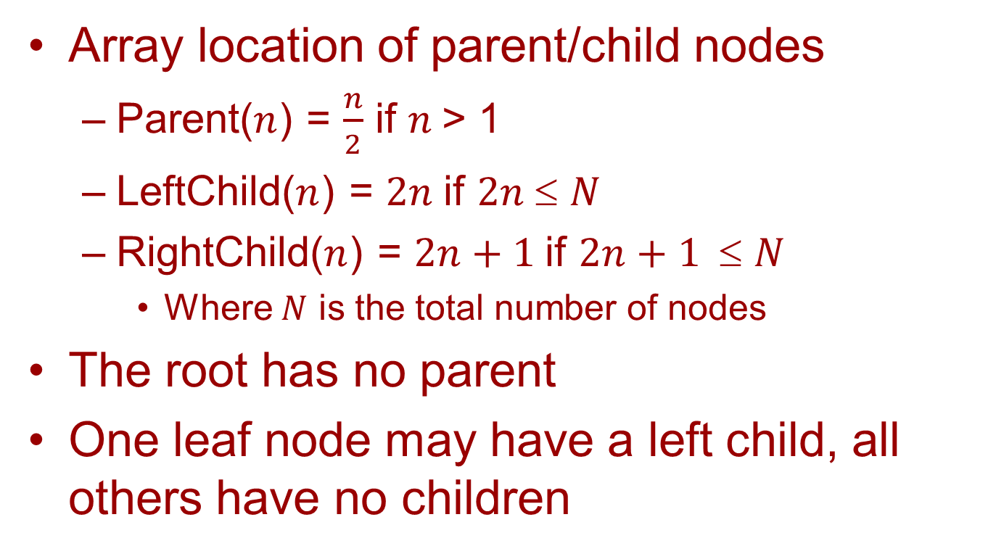
Parent/Child Formulas
Array location of parent/child nodes
Parent($n$) = $\frac{n}{2}$ if $n$> 1
LeftChild($n$) = $2n$if $2n$≤ $N$
RightChild($n$) = $2n+1$if $2n+1$≤ $N$
Where $N$ is the total number of nodes
The root has no parent
One leaf node may have a left child, all others have no children

Slide 5
Level Order Enumeration

Slide 6
Enqueue Operation

Slide 7
Dequeue Operation

Slide 8
Priority Queue Sorting
A priority queue is a natural sorting mechanism regardless of how it is implemented
A succession of enqueues followed by dequeues will produce a sorted list
The implementation influences the efficiency, however

Slide 9
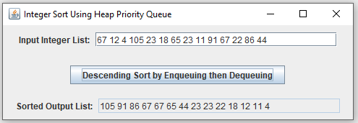
Heap Queue Example

Slide 10
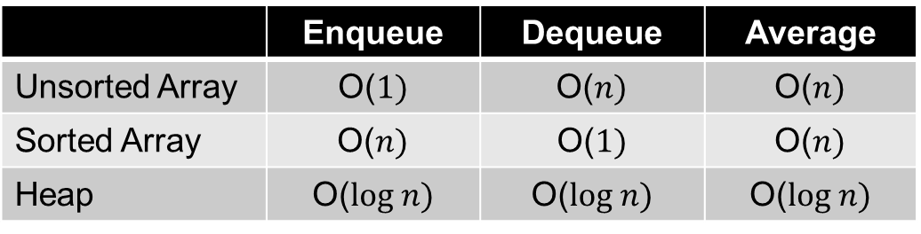
Priority Queue Implementations
Correspondence to sort algorithm
Implementation | Sorting Algorithm
Unsorted Array | Selection Sort
Sorted Array | Insertion Sort
Heap | Heap Sort
Efficiency
 | Enqueue | Dequeue | Average
Unsorted Array | O($1)$ | O($n)$ | O($n)$
Sorted Array | O($n)$ | O($1)$ | O($n)$
Heap | O($log n)$ | O($log n)$ | O($log n)$

Slide 11
Java Priority Queue
Operations in Queue interface
Enqueue operation offer or add
Dequeue operation poll or remove
Implementation of Priority Queue
Uses a heap
Why not use a list implementation?
Array or linked representation?
Sorted or unsorted?

Slide 12
Graph Terminology
Graph components
Vertices (Nodes)
Edges
Types of graphs
Undirected
Directed
Weighted
Path

Slide 13
Adjacency Matrix
A square Boolean matrix in which an entry is true when an edge is present
In an undirected graph, it would be a symmetric matrix
Type declarations
private static final int VERTICES = 25; private boolean[][] matrix = new boolean[VERTICES][VERTICES];

Slide 14
Adjacency Matrix Example

Slide 15
Array of Adjacency Lists
An array of linked (or array) lists that represent adjacent edges
Efficient in memory usage when the graph is sparse
Type declarations
private static final int VERTICES = 25; private LinkedList[] edges = new LinkedList[VERTICES];

Slide 16
List of Adjacency Lists
A linked (or array) list of linked (or array) lists that represent adjacent edges
Allows number of vertices to grow at run-time
Type declarations
private List<List<Integer>> edges = new ArrayList();

Slide 17
Fully Linked Adjacency List
private static class Vertex<E>
{
E element;
Edge<E> firstEdge;
Vertex<E> nextVertex;
}
private static class Edge<E>
{
Vertex<E> vertex;
Edge<E> nextEdge;
}

Slide 18
Fully Linked Example

Slide 19
Cycles or Circuits
Undirected graph
A cycle must have at least three edges
Cycle detection requires avoiding return to previous vertex with depth-first search
A second mark is needed
A search must be begun from all vertices
Directed graph
Edges must all go in the same direction

Slide 20
Connectedness
Undirected graph
Connectness can be determined by preforming a search and checking whether each node is marked
Directed graph
Strongly connected means connected in a directed sense
Weakly connected means connected in an undirected sense

Slide 21
Connected Components
A disjoint union can be used to determine the connected components of a graph
A depth-first sweep can be used also
In a directed graph there are two kinds
Strongly connected components
Weakly connected components
Component or condensation graph
Reduces connected components to a vertices

Slide 22
Connected Component Examples

