Slide 1
CMSC 350 Data Structures and Analysis
Week 8 Graph Algorithms and Sorting

Slide 2
Graph Operations
Inserting a vertex
Inserting an edge
Perform searches
Depth-first
Breath-first
Checking graph characteristics
Connectedness
Cyclic

Slide 3
Depth First Search
Best implemented with recursion and iteration
Recursion to go deeper
Iteration to visit neighbors
Similar to pre, in and postorder tree traversals
Requires marking visited nodes to avoid looping when cycles are present

Slide 4
DFS Algorithm
depth_first_sweep() for all vertices v if undiscovered depth_first_search(v)
depth_first_search(vertex s) if s is discovered cycle detected action return if s is finished return add vertex action mark s as discovered perform descend action for all adjacent vertices v depth_first_search(v) mark s as finished ascend action

Slide 5
Breadth First Search
Requires a FIFO queue
Adjacent vertices are enqueued when a vertex is visited
Visits all neighbors first
Similar to level order tree traversal
Like the depth-first search, marking visited nodes is required to avoid looping when cycles are present

Slide 6
Drawing Graphs
Drawing arbitrary graphs is a challenging problem to minimize crossing edges
Drawing a graph in which the client specifies the location of each vertex is not
interface Displayable
{
int getX();
int getY();
String getName();
}

Slide 7
Disjoint Union Data Structure
Also called a dynamic equivalence relation
Creates a partition of a set
Operations
union
find
Used to determine the connected components of a graph

Slide 8
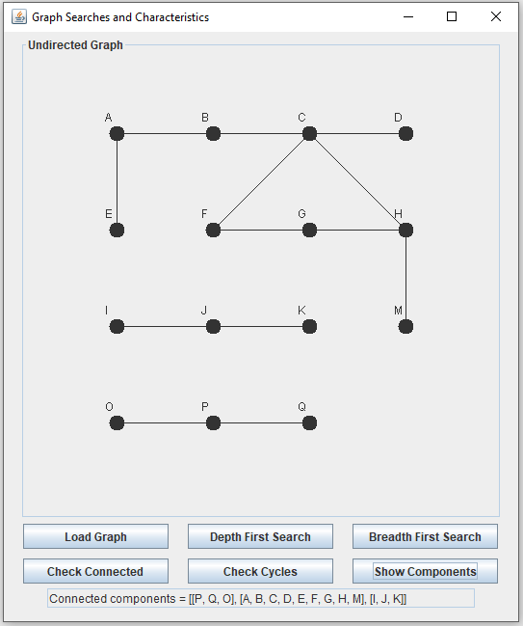
Graph Example UML

Slide 9
Directed Acyclic Graphs
Referred to as DAGs
Correspondence to a partial order
Order is reflexive, transitive closure of relation defined by edges
Condensation graph of strongly connected components
Topological orders
A linear order that preserves the partial order

Slide 10
Weighted Graphs
A weight is typically associated with each edge of the graph
Important algorithms (greedy algorithms)
Minimum spanning tree
Prim’s algorithm
Kruskal’s algorithm (uses disjoint union)
Single source shortest path
All points shortest path

Slide 11
Single Source Shortest Path
Dijkstra’s single source shortest path algorithm is a greedy algorithm
Creates a shortest path tree
Chooses vertex closest to starting vertex

Slide 12
Graph Applications
Undirected graphs
Networks
Directed graphs
Flow charts
Structure charts
Class dependency diagrams
Weighted graphs
Networks

Slide 13
History of Sorting
Fast sorting algorithms had great practical importance in the “data processing” era
Sorting on disk impacted the speed
Batch processing of transactions initially required that they be sorted first
Consequently sorting is one of the most thoroughly studied algorithms

Slide 14
Importance of Sorting
Efficient sorting is a challenging problem
The simple solutions are not the most efficient
The efficient solutions are not simple and require a more creative approach
Sorting algorithms provide good examples for studying algorithm efficiency
Many of them are data sensitive
Determining the average behavior is important

Slide 15
Best and Worst Cases
What constitutes a best or worst case depends upon the algorithm
For the simple sorts the cases are:
Best case: data already sorted
Worst case: data sorted in the opposite direction
There is a continuum between the two extremes

Slide 16
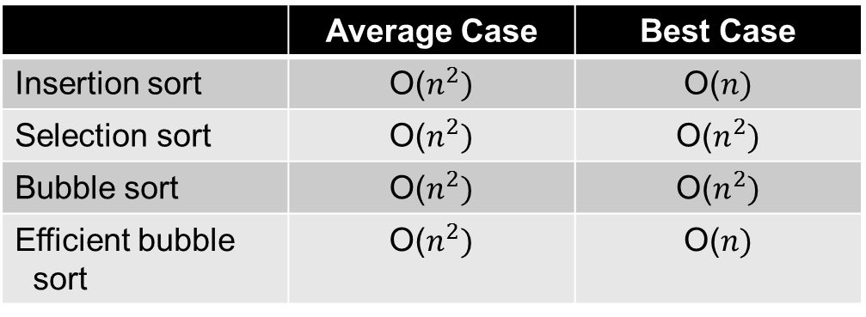
Simple Sorts
 | Average Case | Best Case
Insertion sort | O($n^{2})$ | O($n)$
Selection sort | O($n^{2})$ | O($n^{2})$
Bubble sort | O($n^{2})$ | O($n^{2})$
Efficient bubble sort | O($n^{2})$ | O($n)$
All simple sorts involve nested triangular loops
For two of the sorts, the best case is better than the average

Slide 17
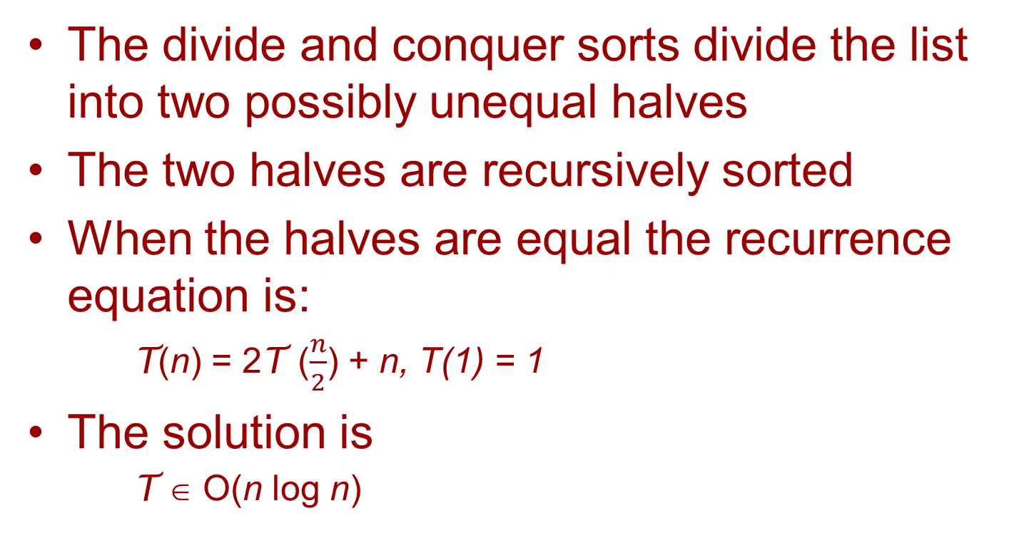
Divide and Conquer Sorts
The divide and conquer sorts divide the list into two possibly unequal halves
The two halves are recursively sorted
When the halves are equal the recurrence equation is:
T(n) = 2T ($\frac{n}{2}$) + n, T(1) = 1
The solution is
T ∈ O(n log n)

Slide 18
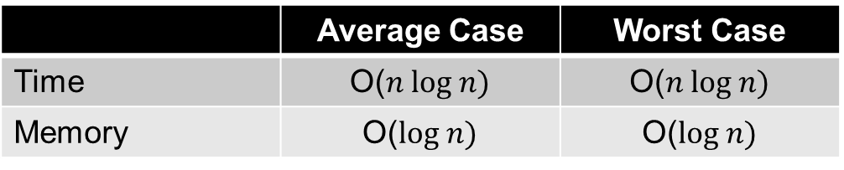
Merge Sort Characteristics
The merge sort merges sorted equal halves of the lists
The merge operation occurs on the way out of the recursion
Efficiency
 | Average Case | Worst Case
Time | O($n log n)$ | O($n log n)$
Memory | O($log n)$ | O($log n)$

Slide 19
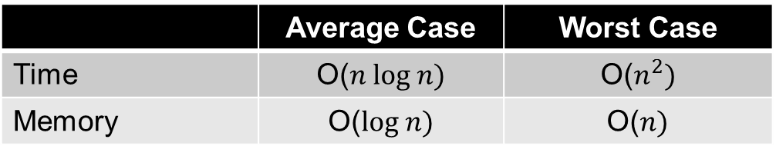
Quick Sort Characteristics
The quick sort divides the list into those less than and those greater than a pivot
The find pivot operation occurs on the way into the recursion
Efficiency
 | Average Case | Worst Case
Time | O($n log n)$ | O($n^{2})$
Memory | O($log n)$ | O($n)$

Slide 20
Optimality of Comparison Sorting
An algorithm is optimal when it can be proven that no more efficient solution can exist—establishing a lower bound
The heap, merge and quick sorts are all optimal comparison sorts
It is possible to perform a sort without doing comparisons

Slide 21
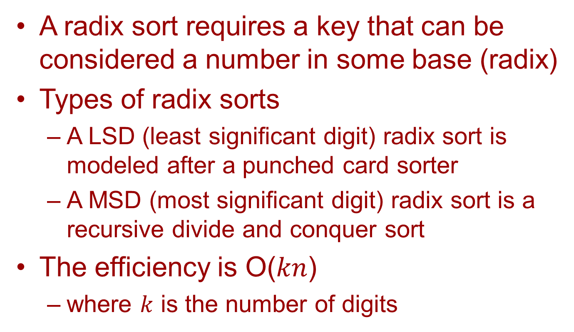
Radix Sort
A radix sort requires a key that can be considered a number in some base (radix)
Types of radix sorts
A LSD (least significant digit) radix sort is modeled after a punched card sorter
A MSD (most significant digit) radix sort is a recursive divide and conquer sort
The efficiency is O($kn$)
where $k$ is the number of digits

Slide 22
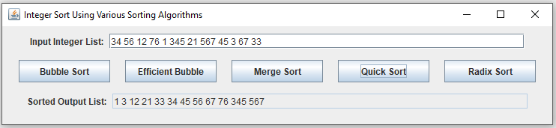
Sort Example UML

