Slide 1
CMSC 350 Data Structures and Analysis
Week 3 FIFO Queues and Collections

Slide 2
FIFO Queue – Abstraction
Sets (Data types)
C: Components
Q: Queues
Mathematical functions (Interface)
enqueue ε : Q × C → Q dequeue δ : Q → Q × C empty 0 : ∅ → Q
Axioms (Behavior)
∀ Q ∈ Q, c ∈ C, Q ≠ 0 ⇒ π₁(δ(ε(Q,c))) = ε(π₁(δ(Q)),c)
∀ c ∈ C, δ(ε(0,c)) = (0,c)
δ(0) = (0, ∅)

Slide 3
FIFO Queue UML

Slide 4
Circular Queue Implementation
Need size to test whether empty or full, front == back could be either

Slide 5
Linked Queue Implementation

Slide 6
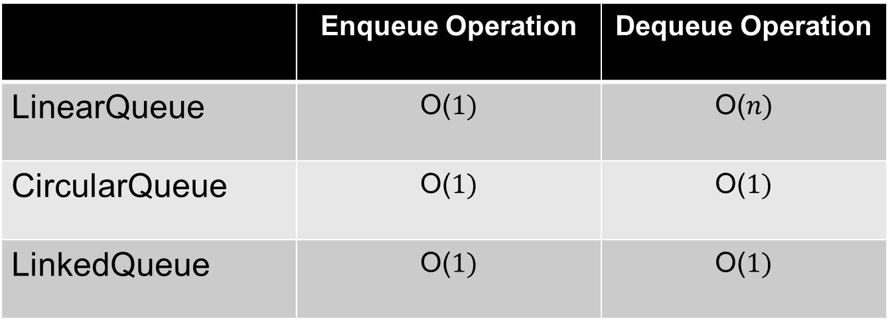
Queue Efficiencies
 | Enqueue Operation | Dequeue Operation
LinearQueue | O($1)$ | O($n)$
CircularQueue | O($1)$ | O($1)$
LinkedQueue | O($1)$ | O($1)$
The need to shift the array elements is what makes the linear array dequeue operation O(n)

Slide 7
Java FIFO Queue
Operations in Queue interface
Enqueue operation offer or add
Dequeue operation poll or remove
Implementation of FIFO Queue
LinkedList class
Why was LinkedList chosen rather than ArrayList?
Should composition have been used?

Slide 8
Doubly Linked Lists
Java LinkedList class uses a doubly linked list, with previous and next links
Can be used for a double-ended queue or Deque, which is a Java interface
Allows adding or removing from both ends in constant time, and backward traversals

Slide 9
Collection ADT
A collection is an unordered group of elements
Collection operations
add
remove
find
Implementations include unsorted or sorted arrays or linked list

Slide 10
Collection UML

Slide 11
Unsorted Array add Operation

Slide 12
Unsorted Array remove Operation

Slide 13
Sorted Collections
Elements must implement the Comparable interface
The generic type must be a bounded type
public interface SortedCollectionInterface<T extends Comparable<T>>
extends CollectionInterface<T>
Although only the compareTo method is required, equals should be defined
public int equals(T other) { return compareTo(other) == 0;}

Slide 14
Sorted Array add Operation

Slide 15
Sorted Array remove Operation

Slide 16
Sorted Array find Operation

Slide 17
Linked List add Operation

Slide 18
Linked List remove Operation

Slide 19
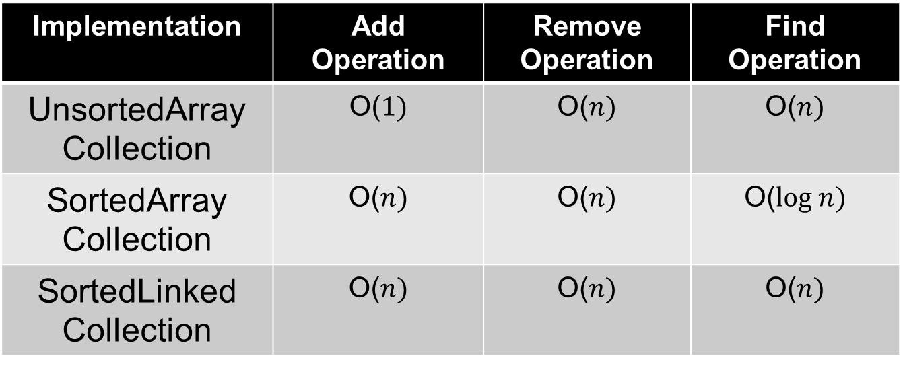
Collection Efficiencies
Implementation | Add Operation | Remove Operation | Find Operation
UnsortedArray Collection | O($1)$ | O($n)$ | O($n)$
SortedArray Collection | O($n)$ | O($n)$ | O($log n)$
SortedLinked Collection | O($n)$ | O($n)$ | O($n)$
Although adding and removing from a linked list is O(1), the find makes add and remove O(n)

Slide 20
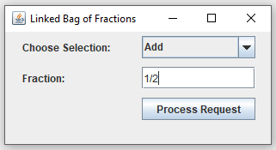
Sorted Linked Bag Example

Slide 21
Set ADT
A set is an unordered collection that excludes duplicates
It models a mathematical set
Our implementations use collections
Java sets have three implementations
TreeSet uses a binary search tree
HashSet uses a hash table
LinkedHashSet maintains insertion order

Slide 22
Bag ADT
The Java Collection Framework contains the most widely used data structures, but not everything
A bag (or multiset) is an unordered collection that allows duplicates
Using a collection is one possible representation for a bag
What is the best list representation to use?

Slide 23
Representation Choices
Primary choices
Arrays
Linked lists
Class relationship choices
Composition
Inheritance
Storage order choices
Unsorted
Sorted

