Slide 1
CMSC 350 Data Structures and Analysis
Week 6 Maps, Hash Tables and Balanced Binary Search Trees

Slide 2
Maps
A map requires a key, value pair
Dictionaries or keyed tables are synonyms
Map implementations
Balanced binary search tree
Hash table
Unsorted or sort list
Map operations include get, put, remove and contains

Slide 3
Hash Table Concept
If the key is an integer value, it can be used as an array index
Advantage
In that case inserting and removing from a table can be done in constant time
Disadvantage
Space is traded off for time
Hashing is a compromise

Slide 4
Hash Functions
Hash functions cannot be one-to-one because codomain is smaller than domain
Collisions are inevitable
Characteristics of good hash functions
Easy and fast to compute
Uniform distribution that minimizes collisions
Involves all digits of a number or all characters of a string

Slide 5
Hash Codes
Java hashCode method
Address of object
Hash codes for primitives
Integer types
Floating types
floatToIntBits
Hash codes for strings
Should factor in character position

Slide 6
Folding and Compressing
Folding 64 bits into 32
Used for keys of type long
(int) (key ^ (key >> 32)
Compressing hash codes
Reducing modulo a prime
Reducing modulo a power of 2
hashCode % n ⇔ hashCode & (n – 1)

Slide 7
Open Addressing
Linear probing
Checks next location on collision
Clustering
Quadratic probing
Checks locations 1, 4, 9 …
Secondary clustering
Double hashing
Hash function computes increment

Slide 8
Separate Chaining
Separate chaining uses a “bucket” for each key
Array list
Linked list
If too many collisions are allowed the size of these buckets can become too large
Keeping the load factor low enough prevents large buckets

Slide 9
Rehashing
Load factor is the ratio of the number of used elements to the capacity
Load factor thresholds
Open addressing 0.5
Separate chaining 0.9
Rehashing when threshold is reached
Doubles table size
Rehashes all elements of the table

Slide 10
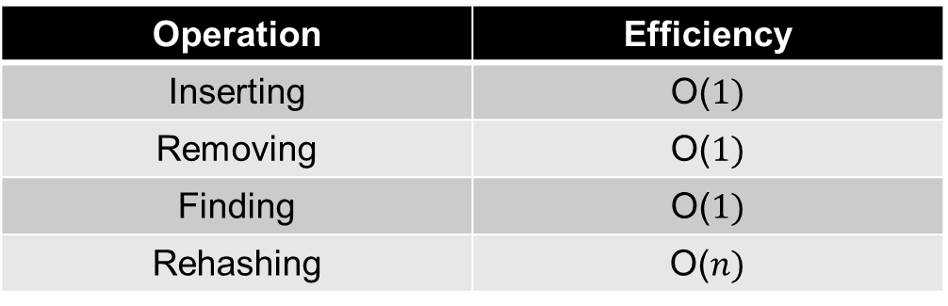
Hash Table Benefits
Keys do not have to be an ordered type
Both sets and maps can be implemented efficiently using hash tables
Operation | Efficiency
Inserting | O($1)$
Removing | O($1)$
Finding | O($1)$
Rehashing | O($n)$

Slide 11
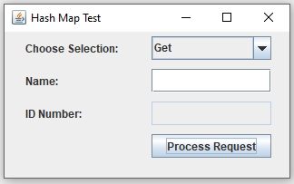
Hash Map Example

Slide 12
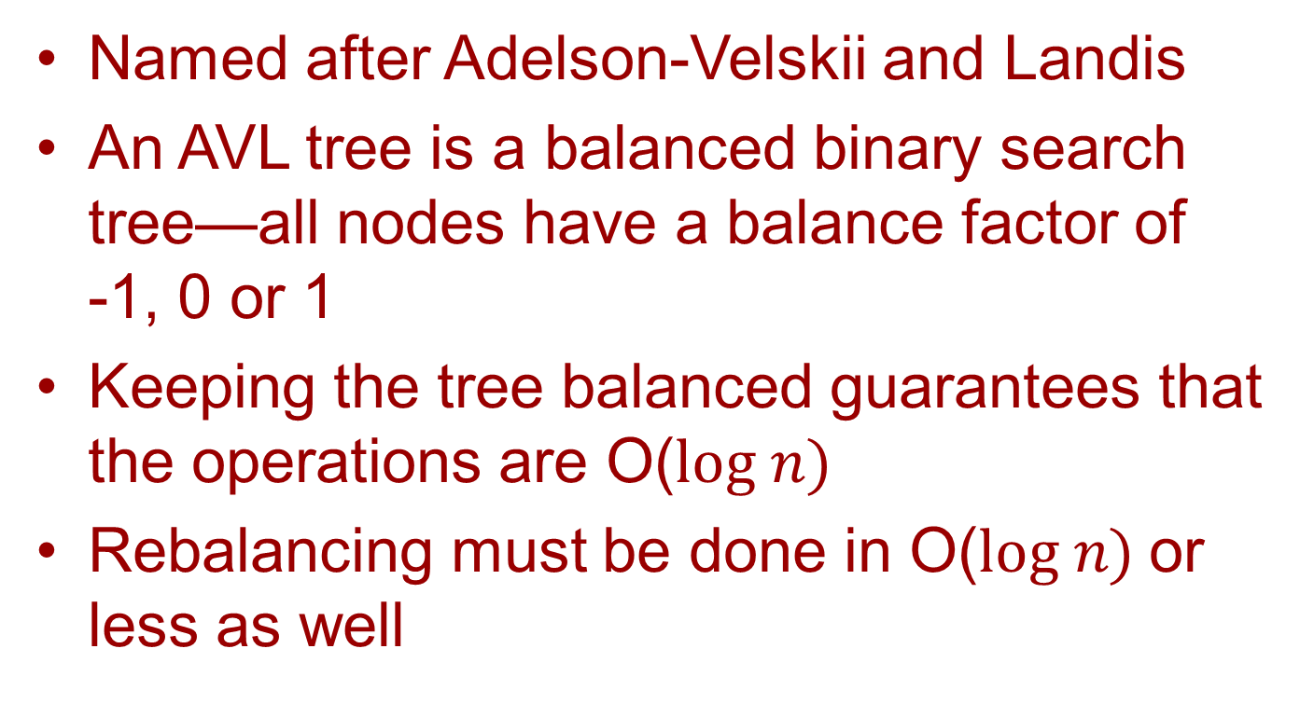
AVL Trees
Named after Adelson-Velskii and Landis
An AVL tree is a balanced binary search tree—all nodes have a balance factor of -1, 0 or 1
Keeping the tree balanced guarantees that the operations are O($log n)$
Rebalancing must be done in O($log n)$or less as well

Slide 13
Recomputing Balance Factors
Inserting a new leaf node can cause the height of the tree to change
A change to the tree height can cause an ancestor’s node to go out-of-balance
When that occurs, the out-of-balance subtree must be rebalanced
Four cases must be considered

Slide 14
LL Rotation
if (parent != root)
return parent;
parent.left = child.right;
child.right = parent;
return root = child;

Slide 15
LR Rotation

Slide 16
RR and RL Rotations
RR rotations are similar to LL rotations
RL rotations are similar to LR rotations

Slide 17
Red-Black Trees
The root and all null leaves are black
Both children of red nodes are black
Every branch has the same number of black nodes

Slide 18
Red-Black Tree Invariant
Red-black trees are not necessarily perfectly balanced (height-balanced 1)
The longest branch is at most twice as long as the shortest

Slide 19
Red-Black vs AVL Trees
The get operation of AVL trees is faster because the trees are more balanced
The put and remove operations of red-black trees are faster because there are fewer rotations needed
Red-black nodes require less memory
Languages including Java use red-black trees, whereas databases use AVL trees

Slide 20
Java Map Hierarchy

Slide 21
Map Operation Efficiency
When using a balanced binary search tree implementation, the operations to insert, remove and a find an element are O(log n)
When using a hash table representation, the operations to insert, remove and a find an element are O(1)
Because O(log n) grow so slowly, it is not much worse than O(1)

Slide 22
Choosing a Map Representation
If the key type is not an ordered type, a hash table is the only choice
The Object class defines a method hashCode, so all objects has hash codes
When keeping the data in sorted order is important, a balanced binary search tree representation is required

