Slide 1
CMSC 350 Data Structures and Analysis
Week 4 Lists

Slide 2
Lists vs Collections
A list is an ordered collection, so it is stored in sequential or linear order
List representations
Sorted or unsorted arrays
Sorted or unsorted linked lists
Because collections were build with arrays and linked lists, lists can be extensions of those implementations

Slide 3
List Abstract Data Type
Additional operations beyond what collections support
boolean add(T element, int index);
T set(int index, T element);
T get(int index);
int indexOf(T element);
T remove(int index);
Operations all involve an index

Slide 4
Iterators
Iterators allow a list to be traversed
List interface extends Iterable, which requires an iterator method that returns an Iterator object
An inner class that implements Iterator is required with these methods
hasNext
next

Slide 5
Implementing Array Lists
The underlying representation uses an array
When the array is full, an array twice the size is allocated and the new array is copied to it
The get and set operations are very efficient because they involve an array access

Slide 6
Array Resizing
Resizing the array and recopying it too often would compromise the efficiency of the append operation
Amortized analysis is used to consider the cost of resizing and copying
It spreads out the cost over all append operations

Slide 7
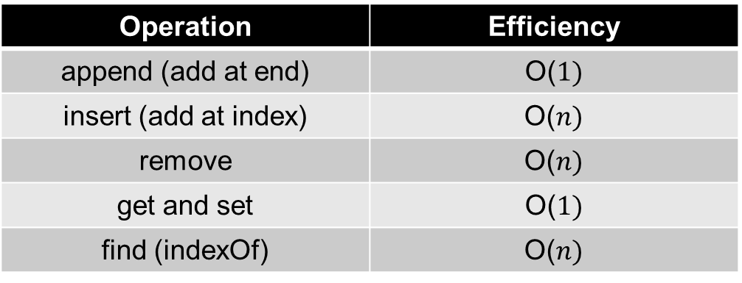
Unsorted Array List Efficiency
Operation | Efficiency
append (add at end) | O($1)$
insert (add at index) | O($n)$
remove | O($n)$
get and set | O($1)$
find (indexOf) | O($n)$
Appending elements requires no shifting
Inserting elements involves a right shift
Removing elements involves a left shift
Inherited remove must be overridden

Slide 8
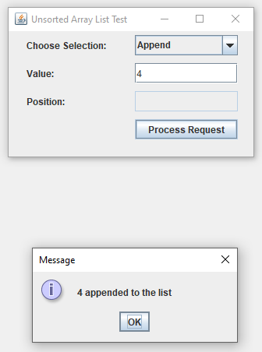
Unsorted Array List Example

Slide 9
Sorted Array Lists
Unlike the unsorted array list, the remove inherited from the unsorted collection need not be overridden, it already shifts values
Two operations of the list interface are not supported and throw exceptions
Inserting a value at a position (add)
Setting a value at a position (set)
Allowing either could break sorted order

Slide 10
Linked Lists
Singly or doubly linked lists can be used
Although insertion and removal are O(1)
Finding either the element or its position is O(n) whether the list is sorted or unsorted
Insert, remove and find operations can be done iteratively or recursively
Iterative implementations require a two node window, recursive ones do not

Slide 11
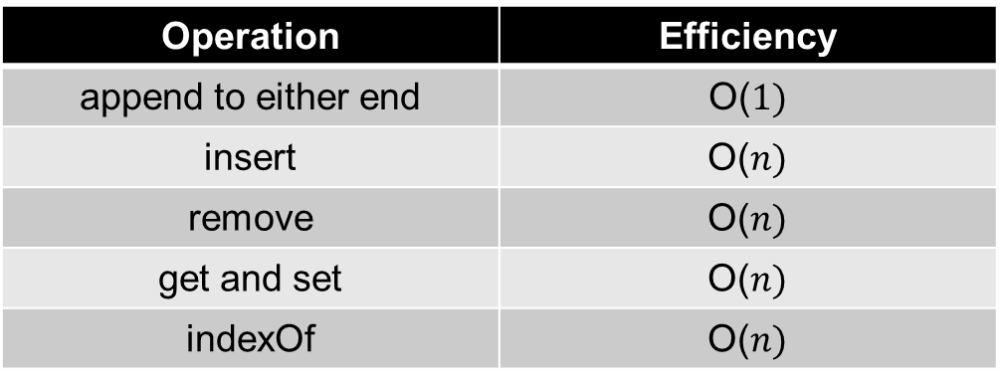
Unsorted Linked List Efficiency
Operation | Efficiency
append to either end | O($1)$
insert | O($n)$
remove | O($n)$
get and set | O($n)$
indexOf | O($n)$
Appending elements is efficient
Inserting elements and removing element involves traversing the list
Getting an element involves a traversal

Slide 12
Recursive Insert - Sorted List

Slide 13
Recursive Remove - Sorted List

Slide 14
Comparators
Comparators can be created for classes that don't implement Comparable so the objects can be compared
They can also be created to provide an alternate comparison
Comparator is a functional interface with a compare method similar to compareTo
int compare(T o1, T o2)

Slide 15
Comparator Example
public class Pair implements Comparable<Pair>
{
private int first, second;
@Override
public int compareTo(Pair other)
{
if (first != other.first)
return first - other.first;
return second - other.second;
}
public static Comparator<Pair> getCompare()
{
return (Pair left, Pair right) ->
{
if (left.second != right.second)
return left.second - right.second;
return left.first - right.first;
};
}
}
Comparable compareTo order
1,2 < 1,5 < 2,1 < 2,5
Comparator compare order
2,1 < 1,2 < 1,5 < 2,5
Because Comparator is a functional interface a lambda expression can be used

Slide 16
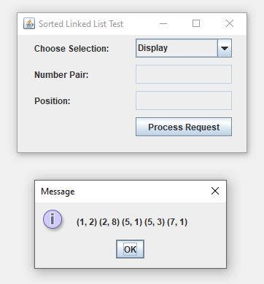
Sorted List of Pairs Example

Slide 17
Multilevel Lists
Multilevel lists are used in programming languages like LISP
Such lists are very similar to trees

Slide 18
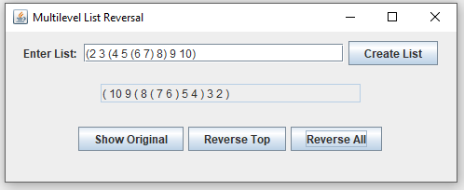
Multilevel List Example
Reverses multilevel lists at top or at all levels

Slide 19
Java List Hierarchy
The Vector and Stack classes predate the Java Collection Framework

Slide 20
Execution Time Tradeoffs
The ArrayList class efficiently implements the ability to extract elements at a specific index
The LinkedList class efficiently implements insertions and deletions at both ends
Neither is more efficient at insertions or deletions in the middle

Slide 21
Memory Tradeoffs
The ArrayList class usually has more allocated memory than is used
The LinkedList class requires twice as much memory as is used because of links
When an ArrayList object is more than half full it uses memory more efficiently than a LinkedList object

Slide 22
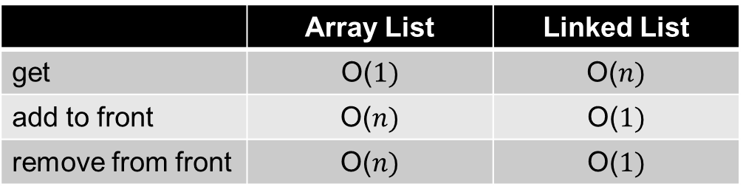
Comparing Array and Linked List Efficiencies
 | Array List | Linked List
get | O($1)$ | O($n)$
add to front | O($n)$ | O($1)$
remove from front | O($n)$ | O($1)$
An array list is clearly the better choice when numerous gets are needed
A linked list is the better choice when adding and removing at both ends is needed

