Slide 1
CMSC 330 Advanced Programming Languages
Week 2 Recursive Descent Parsing and Semantics

Slide 2
Parsing Strategy
One method per production
Methods return true for successful parsing and false for syntax errors
Each token in a production must be verified and the next token obtained
Each nonterminal in a production generates a call to the method that parses that nonterminal

Slide 3
Parsing a while Statement
while_statement → WHILE (expression) statement
boolean parseWhileStatement() {
if (token == WHILE) {
token = getNextToken();
if (token == '(') {
token = getNextToken();
if (parseExpression()) {
if (token == ')') {
token = getNextToken();
if (parseStatement())
return true;
}
}
}
}
return false;
}

Slide 4
Productions with Multiple RHSs
Methods for productions with multiple RHSs must choose the right one
The choice of which RHS is made by examining the first token
Each RHS must begin with a different token
Being able to choose based on the first token is called "one token look-ahead"

Slide 5
Parsing a statement
statement → if_statement | while_statement | for_statement
boolean parseStatement() {
if (token == IF)
return parseIfStatement();
if (token == WHILE)
return parseWhileStatement();
if (token == FOR)
return parseForStatement();
return false;
}

Slide 6
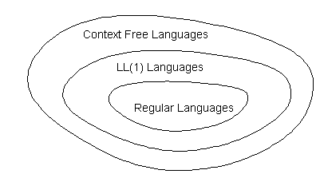
Non LL(1)Grammars
Left recursive or ambiguous grammars
No one token lookahead
Parse tables have multiple entries
FIRST sets are not mutually disjoint
Some languages have no LL(1) grammar that defines them

Slide 7
FIRST and FOLLOW Sets
RHSs begin with terminals
A → bB | aC | bDe {b}, {a}, {b}
RHS begins with nonterminal
A → Bac | aC | bDe {c,d}, {a}, {b}
B → cC | dCa {c}{d}
RHS is empty string
A → λ | aC {b,d}, {a}
B → Ab
C → cAd

Slide 8
Left Factoring
Left factoring LL(2) grammar gives LL(1)
Statement ::=
if_statement |
while_statement |
compound_statement |
IDENTIFIER ( expression_list ) |
IDENTIFIER ASSIGNOP expression;
The FIRST sets are now mutually disjoint
identifier_statement ::=
( expression_list ) |
ASSIGNOP expression

Slide 9
Semantics
Static Semantics: Rules of a language that define whether a program is meaningful
The semantic analyzer phase verifies that a program complies with static semantic rules
Dynamic Semantics: A mechanism for defining the meanings of programs
The code generator phase implements the dynamic semantics of the language

Slide 10
Syntax And Static Semantics In Natural Languages
English words
English sentences
 | Syntax | Semantics
car | √ | √
fot | √ | ×
mzt | × | ×
 | Syntax | Semantics
The boy hit the ball. | √ | √
The car ate the apple. | √ | ×
Jump green in of the. | × | ×

Slide 11
Syntax And Static Semantics In Programming Languages
 | Syntax | Semantics
Lexical Level | Invalid Token | Undefined Variable
Textual Level | Missing Semicolon | Type Mismatch
Static semantic rules apply to both the lexical and textual levels of the language
The semantic analyzer relies on the symbol table to check static semantic rules
The line between syntax and static semantics is not a sharp one

Slide 12
Static Semantic Rules
Context rules
Exit statements can only be inside loops
Type checking rules
If statement expressions must be Boolean
Category checking rules
Name in assignment must be variable name
Number checking rules
Number of parameters and arguments match

Slide 13
Attribute Grammars
The symbols of a context-free grammar can be given attributes that are used to define some of the static semantic rules
Type and category checking are most common examples
if_statement ::= IF expression THEN statement [ELSE statement]
expression.type = BOOLEAN

Slide 14
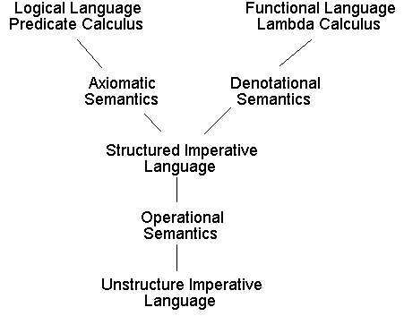
Dynamic Semantics
Language Level | Features
Declarative | No Assignments, No Gotos
Structured Imperative | Assignments, No Gotos
Unstructured Imperative | Assignments, Gotos

Slide 15
Operational Semantics
Defining meaning with a linear language
Assignment statements
x ← y
x ← unary_operator y
x ← y binary_operator z
Transfer of control statements
if x relational_operator y goto L
if ¬x goto L
goto L
Input / output statements
Call and return statements

Slide 16
Operational Statement Meaning
if statement
while statement
if B then S₁ else S₂ | if ¬B goto L₁ S₁ goto L₂ L₁ S₂ L₂ ...
while B do S | L₁ if ¬B goto L₂ S goto L₁ L₂ ...

Slide 17
PROGRAM TriangularNumbers (Input, Output);
VAR
Value, Index, Sum, Formula: Integer;
BEGIN
Readln(Value);
Sum := 0;
FOR Index := 1 TO Value DO
Sum := Sum + Value;
Formula := (Value * (Value - 1)) / 2;
Writeln(Sum, Formula)
END.

Slide 18
get(Value)
Sum ← 0
Index ← 1
S1: if Index > Value goto S2
Sum ← Sum + Value
Index ← Index + 1
goto S1
S2: t1 ← Value - 1
t2 ← t1 * Value
Formula ← t2 / 2
put(Sum)
put(Formula)

Slide 19
Axiomatic Semantics
Program meaning using predicate calculus
Used to prove programs are correct
The meaning of program S is {P} S {Q}
P Precondition
S Program
Q Postcondition
A program is correct if whenever P is true, and S is executed, Q is true

Slide 20
Axiomatic Statement Meanings
Inference rules define statement meaning
if statement
while statement
P in while statement is the loop invariant
{P ∧ B} S₁ {Q}, {P ∧ ¬B} S₂ {Q} ∴ {P} if B then S₁ else S₂ {Q}
{P ∧ B} S {P} _ ∴ {P} while B do S {P ∧ ¬B}

Slide 21
PROCEDURE Division(Dividend {d₁}, Divisor {d₂}: Integer;
VAR Quotient {q}, Remainder {r}: Integer);
BEGIN { P₀: (d₁ ≥ 0) ∧ (d₂ > 0) }
Quotient := 0;
{ P₁: (0 = q * d₂) ∧ (d₁ ≥ 0) ∧ (d₂ > 0) }
Remainder := Dividend;
{ P₂: (d₁ = q * d₂ + r) ∧ (r ≥ 0) ∧ (d₂ > 0) }
WHILE Remainder >= Divisor { B } DO
{ P₃: (d₁ = q * d₂ + r) ∧ (r ≥ d₂ > 0) }
BEGIN
Remainder := Remainder - Divisor;
{ P₄: (d₁ = (q + 1) * d₂ + r )) ∧ (r ≥ 0) ∧ (d₂ > 0) }
Quotient := Quotient + 1
{ P₅: (d₁ = q * d₂ + r) ∧ (r ≥ 0) ∧ (d₂ > 0) }
END
END; { P₆: (d₁ = q * d₂ + r) ∧ (d₂ > r ≥ 0) }

Slide 22
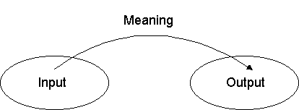
Denotational Semantics
Defining program meanings using functions (lambda calculus)
The meaning of a program is defined by the function that maps the input as domain to the output as co-domain

Slide 23
Denotational Statement Meanings
Second order functions define meaning
if B then S₁ else S₂
while B do S
Main creates the state from the input and extracts the output from the final state
I(s) = { | S₁ (s), if B (s) S₂ (s), otherwise
W(s) = { | W ° S (s), if B (s) s, otherwise

Slide 24
FUNCTION Fibonacci(Value: Integer): Integer;
VAR
Index, Previous, Current, Next: Integer;
BEGIN
Previous := 0;
Current := 1;
FOR Index := 1 TO Value DO
BEGIN
Next := Previous + Current;
Previous := Current;
Current := Next
END;
Fibonacci := Previous
END;
0 if n = 0 f(n) = 1 if n = 1 f(n - 1 ) + f(n - 2) otherwise
{

