Slide 1
CMSC 330 Advanced Programming Languages
Week 5 Subprograms and Parameters

Slide 2
Subprogram Rationale
Subprogram benefits
Avoids code duplication
One copy called multiple times
Simplifies by reducing subprogram size
The subprogram concept is among the oldest language features
Assembly language programs can have subprograms

Slide 3
Subprogram Terminology
Subprogram is a generic term
FORTRAN has subroutines and functions
Pascal and Ada have procedures and functions
C++ has functions and member functions
Java and C# have methods
Synonyms
Subroutines, procedures and void functions
Member functions and methods

Slide 4
Subprogram Calls
A call to a subroutine, procedure or void function is a statement
A call to function is an expression
Function calls can be nested but procedure calls cannot
Because function calls are expressions, side effects are of greater concern

Slide 5
Overloaded Subprograms
Most newer languages allow overloading subprograms
Overloaded subprograms share the same name but have different signatures
Resolution happens at compile time by comparing parameters and arguments
Some languages allow operators to be overloaded

Slide 6
class string
{
public:
string(int l = 0) {length = l; ptr = 0;}
string(const char* s);
string(string& s);
~string() {if (ptr && --*ptr == 0) delete [] ptr;}
string& operator=(string& s);
friend string operator+(const string& s, const string& t);
friend int operator==(const string& s, const string& t);
char& operator[](int i) const;
string operator()(int i, int j) const;
friend istream& operator>>(istream& in, string& s);
friend ostream& operator<<(ostream& out, const string& s);
private:
void check(int i) const;
char* ptr;
int length;
};

Slide 7
string operator+(const string& s, const string& t)
{
if (s.length == 0)
return t;
if (t.length == 0)
return s;
string u(s.length + t.length);
u.ptr = new char[u.length+2];
*(u.ptr) = 1;
strncpy(u.ptr+1, s.ptr+1, s.length);
strncpy(u.ptr+1+s.length, t.ptr+1, t.length);
return u;
}
int operator==(const string& s, const string& t)
{
if (s.length != t.length)
return 0;
return strncmp(s.ptr+1, t.ptr+1, s.length) == 0;
}

Slide 8
char& string::operator[](int i) const
{
check(i);
return *(ptr+1 + i);
}
string string::operator()(int i,int j) const
{
check(i);
check(j);
string sub(j-i+1 < 0 ? 0 : j-i+1);
sub.ptr = new char[sub.length+1];
*(sub.ptr) = 1;
strncpy(sub.ptr+1, ptr+1 + i, sub.length);
return sub;
}

Slide 9
string& string::operator=(string& s)
{
if ((length = s.length) == 0)
ptr = 0;
else
{
(*s.ptr)++;
if (ptr && --*ptr == 0)
delete[] ptr;
ptr = s.ptr;
}
return *this;
}
ostream& operator<<(ostream& out, const string& s)
{
for (int i = 0; i < s.length; i++)
out << *(s.ptr+1 + i);
return out;
}

Slide 10
Recursion and Call Stack
Earliest versions of FORTRAN did not support recursion
Recursion is really a declarative concept not needed in an imperative language
When a language supports recursion a run-time call stack is needed to store local variables, temporaries and the subprogram return address

Slide 11
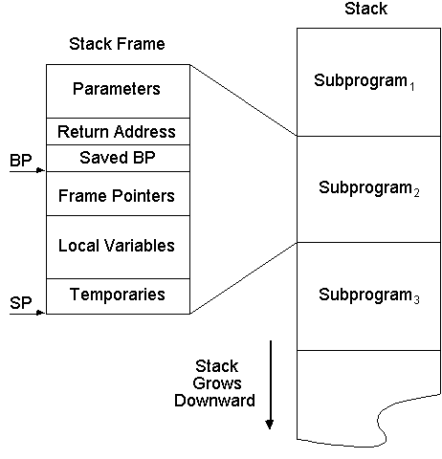
Activation Records
Each call creates an activation record

Slide 12
Nested Subprograms and Blocks
Nested subprograms were an essential component of block-structured languages
Algol, Pascal and Ada allow nested subprograms
Nested subprograms complicate the design of the compiler, blocks do not
The C family does not support them
Object-orientation eliminated the need

Slide 13
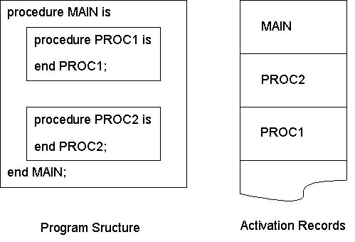
Implementing Nested Subprograms
Nested subprograms require more than one accessible activation record

Slide 14
Parameter Passing Issues
Languages vary considerably
Interaction between data flow direction and passing technique
Data flow directions: in, in-out and out
Interaction between argument syntax and passing technique
Argument syntax: variable, constant or expression

Slide 15
Parameter Passing Techniques
Pass by value
Argument is copied to the parameter
Pass by reference
Parameter is a reference to the argument
Pass by result
Parameter is copied to the argument
Pass by value-result
Argument copied in, parameter copied out
Pass by name

Slide 16
Semantics and Implementation
 | In | In-Out | Out
Value | √
Reference | √ | √ | √
Result |  |  | √
Value-Result | √ | √ | √
Name | √ | √ | √

Slide 17
Argument Syntax and Implementation
Argument syntax not independent from parameter passing technique
Reference parameters require argument to be a variable
Value parameters allow variables, constants or expressions
z = sqrt(x);
z = sqrt(25); z = sqrt(x + y);

Slide 18
Generality: Value Vs Reference
 | Variable Argument | Constant Argument | Expression Argument
In | √ | √ | √
In/Out | √
Out | √
Certain combinations should never be allowed
Call by reference permits the most semantic generality
Call by value permits the most general argument

Slide 19
Pointers and Parameter Passing
 | Pointer |  | Value
 | In | Out | In | Out
Pointer By Value | √ |  | √ | √
Pointer By Reference | √ | √ | √ | √

Slide 20
#include <iostream>
using namespace std;
int c = 2;
void f(int* a, int* b)
{
*a = 2;
b = &c;
}
int main()
{
int x = 1, y = 1;
int *px = &x, *py = &y;
f(px, py);
cout << “*px = " << *px << " *py = " << *py << endl;
return 0;
}

Slide 21
#include <iostream>
using namespace std;
int c = 2;
void f(int*& a, int*& b)
{
*a = 2;
b = &c;
}
int main()
{
int x = 1, y = 1;
int *px = &x, *py = &y;
f(px, py);
cout << “*px = " << *px << " *py = " << *py << endl;
return 0;
}

Slide 22
Language Approaches
Algol: By value, call by name
C++: Call by value, pointers and references used for passing by reference, constant mode
Ada: Programmer specifies the mode, which include: in inout out
Java: Call by value only including objects, although object names are references
C#: Call by value is the default, ref and out

Slide 23
import java.util.*; class JavaParameters { public static void main(String[] args) { StringBuffer s = new StringBuffer("Java passes"), t = s; m(s, t); System.out.println(s); System.out.println(t); } private static void m(StringBuffer s, StringBuffer t) { s.append(" by value"); t = new StringBuffer("Java passes by reference"); } }

Slide 24
with Text_IO; use Text_IO;
procedure Main is
type Integer_Array is (1..2) of Integer;
Actual: Integer_Array;
procedure Alias(Formal: in out Integer_Array) is
begin
Formal(1) := Formal(1) + 1;
Formal(1) := Formal(1) + Actual(1);
end Alias;
begin
Actual(1) := 2;
Alias(Actual);
Put(Integer'Image(Actual(1)));
end Main;

Slide 25
Constant Parameters
C++ allows both pointers and the values pointed to be constant
void f(const int* p1, int* const p2)
{
*p1 = 0;
p2 = new int;
}
Both assignments are errors
Java final applies only to the reference

Slide 26
Default Parameters
Some languages support default parameters
C++ and Ada do
Java does not
When calling a subprogram with a default parameter, the argument can be omitted
Default parameters can minimize the need for overloading subprograms

Slide 27
Feature Interaction
Overloaded functions with default parameters can create ambiguity
Given overloaded functions
void f(int i, bool b = true);
void f(int i, int j = 0);
The following function call
f(0);
Will generate a compilation error due to ambiguity

Slide 28
Named Association
Some languages support named parameter association
Ada and C# are ones that do
With named association both the parameter name and argument are included in the call
When named association is used, the order no longer matters

