Slide 1
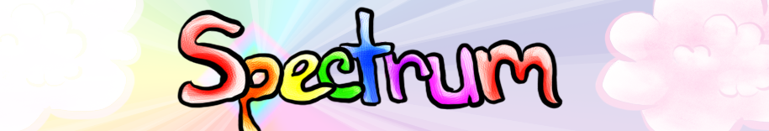
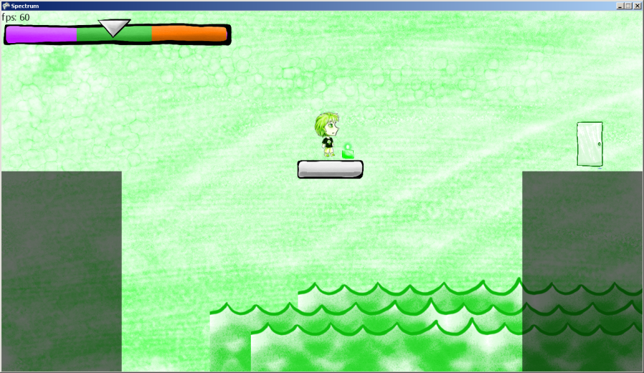
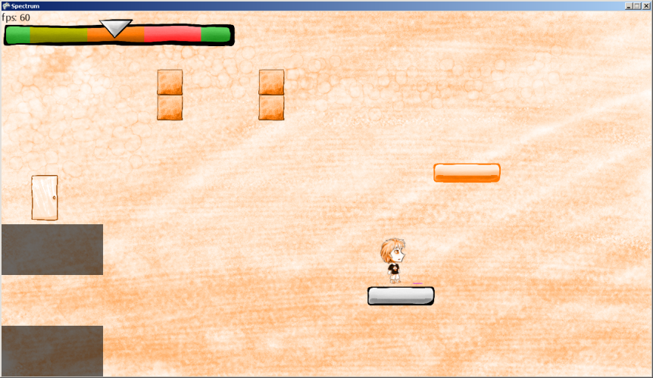
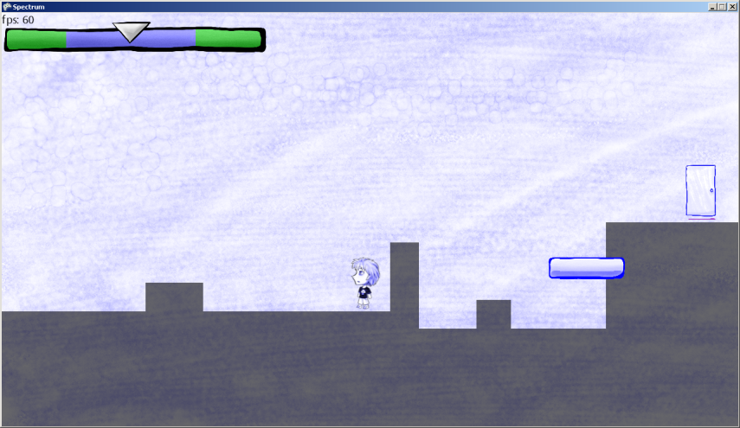
Your character has a strange condition where he can only view one color at a time.
You must use your knowledge of how colors mix to escape each level!
Switch between color viewing modes in order to view different “dimensions” of the same world.
Experience puzzling paradoxes and clever solutions in this alternate reality.
Work your way through the levels to unlock new color viewing abilities.
A game by Dustin Bachrach
and Nick Bridle
Art by Jennifer Humphreys

