Slide 1
Adjacency Matrices, Incidence Matrices, Database Schemas, and Associative Arrays
Jeremy Kepner & Vijay Gadepally
IPDPS Graph Algorithm Building Blocks
This work is sponsored by the Assistant Secretary of Defense for Research and Engineering under Air Force Contract #FA8721-05-C-0002. Opinions, interpretations, recommendations and conclusions are those of the authors and are not necessarily endorsed by the United States Government.
Notes:
Title slide.

Slide 2
Outline
Introduction
Associative Arrays & Adjacency Matrices
Database Schemas & Incidence Matrices
Examples: Twitter & DNA
Summary
Notes:
Outline slide.

Slide 3
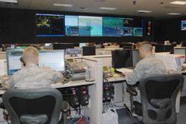

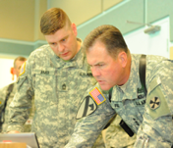




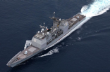
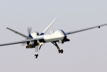
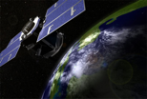





Common Big Data Challenge
Operators
Analysts
Commanders
Users
Rapidly increasing
- Data volume
- Data velocity
- Data variety
Data
Gap
Users
2000
2005
2010
2015 & Beyond
Data
<html>
OSINT
Weather
HUMINT
C2
Ground
Maritime
Air
Space
Cyber
Notes:
Increasing data volume, velocity, and variety has created a growing gap between data and users.
Image Sources:
Operators: http://en.wikipedia.org/wiki/Air_and_Space_Operations_Center
Analysts: © Comstock http://www.gettyimages.com/detail/photo/businessman-at-computer-royalty-free-image/78479774.
Commanders: US Forces Korea General News http://www.usfk.mil/usfk/%28A%28dL8DLge1ywEkAAAAYzg4NWY4MzMtM2I0OS00YWI5LTljYjctMWQ0NDM4MGUwYzVmgU4GPacw1yQ4-d8XCgyTu_0lbjQ1%29S%28aw5nfc45hpuvapn5pihn0o45%29%29/news.annual.command.post.exercise.winds.down.in.korea.printview.648
OSINT: Acrobat logo is © Adobe Systems Inc., © Twitter and Office 2011 logos are © Microsoft
Weather: © Rebecca van Ommen : http://www.gettyimages.com/detail/photo/paper-craft-weather-royalty-free-image/180478515
HUMINT: U.S. Dept of State http://www.rewardsforjustice.net/index.cfm?page=zulkifli&language=english
C2: http://www.disa.mil/Services/Command-and-Control/GCCS-J
Ground: Staff Sgt. William Tremblay/U.S. Army via Wired : http://www.wired.com/dangerroom/2010/09/afghan-biometric-dragnet-could-snag-millions/
Maritime: This file is a work of a sailor or employee of the U.S. Navy, taken or made as part of that person's official duties. As a work of the U.S. federal government, the image is in the public domain. http://en.wikipedia.org/wiki/File:USS_Lake_Champlain_%28CG-57%29.JPG
Air: This image or file is a work of a U.S. Air Force Airman or employee, taken or made as part of that person's official duties. As a work of the U.S. federal government, the image or file is in the public domain. http://en.wikipedia.org/wiki/File:MQ-9_Reaper_in_flight_%282007%29.jpg
Space: This file is in the public domain because it was solely created by NASA. NASA copyright policy states that "NASA material is not protected by copyright unless noted". http://en.wikipedia.org/wiki/File:CloudSat_-_Artist_Concept.jpg
Cyber: © derrrek : http://www.gettyimages.com/detail/illustration/abstract-backgrounds-royalty-free-illustration/185548379
This graphic was previously approved for public release as MS-77705

Slide 4
Common Big Data Architecture
Operators
Analysts
Commanders
Users
Web
Ingest & Enrichment
Databases
Ingest & Enrichment
Ingest
Analytics
Files
Scheduler
Computing
Data
<html>
OSINT
Weather
HUMINT
C2
Ground
Maritime
Air
Space
Cyber
Notes:
The Common Big Data Architecture shows the components that are common to many big data and supercomputing systems. The platform is designed to support standardized data access and dynamic composition of functionalities.
Image Sources:
Operators: http://en.wikipedia.org/wiki/Air_and_Space_Operations_Center
Analysts: © Comstock http://www.gettyimages.com/detail/photo/businessman-at-computer-royalty-free-image/78479774.
Commanders: US Forces Korea General News http://www.usfk.mil/usfk/%28A%28dL8DLge1ywEkAAAAYzg4NWY4MzMtM2I0OS00YWI5LTljYjctMWQ0NDM4MGUwYzVmgU4GPacw1yQ4-d8XCgyTu_0lbjQ1%29S%28aw5nfc45hpuvapn5pihn0o45%29%29/news.annual.command.post.exercise.winds.down.in.korea.printview.648
OSINT: Acrobat logo is © Adobe Systems Inc., © Twitter and Office 2011 logos are © Microsoft
Weather: © Rebecca van Ommen : http://www.gettyimages.com/detail/photo/paper-craft-weather-royalty-free-image/180478515
HUMINT: U.S. Dept of State http://www.rewardsforjustice.net/index.cfm?page=zulkifli&language=english
C2: http://www.disa.mil/Services/Command-and-Control/GCCS-J
Ground: Staff Sgt. William Tremblay/U.S. Army via Wired : http://www.wired.com/dangerroom/2010/09/afghan-biometric-dragnet-could-snag-millions/
Maritime: This file is a work of a sailor or employee of the U.S. Navy, taken or made as part of that person's official duties. As a work of the U.S. federal government, the image is in the public domain. http://en.wikipedia.org/wiki/File:USS_Lake_Champlain_%28CG-57%29.JPG
Air: This image or file is a work of a U.S. Air Force Airman or employee, taken or made as part of that person's official duties. As a work of the U.S. federal government, the image or file is in the public domain. http://en.wikipedia.org/wiki/File:MQ-9_Reaper_in_flight_%282007%29.jpg
Space: This file is in the public domain because it was solely created by NASA. NASA copyright policy states that "NASA material is not protected by copyright unless noted". http://en.wikipedia.org/wiki/File:CloudSat_-_Artist_Concept.jpg
Cyber: © derrrek : http://www.gettyimages.com/detail/illustration/abstract-backgrounds-royalty-free-illustration/185548379
This graphic was previously approved for public release as MS-77705

Slide 5




Common Big Data Architecture - Data Volume: Cloud Computing -
Operators
Analysts
MIT SuperCloud merges four clouds
Operators
Analysts
Commanders
Users
Enterprise Cloud
Compute Cloud
MIT
SuperCloud
Web
Ingest & Enrichment
Databases
Ingest & Enrichment
Ingest
Analytics
Files
Big Data Cloud
Database Cloud
Scheduler
Computing
Data
<html>
OSINT
Weather
HUMINT
C2
Ground
Maritime
Air
Space
Cyber
LLSuperCloud: Sharing HPC Systems for Diverse Rapid Prototyping, Reuther et al, IEEE HPEC 2013
Notes:
Addressing data volume requires a large computing cloud. MIT SuperCloud merges four main clouds.
Image Sources:
Operators: http://en.wikipedia.org/wiki/Air_and_Space_Operations_Center
Analysts: © Comstock http://www.gettyimages.com/detail/photo/businessman-at-computer-royalty-free-image/78479774.
Commanders: US Forces Korea General News http://www.usfk.mil/usfk/%28A%28dL8DLge1ywEkAAAAYzg4NWY4MzMtM2I0OS00YWI5LTljYjctMWQ0NDM4MGUwYzVmgU4GPacw1yQ4-d8XCgyTu_0lbjQ1%29S%28aw5nfc45hpuvapn5pihn0o45%29%29/news.annual.command.post.exercise.winds.down.in.korea.printview.648
OSINT: Acrobat logo is © Adobe Systems Inc., © Twitter and Office 2011 logos are © Microsoft
Weather: © Rebecca van Ommen : http://www.gettyimages.com/detail/photo/paper-craft-weather-royalty-free-image/180478515
HUMINT: U.S. Dept of State http://www.rewardsforjustice.net/index.cfm?page=zulkifli&language=english
C2: http://www.disa.mil/Services/Command-and-Control/GCCS-J
Ground: Staff Sgt. William Tremblay/U.S. Army via Wired : http://www.wired.com/dangerroom/2010/09/afghan-biometric-dragnet-could-snag-millions/
Maritime: This file is a work of a sailor or employee of the U.S. Navy, taken or made as part of that person's official duties. As a work of the U.S. federal government, the image is in the public domain. http://en.wikipedia.org/wiki/File:USS_Lake_Champlain_%28CG-57%29.JPG
Air: This image or file is a work of a U.S. Air Force Airman or employee, taken or made as part of that person's official duties. As a work of the U.S. federal government, the image or file is in the public domain. http://en.wikipedia.org/wiki/File:MQ-9_Reaper_in_flight_%282007%29.jpg
Space: This file is in the public domain because it was solely created by NASA. NASA copyright policy states that "NASA material is not protected by copyright unless noted". http://en.wikipedia.org/wiki/File:CloudSat_-_Artist_Concept.jpg
Cyber: © derrrek : http://www.gettyimages.com/detail/illustration/abstract-backgrounds-royalty-free-illustration/185548379
This graphic was previously approved for public release as MS-77705

Slide 6
Common Big Data Architecture - Data Velocity: Accumulo Database -
Operators
Analysts
Commanders
Users
Web
Ingest & Enrichment
Databases
Ingest & Enrichment
Ingest
Analytics
Lincoln benchmarking validated Accumulo performance
Files
Scheduler
Computing
Data
<html>
OSINT
Weather
HUMINT
C2
Ground
Maritime
Air
Space
Cyber
Notes:
Data velocity requires high performance databases. Lincoln has confirmed the claims of the Accumulo database.
Image Sources:
Operators: http://en.wikipedia.org/wiki/Air_and_Space_Operations_Center
Analysts: © Comstock http://www.gettyimages.com/detail/photo/businessman-at-computer-royalty-free-image/78479774.
Commanders: US Forces Korea General News http://www.usfk.mil/usfk/%28A%28dL8DLge1ywEkAAAAYzg4NWY4MzMtM2I0OS00YWI5LTljYjctMWQ0NDM4MGUwYzVmgU4GPacw1yQ4-d8XCgyTu_0lbjQ1%29S%28aw5nfc45hpuvapn5pihn0o45%29%29/news.annual.command.post.exercise.winds.down.in.korea.printview.648
OSINT: Acrobat logo is © Adobe Systems Inc., © Twitter and Office 2011 logos are © Microsoft
Weather: © Rebecca van Ommen : http://www.gettyimages.com/detail/photo/paper-craft-weather-royalty-free-image/180478515
HUMINT: U.S. Dept of State http://www.rewardsforjustice.net/index.cfm?page=zulkifli&language=english
C2: http://www.disa.mil/Services/Command-and-Control/GCCS-J
Ground: Staff Sgt. William Tremblay/U.S. Army via Wired : http://www.wired.com/dangerroom/2010/09/afghan-biometric-dragnet-could-snag-millions/
Maritime: This file is a work of a sailor or employee of the U.S. Navy, taken or made as part of that person's official duties. As a work of the U.S. federal government, the image is in the public domain. http://en.wikipedia.org/wiki/File:USS_Lake_Champlain_%28CG-57%29.JPG
Air: This image or file is a work of a U.S. Air Force Airman or employee, taken or made as part of that person's official duties. As a work of the U.S. federal government, the image or file is in the public domain. http://en.wikipedia.org/wiki/File:MQ-9_Reaper_in_flight_%282007%29.jpg
Space: This file is in the public domain because it was solely created by NASA. NASA copyright policy states that "NASA material is not protected by copyright unless noted". http://en.wikipedia.org/wiki/File:CloudSat_-_Artist_Concept.jpg
Cyber: © derrrek : http://www.gettyimages.com/detail/illustration/abstract-backgrounds-royalty-free-illustration/185548379
This graphic was previously approved for public release as MS-77705

Slide 7
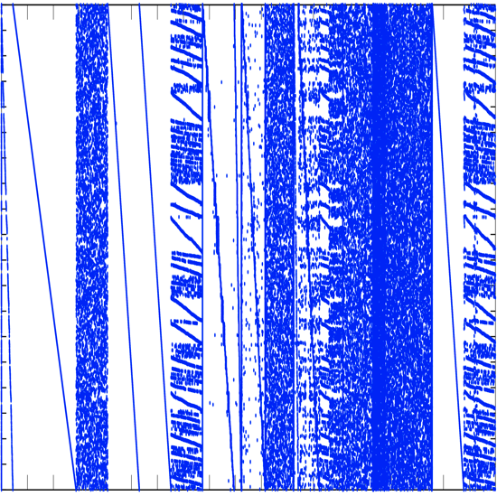
Common Big Data Architecture - Data Variety: D4M Schema -
Operators
Analysts
Commanders
Users
D4M demonstrated a
universal approach to diverse data
columns
raw
Web
Ingest & Enrichment
Databases
Ingest & Enrichment
Ingest
Analytics
Files
rows
Scheduler
Computing
Σ
intel reports, DNA, health records, publication citations, web logs, social media, building alarms, cyber, … all handled by a common 4 table schema
Data
<html>
OSINT
Weather
HUMINT
C2
Ground
Maritime
Air
Space
Cyber
D4M 2.0 Schema: A General Purpose High Performance Schema for the Accumulo Database, Kepner et al, IEEE HPEC 2013
Notes:
Data variety require new schemas that allow data to be flexibly stored. D4M Schema provides a simple approach that has been validated on a wide range of data.
Image Sources:
Operators: http://en.wikipedia.org/wiki/Air_and_Space_Operations_Center
Analysts: © Comstock http://www.gettyimages.com/detail/photo/businessman-at-computer-royalty-free-image/78479774.
Commanders: US Forces Korea General News http://www.usfk.mil/usfk/%28A%28dL8DLge1ywEkAAAAYzg4NWY4MzMtM2I0OS00YWI5LTljYjctMWQ0NDM4MGUwYzVmgU4GPacw1yQ4-d8XCgyTu_0lbjQ1%29S%28aw5nfc45hpuvapn5pihn0o45%29%29/news.annual.command.post.exercise.winds.down.in.korea.printview.648
OSINT: Acrobat logo is © Adobe Systems Inc., © Twitter and Office 2011 logos are © Microsoft
Weather: © Rebecca van Ommen : http://www.gettyimages.com/detail/photo/paper-craft-weather-royalty-free-image/180478515
HUMINT: U.S. Dept of State http://www.rewardsforjustice.net/index.cfm?page=zulkifli&language=english
C2: http://www.disa.mil/Services/Command-and-Control/GCCS-J
Ground: Staff Sgt. William Tremblay/U.S. Army via Wired : http://www.wired.com/dangerroom/2010/09/afghan-biometric-dragnet-could-snag-millions/
Maritime: This file is a work of a sailor or employee of the U.S. Navy, taken or made as part of that person's official duties. As a work of the U.S. federal government, the image is in the public domain. http://en.wikipedia.org/wiki/File:USS_Lake_Champlain_%28CG-57%29.JPG
Air: This image or file is a work of a U.S. Air Force Airman or employee, taken or made as part of that person's official duties. As a work of the U.S. federal government, the image or file is in the public domain. http://en.wikipedia.org/wiki/File:MQ-9_Reaper_in_flight_%282007%29.jpg
Space: This file is in the public domain because it was solely created by NASA. NASA copyright policy states that "NASA material is not protected by copyright unless noted". http://en.wikipedia.org/wiki/File:CloudSat_-_Artist_Concept.jpg
Cyber: © derrrek : http://www.gettyimages.com/detail/illustration/abstract-backgrounds-royalty-free-illustration/185548379
This graphic was previously approved for public release as MS-77705

Slide 8






Reference & Database Workshop
Database Discovery Workshop
3 day hands-on workshop on:
Systems
Parse, ingest, query, analysis & display
Optimization
Files vs. database, chunking & query planning
Fusion
Integrating diverse data
Technology selection
Knowing what to use is as important as knowing how to use it
Using state-of-the-art technologies:
Python
Hadoop
SciDB
Notes:
Text provides a mathematical foundation for many of the concepts in the course.

Slide 9
Outline
Introduction
Associative Arrays & Adjacency Matrices
Database Schemas & Incidence Matrices
Examples: Twitter & DNA
Summary
Notes:
Outline slide.

Slide 10

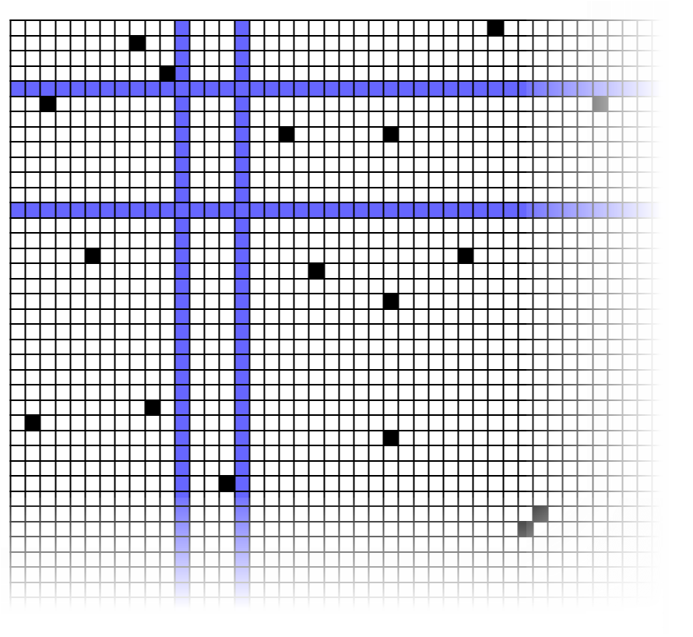
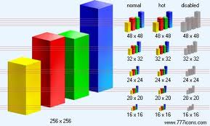
High Level Language: D4M d4m.mit.edu
Accumulo
Distributed Database
D4M
Dynamic
Distributed
Dimensional
Data Model
Associative Arrays
Numerical Computing Environment
A
B
C
Query:
Alice
Bob
Cathy
David
Earl
E
D
A D4M query returns a sparse matrix or a graph…
…for statistical signal processing or graph analysis in MATLAB or GNU Octave
D4M binds associative arrays to databases, enabling rapid prototyping of data-intensive cloud analytics and visualization
Dynamic Distributed Dimensional Data Model (D4M) Database and Computation System, Kepner et al, ICASSP 2012
Notes:
We make use of the high-level language D4M to enable to construction of graph representations of large-scale data

Slide 11
D4M Key Concept: Associative Arrays Unify Four Abstractions
Extends associative arrays to 2D and mixed data types
A('alice ','bob ') = 'cited '
or A('alice ','bob ') = 47.0
Key innovation: 2D is 1-to-1 with triple store ('alice ','bob ','cited ')
or ('alice ','bob ',47.0)
A^{T}
x
A^{T}x
bob
bob
cited
carl
alice
→
cited
carl
alice
Notes:
Associative arrays bridge strings, adjacency matrices and graphs.

Slide 12
Composable Associative Arrays
Key innovation: mathematical closure
All associative array operations return associative arrays
Enables composable mathematical operations
A + B A - B A & B A|B A*B
Enables composable query operations via array indexing
A('alice bob ',:) A('alice ',:) A('al* ',:)
A('alice : bob ',:) A(1:2,:) A == 47.0
Simple to implement in a library (~2000 lines) in programming environments with: 1st class support of 2D arrays, operator overloading, sparse linear algebra
Complex queries with ~50x less effort than Java/SQL
Naturally leads to high performance parallel implementation
Notes:
Associative arrays operations are composable, enabling complex queries to be constructed with a few lines.

Slide 13
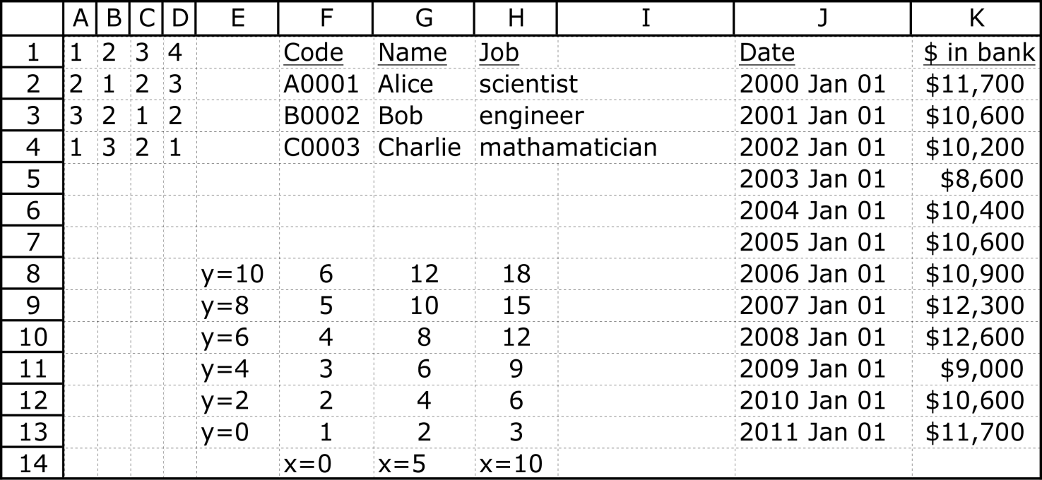
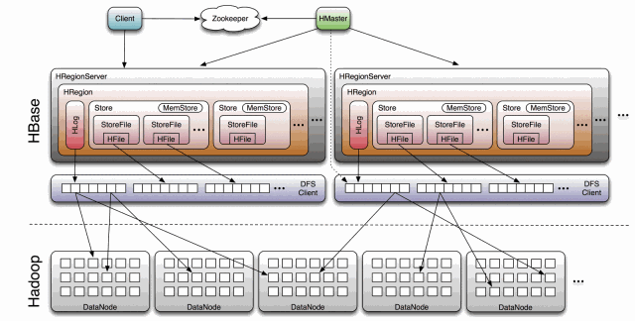
What are Spreadsheets and Big Tables?
Big Tables
Spreadsheets
Spreadsheets are the most commonly used analytical structure on Earth (100M users/day?)
Big Tables (Google, Amazon, …) store most of the analyzed data in the world (Exabytes?)
Simultaneous diverse data: strings, dates, integers, reals, …
Simultaneous diverse uses: matrices, functions, hash tables, databases, …
No formal mathematical basis; Zero papers in AMA or SIAM
Notes:
Data containing words and strings with semantic meaning are increasingly important.

Slide 14
An Algebraic Definition For Tables
First step axiomatization of the associative array
Desirable features for our “axiomatic” abstract arrays
Accurately describe the tables and table operations from D4M
Matrix addition and multiplication are defined appropriately
As many matrix-like algebraic properties as possible
A(B + C) = AB + AC A + B = B + A
Definition An associative array is a map A:K^{n} → S from a set of (possibly infinite keys) into a commutative semi-ring where A(k₁,…,k_{n}) = 0 for all but finitely many key tuples
Like an infinite matrix whose entries are “0 almost everywhere”
“Matrix-like” arrays are the maps A:K^{n} → S
Addition [A + B](i,j) = A(i,j) + B(i,j)
Multiplication [AB](i,j) = ∑_{k} A(i,k) x A(k,j)
The Abstract Algebra of Big Data, Kepner & Chaidez, Union College Mathematics Conference 2013
Notes:
Mathematical definition of an associative array.

Slide 15
Outline
Introduction
Associative Arrays & Adjacency Matrices
Database Schemas & Incidence Matrices
Examples: Twitter & DNA
Summary
Notes:
Outline slide.

Slide 16
Generic D4M Triple Store Exploded Schema
Accumulo Table: Ttranspose
Input Data
 | 01-01-2001 | 02-01-2001 | 03-01-2001
Col1|a | 1
Col1|b |  | 1
Col2|b |  | 1
Col2|c |  |  | 1
Col3|a | 1
Col3|c |  |  | 1
Time | Col1 | Col2 | Col3
2001-01-01 | a |  | a
2001-01-02 | b | b
2001-01-03 |  | c | c
 | Col1|a | Col1|b | Col2|b | Col2|c | Col3|a | Col3|c
01-01-2001 | 1 |  |  |  | 1
02-01-2001 |  | 1 | 1
03-01-2001 |  |  |  | 1 |  | 1
Accumulo Table: T
Tabular data expanded to create many type/value columns
Transpose pairs allows quick look up of either row or column
Flip time for parallel performance
Notes:
Exploded schema allow fast access to row and columns.

Slide 17
Tables: SQL vs D4M+Accumulo
SQL Dense Table: T
log_id | src_ip | srv_ip
001 | 128.0.0.1 | 208.29.69.138
002 | 192.168.1.2 | 157.166.255.18
003 | 128.0.0.1 | 74.125.224.72 208.29.69.138
Use as row indices
Create columns for each unique type/value pair
 | src_ip|128.0.0.1 | src_ip|192.168.1.2 | srv_ip|157.166.255.18 | srv_ip|208.29.69.138 | srv_ip|74.125.224.72
log_id|100 | 1 |  |  | 1
log_id|200 |  | 1 | 1
log_id|300 | 1 |  |  | 1 | 1
Accumulo D4M schema (aka NuWave) Tables: E and E^{T}
Both dense and sparse tables stored the same data
Accumulo D4M schema uses table pairs to index every unique string for fast access to both rows and columns (ideal for graph analysis)
Notes:
SQL tables are dense. D4M+Accumulo tables are sparse.

Slide 18
Queries: SQL vs D4M
Query Operation | SQL | D4M
Select all | SELECT * FROM T | E(:,:)
Select column | SELECT src_ip FROM T | E(:,StartsWith('src_ip| '))
Select sub-column | SELECT src_ip FROM T WHERE src_ip=128.0.0.1 | E(:,'src_ip|128.0.0.1 ')
Select sub-matrix | SELECT * FROM T WHERE src_ip=128.0.0.1 | E(Row(E(:,'src_ip|128.0.0.1 '))),:)
Queries are easy to represent in both SQL and D4M
Pedigree (i.e., the source row ID) is always preserved since no information is lost
Notes:
SQL queries use human language style constructs. D4M uses linear algebraic style constructs.
For queries, both are compact. SQL is more readable.

Slide 19
Analytics: SQL vs D4M
Query Operation | SQL | D4M
Histogram | SELECT COUNT(src_ip) FROM T GROUP BY src_ip | sum(E(:,StartsWith('src_ip| ')),2)
Graph traversal | SELECT * FROM T WHERE src_ip=128.0.0.1 ... | v0 = 'src_ip|128.0.0.1 ' v1 = Col(E(Row(E(:,v0)),:)) v2 = Col(E(Row(E(:,v1)),:))
Graph construction | … many lines … | A = E(:,StartsWith('src_ip| ')). ’ * E(:,StartsWith('srv_ip| '))
Graph eigenvalues | … many lines … | eigs(Adj(A))
Analytics are easy to represent in D4M
Pedigree (i.e., the source row ID) is usually lost since analytics are a projection of the data and some information is lost
Notes:
For analytics, SQL queries grow in size, while D4M queries remain small.

Slide 20
Outline
Introduction
Associative Arrays & Adjacency Matrices
Database Schemas & Incidence Matrices
Examples: Twitter & DNA
Summary
Notes:
Outline slide.

Slide 21

Tweets2011 Corpus http://trec.nist.gov/data/tweets/
Assembled for Text REtrieval Conference (TREC 2011)*
Designed to be a reusable, representative sample of the twittersphere
Many languages
16,141,812 million tweets sampled during 2011-01-23 to 2011-02-08 (16,951 from before)
11,595,844 undeleted tweets at time of scrape (2012-02-14)
161,735,518 distinct data entries
5,356,842 unique users
3,513,897 unique handles (@)
519,617 unique hashtags (#)
Ben Jabur et al, ACM SAC 2012
*McCreadie et al, “On building a reusable Twitter corpus,” ACM SIGIR 2012
Notes:
Tweets2011 is a publicly available data of over 16 million Tweets.

Slide 22
Twitter Input Data
TweetID | User | Status | Time | Text
29002227913850880 | Michislipstick | 200 | Sun Jan 23 02:27:24 +0000 2011 | @mi_pegadejeito Tipo. Você ...
29002228131954688 | __rosana__ | 200 | Sun Jan 23 02:27:24 +0000 2011 | para la semana q termino ...
29002228165509120 | doasabo | 200 | Sun Jan 23 02:27:24 +0000 2011 | お腹すいたずえ
29002228937265152 | agusscastillo | 200 | Sun Jan 23 02:27:24 +0000 2011 | A nadie le va a importar ...
29002229444771841 | nob_sin | 200 | Sun Jan 23 02:27:24 +0000 2011 | さて。札幌に帰るか。
29002230724038657 | bimosephano | 200 | Sun Jan 23 02:27:25 +0000 2011 | Wait :)
29002231177019392 | _Word_Play | 200 | Sun Jan 23 02:27:25 +0000 2011 | Shawty is 53% and he pick ...
29002231202193408 | missogeeeeb | 200 | Sun Jan 23 02:27:25 +0000 2011 | Lazy sunday ╰(◣﹏◢)╯ oooo !
29002231692922880 | PennyCheco06 | 301 | null | null
… | … | … | … | …
Mixture of structured (TweetID, User, Status, Time) and unstructured (Text)
Fits well into standard D4M Exploded Schema
Notes:
Example Tweets found in the Tweet2011 corpus.

Slide 23
Tweets2011 D4M Schema
Colum Key
Accumulo Tables:
Tedge/TedgeT
user|bimo...
word|@mi...
user|Mich...
word|Tipo.
time|2011-
user|Pen...
word|Você
time|2011-
time|2011-
word|null
word|Wait
stat|200
time|null
stat|301
stat|302
stat|403
user|…
08805831972220092
75683042703220092
08822929613220092
…
Degree | 10864273 | 2861507 | 836327 | 825822 |  | 6 | 7 | 7 | 4545968 |  | 6 | 7 | 3 |  |  | 3 | 4546039 | 16 | 10223 | 1624
08805831972220092 | @mi_pegadejeito Tipo. Você fazer uma plaquinha pra mim, com o nome do FC pra você tirar uma foto, pode fazer isso?
75683042703220092 | Wait :)
08822929613220092 | null
…
Row Key
TedgeDeg^{t}
Row Key
TedgeTxt
text
Row Key
Standard exploded schema indexes every unique string in data set
TedgeDeg accumulate sums of every unique string
TedgeTxt stores original text for viewing purposes
Notes:
Tweets2011 fits naturally into the standard D4M schema.

Slide 24
Word Tallies
D4M Code
Tdeg = DB('TedgeDeg');
str2num(Tdeg(StartsWith('word|: '),:)) > 20000
D4M Result (1.2 seconds, N_{p} = 1)
word|: 77946
word|:( 80637
word|:) 263222
word|:D 151191
word|:P 34340
word|:p 56696
Sum table TedgeDeg allows tallies to be seen instantly
Notes:
Tally table allows counts to be obtained quickly.

Slide 25
Users Who ReTweet the Most Problem Size
D4M Code to check size of status codes
Tdeg = DB('TedgeDeg');
Tdeg(StartsWith(’stat| '),:))
D4M Results (0.02 seconds, N_{p} = 1)
stat|200 10864273 OK
stat|301 2861507 Moved permanently
stat|302 836327 ReTweet
stat|403 825822 Protected
stat|404 753882 Deleted tweet
stat|408 1 Request timeout
Sum table TedgeDeg indicates 836K retweets (~5% of total)
Small enough to hold all TweeetIDs in memory
On boundary between database query and complete file scan
Notes:
Count table can be used to plan the phases of a query.

Slide 26
Users Who ReTweet the Most Parallel Database Query
D4M Parallel Database Code
T = DB('Tedge','TedgeT'); Ar = T(:,'stat|302 ');
my = global_ind(zeros(size(Ar,2),1,map([Np 1],{},0:Np-1)));
An = Assoc('','',''); N = 10000;
for i=my(1):N:my(end)
Ai = dblLogi(T(Row(Ar(i:min(i+N,my(end)),:)),:));
An = An + sum(Ai(:,StartsWith('user|,')),1);
end
Asum = gagg(Asum > 2);
D4M Result (130 seconds, N_{p} = 8)
user|Puque007 103, user|Say 113,
user|carp_fans 115, user|habu_bot 111,
user|kakusan_RT 135, user|umaitofu 116
Each processor queries all the retweet TweetIDs and picks a subset
Processors each sum all users in their tweets and then aggregate
Notes:
Large queries can be executed in parallel using a database.

Slide 27
Users Who ReTweet the Most Parallel File Scan
D4M Parallel File Scan Code
Nfile = size(fileList);
my = global_ind(zeros(Nfile,1,map([Np 1],{},0:Np-1)));
An = Assoc('','','');
for i=my
load(fileList{i});
An = An + sum(A(Row(A(:,'stat|302,')),StartsWith('user|,')),1);
end
An = gagg(An > 2);
D4M Result (150 seconds, N_{p} = 16)
user|Puque007 100, user|Say 113,
user|carp_fans 114, user|habu_bot 109,
user|kakusan_RT 135, user|umaitofu 114
Each processor picks a subset of files and scans them for retweets
Processors each sum all users in their tweets and then aggregate
Notes:
Large queries can be executed in parallel using a file system.

Slide 28
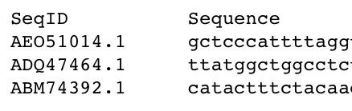
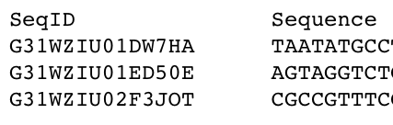
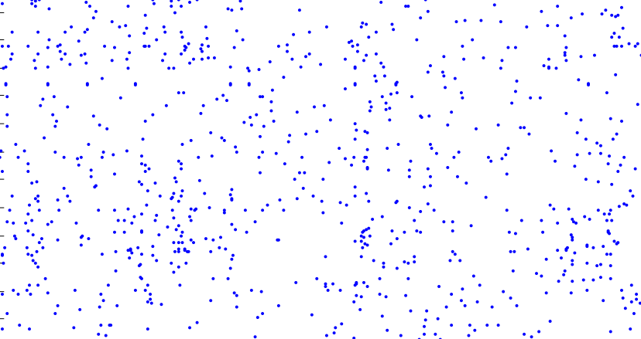
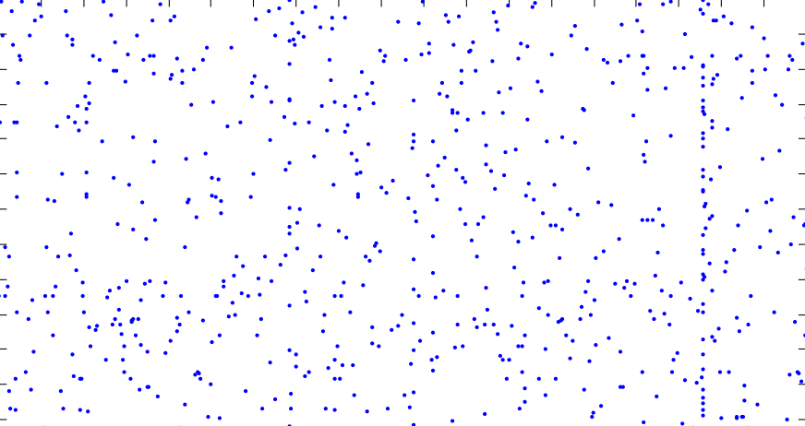
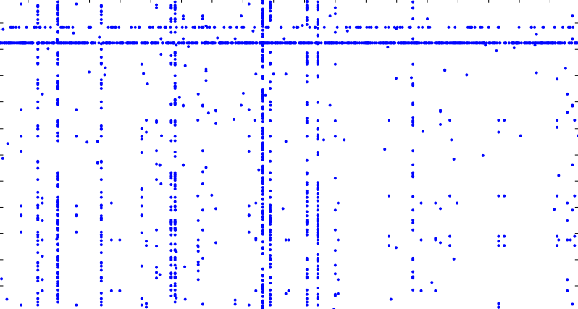
Sequence Matching ⬄ Graph ⬄ Sparse Matrix Multiply in D4M
RNA Reference Set
Collected Sample
reference
fungi
unknown sample
A₁
A₂
reference
sequence ID
unknown
sequence ID
A₁ A₂'
sequence word (10mer)
sequence word (10mer)
reference
sequence ID
unknown sequence ID
Associative arrays provide a natural framework for sequence matching
Taming Biological Big Data with D4M, Kepner, Ricke & Hutchison, MIT Lincoln Laboratory Journal, Fall 2013
Notes:
The beauty of D4M is that we can extend the concept of comparing two sequences with a vector dot product and compare numerous sequences with a simple matrix multiplication.
Break all sequences into 10-mers and index into matrices
Simple sparse linear algebra multiplication – A1 A2’
One matrix multiplication tells how many words every reference has in common with every sample.
MOST IMPORTANT STEP! – one line of D4M code does what thousands of lines of BLAST code do
Multiplication is built-in function, so it goes fast

Slide 29
Leveraging “Big Data” Technologies for High Speed Sequence Matching
100x smaller
D4M
BLAST (industry standard)
100x faster
D4M +
Accumulo
High performance triple store database trades computations for lookups
Used Apache Accumulo database to accelerate comparison by 100x
Used Lincoln D4M software to reduce code size by 100x
Notes:
D4M combined with Accumulo database accelerates sequence comparison by 100x with 100x less code.

Slide 30
Computing on Masked Data
10⁵
10⁴
10³
10²
10¹
10⁰
FHE
RND: Semantically Secure
DET: Deterministic
OPE: Order Preserving Encryption
CLEAR: No Masking (L=∞)
MPC
Compute Overhead
CMD
Big Data Today
∞
RND
DET
OPE
CLEAR
Information Leakage
Computing on masked data (CMD) raises the bar on data in the clear
Uses lower over head approaches than Fully Homomorphic Encyption (FHE) such as deterministic (DET) encryption and order preserving encryption (OPE)
Associative array (D4M) algebra is defined over sets (not real numbers); allows linear algebra to work on DET or OPE data
Notes:
Computing on masked seeks to raise the bar on current big data which is generally stored in the clear.

Slide 31
Summary
Big data is found across a wide range of areas
Document analysis
Computer network analysis
DNA Sequencing
Non-traditional, relaxed consistency, triple store databases are the backbone of many web companies
Adjacency matrices, incidence matrices, and associative arrays provides a general, high performance approach for harnessing the power of these databases
Notes:
Summary.

