Slide 1
GraphX: Unifying Table and Graph Analytics
Presented by Joseph Gonzalez
Joint work with Reynold Xin, Daniel Crankshaw, Ankur Dave, Michael Franklin, and Ion Stoica
IPDPS 2014
*These slides are best viewed in PowerPoint with animation.

Slide 2
Graphs are Central to Analytics
Hyperlinks
PageRank
Top 20 Pages
Raw
Wikipedia
Text
Table
Title
PR
< / >
Title
Body
Term-Doc
Graph
Topic Model
(LDA)
< / >
< / >
Word Topics
XML
Word
Topic
Discussion
Table
Community
Detection
User
Community
Community
Topic
Editor Graph
User
Disc.
User
Com.
Topic
Com.

Slide 3
PageRank: Identifying Leaders
Rank of user i
Weighted sum of neighbors’ ranks
Update ranks in parallel
Iterate until convergence

Slide 4

Mean Field Algorithm
X₃
X₂
Y₃
Post
Sum over Neighbors
X₁
Post
Y₂
Y₁
Post

Slide 5
Recommending Products
Low-Rank Matrix Factorization:
f(3)
r₁₃
Movies
f(1)
Netflix
≈
x
Users
Users
f(j)
r₁₄
f(4)
f(i)
User Factors (U)
Movie Factors (M)
r₂₄
f(2)
Movies
r₂₅
f(5)
Iterate:

Slide 6
The Graph-Parallel Pattern
Model / Alg.
State
Computation depends only on the neighbors

Slide 7
Many Graph-Parallel Algorithms
MACHINE LEARNING
SOCIAL NETWORK ANALYSIS
Collaborative Filtering
Alternating Least Squares
Stochastic Gradient Descent
Tensor Factorization
Structured Prediction
Loopy Belief Propagation
Max-Product Linear Programs
Gibbs Sampling
Semi-supervised ML
Graph SSL
CoEM
Community Detection
Triangle-Counting
K-core Decomposition
K-Truss
Graph Analytics
PageRank
Personalized PageRank
Shortest Path
Graph Coloring
Classification
Neural Networks
GRAPH ALGORITHMS

Slide 8


Graph-Parallel Systems
Pregel
oogle
Expose specialized APIs to simplify graph programming.

Slide 9
“Think like a Vertex.”
- Pregel [SIGMOD’10]
Notes:
Austern

Slide 10
The Pregel (Push) Abstraction
Vertex-Programs interact by sending messages.
Pregel_PageRank(i, messages) :
// Receive all the messages
total = 0
foreach( msg in messages) :
total = total + msg
// Update the rank of this vertex
R[i] = 0.15 + total
// Send new messages to neighbors
foreach(j in out_neighbors[i]) :
Send msg(R[i]) to vertex j
i
Malewicz et al. [PODC’09, SIGMOD’10]

Slide 11
The GraphLab (Pull) Abstraction
Vertex Programs directly access adjacent vertices and edges
GraphLab_PageRank(i)
// Compute sum over neighbors
total = 0
foreach( j in neighbors(i)):
total = total + R[j] * w_{ji}
// Update the PageRank
R[i] = 0.15 + total
R[4] * w₄₁
4
+
1
R[3] * w₃₁
R[2] * w₂₁
+
3
2
Data movement is managed by the system and not the user.

Slide 12
Iterative Bulk Synchronous Execution
Compute
Communicate
Barrier
Notes:
Put equation on slide

Slide 13
Graph-Parallel Systems
Pregel
oogle
Expose specialized APIs to simplify graph programming.
Exploit graph structure to achieve orders-of-magnitude performance gains over more general data-parallel systems.

Slide 14
PageRank on the Live-Journal Graph
Spark is 4x faster than Hadoop
GraphLab is 16x faster than Spark
Notes:
----- Meeting Notes (3/21/14 15:09) -----
How many vertices is LJ, Wiki, Twitter?
----- Meeting Notes (3/24/14 20:39) -----
Animate, build in
spark x faster than hadoop
graphlab x faster than spark

Slide 15
Triangle Counting on Twitter
40M Users, 1.4 Billion Links
Counted: 34.8 Billion Triangles
Hadoop [WWW’11]
1536 Machines
423 Minutes
64 Machines
15 Seconds
1000 x Faster
GraphLab
S. Suri and S. Vassilvitskii, “Counting triangles and the curse of the last reducer,” WWW’11

Slide 16
Graph Analytics Pipeline
Hyperlinks
PageRank
Top 20 Pages
Raw
Wikipedia
Text
Table
Title
PR
< / >
Title
Body
Term-Doc
Graph
Topic Model
(LDA)
< / >
< / >
Word Topics
XML
Word
Topic
Discussion
Table
Community
Detection
User
Community
Community
Topic
Editor Graph
User
Disc.
User
Com.
Topic
Com.

Slide 17
Tables
Hyperlinks
PageRank
Top 20 Pages
Raw
Wikipedia
Text
Table
Title
PR
< / >
Title
Body
Term-Doc
Graph
Topic Model
(LDA)
< / >
< / >
Word Topics
XML
Word
Topic
Discussion
Table
Community
Detection
User
Community
Community
Topic
Editor Graph
User
Disc.
User
Com.
Topic
Com.

Slide 18
Graphs
Hyperlinks
PageRank
Top 20 Pages
Raw
Wikipedia
Text
Table
Title
PR
< / >
Title
Body
Term-Doc
Graph
Topic Model
(LDA)
< / >
< / >
Word Topics
XML
Word
Topic
Discussion
Table
Community
Detection
User
Community
Community
Topic
Editor Graph
User
Disc.
User
Com.
Topic
Com.

Slide 19


Separate Systems to Support Each View
Table View
Graph View
Pregel
Table
Dependency Graph
Row
Row
Result
Row
Row
Notes:
----- Meeting Notes (1/5/14 14:58) -----
Spark too.

Slide 20
Having separate systems for each view is difficult to use and inefficient

Slide 21


Difficult to Program and Use
Users must Learn, Deploy, and Manage multiple systems
Leads to brittle and often complex interfaces

Slide 22
Inefficient
Extensive data movement and duplication across the network and file system
< / >
< / >
< / >
XML
HDFS
HDFS
HDFS
HDFS
Limited reuse internal data-structures across stages

Slide 23
GraphX Solution: Tables and Graphs are views of the same physical data
GraphX Unified
Representation
Table View
Graph View
Each view has its own operators that exploit the semantics of the view
to achieve efficient execution
Notes:
and users can move between views without copying or moving data

Slide 24
Graphs → Relational Algebra
Encode graphs as distributed tables
Express graph computation in relational algebra
Recast graph systems optimizations as:
Distributed join optimization
Incremental materialized maintenance
Integrate Graph and Table data processing systems.
Achieve performance parity with specialized systems.

Slide 25
Distributed Graphs as Distributed Tables
Vertex Table
Routing
Table
Edge Table
Property Graph
Part. 1
A
B
B
A
A
1
2
B
C
C
A
C
B
B
1
B
C
C
D
A
A
A
D
D
D
C
C
1
2D Vertex Cut Heuristic
A
D
Part. 2
A
E
D
D
1
2
A
F
F
F
E
E
E
E
2
E
D
F
F
2
E
F

Slide 26
Table Operators
Table operators are inherited from Spark:
map
filter
groupBy
sort
union
join
leftOuterJoin
rightOuterJoin
reduce
count
fold
reduceByKey
groupByKey
cogroup
cross
zip
sample
take
first
partitionBy
mapWith
pipe
save
...

Slide 27
Graph Operators
class Graph [ V, E ] {
def Graph(vertices: Table[ (Id, V) ],
edges: Table[ (Id, Id, E) ])
// Table Views -----------------
def vertices: Table[ (Id, V) ]
def edges: Table[ (Id, Id, E) ]
def triplets: Table [ ((Id, V), (Id, V), E) ]
// Transformations ------------------------------
def reverse: Graph[V, E]
def subgraph(pV: (Id, V) => Boolean,
pE: Edge[V,E] => Boolean): Graph[V,E]
def mapV(m: (Id, V) => T ): Graph[T,E]
def mapE(m: Edge[V,E] => T ): Graph[V,T]
// Joins ----------------------------------------
def joinV(tbl: Table [(Id, T)]): Graph[(V, T), E ]
def joinE(tbl: Table [(Id, Id, T)]): Graph[V, (E, T)]
// Computation ----------------------------------
def mrTriplets(mapF: (Edge[V,E]) => List[(Id, T)], reduceF: (T, T) => T): Graph[T, E]
}
Notes:
Make mrTriplets more visible.

Slide 28
Triplets Join Vertices and Edges
The triplets operator joins vertices and edges:
SELECT s.Id, d.Id, s.P, e.P, d.P
FROM edges AS e
JOIN vertices AS s, vertices AS d
ON e.srcId = s.Id AND e.dstId = d.Id
Vertices
Triplets
Edges
A
A
A
A
B
B
B
B
A
C
A
C
C
B
C
B
C
D
C
D
C
D
The mrTriplets operator sums adjacent triplets.
SELECT t.dstId, reduce( map(t) ) AS sum
FROM triplets AS t GROUPBY t.dstId
Notes:
w

Slide 29
Example: Oldest Follower
23
42
B
C
Calculate the number of older followers for each user?
val olderFollowerAge = graph .mrTriplets( e => // Map if(e.src.age < e.dst.age) { (e.srcId, 1) else { Empty } , (a,b) => a + b // Reduce ) .vertices
30
A
D
19
E
75
F
16

Slide 30
We express enhanced Pregel and GraphLab abstractions using the GraphX operators in less than 50 lines of code!

Slide 31
Enhanced Pregel in GraphX
Require Message Combiners
pregelPR(i, messageList ):
messageSum
// Receive all the messages
total = 0
foreach( msg in messageList) :
total = total + msg
messageSum
// Update the rank of this vertex
R[i] = 0.15 + total
combineMsg(a, b):
// Compute sum of two messages
return a + b
Remove Message Computation from the
Vertex Program
// Send new messages to neighbors
foreach(j in out_neighbors[i]) :
Send msg(R[i]/E[i,j]) to vertex
sendMsg(i→j, R[i], R[j], E[i,j]):
// Compute single message
return msg(R[i]/E[i,j])
Malewicz et al. [PODC’09, SIGMOD’10]

Slide 32
PageRank in GraphX
// Load and initialize the graph
val graph = GraphBuilder.text(“hdfs://web.txt”)
val prGraph = graph.joinVertices(graph.outDegrees)
// Implement and Run PageRank
val pageRank =
prGraph.pregel(initialMessage = 0.0, iter = 10)(
(oldV, msgSum) => 0.15 + 0.85 * msgSum,
triplet => triplet.src.pr / triplet.src.deg,
(msgA, msgB) => msgA + msgB)

Slide 33
Join Elimination
Identify and bypass joins for unused triplet fields
sendMsg(i→j, R[i], R[j], E[i,j]):
// Compute single message
return msg(R[i]/E[i,j])
Factor of 2 reduction in communication

Slide 34
We express the Pregel and GraphLab like abstractions using the GraphX operators in less than 50 lines of code!
By composing these operators we can construct entire graph-analytics pipelines.

Slide 35
Example Analytics Pipeline
// Load raw data tables
val verts = sc.textFile(“hdfs://users.txt”).map(parserV)
val edges = sc.textFile(“hdfs://follow.txt”).map(parserE)
// Build the graph from tables and restrict to recent links
val graph = new Graph(verts, edges)
val recent = graph.subgraph(edge => edge.date > LAST_MONTH)
// Run PageRank Algorithm
val pr = graph.PageRank(tol = 1.0e-5)
// Extract and print the top 25 users
val topUsers = verts.join(pr).top(25).collect
topUsers.foreach(u => println(u.name + ‘\t’ + u.pr))

Slide 36
The GraphX Stack (Lines of Code)
PageRank (5)
Connected Comp. (10)
Shortest Path (10)
SVD
(40)
ALS
(40)
K-core
(51)
Triangle
Count
(45)
LDA
(120)
Pregel (28) + GraphLab (50)
GraphX (3575)
Spark

Slide 37
Performance Comparisons
Live-Journal: 69 Million Edges
GraphX is roughly 3x slower than GraphLab
Notes:
----- Meeting Notes (3/24/14 20:39) -----
Build in, data-parallel first, then rest

Slide 38
GraphX scales to larger graphs
Twitter Graph: 1.5 Billion Edges
GraphX is roughly 2x slower than GraphLab
Scala + Java overhead: Lambdas, GC time, …
No shared memory parallelism: 2x increase in comm.

Slide 39
PageRank is just one stage…. What about a pipeline?

Slide 40
A Small Pipeline in GraphX
Raw Wikipedia
Hyperlinks
PageRank
Top 20 Pages
< / >
< / >
< / >
HDFS
HDFS
XML
Spark Preprocess
Compute
Spark Post.
605
375
Timed end-to-end GraphX is faster than GraphLab
Notes:
Also faster in human time but it is hard to measure.

Slide 41
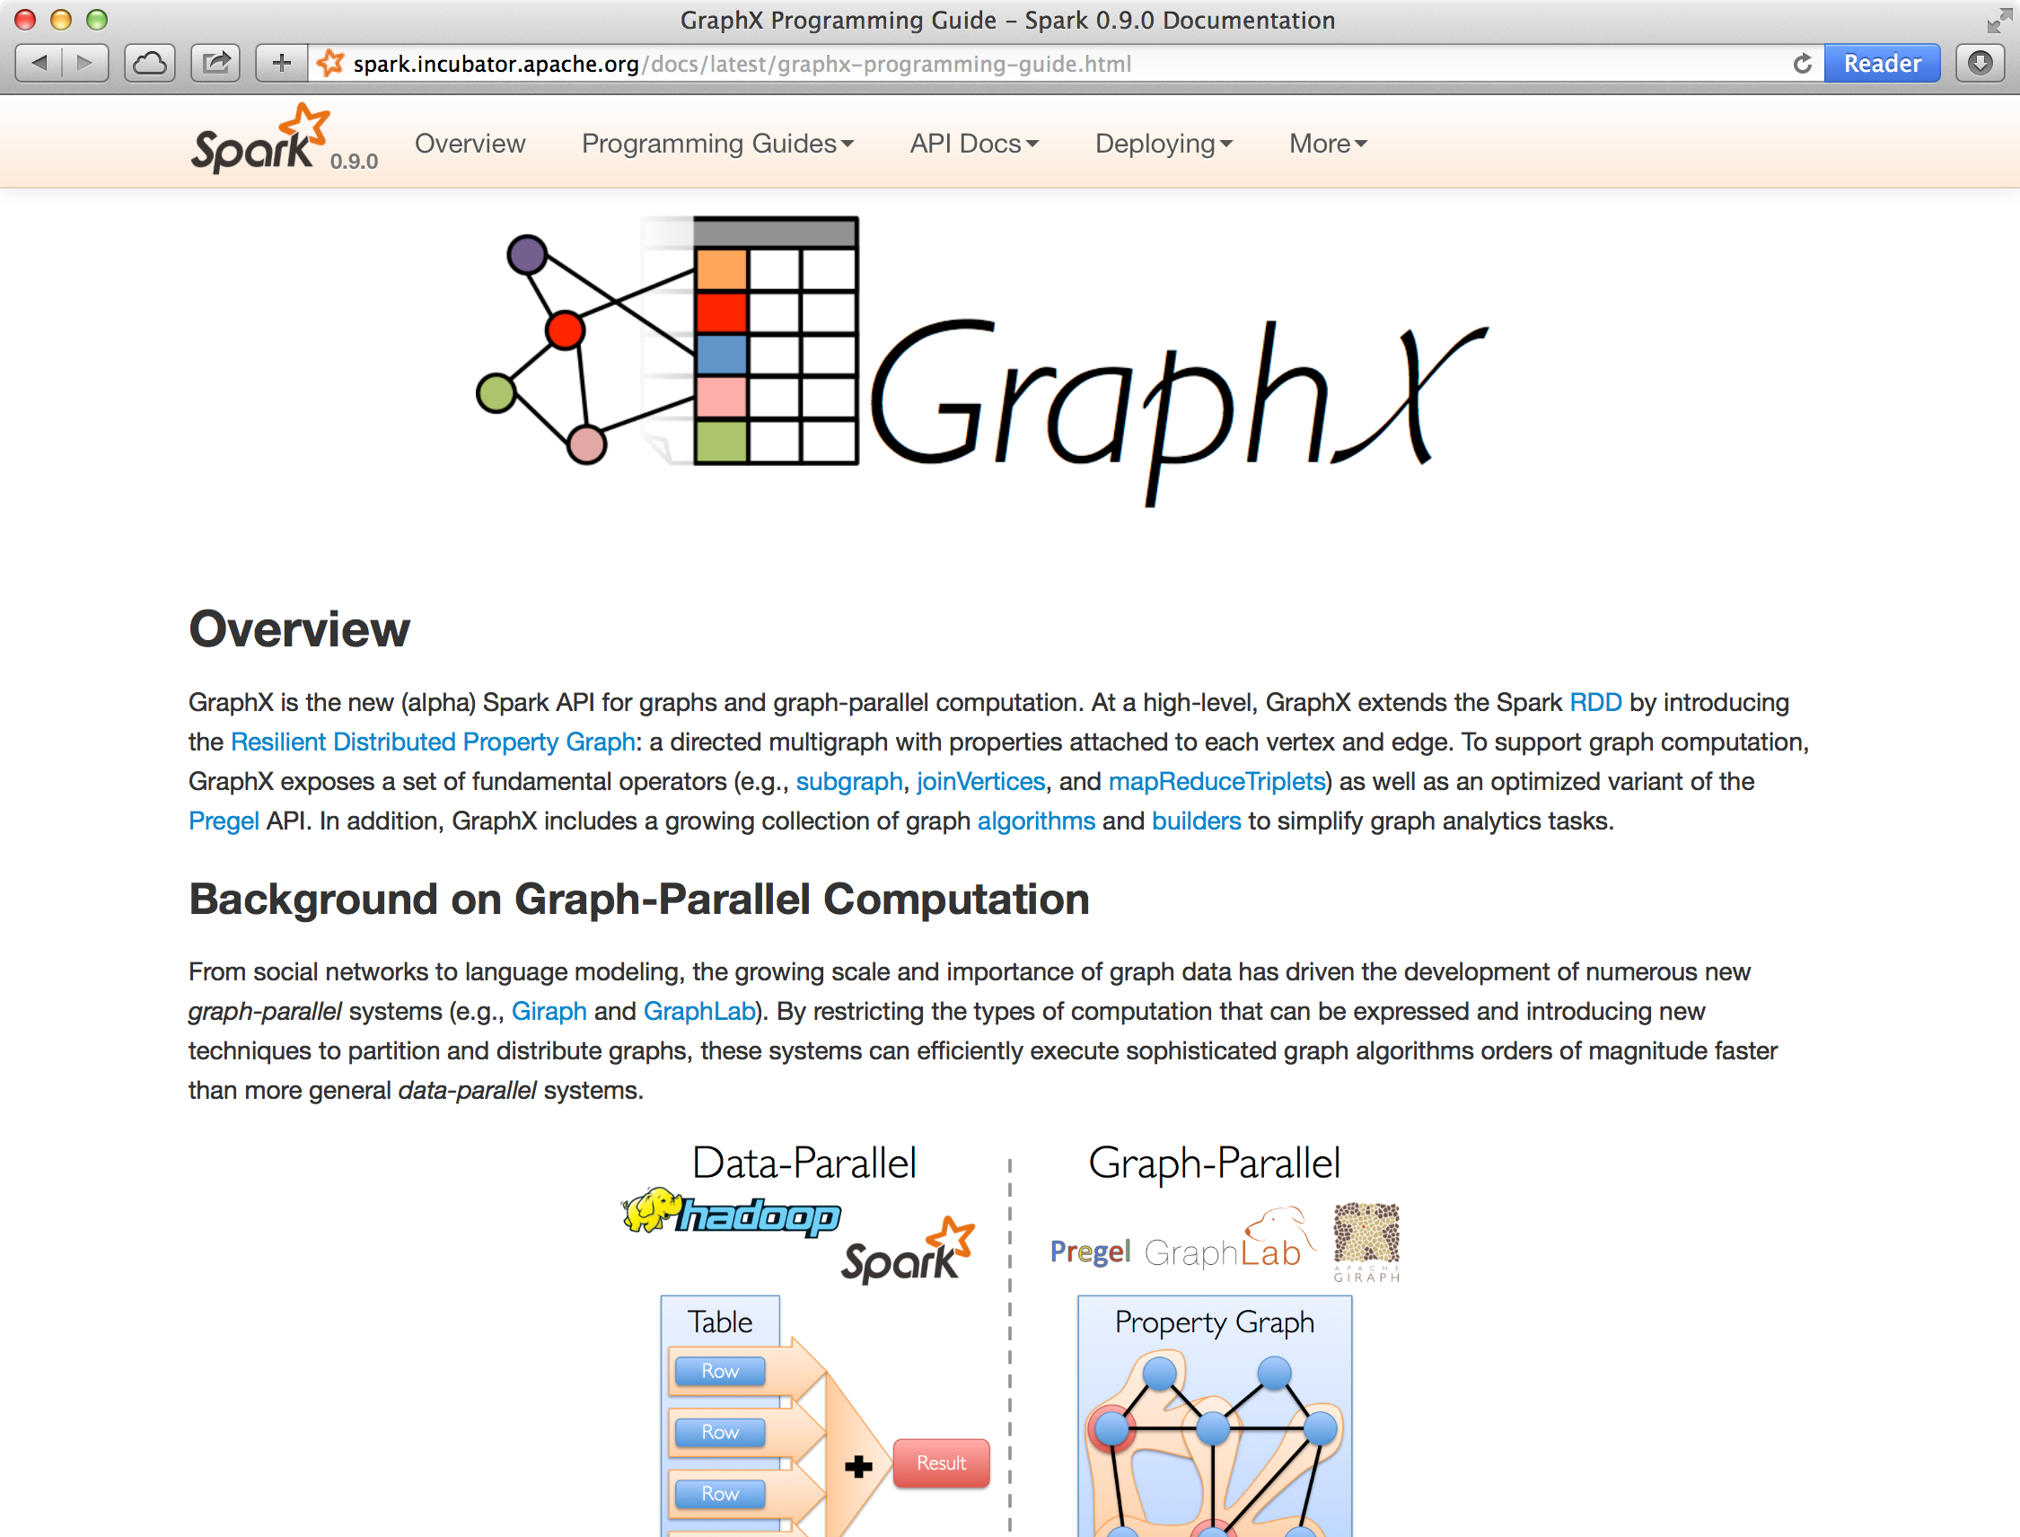
Status
Part of Apache Spark
In production at several large technology companies

Slide 42
GraphX: Unified Analytics
New API
Blurs the distinction between Tables and Graphs
New System
Combines Data-Parallel Graph-Parallel Systems
Enabling users to easily and efficiently express the entire graph analytics pipeline

Slide 43
A Case for Algebra in Graphs
A standard algebra is essential for graph systems:
e.g.: SQL → proliferation of relational system
By embedding graphs in relational algebra:
Integration with tables and preprocessing
Leverage advances in relational systems
Graph opt. recast to relational systems opt.

Slide 44

Conclusions
Composable domain specific views and operators
Single system that efficiently spans the pipeline
Graphs through the lens of database systems
Graph-Parallel Pattern → Triplet joins in relational alg.
Graph Systems → Distributed join optimizations
Joseph E. Gonzalez
jegonzal@eecs.berkeley.edu
http://tinyurl.com/ampgraphx
UC BERKELEY
Notes:
minimize data movement and duplication
eliminates need to learn and manage multiple systems
----- Meeting Notes (3/24/14 20:39) -----
Switch order - future work then conclusion
Cut down on text, put amplab logo, name, email, twitter handle, website

Slide 45
Thanks!
http://amplab.cs.berkeley.edu/projects/graphx/
ankurd@eecs.berkeley.edu
crankshaw@eecs.berkeley.edu
rxin@eecs.berkeley.edu
jegonzal@eecs.berkeley.edu

Slide 46
Recommending Products
Low-Rank Matrix Factorization:
f(3)
r₁₃
Movies
f(1)
Netflix
≈
x
Users
Users
f(j)
r₁₄
f(4)
f(i)
User Factors (U)
Movie Factors (M)
r₂₄
f(2)
Movies
r₂₅
f(5)
Iterate:

Slide 47
Mean Field Algorithm
X₃
X₂
Y₃
Post
Sum over Neighbors
X₁
Post
Y₂
Y₁
Post

Slide 48
GraphX System Design

Slide 49
Caching for Iterative mrTriplets
Vertex Table (RDD)
Edge Table
(RDD)
Mirror
Cache
A
B
A
A
A
A
A
C
B
B
B
B
C
C
D
C
D
C
C
Mirror
Cache
A
E
D
D
D
A
A
F
E
D
E
E
D
E
F
F
F
E
F

Slide 50
Incremental Updates for Iterative mrTriplets
Vertex Table (RDD)
Edge Table
(RDD)
Mirror
Cache
A
B
Change
A
A
A
A
A
C
B
B
B
C
C
D
C
D
C
Mirror
Cache
A
E
D
A
A
F
D
Change
E
Scan
E
E
D
E
F
F
E
F

Slide 51
Aggregation for Iterative mrTriplets
Vertex Table (RDD)
Edge Table
(RDD)
Mirror
Cache
A
B
Change
A
A
A
C
Local
Aggregate
B
B
Change
B
B
C
C
C
D
C
D
Change
C
Mirror
Cache
A
E
Change
D
A
A
F
Local
Aggregate
D
E
Scan
Change
D
E
D
E
Change
F
F
F
E
F

Slide 52
Reduction in Communication Due to Cached Updates
Most vertices are within 8 hops of all vertices in their comp.

Slide 53
Benefit of Indexing Active Edges
Scan All Edges
Index of “Active” Edges

Slide 54
Additional Query Optimizations
Indexing and Bitmaps:
To accelerate joins across graphs
To efficiently construct sub-graphs
Substantial Index and Data Reuse:
Reuse routing tables across graphs and sub-graphs
Reuse edge adjacency information and indices
Notes:
Split Hash Table: reuse key sets across hash tables

