Slide 1

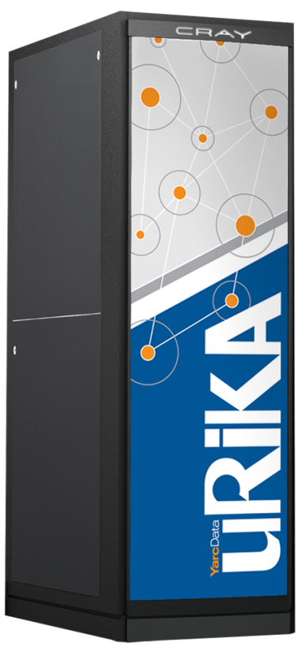
Hybridizing SPARQL Queries and Graph Algorithms David Mizell Cray Inc., Austin, TX Graph Algorithms Building Blocks Workshop May 2014

Slide 2
What’s Urika?
RDF triples database – memory-resident
SPARQL query language
Aimed at customers who
Have large datasets
Want to do graph analytics

Slide 3
What are RDF Triples?
“Resource Data Framework”
A data representation intended to be
Somewhat self-defining
Data items unique across the Internet
Each triple represents an item of information
Subject <http://yarcdata.com/GABBexample/person#JohnGilbert>
Predicate <http://yarcdata.com/GABBexample/drivesCar>
Object <http://yarcdata.com/GABBexample/carType#Yugo>
“John Gilbert drives a Yugo”

Slide 4
RDF Triples (2)
They waste space compared to relational DB
BUT they’re graph-oriented
person
car
John Gilbert | Yugo
yd:carType#Yugo
<http://yarcdata.com/GABBexample/carType#Yugo>
<http://yarcdata.com/GABBexample/person#JohnGilbert>

Slide 5
What’s SPARQL?
SPARQL Protocol And RDF Query Language
Similar to SQL
prefix yd: <http://yarcdata.com/GABBexample/>
SELECT ?car
WHERE {
yd:person#JohnGilbert yd:drivesCar ?car
}
car
Yugo

Slide 6
Or
prefix yd: <http://yarcdata.com/GABBexample/>
SELECT ?driver ?car
WHERE {
?driver yd:drivesCar ?car
?driver a yd:UniversityProf
}
driver car
JohnGilbert Yugo
AndrewLumsdaine Studebaker
DavidBader AMC_Matador

Slide 7
Like SQL, it has FILTERs
SELECT ?driver ?car
WHERE {
?driver yd:drivesCar ?car
?driver a yd:UniversityProf
?car yd:yearBuilt ?modelYear
}
FILTER ( ?modelYear > “1985-01-01T12:00:00”^^xsd:dateTime )
driver car
Plus other useful features like updates, etc.

Slide 8
Unlike SQL, Intense Joinery
LUBM Query 9:
PREFIX rdf: <http://www.w3.org/1999/02/22-rdf-syntax-ns#>
PREFIX ub: <http://www.lehigh.edu/~zhp2/2004/0401/univ-bench.owl#>
SELECT ?X, ?Y, ?Z
WHERE
{ ?X rdf:type ub:Student .
?Y rdf:type ub:Faculty .
?Z rdf:type ub:Course .
?X ub:advisor ?Y .
?Y ub:teacherOf ?Z .
?X ub:takesCourse ?Z }
?X
?Y
?Z

Slide 9
Typical Customer Reaction to SPARQL
“Cool. Can you also do betweenness centrality on that?”

Slide 10

SPARQL Almost Limited to Fixed-Length Query Patterns
Steve “Nailgun” Reinhardt’s breadth-first search
“Get neighbors of these vertices”
Urika
external server
iterative
script
w. SPARQL API
SPARQL
query
engine
Set of vertices

Slide 11
What We’re Doing
Extending SPARQL with “INVOKE” operator
INVOKE <http://yarcdata.com/graphAlgorithm.vertexBetweenness> ( )
INVOKE is paired with SPARQL’s existing CONSTRUCT operator
CONSTRUCT WHERE {
yd:person#JohnGilbert ?p1 ?o1 .
?o1 ?p2 ?o2 .
?o2 ?p3 ?o3 .
}
INVOKE <http://yarcdata.com/graphAlgorithm.st_connectivity> ( yd:person#JohnGilbert, yd:carType#Ferrari )
We extended SPARQL so that you can nest a CONSTRUCT/INVOKE pair.

Slide 12
Nesting Example: k-point-five neighborhood
SELECT ?vertexID ?edgeID ?vertex2ID
WHERE {
CONSTRUCT {
?s1 ?s2 ?s3 .
?startVertex a <http://yd.selectedStartingVertex> .
}
WHERE
{
{ ?s1 ?s2 ?s3 .
FILTER (!sameterm( ?s2, <http://www.w3.org/1999/02/22-rdf-syntax-ns#type> ) )
}
UNION
{ VALUES ?startVertex
{ lub:GraduateStudent30
lub:GraduateStudent102
lub:GraduateStudent68
lub:GraduateStudent16
lub:GraduateStudent5
}
}
}
INVOKE yd:graphAlgorithm.kpointfive(1)
PRODUCING ?vertexID ?edgeID ?vertex2ID
}

Slide 13
A Peek Under the Hood
three-column “IRA”
input graph algorithm expects
S P O
query
Graph algorithm “wrapper”
graph algorithm from library
query engine
three-column “IRA”
vertexID edgeID vertex2ID
graph algorithm results

Slide 14
Future Directions
VHLL for graph algorithms
Maybe extend with some RDF access features
New platform for Urika
Likely to be commodity processor-based

Slide 15
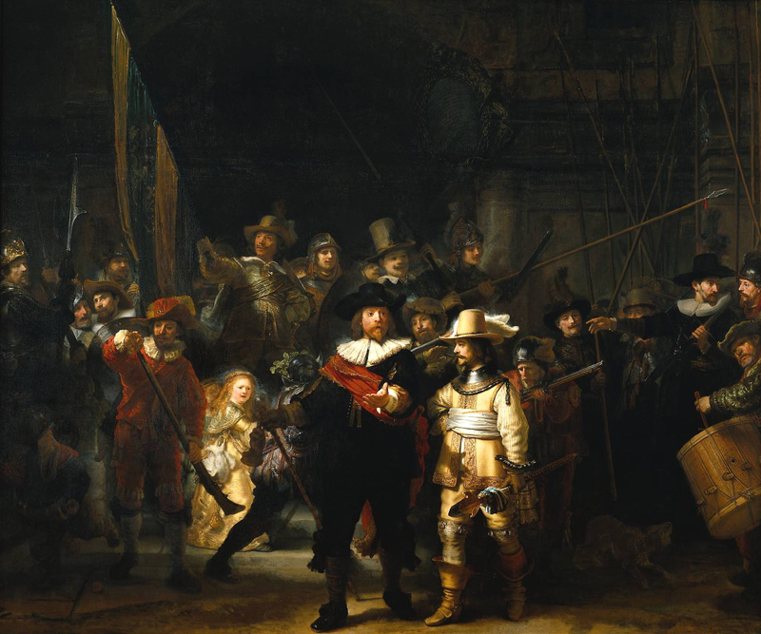
In conclusion…

