Slide 1
SQL Containers in the Cloud! An intro to running Docker in Azure

Slide 2

About Me
Andrew Pruski
@dbafromthecold
dbafromthecold@gmail.com
www.dbafromthecold.com
SQL Server DBA & Data Platform MVP
Originally from Wales, now living in Dublin

Slide 3
Session Aim
To give an overview of the different options available to run SQL Server Docker containers in Azure

Slide 4
Agenda
Running Docker on standalone VMs
Docker for Azure (Swarm)
Azure Container Registry
Azure Container Instances
Azure Container Services (ACS & AKS)

Slide 5
Agenda
Running Docker on standalone VMs
Docker for Azure
Azure Container Registry
Azure Container Instances
Azure Container Services (ACS & AKS)

Slide 6
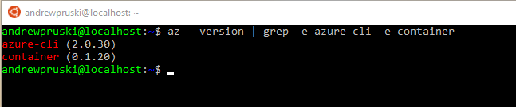
Tools – Azure CLI
Command line tool for managing Azure resources
Available on Windows, Mac, or Linux (incl. WSL)
https://docs.microsoft.com/en-us/cli/azure/install-azure-cli?view=azure-cli-latest

Slide 7
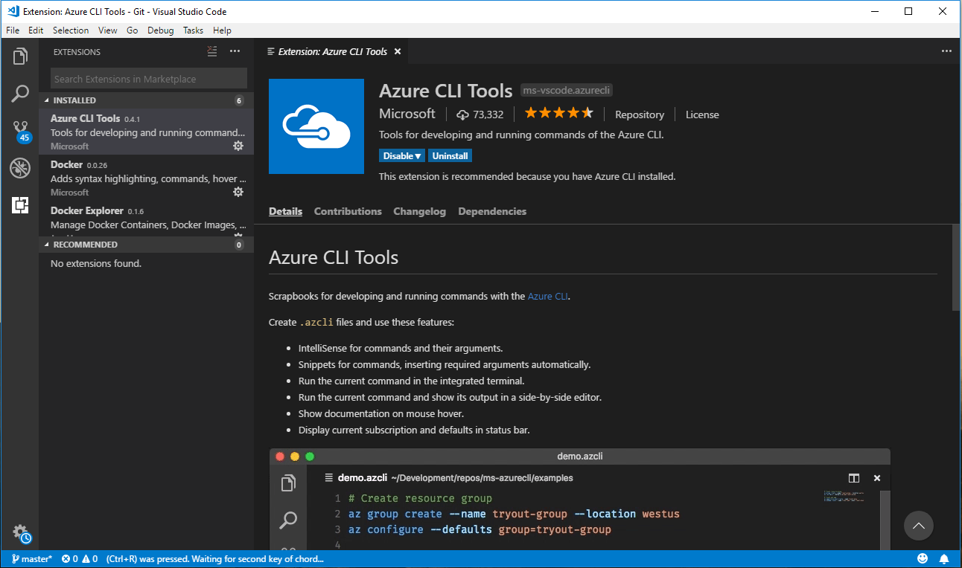
Tools – Visual Studio Code

Slide 8
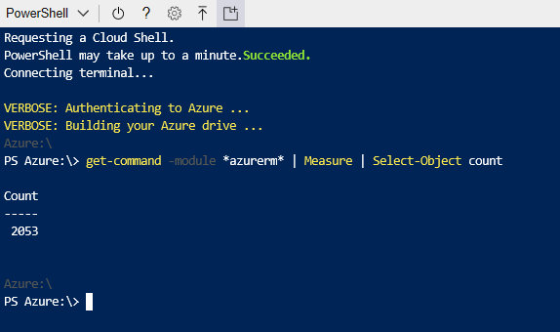
Tools – Powershell
AzureRM module
Install locally or in CloudShell
Huge amount of commands available

Slide 9
Running Docker on VMs

Slide 10
VM Templates
Windows Datacenter with Containers
Docker pre-installed
Images available (server core & nano server)

Slide 11
Demo

Slide 12
Docker EE for Azuzre

Slide 13
Docker EE for Azure
https://store.docker.com/editions/enterprise/docker-ee-azure

Slide 14
Demo

Slide 15
Azure Container Registry

Slide 16
Azure Container Registry
Managed Docker registry service
Stores private docker images
Images can be pulled to
Other Azure Services
Orchestrators

Slide 17
Azure Container Registry
Registry
Storage of images
Repository
Groups of container images
Image
Read only snapshot of a container

Slide 18
Demo

Slide 19
Azure Container Instances

Slide 20
Azure Container Instances
Running containers without servers
No need to manage VMs
Spin up in seconds
Deployed via the CLI, powershell, or Azure Portal
Billed by the second

Slide 21
ACI - Options
Linux & Windows containers
Containers exposed directly to the internet
IP Address and FQDN
Hypervisor level isolation
Persistent storage
Azure files shares
Container Groups

Slide 22
Demo

Slide 23
Azure Container Services

Slide 24
Azure Container Services
Two flavours
Azure Container Services (ACS)
Azure Container Service (AKS)
ACS provides container hosting using DC/OS, Swarm, or K8s
AKS is specifically built to implement Kubernetes

Slide 25
Kubernetes
Open Source system for managing containers
Deployed as a cluster containing a master and multiple nodes
Pods hold containers running on the nodes
Services define/allow access to sets of pods
Deployments created and managed via Kubectl

Slide 26
Azure Container Services (AKS)
Simplifies deployment of Kubernetes clusters in Azure
Cluster can be spun up with one line of code
Applications deployed to cluster via yaml files
Managed by Azure-CLI/powershell and kubectl

Slide 27
Demo

Slide 28
Resources

Slide 29

Questions?

