Slide 1
SQL Containers in the Cloud! An intro to running Docker in Azure

Slide 2
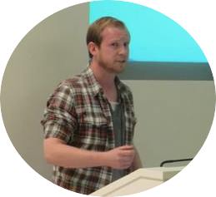
About Me
Andrew Pruski
@dbafromthecold
dbafromthecold@gmail.com
www.dbafromthecold.com
SQL Server DBA & Data Platform MVP
Originally from Wales, now living in Dublin

Slide 3
Session Aim
To give an overview of the different options available to run SQL Server Docker containers in Azure

Slide 4
Agenda
Running Docker on standalone VMs
Docker for Azure (Swarm)
Azure Container Registry
Azure Container Instances
Azure Container Services (ACS & AKS)

Slide 5
Header

Slide 6
Running Docker on VMs

Slide 7
Header

Slide 8
Demo

Slide 9
Docker for Azure (Swarm)

Slide 10
Header

Slide 11
Demo

Slide 12
Azure Container Registry

Slide 13
Header

Slide 14
Demo

Slide 15
Azure Container Instances

Slide 16
Header

Slide 17
Demo

Slide 18
Azure Container Services

Slide 19
Header

Slide 20
Demo

Slide 21
Resources

Slide 22

Questions?

