Slide 1
SQL Containers in the Cloud! An intro to running Docker in Azure

Slide 2

About Me
Andrew Pruski
@dbafromthecold
dbafromthecold@gmail.com
www.dbafromthecold.com
SQL Server DBA & Data Platform MVP
Originally from Wales, now living in Dublin

Slide 3
Session Aim
To give an overview of the different options available to run SQL Server Docker containers in Azure

Slide 4
Agenda
Azure Container Registry
Azure Container Instances
Azure Container Services (ACS & AKS)
Other options

Slide 5
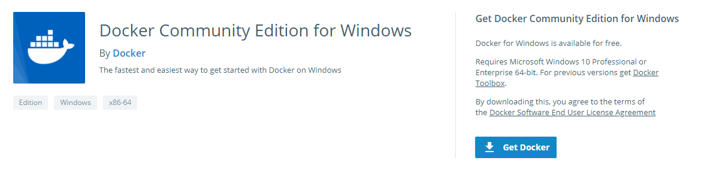
Tools – Docker for Windows
https://store.docker.com/editions/community/docker-ce-desktop-windows

Slide 6
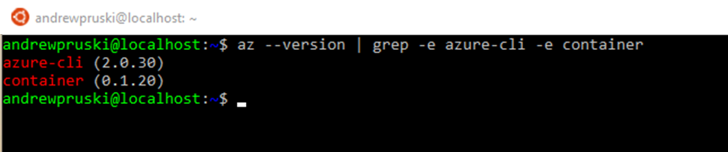
Tools – Azure CLI
Command line tool for managing Azure resources
Available on Windows, Mac, or Linux (incl. WSL)
https://docs.microsoft.com/en-us/cli/azure/install-azure-cli?view=azure-cli-latest

Slide 7
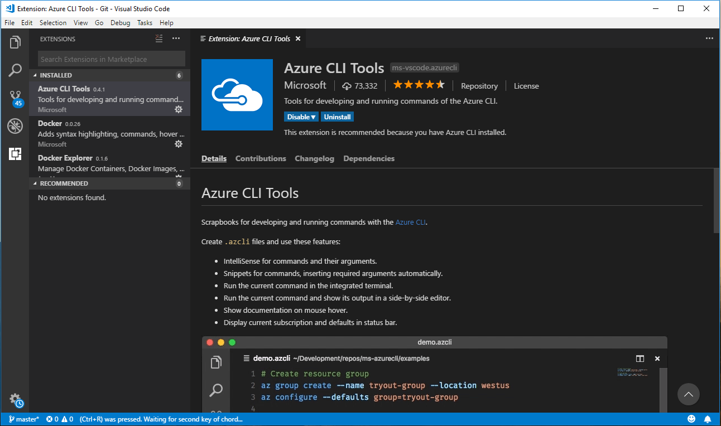
Tools – Visual Studio Code

Slide 8
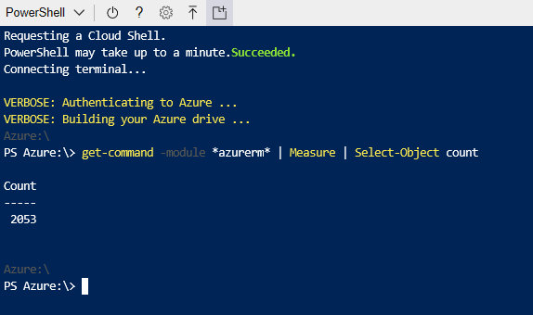
Tools – Powershell
AzureRM module
Install locally or in CloudShell
Huge amount of commands available

Slide 9
Azure Container Registry

Slide 10
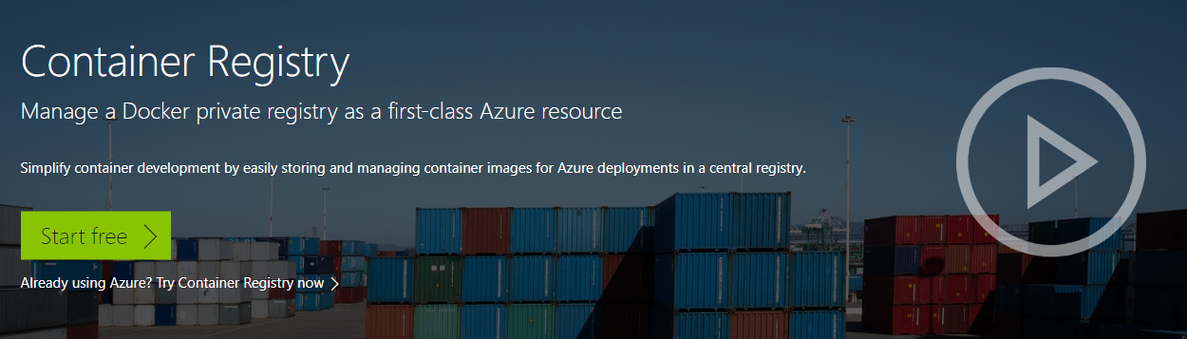
Azure Container Registry
https://azure.microsoft.com/en-us/services/container-registry/

Slide 11
Azure Container Registry - Terminology
Registry
Service that stores container images
Repository
Groups of container images – Same name, identified by tags

Slide 12
Azure Container Registry - Features
Encryption
All images encrypted at rest
Geo-redundant storage
Replication of images
Geo-replication
Guards against total regional failure

Slide 13
Azure Container Registry - SKUs
Type | Managed | Storage (GB) | Web Hooks | Geo-Replication
Basic | Yes | 10 | 2 | No
Standard | Yes | 100 | 10 | No
Premium | Yes | 500* | 100* | Yes

Slide 14
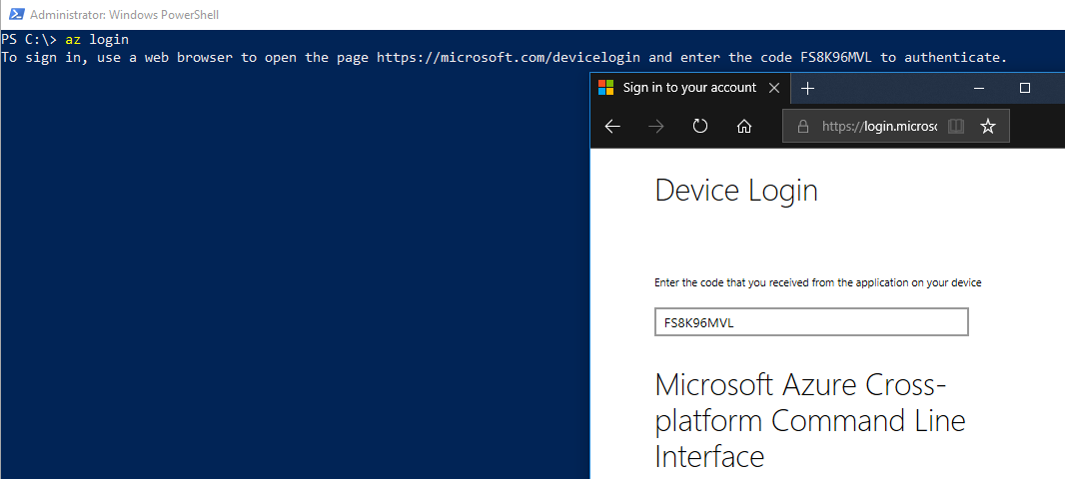
ACR - Login
az login

Slide 15
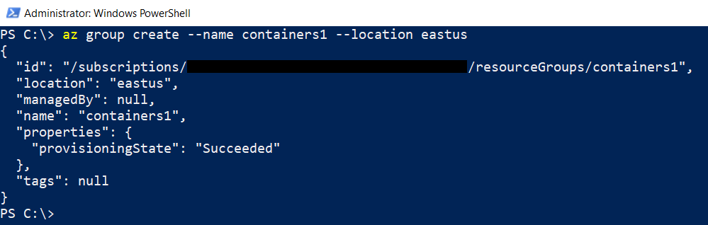
ACR – Create Resource Group
az group create --name containers1 --location eastus

Slide 16
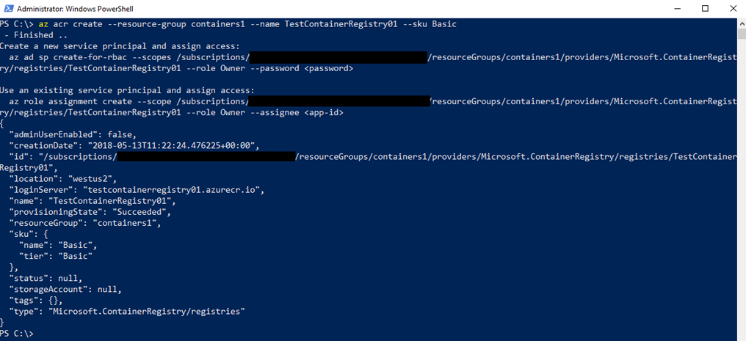
ACR – Create Container Registry
az acr create --resource-group containers1 `
--name TestContainerRegistry01 --sku Basic

Slide 17
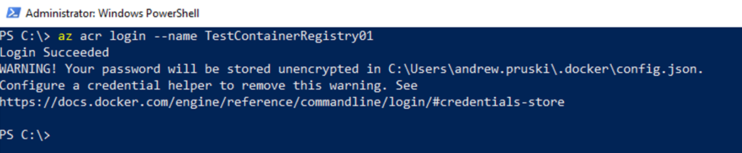
ACR – Log into Registry
az acr login --name TestContainerRegistry01

Slide 18
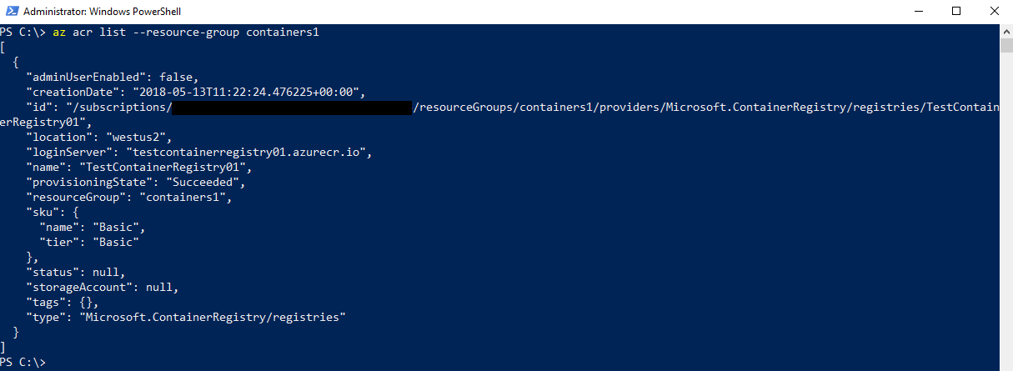
ACR – Get Registry Details
az acr list --resource-group containers1

Slide 19
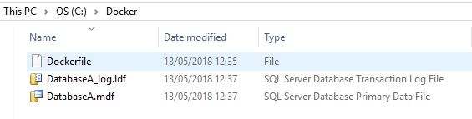
ACR – Dockerfile
FROM microsoft/mssql-server-linux:latest
COPY DatabaseA.mdf /var/opt/sqlserver
COPY DatabaseA_log.ldf /var/opt/sqlserver
ENV MSSQL_BACKUP_DIR="/var/opt/sqlserver"
ENV MSSQL_DATA_DIR="/var/opt/sqlserver"
ENV MSSQL_LOG_DIR="/var/opt/sqlserver"
HEALTHCHECK --interval=10s \
CMD /opt/mssql/bin/sqlservr & \
/opt/mssql-tools/bin/sqlcmd -S . -U sa -P $SA_PASSWORD \
-Q "CREATE DATABASE [DatabaseA] ON (FILENAME = '/var/opt/sqlserver/DatabaseA.mdf’),
(FILENAME = '/var/opt/sqlserver/DatabaseA_log.ldf') FOR ATTACH"

Slide 20
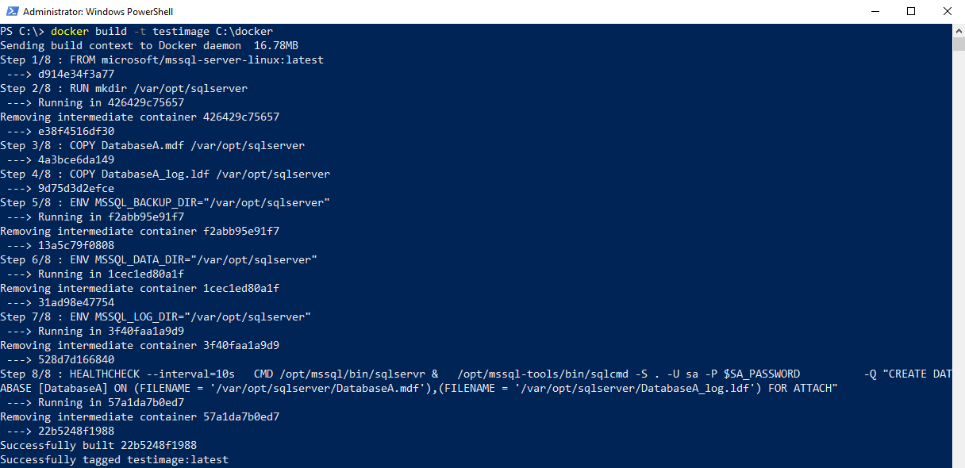
ACR – Build image
docker build -t testimage C:\docker

Slide 21
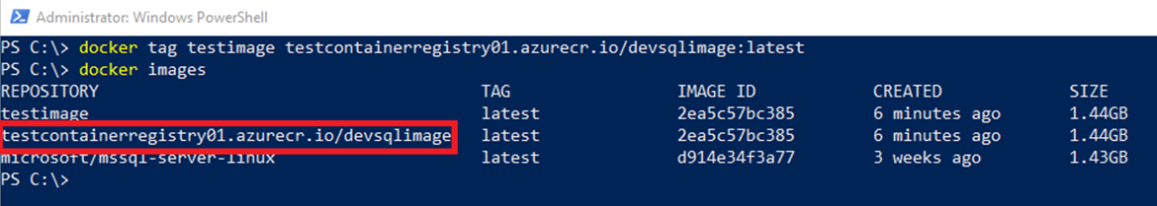
ACR – Tag Custom Image
docker tag testimage ` testcontainerregistry01.azurecr.io/devsqlimage:latest

Slide 22
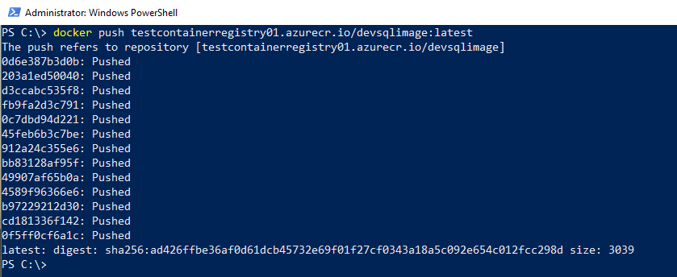
ACR – Push Image
docker push testcontainerregistry01.azurecr.io/devsqlimage:latest

Slide 23
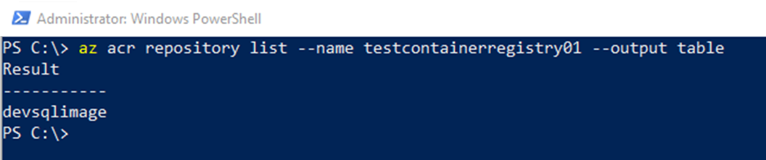
ACR – List Images
az acr repository list --name testcontainerregistry01 --output table

Slide 24
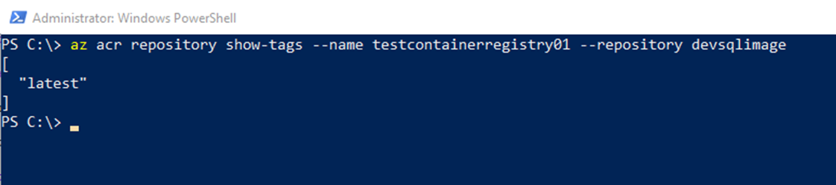
ACR – Show Tags
az acr repository show-tags `
--name testcontainerregistry01 `
--repository devsqlimage

Slide 25
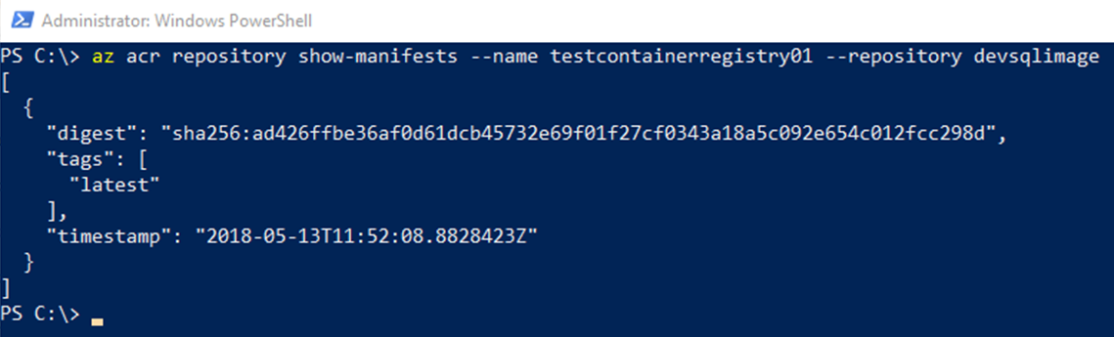
ACR – Show Manifest
az acr repository show-manifests `
--name testcontainerregistry01 `
--repository devsqlimage

Slide 26
Demo

Slide 27
Azure Container Instances

Slide 28
Azure Container Instances
Running containers without servers
No need to manage VMs
Spin up in seconds
Deployed via the CLI, powershell, or Azure Portal
Billed by the second

Slide 29
ACI - Options
Linux & Windows containers
Containers exposed directly to the internet
IP Address and FQDN
Hypervisor level isolation
Persistent storage
Azure files shares
Container Groups

Slide 30
ACI – Get ACR Credentials
# enable admin
az acr update -n TestContainerRegistry01 --admin-enabled true
# get credentials
az acr credential show -n TestContainerRegistry01

Slide 31
ACI – Create Container
az container create `
--resource-group containers1 `
--image testcontainerregistry01.azurecr.io/devsqlimage:latest `
--registry-username <<USERNAME>> `
--registry-password <<PASSWORD>> `
--name testcontainer1 `
--cpu 2 --memory 4 `
--environment-variables ACCEPT_EULA=Y SA_PASSWORD=Testing1122 `
--ip-address public `
--ports 1433

Slide 32
ACI – Get Container Status
az container show `
--name testcontainer1
--resource-group containers1

Slide 33
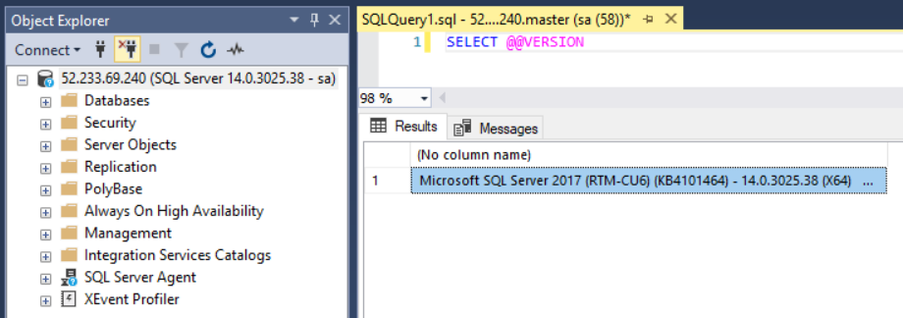
ACI – Connect to SQL Server

Slide 34
Demo

Slide 35
Azure Container Services

Slide 36
Azure Container Services
Two flavours
Azure Container Services (ACS)
Azure Container Service (AKS)
ACS provides container hosting using DC/OS, Swarm, or K8s
AKS is specifically built to implement Kubernetes

Slide 37
Kubernetes
Open Source system for managing containers
Deployed as a cluster containing a master and multiple nodes
Pods hold containers running on the nodes
Services define/allow access to sets of pods
Deployments created and managed via Kubectl

Slide 38
Azure Container Services (AKS)
Simplifies deployment of Kubernetes clusters in Azure
Cluster can be spun up with one line of code
Applications deployed to cluster via yaml files
Managed by Azure-CLI/powershell and kubectl

Slide 39
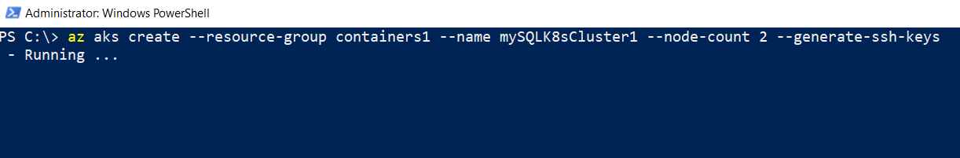
AKS – Create Cluster
az aks create `
--resource-group containers1 `
--name mySQLK8sCluster1 `
--node-count 2 `
--generate-ssh-keys

Slide 40
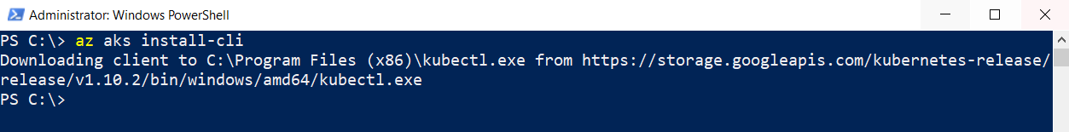
AKS – Install kubectl
az aks install-cli

Slide 41
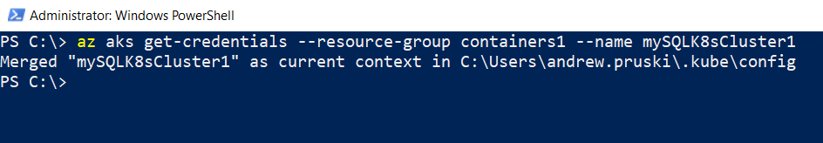
AKS – Get Cluster Credentials
az aks get-credentials `
--resource-group containers1 `
--name mySQLK8sCluster1

Slide 42
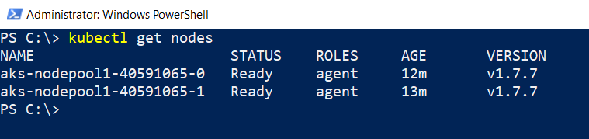
AKS – View Cluster Nodes
kubectl get nodes

Slide 43
AKS – Get Cluster & ACR Details
az aks show `
--resource-group containers1 `
--name mySQLK8sCluster1 `
--query "servicePrincipalProfile.clientId" --output tsv
az acr show `
--name TestContainerRegistry02 `
--resource-group containers1 `
--query "id" `
--output tsv

Slide 44
AKS – Create Role to Deploy
az role assignment create `
--assignee <<CLIENTID>> `
--role Reader `
--scope <<ACRID>>

Slide 45
AKS – yaml file
apiVersion: apps/v1beta1
kind: Deployment
metadata:
name: sqlserver
labels:
app: sqlserver
spec:
replicas: 1
template:
metadata:
labels:
name: sqlserver

Slide 46
AKS – yaml file
spec:
containers:
- name: sqlserver1
image: microsoft/mssql-server-linux:latest
ports:
- containerPort: 1433
env:
- name: SA_PASSWORD
value: "Testing1122"
- name: ACCEPT_EULA
value: "Y"

Slide 47
AKS – Deploy to Cluster
kubectl create -f sqlserver.yml

Slide 48
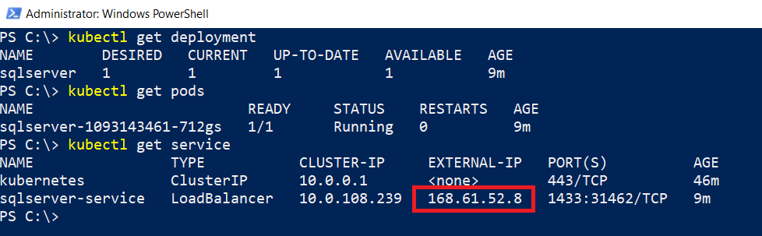
AKS – View Deployment Information
kubectl get deployments
kubectl get pods
Kubectl get service

Slide 49
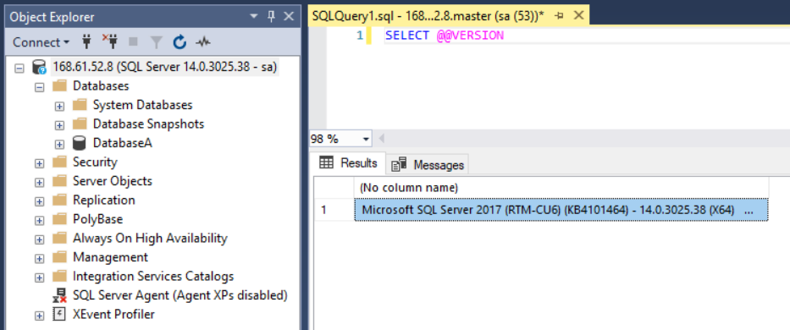
AKS – Connect to SQL Server

Slide 50
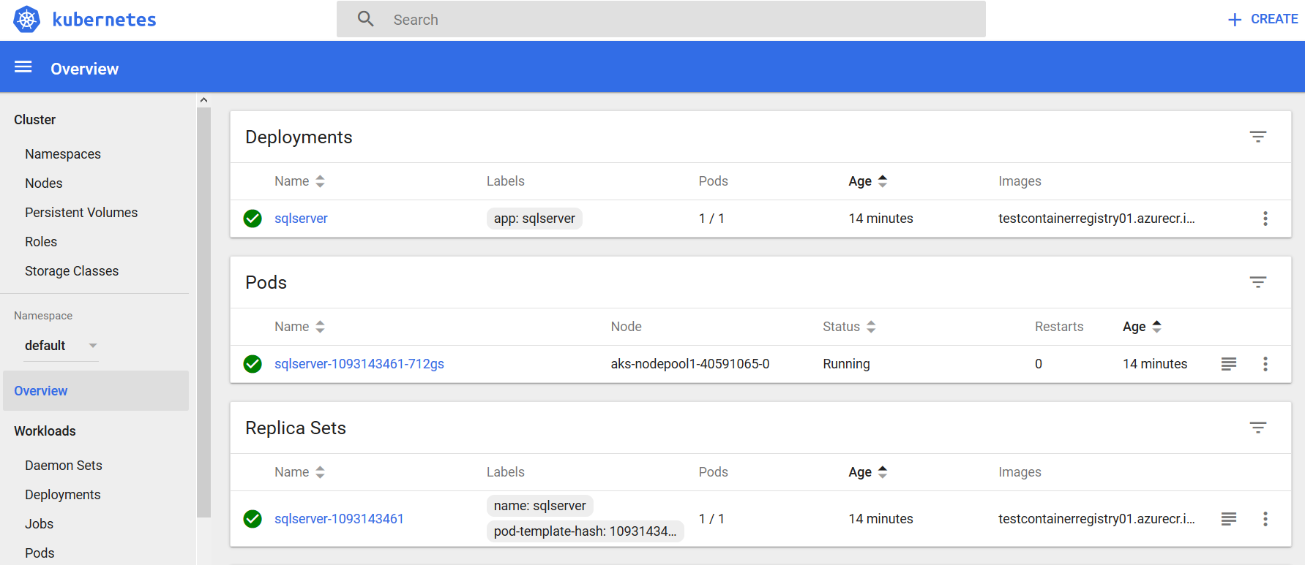
AKS – Connect to K8s Dashboard
az aks browse --resource-group containers1 --name mySQLK8sCluster1

Slide 51
Demo

Slide 52
Other options

Slide 53
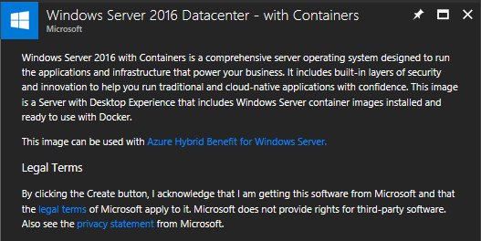
VM Templates
Windows Datacenter with Containers
Docker pre-installed
Images pre-pulled (server core & nano server)

Slide 54
Docker EE for Azure
https://store.docker.com/editions/enterprise/docker-ee-azure

Slide 55
Resources

Slide 56

Questions?

