Slide 1
Physiology of Perception
Fire in the brain

Slide 2

Reminder: Outline of Topics
https://gatech.instructure.com/courses/181190/pages/schedule-of-lecture-topics-2021
Wk Date | Topic | Reading(s) * | Notes
01 1/15 | Introduction to Course | Syllabus | None
None | None | List of Extra Readings | None
None | None | Lippstreu & Griffin (2005) on</li> | None
None | None | Waters (2007) on citations | None
02 1/18 | School Holiday--MLK Day--no classes | None | None
02 1/20 | History & Philosophy | Bartoshuk (2019) | None
02 1/22 | Methods & Techniques | Goldstein CH1 | None
03 1/25 | Psychophysics; Signal Detection Theory | Goldstein Appendix A, B, C & D | None
None | None | Stevens (1961) | None
03 1/27 | Physiology of Perception | Goldstein CH2 | None
03 1/29 | Neuroimaging; Bottom-Up vs. Top-Down | None | None
04 2/01 | Cutaneous Senses | Goldstein CH14 | None
04 2/03 | Pain | Goldstein CH14; | None
None | None | No Pain video | None

Slide 3
Overview
Brain as center of perception
Brain Structure
Transduction & Transmission
Neural Signals
Coding
Upcoming

Slide 4
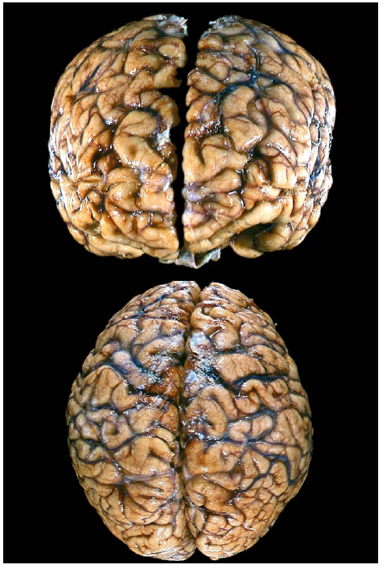
Brain as Center of Perception
Study of the human as a perceiving “machine” led to the conclusion that the brain was center of thought and perception
Early anatomists tried dissection to determine (1) structure, then (2) function
Modern efforts much more effective !

Slide 5
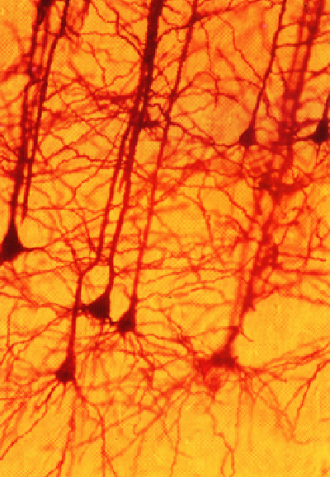
Made Up of Neurons…
The Neuron Doctrine
Neurons & their synapses are the fundamental entities in brain functions, including the mind and consciousness
All the functions of the brain must ultimately be understood in terms of neurons and their interactions
Note: Neurons are electric

Slide 6
Basic Brain Structure
The brain has modular organization
The sensory modalities have primary receiving areas
Audition - temporal lobe
Tactile senses - parietal lobe
Vision - occipital lobe
Etc.
Frontal lobe coordinates information received from two or more senses

Slide 7
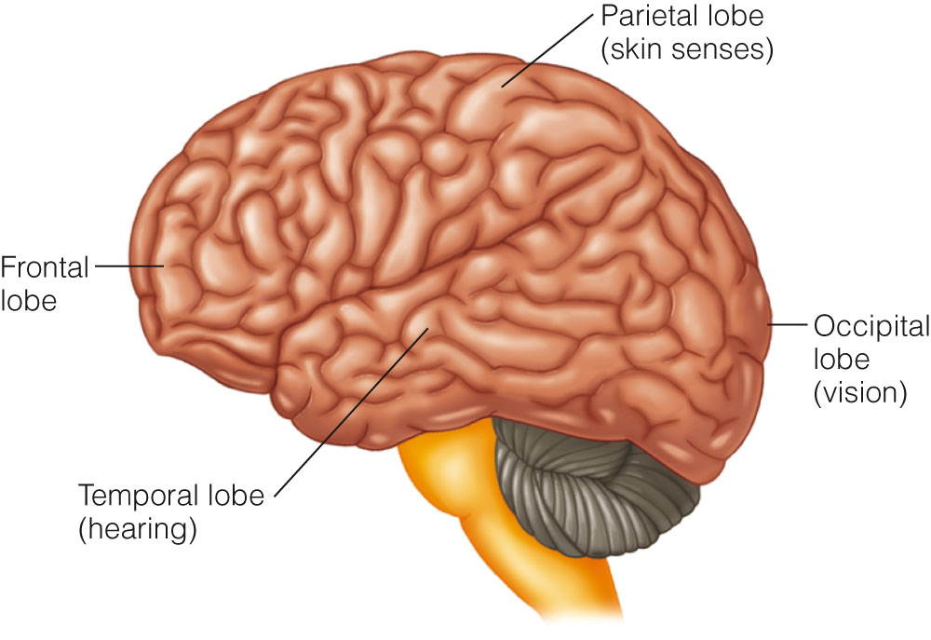
Figure 2.3 The human brain, showing the locations of the primary receiving areas for the senses in the temporal, occipital, and parietal lobes, and the frontal lobe, which is involved with integrating sensory functions.

Slide 8
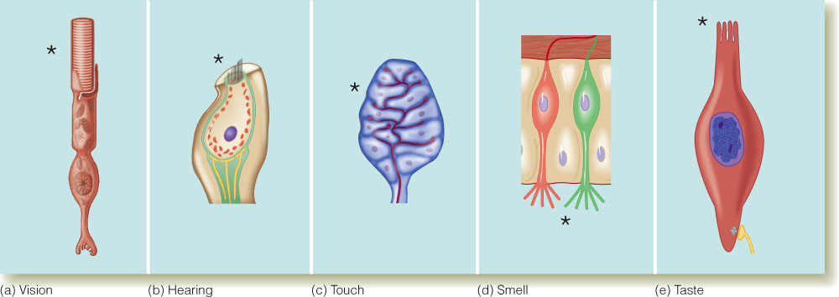
Neurons: Transduction & Transmission
Receptors - specialized neurons that respond to specific kinds of energy

Slide 9
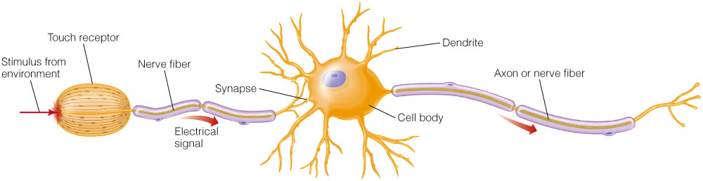
Neurons: Transduction & Transmission
Key components of neurons:
Cell body
Dendrites
Axon or nerve fiber
Figure 2.4 The neuron on the right consists of a cell body, dendrites, and an axon, or nerve fiber. The neuron on the left that receives stimuli from the environment has a receptor in place of the cell body.

Slide 10
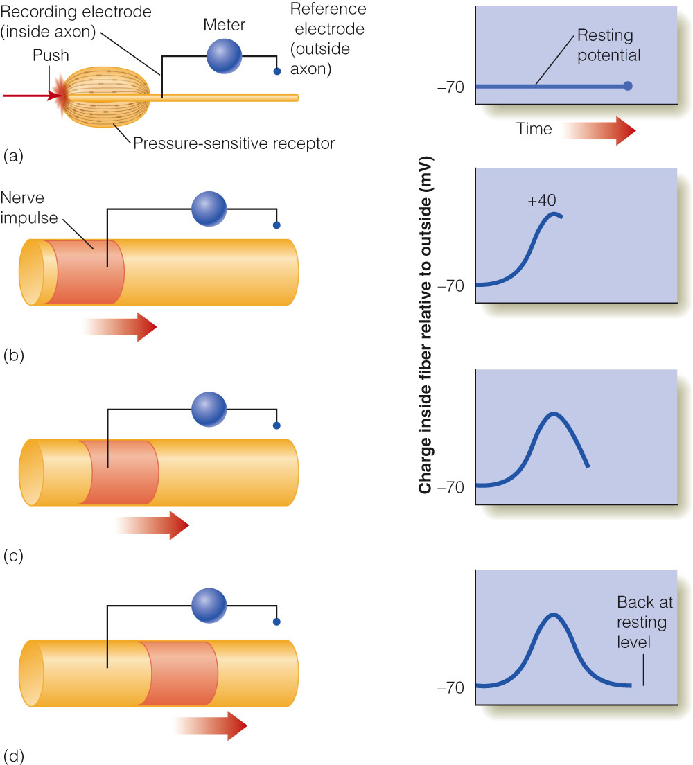
Neural Signals
Electrical signals or action potentials occur when:
permeability of the membrane changes
Na+ flows into the fiber making the neuron more positive
K+ flows out of the fiber making the neuron more negative
This process travels down the axon in a propagated response

Slide 11
Properties of Action Potentials
Action potentials:
show propagated response.
remain the same size regardless of stimulus intensity.
increase in rate to increase in stimulus intensity.
have a refractory period of 1 ms - upper firing rate is 500 to 800 impulses per second.
show spontaneous activity that occurs without stimulation (neuronal noise).

Slide 12
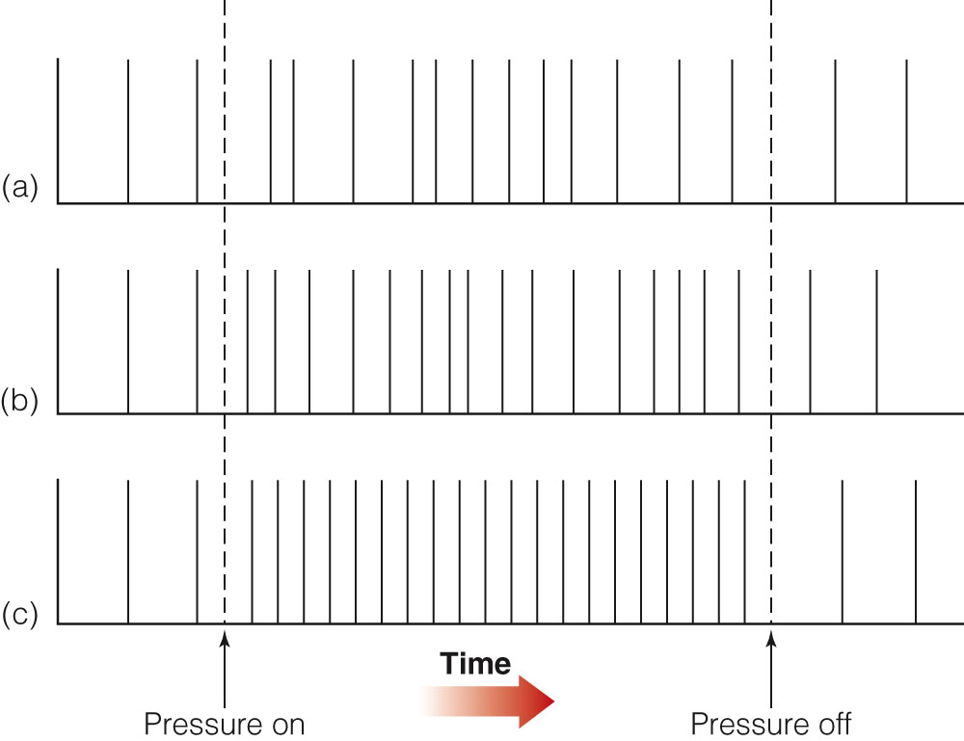
Stimulus Intensity & Firing Rate
Soft pressure
Medium pressure
Strong pressure
Figure 2.10 Response of a nerve fiber to (a) soft, (b) medium, and (c) strong stimulation. Increasing the stimulus strength increases both the rate and the regularity of nerve firing in this fiber.

Slide 13
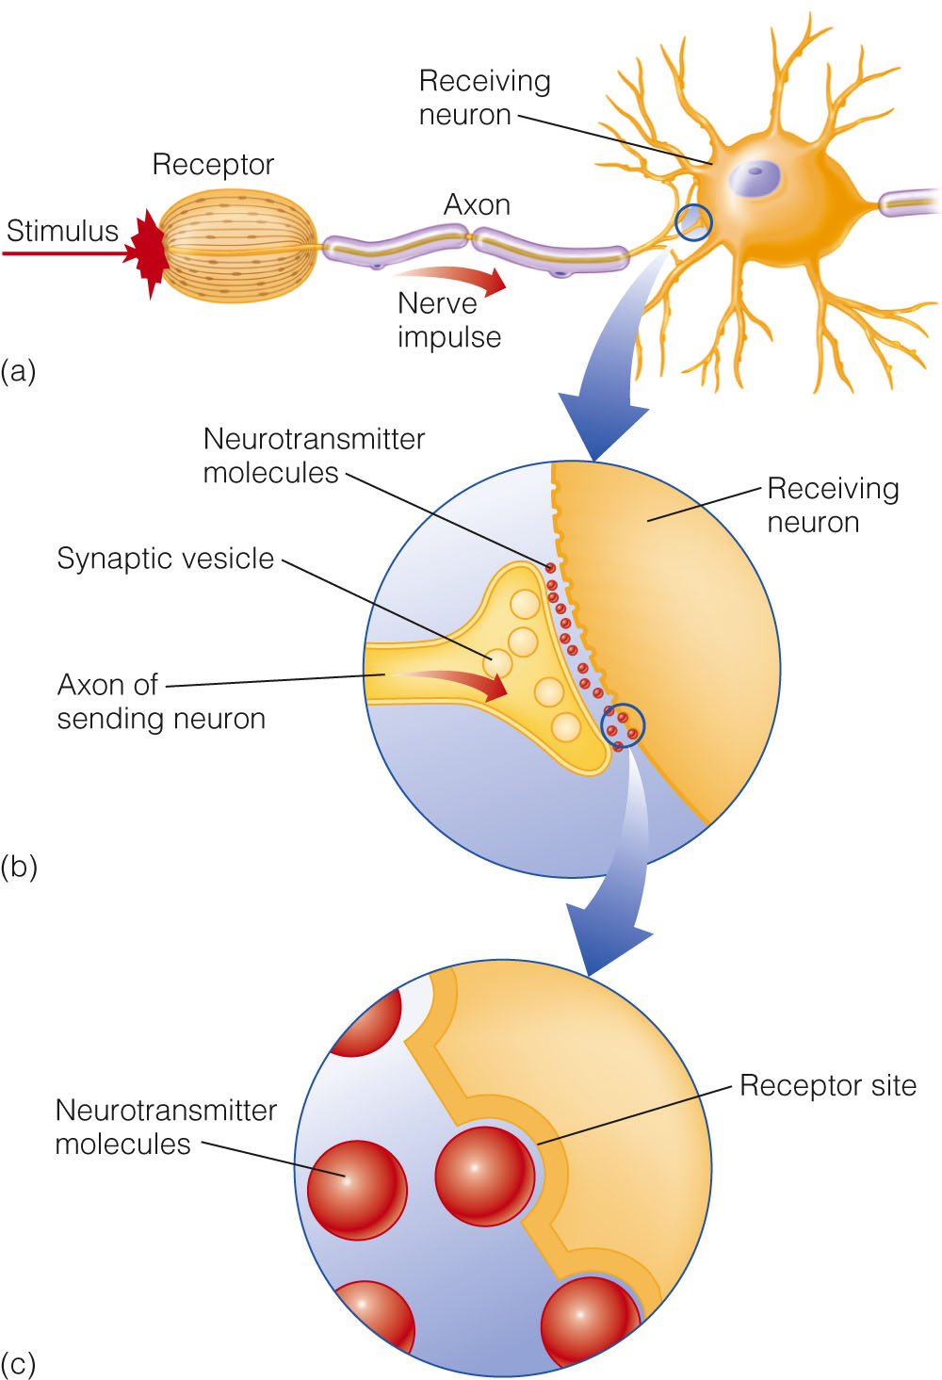
Synaptic Transmission of Impulses
Neurotransmitters are:
released by the presynaptic neuron from vesicles.
received by the postsynaptic neuron on receptor sites.
matched like a key to a lock into specific receptor sites.
used as triggers for voltage change in the postsynaptic neuron.

Slide 14
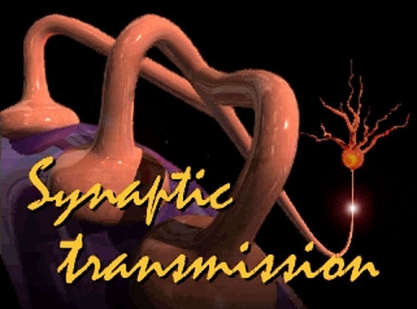
Video: Synaptic Transmission

Slide 15
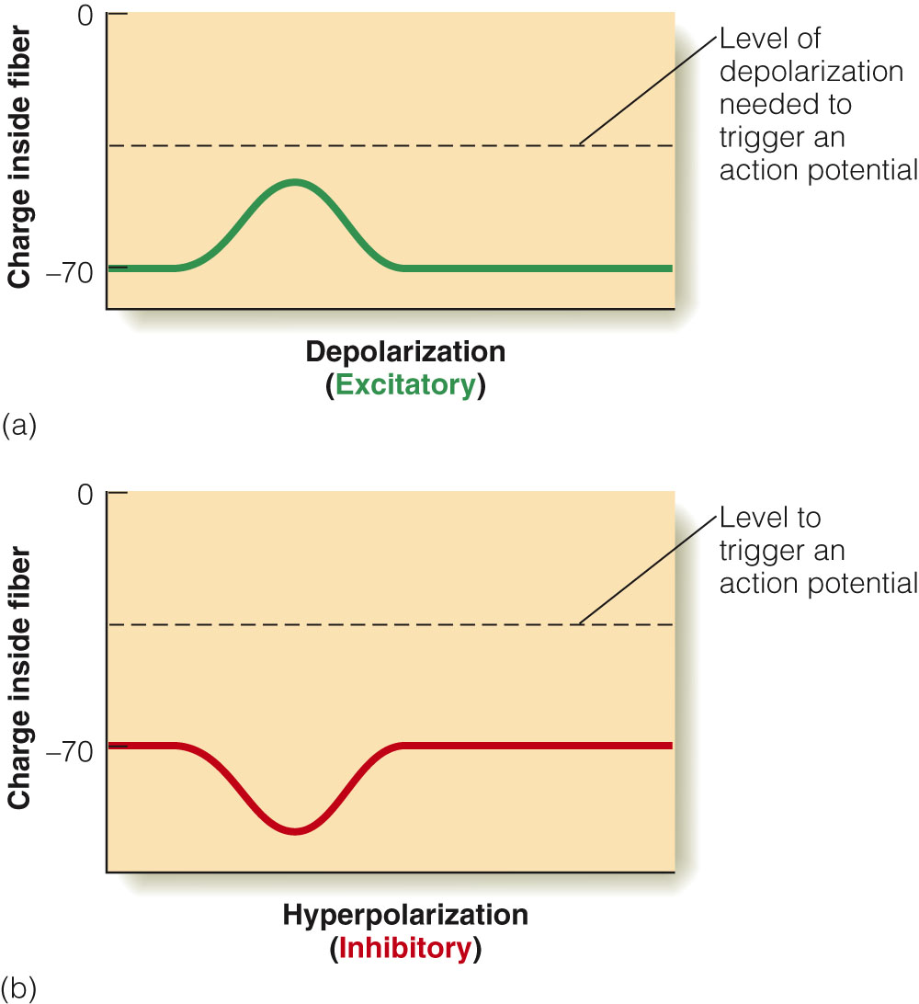
Types of Neurotransmitters
Excitatory transmitters - cause depolarization
Neuron becomes more positive
Increases the likelihood of an action potential
Inhibitory transmitters - cause hyperpolarization
Neuron becomes more negative
Decreases the likelihood of an action potential
Figure 2.12 (a) Excitatory transmitters cause depolarization, an increased positive charge inside the neuron. (b) Inhibitory transmitters cause hyperpolization, an increased negative charge inside the axon. The charge inside the axon must reach the dashed line to trigger an action potential.

Slide 16
Neural Circuits
Groups of neurons connected by excitatory and inhibitory synapses
A simple circuit has no convergence and only excitatory inputs.
Input into each receptor has no effect on the output of neighboring circuits.
Each circuit can only indicate single spot of stimulation.

Slide 17
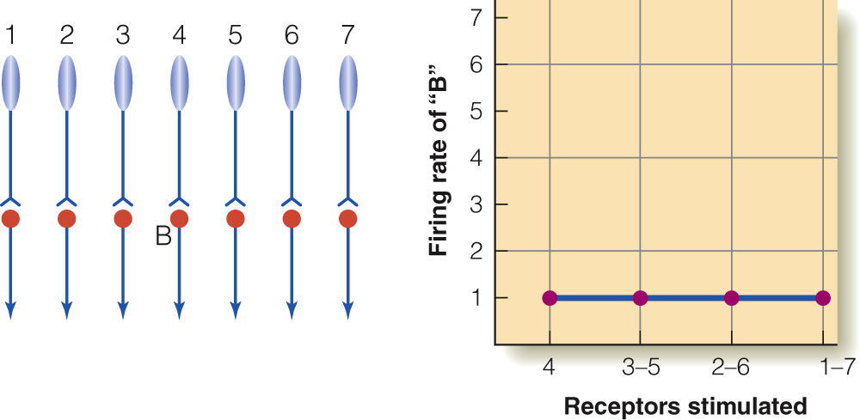
Simple Circuit
Figure 2.14 Left: A circuit with no convergence. Right: Response of neuron B as we increase the number of receptors stimulated.

Slide 18
Neural Circuits - continued
Convergent circuit with only excitatory connections
Input from each receptor summates into the next neuron in the circuit.
Output from convergent system varies based on input.
Output of circuit can indicate single input and increases output as length of stimulus increases.

Slide 19
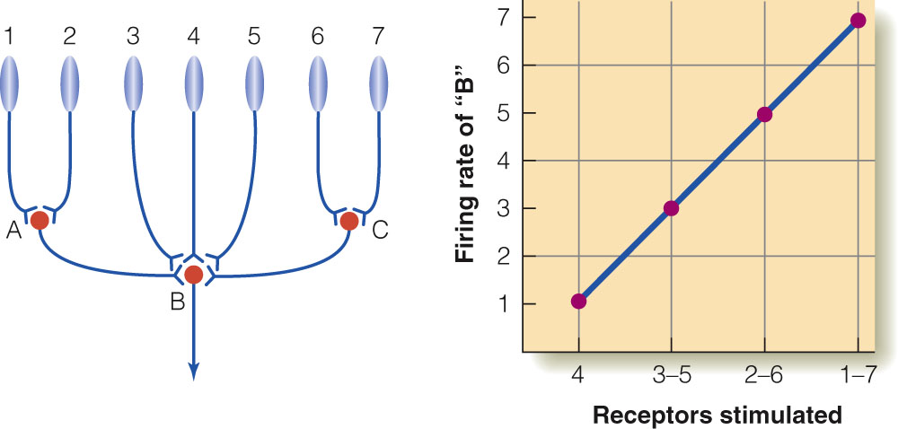
Convergent Circuits (+ only)
Figure 2.15 Circuit with convergence added. Neuron B now receives inputs form all of the receptors, so increasing the size of the stimulus increases the size of neuron B’s response.

Slide 20
Neural Circuits - continued
Convergent circuit with excitatory and inhibitory connections
Inputs from receptors summate to determine output of circuit.
Summation of inputs result in:
weak response for single inputs and long stimuli.
maximum firing rate for medium length stimulus.

Slide 21
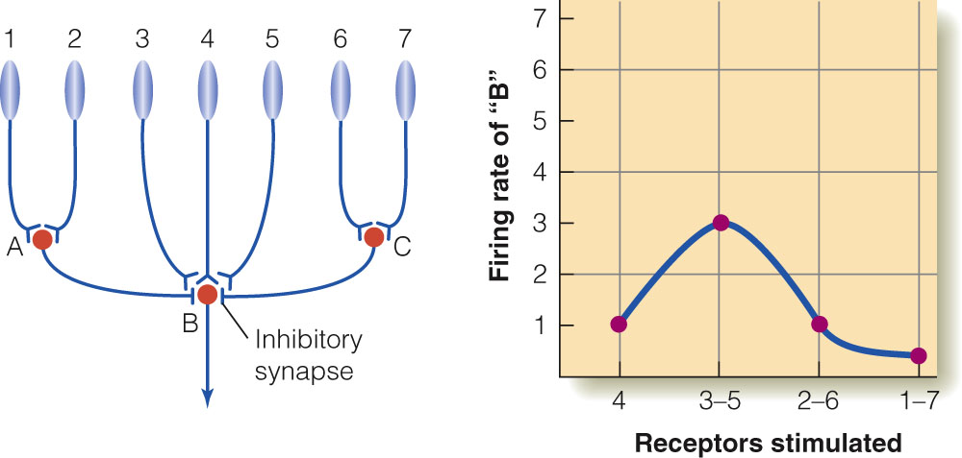
Convergent Circuits (+ and -)
Figure 2.16 Circuit with convergence and inhibition. Because stimulation of the receptors on the side (1, 2, 6, and 7) sends inhibition to neuron B, neuron B responds best when just the center (3 - 5) are stimulated.

Slide 22
Receptive Fields
Area of receptors that affects firing rate of a given neuron in the circuit
Receptive fields are determined by monitoring single cell responses.
Research example for vision
Stimulus is presented to retina and response of cell is measured by an electrode.
Notes:
Important to emphasize that the receptive field is on the retina. Students tend to forget this as you work your way through the explanation of more specifically tuned neurons further into the system.

Slide 23
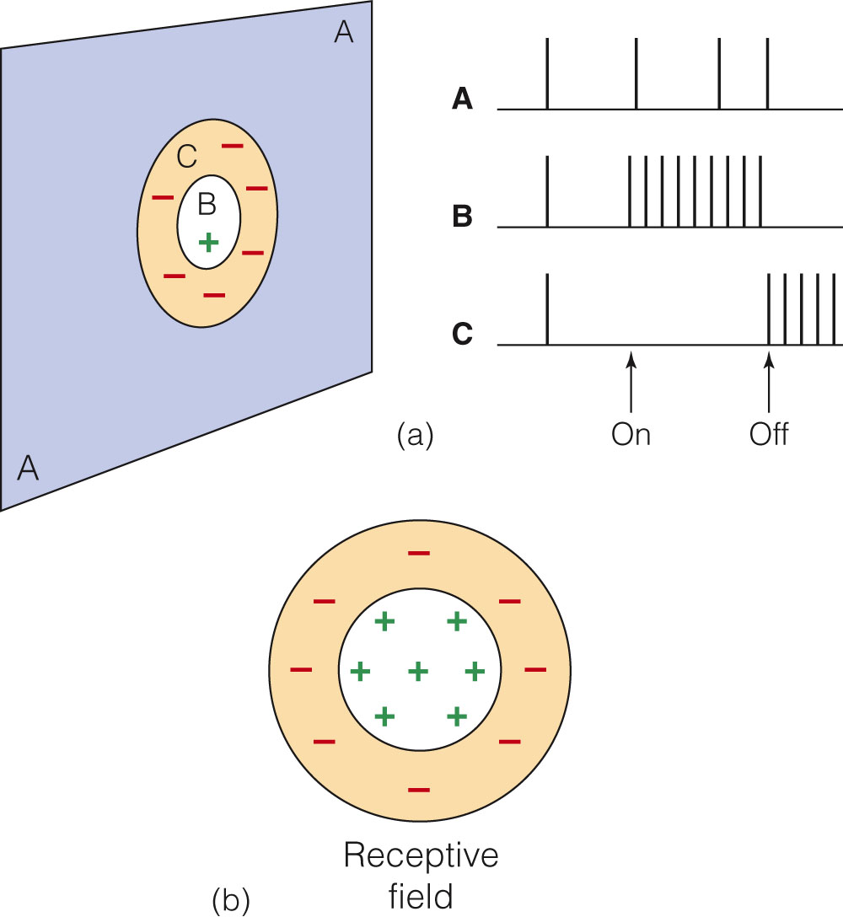
Center-Surround Receptive Fields
Excitatory and inhibitory effects are found in receptive fields.
Center and surround areas of receptive fields result in:
Excitatory-center-inhibitory surround
Inhibitory-center-excitatory surround
Figure 2.18 (a) Response of a ganglion cell in the cat’s retina to stimulation: outside the cell’s receptive field (area A on the screen); inside the excitatory area of the cell’s receptive field (area B); and inside the inhibitory area of the cell’s receptive field (area C). (b) The receptive field is shown without the screen.

Slide 24
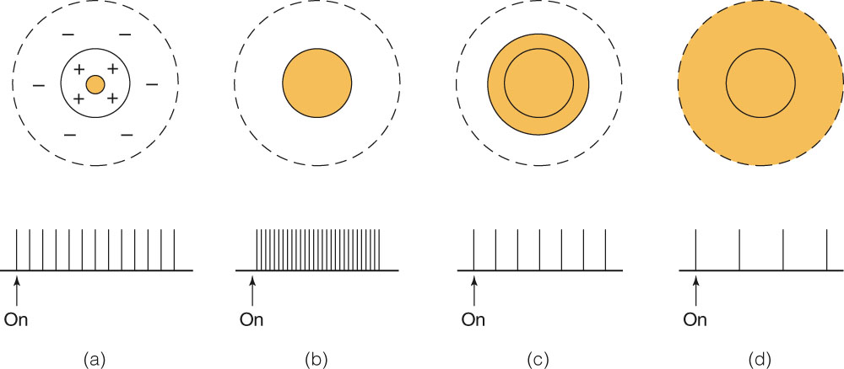
Center-Surround Antagonism
Output of center-surround receptive fields changes depending on area stimulated:
Highest response when only the excitatory area is stimulated
Lowest response when only the inhibitory area is stimulated
Intermediate responses when both areas are stimulated
Figure 2.19 Response of an excitatory-center-inhibitory-surround receptive field as stimulus size is increased. Shading indicates the area stimulated with light. The response to the stimulus is indicated below each receptive field. The largest response occurs when the entire excitatory area is illuminated, as in (b). Increasing stimulus size further causes a decrease in firing due to center-surround antagonism. (Adapted from Hubel and Wiesel, 1961.)

Slide 25
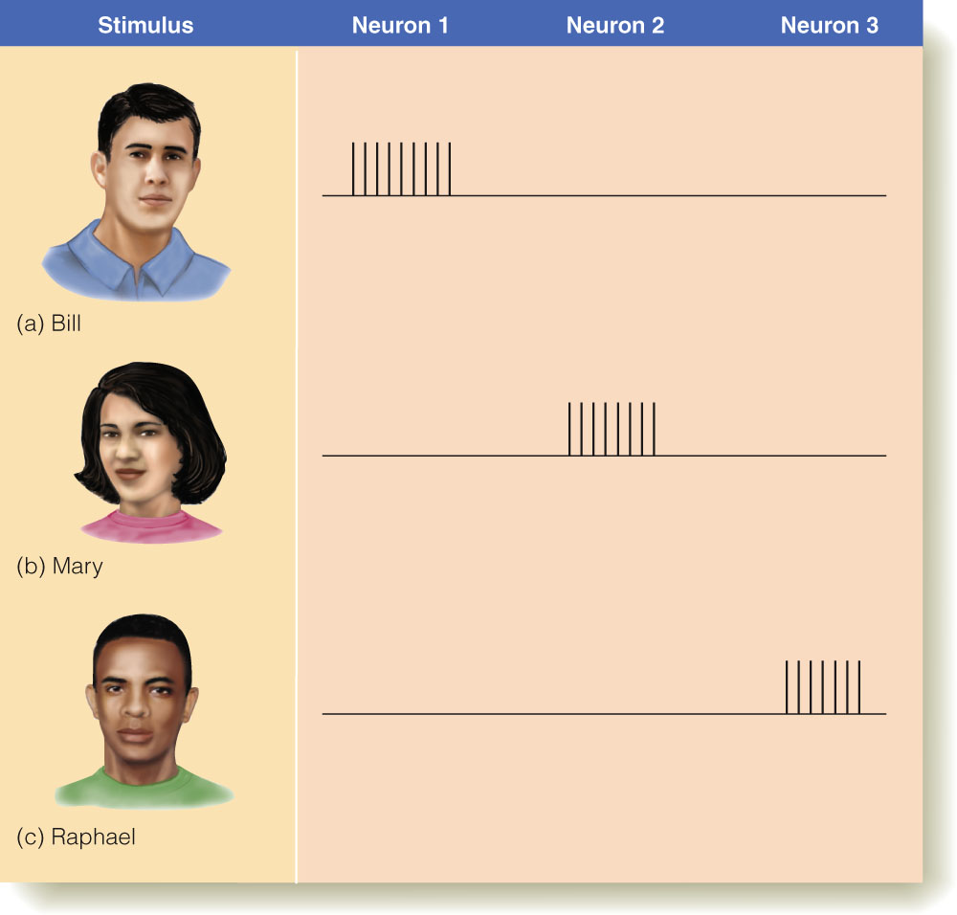
Sensory Code: Specificity Encoding
Specificity coding - specific neurons responding to specific stimuli
Leads to the “grandmother cell” hypothesis
Cells in the hippocampus that respond to concepts such as Halle Berry.
Problems with specificity coding:
Too many different stimuli to assign specific neurons
Most neurons respond to a number of different stimuli.
Figure 2.21 How faces could be coded by specificity coding. Each face causes one specialized neuron to respond.

Slide 26
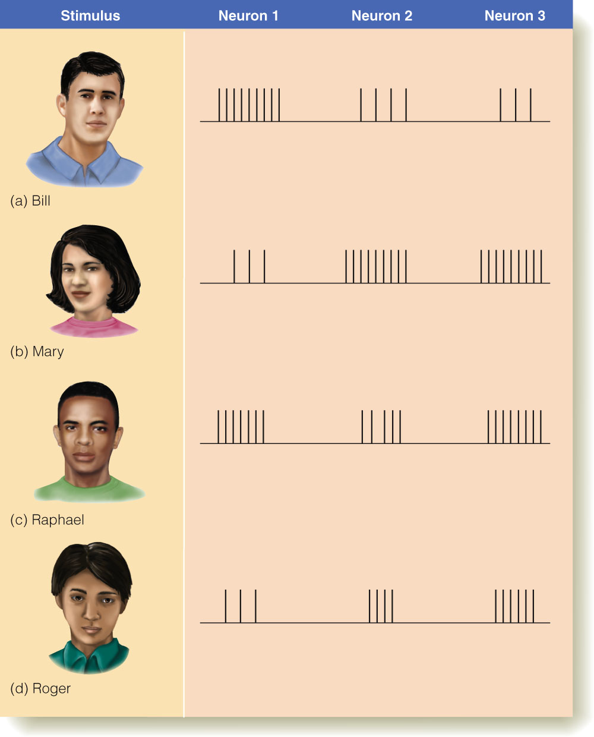
Sensory Code: Distributed Encoding
Distributed coding - pattern of firing across many neurons codes specific objects
Large number of stimuli can be coded by a few neurons.
Figure 2.23 How faces could be coded by distributed coding. Each face causes all the neurons to fire, but the pattern of firing is different for each face. One advantage of this method of coding is that many faces could be represented by the firing of the three neurons.

Slide 27
Upcoming
Neuroimaging
Bottom-up vs. Top-down Processing
Extra Readings
Download from Web site

Slide 28
Basics of Neural Signals
Neurons are surrounded by a solution containing ions.
Ions carry an electrical charge.
Sodium ions (Na⁺) - positive charge
Chlorine ions (Cl⁻) - negative charge
Potassium ions (K⁺) - positive charge
Electrical signals are generated when such ions cross the membranes of neurons.
Membranes have selective permeability.

Slide 29
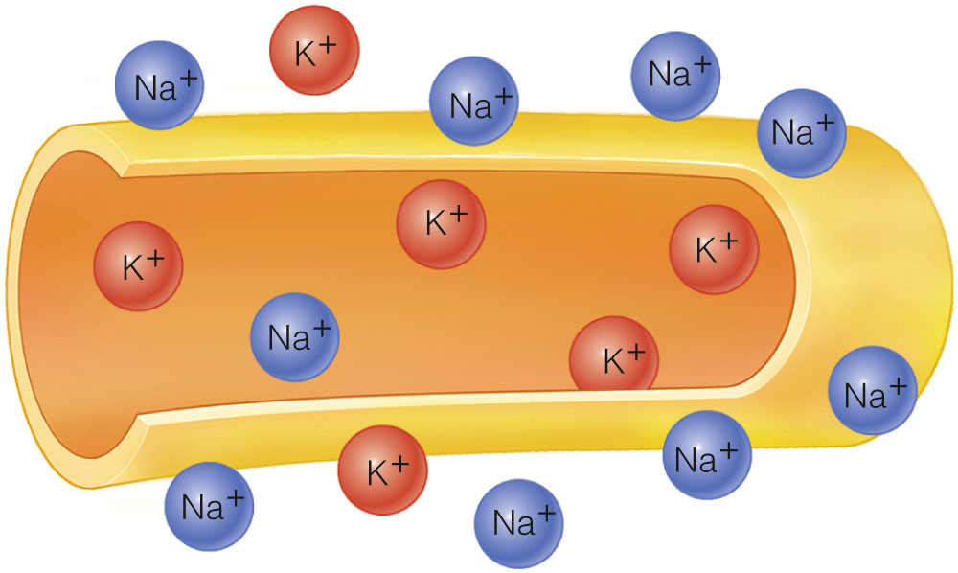
Figure 2.8 A nerve fiber, showing the high concentration of sodium outside the fiber and potassium inside the fiber. Other ions, such as negatively charged chlorine, are not shown.

