Slide 1
T-DSCM: A Three-Dimensional Framework for Service Change Management in SOA Environments
Davood Bahadori & ahmad abdollahzadeh barforoush
Amirkabir university of technology

Slide 2
Outline
Introduction
Background
Framework Overview
Framework Evaluation

Slide 3
Introduction
Service Oriented Architecture
SOA is an architectural style, which encapsulates system or application function(s) into service as a coarse-grained, discoverable software entity and provides those usable for public consumers
Today, in ICT and Industry 4.0 domains, SOA and related technologies, as well as standards such as Enterprise Service Bus (ESB) are one of the key features of reference architecture due to providing automated interoperability and real-time dynamic response to change in the environment
In SOA, services can be developed using a variety of technologies, which are different in design and implementation models
  SOAP Web service & REST-full service
  Object Management Group CORBA, RMI, and DCOM
  Asynchronies services (e.g. IBM MQ)
  ebXML

Slide 4
Introduction (Cont.)
Service Oriented Architecture
Main entities of SOA
  Service Provider
  Service Consumer
  Service Broker
Notes:
a new version of a service is backward compatible with its old version when all of the applications that consume the service using old version, still can continue to exchange valid message with the new version of service without any necessary changes

Slide 5
Introduction (Cont.)
Service Oriented Architecture
Most widely technology to support the implementation of SOA is the Web Service
Web services provide more interoperable and loosely coupled services as a result of using open standards and protocols such as XML, SOAP, UDDI, and WSDL
SOAP is an XML-based lightweight protocol which used to exchange information in a decentralized and distributed environment
The UDDI defines a standard method for both publishing and discovering web services
WSDL is an XML-based description language, describing the public interface for web services

Slide 6
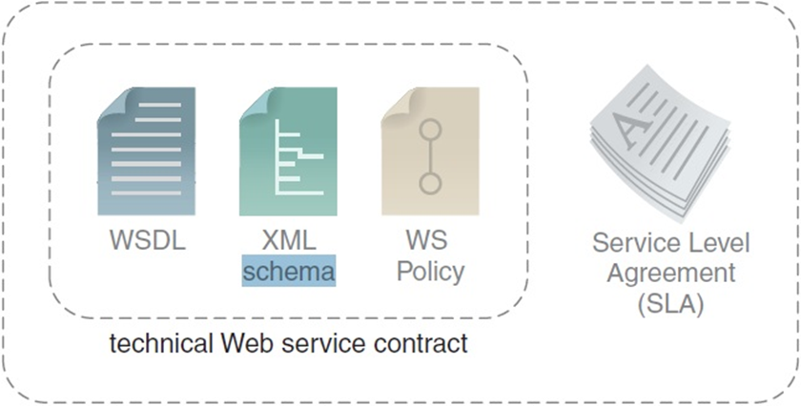
Introduction (Cont.)
Web Service Contract
Parts of Web service contract
  WSDL
  XML Schema
  WS Policy
  SLA
Notes:
a new version of a service is backward compatible with its old version when all of the applications that consume the service using old version, still can continue to exchange valid message with the new version of service without any necessary changes

Slide 7
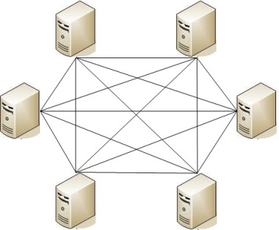
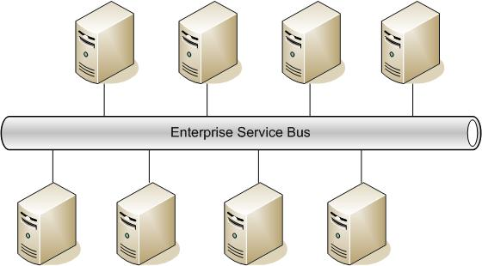
Introduction (Cont.)
Enterprise Service Bus

Slide 8
Background
Compatibility and Versioning in Service
it is a concept representing the type and severity of applied changes
Compatibility can be considered as a metric for measuring the impact of service changes on other environmental entities
Compatibility between different versions of services can be categorized into two general types
  backward compatibility
  forward compatibility

Slide 9
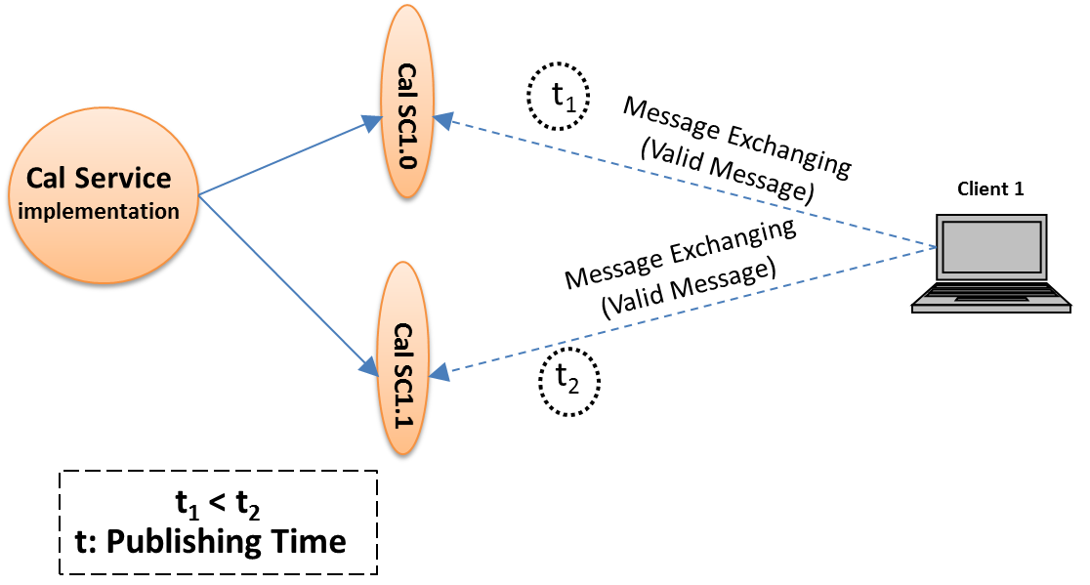
Background (Cont.)
Backward compatibility
Client1 bind to Cal Service and exchange message in t1 using Cal SC 1.0 version
Client1 still can exchange valid message with Cal Service after t2 using Cal SC 1.1 version.
There is no need any change to Client1 for exchanging valid message with Cal Service
Notes:
a new version of a service is backward compatible with its old version when all of the applications that consume the service using old version, still can continue to exchange valid message with the new version of service without any necessary changes

Slide 10
Background (Cont.)
Compatible and Incompatible Change, Valid Message
The focus of this paper is on backward compatibility
Changes that do not break the backward compatibility known as compatible changes
If the applied change to a service has negative impact for the current user of the service, then this change is incompatible change
A valid message is a message request that compatible with service technical interface, in otherwise is an invalid message
Notes:
In this paper we focus on the backward-compatibility concept, and Changes that do not break the backward compatibility known as compatible changes. In other words, if the applied change to a service has not negative impact for the current user of service, then this change is a compatible change and in otherwise is an incompatible change

Slide 11
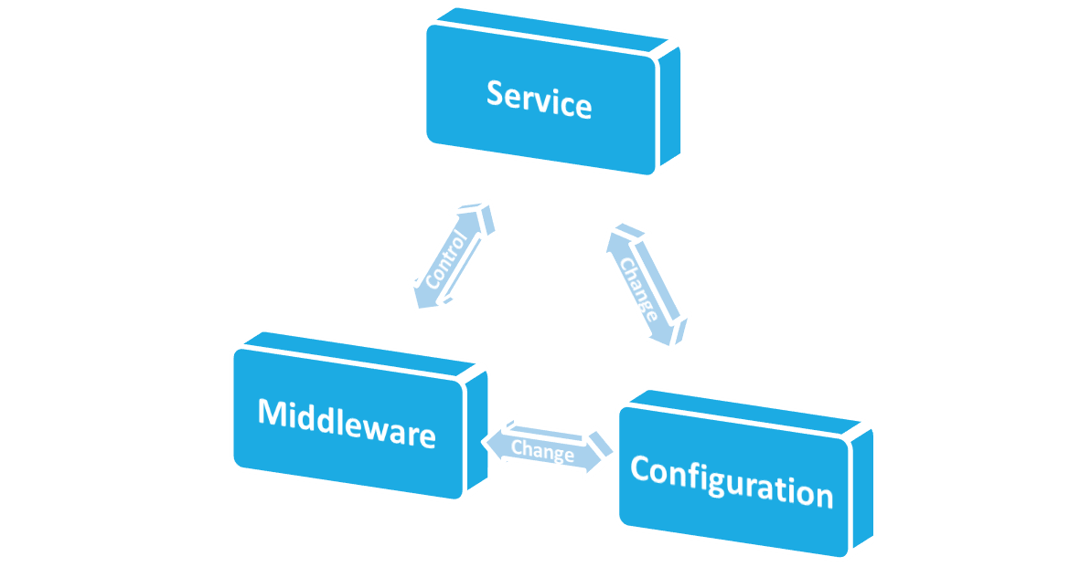
Framework Overview
Service change issues and problems
Details information of the problem
Three Dimensions:
  Service
  Configuration
  Middleware
All dimensions could have effects on each other and activate some system capabilities and functionalities
Problem Domain: Service Dimension
Solution Domain: Middleware and Configuration Dimensions
Strategies
Mechanisms
Techniques
Patterns
Notes:
The proposed framework composed of three dimensions which includes, SD, CD, and MD.
Each of these dimensions can have effects on each other and cause to activate the system capabilities and functionalities.
In the viewpoint of requirement engineering we can map the service dimension into problem domain and the two other dimensions, that is configuration and middleware dimensions into solution domain.

Slide 12
Framework Overview (Cont.)
Service Dimension
In Service Dimension the main problem should be defined
Is the “What dimension” of the domain
Focuses on the service change related problems and issues
  Service evolution
  Service versioning
  Service availability and etc.
Includes some activities in order to identify more details information about the problem
  Type of the changes
  Trigger of the changes
  Potential destinations of the changes and etc.
Notes:
Et cetera.

Slide 13
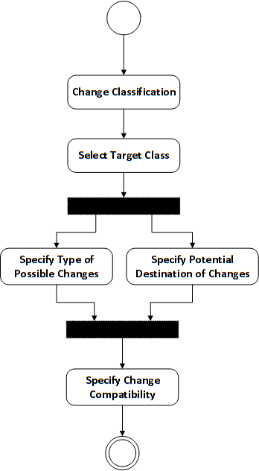
Framework Overview (Cont.)
Service Dimension Activities
Classify all of the changes
Select candidate classes for managing
Specify details information of possible changes in each selected classes:
  Type of change
  Triggers of changes
  Potential destination of change
Specify the compatibility of changes for each possible combination of change type and change destination
Notes:
Et cetera.
In this time we have a set of compatible and incompatible changes which are specified based on the potential destinations and type of changes
If the incompatible change is not managed properly, not only can it lead to service failure of SOA system, but also it can have negative effects on service availability of the system

Slide 14
Framework Overview (Cont.)
Configuration Dimension
Is the solution domain (dimension)
The purpose of this dimension is to provide and prepare required information for Middleware Dimension to manage and control changes
Access to versioning information can be realized using
  Versioning tags in service contract (in service provider side)
  Generating a compatibility message to consumer (in service provider side)
  Calculating delta using comparing versions (in repository or consumer side)
Need to well-form structure for storing the meta-data of the change record
Notes:
Service is the main configuration item in the SOA solution. Since services can be evolved and changed in their lifetime, the configuration management of SOA-based systems is an inevitable and essential task

Slide 15
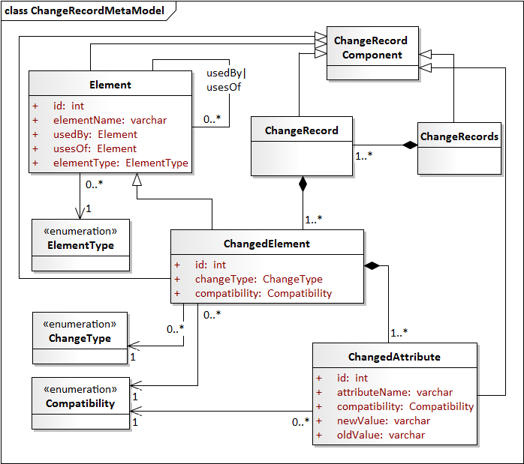
Meta-model for Change Record
Changed element: contains information about the destination of change as well as change type
Dependency: to identify the dependency between elements
  identify the propagation of changes
  UsedBy attribute
  UsesOf attribute
Compatibility: in order to specify the compatibility type of changes

Slide 16
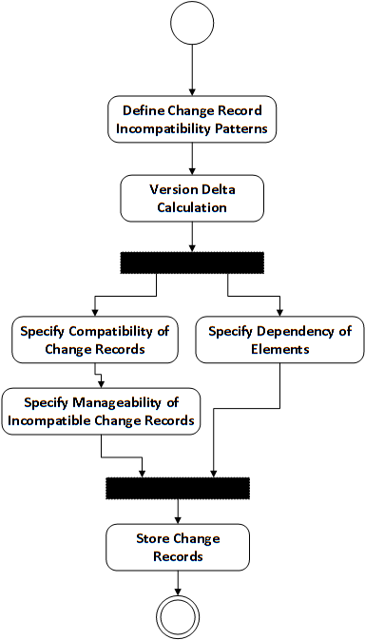
Framework Overview (Cont.)
Configuration Dimension Activities
Define change record incompatibility patterns by considering the compatibility information from service dimension.
Calculate the change delta of the new service version.
Specify dependency between elements.
Specify the compatibility type of occurred changes based on the defined incompatible patterns.
Store the change record of new service version in the repository based on the proposed meta-model.
Specify the manageability of incompatible changes.
Notes:
Service is the main configuration item in the SOA solution. Since services can be evolved and changed in their lifetime, the configuration management of SOA-based systems is an inevitable and essential task

Slide 17
Framework Overview (Cont.)
Middleware Dimension
Is the solution domain (dimension)
In this dimension, mediation patterns and mechanisms will be used to manage service change events
For one or more incompatibility patterns, which specified in CD, we should
  Create a change scenario
  Define a group of one or more Enterprise Integration Pattern (EIP)
Use of Enterprise Service Bus in order to implement the mediation mechanisms for preparing the incoming messages
Notes:
In other words, each change scenario that derived from incompatibility patterns mapped to one or a group of EIP patterns as mediation patterns.

Slide 18
Middleware Dimension (Cont.)
Strategies for Managing Incompatible Changes
There is two strategies for managing occurred change in services
Message manipulation strategy: the incompatible change can be managed with message manipulation using mediators mechanisms.
Service replacement strategy: the incompatible change cannot be managed with message manipulation and need to service replacement or exposing an error response.
Notes:
Often, some of the incompatibility changes can be handled using mediation mechanisms. By doing so and manipulation the incoming messages we can provide continues service delivery whenever changes occur. However, in some cases, the mediation mechanisms cannot be an appropriate solution and we have to replace the target service in order to reply a correct response to client requests or exposing an error message as a response when the system cannot find any services for replacing. Therefore, we have two strategies for managing incompatible changes in services, which include:

Slide 19
Framework Overview: Middleware Dimension (Cont.)
Message Processing Path Record
Passing invalid request messages through processing steps in order to
  Convert to valid message
  Routing to proper alternative destination
We need to meta-model for storing message processing path records
Notes:
Often, some of the incompatibility changes can be handled using mediation mechanisms. By doing so and manipulation the incoming messages we can provide continues service delivery whenever changes occur. However, in some cases, the mediation mechanisms cannot be an appropriate solution and we have to replace the target service in order to reply a correct response to client requests or exposing an error message as a response when the system cannot find any services for replacing. Therefore, we have two strategies for managing incompatible changes in services, which include:

Slide 20
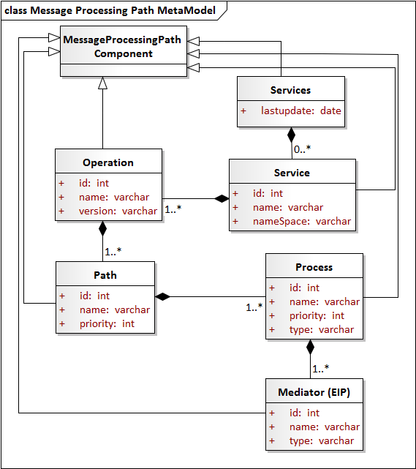
Message Processing Path MetaModel
Services: contains all services that have changed up to now.
Service: represents a service that is subjected to changes.
      Operation: represents the operation of service that are subjected to change.
      Path: contains one or more process components in order to generate a path for message processing
      Process: defines mediation processes
Notes:
Service :
The service component itself is contained of zero or more Operation component and also has three attributes id, name, and namespace
Operation :
The version attribute specifies the version of changed, or deprecated operation which current client already has bounded to it. By using of version attribute if necessary, we can have specific message processing paths for each version of a service. The operation component itself is contained of one or more path component.

Slide 21
    Framework Overview: Middleware Dimension
    Message Preparation General Pattern (MPGP)
MPGP is a general pattern for preparing incoming messages in order to deliver a valid message to destination service (changed service or alternative service)
Makes the main body of the message preparation process
Drives from routing slip pattern
Include 5 steps to prepare the incoming messages
Notes:
we introduce a general pattern for preparing incoming messages in order to deliver a valid message to destination service, either a changed service or an alternative service

Slide 22
    Framework Overview: Middleware Dimension
    Message Preparation General Pattern (MPGP)
Message Preparation General Pattern (MPGP)
Problem: the changed service may publish a new version that is incompatible with previous versions. So, the request messages from clients that bound to it before of change event may have an invalid form and resulting to service failure.
Intent: convert a request message with targeted to changed service from invalid form to valid form using EIP patterns. So, the message will be prepared for delivery to changed service or alternative service in order to provide continuous service delivery.
Notes:
we introduce a general pattern for preparing incoming messages in order to deliver a valid message to destination service, either a changed service or an alternative service

Slide 23
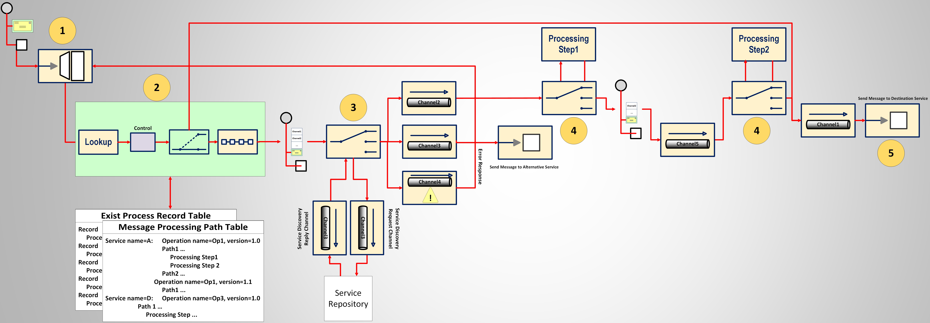
Framework Overview: Middleware Dimension
Message Preparation General Pattern (MPGP)
All incoming messages intercepted using a messaging gateway pattern.
  Each message contains the requester address that indicates where to send the reply message

Slide 24
Framework Overview: Middleware Dimension
Message Preparation General Pattern (MPGP)
Search in message processing path table to determine whether the incoming message is a message that require to preparation or not.
  a list of processing steps will be attached to the message header If match. Otherwise, the message will be route to destination channel directly
  Detour pattern can be used as a router in this step
  Attaching to header can be doing using the routing slip pattern
  looking in exist processing step table

Slide 25
Framework Overview: Middleware Dimension
Message Preparation General Pattern (MPGP)
Route the message based on the managing strategy
  In message manipulation strategy, the message will be routed to the related channel for manipulating
  In replacement strategy, the middleware sends a request to service repository to find an alternative service
  If it find an alternative service, it routes the message to channel that associated to alternative endpoint
  If it cannot find an alternative service, an error message will be sent to messaging gateway using invalid message channel pattern

Slide 26
Framework Overview: Middleware Dimension
Message Preparation General Pattern (MPGP)
the message will be routed according to processing steps, or related channel address that attached to its header
  The Routing action can be done using the message router pattern
  the related router removes the step from the list and routes the message to the next step of list
  all processing steps will be defined and implemented in runtime based on the incompatible records

Slide 27
Framework Overview: Middleware Dimension
Message Preparation General Pattern (MPGP)
When all process steps completed, then the message will be routed to the destination service. This step can be done using the message endpoint pattern

Slide 28
    Framework Overview: Middleware Dimension Activities
      Design time activities
  Specify which incompatible records need to service replacement strategy.
  Define change scenarios that must be applied to the incoming messages based on the incompatibility patterns.
  Specify EIP pattern corresponding to each change scenario.
  Specify ESB mechanisms in order to implement each EIP pattern in ESB.
Notes:
we introduce a general pattern for preparing incoming messages in order to deliver a valid message to destination service, either a changed service or an alternative service

Slide 29
    Framework Overview: Middleware Dimension Activities
      Runtime activities
  Acquiring the change records from configuration dimension
  Define message processing path records and processing steps based on the acquired change records.
  Intercept request messages and specify which of them should be sent to the changed services by looking up in message processing path table.
Notes:
we introduce a general pattern for preparing incoming messages in order to deliver a valid message to destination service, either a changed service or an alternative service

Slide 30
Framework Evaluation
Implement a version-aware SOA system in order to prevent service failure when a new version of service is exposed
After classifying the different type of changes in SOA based systems we focus on the changes which can cause to service failure
One of the issues threating service availability and service continuous delivery in such systems is service contract change
the problem that we address using this framework is continuous service delivery in situations that service contract change event occurs
implement two solution dimensions using an open source SOA platform, WSO2

Slide 31
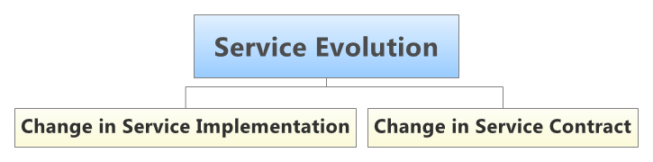
Framework Evaluation (Cont.)
Service Dimension

Slide 32
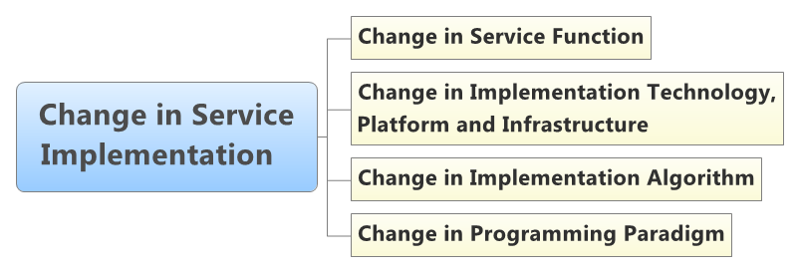
Framework Evaluation (Cont.)
Service Dimension

Slide 33
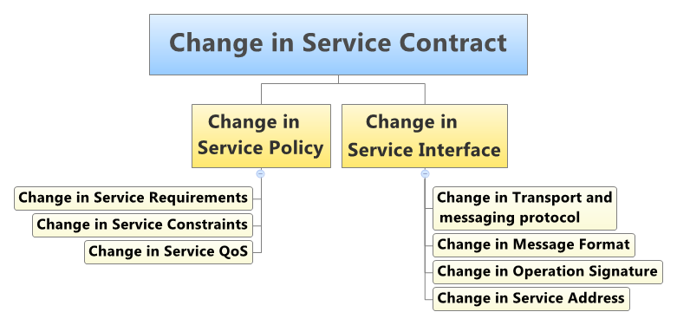
Framework Evaluation (Cont.)
Service Dimension

Slide 34
Framework Evaluation (Cont.)
Configuration Dimension
We create a handler for managing service versioning that is comprised of four component including
  contract comparator: for parsing and comparing each new version of the contract with previous versions,
  delta calculator: for calculating the delta of versions and storing them in change record format
  notification manager: in order to notify all entities which subscribe to inform about change, exposing new service version, and
  versioning manager: acts as orchestrator that control and manage the interaction between other components in versioning handler
Service Version Controller
Handler
Versioning Manager
Contract Comparator
Axis2 Runtime
Delta Web Service
Delta Calculator
Notification Manager

Slide 35
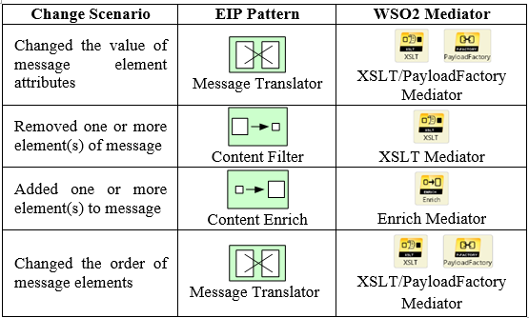
Framework Evaluation (Cont.)
Middleware Dimension
Use of WSO2 ESB to implement mediation mechanisms

Slide 36
Framework Evaluation (Cont.)
Middleware Dimension

Slide 37
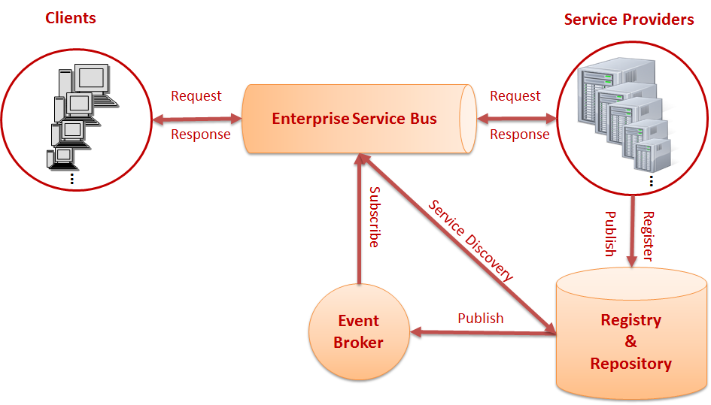
Framework Evaluation (Cont.)
Version-aware SOA System Architecture

Slide 38
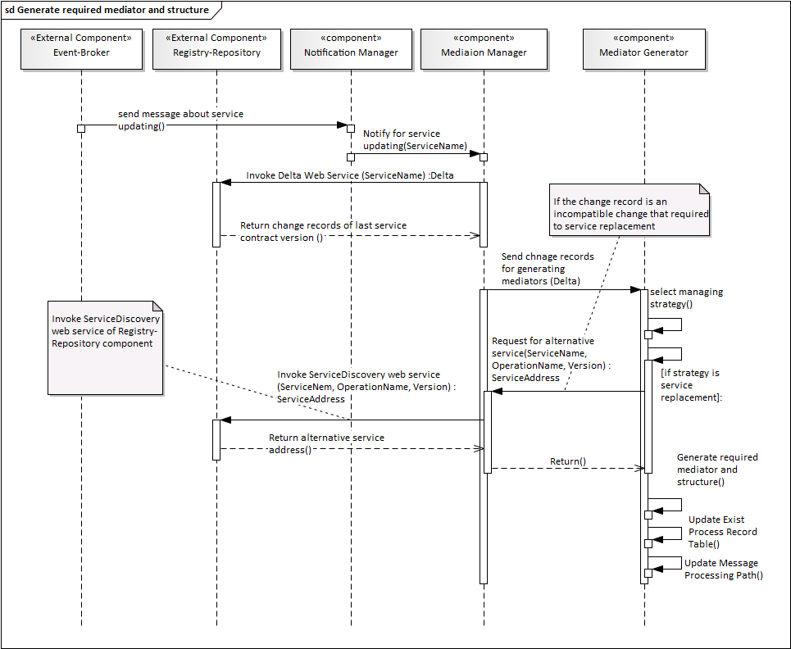
Interaction Between Components

