Slide 1
PCA (Principal Component Analysis)
Dominik Bahlburg
4.4.2017

Slide 2
What is it good for?
Finding patterns in your data and identify the principal components which are responsible for these patterns
Can reduce multidimensional datasets into fewer dimensions to understand them better
Principal component analysis (PCA ) has been called one of the most valuable results from applied linear algebra. PCA is used abundantly in all forms of analysis - from neuroscience to computer graphics - because it is a simple, non-parametric method of extracting relevant information from confusing data sets. With minimal additional effort PCA provides a roadmap for how to reduce a complex data set to a lower dimension to reveal the sometimes hidden, simplified dynamics that often underlie it.

Slide 3
What is it good for?
Look, we have some wine bottles standing here on the table. We can describe each wine by its colour, by how strong it is, by how old it is, and so on (see this very nice visualization of wine properties taken from here). We can compose a whole list of different characteristics of each wine in our cellar. But many of them will measure related properties and so will be redundant. If so, we should be able to summarize each wine with less characteristics! This is what PCA does. […]
PCA is not selecting some characteristics and discarding the others. Instead, it constructs some new characteristics that turn out to summarize our list of wines well. Of course these new characteristics are constructed using the old ones; for example, a new characteristic might be computed as wine age minus wine acidity level or some other combination like that (we call them linear combinations).
“amoeba” at Stackoverflow
Notes:
PCA looks for properties that show as much variation across wines as possible.
PCA looks for properties that allow to reconstruct the original characteristics as well as possible.

Slide 4
What’s the math behind?
Basic statistics:
Mean
Covariance
Basic matrix algebra:
Eigenvectors
Eigenvalues
matrix multiplication

Slide 5
The steps
wine | a | b | c
Chardonnay | 1 | 3 | 5
Burgundy | 2.3 | 5.2 | 8.2
Chardonnay | 0.7 | 2.1 | 3
Riesling | 1.5 | 4.3 | 6.6
Burgundy | 1.8 | 4.9 | 7.5
We start with a dummy dataset
1. (Standardize/center the data)
2. Calculate the covariance-matrix
3. Find eigenvectors and eigenvalues of covariance-matrix
4. Select n largest eigenvalues and corresponding eigenvectors -> principal components
5. plot/rotate data around principal components
6. How to interpret your PCA’s
7. How to do it in R

Slide 6
1. Standardize/center the data
Why?:
Let’s look at it from the other side… If you don’t standardize/center the data, each variable will contribute to covariance and thus eigenvectors and eigenvalues with the ”magnitude of its own range”
that’s a problem when:
variables do not have the same unit
e.g. in taxonomic data when you have very dominant species with high values (can be problematic in dependence on what you’re looking for)
Standardizing the data: each variable contributes equally to covariance
Summary: You have to decide whether you want to standardize your data prior to PCA or not. It’s your decision and it should be dependent on your data structure and on what you’re looking for.
In case you standardize your data: covariance-matrix = correlation-matrix

Slide 7
1. Center the data
wine | a | b | c
Chardonnay | 1 | 3 | 5
Burgundy | 2.3 | 5.2 | 8.2
Chardonnay | 0.7 | 2.1 | 3
Riesling | 1.5 | 4.3 | 6.6
Burgundy | 1.8 | 4.9 | 7.5
wine
Chardonnay
Burgundy
Chardonnay
Riesling
Burgundy
a | b | c
-0.46 | -0.9 | -1.06
0.84 | 1.3 | 2.14
-0.76 | -1.8 | -3.06
0.04 | 0.4 | 0.54
0.34 | 1 | 1.44
mean_{var1} = 1.46
mean_{var2} = 3.9
mean_{var3} = 6.06
Reason: now dataset has a mean of zero!

Slide 8
2. Create covariance matrix
What is covariance?
Covariance is a measure of how changes in one variable are associated with changes in a second variable. Specifically, covariance measures the degree to which two variables are linearly associated. (http://stats.stackexchange.com/questions/29713/what-is-covariance-in-plain-language)
Cov = 0 -> variables are not linearly associated
Cov >> 0 -> variables are linearly associated (higher values of x correspond with higher values of y)
Cov << 0 -> variables are linearly associated (high values of x correspond with low values of y or vice versa)

Slide 9
2. Create covariance matrix
a | b | c
-0.46 | -0.9 | -1.06
0.84 | 1.3 | 2.14
-0.76 | -1.8 | -3.06
0.04 | 0.4 | 0.54
0.34 | 1 | 1.44
Var_{a} | Cov_{a,b} | Cov_{c,a}
Cov_{a,b} | Var_{b} | Cov_{c,b}
Cov_{a,c} | Cov_{b,c} | Var_{c}
0.4030 | 0.8075 | 1.2805
0.8075 | 1.725 | 2.7250
1.2805 | 2.7250 | 4.3580
All variables increase together – surprise surprise…

Slide 10
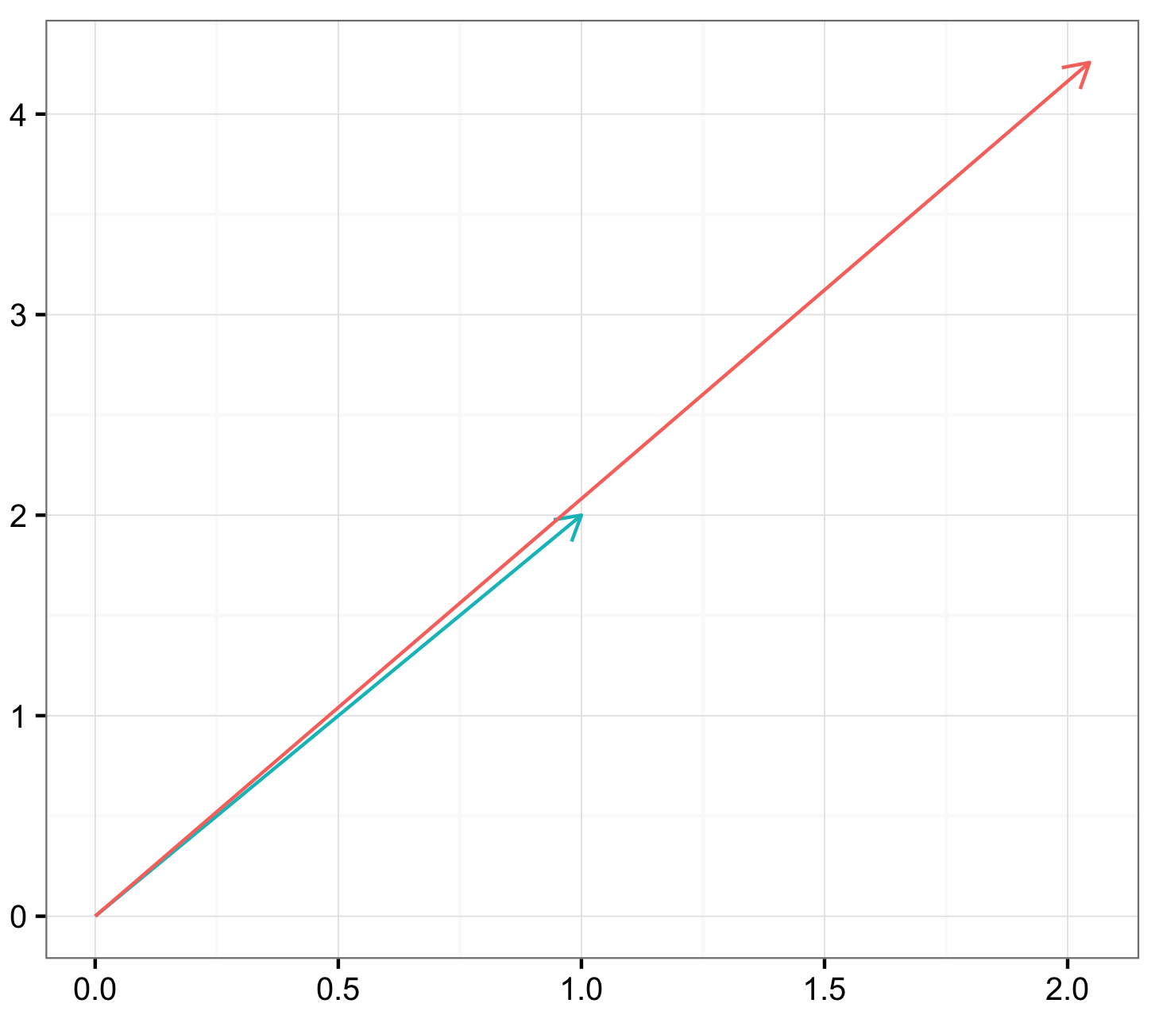
3. Find Eigenvalues and Eigenvectors of Covariance-Matrix
What on earth are those things?
We can look at a matrix like at a function
0.4030 | 0.8075
0.8075 | 1.725
1
2
2.045
4.2575
x
=
Directions of this transformation: eigenvectors!
Magnitude of transformation in direction of the respective eigenvectors: eigenvalues!

Slide 11
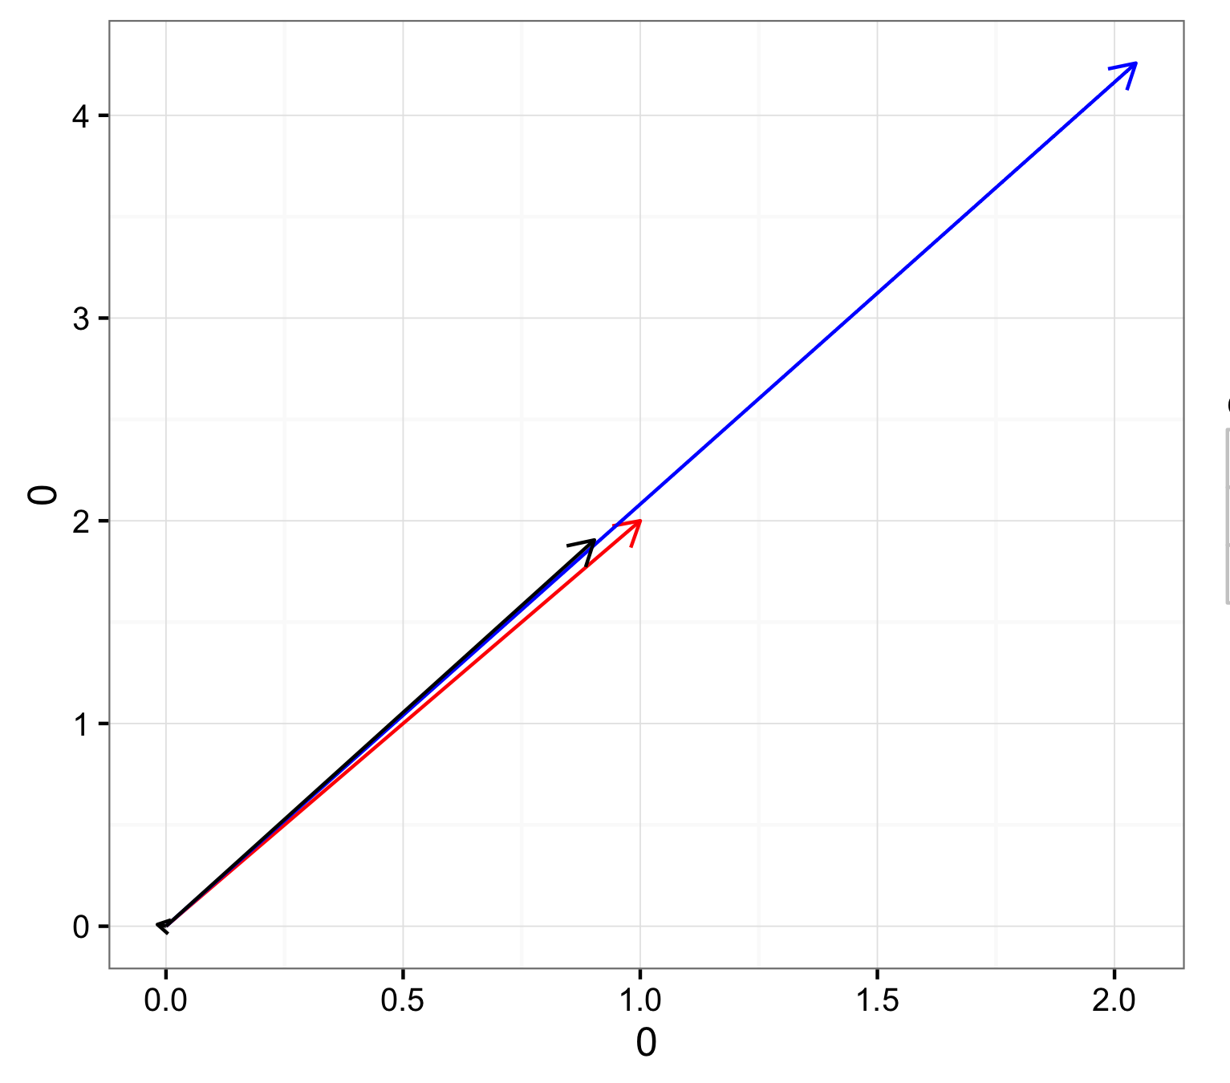
3. Find Eigenvalues and Eigenvectors of Covariance-Matrix
0.4030 | 0.8075
0.8075 | 1.725
1
2
2.045
4.2575
x
=
Eigenvalues: λ₁ = 2.108
λ₂ = 0.020
Eigenvectors: e1 =
e2 =
0.428
0.904
-0.904
0.428

Slide 12
3. Find Eigenvalues and Eigenvectors of Covariance-Matrix
Eigenvectors and their corresponding eigenvalues give information about:
The “direction” of a matrix (eigenvectors)
The magnitude each direction has (eigenvalues)
-> getting these information from our covariance matrix reveals a lot about the data structure and the how strong the different components shape and characterize the data

Slide 13
3. Find Eigenvalues and Eigenvectors of Covariance-Matrix
-0.243
-0.516
-0.822
e1 =
e2 =
e3 =
0.4030 | 0.8075 | 1.2805
0.8075 | 1.725 | 2.7250
1.2805 | 2.7250 | 4.3580
λ₁ = 6.447
λ₂ = 0.025
λ₃ = 0.014
0.919
0.149
-0.365
0.310
-0.844
0.438

Slide 14
4. Rank the Eigenvalues
-0.243
-0.516
-0.822
e1 =
e2 =
e3 =
1. Principal Component
λ₁ = 6.447
λ₂ = 0.025
λ₃ = 0.014
0.919
0.149
-0.365
2. Principal Component
0.310
-0.844
0.438
3. Principal Component

Slide 15
4. Rank the Eigenvalues
-0.243
-0.516
-0.822
Loadings of the PCs as linear combinations of the different variables
e1 =
e2 =
e3 =
PC1
PC1 PC2 PC3
a 0.2429645 0.9190116 0.3104607
b 0.5156843 0.1487096 -0.8437744
c 0.8216070 - 0.3651069 0.4377887
λ₁ = 6.447
λ₂ = 0.025
λ₃ = 0.014
0.919
0.149
-0.365
PC2
Importance of components:
PC1 PC2 PC3
Standard deviation 2.539 0.15794 0.11846
Proportion of Variance 0.994 0.00385 0.00216
Cumulative Proportion 0.994 0.99784 1.00000
0.310
-0.844
0.438
PC3

Slide 16
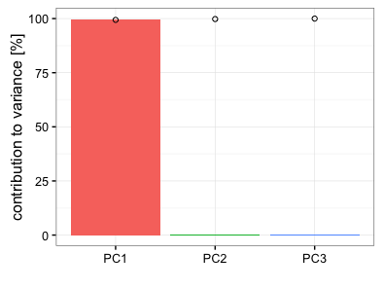
4. Rank the Eigenvalues
Importance of PC’s:
PC1 PC2 PC3
Standard deviation 2.539 0.15794 0.11846
Proportion of Variance 0.994 0.00385 0.00216
Cumulative Proportion 0.994 0.99784 1.00000
>99% of the data variance is explained by the first Principal Component
In this step there it is up to you to decide how many PC’s you want to keep. Unfortunately, there is no rule how many you should keep or how much variance should be explained by your chosen components.

Slide 17
5. Transform/Rotate your data around picked PC’s
-0.243
-0.516
-0.822
PC1 =
PC2 =
-0.46 | -0.9 | -1.06
0.84 | 1.3 | 2.14
-0.76 | -1.8 | -3.06
0.04 | 0.4 | 0.54
0.34 | 1 | 1.44
1.22394 -0.169942
-2.22576 0.184563
3.25944 0.150264
-0.64056 -0.100745
-1.61706 -0.06414
0.243 | 0.919
-0.516 | 0.149
-0.822 | -0.365
x
=
0.919
0.149
-0.365
Dimensions reduced from 3 to 2!!

Slide 18
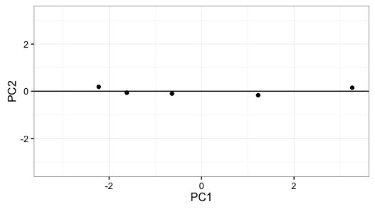
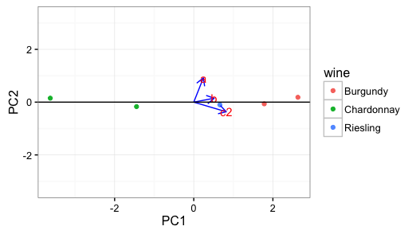
5. Transform/Rotate your data around picked PC’s

Slide 19
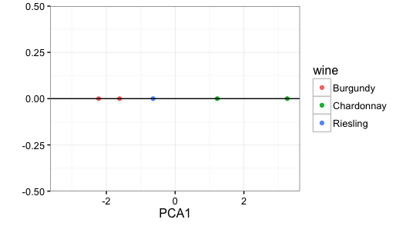
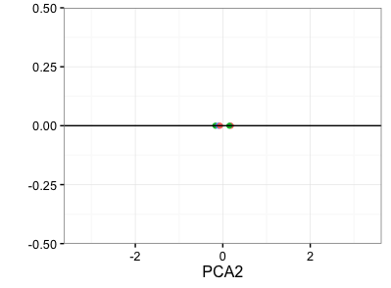
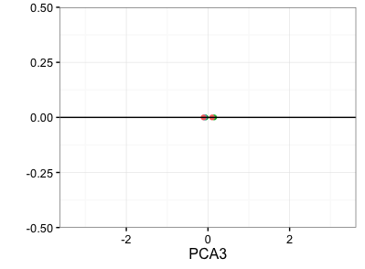
5. Transform/Rotate your data around picked PC’s
PCA1 – best discriminator
PCA2 – worse discriminator
PCA3 – worst discriminator
But: the fewer dimensions the more loss of information…

Slide 20
6. How to interpret your PCA’s
Loadings of the PCA’s show importance of original factors for data discrimination
PC1 PC2
a 0.2429645 0.9190116
b 0.5156843 0.1487096
c 0.8216070 -0.3651069

Slide 21
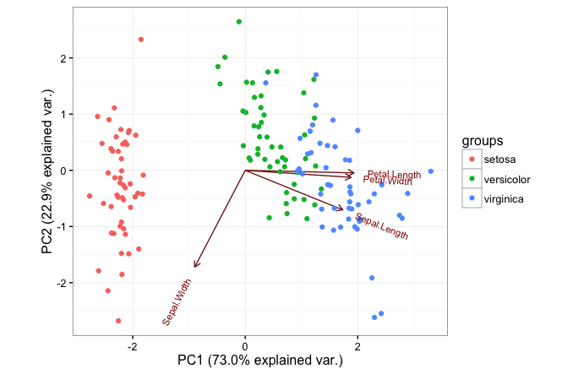
7. How to do it in R
library(devtools)
install_github("vqv/ggbiplot")
library(ggbiplot)
iris <- iris
pca_iris <- prcomp(iris[,1:4], scale=T)
species <- iris$Species
pca_iris
summary(pca_iris)
ggbiplot(pca_iris, choices = 1:2,obs.scale = 1, var.scale = 1, groups = species)+
theme_bw()

Slide 22
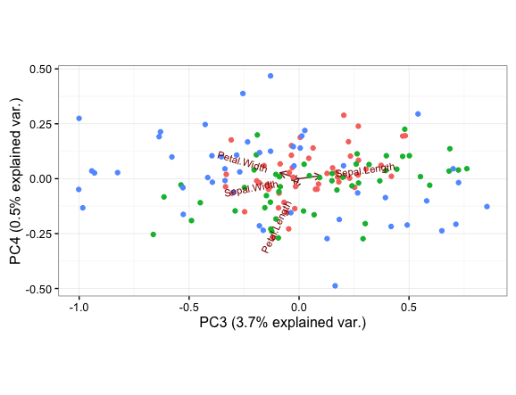
7. How to do it in R
ggbiplot(pca_iris, choices = 1:2,obs.scale = 1, var.scale = 1, groups = species)+
theme_bw()
ggbiplot(pca_iris, choices = 3:4,obs.scale = 1, var.scale = 1, groups = species)+
theme_bw()

