Slide 1
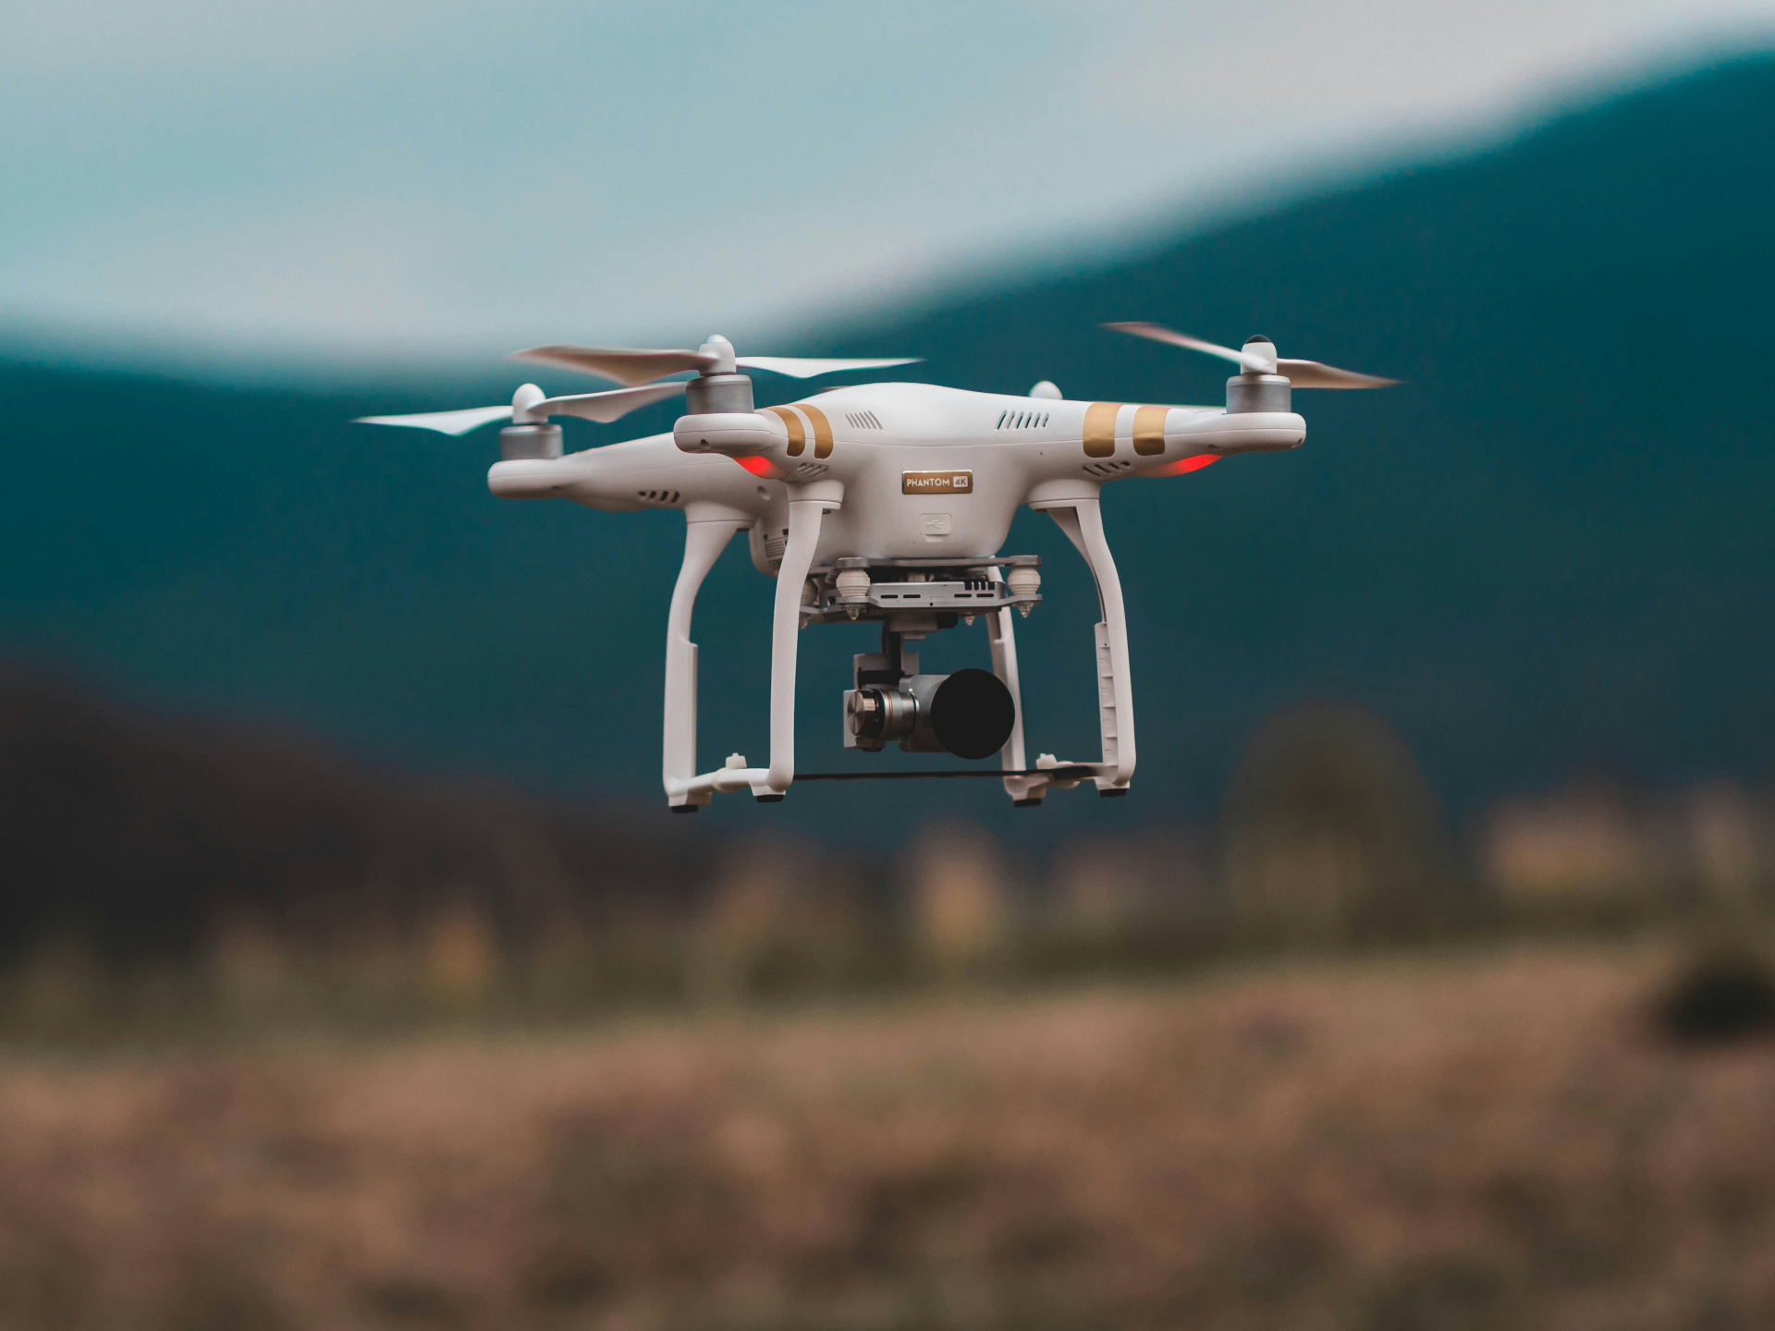
Leveraging LLMs for Adaptive and Secure UAV Control
PhD Dissertation Proposal
Balakrishnan Dharmalingam
Oakland University, 2025
DAC Members:
Dr. Anyi Liu
Dr. Subra Ganesan
Dr. Xiaodong Deng
Dr. Mohammad Wardat

Slide 2
Outline
Introduction and background
Research Problems
Research Objectives
Approach
Methodology
Contribution
Timeline
Q&A

Slide 3
Acknowledgements
Would like to thank Dr. Anyi Liu and Dr. Subra Ganesan for their valuable guidance and advice
Would like to thank Dr. Deng and Dr. Wardat for their comments and feedback
Would like to recognize OU Students Ibrahim, Sid, Brett, and Raj for their contribution to collect sensor data, fine tuning LLMs

Slide 4
Introduction and Background
UAV – Definition
Applications
Control Mechanisms
PID, MPC
Challenges

Slide 5
UAV
Unmanned Aerial Vehicles
Drones, VTOL, Fixed Wing planes
Autonomous
Components
UAV, GCS, Radio Telemetry, Onboard computer, power bank
Onboard Sensors such as GPS, LiDAR, Cameras, Inertial Measurement Unit (IMU)
Applications
Military
Surveillance
Precision strikes
Reconnaissance
Disaster management
Navigating hazardous environment
Agricultural Monitoring
Consumer applications
Package Delivery
Aerial Photography

Slide 6
UAV Flight Management Systems
Firmware
ArduPilot
PixHawk (PX4)
NuttX OS – Linux like OS
System architecture in Appendix

Slide 7
Control Mechanisms
Proportional Integral Differential (PID) Controllers
Changes the outputs of actuators based on sensor feedback
Details in Appendix
Model Prediction Control (MPC)
Optimize control within a prediction horizon
Effective in structured contexts but less effective in
Adverse weather
Evolving mission requirements
Lack adaptability in dynamic/unpredictable settings
Require extensive data, calibration, domain knowledge
Not scalable
May not work on all UAV platforms or mission profiles

Slide 8
Challenges
Adaptive Control
Dynamic Environment - Weather, Obstacles, etc.
Maintains flight and mission performance stable
Cyber Security
Flight Management Systems lack Cyber Security
Adversaries inject malicious data thru GCS, Wi-Fi, GPS Spoofing

Slide 9
Large Language Models
Large – Data and hyper parameters (Weights and Bias)
Natural Language processing (NLP)
In-context learning
Contextual reasoning
Infers patterns from data
Adapts to new tasks with minimal additional training
Can be finetuned for different problem domain
E.g., Llama 4, DeepSeek, GPT-5, Grok 4, Anthropic Sonnet

Slide 10
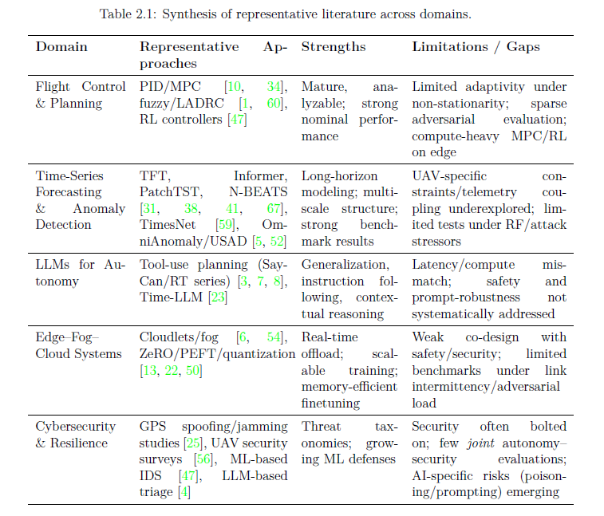
State of the Art

Slide 11
Literature Review
Control Vs. Security
Control engineers focus on stability and gain margins; security researchers focus on threat models. The interaction between controllers and security measures is rarely analyzed.
LLM Practicality
Data Gaps
Most LLM applications for robotics are proofs of concept. Questions about latency, energy use, and resilience under attack remain wide open for real-time drone deployment.
There is a lack of datasets combining flight telemetry, network traces, and annotated attacks, making it difficult to gauge robustness against adversaries.

Slide 12
Research Gap
Not many research done on using LLMs to control UAVs
Not many research on distributed architecture to overcome limited computing resources in UAVs

Slide 13
UAV Control using LLMs
LLMs can:
Integrate diverse data streams (sensors, commands, regulations)
Detect cyber anomalies using historical data
Optimize flight trajectories in response to real-time updates
Dynamically revise decision rules and self-adjust

Slide 14
Research Problems
Investigate integrating LLMs into UAV control systems to enhance adaptability, autonomy, and cybersecurity.
Integration of LLMs into UAV systems is challenging
Focus: Can LLMs enhance adaptability, autonomy, cybersecurity in UAVs?

Slide 15
Research Objectives
Obj 1: Collect dataset using simulations (HITL/SITL), hacking, fuzzing.
Obj 2: Utilize LLM for MITM attacks, generate fake data for training.
Obj 3: Finetune LLMs using PEFT, RLHF, SFT for anomaly detection, path optimization, threats.
Obj 4: Use LLMs for anomaly detection, forecasting; select task-specific models.
Obj 5: Evaluate framework vs. traditional controls (precision, recall, F1, accuracy, latency, resilience).

Slide 16
Publications
B. Dharmalingam, A. Liu, S. Ganesan, and S. Roy. FineObfuscator: Defeating reverse engineering attacks with context-sensitive and cost-efficient obfuscation for android apps. In 2022 IEEE International Conference on Electro Information Technology(eIT), pages 368–374, 2022. doi: 10.1109/eIT53891.2022.9837111.
B. Piggott, S. Patil, G. Feng, I. Odat, R. Mukherjee, B. Dharmalingam, and A. Liu. Net-gpt: A llm-empowered man-in-the-middle chatbot for nmanned aerial vehicle. In 2023 IEEE/ACM Symposium on Edge Computing (SEC), pages 287–293, 2023. doi: 10.1145/3583740.3626809
B. Dharmalingam, I. Odat, R. Mukherjee, B. Piggott and A. Liu, "Heterogeneous Generative Dataset for UASes," 2023 IEEE International Conference on Mobility, Operations, Services and Technologies (MOST), Detroit, MI, USA, 2023, pp. 229-230, doi: 10.1109/MOST57249.2023.00034.
B. Dharmalingam, B. Piggott, G. Feng, R. Mukherjee, and A. Liu. Aero-llm: A distributed framework for secure uav communication and intelligent decision-making. In Proceedings of the ICCCN 2024 Conference. IEEE, 2024.

Slide 17
Contributions
Construct HGDAVE dataset for UASes (CAVs/UAVs).
Design LLM-powered MITM chatbot (Net-GPT).
Optimize task-specific LLMs using SFT/RLHF.
Develop distributed LLM architecture for UAV missions.
Implement anomaly detection using LLM.
Evaluate framework in real/simulated scenarios.
Benchmark Aero-LLM vs. standard controllers.

Slide 18
Approach
Collect comprehensive data from sensors
Pre-process the data - Missing data, normalizing data, extrapolating, remove noise, etc.
Select LLM models for Time series data
Finetune foundational model with UAV sensor data collected
Use Ubuntu with GPU
Use cloud containers with GPU
Use the finetuned model for controlling UAV and anomaly detection

Slide 19
Methodology – Data Collection
GCS, Simulation, Physical hacking, Fuzzing, TCP, UDP, MavLink
Pre-process sensor/TCP/UDP data
Select foundation models for tuning
Header fields selected for fine tuning

Slide 20
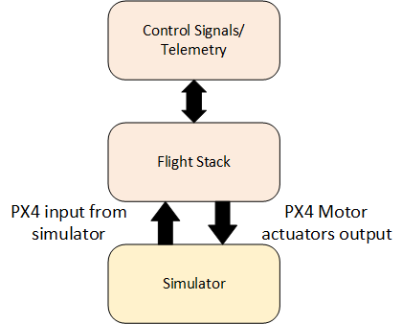
Methodology - Simulation
PX4 Autopilot Firmware
Simulation Types: SITL (software-only), HITL (hardware-integrated).
Simulators:
Gazebo
jMavSim

Slide 21
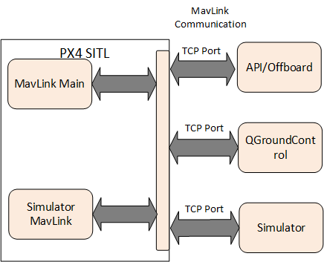
Methodology - SITL
SITL Setup: Run on computer, simulators like Gazebo.

Slide 22
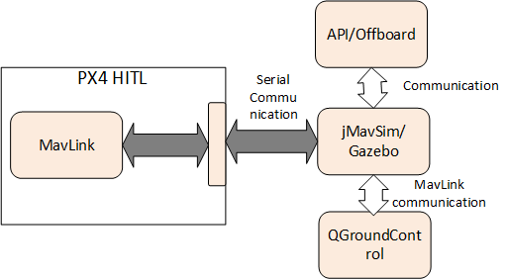
Methodology - HITL
HITL Setup: Real hardware + simulator for validation.

Slide 23
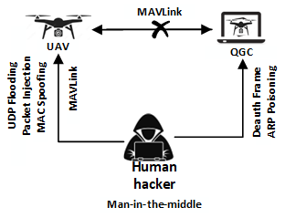
Methodology – Manual Hacking

Slide 24
Methodology - Fuzzing
PGFuzz
Manipulates input data from three different sets:
Commands
Parameters
Environmental factors

Slide 25
LLM - Finetuning
Sensor data is Time Series data
LLM for Time Series
Timesnet
Time-LLM
Based on Llama-2-7B
QLoRA
RLHF

Slide 26
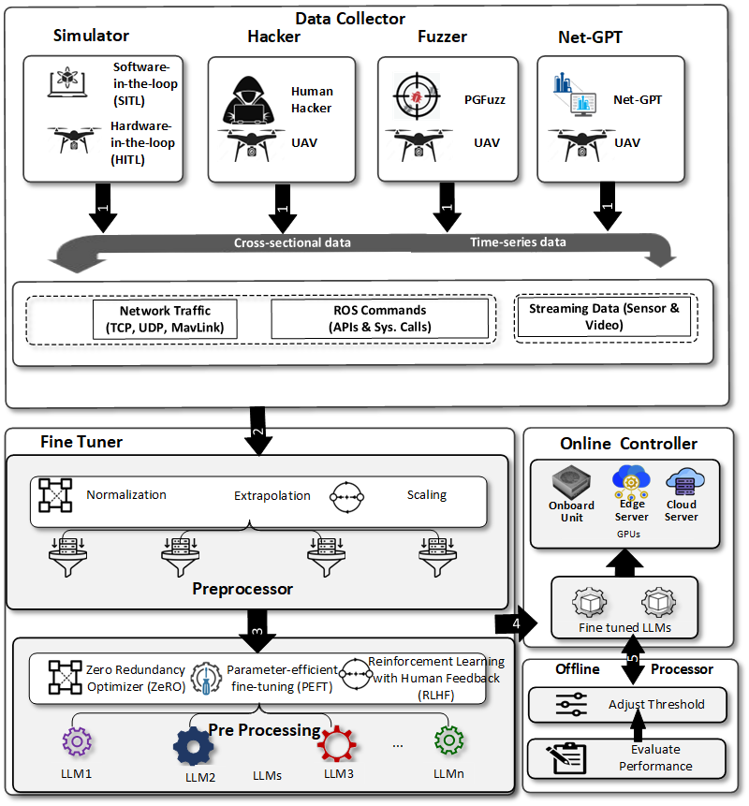
System Architecture

Slide 27
System Design
Data Collector
Integration: LLM generates commands via offboard control (MAVLink messages).
Data: µORB topics (position, attitude, sensors), MAVLink traffic.
Generation: Adverse weather, obstacles, missions for training.

Slide 28
System Design
Fine tuner
Preprocessor: Preprocess collected data
Fine tune: Train foundation models using preprocessed data
Deploy fine tuned models
Onboard
Edge
Cloud

Slide 29
System Design
Online Controller
Monitor sensor data
Infer if anomalous
Mitigate attack

Slide 30
System Design
Offline Processor
Evaluate performance
Adjust parameters if needed

Slide 31
Threat Model
Attacks: Network (jamming/spoofing/MITM), sensor manipulation, software vulns, insider threats.
Infrastructure: Reliable network, GPUs at edge/cloud.
Launched Attacks: MAC spoofing, session hijacking, etc. (C, P, I, A impacted).

Slide 32




Threat Model
Network Attacks
Unauthorized access, data breaches, and disruption of communication channels.
Adversaries may attempt to tamper with or spoof sensor data, leading to incorrect decisions and catastrophic consequences.
Sensor Manipulation Attacks
Software/firmware vulnerabilities may lead to the compromise of confidentiality, integrity, availability and authenticity of the UAV system.
Software vulnerabilities
Malicious insiders with access to the UAV system potentially sabotage operations or leak sensitive information.
Insider threats

Slide 33
Fine Tuning
Process: Train foundation model with domain data for prompt-based inference.
Data: TCP/UDP (headers: ports, seq, ack), MavLink sensors (time-series from Ulog to CSV).
Models: TimesNet (anomaly), Time-LLM (forecasting).
Techniques: SFT, RLHF, QLORA (params in table 3.4).

Slide 34
Fine Tuning
Research Paper:
B. Dharmalingam, B. Piggott, G. Feng, R. Mukherjee, and A. Liu. Aero-LLM: A distributed framework for secure UAV communication and intelligent decision-making. In Proceedings of the ICCCN 2024 Conference. IEEE, 2024
2 Models for different tasks:
TimesNet – Anomaly Detection
TimesLLM – Forecasting

Slide 35
Fine Tuning - TimesNet
TimesNet Tuning
Collect UAV sensor data, such as altitude and GPS coordinates
Preprocess data that includes imputation of missing values and feature scaling
Divide the dataset into subsets, ensuring a mix of normal and anomalous points, and label them
Initialize with pre-trained weights, then set the fine-tuning parameters, such as sequence length and learning rate
Training on the dataset until performance plateaus
The refined model is saved and ready for real-time anomaly detection in UAV operations

Slide 36
Fine Tuning – Time-LLM
Time-LLM Tuning
Collect UAV sensor data, such as IMU
Preprocess data filling in missing values, normalization
Divide the dataset into training, validation, and test subsets
Initialize with pre-trained weights, then set the fine-tuning parameters, such as sequence length and learning rate
Tokenize data to match Time-LLM's language
Train on the dataset until performance plateaus
Evaluate on the test set to gauge its forecasting performance such as accuracy and precision by calculating MAE and MSE
The optimized model is saved for future predictions

Slide 37
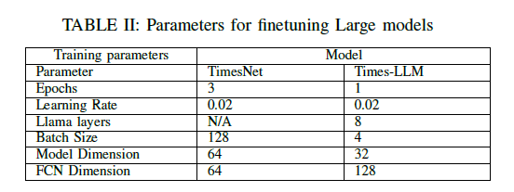
Parameters for Fine Tuning

Slide 38
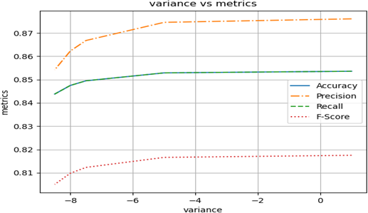
Metrics
Variance of Anomalous Data
Resilience of TimesNet Model
Can handle variations in the data without significant degradation in performance
Performance Metrics Stability
Metrics remain largely unaffected despite the variance
Effective Anomaly Detection
Consistently identifies anomalies effectively

Slide 39
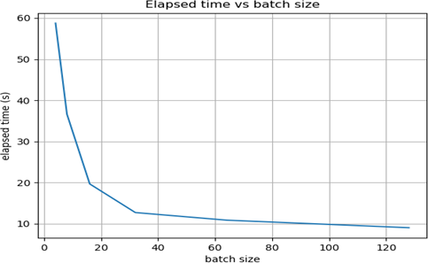
Metrics
Impact of Batch Size
Batch Size of 48 and Above
Batch sizes of 48 and higher significantly reduce the elapsed processing time
Increasing the batch size beyond 48 does not proportionally reduce the elapsed time
Optimization Insights
Larger batch sizes no longer contribute to significant time savings.
Batch size of 48 is optimal for balancing performance and processing efficiency.

Slide 40
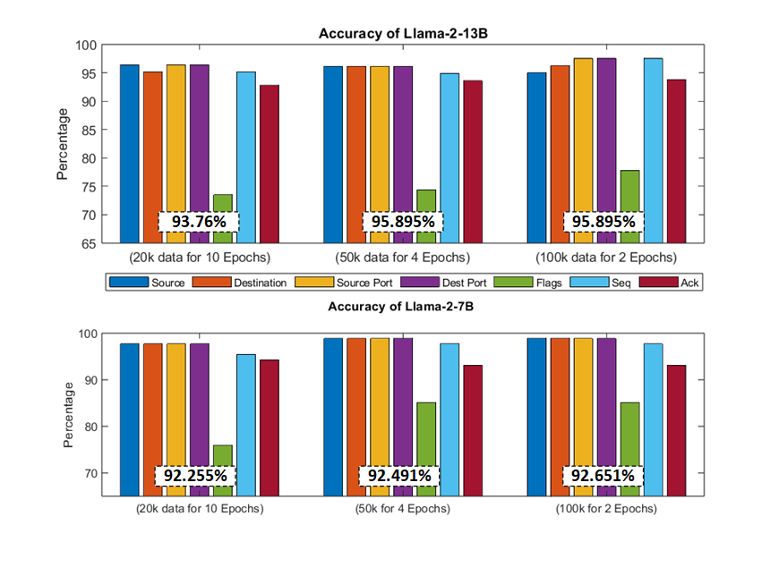
Metrics

Slide 41
Framework Design
Distributed: Onboard (lightweight for anomaly/decisions), Edge (fusion/analysis), Cloud (analysis/simulations).
Subsystems: Data Collector, Fine-Tuner (pre-processing), Online Controller, Offline Processor.
Workflow: Collect → Preprocess → Tune → Deploy → Evaluate → Harden.

Slide 42
Approach
Models: TimesNet (sentinel), Time-LLM (forecaster), LLM Toolformer (policy).
Foundations: SFT, RLHF, ZeRO/PEFT for efficiency.
Data Pipeline: Acquisition, Preprocessing, Feature Eng.
Distributed: Onboard (low latency), Edge (higher capacity), Cloud (batch).
Assumptions: PX4 stack, intermittent links, heterogeneous compute, adversaries.

Slide 43
Current & Expected Outcomes
HGDAVE Dataset: For UASes, from scripts, fuzzing, exploits; use Digital Twin.
Robust, relevant for LLM training.

Slide 44
Outcomes - Malicious UAV Model (Net-GPT)
Analyzes/executes MITM; synthetic packets via LLMs.
Evaluation: Llama-2-13B/7B ~95% accuracy; smaller models ~75%.
Cost-Efficiency: Analyzed for configs (fig 4.1).

Slide 45






Timeline – Roadmap
Apr 2023
Apr 2024
Nov 2025
HGDAVE
NetGPT
Dissertion Propoal
Collect Network and Mavlink Sensor Data and publish paper
Design Net-GPT using LLM and publish paper
Proposal Defense Presentation
FineTune LLM
Aero-LLM
Dissertation Defense
Fine tune timeseries based LLM foundation models and publish paper
Design Aero-LLM distributed framework and publish paper
Defend Dissertation
Dec 2023
Dec 2024
Dec 2025
Notes:
© Copyright PresentationGO.com – The free PowerPoint and Google Slides template library

Slide 46
Q&A
- Thank you for your attention.
- Questions?

Slide 47
References
Haixu Wu, undefined., et al, "TimesNet: Temporal 2D-Variation Modeling for General Time Series Analysis," in International Conference on Learning Representations, 2023.
Jin, M., et al, "Time-LLM: Time series forecasting by reprogramming large language models," in International Conference on Learning Representations (ICLR), 2024.
X. Liu, undefined. H. Ning, undefined. Y. Xu. "A Survey on Industrial Internet of Things: A Cyber-Physical Systems Perspective," in IEEE Internet of Things Journal, vol. 6, no. 5, pp. 855-869, 2024.
S. Gupta, undefined. P. Kumar. "Enhancing CPS Architectures with SOA for Industry 4.0 Enterprise Applications," in IEEE Transactions on Industrial Informatics, vol. 10, no. 3, pp. 567-580, 2024.
R. Patel, undefined. M. Gupta. "AI and IoT in Industry 4.0: Trends and Applications," in Springer AI and Industry Journal, vol. 15, no. 4, pp. 210-230, 2024.
M. Zhang, undefined. Q. Wei. "A Systematic Review of Data Quality in CPS and IoT for Industry 4.0," in International Journal of Data Quality, vol. 8, no. 2, pp. 123-145, 2024.
Shumaila Javaid, undefined. Nasir Saeed, undefined. Bin He, "Large Language Models for UAVs: Current State and Pathways to the Future," 2024.

Slide 48

PX4 Autopilot
System Architecture

Slide 49
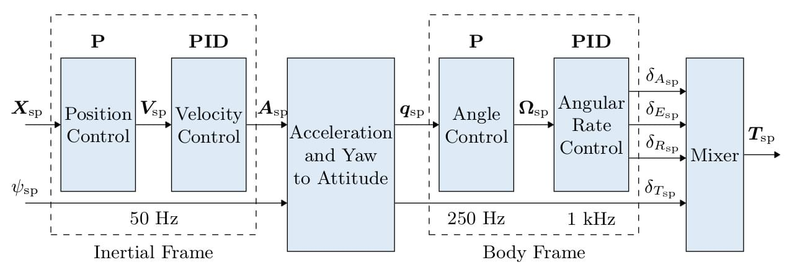
Multicopter Control Architecture

Slide 50
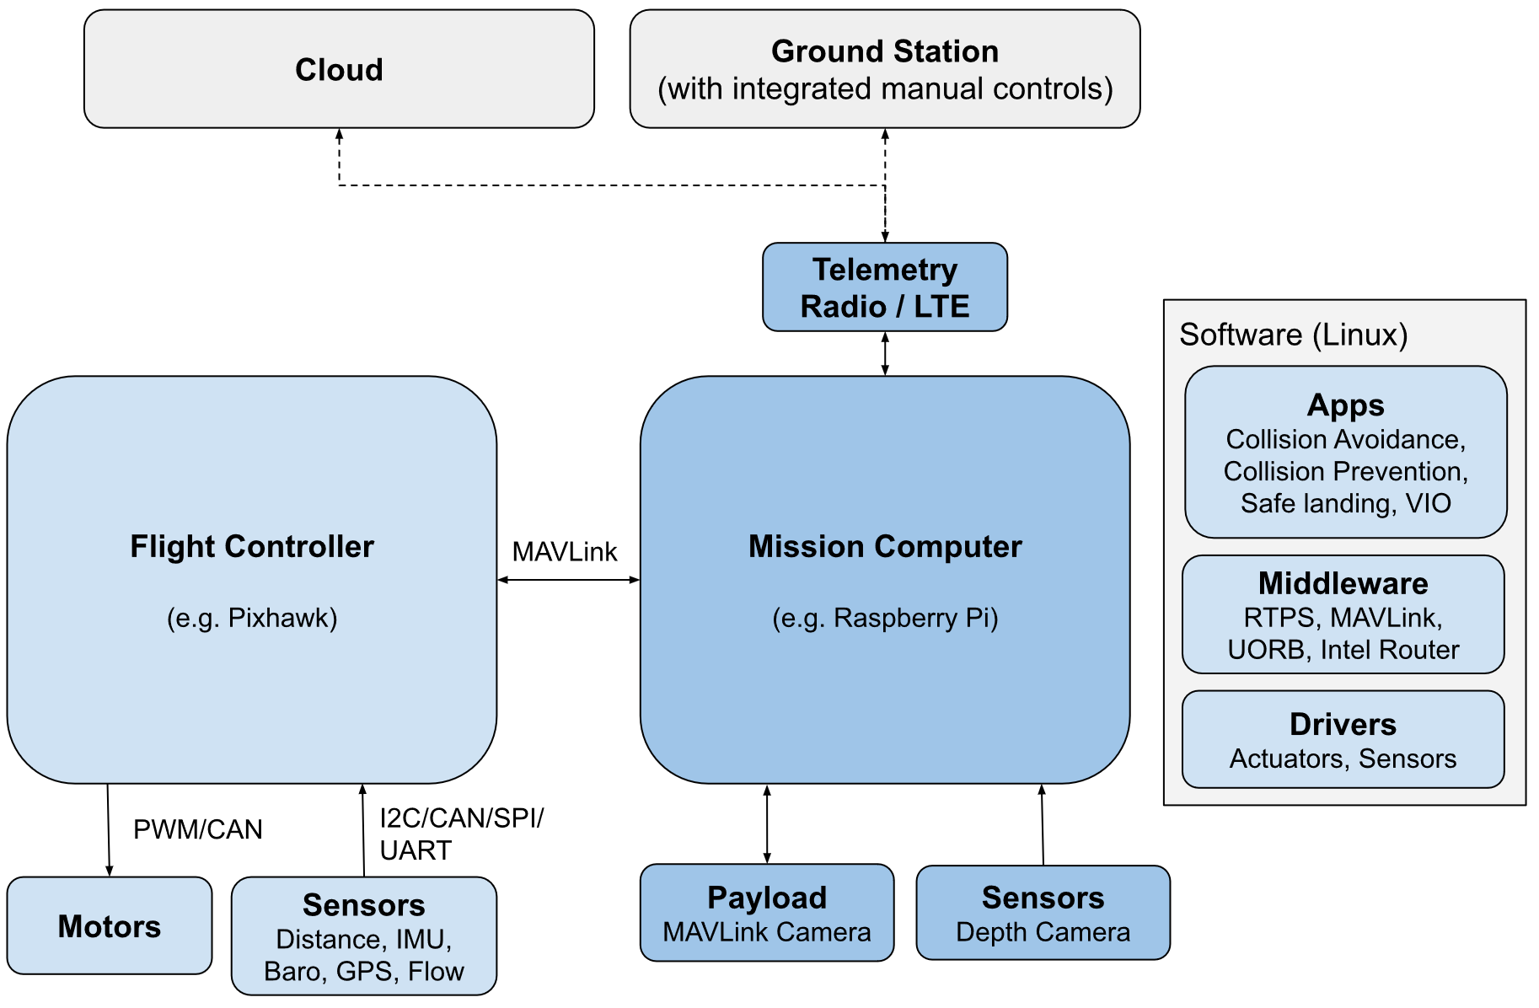
FC and Companion Computer

Slide 51
Fine Tuning - Implementation
Ubuntu 22.04
Python 3.12
PyTorch
Nvidia RTX 4090 GPU

Slide 52
Code Repo
FineTuning code in GitHub
https://github.com/dbalki/px4.git
https://github.com/dbalki/handshakeGPT.git

