Slide 1
Min Color Graph Exact Solution
Hunter Bowles and Dylan Ballard

Slide 2
What is the Problem?
Decision:
The Min Color Graph can be summarized in a decision problem like “can graph G be colored using k colors?”
Optimization:
As an optimization problem, this can be reframed to more accurately reflect the issue:
“What is the fewest number of colors such that each vertex is not adjacent to a vertex with the same color?”

Slide 3
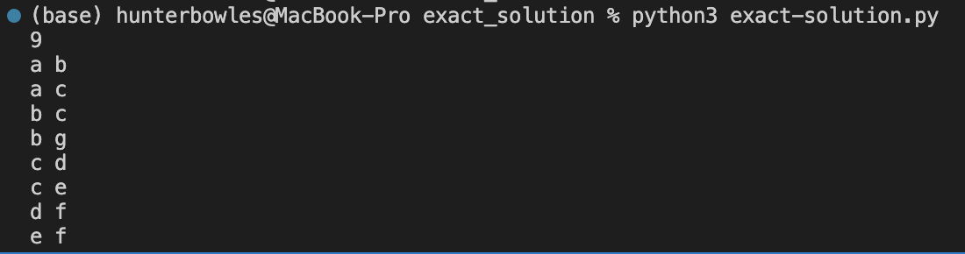
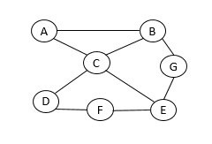
Inputs
A short sample input (that isn’t what was provided by Doctor Molloy) would be as follows:
As you can see, there are 9 edges.
The graph would look like this (uncolored):

Slide 4
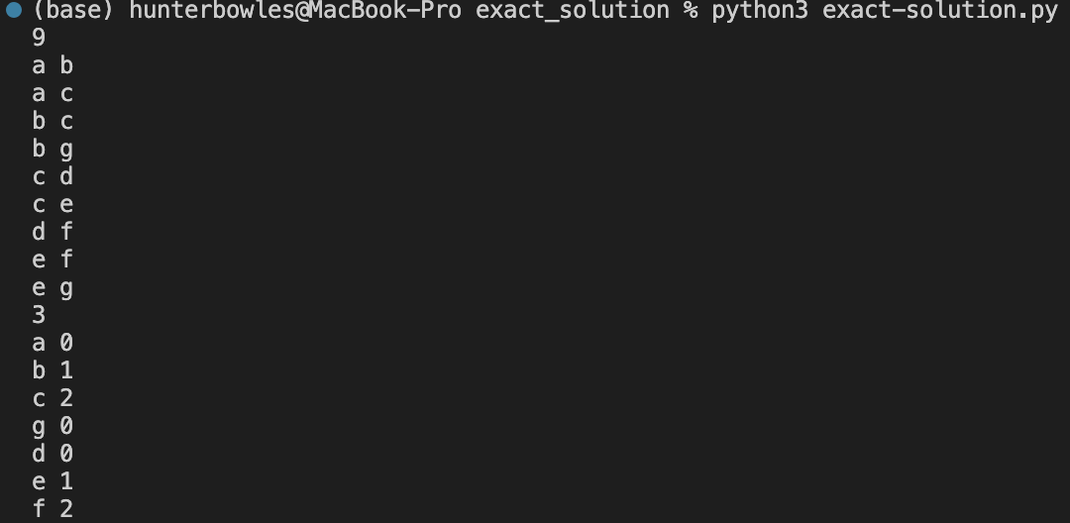
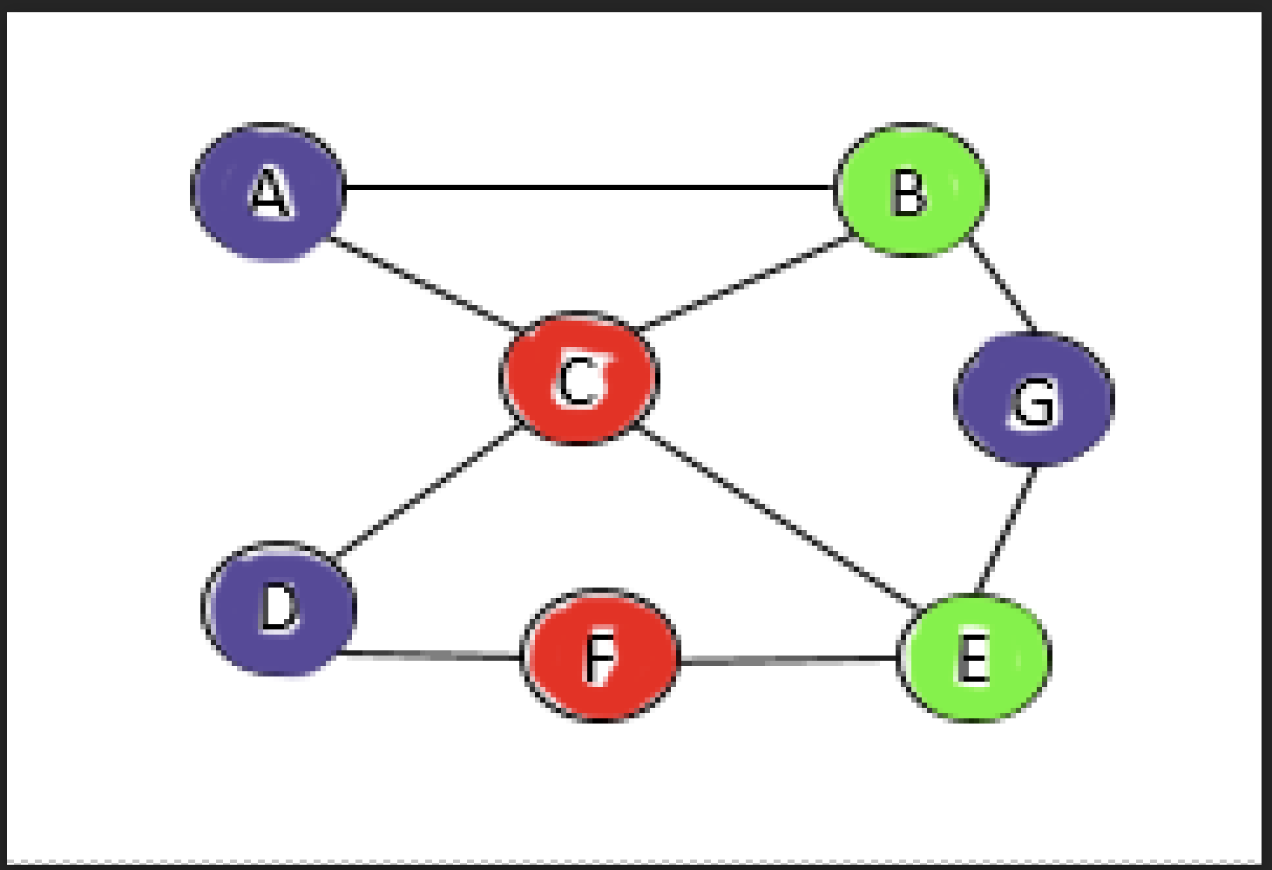
Outputs
The input of the previous slide would product the following output:
As before, the graph now looks like:

Slide 5
Practical Applications?
Some real practical uses of min color graphs include:
Scheduling
Sudoku
Determining if a graph is bipartite
And more!

Slide 6
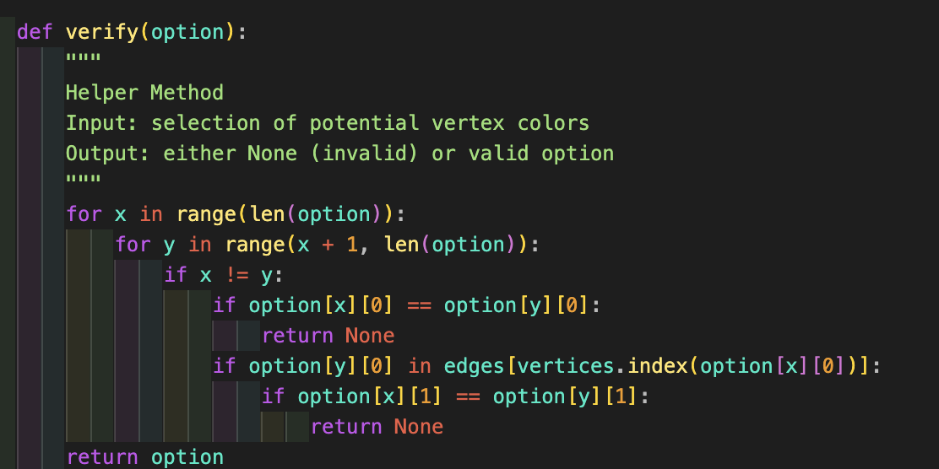
The Certifier Process:
Our certifier is encapsulated in the verify(option) method

Slide 7
Reduction
Independent Set ≤_{p} Min Color Graph
Min Color Graph can be reduced to the known NP-Complete Problem of Independent Set because each color on the graph is an Independent Set. If you just find the minimum number of Independent Sets on the graph such that every vertex is used exactly once, then you have found the minimum number of colors to color the graph (examples on next slide)
Notes:
I’m so sorry for this slide. I’m very tired and most likely will not sleep teh night before presenting this project.

Slide 8
EXAMPLES!!!
Take this graph from earlier:
{A,D,G} is an IS
{C,F} is too
So is {B,E}
That’s all the vertices

Slide 9
Our Coded Solution Explained
The Exact Solution to Min Color Graph follows a Brute Force Method:
Assemble every combination of colors and vertices
Check every graph that could be formed using these pairings
Find one that meets the criteria of a Min Color Graph
There you go

Slide 10
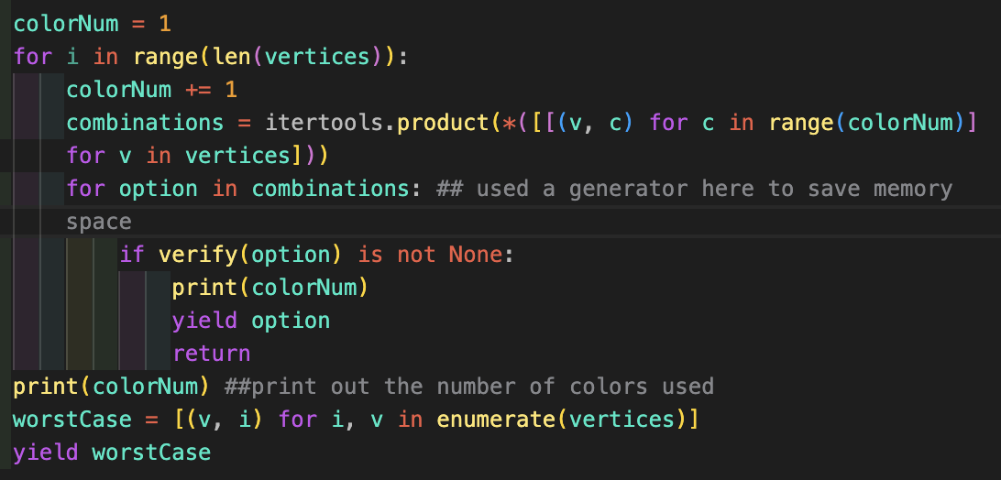
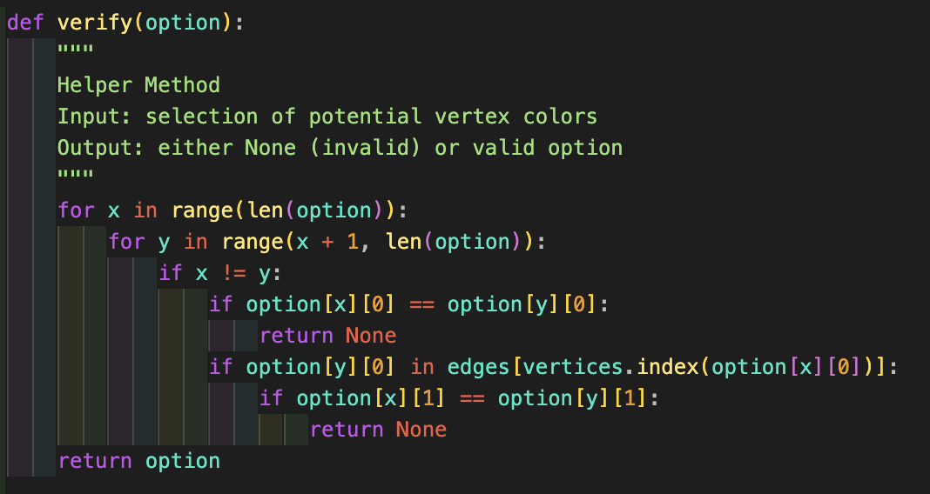
Big O time
The Big O runtime for this solution is O(n^3), since in the worst case scenario the program runs through every vertex 3 separate times
The dominant term in this program is as follows, in MinColorExact:
Along with this, from verify:

Slide 11
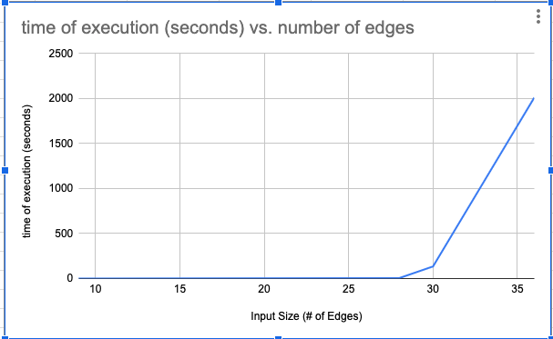
Wall Clock Time

