Slide 1
Min Graph Coloring
Approximation Solution
By: Dylan Ballard

Slide 2
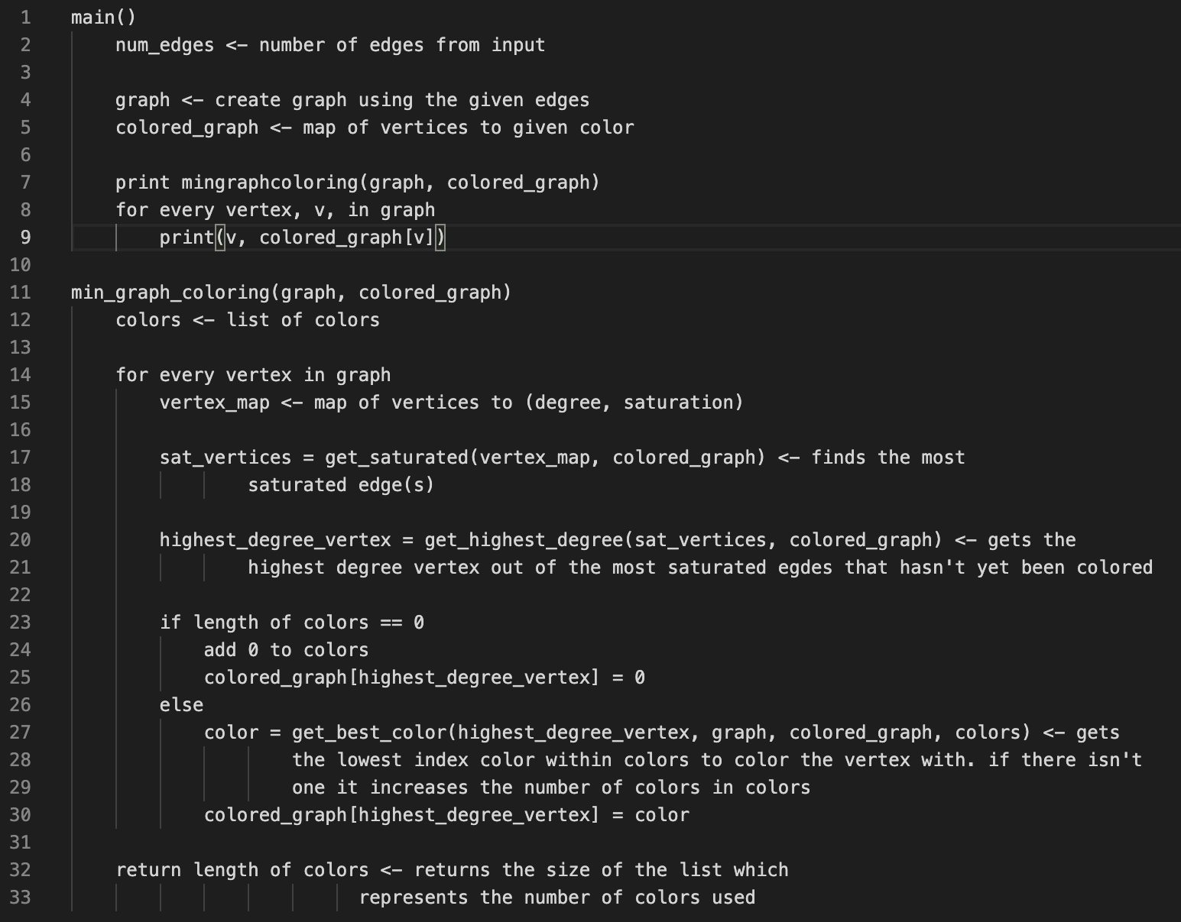
How it works
This approximation is a greedy solution to the min graph coloring solution.
Finds the most saturated vertex.
If there is more than 1 most saturated edge, it selects the highest degree vertex.
Assigns a color to the chosen vertex.
Repeats this process until

Slide 3
Analytical Run Time Analysis
- Creating the graph takes O(E), for the number of edges
- Approximation loops through every vertex, O(n)
- Creating vertex the map, O(n)
- To find the most saturated vertices, check all vertices connect to
vertex, v, which in the worst case runs in O(n)
- Finding the highest degree vertex will check through all of the most
saturated vertices, which in the worst case runs in O(n)
- Finally, to find the color to assign to the vertex will check all of the
vertices it’s connected to so it will take O(n) time.
- Therefore, O((V * (V + V + V + V)) + E) = O(V * 4V + E) = O(4V^2) = O(V^2)

Slide 4
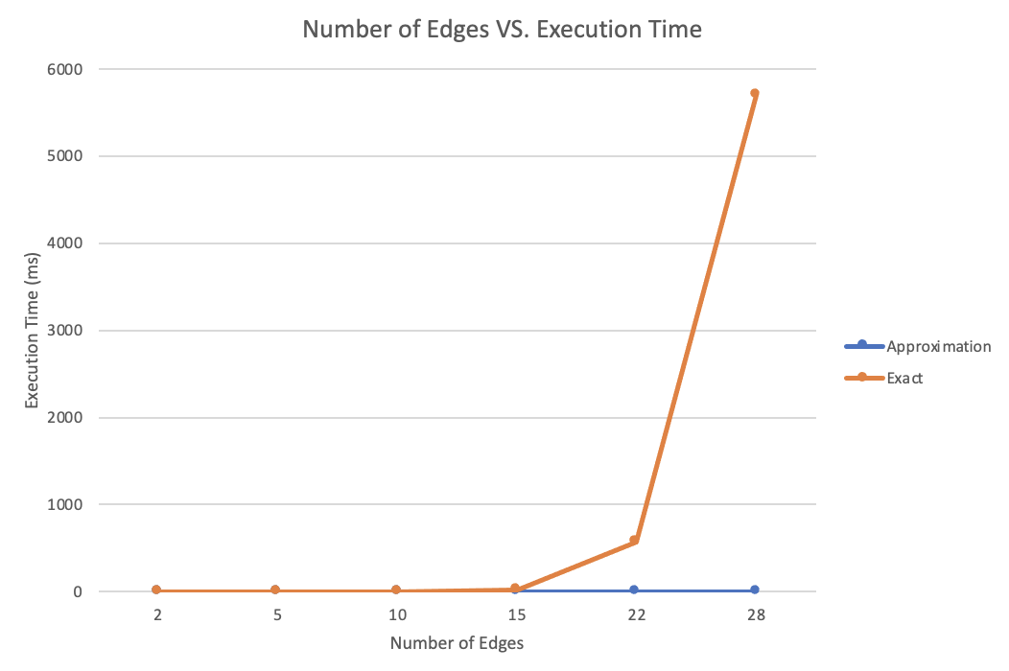
Analysis Pt. 1

Slide 5
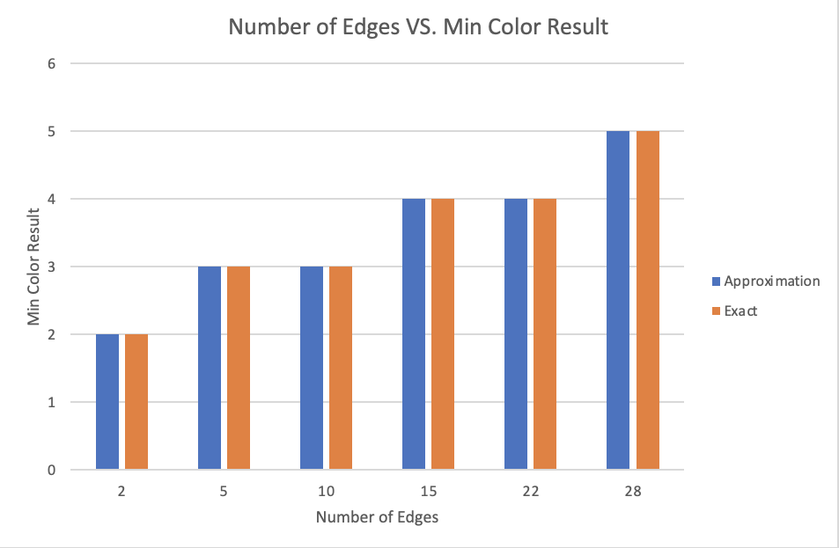
Analysis Pt. 2

Slide 6
Works Cited
Rule, Parker J. “Approximate Graph Coloring.” Approximate Graph Coloring, 7 Aug. 2020, https://pjrule.me/comp150-alg/.

