Slide 1
Project objectives
Find e-mails network relations between senders and recipients and the working groups/communities based on the the e-mail communications using graph theory.
Text mining of the e-mails content and topics using Latent Dirichlet allocation (LDA).

Slide 2
Data set
The dataset used for analyses are the Enron emails’ which are public available and can be downloaded from http://www.cs.cmu.edu/~enron/
The emails are from 150 people in text format, one file per e-mail.
Files/directories structure
on directory per employee.
subdirectories which correspond to the e-mail directories: sent, inbox, deleted_items, any users’ email directories.

Slide 3
Methodology – network analyses
Email network analyses/working groups using igraph package
Use the e-mails from the sent directories from each employee to create a frequency matrix.
Rows represent the sender and columns represent the receivers which can be in all the receiver email fields: To, Cc and Bcc.
Transform the frequency matrix to a directed graph representation.
Plot the raw and reduced graphs.
Find the communities/working groups.
Display members of specific community.

Slide 4
Company main activities/topics
Merge all the e-mails content in one file per employee :
Include only the e-mails’ content and e-mails’ subject.
The content from reply part is deleted if exist.
Delete the e-mails’ lines which have: e-mail addresses, subject, bcc, ---
Create a corpus with all emails’ content files using tm package.
Clean the tm corpus data: transform lowercase, delete punctuation, white spaces, stop words, delete specific words from a list file and stemming the words.
Find the main 4 topics using LDA from topicsmodels package.

Slide 5
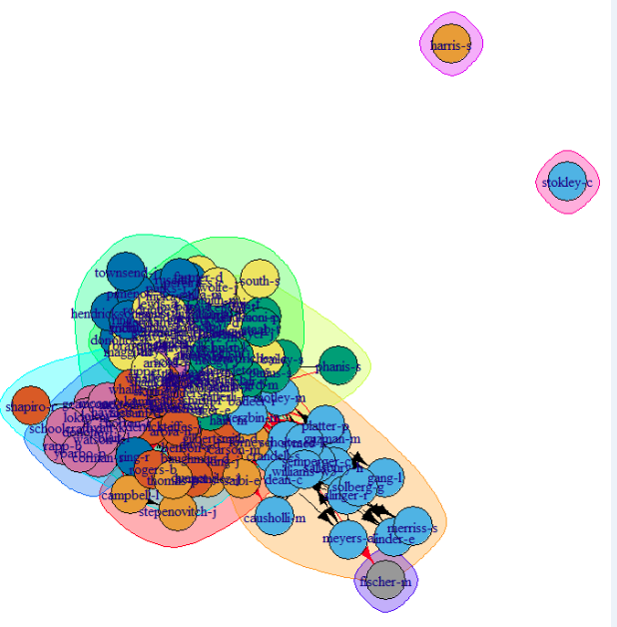
Email working groups
Working groups based on the e-mails frequencies created with igraph package from R

Slide 6
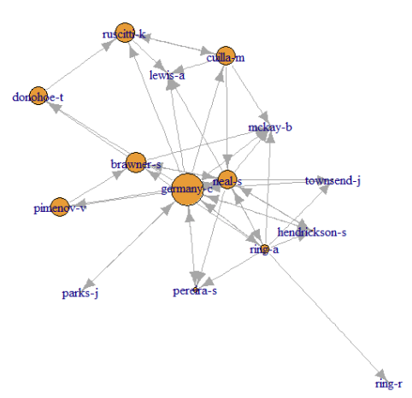
Details of the largest working group
Graph display for the largest working group.
The node size is proportional with the betweeness centrality of the node/employee in the working group (community).
More plots can be found on the github repository.

Slide 7
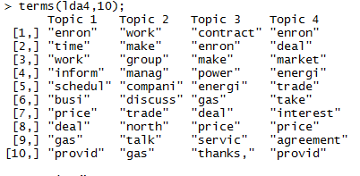
Companies/working group main topics
Top 10 words for the 4 possible topics.
Notice that the principal activities are related to enron, work, price, deal, gas, provid, company, trade, gas, power, energi, service, market, interest, agreement which reflect the Enron main activities.

Slide 8
Conclusion
Network analyses/working group can be extracted/defined using graph analyses based on the e-mails frequencies.
Company/groups main activity is not very well defined only from email content analyses, but provide a good general overview. Maybe a different algorithm for the topics can provide more narrow details, but there is a good probability that the data available in e-mails is not good enough for topics text analyses.
All the code used and the output files are available on github at: https://github.com/dbancea/enron-email-analyses

