Slide 1
Introduction
Find the working group, communities in a company using the e-mail communications
Find the company main activities by extracting the main topics from e-mails’ content

Slide 2
Techniques used
Working groups
use graph theories to analyze and find the communities in a graph
Company activity based on e-mail topics
text analyzes with topics generation/creation

Slide 3
Data set
The dataset used for analyzes are the Enron email’s which are public available.
The emails are from 150 people in text format, one file per e-mail.
Files/directories structure
on directory per employee
subdirectories which correspond to the e-mail directory like: sent, inbox, deleted_items, any custom email directories.

Slide 4
Methodology – network analyses
Email network analyses – working groups
used sent directories from each employee to create a directed graph matrix
Rows represent the sender and columns represent the receivers which can be in all the receiver email fields: To, Cc and Bcc.

Slide 5
Company main activities/topics
Create one file per employee which has only the e-mails content. And e-mail subject.
The content from reply part is deleted if exist.
Delete the e-mails lines which have: e-mail addresses, subject, bcc, ---
Create a corpus with all email content files using tm package
Clean the tm corpus data: transorm lowercase, delete punctuation, white spaces, stop words, specific words saved in a file, stemming the words.
Find the main 4 topics using LDA from topicsmodels package.

Slide 6
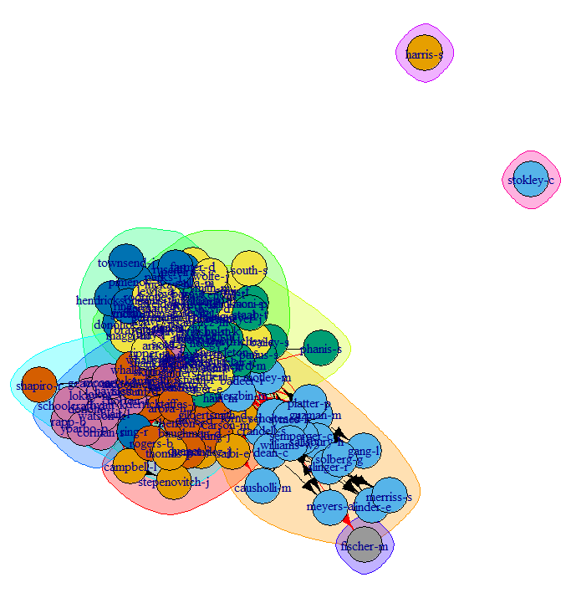
Email working groups
Working groups based on the e-mails frequencies created with igraph package from R

Slide 7
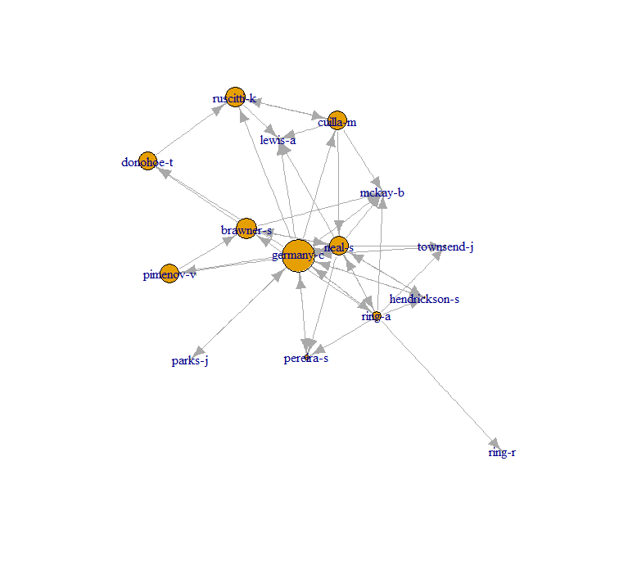
Details of the largest working group
Graph display for the largest working group.
The ??largest node/employee is proportional with the betweeness/centrality of the node/employee in the working group (community).

Slide 8
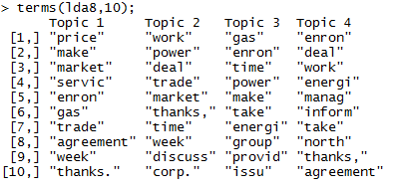
Companies/working group main topics
Top 10 words for the 4 possible topics.
Notice that the principal activities are related to gas, energy, trade, market, price, power, agreement which reflect the Enron main activity.

Slide 9
Conclusion
Network analyses/working group can be extracted/defined using graph analyses based on the e-mails traffic/frequencies.
Company/groups main activity is not very well defined only from email content analyses, but provide a good general overview. Maybe a different algorithm used for the topics can provide more narrow details, but there is a good probability that the data available in e-mails is not good enough for this type analyses.
All the code used and the output files are availe on github at: https://github.com/dbancea/enron-email-analyses

