Slide 1
--------------------------------
Building a Chatbot with Serverless Computing
--------------------------------
Khushboo (Khushi)
Student ID-300437942
NWEN 406
7 August 2017

Slide 2
Content
---------------
Main Idea & Motivation
Openwhisk
Chatbot
Future Research Challenges
Related Work
Questions

Slide 3
Main Idea
-------------
AI application like Chatbot use a serverless computing to facilitate the building process and the deployment process.
Developers can construct stateless functions together to execute useful actions in the serverless platform.

Slide 4
Motivation
---------------
The emerging of the chatbots market requires developers not only build the chatbots easily but also deploy easily.
Developers need to find a solution to handle the extensibility, scalability, and maintenance of the AI application.

Slide 5
OPENWHISK
------------------
OpenWhisk is a serverless platform from IBM.
It is freely available in Open Source.
Developers can write functions using a variety of Languages like Javascript,Swift,Python,Java.

Slide 6
OpenWhisk Basic Programming Model
----------------------------------------------------
The OpenWhisk Model is based on three Primitives:
Action - is a stateless function that can be invoked asynchronously or synchronously.
Trigger - is a class of events that come from a variety of sources.
Rule - is a class of events that come from a variety of sources.

Slide 7
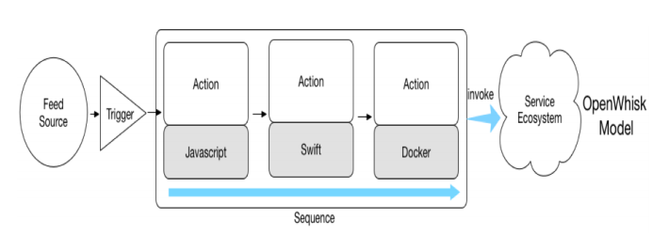
OpenWhisk Basic Programming Model
-----------------------------------------------------------
The three actions written in different languages are chained together into a sequence.
The output of one action is piped to the input of another action.
Actions can be grouped together into packages to create a service that can be invoked from other actions.

Slide 8
CHATBOT
-------------
Cloud providers are offering a growing number of Cognitive Services.
One such popular AI application is a “chatbot,” which uses a conversational interface to interact with the user.
Serverless Computing is an ideal platform for building extensible Chatbots.

Slide 9
CHATBOT- Architecture
--------------------------------
The basic architecture consists of three levels of serverless actions and a microservice endpoint.-
The first level of processing is Audio I/O,
The second level of processing is Text I/O.
The third level of processing is for domain specific chatbot “Abilities.”

Slide 10
Levels of Serverless Actions
---------------------------------------
Audio I/O - converts user audio input to text, and vice versa.
Text I/O - is responsible for routing the user input to the correct set of serverless actions
“Abilities” - Each ability has to do at least two things.
It must convert the raw user input into a parameterized function call.
It takes the parameters and invokes one or more actions to handle the input.

Slide 11
CHATBOT- Prototype
-----------------------------
The six Abilities that span different Application Paradigms:
News.
Jokes.
Date.
Weather.
Music Tutor.
An Alarm Service.

Slide 12
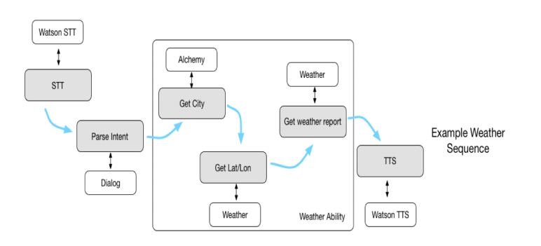
CHATBOT- Prototype
-----------------------------
The Weather Ability -
The Shaded Blocks - OpenWhisk actions.
The White Blocks - endpoints used by the actions.
A Box - separate common routing code from domain-specific ability code.
Actions -
STT action - convert the audio data to text and uses the Watson Speech-to-Text service.
The Parse Intent action - interact with the Watson Dialog Service (WDS).
TTS action - generate a speech string.
Weather Flow Example

Slide 13
Basic Structure of the Weather Ability
-----------------------------------------------------
It consists of an OpenWhisk Sequence of three actions -
The Get City action - detect the city in question.
The Get Lat/Lon action - identify the longitude and latitude points for the detected city.
The Get Weather Report action - get a weather report from the longitude and latitude points specified.

Slide 14
Basic Structure of the Weather Ability
-----------------------------------------------------
Response from the Weather Service -
It is a human readable weather report.
Once the appropriate weather report is fetched.
TTS action is used to generate a Base64 encoded speech string.
The string is stored as an audio file locally and played to the user.

Slide 15
RESEARCH CHALLENGES
-----------------------------------
Composing Serverless Functions lacks certain Aspects
Programing & Debugging - Composing a series of functions and Lack of tooling.
Performance - providing QoS guarantees is hard.
Monitoring - execution of their functions is directly mapped to a cost model .
Security - understanding potential sources of information leakage and ensure that protected information remains safe and Token management is also an issue.

Slide 16
Related Work
-------------------
People have been using chatbot since the 1960s but it becomes more significant recently because of the dominant of the mobile market.
AWS (Amazon Web Services) Lambda is the pioneer of the serverless platform market.
Besides OpenWhisk, OpenLambda is also an open source serverless platform.

Slide 17
Questions
----------------

Slide 18
Thank You!
----------------
Khushi :)

