Slide 1
Kafka versus RabbitMQ
Marc Laroza
Mohsen Javaher
14/08/17

Slide 2
Apache Kafka vs RabbitMQ
How do they compare against each other?
Which one to use?
Notes:
Marc
Apache Kafka and RabbitMQ are two popular open-source and commercially-supported pub/sub systems that have been around for almost a decade.
The popularity of these two systems, have established many common frequently asked question by many people online: How do they compare against each other and which one to use for certain applications?
By Philippe Dobberlaere and Kyumars Esmaili

Slide 3
Introduction
Brief description and core functionalities of pub/sub systems.
High-level description of both Apache Kafka and RabbitMQ.
Qualitative and quantitative of the common features of the two systems.
Most important features that are unique from the two systems.
Use case classes that are best-suited for Apache Kafka or RabbitMQ.
Notes:
Marc
Throughout our presentation, we will provide a holistic information that we have acquired from the industry paper and try to answer the two commonly asked questions that I have mentioned from the last slide.
Since both Kafka and RabbitMQ are branded as a pub/sub system it is appropriate to establish common framework or basic knowledge of what pub/sub systems are and their functionalities.
We next enumerate a number of use case classes that are best-suited for Kafka or RabbitMQ. The authors of the paper have proposed some options for a combined use of the two systems. Also, they have provided a determination table to help choose the best architecture when given a particular set of requirements.

Slide 4
Main idea of industry paper: Kafka versus RabbitMQ
Comparing the core functionalities between Apache Kafka and RabbitMQ.
Comparing high level description such as: Apache Kafka architecture & RabbitMQ architecture, Apache Kafka implementation and RabbitMQ implementation.
Comparing both Apache Kafka and RabbitMQ in terms of time efficient and benefits.
Notes:
Mohsen
The Point of this slide is to give students a brief explanation of what has been cover in the Industry Paper: Kafka versus RabbitMQ article and later on explain the behaviour of these bullet points

Slide 5
Main idea of industry paper: Kafka versus RabbitMQ
Point out the common features of Apache Kafka and RabbitMQ.
Point out the features unique to Apache Kafka and RabbitMQ. We talk about the benefits of Apache Kafka and RabbitMQ.
Briefly talk about the best suited use case for Apache Kafka and RabbitMQ. Where do they get get applied?
Notes:
Mohsen
The Point of this slide is to give students a brief explanation of where does it get apply and what are the benefits and the features of using these two apaches and why they should use it :)

Slide 6
Problems & constraints
The demand for more elastic communication approaches and systems that illustrate the dynamic and decoupled nature of the systems.
The demand for interoperability of various asynchronous messaging middleware systems.
Notes:
Mohsen
The motivation of this paper is to solve the communication approaches where they are dynamically implemented.
What I mean by dynamically implemented is that for example we have a post on a wall of our website and then there are people subscribing the post and they keep publishing messages so we need a system that illustrate a dynamic pattern.

Slide 7
Motivations
The traditional point to point synchronous communication results in rigid and static applications which makes it difficult to scale up to dynamic applications.
We need to reduce the burden of application designers, the high coupling between the different entities in such large-scale settings should be transferred to a particular middleware system based on an competent communication scheme.
The publish/subscribe interaction scheme provides the loosely coupled form of interaction required in such large scale settings.
Notes:
Marc

Slide 8
Background: Pub/Sub System
The main idea of the publish/subscribe pattern, it’s required and desired guarantees as well as some of its achievement out there.
Publish/subscribe is a distributed interaction pattern well suited to the deployment of loosely coupled and scalable systems.
Decoupling the publishers and subscribers is the most basic feature of a pub/sub system.
Another core functionality of pub/sub systems is routing logic (also known as subscription model) which decides if and where a packet that is coming from a producer will end up at a consumer.
Notes:
Mohsen
The publish-subscribe pattern (or pub/sub, for short) is a Ruby on Rails messaging pattern where senders of messages (publishers), do not program the messages to be sent directly to specific receivers (subscribers).
Coupling of producers being separated from consumers and that
Decoupling can happen in a number of ways:
Logical decoupling: would be an example where the produce and the consumer actually don't know anything about each other where their share no context whatsoever except all the routing information
Temporal decoupling: The example of this would be if you listen to this with the recording of this webinar in a couple of weeks time or from Monday I believe it will be available the message was sent off today on the 14th of August and you might be listening in to it in some view today

Slide 9
Publish/Subscribe System (Example Code)
function publish_subscriber_demo() {
this._lastID = 0;
this._queue = {};
}
publish_subscriber_demo.prototype.register = function(callback) {
var id = 'CID_' + this._lastID++;
this._queue[id] = callback;
return id;
};
publish_subscriber_demo.prototype.publish = function(action) {
for (var id in this._queue) {
this._queue[id](action);
}
};
var pul = new publish_subscriber_demo () ;
pul.register(function(ms){console.log("sub one is getting the msg :" +ms)}) ;
pul.register(function(ms){console.log("sub two is getting the msg :" + ms )}) ;
pul.register(function(ms){console.log("sub three is getting the msg :" +ms )})
pul.publish("welcome to NWEN 406"); // We changing the action of the publisher by passing a value as an argument
console.log("the next announcements:")
pul.publish("welcome to COMP 361"); // We changing the action of the publisher by passing a value as an argument
Notes:
Mohsen
In this slide I provided you guys a javascript code which is kind of an explanatory of how the publishing and the subscribing systems work.
For the real pub/sub systems there are multiple servers and they keep track of the request and the messages will publish however in the code above I just made a queue data structure which will keep track of the people who have already subscribed a post and they would like to publish a message or messages in the post that they following so as a summary one of the most important key of the pub/sub systems is that if a person has subscribed a post and then he/she is in the subscribing system then they can request to publish a message and these requests will be tracked in a queue so the person who has tried to publish a message earlier than the other people will be at the top of the queue (first in first out).

Slide 10
Examples of related work based on the same topic
In IBM MQ pub/sub, a sub is a system that requests all the informations about a particular topic from a queue manager in a pub/sub network. A subscriber can be given messages, about any type of topics, from multiple publishers.
In IBM MQ pub/sub, a publisher is a system that makes information about a particular topic obtainable to a queue manager in the form of a standard IBM MQ message called a publication. A publisher can broadcast information about multiple topics.
Notes:
Mohsen

Slide 11
What is Kafka?
Kafka is a distributed and scalable publish/subscribe system.
Lets you publish and subscribe to streams of records. This is the same as message queue or enterprise messaging system.
Also, lets you store streams of records in a fault-tolerant way and process them as they occur.
Kafka is designed to handle high throughput and low-latency platform for handling real-time data feeds.
Notes:
Marc
Kafka is a distributed publish/subscribe system, that means that there are data are published into it and consumed by other machines. Kafka has some interesting feature that are focus on big data
It lets you publish and subscribe to streams of records. In this respect it is similar to a message queue or enterprise messaging system (messaging system allowing software applications and systems to communicate semantically. The semantics can be applied by sending precise messages to and from throughout the enterprise).
Kafka is designed to handle high throughput (billions of messages). In its design, particular attention has been paid to the efficient handling of multiple consumers of the same stream that read at different speeds.

Slide 12
What is Kafka developed by?
Kafka is originally developed at LinkedIn as its centralized event pipelining platform.
In 2011, Kafka became an open-source and has evolved and established itself as a popular tool for building real time data pipelines and streaming apps.
Notes:
Marc
Kafka has evolved and established itself as a popular tool for building real time data pipelines. Now it’s securing and sharing real time applications.

Slide 13
Kafka Components
Topic
is a category of feed names to which messages are stored and published.
can have multiple partitions.
Partitions
for each topic, Kafka maintains partition logs which contains messages that are sequentially ordered.
Kafka Message Broker
is a Kafka cluster that consists of one or more servers. They receive messages from the producer and store these messages.
Producers
are processes which publish data to a topic of their choice in the Kafka Broker.
does not need to know all the downstream processing that has to happen.
Consumers
reads messages published under topics from the Kafka broker and process it.
labelled themselves with consumer groupname.
they have to be subscribe into a topic to gain the data or messages.
Notes:
Marc
Topic: is a category feed name to which messages are stored and published and can have multiple partitions.
Partitions: for each topic, Kafka maintains at least one partitioned log files. For every partitioned logs contains messages in an unchangeable sequence and each message is identified by its unique sequential ID called offset. These partitions are replicated over a few servers which in turn form the Kafka broker.
Kafka Broker: is a Kafka cluster that consists of one or more servers. The kafka broker is the middleware program of the system. They receive the messages from the producer, then stores and manages these messages.
Producers: are processes which publish data to a topic of their choice within a topic. The producers makes a particular message and sends these messages to the kafka message broker under a chosen partition. The producers does not have to know all the downstream processing that has to happen, all it has to do is to send the message to the broker and the broker will handle all the distribution and communications with the subscribers or consumers
Consumers: reads messages published under topics from the Kafka broker. The consumer process the message and do whatever they want to do with it. Consumers label themselves with a consumer groupname. Messages are delivered to one consumer instance within each subscribing consumer group

Slide 14
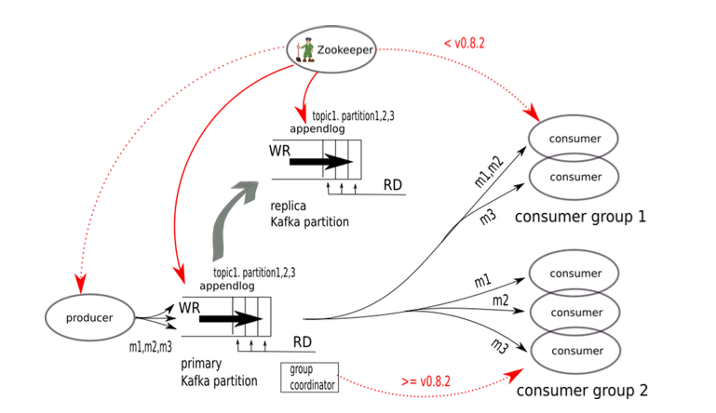
Kafka Architecture
Notes:
Marc

Slide 15
What is RabbitMQ?
RabbitMQ is a message broker software.
It’s a popular open-source and monetary-supported publish or subscribe systems.
It has been useful for transactional behavior.
It has been support for asynchronous batch transfer.
supports a degree of coupling between producers and consumers
Notes:
Mohsen
Messaging is a way of dealing with data in internet. example: people use it to scale applications. Market data which is a form of monitoring you might use messaging if you want to send a box of data to a lots of people at the same time. OR you might want things to be done in a certain order another reason that people use messaging is because it provides a seriality guarantees so you can use it in transaction systems for guaranteeing the order specially in distributed system that can be very important
It takes messages and it sends them to other places.
In computer programming, a message broker is an intermediary program module that translates a message from the formal messaging protocol of the sender to the formal messaging protocol of the receiver
Examples:
In a topic-based system, messages are published to "topics" or named logical channels. Subscribers in a topic-based system will receive all messages published to the topics to which they subscribe, and all subscribers to a topic will receive the same messages. ... The subscriber is responsible for classifying the messages.

Slide 16
What is RabbitMQ developed by?
The RabbitMQ server is written in the Erlang programming language.
Also, RabbitMQ is built on the Open Telecom Platform framework for clustering and failover.
primarily known used as an efficient and scalable implementation of the Advanced Message Queuing Protocol (AMQP).
Notes:
Mohsen
Erlang is a general-purpose, concurrent, functional programming language, as well as a garbage-collected runtime system.The Erlang runtime system is known for its designs that are well suited for systems with the following characteristics: Distributed.

Slide 17
RabbitMQ Implementation
RabbitMQ is much closer to the classic messaging systems.
Takes care of most of the consumption bookkeeping.
Its main design goal is to handle messages in DRAM memory.
The queue logic is optimized for empty-or-nearly-empty queues and the performance degrades significantly if messages are allowed to accumulate
Notes:
Mohsen
For example it takes care of when or what time the message has been sent to the queue or it keeps track of when or what time the message has been opened by the consumers and etc.
Dynamic random-access memory (DRAM) is a type of random-access memory that stores each bit of data in a separate capacitor within an integrated circuit.

Slide 18
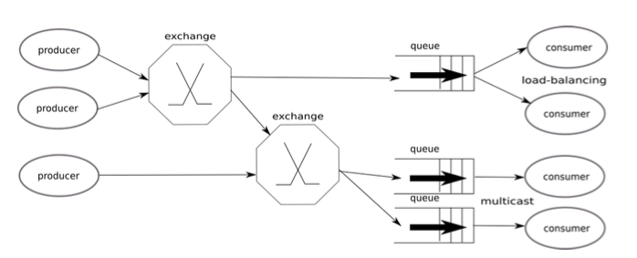
RabbitMQ Architecture
Notes:
Mohsen
There always a certain amount of questions
-Who is the producer?
-Who is the consumer?
-What are they?
-What happens if the channel becomes unavailable or becomes interrupted
The producer can be anything could be a divinest process some agent on a machine and
The Exchange would be the broker and the member of the audience would be the consumer of this message and they shuffle the messages around and send them to the correct Queue potentially duplicating them better than low points as the message actually suitable at the exchange
The next step is the finding queues are related to the exchanges via binding. Quese themselves have little logic in them all they do is offer up messages until consumers choose to pick them off the queue
So the protocol spoken between the consumer and the cubes mpq
The protocol spoken between the producers and exchanges AMQP
The lines connecting the exchanges and the queues are binding
However in this architecture we are not covering all the possible cases because when we are sending a message as a producer and it passes through the exchanges and it gets published and at the end when the consumer is getting the message what would happen if they want to reply something.

Slide 19
Qualitative Comparison : Kafka and RabbitMQ
Time Decoupling:
Kafka - Designed with various consumption rates and is much better positioned to handle a wider scale of time decoupling.
RabbitMQ - Stores message in DRAM. But once it’s fully consumed, it will start to store messages on disk which will severely impact the performance.
Routing Logic:
Kafka - Supports a basic form of topic-based routing.
RabbitMQ - Flexible topic-based exchange that support multipart “a.b.c” topic-based routing with wildcard support and content-based exchange.
Delivery Guarantees:
Kafka - “at least once” without order.
RabbitMQ - “at least once” with order.
Ordering Guarantees:
Kafka - order is conserved only inside a partition.
RabbitMQ - flows are ordered using a single AMQP channel. Retransmitted packets are reordered inside its queue logic.
Notes:
Mohsen & Marc
This is the qualitative comparison of Kafka and RabbitMQ across a number of common pub/sub features.
Time Decoupling:
Kafka - specifically designed with the various consumption rates requirements in mind and hence is much better positioned to handle a wider scale of time decoupling.
RabbitMQ - stores messages in DRAM as long as possible but once the available DRAM is completely consumed. RabbitMQ will start storing messages on disk without a copy in DRAM, which will severely impact performance.
Routing Logic:
Kafka - it supports a basic form of topic-based routing. The producer controls which partition it publishes messages to. This can be done at random (i.e. load balancing) or by some partitioning function by allowing the user to specify a partition-by key and using this to hash to a partition.
RabbitMQ - RabbitMQ provides a number of different exchange types, most notably: (i) a very flexible topic- based exchange (of type topic) that supports multipart “a.b.c” topic- based routing with wildcard support (“*” for one part and “#” for an arbitrary number of parts), (ii) a content-based exchange (of type header ).
Delivery Guarantees:
“At least once” is a mode that means guarantee no loss. The system will make sure that no packets get lost. Recovery from failures might cause duplicate packets to be sent, possibly out-of-order.
Kafka - Kafka cannot preserve order when sending multiple partitions.
RabbitMQ -RabbitMQ sorts messages when writing them to queue structures, meaning that lost messages can be correctly delivered in order without the need to resend the full batch that lost 1 or more messages.
Ordering Guarantees:
Kafka - Kafka will conserve order only inside a partition.
RabbitMQ - RabbitMQ will conserve order for flows (a sequence of messages that is to be processed) using a single AMQP channel. It also reorders retransmitted packets inside its queue logic so that a consumer does not need to resequence buffers.

Slide 20
cont. Qualitative Comparison : Kafka and RabbitMQ
Availability:
Kafka - Availability requires running the system with a suitably high replication factor.
RabbitMQ - Can be configured to replicate all the exchange and binding informations.
Transactions:
Kafka - Does not support transactions.
RabbitMQ - Transaction only applies to publishes and acks.
Multicast:
Kafka - Multicast logic is handled completely at the consumer side.
RabbitMQ - Supports multicast by providing a dedicated queue per individual consumer.
Dynamic Scaling:
Kafka - User can decide to move existing partitions to the newly added nodes to the cluster. Adding nodes to Kafka clusters are not transparent to consumers.
RabbitMQ - Adding additional nodes to running clusters or removing a node from a cluster is well supported. Adding nodes is transparent to the users.
Notes:
Mohsen & Marc
Availability: (Both Kafka and RabbitMQ provide availability via replication)
Kafka - For Kafka, availability requires running the system with a suitably high replication factor.
RabbitMQ - RabbitMQ Clusters can be configured to replicate all the exchange and binding information. However, it will not automatically create mirrored queues (RabbitMQ’s terminology for replicated queues) and will require explicit setting during queue creation.
Transactions:
Kafka - Kafka currently does not support transactions. However, a proposal to extend it with this feature in the future releases has recently been adopted.
RabbitMQ - AMQP transactions only apply to publishes and acks. RabbitMQ has additionally made rejection transactional. On the consuming side, the acknowledgments are transactional, not the consuming of the messages themselves. AMQP guarantees atomicity only when transactions involve a single queue. RabbitMQ provides no atomicity guarantees even in case of transactions involving just a single queue
Multicast:
Kafka - In Kafka, only one copy of messages within a topic is maintained in the brokers (in non-replicated settings); however, the multicast logic is handled completely at the consumer side.
RabbitMQ - RabbitMQ supports multicast by providing a dedicated queue per individual consumer. As a result, the only impact on the system is that there is an increased number of bindings to support these individual queues.
Dynamic Scaling:
Kafka - In Kafka, upon adding new nodes to the cluster, the user can decide to move existing partitions to the new node. In that case, a new replica is created on the new node and once it has caught up, the old replica of the partition can be deleted. Adding nodes to a Kafka cluster is not transparent for consumers, since there needs to be a mapping from partitions to consumers in a consumer group.
RabbitMQ - For RabbitMQ, adding additional nodes to running clusters or re- moving a node from a cluster is well supported. Adding nodes in a RabbitMQ cluster is transparent for consumers.

Slide 21
Quantitative Comparison : Kafka
Latency Results
Latency in ‘At Most Once Mode’
The latency values will rapidly increase when consumers are slower than producers.
Kafka runs on JVM which severely impacts the latency. Especially, if the messages are large which can cause longer garbage collection pauses.
Latency in ‘At Least Once Mode’
The latency increases in case of replication.
Summary:
Reading from OS cache:
At most once mode: below 10ms.
At least once mode: twice as large.
Reading from disk, grow up to 100ms.
Notes:
Marc
On this part, is the quantitative comparison of the two systems based on their efficiency/performance. According to the authors that the efficiency is primarily measures in terms of latency and throughput.
At Most Once mode: “best effort”, guarantees no-duplicates
This mode, under normal operating conditions, packets will be delivered but during failure packet loss might occur. Trying to do better than this will always cost system resources so this mode has the best throughput.
At Least Once mode: guarantees no-loss
This mode, the system will make sure that no packets get lost. Recovery from failures might cause duplicate packets to be sent, possibly out-of-order.
At Most Once mode:
When consumers are slower than producers (which can be a common case), packets will have to be transferred from disk to cache before a read completes. Even with an architecture that profits from sequential disk access, the latency values will rapidly increase, not only for the slow consumer where the effect is not important but also for fast consumers that will see their cache trashed.
Another factor that can severely impact Kafka latencies is the fact that Kafka runs on the JVM and large messages can cause longer garbage collection pauses as Kafka allocates large chunks.
At Least Once mode:
The latency increases in case of replication since Kafka only delivers messages to consumers when they are acknowledged by a quorum of the active replicas
Kafka’s latency depends on the mode it is using and from which location it is reading. So, if it can read from OS cache, its latency for at most once mode is below 10ms and about twice as large for the at least once mode. However, when it reads from disk, its latency can grow by up to an order of magnitude to around 100ms.

Slide 22
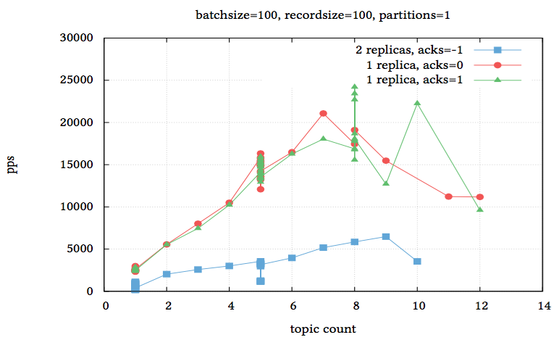
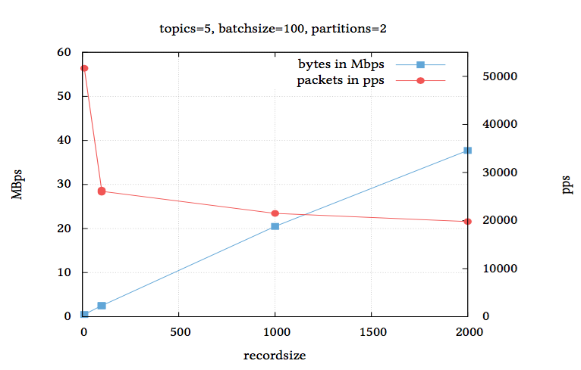
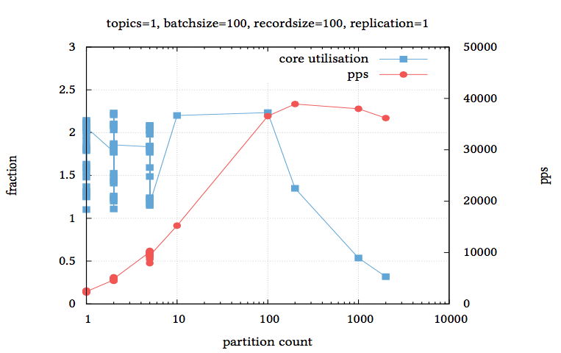
Quantitative Comparison : Kafka
Throughput Results
Throughput in ‘At Most Once Mode’
Three important factors for measuring throughput of Kafka are record size, partition count and topic count.
Notes:
Marc
Shows how the record size influences the throughput of Kafka. The throughput in bytes per unit of time has a linear relation to the record size.
Shows how the throughput of Kafka is impacted by the number of topics. Based on the graph, it is a linear relation and with a higher topic count, performance diminishes.
Shows the throughput of Kafka as a function of partition counts. Its slopes taper offs at about 10 and the curve peaks at 200 partitions.

Slide 23
Quantitative Comparison : Kafka
Throughput Results
Throughput in ‘At Least Once Mode’
The only way to get truly reliable message delivery with Kafka is running it in a mode where acknowledges are sent only if a batch has been written to the disk medium, or has been received by a quorum of replicas.
Kafka’s throughput in at least once mode decreases by 50% to 75% compared to the best effort scenario.
Notes:
Marc
The only way to get truly reliable message delivery with Kafka is running it in a mode where acknowledges are sent only if a batch has been written to the disk medium, or has been received by a quorum of replicas. This effectively slows down the producer to wait for a confirmation of a batch before the next batch can be written.
Kafka’s throughput in at least once mode decreases by 50% to 75% compared to the best effort scenario.

Slide 24
Quantitative Comparison : RabbitMQ
Latency Results
Latency in ‘At Most Once Mode’
At maximum load, RabbitMQ will start to write packets to disk to free up memory it needs for computation. This effectively deteriorate the latency.
Latency in ‘At Least Once Mode’
Latency is not really impacted by switching to a higher level of reliability.
Summary:
Up to medium level of load, latency for both mode is below 10ms.
Notes:
Mohsen
At most once mode
When RabbitMQ is running close to maximum load, the broker will start to write packets to disk to free up memory it needs for computation. This means that the latency figures will rapidly deteriorate.
At least once mode:
Latency is not really impacted by switching to a higher level of reliability. The packet will be written out to disk but since it is also available in memory this does not impact how fast it can consumed.
In summary, up to medium level of load, the latency for both the most once and at least once modes is below 10ms.

Slide 25
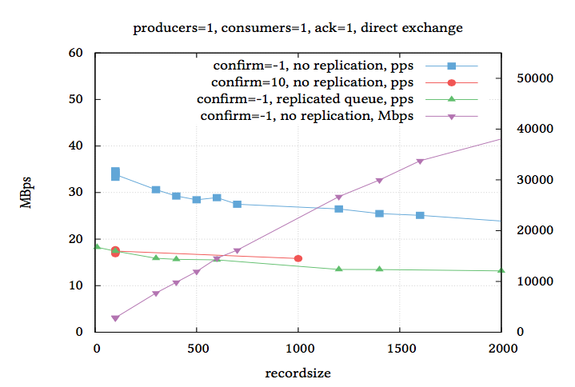
Quantitative Comparison : RabbitMQ
Throughput Results
Throughput in ‘At Most Once Mode’
Throughput for RabbitMQ is optimal if the broker is configured to allow an unlimited number of unconfirmed publishes.
Notes:
Mohsen
The graph shows the impact of record size (in bytes) on throughput for a single RabbitMQ node. As to expected, throughput decreases for larger packet. In addition, replication lowers the throughput.

Slide 26
cont. Quantitative Comparison : RabbitMQ
Throughput Results
Throughput in ‘At Least Once Mode’
Implies writing packets to disk.
Switching on mirrored queues will have a negative impact on throughput.
Throughput drops by 50% compared to the best effort scenario.
Notes:
Mohsen
For RabbitMQ, at least once mode implies writing packets to disk. The read will still happen from memory as long as the packet is in memory has not been trashed.
Switching on mirrored queues will have a negative impact on this throughput since the ACK now needs to be guaranteed from all the replicated queues.
Referring to the previous graph for at least once delivery scenario. Throughput drops by 50% compared to the best effort scenario.

Slide 27
Distinct Features : Kafka
Long Term Message Storage
Kafka stores its message on disk.
Message Replay
Kafka keeps no state about consumers and messages can be stored long term, consumers can easily reply messages when needed.
Kafka Connect
Scalable and reliable streaming of data between Apache Kafka and other systems.
Log Compaction
Ensures that it will always retain at least the last known value for each message key within the log of data for a single topic partition.
Notes:
Marc
From the previous slides we discussed the common features that Kafka and RabbitMQ shares. Now, we are going to discuss their own distinct features. These features can be an important factor while making the decision to choose one of the two systems to be implemented in your app.
Long Term Message Storage
Kafka stores its messages on disk. Purging of messages is done automatically and configured per topic. Messages are purged either after a retention time or when the topic’s disk quota has been exceeded.
Message Replay
Since Kafka keeps no state about consumers and messages can be stored long term, this mean that the consumers can easily replay messages when needed. This can be a very useful feature for the fault tolerance of the downstream systems.
Kafka Connect
Kafka Connect is a framework for scalable and reliable streaming of data between Apache Kafka and other systems. It makes it simple to quickly define connectors that move large collections of data into and out of Kafka.
Log Compaction
Kafka’s log compaction feature ensures that it will always retain at least the last known value for each message key within the log of data for a single topic partition. This can be particularly useful in the use cases that are based on change feeds.

Slide 28
Distinct Features : RabbitMQ
Standard Protocol
Since RabbitMQ is an open source implementations of AMQP, so it has a high performance in terms of getting the work done.
Multi-protocol
RabbitMQ gets to be more used in the industry because it does have a few other tech protocols for pub & cons messages.
Comprehensive Management and Monitoring Tools
RabbitMQ offers a really perspective UI which means It is easy to use because it allows user to monitor and control every aspect of the message.
Notes:
Mohsen
AMQP is an advanced messaging queue protocol and it has been implemented in the most efficient way.
RabbitMQ has more framework that helps to implement things easier and that is the reason that people use it more in the industry.
RabbitMQ IDE has a really handy user interface to use. Also, it lets people to see everything and they have access to the servers to control message.

Slide 29
cont. Distinct Features : RabbitMQ
Consumer Tracking
In the queue processing it keeps track of the consumers actions.
Disk-less Use
RabbitMQ doesn’t need space in disk to route packets, if the item that we are keeping doesn’t need to be in there permanently.
Queue Size Limits
A queue can have a certain amount of items. is mechanism can help in a flow control scenario when deletion of messages is acceptable.
Message TTL
A message has a certain amount of time to be delivered. If it doesn’t get delivered on the time the it will never be consumed to the consumer.
Notes:
Mohsen
For example when they have received a message or when they have read a message.
4. This makes a lot of sense for real time data that becomes irrelevant after a specific time.

Slide 30
Preferred Use Cases : Kafka
Pub/Sub Messaging
If the routing logic is simple, so that a Kafka “topic” concept can handle the requirements.
If the throughput per topic is beyond what RabbitMQ can handle.
Scalable Ingestion System
Kafka offers a scalable solution for processing Big Data.
Data-Layer Infrastructure
Kafka can serve as an underlying data infrastructure that connects various batch and streaming services and applications within an enterprise.
Capturing Change Feeds
Change feeds are sequences of update events that capture all the changes applied on an initial state. Kafka’s log-centric design, makes it an excellent backend for an application in this style.
Stream Processing
A lightweight stream processing library called Kafka Streams is available in Apache Kafka to perform stateful and fault-tolerant data processing.
Notes:
Marc
Pub/Sub Messaging
Kafka can be a good match for the pub/sub use cases that exhibit the following properties: (i) if the routing logic is simple, so that a Kafka “topic” concept can handle the requirements, (ii) if throughput per topic is beyond what RabbitMQ can handle (e.g. event firehose).
Scalable Ingestion System
Many of the leading Big Data processing platforms enable high throughput processing of data once it has been loaded into the system. However, in many cases, loading of the data into such platforms is the main bottleneck. Kafka offers a scalable solution for such scenarios and it has already been integrated into many of such platforms including Apache Spark and Apache Flink, to name a few.
Data-Layer Infrastructure
Due to its durability and efficient multicast, Kafka can serve as an underlying data infrastructure that connects various batch and streaming services and applications within an enterprise.
Capturing Change Feeds
Change feeds are sequences of update events that capture all the changes applied on an initial state (e.g. a table in database, or a particular row within that table). Traditionally, change feeds have been used internally by DBMSs to synchronize replicas. More recently, some of the modern data stores have exposed their change feeds externally, so they can be used to synchronize state in distributed environments. Kafka’s log-centric design, makes it an excellent backend for an application built in this style.
Stream Processing
A lightweight stream processing library called Kafka Streams is available in Apache Kafka to perform stateful and fault-tolerant data processing.

Slide 31
Preferred Use Cases : RabbitMQ
Pub/Sub Messaging
The Publish and subscribing messages is really critical in the edge/core message routing mechanism where the brokers are propagating through the interconnect network topology.
Request-Response Messaging
RabbitMQ offers features such as: RPC style communication which means that when a consumer or a client receives reply directly.
Operational Metrics Tracking
Real Time processing
Information-centric Networking
Capabilities of the architecture to intelligently route packets.
Notes:
Mohsen
without going through a dedicated reply queue
So when the client is replying it doesn't need to go through a dedicated reply queue
Like Market data which is a form of monitoring, send a box of data to a lots of people at the same time.
So for examples when the producers and the consumers message on completely different locations so for example I might be in London and Ian would be in France or somewhere in Europe because this is the European session.

Slide 32
Future work
Plans to extend this study in near future and also solicit additional feedback.
Any update in this regard will be included in a “living” version of this report:
https://arxiv.org/find/cs/1/au:+Esmaili K/0/1/0/all/0/1
Notes:
Marc
According to the authors of the paper, their future work for this research is to extend their study in the near future and also solicit additional feedback. They also provided a link that can be publicly access to see any update in this research.

Slide 33
Conclusion
We briefly talked about the comparison frameworks to help us to understand the benefits and both qualitatively and quantitatively of Apache Kafka and RabbitMQ.
We talked about the efficiency of both applications in terms of delivering in short amount of time(median/mean of around 10 ms).
Also, we talked about the best prefered use cases of Kafka and RabbitMQ.
Notes:
Mohsen
Like for example we talked about the Implementation and the architecture of RabbitMQ and Apache Kafka
In case of RabbitMQ,the difference between at most once and at least once delivery modes is not significant. For Kafka, on the other hand, latencyincreasesabouttwiceaslargefortheatleastoncemode. Additionally,if it needs to read from disk,its latency can grow by up to an order of magnitude.
In terms of throughput, in the most basic set up(i.e. On a single node,single producer/channel,single partition,no replication) RabbitMQ’s throughput outperforms Kafka’s. Increasing the Kafka partition count on the same node,however,can significantly improve its performance, demonstrating its superb scalability. Increasing the producer/channel count in RabbitMQ,on the other hand, could only improve its performance moderately.

Slide 34
Questions: (Adrian’s Question)
How does this topic relate to distributed computing?
For example, let's say that we want to send a box of data to a lot of people at the same time which means that we have a lot of consumers. We split these people into different servers of different people in different countries however they are all in the same continent so sending a message through these distributed servers of people is the relation between this topic and distributed computing.
However, there is a lot more examples that we could talk about.

Slide 35
Questions: (Zoltan’s Question)
How does this topic relate to distributed computing?
For example, let's say that we want to send a box of data to a lot of people at the same time which means that we have a lot of consumers. We split these people into different servers of different people in different countries however they are all in the same continent so sending a message through these distributed servers of people is the relation between this topic and distributed computing.
However, there is a lot more examples that we could talk about.

Slide 36
Questions: (Zoltan’s Question)
Are there any security consideration for the two systems?
Security was not mentioned in the industry paper that we have read. But we did some further research regarding about the message broker as a middleware in both systems. Since the message broker is responsible for receiving messages from the producer, stores, manages these messages, and then distributing these messages to every subscribers. This makes the message broker to be a target of an attack as all the information/messages are stored in there. The message broker may be compromised if it is not configured properly.

Slide 37
Questions: (Michael’s Question)
Is pub/sub sort of replaced with the idea of the macro services?
We are not too sure about the answer to this question however we provided some information macro services and the difference between these two topics.
So first of all the macro services are: Service-oriented Architecture (SOA) is a matured software architectural style that has evolved over the last decade and comprises of autonomous, stateless and loosely-coupled services. Microservice Architecture (MSA) is a budding software architecture style with a suite of small, granular and independent services

Slide 38
Thank You All For Listening
Does anyone have any questions?

