Slide 1
Apache Spark: A Unified Engine for Big Data Processing
Part I
Overview and Programming Model
Shusen Yi
Notes:
This this the part one Overview and Programming Model of the article of : Apache Spark: A Unified Engine for Big Data Processing.

Slide 2
Table of Contents
1. Overview
1.1 Why is Spark?
1.2 What is Spark?
1.3 Benefits
1.4 Spark in Action
2. Programming Model
2.1 Resilient Distributed Datasets (RDDs)
2.2 Example
2.3 Longer Example
3. Summary of Part I
4. Questions?
Notes:
I will cover the introduction, or you may call it as overview, and Programming Model. In the overview, I’ll answer you the questions on why we should use Spark, what is Spark, and the 3 benefits of using Spark. and show you some areas using Spark successfully.

Slide 3




Smartphone
Multi functions! Yeah!
Notes:
Consider smartphone scenario, a smartphone combines everything together but extend the function to send photos or videos through text or make video phone call. We’ll see Spark will fall into the same way , ie, combine everything together but also extend the functions.

Slide 4
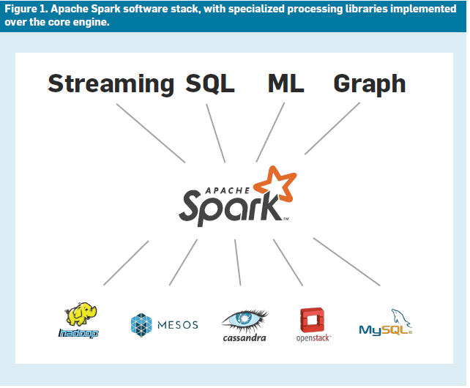
1.1 Why is Spark?
Opportunities and challenges of big data
Current systems
Cluster programming systems - Relatively specialized
MapReduce - Support batch processing
Google Gremel - SQL
Pregel - Graph
Storm and Impala are also specialized
These systems when handling everything together
will become complex and inefficient.
We need a fast and general engine for large-scale data processing - UCB started Spark in 2009
Notes:
There are opportunities and challenges of big data. that a single computer cannot handle. So systems were developed. But all of them are relatively specialised. No “one size fits all”.. All these systems either simply cannot handle big data from different sources or different formats or the performance is not good enough or the

Slide 5
1.2 What is Spark?
This paper | Spark website | My View
This open source computing framework unifies streaming, batch, and interactive big data workloads to unlock new applications. | Apache Spark™ is a fast and general engine for large-scale data processing. | Spark is an open source framework similar to MapReduce but can handle big data from different sources and formats.
Notes:
What is Spark?
It’s NOT the company which provides telephone and internet connections.
Compare the three definitions.

Slide 6
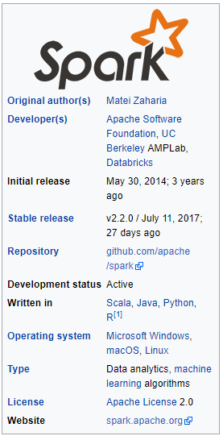
Notes:
Background of Spark from wiki.. Our paper says the first release was in 2010.

Slide 7
Notes:
Spark core engine unifies everything together.

Slide 8
1.3 Benefits
Applications are easier to develop
using a unified API
More efficient
combine processing tasks
Can run diverse functions over the same data often in memory
Enable new applications
example, interactive queries on a graph
similar to smartphone case
Notes:
The three benefits are also why we should use Spark. similar scenario to smartphone case.

Slide 9
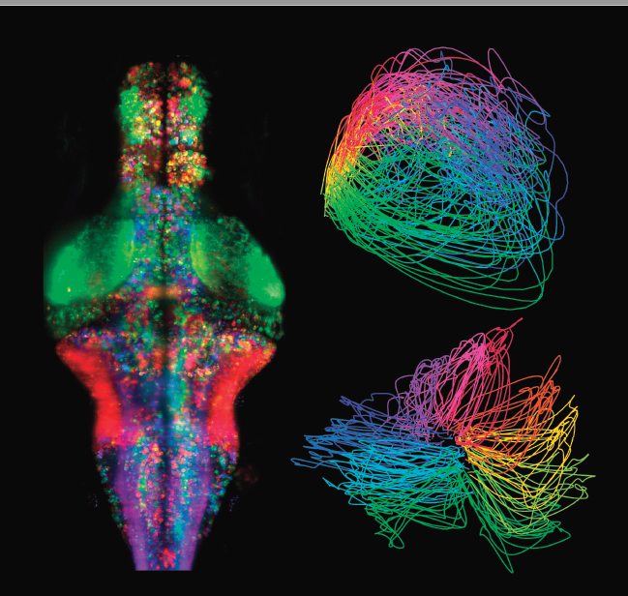
1.4 Spark in Action
Most popular big data processing project
More than 1,000 contributors
In many industries
Banks, technology, retail, biotechnology, astronomy
Largest public kown deployment >8,000 nodes
Analyses brain activities
Notes:
Spark is growing rapidly and widely used in may areas.

Slide 10
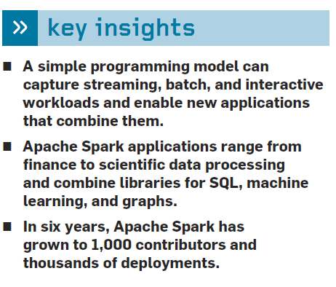
Notes:
key insights
˽˽ A simple programming model can capture streaming, batch, and interactive workloads and enable new applications that combine them.
˽˽ Apache Spark applications range from finance to scientific data processing and combine libraries for SQL, machine learning, and graphs.
˽˽ In six years, Apache Spark has grown to 1,000 contributors and thousands of deployments.

Slide 11
2. Programming Model
From the other paper it says:
Resilient Distributed Datasets (RDDs)
Parallel Operations
Shared Variables
This paper is different by providing examples to explain how Spark works.
Notes:
From the other paper it says:
To use Spark, developers write a driver program that implements
the high-level control flow of their application
and launches various operations in parallel. Spark provides
two main abstractions for parallel programming:
resilient distributed datasets and parallel operations on
these datasets (invoked by passing a function to apply on
a dataset). In addition, Spark supports two restricted types
of shared variables that can be used in functions running
on the cluster.

Slide 12
Resilient Distributed Datasets (RDDs)
A resilient distributed dataset (RDD) is a read-only collection of objects partitioned across a set of machines that can be rebuilt if a partition is lost.
Factors:
fault-tolerant
can be manipulated in parallel
can be rebuilt if a partition is lost
create RDDs by applying operations called “transformations” (such as map, filter, and groupBy) to the data
exposes RDDs through a functional programming API in Scala, Java,Python, and R
Notes:
To use Spark, developers write a driver program that implements the high-level control flow of their application and launches various operations in parallel. Spark provides two main abstractions for parallel programming:
resilient distributed datasets and parallel operations on these datasets (invoked by passing a function to apply on a dataset). In addition, Spark supports two restricted types of shared variables that can be used in functions running on the cluster

Slide 13
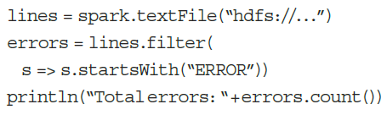
Example in Scala Code
Spark exposes RDDs through a functional programming API in Scala, Java, Python, and R, where users can simply pass local functions to run on the cluster.
1st line: Defines a RDD of collections of lines of text in a HDFS
2nd line: Calls the filter to get a new RDD
3rd line: Calls count RDD function return the result(NOT another RDD)
Notes:
This is an example in Scala code. It creates an RDD representing the error messages in a log file.
1st line: Defines a RDD of collections of lines of text in a HDFS
2nd line: Calls the filter to get a new RDD
3rd line: Calls count RDD function return the result(NOT another RDD)

Slide 14

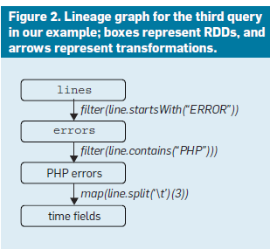
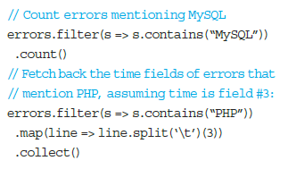
Example Continue
Call to load just error messages to memory
Then run a variety of queries on the in-memory data
Notes:
a user searching through a large set of log files in HDFS to debug a problem might load just the error messages into memory across the cluster by calling
errors.persist()
run a variety of queries on the in-memory data
we can how easy it is.

Slide 15
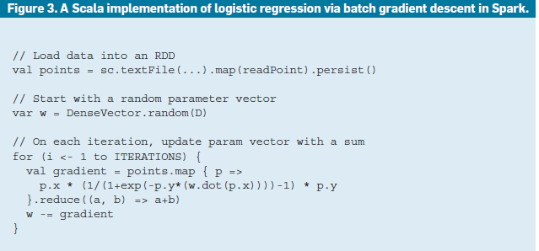
A longer example
Logistic regression
Batch gradient descent
Easy to load data in memory
Faster than traditional MapReduce
Notes:
As a longer example,Figure 3 shows an implementation of logistic regression in Spark. It uses batch gradient descent, a simple iterative algorithm that computes a gradient function over the data repeatedly as a parallel sum.

Slide 16
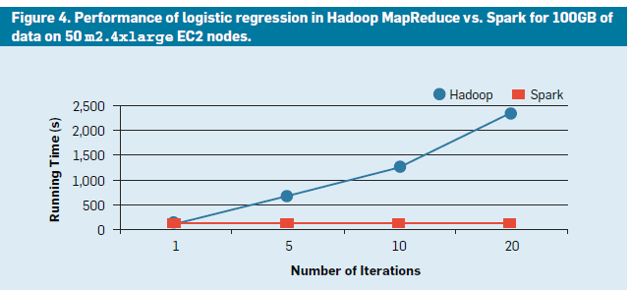
Faster than traditional MapReduce
Notes:
Spark makes it easy to load the data into RAM once and run multiple sums. As a result, it runs faster than traditional MapReduce. For example, in a 100GB job (see Figure 4), MapReduce takes 110 seconds per iteration because each iteration loads the data from disk, while Spark takes only one second per iteration after the first load.

Slide 17
Integration with storage systems
Cluster file system like HDFS
Key-value storage like S3 and Cassandra
Apache Hive
RDDs usually store temporary data within applications
Some applications like SQL JDBC server also share RDDs among multiple users
Spark’s storage-system-agnostic engine make it easy to run computations against existing data and join diverse data sources.
Notes:
Integration with storage systems

Slide 18
Summary
The Challenges
Current products
Examples
Spark is the best!
Notes:
We’ve been to any production presentation, in presenter will first tell you how good their product is.

Slide 19
Questions?
Notes:
Any questions?

