Slide 1
SYSTEM
VIRTUAL MACHINES
Adrian (SONGBO WU) 11/09/2017
Notes:
cover

Slide 2
Agenda
Main idea
Motivation
Related work
Five Important points
Future work
Notes:
Summary slides

Slide 3
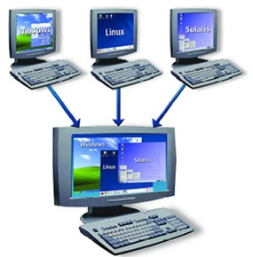
Main idea:
A system VM supplies a well rounded environment which can allow operating systems(OS) and many processes from different users to coexist.
By leveraging system VMs, a individual host hardware system can host multiple, isolated guest OS environments concurrently.
Equivalence / Fidelity
Resource control / Safety
Efficiency / Performance
Notes:
System VM is as known as full virtualization.The term virtual machine was originally defined by Popek and Goldberg as "an efficient, isolated duplicate of a real computer machine."
According to Popek and Goldberg, a VMM must satisfy all three properties:
“Equivalence / Fidelity A program running under the VMM should exhibit a behavior essentially identical to that demonstrated when running on an equivalent machine directly. “
“Resource control / Safety The VMM must be in complete control of the virtualized resources. “
“Efficiency / Performance A statistically dominant fraction of machine instructions must be executed without VMM intervention.”
https://www.maketecheasier.com/create-virtual-machine-of-windows-os/
https://en.wikipedia.org/wiki/Popek_and_Goldberg_virtualization_requirements

Slide 4
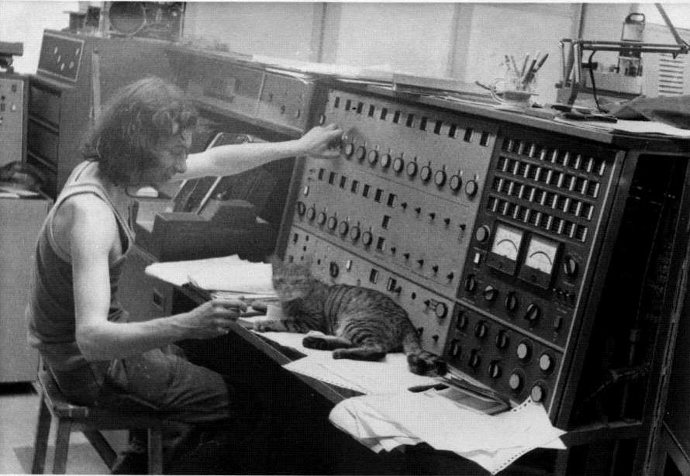
Motivation :
System VM had merged since 1960s when mainframe computer were very large and shared by huge amount of users.
With VM, users from different designated user group can run various OS on the shared machine
Isolation between different OS running on the same hardware set
Notes:
The need for running multiple systems in the same hardware system was the initial motive for VM which allows time sharing among several single tasking OS.
In the 1960, the cost of a mainframe computer is very costly, which means one department may have one but different user groups need different OS to perform different tasks. So they need to share the OS in the same the hardware to lower the cost.
http://www.ict1301.co.uk/13010110.htm

Slide 5
Related work:
CP/CMS (Control Program/Cambridge Monitor System) in early 1967
Discontinued time sharing operating system in 1960s
The predecessor of the VM family
Important influence of the development of the operating system theory
Notes:
CP/CMS has two components :
Control programme which creates the virtual machine environment.
Cambridge Monitor System (aka Console Monitor System or Conversational Monitor System) is a lightweight single user OS for interactive time-sharing (a technique which enables many people, located at various terminals, to use a particular computer system at the same time) use.
Multiple copies of CMS are running on top of the CP VM.
https://en.wikipedia.org/wiki/CP/CMS

Slide 6
Point one : Classic system VMs
System VMs hide the information details from users but exposing the similar the functionality to the users
Virtual Machine Monitor is straight on top of the hardware layer with Virtual Machine on the top.
Virtual Machine Monitor is with the highest privilege to control the action of the guest operating system
Notes:
Virtual machine monitor (VMM) is a hypervisor (supervisor of the supervisor) which creates and run the virtual machine.
A computer which runs the VMM is the host machine, while the virtual machine created by VMM is the guest machine.

Slide 7
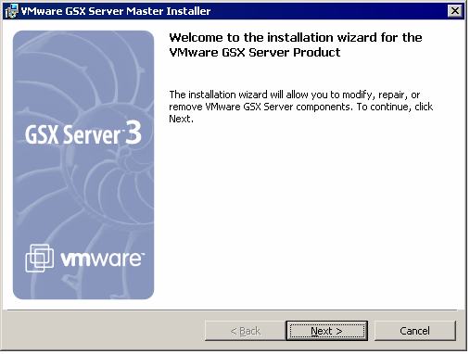
Point two : Hosted VMs
Hosted Virtual Machines directly installs on the host operation system.
Rely on the the host OS to supply device drivers and other lower level services
VMware GSX server is an example of hosted VM.
Notes:
VMware GSX has renamed to VMware Server which can create, edit and play virtual machines. GSX allows remote access to the VM by utilizing client server modelling architecture at the expense of the GPU.
Hosted VMS do not rely on VMM but the hosted OS.
https://stuff.mit.edu/afs/sipb/project/vmdialup/lib/vmware-console/help-manual/install_winsteps_gsx.htm

Slide 8
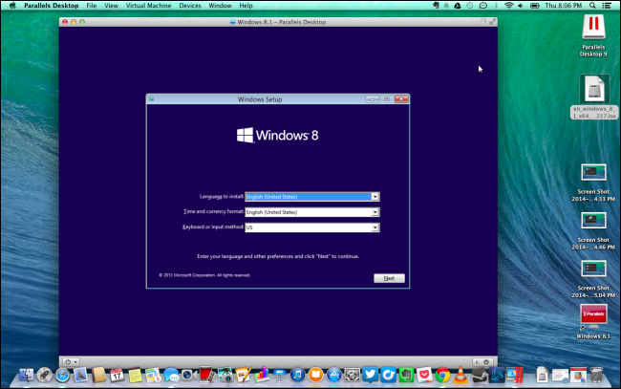
Point three : Whole-system VMs
For the situation in which the Instruction set architecture (ISA) of hosting and guest OS is different.
Virtualizing all the software including the OS and other applications
Responsible for emulating both the application and OS source code
Notes:
Whole-system VM is taking the virtualizing process to the next level.
Windows Virtual PC is an example of the whole system VM.
A typical use of Virtual PC is to initialize an Windows virtual OS on a Macintosh platform.
Virtual PC emulates Intel Pentium II processor, standard SVGA graphics card, BIOS for motherboard, Ethernet network card.
https://www.howtogeek.com/187359/5-ways-to-run-windows-software-on-a-mac/

Slide 9
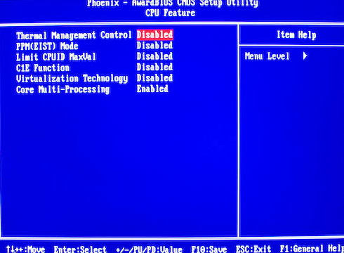
Point four : Multiprocessor virtualization
Suitable for large shared memory multiprocessor.
Physical partitioning can guarantee the physical hardware resource used by one VM is not used by the other VM at the same time. (e.g.RAID)
Logical partitioning leverages the time multiplexed improve the efficiency of the system resource utilization.
Notes:
Physical partitioning provides a high level of the isolation which ensures the hardware or software level issues will not be propagated to the other VMs in other physical partitions.
Time-Division Multiplexing(TDM) is a digital or analogue technology which multiple signals or data stream can be transmitted in one communication channel which are divided by sub channels.
https://forums.geforce.com/default/topic/485242/e6550-core-missing-in-nvidia-650i-mobo/

Slide 10
Point five : Codesigned VMs
Aim to provide customized implementation for the proprietary ISA for specific requirements
VMM stays on hidden memory address invisible from other software.
Binary translator converts guest instruction into optimized sequences of ISA
Optimized sequences are cached in the hidden memory
Notes:
Different codesigned VMS have different focus. For example, Transmeta is primarily for power saving, while IBM AS/400 is aiming to provide support for the object based instruction set which can redesign the HW/SW interface in a new approach.
Perform both translation and optimization
Provide interface between standard ISA software and implementation ISA
Primary goal is performance or power efficiency
Use proprietary implementation ISA

Slide 11
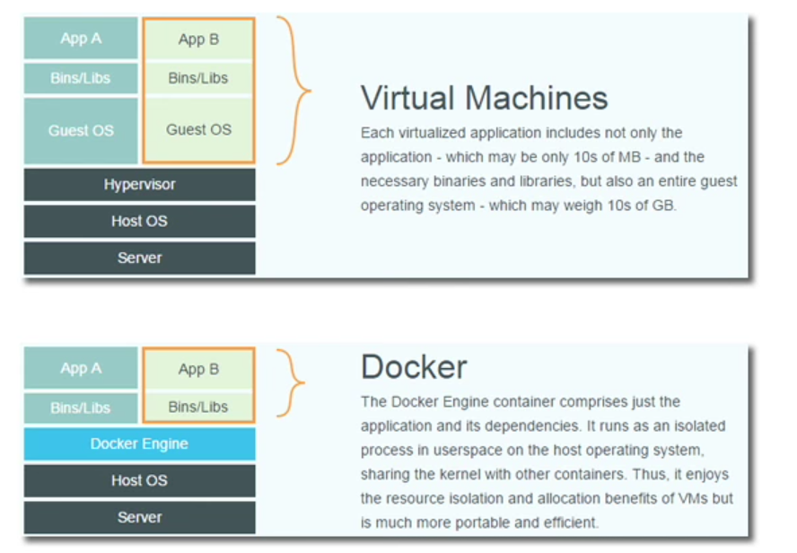
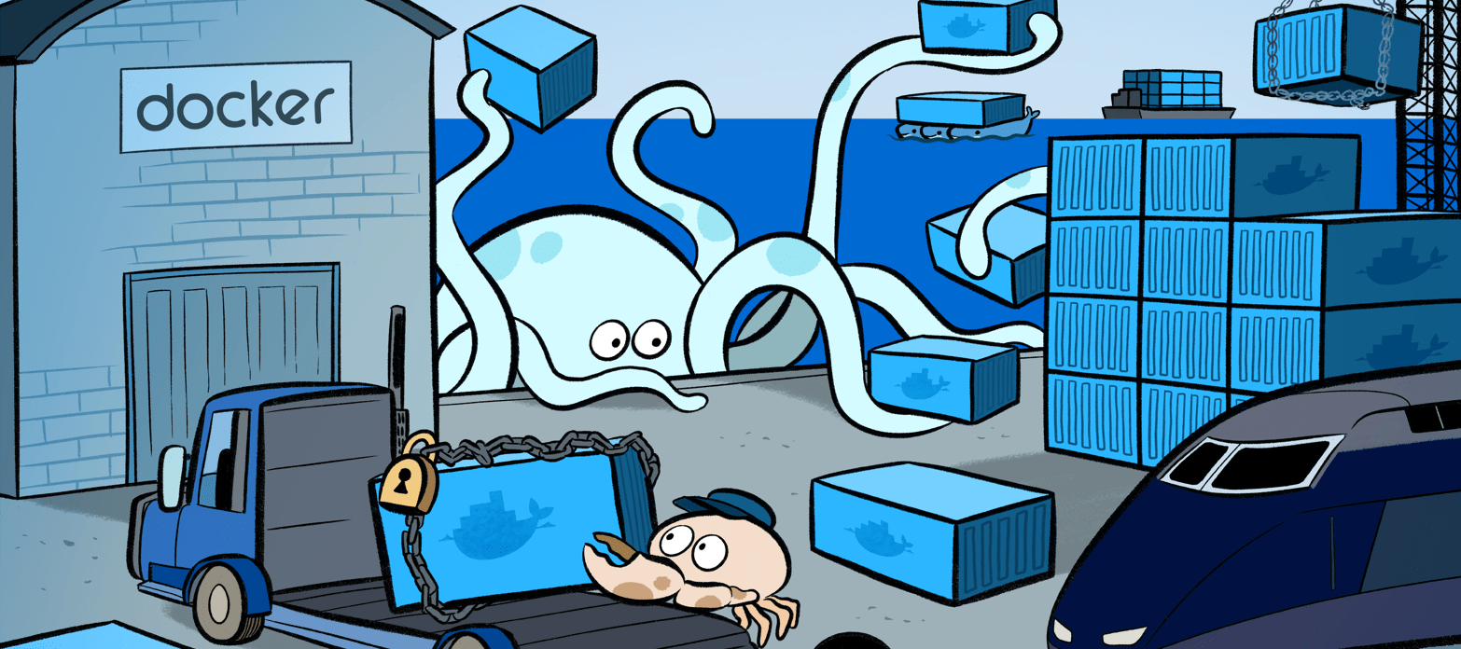
Future work
Docker separates APP from infrastructure using container technology
VM separates the OS From the bare metal
Developer and system admin become BFF because of Docker
Notes:
What business needs is an efficient runtime environment not a complete OS which may be wasting unnecessary resources.
Containers are lightweight and less overhead compared to the VMs, there are stateless and no persistent files , the host system inits the containerized application directly in an init daemon just like an common process on the host system.
Virtualization decoupled provisioning from hardware deployment while Containers decouple provisioning from OS deployment and boot up.
VM includes not only the APP and its dependencies but also the entire guest OS while Docker only contains the APP and the dependencies.
Hypervisor visualize the lower level device , Docker is based on kernel and isolate the lower level visualization via Linux process
Container is for running multiple copies of a single application while VM is for running multiple applications.
It's the ultimate security sandbox.
It makes software installation a no-brainer.
The operating system doesn't matter.
http://www.linuxjournal.com/content/containers%E2%80%94not-virtual-machines%E2%80%94are-future-cloud?page=0,1
https://www.youtube.com/watch?v=aLipr7tTuA4

Slide 12
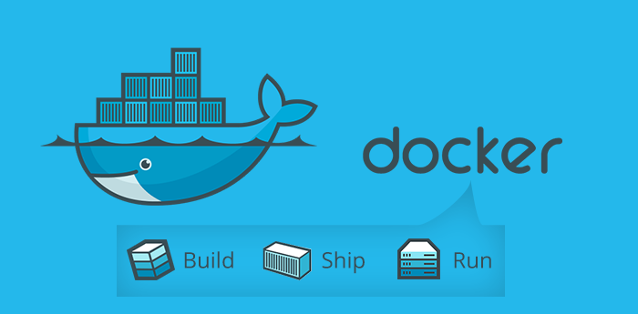
Notes:
Dockerlization

Slide 13

Notes:
Question : How is the benefit of physical partitioning ?
With physical partitioning, the physical resources that one virtual system uses are exclusively separated from those used by other virtual systems. Physical partitioning provides a high degree of isolation so that both software problems and hardware failures on one partition will not be propagated into other partitions.

Slide 14
Question : How is the benefit of physical partitioning ?
Answer : With physical partitioning, the physical resources that one virtual system uses are exclusively separated from those used by other virtual systems. Physical partitioning provides a high degree of isolation so that both software problems and hardware failures on one partition will not be propagated into other partitions.
Notes:
Question : How is the benefit of physical partitioning ?
With physical partitioning, the physical resources that one virtual system uses are exclusively separated from those used by other virtual systems. Physical partitioning provides a high degree of isolation so that both software problems and hardware failures on one partition will not be propagated into other partitions.

