Slide 1

NWEN406
19-SEP-2017
Amazon Storage- S3 and Glacier
Khushboo (Khushi)
STUDENT ID - 300437942

Slide 2
Agenda
Main Idea - AWS and Storage Services
Motivation - Need For Storage.
What is Amazon S3?
What is Amazon Glacier?
Amazon S3 To Amazon Glacier.
Cost Model
Future of AWS.
Questions.

Slide 3

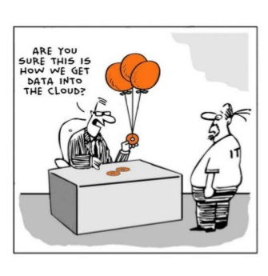

Slide 4
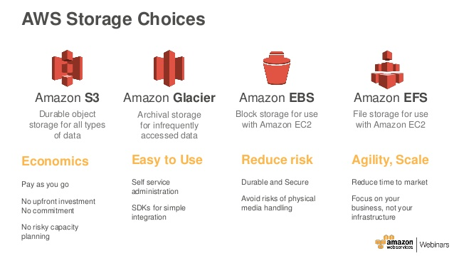
Main Idea
Amazon Web Services
Amazon Web Services (AWS) is a flexible, cost-effective, easy-to-use cloud computing platform.
Amazon Storage Services
It provides different data storage services with high durability and availability.
It offers storage choices for backup, archiving, and disaster recovery use cases and provides block, file, and object storage.

Slide 5

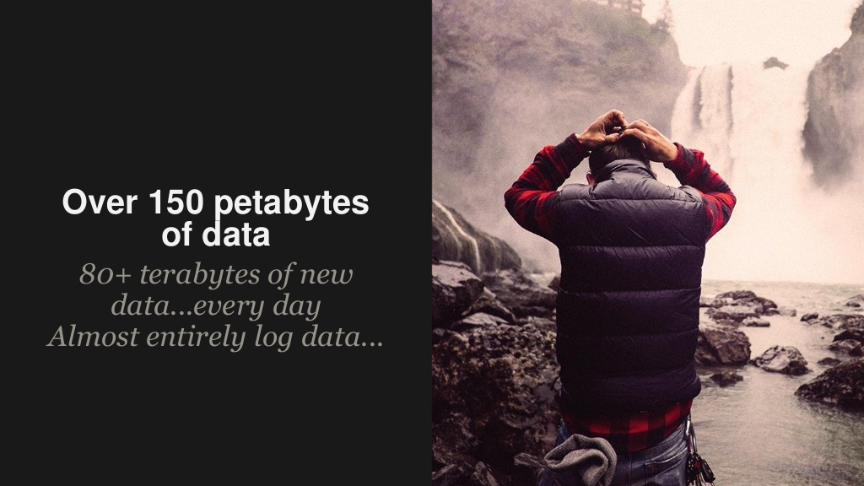
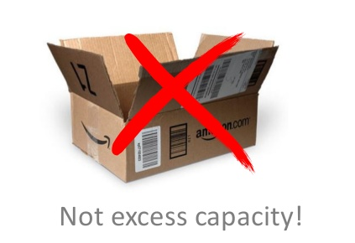

Motivation
Need For Storage

Slide 6


Slide 7

Amazon S3
What is Amazon S3?
Key Features
Concept
Interfaces
Security
Customer References

Slide 8
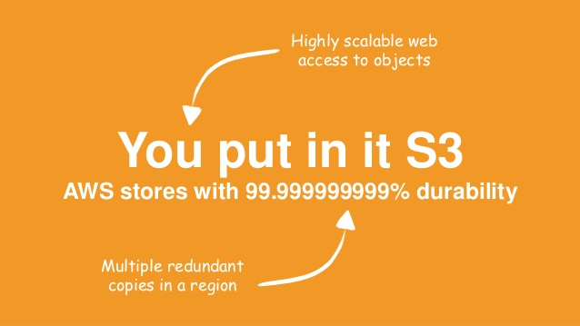
What is Amazon S3?
Amazon S3 – Amazon Simple Storage Service.
(But It is more than a ‘simple’ storage platform.)
S3 is a cloud storage service for Object Storage.
A web storage, not a file system
Store and retrieve any amount of data.
At any time.
From anywhere on the web.
Access via simple web interface.

Slide 9
Features most powerful object storage platform
Durability– 99.99999999999 (11 nines) per object.
Availability – 99.99 % over an year period.
Automatically and synchronously store data across multiple devices within your selected geographical region.
Storage- Supports a virtually unlimited number of files in any bucket.
Scalability –Automatically manage scaling and distribute copies of your information to the other services in other locations in the same region.
Security – Highly secure, provide multiple mechanism for control of access to your S3 resources and it supports encryption.
Interface – Easy to use web service interface.
Pricing – very low cost.

Slide 10
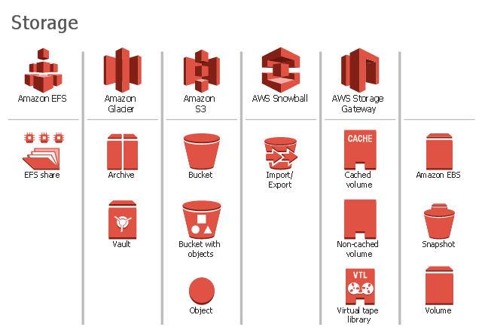
Concept
Objects
Objects can be any files like photos, videos or documents.
Buckets
Logical unit of storage in S3
Root folder to store objects.
Containers for objects stored in S3.
Create and upload any number of objects inside a single bucket.
Object is uniquely identified with in a bucket by a key (name).

Slide 11
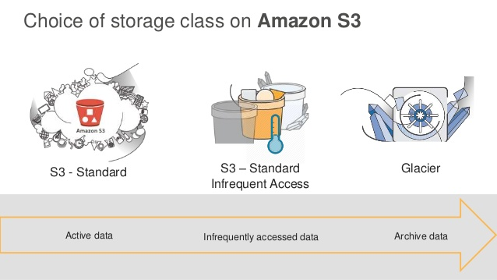
Storage Classes Controlling the way S3 holds your data.
Amazon S3 – Frequently Assessed Data.
Standard S3 Standard-IA – Less Frequently Data.
Amazon Glacier – Low Cost Archival Data.

Slide 12
Interfaces
Simple REST-based APIs – Both management and data operations.
The APIs allow Amazon S3 objects to be completely stored in uniquely named buckets.
High level tool kit or Software development kit (SDK)
AWS SDK are available for Android, Browser, iOS, Java, .NET, Node.js, PHP, Python, Ruby, and Go.
Integrated AWS Command Line Interface (AWS CLI)
By using AWS CDI ,you can perform recursive uploads and downloads using a single folder-level Amazon S3 command
AWS Management Console
can easily create and manage Amazon S3 buckets, upload and download objects, and browse the contents of your S3 buckets using a simple web-based user interface.
Amazon S3 Notification Feature.

Slide 13
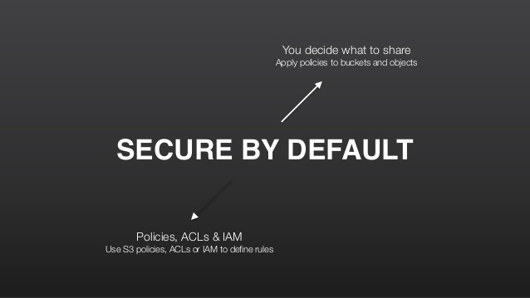
Security Highly secure
Support Encryption - Multiple server-side and client-side encryption option.
Manage access - flexible access control mechanisms, by writing an access policy.
Versioning – to preserve, retrieve and restore every version of every object stored in your Amazon S3 bucket.
MFA delete – Multi-Factor Authentication delete for a bucket.
Access Logging – to track requests for access to your bucket.

Slide 14
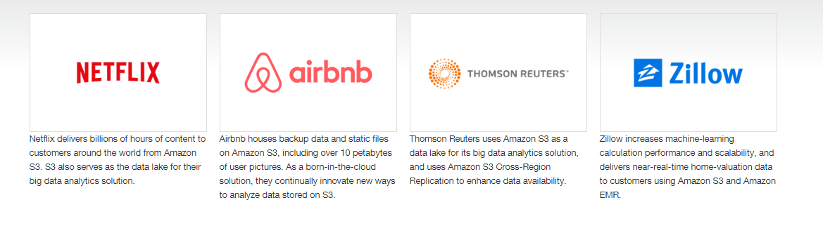
Customer References

Slide 15
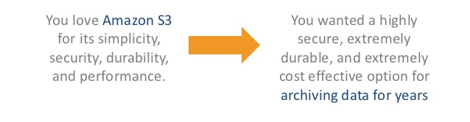


Slide 16

Amazon Glacier
What is Amazon Glacier?
Key Features
Concept
Interfaces
Security
Customer References

Slide 17
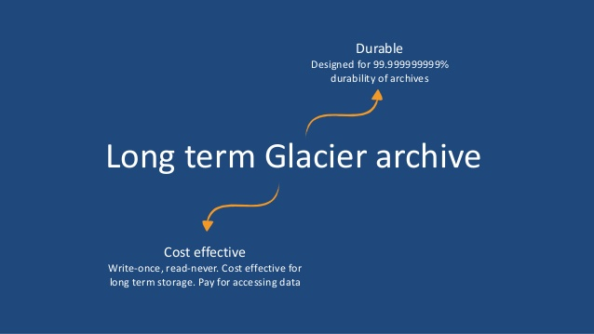
What is Amazon Glacier?
Amazon Glacier is a low- cost archival data storage service and provides long-term backup.
reliably store large or small amounts of data.
(as little as $0.007 per GB per month.)
Designed to store infrequently accessed and long lived data.
3 – 5 hours of retrieval time.

Slide 18
Concept
Achieves
An Achieve is any object such as photo, video, document or compressed collection.
Data is stored in Amazon Glacier as Achieves.
Can upload data as single file or multiple files by using multipart upload API
Vault
Vaults are used to organize data stored in Amazon Glacier.
Each archive is stored in a vault of your choice.
Control access to your data by setting vault- level policies.

Slide 19
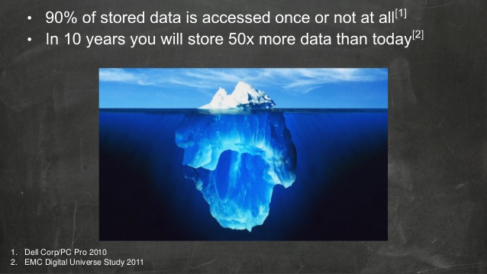
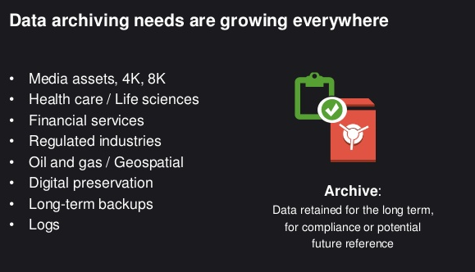
Need for Archival

Slide 20
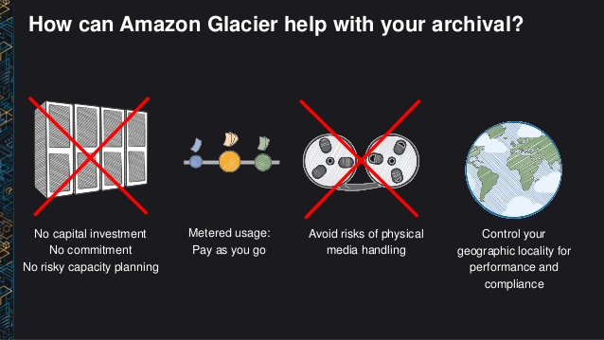
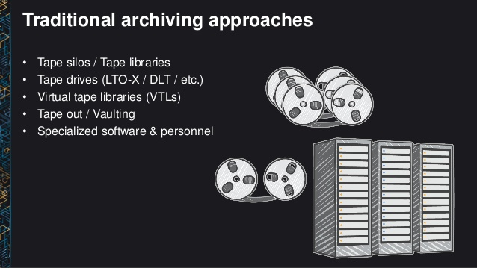
Archieval
Traditional Vs Amazon Glacier

Slide 21
Features most powerful object storage platform
Durability– 99.99999999999 (11 nines) for an achieve per year.
Availability – 99.99 % over an year period.
Storage –No limit to the total amount of data you can store in the service.( Single achieve is limited to 40 TB in size.
Scalability- Automatically Scales your storage up and down as needed.
Security – Highly secure, only you can access your data, set up data access controls.
Interface – Easy to use web service interface.
Pricing – very low cost.

Slide 22
Interfaces
Standard based REST Web Services Interface.
Access using Java SDKs or .NET SDK.
AWS Management Console or Amazon Glacier APIs actions to create Vaults to organise the achieves.
How it works?
APIs actions to upload, retrieve achieves, to monitor the status of jobs and to send notifications through Amazon SNS when job is complete.

Slide 23
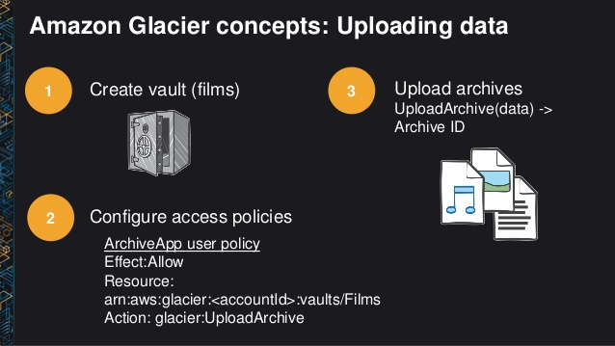
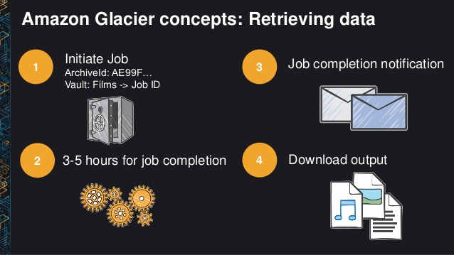
API Actions

Slide 24
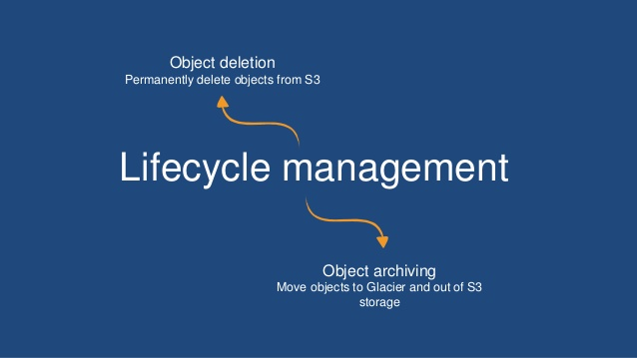
Interfaces
2. S3 Lifecycle Management
Use as a storage class
Provides Automatic, policy driven achieving from Amazon s3 to Amazon Glacier.

Slide 25
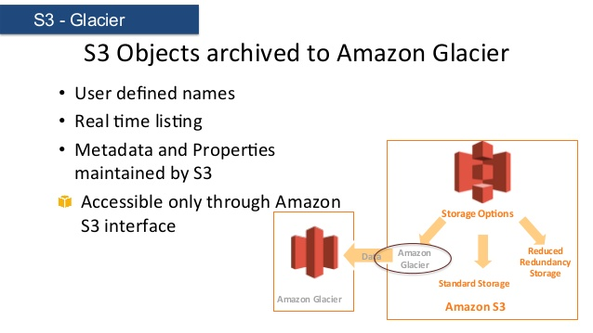
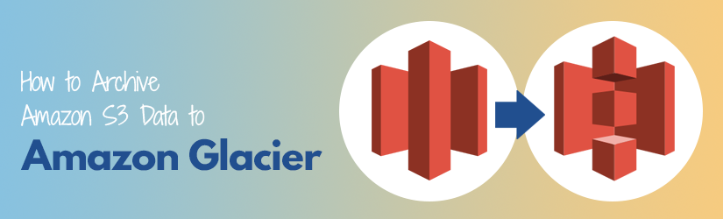
S3 Lifecycle Mamagemnt Policy

Slide 26
Security
Amazon Glacier Vault Lock – Complaince control on individual vaults.
Vault Access Policies - Enforces the prescribed controls by using Lockable policies.
Access Management (IAM) Policy- Specifies which account users have rights to operations on a given vault.
Encryption by default – server side encryption.
Amazon Glacier automatically encrypts data at rest using Advanced Encryption Standard (AES).
AWS Cloudtrail –Track user activity and API usage.

Slide 27
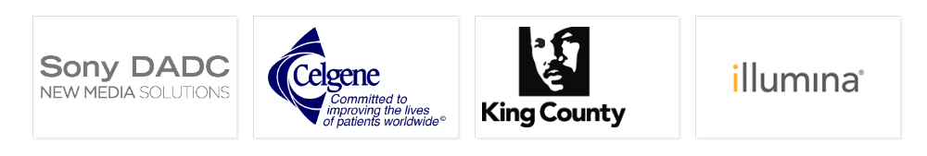

Customer References

Slide 28
Cost Model for S3 and Glacier no minimum fee and no set up cost
Pay only for what you “actually use”.
Three pricing components –
storage (per GB per month)
data transfer in or out (per GB per month)
requests (per thousand requests per month).
Transfers between S3 buckets or from S3 to any service(s) within the same region are free.
Retrieve up to 5% of your average monthly storage for free each month in Amazon Glacier.

Slide 29
AWS Free Usage Tier For New Custmores
you can get started with AWS for free.
Upon sign-up - It provides AWS Free Usage Tier which includes
Amazon S3
5 GB of storage,
20,000 Get Requests,
2,000 Put Requests, and
15 GB of data transfer out
each month for 1year for free.
Estimate your monthly bill using the AWS Simple Monthly Calculator.
Amazon Glacier
10 GB Retrieval of data
per month for free.
Use any time during the month
and applies to Standard retrievals.

Slide 30
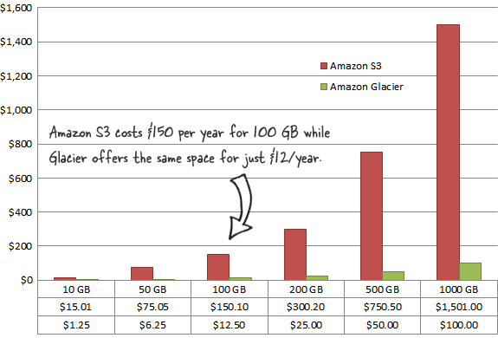
Pricing

Slide 31
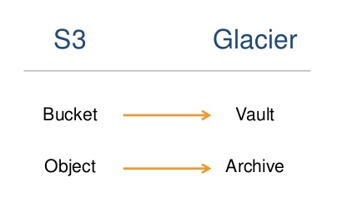
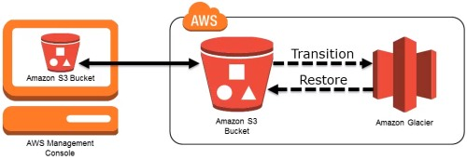
S3 and Glacier Overview

Slide 32
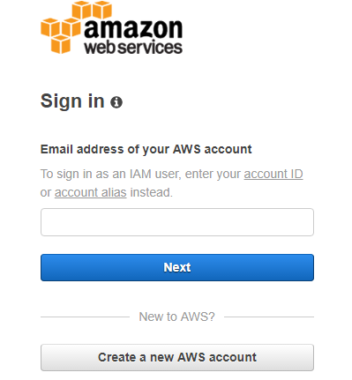
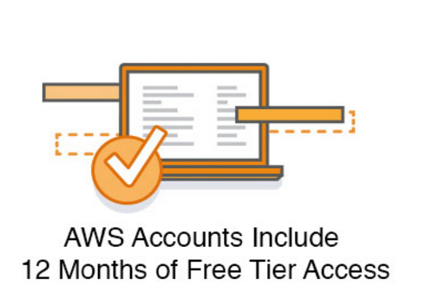
Start Using Amazon Web Services NOW

Slide 33
Future of AWS
Past
AWS was started way early in the year 2006, when no company was ready to set foot in the cloud computing industry, because of the risk, since no one ever tried it!
Present
This basically means AWS as a cloud provider has more experience in the field of cloud computing, and hence becomes an obvious choice when people are looking for a reliable cloud provider.
Future ?
Indeed a very bright and good future.

Slide 34
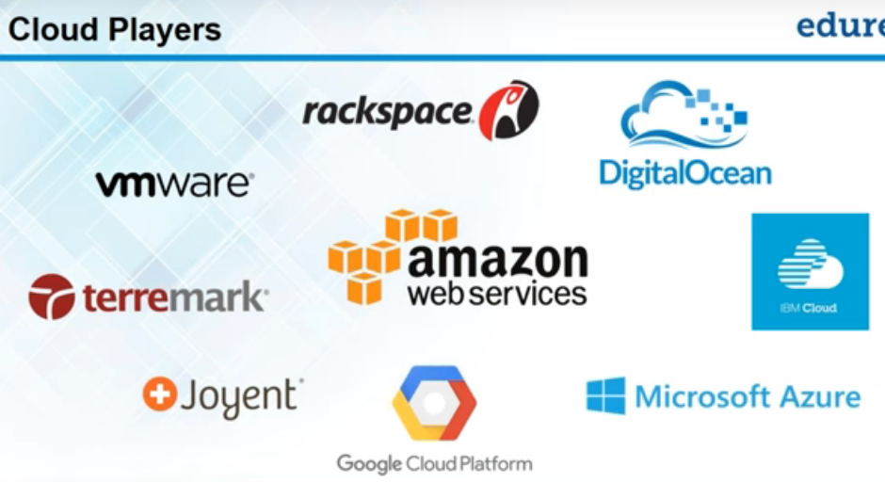
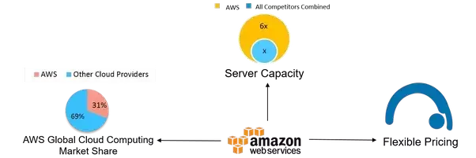
Future of AWS
All covered for its future,
It’s competitors have build up their game.
Ultimate battle of cloud Giants - Microsoft, Google and AWS
Despite crazy growth of Cloud, AWS would remain the leader.

Slide 35
Useful Links
https://aws.amazon.com/s3/
AWS Simple Monthly Calculator

Slide 36

Questions

