Slide 1
Above the Clouds: A Berkeley View of Cloud Computing
NWEN 406: Distributed Computing in Grids and Clouds
2017 : Ian Welch
Some slides from ECE1779: Introduction to Cloud Computing

Slide 2
Origins
Computing may someday be organized as a public utility just as the telephone system is a public utility,” Professor John McCarthy said at MIT’s centennial celebration in 1961. “Each subscriber needs to pay only for the capacity he actually uses, but he has access to all programming languages characteristic of a very large system … Certain subscribers might offer service to other subscribers … The computer utility could become the basis of a new and important industry.”
https://www.technologyreview.com/s/425623/the-cloud-imperative/
Notes:
The idea of Utility Computing has been around since the beginning of the 1960s.
Professor John McCarthy was the pioneer of artificial intelligence (see https://en.wikipedia.org/wiki/John_McCarthy_(computer_scientist)).

Slide 3
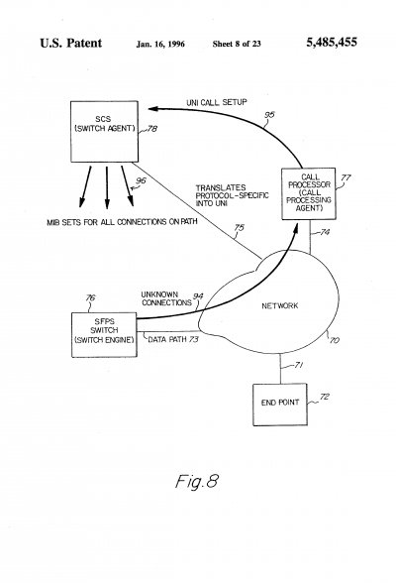
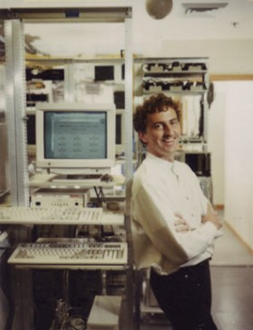
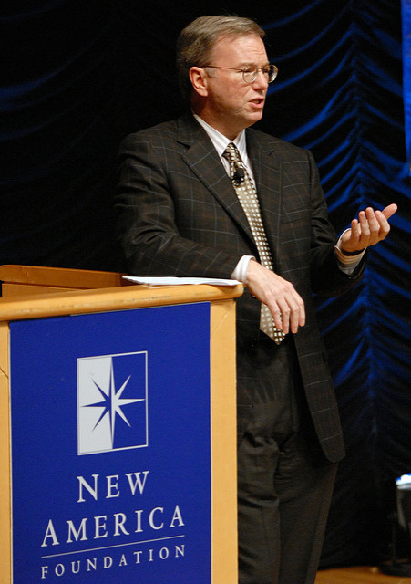
History of term “Cloud Computing”
1994 Patent: Network cloud = someone else’s problem
Sean O’Sullivan (1997)
Eric Schmidt (2006)
Notes:
https://www.technologyreview.com/s/425970/who-coined-cloud-computing/
October 2011
Unclear who exactly came up with the term.
Entrepreneur Sean O’Sullivan filed a trademark on “cloud computing” in 1997. Startup NetCentric working with Compaq.
Didn’t catch on and until recently everyone forgot the term although the details of business plan anticipate many features of cloud computing.
Many believe the first use of “cloud computing” in its modern context occurred on August 9, 2006, when then Google CEO Eric Schmidt introduced the term to an industry conference. “What’s interesting [now] is that there is an emergent new model,” Schmidt said, “I don’t think people have really understood how big this opportunity really is. It starts with the premise that the data services and architecture should be on servers. We call it cloud computing—they should be in a “cloud” somewhere.”

Slide 4
Originally a Marketing Term
The interesting thing about Cloud Computing is that we’ve redefined Cloud Computing to include everything that we already do. . . . I don’t understand what we would do differently in the light of Cloud Computing other than change the wording of some of our ads.
Larry Ellison, quoted in the Wall Street Journal, September 26, 2008
It’s stupidity. It’s worse than stupidity: it’s a marketing hype campaign. Somebody is saying this is inevitable — and whenever you hear somebody saying that, it’s very likely to be a set of businesses campaigning to make it true.
Richard Stallman, quoted in The Guardian, September 29, 2008
Notes:
Back in 2008 people were skeptical about cloud computing and did not have a clear idea of what it was.

Slide 5
Current Definitions
“Cloud computing is the on-demand delivery of compute power, database storage, applications, and other IT resources through a cloud services platform via the internet with pay-as-you-go pricing.”
https://aws.amazon.com/what-is-cloud-computing/
“Cloud computing, often referred to as simply “the cloud,” is the delivery of on-demand computing resources—everything from applications to data centers—over the internet on a pay-for-use basis.
Elastic resources—Scale up or down quickly and easily to meet demand
Metered service so you only pay for what you use
Self service—All the IT resources you need with self-service access”
https://www.ibm.com/cloud-computing/learn-more/what-is-cloud-computing/
Notes:
Cloud computing has become everyday.
These definitions come from Amazon and IBM.
Key features:
Pay-as-you-go
Scales on demand
Computational resources

Slide 6
How it appears to a User
Illusion of infinite resources available on demand.
Elimination of up-front commitment by Cloud users.
Ability to pay for use on short-term basis as needed and release as needed rewarding conservation.
Notes:
So what was new here?
The illusion of infinite computing resources available on the demand thereby eliminating the need for Cloud Computing users to plan far ahead for provisioning.
The elimination of up-front commitment by Cloud users, thereby allowing companies to start small and increase hardware resources only when there is an increase in their needs.
The ability to pay for use of computing resources on a short-term basis as needed (e.g. processors by the hour and storage by the day) and release them as needed, thereby rewarding conservation by letting machines and storage go when there are no longer useful.

Slide 7
Why move to the cloud?
Elasticity (fast provisioning or de-provisioning)
No risk of under or over-provisioning.
Share benefits of dropping hardware costs
Building your own datacenter takes time
You are buying incremental capacity
Flexibility
No operational costs
You are buying expertise as well as resources
Power and cooling are not your problem (datacenter can be placed wherever cheapest, you can’t do this)
Notes:
Even though Amazon’s pay-as-you-go pricing (for example) could be more expensive than buying and depreciating a comparable server over the same period, we argue that the cost is outweighed by the extremely important Cloud Computing economic benefits of elasticity and transference of risk, especially the risks of overprovisioning (underutilization) and underprovisioning (saturation).
Elasticity – being able to rapidly add or remove resources. Few users deliberately provision for less than the expected peak, and therefore they must provision for the peak and allow the resources to remain idle at nonpeak times. The more pronounced the variation, the more the waste. Elasticity allows reducing this waste and can therefore more than compensate for the potentially higher cost per server-hour of paying-as-you-go vs. buying.
(would have been good to have had a slide illustrating an example here).
Risk Transference – if you underprovision you will lose customers who experience bad service. Cloud allows you to scale with the risk being taken by the provider.
Share benefits of dropping hardware costs -- technology trends suggest that over the useful lifetime of some purchased equipment, hardware costs will fall and new hardware and software technologies will become available. Cloud providers, who already enjoy economy-of-scale buying power as described in Section 3, can potentially pass on some of these savings to their customers. Indeed, heavy users of AWS saw storage costs fall 20% and networking costs fall 50% over the last 2.5 years, and the addition of nine new services or features to AWS over less than one year (note as at 2008).
No operational costs – when comparing with building your own datacenter you have to factor in the costs of employing skilled people to manage the systems as well as other costs such as power or cooling. Using the Cloud allows you to benefit from economies of scale (per machine it is cheaper to have one person managing many machines not just one, more efficient to cool many machines instead of just one).

Slide 8
New Application Opportunities
Mobile interactive applications
Parallel batch processing
Data parallelism
Programming frameworks simplifying
Big search
eScience
Data analytics
Data mining
Predictive analytics
Web applications
Elastic demand
Not so good “earthbound applications”
Stock exchange
Some image processing with time constraints
Data transfer issue
Notes:
While we have yet to see fundamentally new types of applications enabled by Cloud Computing, we believe that several important classes of existing applications will become even more compelling with Cloud Computing and contribute further to its momentum.
“Earthbound” applications. Some applications that would otherwise be good candidates for the cloud’s elasticity and parallelism may be thwarted by data movement costs, the fundamental latency limits of getting into and out of the cloud, or both. For example, while the analytics associated with making long-term financial decisions are appropriate for the Cloud, stock trading that requires microsecond precision is not. Until the cost (and possibly latency) of wideareadata transfer decrease (see Section 7), such applications may be less obvious candidates for the cloud.

Slide 9
Why Become a Provider?
Necessary but not sufficient condition: already have existing investment in infrastructure plus operational expertise.
Factors:
Make a lot of money (economies of scale)
Leverage existing investment (offer a low incremental cost)
Defend a franchise (stay with Microsoft)
Attack an incumbent (enter the market before lose chance to enter because of costs)
Notes:
1. Make a lot of money. Although 10 cents per server-hour seems low, Table 2 summarizes James Hamilton’s
estimates [23] that very large datacenters (tens of thousands of computers) can purchase hardware, network
bandwidth, and power for 1=5 to 1=7 the prices offered to a medium-sized (hundreds or thousands of computers)
datacenter. Further, the fixed costs of software development and deployment can be amortized over many more
machines. Others estimate the price advantage as a factor of 3 to 5 [37, 10]. Thus, a sufficiently large company
could leverage these economies of scale to offer a service well below the costs of a medium-sized company and
still make a tidy profit.
2. Leverage existing investment. Adding Cloud Computing services on top of existing infrastructure provides a
new revenue stream at (ideally) low incremental cost, helping to amortize the large investments of datacenters.
Indeed, according to Werner Vogels, Amazon’s CTO, many Amazon Web Services technologies were initially
developed for Amazon’s internal operations [42].
3. Defend a franchise. As conventional server and enterprise applications embrace Cloud Computing, vendors
with an established franchise in those applications would be motivated to provide a cloud option of their own.
For example, Microsoft Azure provides an immediate path for migrating existing customers of Microsoft enterprise
applications to a cloud environment.
4. Attack an incumbent. A company with the requisite datacenter and software resources might want to establish a
beachhead in this space before a single “800 pound gorilla” emerges. Google AppEngine provides an alternative
path to cloud deployment whose appeal lies in its automation of many of the scalability and load balancing
features that developers might otherwise have to build for themselves.

Slide 10
Cloud Computing Taxonomy/Classes Utility Computing
Infrastructure/hardware as a Service (IaaS)
Platform as a Service (PaaS)
Software as a Service (SaaS)

Slide 11
IaaS
Also know as Utility Computing
VM images of different OS flavors •
Can run any application natively on chosen OS •
User administers VMs
User in charge of elasticity and failover
Almost like buying your how HW
Billing:
CPU hour
Gigabyte of storage per month
Network traffic in and out of datacentre
Examples:
Amazon Elastic Compute Cloud (EC2)
Rackspace

Slide 12
PaaS
Application need to conform to provider’s API
VM managed automatically by provider
Automatic scaling and failover
Billing:
Per-request
Gigabyte of storage per month
Network traffic in and out of datacenter
Examples:
Google App Engine
AWS Lambda

Slide 13
Software as a Service
SaaS: services and applications available on an ondemand basis.
Billing:
Application specific
Per hour
Per transaction
Examples:
Xero
Google Docs

Slide 14
Berkley View
Cloud Provider = hardware/software provider
SaaS Provider/Cloud User= built on top of the Utility Computing service provided by Cloud Provider
Web applications = SaaS interface
They see it all as just different levels of abstraction
Notes:
Berkley group do not like the previous definitions.
We will eschew terminology such as “X as a service (XaaS)”; values of X we have seen in print include Infrastructure, Hardware, and Platform, but we were unable to agree even among ourselves what the precise differences among them might be.
For Berkley -- Cloud Computing refers to both the applications delivered as services over the Internet and the hardware and systems software in the datacenters that provide those services. The services themselves have long been referred to as Software as a Service (SaaS), so we use that term. The datacenter hardware and software is what we will call a Cloud.
When a Cloud is made available in a pay-as-you-go manner to the public, we call it a Public Cloud; the service being sold is Utility Computing. Current examples of public Utility Computing include AmazonWeb Services, Google AppEngine, and Microsoft Azure. We use the term Private Cloud to refer to internal datacenters of a business or other organization that are not made available to the public. Thus, Cloud Computing is the sum of SaaS and Utility Computing, but does not normally include Private Clouds.

Slide 15
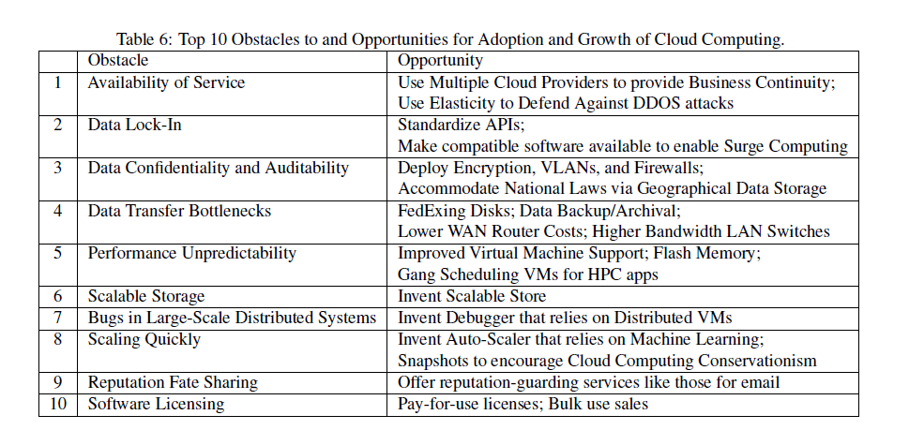
Challenges
Notes:
We will revist these later in the course.

Slide 16
Supercomputers, Clusters and Grid
Supercomputers:
accessed remotely
job processing
Cluster computing:
commodity hardware
job processing
Grid computing (closest to McCarthy vision):
share access to compute and storage resources across institutions
universities, research institutions, non-commercial
highly interoperable
focus still is job processing
Cloud computing:
commercial sharing of resources
not necessarily interoperable
supports interactive computing and job processing
Notes:
Next week we will look at papers that talk about some related technologies.

