Slide 1
Infrastructure as a Service and Cloud Technologies
Zoltan Debre
NWEN 406
1st of Aug 2017

Slide 2
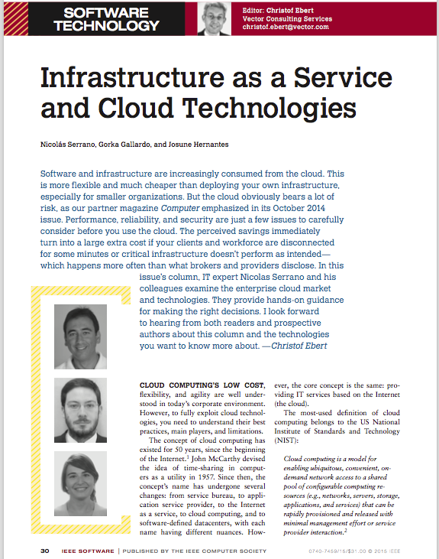
Content
Main topic and the motivation
Cloud Computing - Best Practices
Public Cloud Providers
Private Cloud Solutions
Homework
Original Paper:
Nicolas Serrano, Gorka Gallardo, and Josune Hernantes: Infrastrucutre as a Service and Cloud Technologies (2014)
Notes:
Original article: https://victoria.rl.talis.com/items/559589CF-091E-422C-C113-399800882993.html?referrer=%2Flists%2FAD85CC0D-ADD8-0159-CED7-08A561461C8D.html%23item-559589CF-091E-422C-C113-399800882993

Slide 3
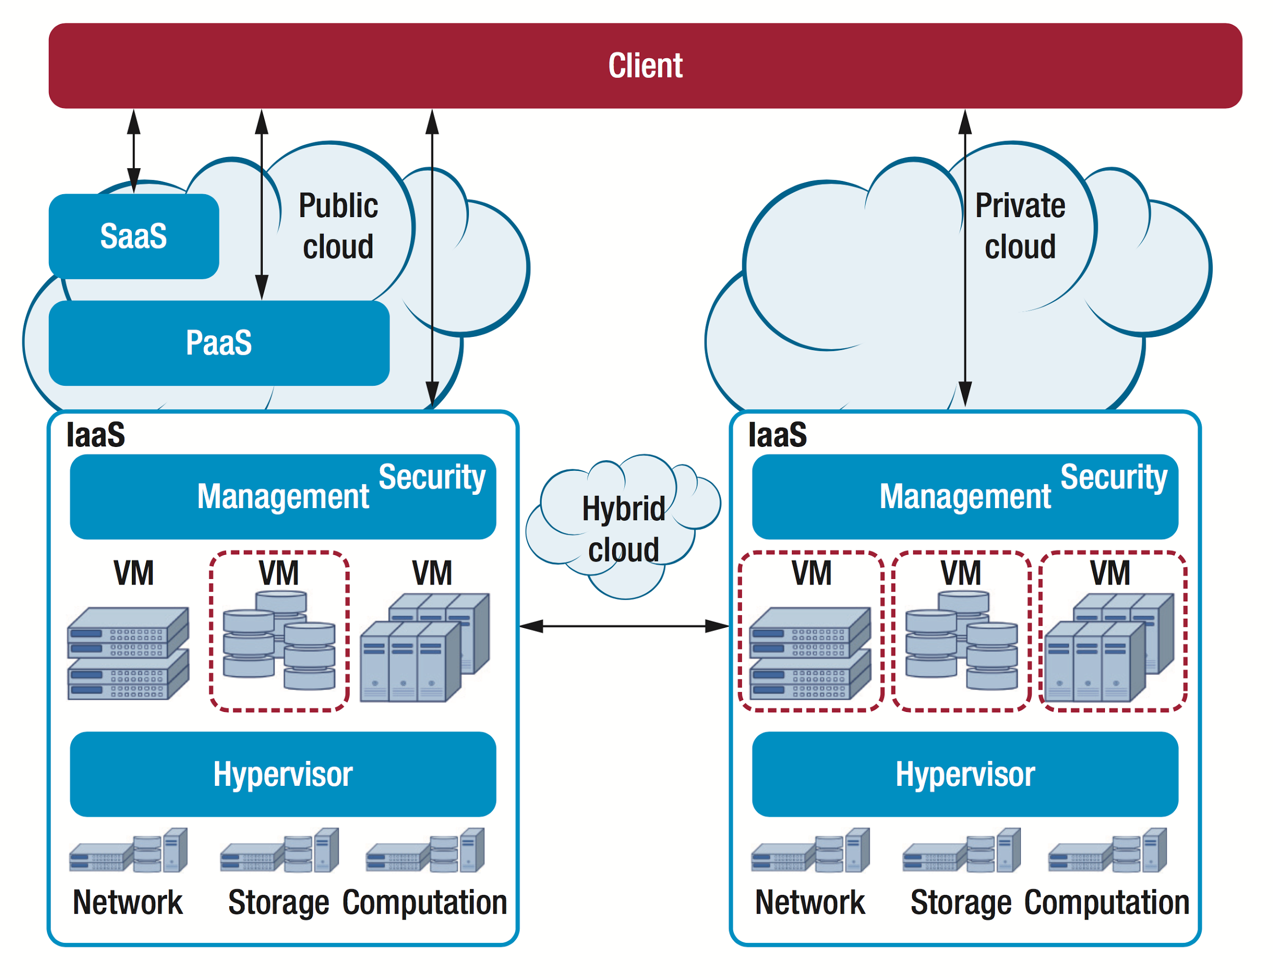
Main idea and motivation
Our main focus:
IaaS (infrastructure as a service)
Options:
Public Cloud
Private Cloud
Hybrid Cloud
Main motivation:
How can we choose the most appropriate cloud-computing model?
To choose the most appropriate cloud-computing model, we must analyse our IT infrastructure, usage and needs.
Notes:
Providers use three well known models (see Figure 1): IaaS (infra- structure as a service), PaaS (plat- form as a service), and SaaS (soft- ware as a service). Here, we focus on IaaS. The next step is to decide on a model for deploying cloud ser- vices. In a public cloud, a provider provides the infrastructure to any customer. A private cloud is offered only to one organization. In a hybrid cloud, a company uses a combina- tion of public and private clouds.
To choose the most appropriate cloud-computing model for your orga- nization, you must analyze your IT in- frastructure, usage, and needs. To help with this, we present here a picture of cloud computing’s current status.

Slide 4
Cloud Computing Best Practices
Notes:
As with every new architectural par- adigm, it’s important to design your systems taking into account the new technology’s characteristics. To se- lect a cloud provider or technology, you should understand your require- ments in order to list the needed fea- tures. Here are some best practices for cloud migration.

Slide 5
Elastic Architecture
IaaS offers precise scalability
How should you architect your system to be able to migrate to Cloud Computing?
Your architecture should be:
Service-oriented architecture
Architect your applications with as much decoupling as possible,
Using queues between services.
Buzzwords to remember:
containers (docker container, kubernetes)
micro-services (vs. monolith)
Notes:
IaaS offers precise scalability. The cloud can outperform physical hard- ware’s classic scale-up or scale-out strategies. To gain as much as you can from this potential, architect your systems and application with as much decoupling as possible, using a service-oriented architecture and us- ing queues between services.

Slide 6
Design For Failure
More services, more software layers, less robust system, more complexity and failure points.
Your system has to be
more redundant,
more fault tolerant,
automatic reboot, relaunch,
has to have a clear backup strategy.
You have to adapt modern development practices:
Automatic Deployment, Continuous Integration, Test-driven development (TDD) For example: a customer feedback about a bug → manual test (confirming the issue) → write automatic test → implement the solution → QA manual test → CI server runs full automatic test → CI server deploy on staging → CI server deploy on production)
Using Chef, Puppet, Ansible, Jenkins, etc.
Notes:
High scalability has limitations. IaaS technology and architecture lead to a less robust system because you’re replacing hardware with sev- eral software layers, adding obvious complexity and failure points. Redundancy and fault tolerance are primary design goals.
Besides having an established backup strategy, to assure business continuity, ensure your system is pre- pared for reboots and relaunches. Automation in your deployment practice is a must, with recipes for server configuration and deployment. Providing automation requires new development practices (development and operations management, continuous integration, test-driven development, and so on) and new tools such as Chef, Puppet, or Ansible.

Slide 7
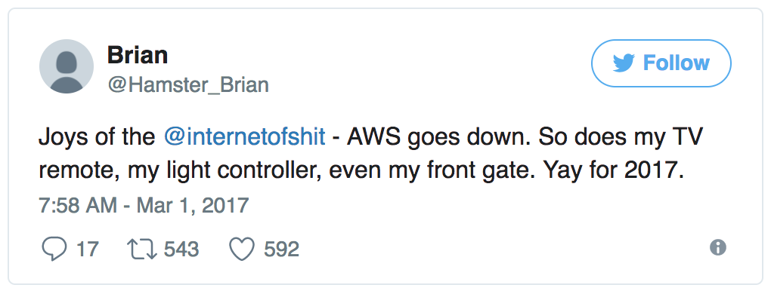
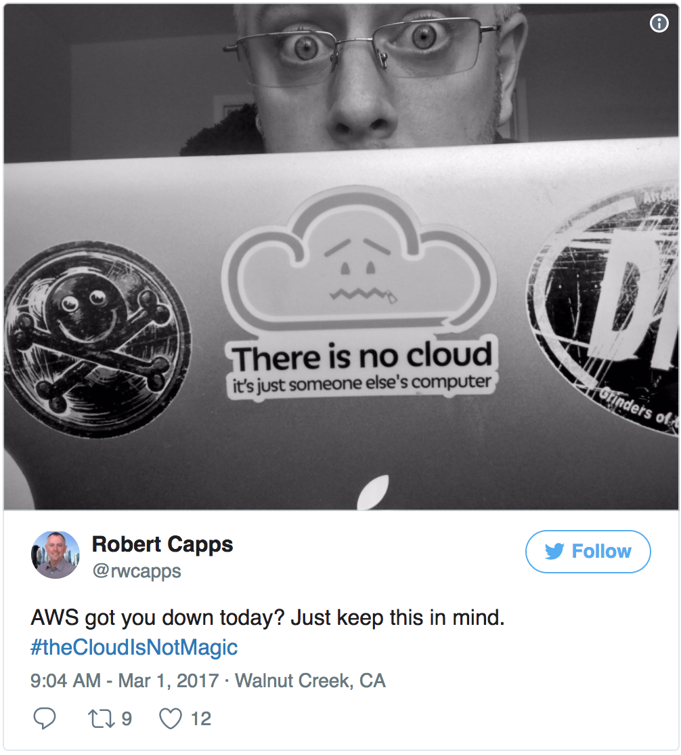
High Availability
We lose the control of the underlying infrastructure. Generally, the service-level agreement (SLA) won't cover all the cost. We have to be prepared for any outages.
Easy to create instances, deploying clusters of servers
Load balancing (important feature to consider when selecting a cloud provider)
Use several available zones in different datacenters, in different regions.
(AWS / Xero outage on 1st of March.)
Notes:
XERO was down because Amazon was down.
http://www.stuff.co.nz/business/world/89916366/Xero-among-cloud-companies-hit-by-Amazon-outage
IT resource disruption has a huge negative impact on any business. Lost control of the underlying infra- structure when moving to the cloud, and the fact than the service-level agreement (SLA) won’t cover all the
incurred costs, should lead you to de- sign with outages and high availabil- ity in mind. With the ease of creating virtual instances, deploying clus- ters of servers or services is a popu- lar approach. In this scenario, load balancing is a well-established tech- nique for operating with clusters; it’s an important feature to consider when selecting a cloud provider.
It’s also important to use several available zones or at least different datacenters to make your system as robust as possible. Amazon Web Ser- vices (AWS) experienced this in April 2011 when its systems didn’t run or ran intermittently for four days. Separating clusters into regions and datacenters will increase your re- sources’resilience.

Slide 8
Performance
Limitations.
Lack of isolation and lost robustness.
Multitenant environment.
A usage burst in a neighbour's instance can affect the available resources.
Latency issues.
Possible solution:
Caching.
Using third party content delivery networks (CDN).
Notes:
You need to consider the technology’s limitations regarding performance - mainly, lack of isolation and lost robustness. In any multitenant environment, an instance’s performance can be affected by your neighbors. A usage burst in a neighbor’s instance can affect the available resources, notably compute units and disks’ IOPS. Your architecture should deal with these changes.
Also, bottlenecks might arise owing to latency issues, even within instances at the same datacenter. Cloud providers offer some features to deal with this (for example, AWS placement groups). However, if your architecture has servers at differ- ent regional datacenters, you should use other techniques (for example, caching).

Slide 9

Security
Public cloud. It is open, you basically store data on "someone else's computer".
Well-established security practices:
Firewalls.
Minimal server services (open ports)
Up-to-date operating systems.
Key-based authentication.
Challenge:
increased number of servers, different development environments (development, staging, production)
Solution:
isolating and securing each environment
Notes:
Links to the story:
https://www.reddit.com/r/cscareerquestions/comments/6ez8ag/accidentally_destroyed_production_database_on/
https://news.ycombinator.com/item?id=14476421
Because of a public cloud’s open characteristics, designing and maintaining a secure infrastructure should be an important driver in any cloud deployment. Enforce well-established security practices: firewalls, minimal server services to reduce attack vectors, up-to-date operating systems, key-based authentication, and so on. But challenges might arise from the increased number of servers to maintain and the use of the cloud for different development environments: development, staging, and production. In this scenario, isolating and securing each environment is important because a breach in a prototyping server can give access through the secret keys to the whole infrastructure.

Slide 10

Monitoring
The number of servers grow exponentially.
Monitoring, logging tools are vital.
Automatic scaling based on events.
Help testing how robust your infrastructure (ex. Netflix Chaos Monkey: https://github.com/Netflix/chaosmonkey )
Important for detecting security breaches and forensics investigation
Notes:
https://github.com/Netflix/chaosmonkey
Chaos Monkey randomly terminates virtual machine instances and containers that run inside of your production environment.
The ease of deploying new resources can make the number of servers grow exponentially. This raises new issues, and monitoring tools are vital to system management. First, they play a basic role in automatic scaling on a cyclical basis and based on events. Second, they’re part of the tools needed to ensure a robust architecture, as the Netflix Chaos Monkey showed. Finally, they’re important for detecting security breaches and forensic investigation, as some security breaches have shown.

Slide 11
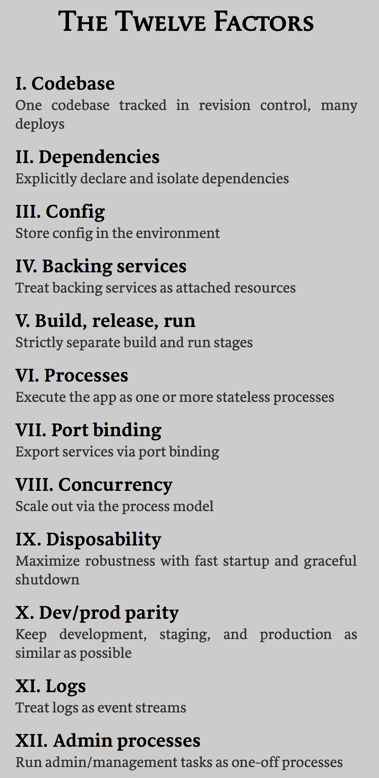
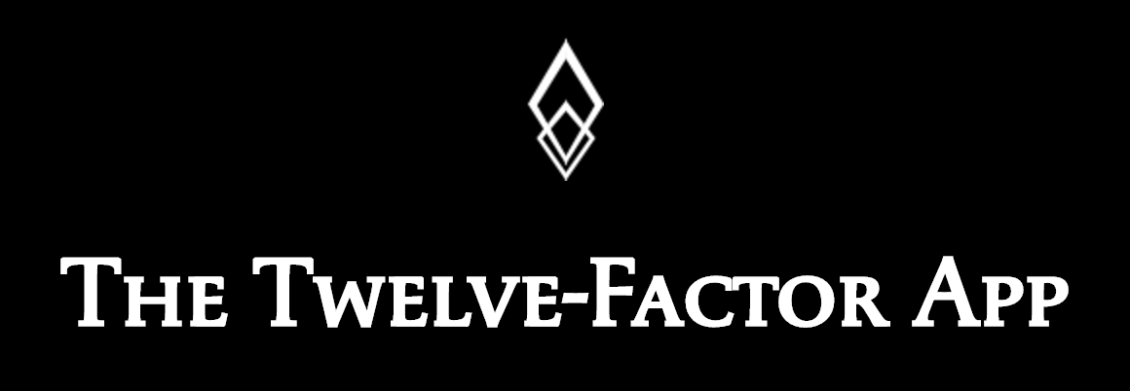
Side note and reminder: The 12 Factor App
https://12factor.net/
The twelve-factor app is a methodology for building software-as-a-service apps.

Slide 12
Public Clouds

Slide 13
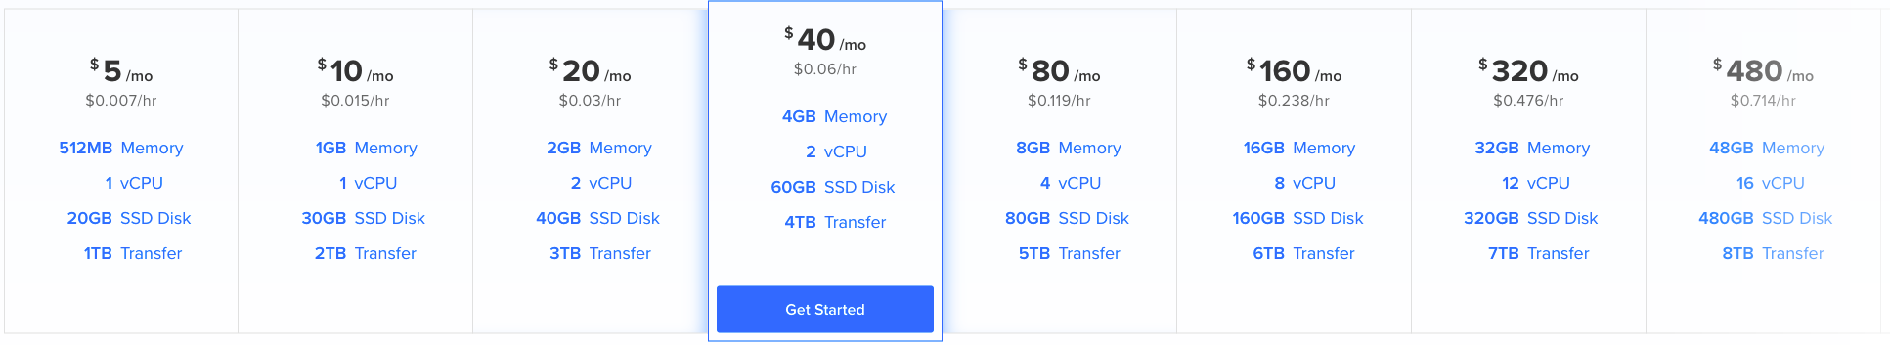
You should consider the followings when you choose public cloud provider
performance-cost ratio (pricing table)
guaranteed performance level
startup times
scalability (load balancer)
latency (CDN)
datacenter location
compliance with data privacy laws and corporate policies
evaluate the accountability the SLA offers in case of noncompliance
Notes:
The public cloud was the first type of cloud offered to the general public, when AWS offered its experience with its private cloud to the general public. When you’re selecting a vendor, it’s important to consider several factors, mainly cost, performance, features, data location, and availability. But because the public cloud is a fairly recent technology, you should also consider vendor positioning and future use trends (see Table 1).
Cloud providers are battling for market position, which is leading them to reduce their public IaaS cloud prices, offering attractive solutions.
It’s important to select the most effective vendor from a performance–cost perspective. However, your comparison should also con- sider whether the performance level is guaranteed, startup times, scalability responsiveness, and latency. These factors might vary among
providers and impact the infrastructure’s responsiveness.
The datacenters’ location can affect your decision. The provider should comply with data privacy laws and corporate policies; the server locations should be based on these considerations. These restrictions might vary among countries and among companies. You might find you’ll need to have all data under the same jurisdiction (for example, in Europe). In other cases, Safe Harbor principles, in which US companies comply with EU laws, can be good enough.
Understanding each player’s SLA is important. But because almost every provider offers high-enough service levels (more than 99.95 per- cent), it’s important to evaluate the accountability the SLA offers in case of noncompliance. Normally, this won’t cover the costs of outages, so your infrastructure should be prepared for them.

Slide 14
Cloud Providers
Amazon (dominant, from 2006, pay-as-you-go, valuable for startups and agile projects, extensive technical support is a premium feature)
Microsoft Azure (from 2010, UI is easy to use)
Rackspace (from 1998, founder of OpenStack, focusing on small-to-medium enterprises)
Google (Google Compute Engine relatively new)
HP (from 2012, HP Cloud Compute, built on OpenStack, great for hybrid cloud)
IBM (for large enterprises, heavy data processing needs and security)

Slide 15
(Issues and Concerns)
Issues that cloud users face:
expertise
security
compliance
cost
performance
managing multiple clouds
Notes:
When considering adoption of a cloud architecture, it’s important to understand what the technology can offer you and the main issues you’ll have to deal with in each of these new infrastructures. Only by clearly understanding each of the approaches’ business and technical opportunities and limitations will you be able to select the best option on the basis of your needs.
Besides the economic advantages from a cost perspective, the main competitive advantages are the flexibility and speed the cloud architecture can add to your IT environment. In particular, this kind of architecture can provide faster deployment of and access to IT resources, and ne-grain scalability.
A recent survey indicated the issues that beginner and experienced enterprise cloud users face.
For beginners, the main issues are security, managing multiple clouds, integration with current systems, governance, and lack of expertise. Experienced companies face issues of compliance, cost, performance, managing multiple clouds, and security.
The differences are understandable. Different problems arise on the basis of the degree of advancement of cloud architecture adoption. Early on, the main issues are resource expertise and control because the company hasn’t acquired enough knowledge of and experience with the architecture. For more experienced companies, performance and cost are important because the architecture’s limitations might have started emerging.
Both groups must deal with security, compliance, and managing multiple clouds. Regarding security and compliance, some problems might arise from the multitenant architecture. Some of these problems might not be solved, which might tip the balance toward a private or hybrid cloud. Such a decision is plausible, in keeping with the issue of managing multiple clouds.

Slide 16
Private and Hybrid Clouds

Slide 17
Motivation
Public clouds main issues: security, compliance, multitenancy.
Solutions is private and hybrid clouds.
usually virtual machines
only the customer's organization can operate it
Notes:
To solve the issues with public clouds, cloud-computing providers introduced the private cloud. This cloud might be in the organization’s buildings, in the farm of the organization’s provider, or in another provider’s datacenter. Usually, it will be virtualized, but other combinations are possible. The important element is that only the customer’s organization can operate it.
Because all private-cloud products allow integration with public clouds, we discuss both private and hybrid clouds here.

Slide 18
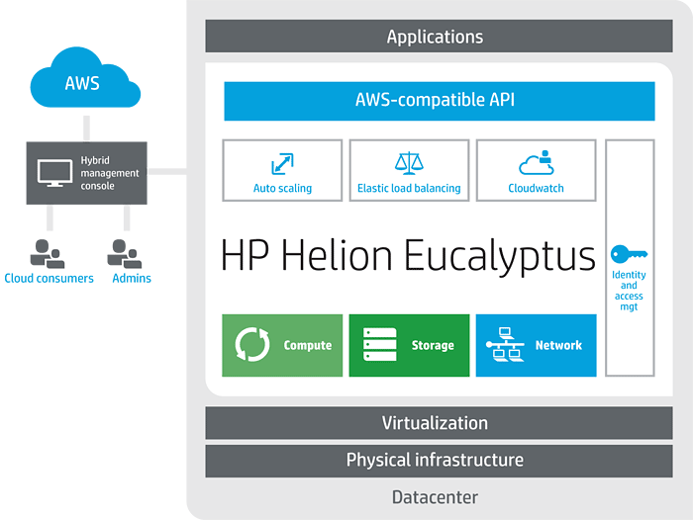
Solutions / Products / Technologies
Open Source Solutions:
Eucalyptus (bought by HP, open source, AWS compatible)
OpenStack (open source, support from big companies such as AT&T, AMD, Cisco, Dell, HP, IBM, Intel, NEC, Red Hat, VMware, Yahoo)
need more expertise
advantage: portability, you can change provider
CloudStack (Citrix, Apache Foundation, complete GUI, monolithic architecture, AWS compatible)
Proprietary Solutions:
VMware (vCloud Hybrid Service, vCloud Connector, vSphere)
Microsoft (Azure, Windows Server, System Center)
Lack of portability
Notes:
https://en.wikipedia.org/wiki/Eucalyptus_(software)
https://www.openstack.org/
Eucalyptus (www.eucalyptus.com) released its first product in 2008. Nowadays the company provides its software as open source products and services. (Recently, Eucalyptus was bought by HP, a supporter of OpenStack.) From the company’s download area, you can install a private cloud on your computer. From its product area, you can contract servers for your private cloud.
Eucalyptus software’s main advantage is its AWS compatibility (see Table 3), based on a partnership with Amazon. So, some features that AWS makes available for the public cloud are applicable to Eucalyptus services.
Eucalyptus software’s weak points are the limited GUI and the risk of uncertainty generated by AWS’s private-cloud strategy: AWS offers Amazon Virtual Private Cloud and a connection to a hardware VPN (virtual private network).
OpenStack (www.openstack.org) is the other main player in the privatecloud field. It’s also open source, and its greatest strength is its support from companies such as AT&T, AMD, Cisco, Dell, HP, IBM, Intel, NEC, Red Hat, VMware, and Yahoo.
OpenStack is complex, with different components and multiple command-line interfaces. Competitors say it’s not a product but a technology. This can be a barrier for nontechnical companies but not for public- and private-cloud providers, which are OpenStack’s main users. For them, an open source product is attractive because, just as with using Linux in server computers, there are cost and portability advantages for the end user.
Portability is another important feature of OpenStack because end users don’t want to be locked into a particular provider. However, providing the option of portability can be an issue for providers that want to offer differentiated proprietary features

Slide 19
Low Budget Solutions
Static website providers (free)
Github Pages (https://pages.github.com/)
Surge.sh (http://surge.sh/)
Cheap cloud services
Digital Ocean (https://www.digitalocean.com/)
IWStack (http://iwstack.com/)
Vultr (https://www.vultr.com/)
Linode (https://www.linode.com/)
Always a good option:
Heroku (http://heroku.com/)
Firebase from Google (https://firebase.google.com/)

Slide 20
Homework
12 factor app
Playing with static website hosting services
Playing with Heroku
Build and deploy and app on Firebase (www.yoember.com)

Slide 21
Thank You!
http://zoltan.nz

