Slide 1
Apache Spark: A Unified Engine for Big Data Processing
Part 2 :
Higher-level Libraries and Applications
Jinsu Li
2017/8/21

Slide 2
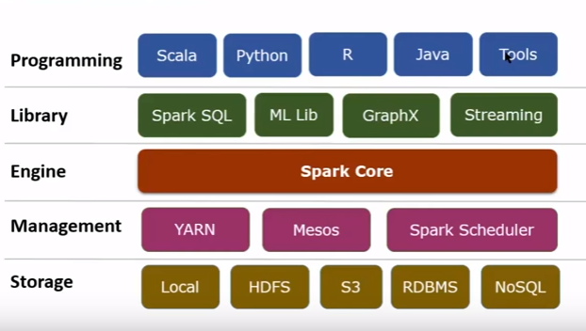
Apache Spark Framework
Notes:
Overview of Apache Spark Framework

Slide 3
Higher-level Libraries
SQL and DataFrames
Spark Streaming
GraphX
MLlib
Notes:
The RDD programming model provides only distributed collections of objects and functions to run on them.
There are a variety of higher-level libraries on Spark, targeting many of the use cases of specialized computing engines.
The key idea is that if we control the data structures stored inside RDDs, the partitioning of data across nodes, and the functions run on them, we can implement many of the execution techniques in other engines.
We now discuss the four main libraries included with Apache Spark.

Slide 4
Spark SQL
Spark SQL is used for structured/semi structured data and implements relational queries.
Spark SQL uses techniques similar to analytical databases.
columnar storage
cost-based optimization
code generation for query execution
Make queries fast
Notes:
One of the most common data processing paradigms is relational queries.
Spark SQL and predecessor, Shark, implement such queries on Spark.
For example, these systems support columnar storage, cost-based optimization, and code generation for query execution.
The main idea behind these systems is to use the same data layout as analytical databases—compressed columnar storage—inside RDDs.
Advantages:
Provide a common way to access a variety of data sources, including Hive, Avro, Parquet, ORC, JSON, and JDBC.
Usable in Java, Scala, Python and R.
Use In-Memory Columnar Storage, byte-code generation techniques.
Hive Compatibility
Standard Connectivity, JDBC or ODBC

Slide 5
DataFrames
Spark SQL engine provides a higher-level abstraction for basic data transformations called DataFrames.
A DataFrame is a distributed collection of data organized into named columns.
DataFrames can be constructed from a wide array of sources such as: structured data files, tables in Hive, external databases, or existing RDDs.
Notes:
Beyond running SQL queries, Spark SQL engine provides a higer-level abstraction for basic data transformations called DataFrames,
which are RDDs of records with a known schema.
When running SQL from within another programming language the results will be returned as a DataFrame.
Because Spark SQL provides a common way to access a variety of data sources, users can use DataFrame API to perform various relational operations on both external data sources and Spark’s built-in distributed collections without providing specific procedures for processing data.
Also, programs based on DataFrame API will be automatically optimized by Spark’s built-in optimizer, Catalyst.

Slide 6
SQL and DataFrames – Examples
context = HiveContext(sc)
results = context.sql("SELECT * FROM people")
context.jsonFile("s3n://...").registerTempTable("json")
results = context.sql(
"""SELECT * FROM people JOIN json ...""")
Notes:
Spark SQL lets you query structured data inside Spark program, using either SQL or a familiar DataFrame API.
Usable in Java, Scala, Python and R.
Example1 :
Use SQL queries to access structured data.
DataFrames and SQL provide a common way to access a variety of data sources, including Hive, Avro, Parquet, ORC, JSON, and JDBC.
You can even join data across these sources.
Example2:
Join data across structured data and json.

Slide 7
SQL and DataFrames – Examples
import org.apache.spark.sql.SQLContext
// URL for your database
val url = "jdbc:mysql://yourIP:yourPort/test?user=yourUsername;password=yourPassword" server.
// Create a sql context object
val sqlContext = new org.apache.spark.sql.SQLContext(sc)
// Looks the schema of this DataFrame.
val df = sqlContext.read.format("jdbc").option("url", url).option("dbtable", "people").load()df.printSchema()
Notes:
You can also interact with the SQL interface using the command-line or over JDBC/ODBC.
This is a examples which uses JDBC.

Slide 8
SQL and DataFrames
Filtering
Computing New Cols
IndexedRDDs
Aggregation
ZipWithIndex
Indexing
StringIndexer
Notes:
DataFrames are a common abstraction for tabular data in R and Python, with programmatic methods for filtering,
computing new columns, and aggregation.
In the article, they mentioned that one technique not yet implemented in Spark SQL is indexing.
But there are other libraries or functions over Spark do use it. (such as IndexedRDDs)
For example, you can convert the DataFrame to an RDD, do zipWithIndex, and convert the resulting RDD back to a DataFrame.
Another approach could be to use the Spark MLLib String Indexer.

Slide 9
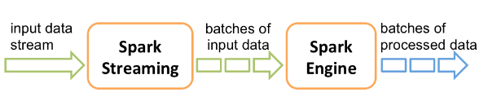
Spark Streaming
Spark Streaming implements incremental stream processing using a model called “discretized streams.”(DStream)
It works as follows.
Split the input data into small batches (such as every 200 milliseconds)
Combine these small batches with state stored inside RDDs to produce new results.
Notes:
Spark Streaming is an extension of the core Spark API that enables scalable, high-throughput, fault-tolerant stream processing of live data streams. Data can be ingested from many sources like Kafka, Flume, Kinesis, or TCP sockets, and can be processed using complex algorithms expressed with high-level functions like map, reduce, join and window. Finally, processed data can be pushed out to file systems, databases, and live dashboards. In fact, you can apply Spark’s machine learning and graph processing algorithms on data streams.
Internally, it works as follows. Spark Streaming receives live input data streams and divides the data into batches, which are then processed by the Spark engine to generate the final stream of results in.

Slide 10
Spark Streaming
Running steaming computations this way have several benefits:
Fault recovery is less expensive due to using lineage.
It is possible to combine streaming with batch and interactive queries.
Notes:
Running steaming computations this way have several benefits than traditional ones, such as Apache Storm and Apache Flink

Slide 11
GraphX
GraphX is a distributed graph processing framework.
GraphX is used for graphs and graph-parallel computation
GraphX provides a graph computation interface similar to Pregel and GraphLab.
Notes:
GraphX implements the same placement optimizations as these systems (such as vertex partitioning
schemes) through its choice of partitioning function for the RDDs it builds.
At a high level, GraphX extends the Spark RDD by introducing a new Graph abstraction: a directed multigraph with properties attached to each vertex and edge. To support graph computation, GraphX exposes a set of fundamental operators (e.g., subgraph, joinVertices, and aggregateMessages) as well as an optimized variant of the Pregel API. In addition, GraphX includes a growing collection of graph algorithms and builders to simplify graph analytics tasks.

Slide 12
MLlib
Spark MLlib is a distributed machine learning framework.
Spark MLlib implements more than 50 common algorithms for distributed model training, such as classification, regression, clustering, and collaborative filtering
For example:
the common distributed algorithms of decision trees (PLANET)
Latent Dirichlet Allocation
Alternating Least Squares matrix factorization
Notes:
MLlib is Spark’s machine learning (ML) library. Its goal is to make practical machine learning scalable and easy.
At a high level, it provides tools such as:
1) ML Algorithms: common learning algorithms such as classification, regression, clustering, and collaborative filtering
2) Featurization: feature extraction, transformation, dimensionality reduction, and selection
3) Pipelines: tools for constructing, evaluating, and tuning ML Pipelines
4) Persistence: saving and load algorithms, models, and Pipelines
5) Utilities: linear algebra, statistics, data handling, etc.

Slide 13
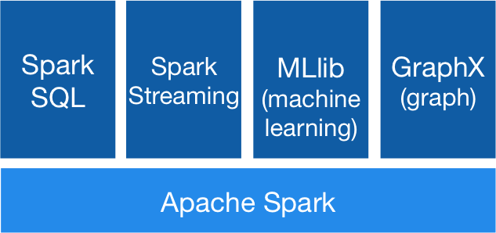
Combining processing tasks
These libraries can be combined easily and seamlessly in the same application.
Compatibility at the API/libraries level
Notes:
Spark’s libraries all operate on RDDs as the data abstraction, making them easy to combine in applications.

Slide 14
Example: combining the SQL, MLlib and Streaming libraries in Spark
// Load historical data as an RDD using Spark SQL
val trainingData = sql(
“SELECT location, language FROM old_tweets”)
// Train a K-means model using MLlib
val model = new KMeans().setFeaturesCol(“location”)
.setPredictionCol(“language”).fit(trainingData)
// Apply the model to new tweets in a stream
TwitterUtils.createStream(...)
.map(tweet => model.predict(tweet.location))
Notes:
For example, it shows a program that reads some historical Twitter data using Spark SQL, trains a K-means clustering
model using MLlib, and then applies the model to a new stream of tweets.
The data tasks returned by each library (here the historic tweet RDD and the K-means model) are easily passed to other
libraries.

Slide 15
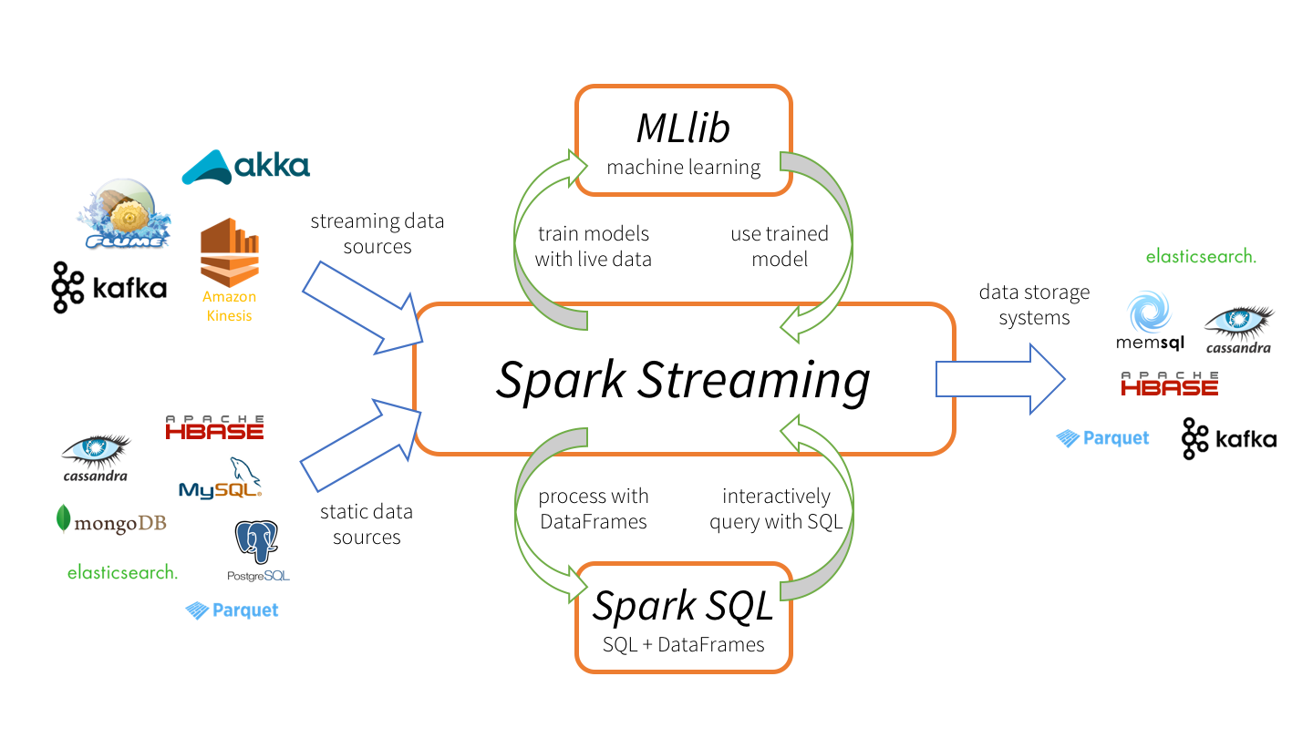
Example: Spark Streaming ecosystem
Notes:
Spark Streaming ecosystem: Spark Streaming can consume static and streaming data from various sources, process data using Spark SQL and DataFrames, apply machine learning techniques from MLlib, and finally push out results to external data storage systems

Slide 16
Combining processing tasks
Spark will fuse these operations into a single map - Map B
Compatibility at the execution level
Library A
Map A
e.g.
Library B
Map A1
Notes:
Apart from compatibility at the API level, composition in Spark is also efficient at the execution level, because Spark can optimize across processing libraries.
For example, if one library runs a map function and the next library runs a map on its result, Spark will fuse these operations into a single map.
Likewise, Spark’s fault recovery works seamlessly across these libraries, re-computing lost data no matter which libraries produced it.

Slide 17
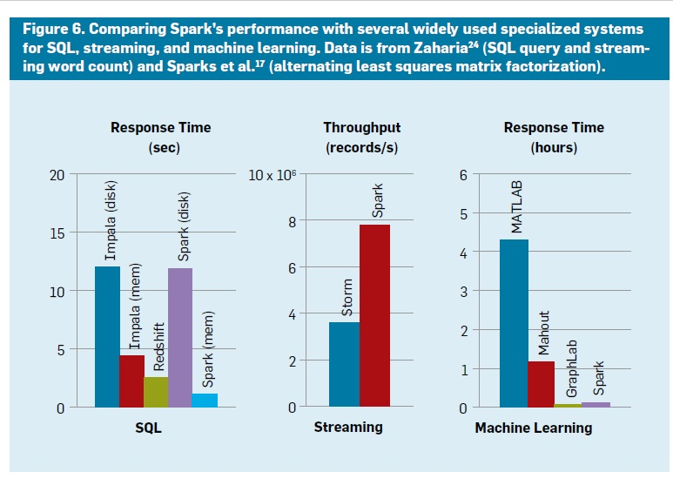
Performance
Conclusion:
Spark is generally comparable with specialized systems like Storm, GraphLab, and Impala
In 2014, Spark entered the Daytona GraySort benchmark (http://sortbenchmark.org/)
Notes:
Given that these libraries run over the same engine, do they lose performance?
Figure compares Spark’s performance on three simple tasks—a SQL query, streaming word count, and machine learning—versus other engines.
While the results vary across workloads, Spark is generally comparable with specialized systems like Storm, GraphLab, and Impala.

Slide 18
Applications
More than 1000 companies use Apache Spark.
(On website ”idatalabs.com”, it shows that there are 2,862 companies using Apache Spark.
https://idatalabs.com/tech/products/apache-spark)
Used in a wide range of areas, such as web services, biotechnology, finance
Users often combine multiple of its libraries.
Notes:
Apache Spark is used in a wide range of applications.
There are more than 1000 companies using Spark, in areas from web services to biotechnology to finance.
On website “https://idatalabs.com/tech/products/apache-spark” , it shows that there are 2,862 companies using Apache Spark.
Across these workloads, users take advantage of Spark’s generality and often combine multiple of its libraries.

Slide 19
Applications
Batch processing
Interactive queries
Stream processing
Scientific applications
Spark components used
Notes:
Here, we will cover a few top use cases.

Slide 20
Batch processing
Spark’s most common applications are for batch processing.
Page personalization and recommendation at Yahoo!
Managing a data lake at Goldman Sachs
Graph mining at Alibaba
Financial Value at Risk calculation
Text mining of customer feedback at Toyota
8,000-node cluster at Chinese social network Tencent that ingests 1PB of data per day
Notes:
Spark’s most common applications are for batch processing on large datasets, including Extract-Transform-Load workloads to
convert data from a raw format (such as log files) to a more structured format and offline training of .machine learning models.
The largest published use is an 8,000-node cluster at Chinese social network Tencent that ingests 1PB of data per day.
While Spark can process data in memory, many of the applications in this category run only on disk. In such cases, Spark can still improve performance over MapReduce due to its support for more complex operator graphs.

Slide 21
Interactive queries
Three main types:
Using Spark SQL for relational queries – Tableau
e.g. eBay, Baidu
Using Spark’s Scala, Python, and R interfaces interactively through shells or visual notebook environments
Using domain-specific interactive applications
e.g. Tresata (anti-money laundering), Trifacta(data cleaning), and PanTera (largescale visualization)
Notes:
several vendors have developed domain-specific interactive applications that run on Spark.

Slide 22
Stream processing
Real-time processing is also a popular use case. Both in analytics and in real-time decision streaming making applications.
Network security monitoring at Cisco
Prescriptive analytics at Samsung SDS
Log mining at Netflix
Content distribution server performance model maintaining at video company Conviva
Notes:
Real-time processing is also a popular use case. Both in analytics and in real-time decision streaming making applications.
Many of these applications also combine decision streaming with batch and interactive queries.
querying it automatically when it moves clients across servers, in an application that requires substantial parallel work for
both model maintenance and queries.

Slide 23
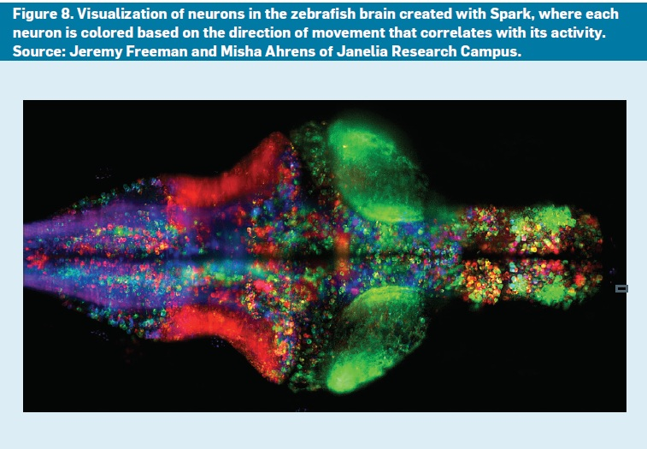
Scientific applications
Thunder platform for neuroscience
Combine
Batch processing, interactive query,
machine learning,
and
stream processing
Notes:
Spark has also been used in several scientific domains, including large-scale spam detection, image processing, and genomic data processing.
One example that combines batch, interactive, and stream processing is the Thunder platform for neuroscience at Howard Hughes Medical Institute, Janelia Farm
It is designed to process brain-imaging data from experiments in real time, scaling up to 1TB/hour of whole-brain imaging
data from organisms (such as zebrafish and mice). Using Thunder, researchers can apply machine learning algorithms
(such as clustering and Principal Component Analysis) to identify neurons involved in specific behaviors. The same
code can be run in batch jobs on data from previous runs or in interactive queries during live experiments.

Slide 24
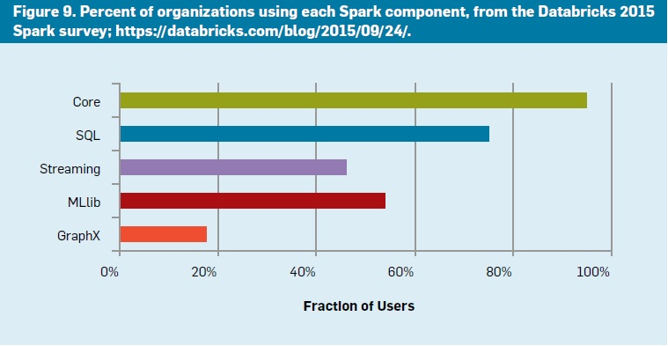
Spark components used
Most organizations use multiple components;
88% use at least two,
60% use at least three,
27% use at least four.
Notes:
We see that many components are widely used, with Spark Core and SQL as the most popular.
Streaming is used in 46% of organizations and machine learning in 54%.
most organizations use multiple components; 88% use at least two of them,
60% use at least three (such as Spark Core and two libraries), and 27% use at least four components.

Slide 25
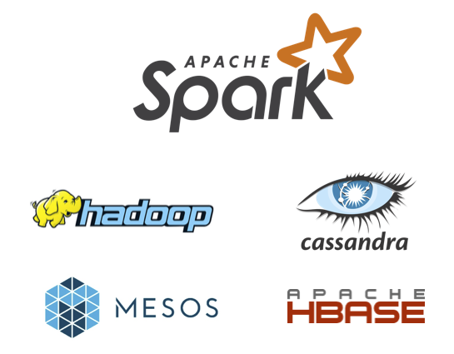
Deployment environments
Spark runs on Hadoop, Mesos, standalone, or on the cloud.
Spark can access diverse data sources including HDFS, Cassandra, HBase, and S3.
Notes:
We also see growing diversity in where Apache Spark applications run and what data sources they connect to.
While the first Spark deployments were generally in Hadoop environments,
only 40% of deployments in our July 2015 Spark survey were on the Hadoop YARN cluster manager.
In addition, 52% of respondents ran Spark on a public cloud.

Slide 26
Thank You!

Slide 27
Questions
What is machine learning?
Machine learning is an application of artificial intelligence (AI) that provides systems the ability to automatically learn and improve from experience without being explicitly programmed. Machine learning focuses on the development of computer programs that can access data and use it learn for themselves.
The process of learning begins with observations or data, such as examples, direct experience, or instruction, in order to look for patterns in data and make better decisions in the future based on the examples that we provide. The primary aim is to allow the computers learn automatically without human intervention or assistance and adjust actions accordingly.

