Slide 1
MapReduce: Simplified Data Processing on Large Clusters
Presented by: David Barnett & Miguel Orevillo
07/08/17

Slide 2
Problem
Had 100’s of special-purpose programs to handle large data
Distributed across 100+ machines
Each with its own implementation of handling distributed computing
Notes:
-----
Google have implemented hundreds of special-purpose
computations that process large amounts of raw data,
such as crawled documents, web request logs, etc., to
compute various kinds of derived data.

Slide 3
Motivation - Issues
Parallelization
Fault Tolerance
Data Distribution
Load Balancing
Notes:
----
However, the input data is usually large and the computations have to be distributed across hundreds or thousands of machines in order to finish in a reasonable amount of time. The issues of how to parallelize the computation, that is how different computations are distributed across different machines, handle failures conspire to obscure the original simple computation with large amounts of complex code to deal with these issues.

Slide 4
Motivation - Proposed Solution
A library that abstracts away the difficulties of processing large data
Parallelization
Functional programming model
Fault-tolerance
Can duplicate tasks
Data Distribution
Distributed file system (GFS)
Load balancing
Master node partitions work
Notes:
As a reaction to this complexity, we designed a new
abstraction that allows us to express the simple computations we were trying to perform but hides the messy details of parallelization, fault-tolerance, data distribution
and load balancing in a library. Our abstraction is inspired by the map and reduce primitives present in Lisp
and many other functional languages. We realized that
most of our computations involved applying a map operation to each logical “record” in our input in order to
compute a set of intermediate key/value pairs, and then
applying a reduce operation to all the values that shared
the same key, in order to combine the derived data appropriately. Our use of a functional model with user specified map and reduce operations allows us to parallelize large computations easily and to use re-execution
as the primary mechanism for fault tolerance.
The major contributions of this work are a simple and
powerful interface that enables automatic parallelization
and distribution of large-scale computations, combined
with an implementation of this interface that achieves
high performance on large clusters of commodity PCs.

Slide 5
Programming Model
Map
Takes input pair
Produces set of intermediate key/value pairs
Reduce
Accepts a key and all values associated with key
Merges all values to possibly form a smaller set of values (typically 1 or 0)
Notes:
Map, written by the user, takes an input pair and produces a set of intermediate key/value pairs. The MapReduce library groups together all intermediate values associated with the same intermediate key I and passes them to the Reduce function.
The Reduce function, also written by the user, accepts an intermediate key I and a set of values for that key. It merges together these values to form a possibly smaller set of values. Typically just zero or one output value is produced per Reduce invocation. The intermediate values are supplied to the user’s reduce function via an iterator. This allows us to handle lists of values that are too large to fit in memory.

Slide 6
Examples
Distributed Grep
Finds a matching pattern
Map - finds matching key (line)
Reduce - pipes to output
Count of URL Access Frequency
Counts number of requests to URL
Map - logs of web page requests (key)
Reduce - totals the count of URL access’
Notes:
Distributed Grep: The map function emits a line if it matches a supplied pattern. The reduce function is an identity function that just copies the supplied intermediate data to the output.
The map function processes logs of web page requests and outputs hURL, 1i. The reduce function adds together all values for the same URL and emits a hURL, total counti pair.

Slide 7
Google File System Background
Distributed File System
Breaks files into different blocks
Replicate across multiple nodes
High read speeds
Notes:
A network based file system that is distributed across a data centre.
Breaks down files into smaller blocks that are then replicated across multiple nodes across the network.

Slide 8
Implementation

Slide 9
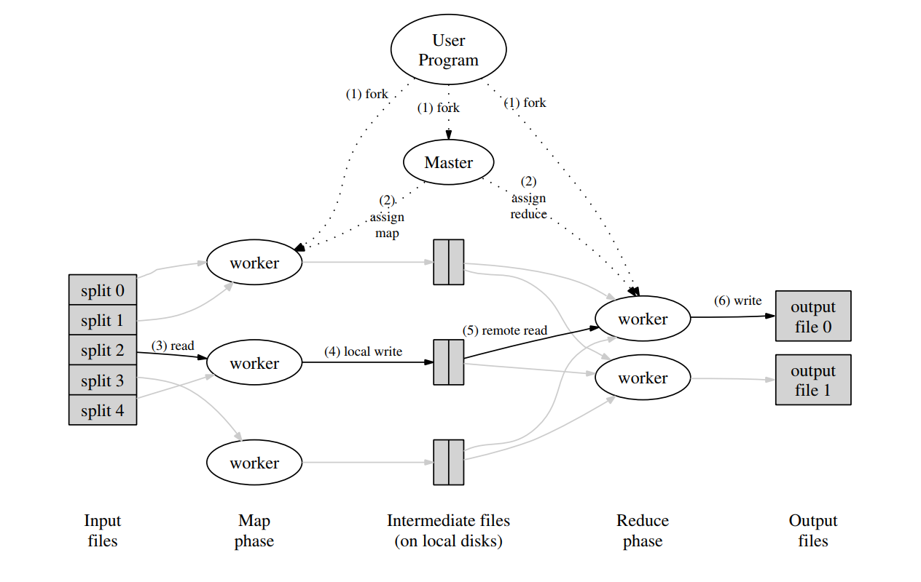
Execution Overview
Notes:
Image shows overall flow of a MapReduce function. From here, we see that Map invocations are distributed across multiple machines which are partitioned into M number of blocks. These input blocks/splits can be processed in parallel by different machines.
This model is a key representation of the overall flow and we will now go over the crucial steps of a MapReduce function

Slide 10
Step 1:
Split input files into M pieces
Typically 16-64 Mb
Starts as many copies of the program on different machines
Notes:
The MapReduce library in the user program first
splits the input files into M pieces of typically 16
megabytes to 64 megabytes (MB) per piece (controllable by the user via an optional parameter, and related to the Google File system setup). It
then starts up many copies of the program on a cluster of machines.

Slide 11
Step 2:
One of the copies is “special” - Master
Master then assigns work to other workers
M number of Map tasks
R number of Reduce Tasks
Picks idle workers
Notes:
One of the copies of the program is special – the
master. The rest are workers that are assigned work
by the master. There are M map tasks and R reduce
tasks to assign. The master picks idle workers and
assigns each one a map task or a reduce task.

Slide 12
Step 3:
If worker has Map task
Reads content of input
Parses key/value pairs and passes to Map function
Buffered in memory
Notes:
A worker who is assigned a map task reads the
contents of the corresponding input split. It parses
key/value pairs out of the input data and passes each
pair to the user-defined Map function. The intermediate key/value pairs produced by the Map function
are buffered in memory.

Slide 13
Step 4:
Periodically writes into memory
Locations on where they are stored passed back to Master
Responsible for forwarding locations to workers with Reduce tasks
Notes:
Periodically, the buffered pairs are written to local
disk, partitioned into R regions by the partitioning
function. The locations of these buffered pairs on
the local disk are passed back to the master, who
is responsible for forwarding these locations to the
reduce workers.

Slide 14
Step 5:
RPC to read buffered data from local disks of workers
Sorts and groups by intermediate keys
Important as many keys map to same reduced task
If too large, external sort used
Notes:
When a reduce worker is notified by the master
about these locations, it uses remote procedure calls
to read the buffered data from the local disks of the
map workers. When a reduce worker has read all intermediate data, it sorts it by the intermediate keys
so that all occurrences of the same key are grouped
together. The sorting is needed because typically
many different keys map to the same reduce task. If
the amount of intermediate data is too large to fit in
memory, an external sort is used.

Slide 15
Step 6:
Reduce worker iterates over data
For each unique key, passes corresponding key and values to Reduce function
Output of Reduce function appended to final output file
Notes:
The reduce worker iterates over the sorted intermediate data and for each unique intermediate key encountered, it passes the key and the corresponding
set of intermediate values to the user’s Reduce function. The output of the Reduce function is appended
to a final output file for this reduce partition.

Slide 16
Step 7:
Wakes up user program
Now in output file
Data can now be used
Notes:
When all map tasks and reduce tasks have been
completed, the master wakes up the user program.
At this point, the MapReduce call in the user program returns back to the user code.
After successful completion, the output of the mapreduce execution is available in the R output files (one per
reduce task, with file names as specified by the user).
Typically, users do not need to combine these R output
files into one file – they often pass these files as input to
another MapReduce call, or use them from another distributed application that is able to deal with input that is
partitioned into multiple files.

Slide 17
Execution Overview
Notes:
Once all of the steps are done, output is then available for users in different output files as seen on the image. These files often pass these files into another MapReduce call, or use them from another distributed application that is able to deal with input that is partitioned into multiple files.

Slide 18
Fault Tolerance
Worker failure
Heartbeat from master
Tasks rescheduled if no response
Resilient to large-scale worker failures
Master failure
Takes snapshots to restore from failure
Failure unlikely
Notes:
-----
Worker Failure
The master pings every worker periodically. If no response is received from a worker in a certain amount of time, the master marks the worker as failed. Any map tasks completed by the worker are reset back to their initial idle state, and therefore become eligible for scheduling on other workers. Similarly, any map task or reduce task in progress on a failed worker is also reset to idle and becomes eligible for rescheduling. Completed map tasks are re-executed on a failure because their output is stored on the local disk(s) of the failed machine and is therefore inaccessible. Completed reduce tasks do not need to be re-executed since their output is stored in a global file system. When a map task is executed first by worker A and then later executed by worker B (because A failed), all workers executing reduce tasks are notified of the re-execution. Any reduce task that has not already read the data from worker A will read the data from worker B. MapReduce is resilient to large-scale worker failures.
Master Failure
It is easy to make the master write periodic checkpoints of the master data structures described above. If the master task dies, a new copy can be started from the last checkpointed state. However, given that there is only a single master, its failure is unlikely; therefore our current implementation aborts the MapReduce computation if the master fails. Clients can check for this condition and retry the MapReduce operation if they desire. Semantics in the Presence of Failures When the user-supplied map and reduce operators are deterministic functions of their input values, our distributed implementation produces the same output as would have been produced by a non-faulting sequential execution of the entire program.

Slide 19
Backup Tasks
All tasks are re-executable
Create backup tasks for almost completed ones
Stragglers
Slow nodes
Their tasks are executed on free nodes
Notes:
When a MapReduce operation is close to completion, the master schedules backup executions of the remaining in-progress tasks. These tasks are then completed as mark whenever either the backup or actual execution are completed. In this case, the mechanism increases its computational resources by only a few percent in order to complete these tasks in order to significantly reduce time to complete large MapReduce operations.
=======
We have a general mechanism to alleviate the problem of stragglers. When a MapReduce operation is close to completion, the master schedules backup executions of the remaining in-progress tasks. The task is marked as completed whenever either the primary or the backup execution completes. We have tuned this mechanism so that it typically increases the computational resources used by the operation by no more than a few percent. We have found that this significantly reduces the time to complete large MapReduce operations.
Stragglers:
One of the common causes that lengthens the total time taken for a MapReduce operation is a “straggler”: a machine that takes an unusually long time to complete one of the last few map or reduce tasks in the computation. Stragglers can arise for a whole host of reasons. For example, a machine with a bad disk may experience frequent correctable errors that slow its read performance from 30 MB/s to 1 MB/s

Slide 20
Locality
Network is scarce
GFS distributes data to all nodes
Replicates to at least 3 nodes
Available nodes close to the data assigned task
On disk
Same switch
Same data center
Notes:
The design focused on the constraint of network is the bottleneck and to reduce this nodes are pre-populated to reduce the load.
----
Network bandwidth is a relatively scarce resource in our
computing environment. We conserve network bandwidth by taking advantage of the fact that the input data
(managed by GFS [8]) is stored on the local disks of the
machines that make up our cluster. GFS divides each
file into 64 MB blocks, and stores several copies of each
block (typically 3 copies) on different machines. The
MapReduce master takes the location information of the
input files into account and attempts to schedule a map
task on a machine that contains a replica of the corresponding input data. Failing that, it attempts to schedule
a map task near a replica of that task’s input data (e.g., on
a worker machine that is on the same network switch as
the machine containing the data). When running large
MapReduce operations on a significant fraction of the
workers in a cluster, most input data is read locally and
consumes no network bandwidth.

Slide 21
Results

Slide 22
Experiment
Sort 1TB of data
Distributed to 1700+ nodes
64MB pieces (15,000M & 4,000R)
Measured time and network utilization
Notes:
This experiment is modelled off the Terasort benchmark for distributed systems.

Slide 23
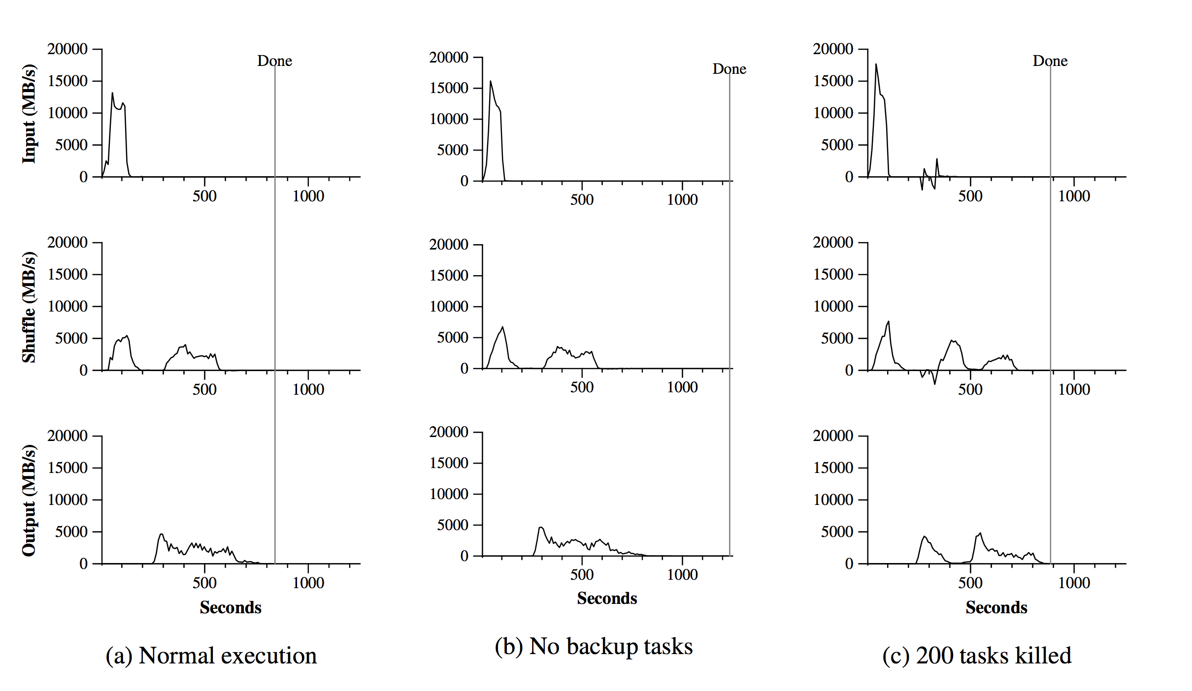
Data transfer rates over time for different executions of the sort program
Notes:
Data from sorting 1TB of data over 1700 computers
Shown is the network usage and time taken
Normal took ~14mins - all operational
No Backup: ~17mins - stragglers are slowing down the whole operation
200 tasks Killed: ~15mins - re-starting tasks & stragglers handled
---
In this section we measure the performance of MapReduce on two computations running on a large cluster of
machines. One computation searches through approximately one terabyte of data looking for a particular pattern.
The other computation sorts approximately one terabyte of data.
These two programs are representative of a large subset of the real programs written by users of MapReduce –
one class of programs shuffles data from one representation to another, and another class extracts a small amount
of interesting data from a large data set.
The sort program sorts 10^10 100-byte records (approximately 1 terabyte of data). This program is modeled after
the TeraSort benchmark [10].
The sorting program consists of less than 50 lines of
user code. A three-line Map function extracts a 10-byte
sorting key from a text line and emits the key and the

Slide 24
Refinements

Slide 25
Local Execution
Faster development
Allows for debugging on the local machine
Run sequentially
Small-scale testing
Notes:
Debugging problems in Map or Reduce functions can be
tricky, since the actual computation happens in a distributed system, often on several thousand machines,
with work assignment decisions made dynamically by
the master. To help facilitate debugging, profiling, and
small-scale testing, we have developed an alternative implementation of the MapReduce library that sequentially
executes all of the work for a MapReduce operation on
the local machine. Controls are provided to the user so
that the computation can be limited to particular map
tasks. Users invoke their program with a special flag and
can then easily use any debugging or testing tools they
find useful (e.g. gdb).

Slide 26
Status Information
Shows progress of computation
Generates links to errors from each task
User can use data to make predictions
Computation length
More resources?
Opportunity for machine learning
Notes:
----
The master runs an internal HTTP server and exports
a set of status pages for human consumption. The status pages show the progress of the computation, such as
how many tasks have been completed, how many are in
progress, bytes of input, bytes of intermediate data, bytes
of output, processing rates, etc. The pages also contain
links to the standard error and standard output files generated by each task. The user can use this data to predict how long the computation will take, and whether or
not more resources should be added to the computation.
These pages can also be used to figure out when the computation is much slower than expected.
In addition, the top-level status page shows which
workers have failed, and which map and reduce tasks
they were processing when they failed. This information is useful when attempting to diagnose bugs in the
user code.

Slide 27

Experience
@
Notes:
Because they eat their own dogfood

Slide 28
How it was Used
Large-scale Machine learning problems
Clustering problems for Google News and Froogle products
Extraction of data for reports
Large-scale graph computations
Notes:
After further enhancements to the initial version of the MapReduce function, there have been several advancements towards this, and have been used across a wide range of domains within Google. These include…..from the paper, these were quite vaguely explained as the stated uses are all internal products at Google and were kept on the down low due to trade secrets, and the works.
From these uses, we can see that the stated problems which was set out at the start of the project has been met and has been overcome.

Slide 29
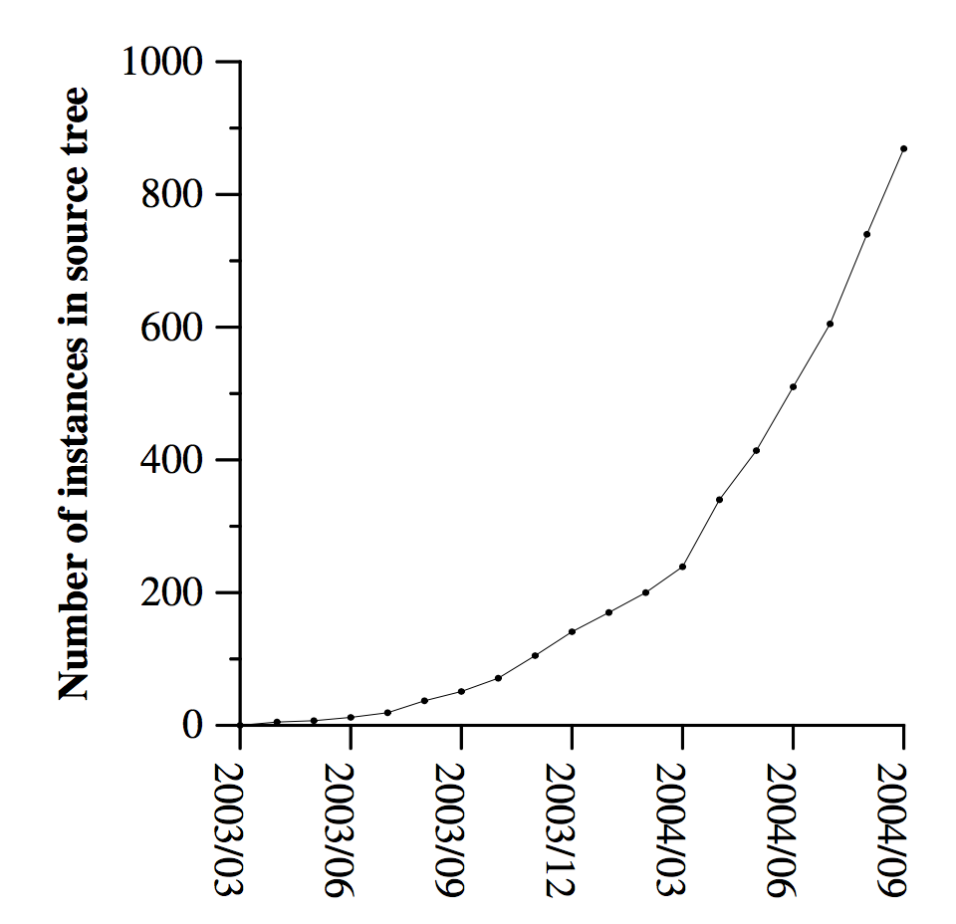
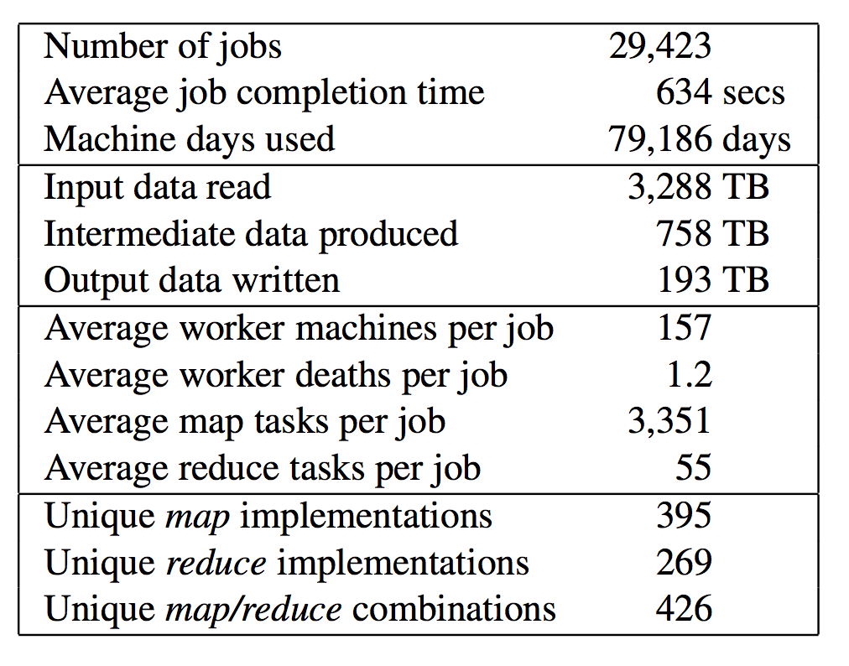
MapReduce instances over time
MapReduce jobs run in August 2004
Notes:
Shown are metrics of the usage of MapReduce at Google, this shows a quick adoption of the technology at Google.

Slide 30
Related Work
Notes:
From this work, there have been many programming models that others have tried and implemented based on the MapReduce Google has made

Slide 31
River
Similar to programming model
Tries to provide good average case performance
Focused on finishing tasks at the same time
MapReduce - finish ASAP
No stragglers
Larger tasks
Notes:
One of these examples would be the River model. The river model has a very similar programming model to MapReduce. River is a model where processes communicate with each other via sending data over different queues. This is because like MapReduce, River tries to average out the performance of each one even in the presence of non uniformities. This is done by carefully scheduling disk and network transfers to achieve balanced completion times. This differs to MapReduce as in MapReduce, tasks are wanted to be completed as soon as possible, that there are no stragglers and that it handles larger tasks than MapReduce.

Slide 32
Others….
Eager Scheduling
Backup task mechanisms similar
MapReduce can drop bad records (continuous failures)
BAD-FS
Different programming models, however;
Uses redundant execution
Locality-aware scheduling
Notes:
Eager scheduling: re-schedules tasks while another node is currently computing it, allows for a faster node to overtake a slower node to speedup the compution as a whole.
Batch Aware Distributed File System (BAD-FS) a file system similar to GFS with optimisations for batches based reads and writes.

Slide 33
HADOOP
Similar
Map-Reduce architecture
Uses distributed file system
Performance Metrics
The Different
Not patented & Legally distinct
Uses std input and output instead of files
Open source
Grants access to a distributed filesystem
Notes:
HADOOP
Apaches implementation for a distributed computing that includes a distributed file system

Slide 34
Summary
Successful model
Was used in Google’s production
Data mining
Machine Learning
Easy to use/program
Replaced with finer-grained controls

Slide 35
Thanks!
Any questions?
You can find us at:
CO228

Slide 36
SlidesCarnival icons are editable shapes.
This means that you can:
Resize them without losing quality.
Change fill color and opacity.
Change line color, width and style.
Isn’t that nice? :)
Examples:

