Slide 1
Introduction to Programming Shared-Memory and Distributed-Memory Parallel Computers
NWEN 406: Distributed Computing in Grids and Clouds 2017 : Kandice McLean and Reuben Puketapu
Notes:
Kandice

Slide 2
Parallel Computing
Parallel computing is a type of computation in which many calculations or the execution of processes are carried out simultaneously.
Notes:
Reuben

Slide 3
How do processors coordinate to solve a problem?
Processors must have the ability to communicate with each other in order to cooperatively complete a task.
Notes:
Reuben

Slide 4
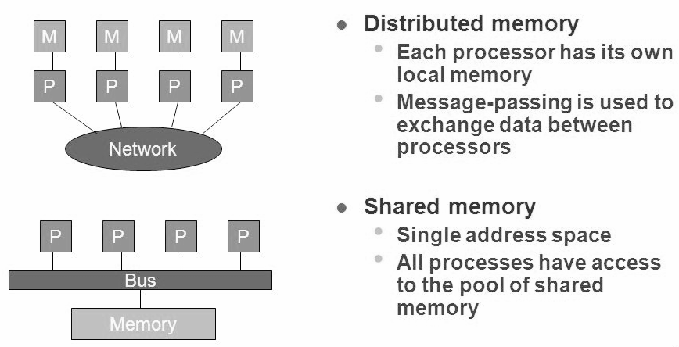
Parallel Computing Architecture
Notes:
Kandice
One parallel computing architecture uses a single address space. Systems based on this concept, otherwise known as shared-memory multiprocessors, allow processor communication through variables stored in a shared address space.
Another major architecture for parallel computers employs a scheme by which each processor has its own memory module. Such a distributed-memory multiprocessor is constructed by connecting each component with a high-speed communications network. Processors communicate to each other over the network.

Slide 5
Parallel Computer Programming
Shared-memory multiprocessor
Different processors can access the same variables
Referencing data stored in memory similar to traditional single-processor programs
Added complexity of shared data integrity
Distributed-memory system
Distribute a computational task to multiple processors with different memory spaces
Reassemble the results from each processor into one solution
Notes:
Reuben

Slide 6
Standards for programming multiprocessors
OpenMP
A set of compiler directives, library functions, and environment variables for developing parallel programs on a shared-memory multiprocessor.
Message Passing Interface (MPI)
An interface for a set of library functions that processors in a distributed-memory multiprocessor can use to communicate with each other
Notes:
Reuben

Slide 7
OpenMP - Introduction
Open standard for providing parallelization in shared-memory multiprocessors.
Specifications for C/C++ and FORTRAN
Specification of compiler directives, library routines and environment variables for parallelisation and runtime characteristics of a program
Notes:
Kandice
OpenMP is an open standard for providing parallelization mechanisms on shared-memory multiprocessors. Specifications exist for C/C++ and FORTRAN, several of the most commonly used languages for writing parallel programs. The standard provides a specification of compiler directives, library routines, and environment variables that control the parallelization and runtime characteristics of a program. Since it is a standard which is enjoying increasing levels of implementation, code written with OpenMP is portable to other shared-memory multiprocessors . The compiler directives defined by OpenMP tell a compiler which regions of code should be parallelized and define specific options for parallelization. In addition, some precompiler tools exist which can automatically convert serial programs into parallel programs by inserting compiler directives in appropriate places, making the parallelization of a program even easier.

Slide 8
OpenMP - Compiler Directives
Tells a compiler which region of code should be parallelised
Define specific options for parallelisation
Some pre-compiler tools exist which can automatically convert serial programs to parallel programs
Notes:
Kandice
The compiler directives defined by OpenMP tell a compiler which regions of code should be parallelized and define specific options for parallelization. In addition, some precompiler tools exist which can automatically convert serial programs into parallel programs by inserting compiler directives in appropriate places, making the parallelization of a program even easier.

Slide 9
OpenMP - Thread Paradigm
Based on a thread paradigm
Running program is allocated its own memory space by OS
Multiple threads may exist in the program
Threads within the same program share the same memory space and can access the same variables
Notes:
Kandice
OpenMP is based on a thread paradigm. A running program, referred to as a process, is allocated its own memory space by the operating system when the program is loaded into memory. Within a process, multiple threads may exist. A thread is an active execution sequence of instructions within a process. Threads within a process share the same memory space and can access the same variables. They have the advantage of allowing a process to perform multiple tasks seemingly simultaneously. For example, a web browser may have a thread that requests and receives web pages, another thread to render web pages for display on the screen, and yet another thread to "listen" for user input and respond appropriately. Without threads, the web browser might be required to block while waiting for a web page to download, preventing a user from doing things such as accessing a pull-down menu.

Slide 10
OpenMP - Fork-Join Model
Fork-Join model of parallel computation
Master thread runs serially until it encounters a directive to fork off new threads
These forked threads can be distributed to different processors for execution
Results of the threads are combined back into a master thread
Notes:
Kandice
The thread paradigm is a logical choice for a shared-memory multiprocessor. The concept is based on the fork-join model of parallel computation. A master thread runs serially until it encounters a directive to fork off new threads. These threads can then be distributed and executed on different processors, reducing execution time since more processor cycles are available per time unit. Results of each thread's execution can then be combined. A user can set the number of threads created for a parallel region by setting the environment variable OMP_NUM_THREADS, or the programmer can set it using the library call omp_set_num_threads.

Slide 11
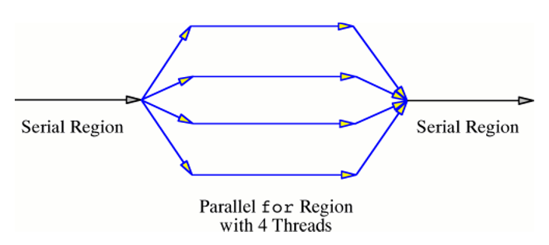
OpenMP - How it works
The execution model of a simple OpenMP program
Notes:
Kandice

Slide 12
Message Passing Interface
MPI is a standard for inter-process communication on distributed-memory multiprocessor. The goal of the Message Passing Interface is to establish a standard for message passing;
Portable
Efficient
Flexible
Notes:
Reuben
The standard has been developed by a committee of vendors, government labs, and universities.

Slide 13
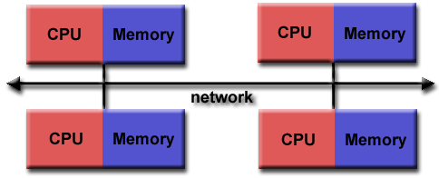
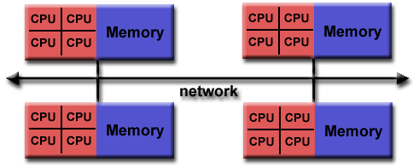
MPI
Originally, MPI was designed for distributed memory architectures, which were becoming increasingly popular at that time (1980s - early 1990s).
MPI implementors adapted their libraries to handle both types of underlying memory architectures seamlessly.
Notes:
Reuben

Slide 14
MPI
Implementation of the standard is usually left up to the designers of the systems on which MPI runs, but a public domain implementation, MPICH, is available.
MPI is a set of library routines for C/C++ and FORTRAN.
Standard interface - so code written for one system can easily be ported to another system with those libraries.
Notes:
Reuben
MPICH
-Based on the Chameleon portability system to provide a lightweight implementation layer
-Open Source
-Portable

Slide 15
MPI - Execution Model
The program spawns into the number of processes.
Each process runs and communicates with other instances of the program, possibly running on the same processor or different processors.
Basic sending and receiving data from one process to another, unlike OpenMP's thread communication via shared variables.
This communication takes place over a high-speed network which connects the processors in the distributed-memory system.
Notes:
Reuben

Slide 16
How MPI Works
A data packet sent with MPI requires several pieces of information:
the sending process
the receiving process
the starting address of the data to be sent
the number of data items being sent
a message identifier
the group of processes that can receive the message.
Notes:
Reuben
All of these items are able to be set by the programmer. For example, one can define a group of processes, then send a message only to that group.

Slide 17
How MPI Works
Some collective communication routines do not require all of items.
For example, a routine which allows one process to communicate with all other processes in a group when called by each of those processes would not require the specification of a receiving process since every process in the group should be a receiver.
Notes:
Reuben

Slide 18
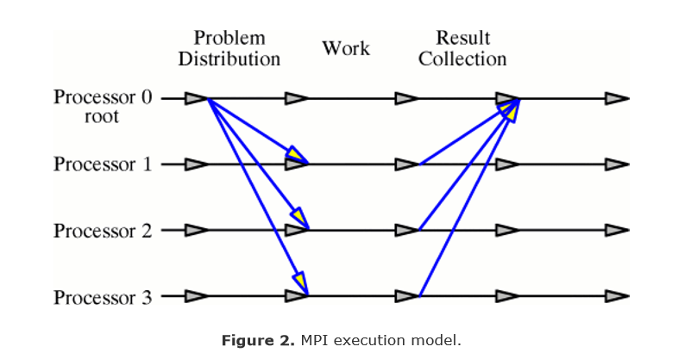
Simple MPI program
A master process sends off work to worker processes.
Those processes receive the data, perform tasks on it, and send the results back to the master process which combines the results.
Notes:
Reuben
Note that the other processes run continuously from the launch of the program, a difference from the OpenMP fork-join model. More complex coordination schemes are possible with MPI, but they introduce challenges which will be discussed shortly.

Slide 19
Code Example - Serial Program
int main(int argc, int *argv[]) { int i, intArray[100]; int sum = 0; /* Assume initArray initializes intArray w/ 1..100*/ initArray(intArray, 100); /* Sum the array elements. */ for (i=0;i<100;i++) { sum = sum + intArray[i]; } }
Notes:
Kandice

Slide 20
Code Example 2 - OpenMP
int main(int argc, int *argv[]) { int i, intArray[100]; int sum = 0; /* Store some values in intArray. */ initArray(intArray, 100); #pragma parallel for #pragma threadprivate(i) #pragma reduction(+: sum) for (i=0;i<100;i++) { sum = sum + intArray[i]; } }
Notes:
Kandice

Slide 21
Code Example - MPI (a)
int main(int argc, int *argv[]) { int i, numberProcessors, myProcessorNumber, sum, result; int intArray[100]; int myChunk[25]; int err; /* We will ignore errors in this code. */ MPI_Status status; /* Initialize MPI. */ err = MPI_Init(&argc, &argv); err = MPI_Comm_size(MPI_COMM_WORLD, &numberProcessors); err = MPI_Comm_rank(MPI_COMM_WORLD, &myProcessorNumber);
Notes:
Reuben

Slide 22
Code Example - MPI (b)
if (myProcessorNumber == 0) { initArray(intArray, 100); /* I am the main processor, so I distribute the problem to processors. */ for (i=1; i<numberProcessors; i++) { err = MPI_Send(&intArray[i*25], 25, MPI_INT, i,100, MPI_COMM_WORLD); copyArray(intArray, myChunk, 25); } }else { err = MPI_Recv(&myChunk[0], 25, MPI_INT, 0, 100, MPI_COMM_WORLD, &status); } /* Now that the problem is distributed, solve it. Each processor will have its share of the work in the myChunk array. */ sum = 0; for (i=0;i<25;i++) { sum = sum + myChunk[i]; }
Notes:
Reuben
pointer to starting address, number of items sent, type of items sent, destination processor, message id, group of processors which are eligible to receive the message (in the case of MPI_COMM_WORLD, all of them)

Slide 23
Code Example - MPI (c)
/* Send the results back to the main processor. */ if (myProcessorNumber == 0) { /* I receive the partial results and compute the total result. */ for (i=1;i<numberProcessors;i++) { err = MPI_Recv(&result, 1, MPI_INT, i, 200, MPI_COMM_WORLD, &status); sum = sum + result; } } else { /* I am not the main processor, so I send off my results. */ err = MPI_Send(&sum, 1, MPI_INT, 0, 200, MPI_COMM_WORLD); } /* Do something with the final result. */ ... /* Have MPI perform its shut-down. */ err = MPI_Finalize(); }
Notes:
Reuben

Slide 24
Code Example - MPI (d)
MPI Send(i)
MPI Recv
MPI Recv
MPI Send(1)
Notes:
Reuben

Slide 25
Issues in Parallel Programming
Load Balancing
Thread Synchronisation
Inter-process communication
Notes:
Kandice

Slide 26
Load Balancing
Load balancing is the problem of distributing a task to a set of processors so that each processor has approximately the same amount of work to perform.
Notes:
Kandice

Slide 27
Load Balancing in Shared-Memory Multiprocessing
Imagine multiple people emptying a sinking ship with buckets
Each person will empty the same number of buckets of water
Some buckets are bigger than others
The people holding larger buckets take longer to empty
Lots of idle time for people with smaller buckets
Notes:
Kandice
One of the issues that arises in any multiprocessing system is load balancing. Load balancing is the problem of distributing a task to a set of processors so that each processor has approximately the same amount of work to perform. As an analogy, consider a group of people bailing out a boat with buckets. There are two sizes of buckets, one twice as large as the other. Everyone removes the same number of buckets of water from the boat, but the larger buckets take twice as long to empty as the smaller buckets because they are heavier. The bailers with smaller buckets end up waiting a long time. In the time it takes the people with the larger buckets to empty one bucket-full, a person with a smaller bucket could have emptied two bucket-fulls. Clearly the water bailing could be more efficient.

Slide 28
Load Balancing in OpenMP
Load balancing is often a problem of thread scheduling
By default, once a thread is finished with a region of code, it waits for the other threads to complete the same region
OpenMP has several options for thread scheduling to prevent idle time
Notes:
Kandice
In OpenMP, load balancing is often a problem of thread scheduling. By default, once a thread is finished with a region of code, it waits for the other threads to complete the same region, much as the water bailers in the example above. OpenMP has several options for thread scheduling to improve the inefficiency that can result in the default thread scheduling algorithm.

Slide 29
Load Balancing in OpenMP
static scheduling - all threads execute n iterations and then wait for all other threads to finish their n iterations
dynamic scheduling - n iterations of the remaining iterations are dynamically assigned to threads that are idle
guided scheduling - each time a thread finishes executing its assigned iterations, it is assigned approximately the number of remaining iterations divided by the number of threads
Notes:
Kandice
It may seem that dynamic scheduling is the best scheduling algorithm available, but that is not always the case. A certain amount of overhead is involved in assigning additional iterations to a thread, slowing down the overall execution time of the OpenMP program. For this reason, finding an optimal n for dynamic scheduling can be difficult.

Slide 30
Load Balancing Distributed-Memory Multiprocessing
In many applications, such as linear systems solving, it is possible to make an estimate of work distribution so that a programmer can build load balancing right into a specific applications program.
However, determining the estimate of work distribution at execution time is far more difficult when the load is not defined.
Notes:
Reuben
The goal of load balancing is for each processor to perform an equitable share of the total workload.

Slide 31
Load Balancing in MPI - Water Bailing Example
Each bailer can bail the same amount of water in the same amount of time
Each bailer is in a different compartment of the ship completely sealed off from other compartments.
We would want the water to be distributed evenly among the compartments
In order to get the work done the most quickly
Notes:
Reuben

Slide 32
Load Balancing in MPI
For some problems, such as multiplying a large dense matrix by a vector, determining a good load balancing scheme is relatively straightforward:
send r/p rows of the matrix and the entire vector to each processor
where r is the number of rows and p is the number of processes
have each process compute a sub-matrix
collect the results back into the final matrix.
Notes:
Reuben
Distributing other problems, however, is not as easy. It can often be difficult or impossible to determine the amount of computation required by a subdomain of a problem.

Slide 33
Thread Synchronization
Thread synchronization is the concurrent execution of two or more threads that share critical resources.
Threads should be synchronized to avoid critical resource use conflicts.
Conflicts may arise when parallel-running threads attempt to modify a common variable at the same time.
Notes:
Reuben

Slide 34
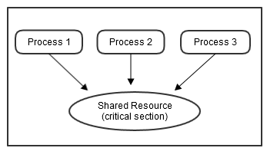
Critical Section
The section of a program which contains the shared resources.
Notes:
Reuben
The problem in the example above is that both processes execute code in what is known as a critical section. Various methods of synchronization exist to prevent two threads from simultaneously executing critical sections. Typically, one thread will acquire a lock on a critical section, preventing other threads from executing code in that section. Threads that attempt to execute a locked critical section must wait until the lock is released by the thread that acquired it .

Slide 35
Race Condition
A race condition occurs when more than one thread can modify the same variable or variables at the same time.
Example:
x = 0; while ( x < 1 ){ x = x + 1; do_a_thing_once(); }
If two threads accessed x at the same time at 0, do_a_thing_once() will execute twice.
Notes:
Reuben

Slide 36
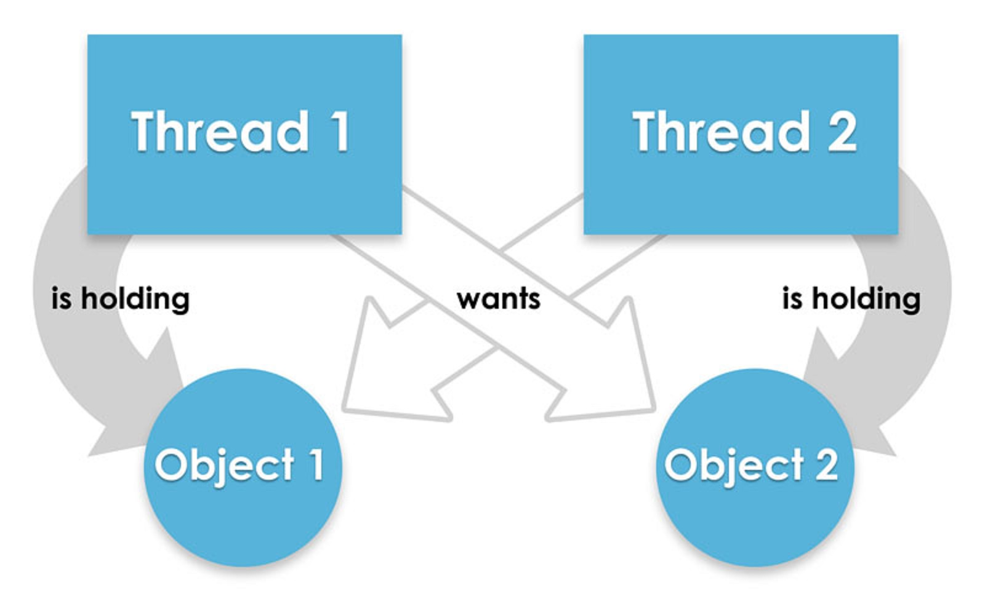
Deadlocks
Preventing a race condition can lead to another problem known as deadlock. Deadlock can occur between two threads when each waits for a lock that the other holds. Since neither thread releases a lock until it acquire the other, both threads wait forever, essentially dead.
Notes:
Reuben

Slide 37
Thread Synchronization in OpenMP
OpenMP provides synchronization capabilities for the programmer to make avoiding the potential pitfalls of a threaded paradigm easier.
One can specify a critical section using #pragma critical. The critical section can only be executed by one thread at a time, preventing any race conditions in that region.
Notes:
Kandice

Slide 38
Thread Synchronization in OpenMP
Can also specify that certain variables be localized to individual threads using the directive #pragma local(list) or #pragma threadprivate(list) where list is a list of the variables to be privatized.
By default, each thread can read and write every variable in a parallelized section of code.
Declaring a variable local or private essentially creates a copy of the variable for each thread to use privately.
Notes:
Kandice

Slide 39
Thread Synchronization in OpenMP
Another directive provided by OpenMP is #pragma reduction(op: list).
Essentially, every variable in list is made private to each thread.
When the threads finish executing the region of code in which the reduction variables are defined, a shared copy receives the value of each local copy combined by the operator.
In this way, every thread receives the final computation of the parallel region.
Notes:
Kandice

Slide 40
Thread Synchronization in OpenMP
Library routines can also be used to specify parallel execution parameters in certain program regions.
Some parameters can be changed during the execution of the program, i.e., the number of threads forked in a parallel region.
They can also be used for data synchronization schemes developed by the programmer.
The environment variables of the specification are used to set characteristics of the parallel execution not defined by the compiler directives or library routines.
For example, one can set the number of threads for parallel regions of code by changing the environment variable OMP_NUM_THREADS.
Notes:
Kandice

Slide 41
Thread Synchronization in MPI
Distributed memory multiprocessors do not suffer from this issue.
There is no risk of two processes accessing the same memory space.
Therefore no need for thread synchronization techniques
Notes:
Kandice

Slide 42
Inter-Process Communication
Inter-process communication (IPC) is a mechanism that allows the exchange of data between processes.
Notes:
Reuben

Slide 43
Inter-Process Communication in MPI
May be the case that a process requires data or computed results from any other process during execution.
Leads back to sequential programming
Ensuring process synchronization in this case adds a level of complexity to programs developed on distributed-memory multiprocessors.
Notes:
Reuben
One of the biggest challenges in programming a distributed-memory multiprocessor is implementing efficient inter-process communication. Making communication efficient, that is, minimizing the overhead involved in message passing, adds further complexity.

Slide 44
Solving Inter-Process Communication in MPI
MPI provides many communication routines to aid the programmer in developing inter-process communication. These routines include:
barriers
blocking sends and receives
non-blocking sends and receives
collective communications
One process to group of processes
Group of processes send to all of the same group
Group of processes send to one process
Notes:
Reuben
points within a program where each process waits until all other processes get there. When this occurs, each process resumes execution.
message passing routines which cause a process to wait until a message is sent or received before continuing execution
message passing routines which do not cause a process to wait until a message is sent or received before continuing execution
messages sent in one of three ways: one process sends other processes in a process group a message, all processes in a group send messages to all processes in the same group, and all processes in a group send a message to one process

Slide 45
Summary of OpenMP and MPI
 | Shared-memory Processors | Distributed-memory Processors
Pros | Simpler to program | No thread issues Good scalability
Cons | Need to be careful about thread synchronisation Poor scalability Increases bus traffic, slowing program execution No fault tolerance | Difficult to divide tasks among processes Difficult to coordinate process communication No fault tolerance
Notes:
Reuben/Kandice
Both shared-memory multiprocessors and distributed-memory processors have advantages and disadvantages in terms of ease of programming. Porting a serial program to a shared- memory system can often be a simple matter by adding loop-level parallelism with OpenMP, but one must be aware of race conditions, deadlocks, and other problems associated with the paradigm that may arise. For programmers used to a thread paradigm, moving to OpenMP is relatively straightforward. Writing an MPI program, on the other hand, involves the additional problem solving of how to divide the domain of a task among processes with separate memory spaces. Coordinating processes with communication routines can be quite a challenge. There is no concern over thread issues, but data synchronization is still a consideration.
Where OpenMP has an advantage in ease of programming and ease of porting serial programs, shared-memory systems in general have poor scalability. Adding additional processors to a shared-memory multiprocessor increases the bus traffic on the system, slowing down memory access time and delaying program execution. Distributed-memory multiprocessors, however, have the advantage that each processor has a separate bus with access to its own memory. Because of this, they are much more scalable. In addition, it is possible to build large, inexpensive cluster computers by using commodity systems connected via a network. The Beowulf Project is developing clusters from Linux systems using MPI. However, latency of the network connecting the individual processors is an issue, so efficient communication schemes must be devised.

Slide 46
Hybrid Distributed Shared Memory Systems
The shared memory component can be a shared memory machine and/or graphics processing units (GPU).
The distributed memory component is the networking of multiple shared memory/GPU machines, which know only about their own memory - not the memory on another machine.
Network communications are required to move data from one machine to another.
Notes:
Kandice
The largest and fastest computers in the world today employ both shared and distributed memory architectures.
Current trends seem to indicate that this type of memory architecture will continue to prevail and increase at the high end of computing for the foreseeable future.

Slide 47
Hybrid Distributed Shared Memory Systems
PRO:
Increased Scalability
CON:
Increased programmer complexity
Notes:
Kandice

Slide 48
Alternative Parallel Programming Options
OpenACC
Similar to OpenMP
Intended for use on systems with heterogeneous HPC hardware platforms and architectures
POSIX and Windows Threads
Not portable to other OS’s
C++11 Threads
Provides the class thread as an abstraction for a thread of execution
Provides several classes and class templates for mutexes, condition variables, and locks
pthreads
C library
Notes:
Kandice
heterogeneous HPC hardware platforms and architectures - systems which contain different types of architectures and hardware, such as multiple type of CPU in one computer

Slide 49
Alternative Parallel Programming Options
Apache Spark
Apache Spark™ is a powerful open source processing engine built around speed, ease of use, and sophisticated analytics
Offers a distributed file system with failure and data replication management.
Allows the addition of new nodes at runtime.
Provides a set of tools for data analysis and management that is easy to use, deploy and maintain
R, SQL, Python,Scala, Java
“ Big Data Analytics in the Cloud: Spark on Hadoop vs MPI/OpenMP on Beowulf ” - Jorge L. Reyes-Ortiz, Luca Oneto, and Davide Anguita
Notes:
Reuben

Slide 50
Thanks for listening!!!!!!
Questions?
Notes:
Reuben

