Slide 1
The Architecture Of Virtual Machines
Part 1 & 2
Presenter: Bilal Shaikh & Mansour Javaher
22/08/2017
Notes:
So far in this course we have been looking at various topics such as introduction to cloud computing
Parallel and distributed programming with grids and clouds
Which are really imp in cloud computing perspective but the actual question is how to implement and achieve these concepts. virtualization is the key component to take advantage of different virtualization types to allocate shared resources to different clients.

Slide 2
Brief History
Virtualization concept first appeared in IBM mainframes in 1972
In late 1990s Intel CPUs fast enough for researchers to try virtualizing on general purpose PCs
XEN and VMware
Expanded to many OSes, CPUs, VMMs (Virtual Machine Monitor - see later slides)
Notes:
IBM allowed multiple users to share a batch-oriented system
Batch operating system
The users of a batch operating system do not interact with the computer directly. Each user prepares his job on an off-line device like punch cards and submits it to the computer operator. To speed up processing, jobs with similar needs are batched together and run as a group. The programmers leave their programs with the operator and the operator then sorts the programs with similar requirements into batches.
The problems with Batch Systems are as follows −
Lack of interaction between the user and the job.
CPU is often idle, because the speed of the mechanical I/O devices is slower than the CPU.
Difficult to provide the desired priority
Virtual machine concept was in existence since 1960s when it was first developed by IBM to provide concurrent, interactive access to a mainframe computer.

Slide 3
Brief History (con.)
VMware- Modern Virtual Machine System
Founded 1998, Research at Stanford University
VMware Workstation
Separates Host OS from virtualization layer
Host OS may be Windows, Linux, etc
Wide variety of Guest operating systems

Slide 4

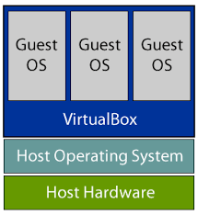
Host and Guest OS
A host system would be the primary & first installed operating system actually running and interacting with underlying hardware
A guest system (guest operating system) is a virtual guest or virtual machine (VM) that is installed under the host operating system. The guests are the VMs that you run in your virtualization platform. The OS running in the simulated environment.
Notes:
A host system (host operating system) would be the primary & first installed operating system. The host operating system is whatever operating system those applications are installed into. The OS actually running on the hardware
A guest system (guest operating system) is a virtual guest or virtual machine (VM) that is installed under the host operating system. The guests are the VMs that you run in your virtualization platform. The OS running in the simulated environment.
Some admins also call the host & guest the parent and child.
Unlike a host OS, which is installed on a computer and interacts with underlying hardware, a guest OS resides on a virtual machine. Although a guest operating system can use some of the host operating system's resources, the two are entirely separate. A guest OS hosted on a virtual machine can be used for testing without having an impact on anything outside that VM
The ultimate relationship between the Host and Guest is one of resource availability/management and resource dependence / Utilization.

Slide 5
What on earth is a Virtual Machine??
Benefits
Cross-Platform Compatibility
Increase Security
Enhance Performance
Reduce Infrastructure Complexity & Cost
Eliminate real machine constraint
Increases portability and flexibility
Enhances Software Interoperability
Notes:
A virtual machine is a software implementation of a machine that executes programs like a physical machine. It shares physical hardware resources with the other users but isolates the OS or application to avoid changing the end-user experience.
Virtual machine adds software to a physical machine to give it the appearance of a different platform or multiple platforms.
Virtual machines are used in a number of subdisciplines ranging from operating systems to programming languages to processor architectures. By freeing developers and users from traditional interface and resource constraints, VMs enhance software interoperability

Slide 6
What is software Interoperability??
Ability of a computer system to run application programs from different vendors, and to interact with other computers across local or wide-area networks regardless of their physical architecture and operating systems.
Notes:
Ability of a computer system to run application programs from different vendors, and to interact with other computers across local or wide-area networks regardless of their physical architecture and operating systems. Interoperability is feasible through hardware and software components that conform to open standards such as those used for internet.
With a common understanding of basic protocols, different software can interact smoothly with little or no specific knowledge of each other. The Internet is perhaps the most obvious example of this kind of interoperability, where any piece of software can connect and exchange data as long as it adheres to the key protocols.
The interoperability of computer systems is vital to security and productivity and can be maintained through regular software and system updates

Slide 7
Abstraction in Virtual World
Well-defined interfaces (separate levels of abstraction)
Levels of abstraction (hide lower-level implementation details, thereby reducing the complexity of the design process)
Notes:
computer systems exist and continue to evolve because they are designed as hierarchies with well-defined interfaces that separate levels of abstraction. Using well defined interfaces facilitates independent subsystem development by both hardware and software design teams.
The simplifying abstractions hide lower-level implementation details, thereby reducing the complexity of the design process.
A well-defined interface defines everything that needs to be done for that exchange to occur; to more, and no less. It precisely defines, for a specific function, what is necessary for systems to interoperate.
An interface is the point of interaction between systems, like the counter at a fast food restaurant. The interface allows systems to connect and exchange something. Think of a fast-food counter: you state your order, the server tells you the cost, you give some form of payment, and the server gives you your food.
Consider health department
The staff should only have to learn one interface for inputting encounter data, and only one interface for generating reports, just like we have only one application for working with e-mail.

Slide 8
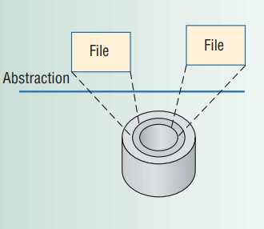
Abstraction in Virtual World
Notes:
Figure 1a shows an example of abstraction applied to disk storage.
The operating system abstracts hard-disk addressing details—for example, that it is comprised of sectors and tracks—so that the disk appears to application software as a set of variable-sized files.
Application programmers can then create, write, and read files without knowing the hard disk’s construction and physical organization.

Slide 9
Instruction Set Architecture
ISA clearly exemplifies the advantages of well defined interfaces.
The instruction set provides commands to the processor, to tell it what it needs to do.
Notes:
A computer’s instruction set architecture (ISA)
The instruction set, also called instruction set architecture (ISA), is part of a computer that pertains to programming, including the native data types, instructions, registers, addressing modes, memory architecture, interrupt and exception handling, and external I/O. which is basically machine language. The instruction set provides commands to the processor, to tell it what it needs to do
clearly exemplifies the advantages of well-defined interfaces. Well-defined interfaces permit development of interacting computer subsystems not only in different organizations but also at different times, sometimes years apart. For example, Intel and AMD(Advanced Micro Devices) designers develop microprocessors that implement the Intel IA-32 (x86) instruction set, while Microsoft developers write software that is compiled to the same instruction set. Because both groups satisfy the ISA specification, the software can be expected to execute correctly on any PC built with an IA-32 microprocessor.

Slide 10

Well-Defined Interfaces Limitations
Notes:
Unfortunately, well-defined interfaces also have their limitations.
Subsystems and components designed to specifications for one interface will not work with those designed for another.
For example, application programs, when distributed as compiled binaries, are tied to a specific ISA and depend on a specific operating system interface. This lack of interoperability can be confining, especially in a world of networked computers where it is advantageous to move software as freely as data.
Virtualization provides a way of getting around such constraints.

Slide 11

Virtualization to the Rescue!!!
Notes:
In computing, virtualization refers to the act of creating a virtual (rather than actual) version of something.
Virtualization provides a way of getting around such constraints.
Virtualizing a system or component—such as a processor, memory, or an I/O device—at a given abstraction level maps its interface and visible resources onto the interface and resources of an underlying, possibly different, real system. Consequently, the real system appears as a different virtual system or even as multiple virtual systems. Unlike abstraction, virtualization does not necessarily aim to simplify or hide details.
Mapping of virtual resources (registers and memory) to real hardware resources
Using real machine instructions to carry out the actions specified by the virtual machine instructions
Virtualization is a technology that allows creating an abstraction (a virtual version) of computer resources, such as hardware architecture, operating system, storage, network, etc. With this abstraction, for example, a single machine can act like many machines working independently.
The usual goal of virtualization is to centralize administrative tasks while improving scalability and workloads. It is not a new concept or technology in computer sciences.

Slide 12
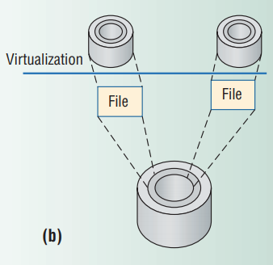
Virtualization to the Rescue!!!
Notes:
Unlike abstraction, virtualization does not necessarily aim to simplify or hide details. For example, in Figure 1b, For example, virtualization transforms a single large disk into two smaller virtual disks, each of which appears to have its own tracks and sectors
Virtualizing software uses the file abstraction as an intermediate step to provide a mapping between the virtual and real disks. A write to a virtual disk is converted to a file write (and therefore to a real disk write). Note that the level of detail provided at the virtual disk interface—the sector/track addressing—is no different from that for a real disk; no abstraction takes place

Slide 13
Different type of virtualization
Server Virtualization
Application Virtualization
Storage Virtualization
Presentation Virtualization
Networks
Notes:
Virtualization can be applied to many systems within IT. There are 5 different categories that can be virtualized.
Server Virtualization – consolidating multiple physical servers into virtual servers that run on a single physical server.
Application Virtualization – an application runs on another host from where it is installed in a variety of ways. It could be done by application streaming, desktop virtualization or VDI, or a VM package (like VMware ACE creates with a player). Microsoft Softgrid is an example of Application virtualization.
Presentation Virtualization – This is what Citrix Met frame (and the ICA protocol) as well as Microsoft Terminal Services (and RDP) are able to create. With presentation virtualization, an application actually runs on another host and all that you see on the client is the screen from where it is run.
Network virtualization is a method of combining the available resources in a network by splitting up the available bandwidth into channels, each of which is independent from the others and can be assigned -- or reassigned -- to a particular server or device in real time.
Storage virtualization is the pooling of physical storage from multiple network storage devices into what appears to be a single storage device that is managed from a central console. Storage virtualization is commonly used in storage area networks.

Slide 14
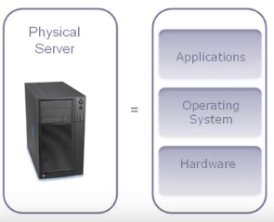
Server Virtualization
It is often referred to as ‘advanced load balancing,’
File Servers - stores files (people documents)
Web servers (runs website)
E-mail Servers - runs an e-mail system
Notes:
It is often referred to as ‘advanced load balancing,’ as it spreads applications across servers, and servers across applications.
This enables IT departments to balance the workload of specific software in an agile way that doesn’t overload a specific server or underload a specific application in the event of a large project or change.
In addition to load balancing it also allows for easier management of servers and applications, since you can manage them as a single instance. Additionally, it gives way to greater network security, as only one server is visible to the public while the rest are hidden behind a reverse proxy network security appliance.

Slide 15
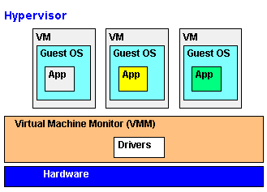
What is Virtual Machine Monitor a.k.a Hypervisor??
Notes:
A Virtual Machine Monitor (VMM) is a software program that enables the creation, management and governance of virtual machines (VM) and manages the operation of a virtualized environment on top of a physical host machine. VMM is also known as Virtual Machine Manager and Hypervisor.
A hypervisor or virtual machine monitor (VMM) is computer software, firmware or hardware that creates and runs virtual machines. A computer on which a hypervisor runs one or more virtual machines is called a host machine, and each virtual machine is called a guest machine.

Slide 16
Types of Hypervisor
Type 1: Bare-Metal
Type 2: Hosted
Notes:
Hypervisors can be divided into two types:
Type 1: Also known as native or bare-metal hypervisors, these run directly on the host computer’s hardware to control the hardware resources and to manage guest operating systems. Examples of Type 1 hypervisors include VMware ESXi, Citrix XenServer and Microsoft Hyper-V hypervisor.
Type 2: Also known as hosted hypervisors, these run within a formal operating system environment. In this type, the hypervisor runs as a distinct second layer while the operating system runs as a third layer above the hardware.

Slide 17
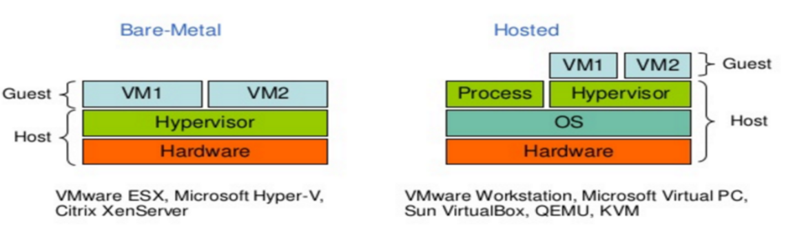

Slide 18
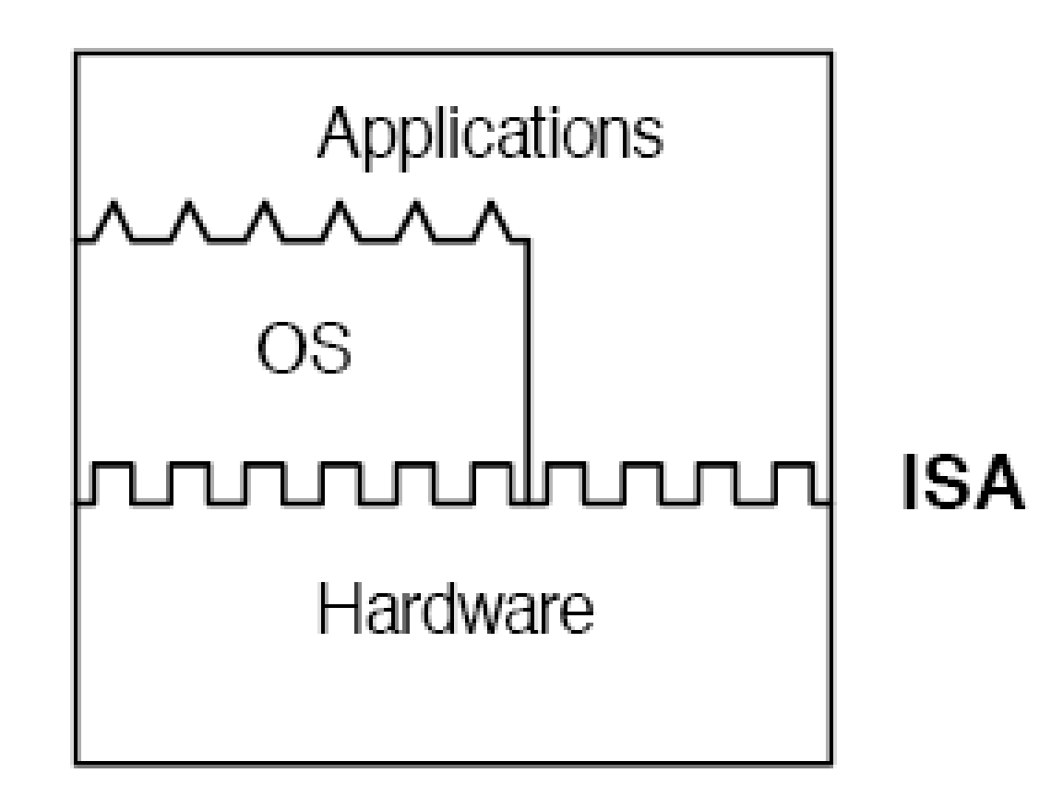
Initial Hardware Model
All applications access hardware resources (i.e. memory, i/o) through system calls to operating system.
Since software is developed separately from hardware. Software is not necessarily optimized for hardware.
Notes:
Advantages
Design is decoupled (i.e. OS people can develop OS separate of Hardware people developing hardware)
Hardware and software can be upgraded without notifying the Application programs
Disadvantage
Application compiled on one ISA will not run on another ISA..
Applications compiled for Mac use different operating system calls then application designed for windows.
Since software is developed separately from hardware. Software is not necessarily optimized for hardware.

Slide 19
Architected Interfaces
VM implementations lie at architected interfaces.
Architecture, refers to a formal specification of an interface in the system, including the logical behavior of resources managed via the interface
Notes:
VM implementations lie at architected interfaces, a major consideration in the construction of a VM is the fidelity with which it implements these interfaces.
Implementation describes the actual embodiment of an architecture. Abstraction levels correspond to implementation layers, whether in hardware or software, each associated with its own interface or architecture
Architecture, as applied to computer systems, refers to a formal specification of an interface in the system, including the logical behavior of resources managed via the interface

Slide 20
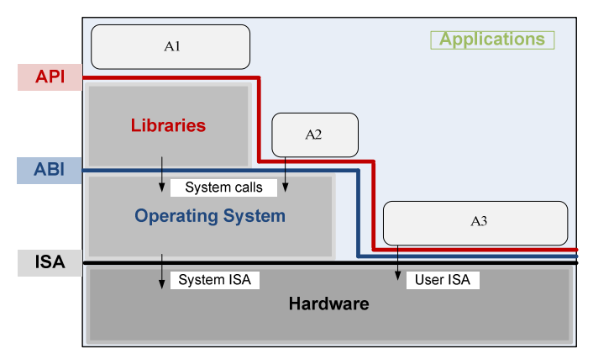
Notes:
Application Programming Interface, Application Binary Interface, and instruction set architecture ISA.
AN APPLICATION USES LIBRARY FUNCTIONS (A1), MAKES SYSTEM CALLS (A2), AND EXECUTES MACHINE INSTRUCTIONS (A3).
Definition of API :
An API (Application Programming Interface ) defines the interfaces by which one piece of software communicates with another at the source level. Any system calls are usually performed through high level libraries.
Definition of ABI :
Whereas an API defines a source interface, an ABI (Application Binary Interface ) defines the low-level binary interface between two or more pieces of software on a particular architecture. It defines how an application interacts with itself, how an application interacts with the kernel, and how an application interacts with libraries. ABI does not include system instructions.
The only difference is API is mostly used by programmers and ABI is mostly used by compiler.

Slide 21
What is a “Machine”??
Consists of a logical memory address space
The machine’s I/O is visible only through the OS.
Thus the ABI defines the machine as seen by a process
Similarly, the API specifies the machine characteristics as seen by an application’s HLL program.
Notes:
The machine consists of a logical memory address space assigned to the process along with user-level instructions and registers that allow the execution of code belonging to the process.
The machine’s I/O is visible only through the operating system, and the only way the process can interact with the I/O system is through operating system calls. Thus the ABI defines the machine as seen by a process. Similarly, the API specifies the machine characteristics as seen by an application’s HLL program.

Slide 22
Process VMs
Virtual machines can be instantiated for a single program (i.e. think Java)
Virtual machine terminates when process terminates.
Provide platform independent programming environment that abstracts away details of underlying hardware or OS.
Notes:
process VM is designed to run single program and supports single process.
Process virtual machine: sometimes called an application virtual machine, runs as a normal application inside a host OS and supports a single process. It is created when that process is started and destroyed when it exits. Its purpose is to provide a platform-independent programming environment that abstracts away details of the underlying hardware or operating system, and allows a program to execute in the same way on any platform. For example Wine software in Linux helps to run Windows application.
Process VMs are implemented using an interpreter; performance comparable to compiled programming languages is achieved by the use of just-in time compilation.
A JIT is a code generator that converts Java bytecode into native machine code. Java programs invoked with a JIT generally run much faster than when the bytecode is executed by the interpreter
This type of VM has become popular with the java programming language, which is implemented using the java virtual machine.
Every developer who uses Java knows that Java bytecode runs in a JRE (Java Runtime Environment). The most important element of the JRE is Java Virtual Machine (JVM), which analyzes and executes Java byte code.

Slide 23
Multiprogrammed systems
Most operating systems can simultaneously support multiple user processes through multiprogramming
Gives each process the illusion of having a complete machine to itself
Notes:
The most common process VM is so ubiquitous (found everywhere) that few regard it as being a VM.
Most operating systems can simultaneously support multiple user processes through multiprogramming, which gives each process the illusion of having a complete machine to itself.
Each process has its own address space, registers, and file structure. The operating system time-shares the hardware and manages underlying resources to make this possible.

Slide 24
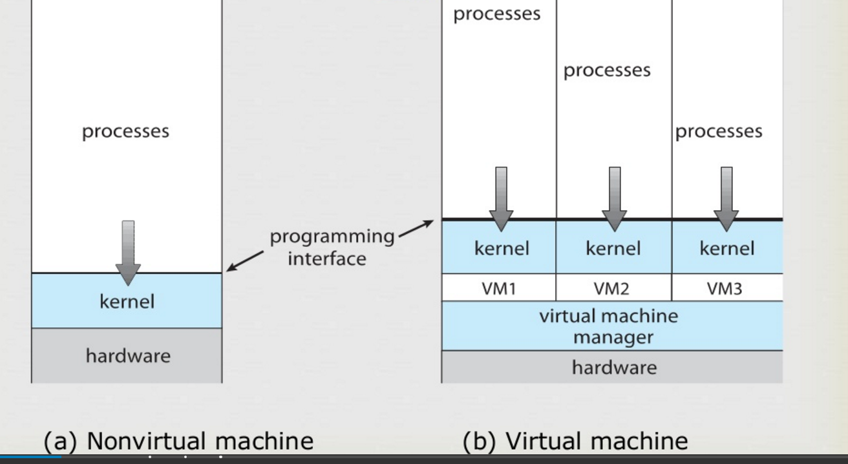

Slide 25
Emulators and dynamic binary translators
Emulation is what we do when we try to make one system behave like or imitate a different system. The most straightforward way of performing emulation is through
Interpretation
An interpreter program fetches, decodes, and emulates the execution of individual guest instructions. However, slow process.
dynamic binary translation, which converts guest instructions to host instructions in blocks rather than instruction by instruction and saves them for reuse in a software cache
Notes:
Emulation is what we do when we try to make one system behave like or imitate a different system. We want to take System A (something we already have) and give it the inputs we would normally use for System B (which we may not have) and have System A produce the same results as System B.
A more challenging problem for process-level VMs is that of supporting program binaries compiled to an instruction set different from the one the host executes.
The most straightforward way of performing emulation is through interpretation.
An interpreter program fetches, decodes, and emulates the execution of individual guest instructions. This can be a relatively slow process, requiring tens of host instructions for each source instruction interpreted. Better performance can be obtained through
dynamic binary translation, which converts guest instructions to host instructions in blocks rather than instruction by instruction and saves them for reuse in a software cache. Repeated execution of the translated instructions thus reduces the relatively high overhead of translation.

Slide 26
Same-ISA binary optimizers
To reduce performance losses, dynamic binary translators sometimes perform code optimizations during translation.
Notes:
To reduce performance losses, dynamic binary translators sometimes perform code optimizations during translation.
Same- ISA means the instruction sets that the host and guest use are the same. Same ISA dynamic binary optimizers use information collected during the interpretation or translation phase to optimize the binary on-the-fly. An example of such an optimizer is the Dynamo (dynamic optimization system) system that operates at run time.

Slide 27
High-level-language VMs
For Process VMs, cross-platform portability is a key objective that requires full-cross-platform portability by designing a process-level VM as part of an overall HLL application development environment.
Notes:
emulating one conventional architecture on another provides cross-platform compatibility only on a case-by-case basis and requires considerable programming effort.
Full cross-platform portability is more readily achieved by designing a process-level VM as part of an overall HLL application development environment. The resulting HLL VM does not directly correspond to any real platform; rather, it is designed for ease of portability and to match the features of a given HLL or set of HLLs.
In high-level language virtual machines, the virtualization layer sits as an application program on top of an operating system. The layer exports an abstraction of the virtual machine that can run programs written and compiled to the particular abstract machine definition. Any program written in the high-level language and compiled for this virtual machine will run in it

Slide 28
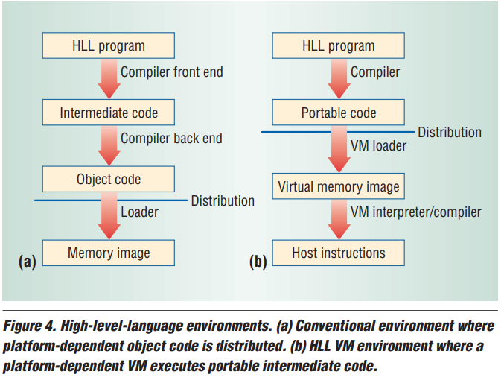
High-level-language VMs
Notes:
Figure shows the difference between a conventional platform-specific compilation environment and an HLL VM environment.
In a conventional system, shown in Figure 4a, a compiler front end first generates intermediate code that is similar to machine code but more abstract.
Then, a code generator uses the intermediate code to generate a binary containing machine code for a specific ISA and operating system.
This binary file is distributed and executed on platforms that support the given ISA/OS combination.
In an HLL VM, as shown in Figure 4b, a compiler front end generates abstract machine code in a virtual ISA that specifies the VM’s interface.
This virtual ISA code, along with associated data structure information (metadata), is distributed for execution on different platforms.
Each host platform implements a VM capable of loading and executing the virtual ISA and a set of library routines specified by a standardized API.
An advantage of an HLL VM is that application software is easily ported once the VM and libraries are implemented on a host platform. While the VM implementation takes some effort, it is much simpler than developing a full-blown compiler for a platform and porting every application through recompilation.
The Sun Microsystems Java VM architecture3 and the Microsoft Common Language Infrastructure, which is the foundation of the .NET framework,4 are widely used examples of HLL VMs

Slide 29
Coming up!
System VMs by one and only the King Adrian.
https://docs.google.com/presentation/d/1Dz9vm15XhWiV7LcPm40cNS_7hJ-hMMMVESEoJRuD04A/edit#slide=id.g244a7599f0_0_1721

Slide 30
Questions asked
Please refer to the presentation notes for the questions asked and the answers we gave.
Notes:
What is an Application Virtualization?
Our answer:
Application virtualization enables clients’ software deployment from the server. It greatly reduces application management costs, maximizes software license usability, smartly manage software versions and usage, reduces software update and migration costs, saves time on software patches and updates, stays clean without software installation and version conflicts. Z!Stream is a back-end application library that streams apps to clients by on-demand basis. Z!Stream competes directly with Citrix XenApp, VMware ThinApp, and MS App-V. Z!Stream provides centralized SaaS management services for Windows apps and it is very much required for cloud computing services accessed via LAN, WAN, INTERNET &, MOBILE. We also added Application Virtualization – application runs on another host from where it is installed in a variety of ways. It could be done by application streaming, desktop virtualization or VDI, or a VM package (like VMware ACE creates with a player). Microsoft Softgrid is an example of Application virtualization.
What is Process VM?
Our answer:
Process VM is designed to run a single program and supports a single process. The purpose is to provide platform independent programming environment that abstracts away details of underlying hardware or OS. It is created when the process is started and destroyed when it ends. In other words, virtual machine terminates when the process terminates. Process VM allows a program to execute in the same way on any platform. For example, Wine software in Linux helps to run Windows application.
What is ISA?
Our answer:
An instruction set architecture (ISA) is an abstract model of a computer. It is also referred to as architecture or computer architecture. An ISA defines everything a machine language programmer needs to know in order to program a computer. The instruction set consists of addressing modes, instructions, native data types, registers, memory architecture, interrupt, and exception handling, and external I/O. An example of an instruction set is the x86 instruction set, which is common to find on computers today.
One question was related to Virtualization Security
Our answer:
The security was not covered in the paper and backed up by Ian. However, our extensive research leads to virtualization security discussion. Due to the lack of proper implementation in Java Virtual Machine, it clearly has some problems in the security area. Ian explained this question and talked about the security aspects. There is more information about security in NWEN 405 paper and there will be a security major next year.

