Slide 1
Rethinking Security in the Era of Cloud Computing
Mansour & Bilal
02/10/2017

Slide 2
Growth of Cloud computing(Public clouds)
Software As Service
Platform As Service
Infrastructure As Service
Database As Service
Notes:
Cloud computing is growing rapidly due to the cost savings and flexibility they enable by freeing tenants from the expenditures of establishing and operating their own data centers. As Cloud computing grows in popularity, clouds become juicier targets for attackers.
As we have previously discussed about virtual machines and how cloud provider provide different facility by virtualizing one big hardware or machine to multiple customers for tenant, a complication factor will be tenant security. For several reasons, security risks could be worse than usual by moving to the cloud.

Slide 3
Main goal of the paper
Exploring security opportunity around cloud.
silver lining to the cloud.
Notes:
Due to the growth of cloud computing University of Wisconsin and Carolina were funded by the NSF to explore security opportunities around cloud; The main goal in this article is to summarize their research agenda and the progress they made so far. In the article they refer it as the Silver project, connoting a silver lining to the cloud.

Slide 4
Motivation
Migration to cloud threats
Enhancing cloud infrastructure
Notes:
There are two main motivation around this paper. The very first, which has been the primary concern of academics is what new threats to tenants arise due to their move to cloud computing, and what tenants can do to mitigate those threats. That is because when a company wants to move their application in the cloud, as initial application is not completely architectured specifically for cloud infrastructure there will be security vulnerabilities that need to be considered.
Second motivation is enhancing clouds to help tenants achieve secure deployments. They only reason for the second motivation is that because they were thinking all the vulnerabilities are from the application. There are some vulnerabilities from cloud provider which gives the opportunity to a

Slide 5
Security risks arises from moving to cloud
Cross-tenant attacks
Steal Secret
Computing resources
Distributed Denial of Service Attack
Cloud operator
Notes:
Much work has focused on determining how the shift to cloud computing and public clouds might create new vulnerabilities for tenants. In one type of new risk, a cross-tenant attack arises when one cloud tenant seeks to violate the confidentiality, availability, or integrity of another. Many cross-tenant attacks are base from the fact that multi tenancy implies that it’s possible that one’s applications are running on a compute server shared with another tenant who might be hostile. Placement vulnerabilities allow malicious tenants to arrange for their applications to be scheduled (placed) on the same server as a target, and from there, cross-tenant side-channel attacks could allow violating isolation boundaries to, for example, steal secrets or computing resources, or to mount denial-of-service (DoS) attacks.
A second type of new risk is from a cloud operator who is itself malicious. This threat model covers many unqiue and realistic threats, such as a rogue employee’s insider attack and even a careless provider’s accidental errors in the handling of customer data and programs. The widespread occurrence of malicious outsiders intruding into the systems of even large, highly reputed technology companies also encourages such a pessimistic threat model.
These new risks have given rise to several influential research threads, notably works on cryptographic techniques such as verifiable outsourced computing and outsourced private computation via fully homomorphic encryption. These lines of work strive to remove the cloud provider’s software and administrators from the trusted computing base.
In the industry there are many companies that they provide security as a service because of the provider as partner vulnerabilities that arises. Security consulting companies help to resolve to tenants security

Slide 6
Provider As Partner
Deeper Specialization
Provider introspection
Notes:
The Provider as Partner research agendas can be viewed as helping tenants to both understand and preempt new vulnerabilities that arise when moving to a cloud that’s oblivious to its tenants’ plights at best and openly hostile to them at worst.
In Deeper specialization. Cloud-based security services allow many organizations to benefit from the deeper specialization of a few large cloud providers and security service providers.
In Provider As Partner Cloud providers have the unique ability to analyze tenants’ security, which helps facilitate outsourced security management.
The semantic gap between the provider’s observations and the significance of observed behaviors in tenant environments is the key challenge to take advantage of the provider introspection.
Another challenge is cloud providers’ reluctance to access tenant data, due to confidentiality concerns stemming from the sensitivity of tenant data and from regulatory requirements around data sharing.

Slide 7
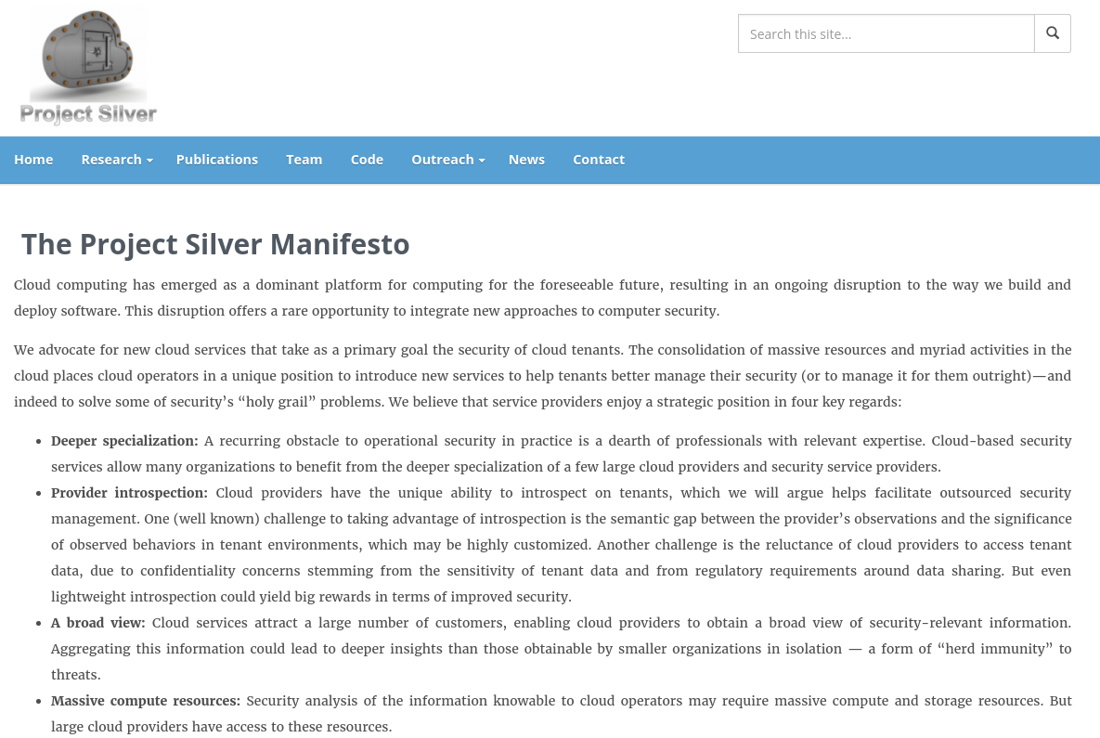
Silver Lining to the cloud
Risks posed by untrusted clients
Account Takeover
DoS attack
Exploit
Fending off DoS attacks against tenant services.
Detecting exploit traffic against tenant services.
Notes:
As I have discussed Silver Lining to the cloud consist of the major part of the research. Here author lay out one vision of how clouds could significantly enhance security for their tenants. We analyze this vision into three distinct but overlapping opportunities for leveraging the cloud to help tenants manage their untrusted client populations, their own outsourced infrastructure, and their dependencies on other tenants in the cloud ecosystem.
A substantial fraction of the effort to run an application service is consumed by addressing the risks posed by untrusted clients. These risks include client account takeovers, DoS attacks, and exploit attempts on the server. We see numerous opportunities to leverage the cloud’s massive resources and elastic scaling capabilities to help tenant services defend against these risks.
Authenticating clients of tenant services Authenticating human users is central to virtually of every web transaction. Overwhelmingly, the most common way to do this today is using passwords. Passwords are an imperfect protection, however. They can be guessed by an attacker or, as today’s industry pandemic shows, they can be stolen by breaching the application server and cracking password hashes stored there.
Pythia and honeywords are two approach to minimize the risk of an undetected password. They can be used by ordinary tenants to protect their authentication systems but are especially attractive as a means to strengthen the identity service providers’ infrastructure. They can also facilitate compliance with security controls for identity and access management.
Pythia allows a cloud operator to harden passwords on an application server, protecting them against compromise during a breach. It’s transparent to application service users, imposes minimal additional latency, and requires only minor modifications to the application server.
Pythia relies on a pseudorandom function (PRF) server, potentially run by the cloud operator. The server applies a PRF—a deterministic cryptographic operation involving a secret key—to a password p that the application server submits for registration (storage) or verification, yielding a corresponding output x. The PRF server thereby “hardens” passwords. Unlike a password hash, which is vulnerable to brute-force cracking if the underlying password is weak, the PRF-hardened value x is computationally infeasible for an adversary to crack.
They have developed a term called honeywords aims to detect password system breaches. A honeyword is a fake but acceptable looking password. The honeywords scheme involves storing for each user in the password database on an application server, not just the user’s real (hashed) password p, but also a set of honeywords. An adversary that breaches the server faces the challenge of distinguishing the unique true password from the honeywords. If the adversary guesses incorrectly and attempts to authenticate using a honeyword, an alarm is triggered. Given good honeyword selection, an adversary will evade detection.
To give further detail, the full set of n passwords, real and fake, is stored on the application server in a randomly permuted list. When an authentication attempt occurs using a password in the list associated with a given user, the associated index is passed to a system maintained by the cloud operator called a honeychecker. The honeychecker stores the index (position) of the unique true password for every user and distinguishes between the true password and honeyword submissions. Thus, the honeyword system (like Pythia) achieves breach resistance by spanning the tenant and the cloud operator environments. Later, we discuss other intriguing uses of honey objects, that is, fake resources for breach detection and adversarial misdirection in the cloud
Fending off DoS attacks against tenant services. A second threat that administrators of application servers must address is DoS attacks against their servers. The damage that DoS attacks cause to organizations in terms of lost revenue and customer trust is well known. DoS defense of application servers today comes primarily in two forms: proprietary solutions that scale to massive load but that are expensive (for instance, Akamai) or hardware appliances that will have difficulty keeping up with adversaries’ ability to dynamically change their attacks’ type, volume, and locations. As part of the Silver project, they envisioned a cloud-based DoS defense architecture that provides the flexibility to seamlessly place defense mechanisms where they’re needed and the elasticity to launch defenses as necessary depending on the attack type and scale.
The other point of research is detecting exploit traffic against tenant services. Another threat type that administrators of application servers need to constantly fend off is exploit attempts against their servers. Sometimes these exploit attempts target logic vulnerabilities in the application servers themselves; in others, they target component protocols that the application servers employ. In many cases, exploits against such vulnerabilities involve clients sending traffic that no legitimate client implementation would send. They have developed a technique that leverages the cloud’s spare compute resources and its visibility across tenant services to detect the emergence of new exploits as soon as they’re attempted against any tenant. A cloud resident verifier analyzes the messages between a tenant server and its clients to detect messaging behavior from the client that’s inconsistent with the expected client software. For example, our verifier can detect a client’s deviation from an OpenSSL implementation of TLS within seconds from when the deviation occurs. Because such deviations are typically characteristic of maliciously crafted packets to exploit server vulnerabilities, this type of verification capability could reduce the delay to detect exploit attempts on zero-day vulnerabilities. For example, this technique could have detected Heartbleed packets within seconds of the first attempted exploit, with no Heartbleed-specific configuration.

Slide 8
Helping Tenants Manage Their Infrastructure
Side channel Defence
FlowTags
OpenNF
Policy Graph Abstraction (PGA)
Notes:
Helping Tenants Manage Their Infrastructure Numerous organizations outsource portions of their own IT infrastructure to clouds, even if only to serve intraorganization purposes while achieving the cost savings associated with cloud computing. There are several ways in which cloud operators could assist tenants in managing the security of their outsourced infrastructure.
Side-channel defense is The basis for the dramatic cost savings enabled by clouds is the sharing of the resources that they enable so effectively. However, this sharing doesn’t come without consequences. Sharing hardware resources can cause the unintentional leakage of secret information across tenant boundaries in cloud contexts. These leakages, called side channels, arise due to tenants’ shared use of microarchitectural components on the computers they occupy together. Indeed, such side channels seem inevitable on current hardware platforms, if left unchecked by other defenses.
As a result, in Silver the development of operator-supported defenses against side channels in cloud contexts, ranging from specialized defenses against side channels in processor caches to more holistic defenses for wide ranges of side-channel attacks arising from coresidency. An example of a cache-specific defense is hypervisor scheduler modifications to ensure that one virtual machine (VM) can’t preempt another with very fine granularity, as this is an ingredient in known side-channel attacks leveraging per-core caches.
They have developed three frameworks to illustrate these possibilities. The first, FlowTags, allows flexible routing of traffic across arbitrary chains of middleboxes, even as middleboxes alter packet header information on which routing traditionally relies. FlowTags achieves this by inserting tags into end-to-end flows; the logic for computing tags resides at a logically central controller that leverages high-level policy to determine how the tags encode required end-to-end paths and any middlebox-internal actions taken along a route (for instance, content being served out of a cache).
The second system, is OpenNF, which is complementary to FlowTags and designed specifically to support distributed processing across multiple middlebox instances. Although virtualization of middleboxes allows easy deployment and teardown of instances in a cloud setting, reallocation of processing across middlebox instances must be coordinated with reallocation of the internal state that middleboxes maintain for the traffic they’re processing. OpenNF allows such state reallocation to be synchronized with traffic reallocation decisions and to take place safely and consistently.
The third system, is Policy Graph Abstraction (PGA), which offers the capability to effectively utilize the other two. In many organizations, policies are independently specified by different actors; for instance, department administrators might want to restrict access to servers they own to users with specific credentials, whereas an enterprise-wide policy might impose general constraints on who can access what resources. It’s important to ensure that such independently specified policies are composed and implemented consistently in the underlying infrastructure. PGA provides operators a simple graphical interface to specify complex policies among different sets of endpoints, including policies on middlebox traversal and elastic scaling. Each policy can be supported individually using FlowTags and OpenNF. Crucially, the PGA runtime analyzes multiple such policies for potential conflicts and, if none exist, quickly computes a routing configuration that ensures consistent policy enforcement.

Slide 9
Strengthening Tenant Ecosystems
Cloud providers to continue to advance their offerings of foundational services
Managed storage, Coordination and Consensus, and Security-Enhancing Services
New cloud services can help to mediate secure interactions among tenants
Shared trust in cloud infrastructure providers can enhance the potential for an open marketplace of cloud-based services.
Notes:
Another research direction is to explore how cloud providers can continue to advance their offerings of foundational services, for example, managed storage, coordination and consensus, and security-enhancing services. Authors envision that these cloud services can help to mediate secure interactions among tenants and further enable tenants to offer secure foundational services and application services to one another. Flexible trust management, rooted in shared trust in cloud infrastructure providers, can enhance the potential for an open marketplace of cloud-based services.

Slide 10
One Motivating Scenario
Enable secure sharing of data and code for cooperative analytics
Goal is to enable jointly trusted computations that combine confidential datasets from multiple owners and produce a privacy-preserving output
Unlock the potential of big data in areas where data privacy is paramount, for instance, healthcare
Notes:
One motivating scenario is to enable secure sharing of data and code for cooperative analytics, in which analytics software is offered as a service for computing with data sets or algorithms that their owners consider confidential. A goal is to enable jointly trusted computations that combine confidential datasets from multiple owners and produce a privacy-preserving output. Safe data sharing can help unlock the potential of big data in areas where data privacy is paramount, for instance, healthcare.

Slide 11
Extend cloud authorization models
A mutually trusted cloud provider can enhance security by mediating these kinds of cross-tenant interactions.
To allow richer policy control over data sharing and other interactions among tenants
A more ambitious direction is to establish new cloud-based trust services
Notes:
A mutually trusted cloud provider can enhance security by mediating these kinds of cross-tenant interactions. One obvious way to approach these goals is to extend cloud authorization models to allow richer policy control over data sharing and other interactions among tenants. A more ambitious direction is to establish new cloud-based trust services that enable clients to derive trust in a tenant. For example, a data owner might trust a third-party service to access a sensitive dataset, if the cloud provider attests that the service is contained—it’s restricted in how it can communicate or release information.

Slide 12
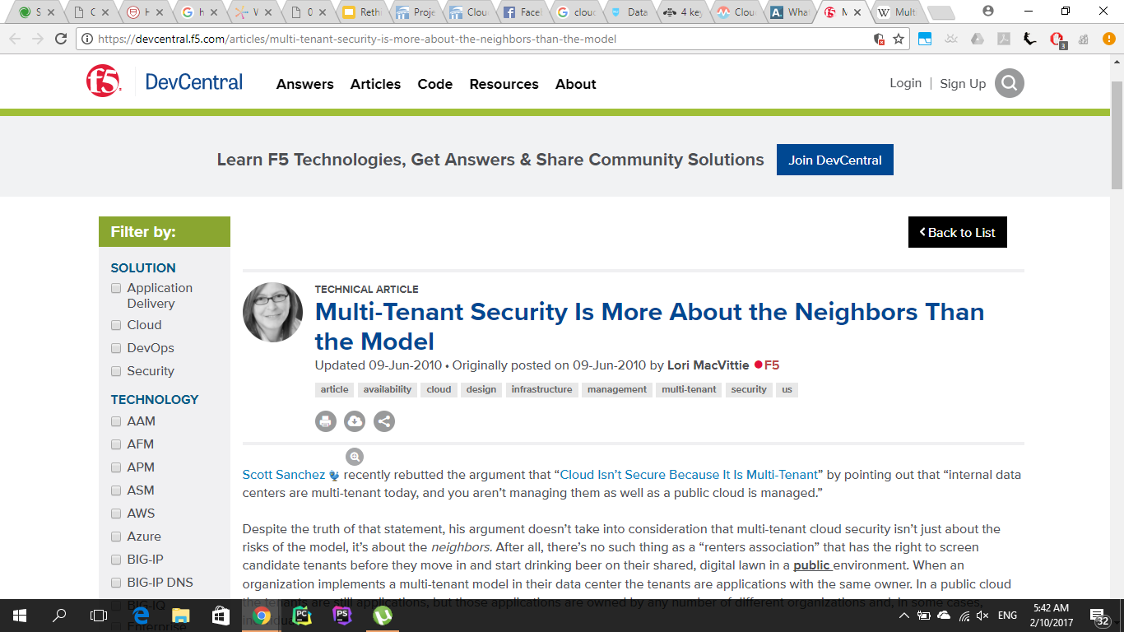
Notes:
https://devcentral.f5.com/articles/multi-tenant-security-is-more-about-the-neighbors-than-the-model
Unlike the public clouds, the resources of the private cloud are shared only within the corporate community. They're controlled by the corporation, not a third-party vendor that has the ability to lease them to anyone it chooses

Slide 13
IBM
4 key design considerations for a multi-tenant cloud
Internal Tenant: A company treats its departments as different tenants. This demands a logical isolation of applications and infrastructure while sharing the physical infrastructure.
External Tenant: A service provider’s environment in which each tenant is a different company. A financial company requires a dedicated infrastructure (physical isolation), while a retail company could share infrastructure with other companies (logical isolation)
Notes:
https://www.ibm.com/blogs/cloud-computing/2016/08/design-considerations-multi-tenant-cloud/
Internal: A company treats its departments as different tenants. This demands a logical isolation of applications and infrastructure while sharing the physical infrastructure.
External: A service provider’s environment in which each tenant is a different company. A financial company requires a dedicated infrastructure (physical isolation), while a retail company could share infrastructure with other companies (logical isolation)

Slide 14
Cloud support for contained execution
A group of tenant instances (VMs) has its network connectivity restricted according to a declared policy as a defense against information leakage
One system prototype, called CQSTR (pronounced “sequester”), implements a new cloud container abstraction as a set of extensions to the OpenStack IaaS platform
Infrastructure as a service (IaaS) is a form of cloud computing that provides virtualized computing resources over the internet.
Notes:
A group of tenant instances (VMs) has its network connectivity restricted according to a declared policy as a defense against information leakage.
One system prototype, called CQSTR (pronounced “sequester”), implements a new cloud container abstraction as a set of extensions to the OpenStack IaaS platform
Infrastructure as a service (IaaS) is a form of cloud computing that provides virtualized computing resources over the internet.

Slide 15
CQSTR
CQSTR is a grouping of VM instances comprising an application deployment
Modifies existing IaaS-level management services to ensure that backups, log monitoring, and other management services can’t be abused to extract data from a closed container.
CQSTR enables a data owner to enforce control over how its data is used by an analytics service.
Notes:
A CQSTR cloud container is a grouping of VM instances comprising an application deployment. CQSTR modifies existing IaaS-level management services to ensure that backups, log monitoring, and other management services can’t be abused to extract data from a closed container
CQSTR enables a data owner to enforce control over how its data is used by an analytics service. The owner can demand and verify that data is held securely in a cloud container that’s safe from data leakage and misuse
A data owner can specify access-control lists (ACLs) with the containment properties needed to access the data

Slide 16
What is a Cloud Containers
Cloud containers are more than the latest security buzzword: They're catching fire for good, security-strengthening reasons!
Cloud containers are designed to virtualize a single application. They are also very portable
It specifies containment properties that limit network and storage access for computations in the container.
Notes:
A cloud container specifies containment properties that limit network and storage access for computations in the container.
cloud containers are designed to virtualize a single application -- e.g., you have a MySQL container and that's all it does, provide a virtual instance of that application. Containers create an isolation boundary at the application level rather than at the server level. This isolation means that if anything goes wrong in that single container it only affects that individual container and not the whole VM or whole server. It also stops compatibility problems between applications that reside on the same operating system (OS)
http://searchcloudsecurity.techtarget.com/feature/Cloud-containers-what-they-are-and-how-they-work
Cloud containers are also very portable -- once the container has been created, it can be deployed to different servers very easily

Slide 17
Building trust in tenant services
CQSTR is just one example of a cloud provider service
Other useful security properties available to the cloud platform include
whether its software is patched adequately
whether it runs defensive (for instance, antivirus) software
whether it encrypts its stored data,
whether its password system is protected by Pythia
Pythia is a verifiable, cryptographic protocol that hardens passwords with the help of a remote service.
Clients can use this information to make informed decisions about whether a service is trustworthy.
Notes:
CQSTR is just one example of a cloud provider service. Other useful security properties available to the cloud platform include a tenant’s firewall posture, whether its software is patched adequately, whether it runs defensive (for instance, antivirus) software, whether it encrypts its stored data, whether its password system is protected by Pythia, attestations of software identity, network security services, and so forth.
http://pages.cs.wisc.edu/~ace/pythia.html
Passwords protected with Pythia are unable to be affected by an offline dictionary attacks (password cracking). Pythia service makes online guessing attacks ineffective.
Clients can use this information to make informed decisions about whether a service is trustworthy, rather than relying merely on its reputation, as is common today

Slide 18
SAFE
A declarative logic-based language (a trust logic) and interpreter software (called SAFE)
To issue authenticated assertions about one another
The language also expresses logical policy rules, which are verifiable.
Is suitable for more general trust management in federated environments, including systems spanning multiple networked cloud providers (for instance, ExoGENI)
Notes:
Authors developed a declarative logic-based language (a trust logic) and interpreter software (called SAFE) to enable participating entities—including services of the cloud providers, tenants, external services, and client software for end users—to issue authenticated assertions about one another, and reason from the assertions of others. The language also expresses logical policy rules, which are verifiable.
SAFE is suitable for more general trust management in federated environments, including systems spanning multiple networked cloud providers (for instance, ExoGENI). In this case, the participants can exchange SAFE security assertions and policy rules as signed certificates and run a local off-the-shelf interpreter to generate proofs of policy compliance end to end. SAFE can also support rich policies to authorize interconnection among tenants and connectivity with external networks.
A federated environment allows the different organizational units to work together through a defined contract that allows the ability to invoke and share public services

Slide 19
Securing the PaaS layer.
Commercial cloud operators offer higher-level platform abstractions (platform-as-a-service, or PaaS) for tenants, for instance, Google’s AppEngine and AWS Elastic MapReduce
PaaS systems are also offered by tenants to other tenants (for instance, Heroku and CloudFoundry).
Developing extensions to a standard Spark analytics stack (spark .apache.org) to provide a PaaS service for secure cooperative analytics
Notes:
Increasingly, commercial cloud operators offer higher-level platform abstractions (platform-as-a-service, or PaaS) for tenants, for instance, Google’s AppEngine and AWS Elastic MapReduce. PaaS systems simplify cloud programming with more powerful models that enhance customer productivity and add value to cloud services. PaaS systems are also offered by tenants to other tenants (for instance, Heroku and CloudFoundry).
Authors are developing minimal trust extensions to a standard Spark analytics stack (spark .apache.org) to provide a PaaS service for secure cooperative analytics. It offers rich access control that allows data owners to regulate data sharing with other tenants on their own terms.
Authors believe that higher-level PaaS programs are more practical to verify and attest than binary executables because they’re compact: they build on powerful languages and a library of standard primitives whose implementations can be trusted

Slide 20
Industry-Inspired Challenges
Securing Security Logs
Security logs are important for forensic investigation of security events and also in security analytics systems.
However, the integrity of security logs; the ability to extract meaningful intelligence from them remains a technical challenge
Solution:
Provide a real-time quickly removing logs from a tenant’s environment for storage in an operator-secured environment.
Operator could enrich logs to improve their utility in security analytics
Notes:
Security logs are important for forensic investigation of security events and increasingly also in security analytics systems, which aim to detect anomalous events indicative of security compromises. Industry practitioners have stressed the importance of ensuring the integrity of security logs; the ability to extract meaningful intelligence from them remains a technical challenge
It could, for example, provide a real-time quickly removing logs from a tenant’s environment for storage in an operator-secured environment. The operator could additionally enrich logs to improve their utility in security analytics. For example, the provider could offer a uniform timestamping service, which would address some of the fundamental synchronization issues identified in today’s logging systems.

Slide 21
Industry-Inspired Challenges
Security Control and Vulnerability Mapping
Map security controls, as defined in information security standards, such as ISO/IEC 27001:2013 and NIST Special Publication SP 800-53, to policies and technical enforcement mechanisms
Amazon CloudTrail (for logging) and Amazon Inspector go some way toward realizing this vision of automated control/ vulnerability mapping.
CloudTrail handles only AWS API calls. Significant opportunities exist in extending the reach and sophistication of these tools
Notes:
Another opportunity in cloud systems that industry practitioners have identified is the need to map security controls, as defined in information security standards, such as ISO/IEC 27001:2013 and NIST Special Publication SP 800-53, to policies and technical enforcement mechanisms. In most organizations,
This process is a time-consuming and labor-intensive business requirement and involves a systematic review of information security policies.
Tools such as Amazon CloudTrail (for logging) and Amazon Inspector go some way toward realizing this vision of automated control/ vulnerability mapping but are limited in scope. For example, CloudTrail handles only AWS API calls. Significant opportunities exist in extending the reach and sophistication of these tools

Slide 22
Thwarting Adversarial Research
One opportunity here lies in counterintelligence using decoy or honey objects
Honeywords is one example of such objects
Cloud operator support of honey objects offers several attractive features.
Maintain state outside a tenant’s environment that distinguishes between real and honey objects;
Observe interaction with honey objects via introspection,
The cloud operator is well positioned to take an active role in honey object deployment.
Honeywords. Is a simple but clever idea. Seed password files with dummy entries that will trigger an alarm when used. That way a site can know when a hacker is trying to decrypt the password file
Notes:
A hallmark of recent advanced persistent threats is their apparent reliance on extensive preliminary research.
One opportunity here lies in counterintelligence using decoy or honey objects. Honeywords is one example of such objects.
Cloud operator support of honey objects offers several attractive features. First, a cloud operator can maintain state outside a tenant’s environment that distinguishes between real and honey objects; such state can thus be protected from compromises that occur inside the tenant’s environment. Second, the cloud operator can observe interaction with honey objects via introspection, enabling well-concealed breach detection and monitoring of adversarial behavior. Finally, the cloud operator is well positioned to take an active role in honey object deployment.
https://research.cornell.edu/research/honey-objects-expanding-cybersecurity-innovation
Honeywords. Is a simple but clever idea. Seed password files with dummy entries that will trigger an alarm when used. That way a site can know when a hacker is trying to decrypt the password file.
https://www.schneier.com/blog/archives/2013/05/honeywords.html
In computer science, honey encryption prevent attackers by giving them decoys. For every wrong guess an attacker makes, trying to decrypt a message, honey encryption gives the attacker a decoy message that looks legitimate. This makes it very difficult or impossible for attackers to know when they’ve hit on the right decryption key or password.this type of encryption called honey objects.
https://research.cornell.edu/research/honey-objects-expanding-cybersecurity-innovation

Slide 23
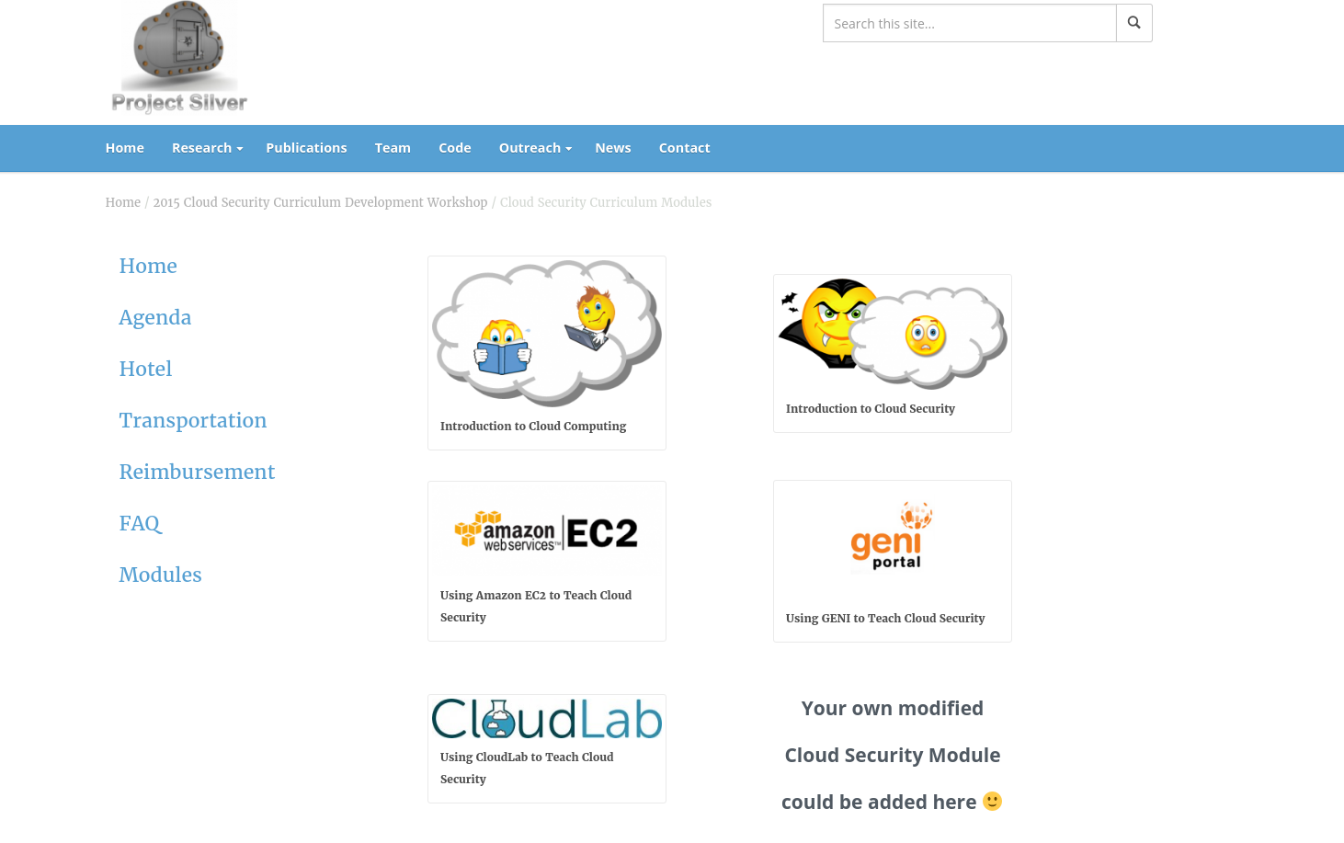
Project Silver Cloud Security Modules
Notes:
For more Information!
http://silver.web.unc.edu/cscw2015-archive/modules/

Slide 24
To Sum up
This paper summarized several of the research directions as well as several additional opportunities identified through conversations with members of the cloud operator and tenant communities.
Authors believe, however, that opportunities for further transformation made possible by the move to clouds remain underexplored, There’s an opportunity to particularly leveraging clouds to improve their tenants’ security.
Notes:
This paper summarized several of the research directions as well as several additional opportunities identified through conversations with members of the cloud operator and tenant communities.
Authors believe, however, that opportunities for further transformation made possible by the move to clouds remain underexplored, There’s an opportunity to particularly leveraging clouds to improve their tenants’ security.

Slide 25
References
Jay Aikat, Aditya Akella, Jeffrey S. Chase, Ari Juels, Michael K. Reiter, Thomas Ristenpart, Vyas Sekar, Michael Swift, "Rethinking Security in the Era of Cloud Computing", IEEE Security & Privacy, vol. 15, no. , pp. 60-69, May/June 2017, doi:10.1109/MSP.2017.80
Notes:
CITATION
Jay Aikat, Aditya Akella, Jeffrey S. Chase, Ari Juels, Michael K. Reiter, Thomas Ristenpart, Vyas Sekar, Michael Swift, "Rethinking Security in the Era of Cloud Computing", IEEE Security & Privacy, vol. 15, no. , pp. 60-69, May/June 2017, doi:10.1109/MSP.2017.80

Slide 26
Questions Asked
Please refer to the presentation notes for the questions asked and the answers we gave.
Notes:
What is Denial of Service Attack (DoS attack)?
A denial-of-service attack (DoS attack) is a cyber-attack where an attacker attempts to make a machine or network resource unavailable to its intended users by temporarily or indefinitely disrupting services of a host connected to the Internet. The sudden increase in traffic can cause the site to load very slowly for legitimate users. Sometimes the traffic is enough to shut the site down completely. Some particularly tricky botnets use uncorrupted computers as part of the attack.
What is Multi-tenancy?
The term "software multitenancy" refers to a software architecture in which a single instance of software runs on a server and serves multiple tenants. A tenant is a group of users who share a common access with specific privileges to the software instance. With a multitenant architecture, a software application is designed to provide every tenant a dedicated share of the instance - including its data, configuration, user management, tenant individual functionality and non-functional properties. Multitenancy contrasts with multi-instance architectures, where separate software instances operate on behalf of different tenants. Further on Ian carried on the discussion to further explain this.
What is Homomorphic encryption?
Homomorphic encryption is a form of encryption that allows computations to be carried out on ciphertext, thus generating an encrypted result which, when decrypted, matches the result of operations performed on the plaintext. This is sometimes a desirable feature in modern communication system architectures. Homomorphic encryption would allow the chaining together of different services without exposing the data to each of those services. Homomorphic encryption schemes are malleable by design. This enables their use in cloud computing environment for ensuring the confidentiality of processed data. In addition, the homomorphic property of various cryptosystems can be used to create many other secure systems, for example secure voting systems,collision-resistant hash functions, private information retrieval schemes, and many more. Further on Ian carried on the discussion to further explain this in depth. Later class discussed about Hash function, to know more please go to the link below.
https://www.tutorialspoint.com/cryptography/cryptography_hash_functions.htm

