Slide 1
Overview of Google Production Architecture
Ben Evans & Marc Laroza 3/10/17
Notes:
Google datacenters are very different from most conventional datacenters and small-scale server farms. These differences present both extra problems and opportunities. This chapter discusses the challenges and opportunities that characterize Google datacenters and introduces terminology that is used throughout the paper.

Slide 2
Hardware
Most of Google’s compute resources are in Google-designed datacenter.
Google-designed datacenter with proprietary:
Power distribution
Cooling
Networking
Compute hardware
Notes:
Most of Google’s compute resources are in Google-designed datacenters with proprietary power distribution, cooling, networking, and compute hardware. Unlike "standard" colocation datacenters, the compute hardware in a Google-designed datacenter is the same across the board.
A colocation is a datacenter facility in which a business can rent space for servers and other computing hardware.

Slide 3
Machine & Server
Machine
A piece of hardware or a VM (Virtual Machine)
Server
A piece of software that implements a service
Machines can run any server, therefore there are no dedicated machines to run specific server programs.
Borg is a system used by Google for resource allocation.
Notes:
To eliminate the confusion between server hardware and server software, they used the following terminology throughout the book: Machine and Server
Machines can run any server, Google didn’t dedicate specific machines to specific server programs. For example, There’s no specific machine that runs Google mail server. Instead, resource allocation is handled by Google cluster operating system, called Borg.

Slide 4
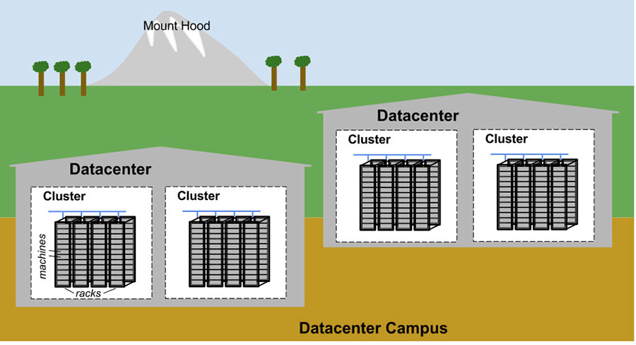
Topology of Google Datacenter
Tens of machines are placed in a rack.
Racks stand in a row.
One or more rows form a cluster.
Usually a datacenter building houses multiple clusters.
Multiple datacenter building that are located close together form a campus.

Slide 5
Google Datacenter Connectivity
Machines within a given datacenter need to be able to connect with each other.
Google created a very fast vSwitches with ten of thousands of ports.
Connecting hundreds of Google-built switches in a Clos network fabric named Jupiter.
Jupiter supports 1.3 Pbps bisection bandwidth among servers.
Datacenters are connected to each other with Google’s globe-spanning backbone network called B4.
B4 is an SDN architecture which supplies high capacity bandwidth.
Notes:
Machines within a given datacenter need to be able to talk with each other, therefore Google created a very fast virtual switch with tens of thousands of ports. They accomplished this by connecting hundreds of Google-built switches in a Clos network fabric named Jupiter. In its largest configuration, Jupiter supports 1.3 Pbps (petabits/sec) bisection bandwidth among servers..
Datacenters are connected to each other with Google’s globe-spanning backbone network B4. B4 is a software-defined networking architecture (and uses the OpenFlow open-standard communications protocol). It supplies massive bandwidth to a modest number of sites, and uses elastic bandwidth allocation to maximize average bandwidth.
B4 is Google’s SDNWAN (Software-defined Networking WAN), which is Google’s private WAN connecting each datacenter.
A Clos network is a type of non-blocking, multistage switching architecture that reduces the number of ports required in an interconnected Ethernet switch fabric (network topology). It is a way to overcome the performance- and cost-related challenges of electromechanical switches

Slide 6
System Software That “Organizes” the Hardware
System software that can handle massive scale to control and administer Google’s hardware.
Google’s notable problems are the hardware failures.
Thousands of machines fail and thousands of hard disks break in a single cluster per year.
Google wants to abstract such problems away from users, and teams running their services similarly don’t want to be bothered by hardware failures.
Notes:
Google’s hardware must be controlled and administered by software that can handle massive scale. Hardware failures are one notable problem that Google manage with software. Given the large number of hardware components in a cluster, hardware failures occur quite frequently. In a single cluster in a typical year, thousands of machines fail and thousands of hard disks break; when multiplied by the number of clusters we operate globally, these numbers become somewhat breathtaking. Therefore, Google want to abstract such problems away from users, and the teams running their services similarly don’t want to be bothered by hardware failures. Each datacenter campus has teams dedicated to maintaining the hardware and datacenter infrastructure.

Slide 7
Managing Machines - Borg System
Borg is a distributed cluster operating system, similar to Apache Mesos.
Responsible for running user’s jobs, which can either be indefinitely running servers or batch processes like a MapReduce.
Jobs can consists of more than one (and sometimes thousands) of identical tasks, for reliability purposes and because a single process can’t usually handle all cluster traffic.
When Borg starts a job, it finds a machine for the tasks and tells the machines to start the server program. Borg then continually monitors these tasks.
A task malfunction is killed and restarted on a different machine.
Notes:
Borg is responsible for running users’ jobs, which can either be indefinitely running servers or batch processes like a MapReduce. Jobs can consist of more than one (and sometimes thousands) of identical tasks, both for reasons of reliability and because a single process can’t usually handle all cluster traffic. When Borg starts a job, it finds machines for the tasks and tells the machines to start the server program. Then Borg continually monitors these tasks. If a task malfunctions, it is killed and restarted, possibly on a different machine.
Apache Mesos - Mesos is built using the same principles as the Linux kernel, only at a different level of abstraction. The Mesos kernel runs on every machine and provides applications (e.g., Hadoop, Spark, Kafka, Elasticsearch) with API’s for resource management and scheduling across entire datacenter and cloud environments.
Google's Borg system is a cluster manager that runs hundreds of thousands of jobs, from many thousands of different applications, across a number of clusters each with up to tens of thousands of machines. It achieves high utilization by combining admission control, efficient task-packing, over-commitment, and machine sharing with process-level performance isolation. It supports high-availability applications with runtime features that minimize fault-recovery time, and scheduling policies that reduce the probability of correlated failures. Borg simplifies life for its users by offering a declarative job specification language, name service integration, real-time job monitoring, and tools to analyze and simulate system behavior.

Slide 8
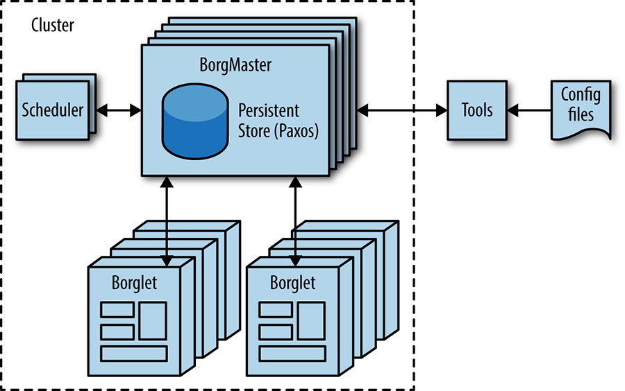
Borg Cluster Architecture
Notes:
Borg Architecture:
Borgmaster
Main Borgmaster process & Scheduler
Five replicas
Borglet
Manage and monitor tasks and resource
Borgmaster polls Borglet every few seconds
Tools and Config files
Command line tools
Web browsers

Slide 9
Managing Machines - Borg System cont.
Google does not simply rely on IP addresses and port numbers to refer to the tasks.
Borg uses Borg Naming Services (BNS):
Allocates a name and index number to each task.
/bns/<cluster>/<user>/<jobname>/<task number> == <IP address>:<port>
Borg is responsible for allocating resources to jobs.
Every job specifies its required resources.
Eg. 3 CPU cores, 2GiB of RAM
Kills and restart the task if it tries to use more resources than it requested.
Binpack the tasks over the machines in an optimal way. Also, takes account for failure domains.
Notes:
Tasks are fluidly allocated over machines, Google can’t simply rely on IP addresses and port numbers to refer to the tasks. Google have solve this problem with an extra level of indirection: when starting a job, Borg allocates a name and index number to each task using the Borg Naming Service (BNS). Rather than using the IP address and port number, other processes connect to Borg tasks via the BNS name, which is translated to an IP address and port number by BNS. For example, the BNS path might be a string such as /bns/<cluster>/<user>/<job name>/<task number>, which would resolve to <IP address>:<port>.
Borg is also responsible for the allocation of resources to jobs. Every job needs to specify its required resources (e.g., 3 CPU cores, 2 GiB of RAM). If a task tries to use more resources than it requested, Borg kills the task and restarts it (as a slowly crashlooping task is usually preferable to a task that hasn’t been restarted at all).
Borg can binpack the tasks over the machines in an optimal way that also accounts for failure domains (for example: Borg won’t run all of a job’s tasks on the same rack, as doing so means that the top of rack switch is a single point of failure for that job).
Binpack strategy will place containers on the most-loaded host that still has enough resources to run the given containers.

Slide 10
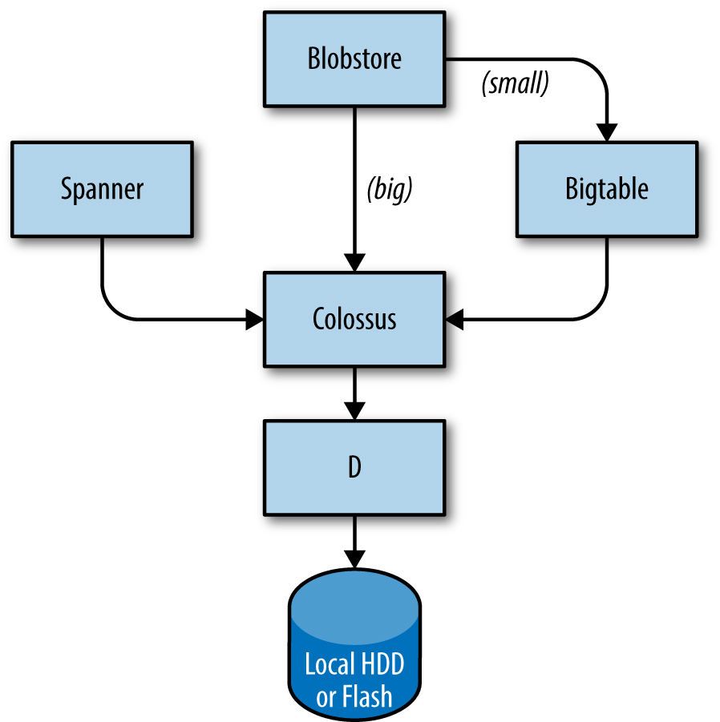
Storage
Storage layer is responsible for offering users easy and reliable access to the storage available for a cluster:
Lower layer called D.
Layer on top of D called Colossus.
Several database-like services built on top of Colossus:
Bigtable is a NoSQL database system.
Spanner offer an SQL-like interface.
Blobstore, another database storage system.
Notes:
Tasks can use the local disk on machines as a scratch pad, but Google have several cluster storage options for permanent storage (and even scratch space will eventually move to the cluster storage model). These are comparable to Lustre and the Hadoop Distributed File System (HDFS).
The storage layer is responsible for offering users easy and reliable access to the storage available for a cluster.
The lowest layer is called D (for disk, although D uses both spinning disks and flash storage). D is a fileserver running on almost all machines in a cluster. However, users who want to access their data don’t want to have to remember which machine is storing their data, which is where the next layer comes into play.
A layer on top of D called Colossus creates a cluster-wide filesystem that offers usual filesystem semantics, as well as replication and encryption. Colossus is the successor to the Google File System.
There are several database-like services built on top of Colossus:
Bigtable is a NoSQL database system that can handle databases that are petabytes in size. A Bigtable is a sparse, distributed, persistent multidimensional sorted map that is indexed by row key, column key, and timestamp; each value in the map is an uninterpreted array of bytes. Bigtable supports eventually consistent, cross-datacenter replication.
Spanner offers an SQL-like interface for users that require real consistency across the world.
Several other database systems, such as Blobstore, are available.
Google File System, a scalable distributed file system for large distributed data-intensive applications.
The Blobstore API allows your application to serve data objects, called blobs, that are much larger than the size allowed for objects in the Datastore service. Blobs are useful for serving large files, such as video or image files, and for allowing users to upload large data files.

Slide 11
Networking
Google uses OpenFlow-based SDN (Software-defined Network) for routing.
Bandwidth Enforcer (BwE) manages the available bandwidth to maximize the average available bandwidth.
To minimize distributed services, Google uses GSLB (Global Software Load Balancer) that performs load balancing in three levels:
Geographic load balancing for DNS request (eg. www.google.com).
Load balancing at a user service level (eg. Youtube or Google Maps).
Load balancing at the RPC (Remote Procedure Call) level.
Notes:
Google’s network hardware is controlled in several ways. As discussed earlier, Google use an OpenFlow-based software-defined network. Instead of using "smart" routing hardware, Google rely on less expensive "dumb" switching components in combination with a central (duplicated) controller that precomputes best paths across the network. Therefore, Google were able to move compute-expensive routing decisions away from the routers and use simple switching hardware.
Network bandwidth needs to be allocated wisely. Just as Borg limits the compute resources that a task can use, the Bandwidth Enforcer (BwE) manages the available bandwidth to maximize the average available bandwidth. Optimizing bandwidth isn’t just about cost: centralized traffic engineering has been shown to solve a number of problems that are traditionally extremely difficult to solve through a combination of distributed routing and traffic engineering
Some services have jobs running in multiple clusters, which are distributed across the world. In order to minimize latency for globally distributed services, Google wants to direct users to the closest datacenter with available capacity. Our Global Software Load Balancer (GSLB) performs load balancing on three levels:
Geographic load balancing for DNS requests (for example, to www.google.com), described in Load Balancing at the Frontend
Load balancing at a user service level (for example, YouTube or Google Maps)
Load balancing at the Remote Procedure Call (RPC) level, described in Load Balancing in the Datacenter
Service owners specify a symbolic name for a service, a list of BNS addresses of servers, and the capacity available at each of the locations (typically measured in queries per second). GSLB then directs traffic to the BNS addresses.

Slide 12

The Production Environment at Google (Pt 2)
Ben Evans & Marc Laroza

Slide 13
Presentation Overview
Hardware
System Software that organizes hardware
Other System Software
Software Infrastructure
Development Environment
Sample Service

Slide 14
Other System Software
Locking
Monitoring / Alerting

Slide 15
Locking
Use a service called "Chubby"
Chubby stores small amounts of data with strong consistency
Distributed filesystem like API
For loosely coupled systems
Reliable but low volume storage
Coarse-grained locking
Design emphasis on availability and reliability, not high performance
Also used for master election (i.e. in BigTable and GFS) - Distributed consensus achieved via the PAXOS protocol
See: https://static.googleusercontent.com/media/research.google.com/en//archive/chubby-osdi06.pdf
Notes:
The Chubby lock service provides a filesystem-like API for maintaining locks. Chubby handles these locks across datacenter locations. It uses the Paxos protocol for asynchronous Consensus. Chubby also plays an important role in master election. When a service has five replicas of a job running for reliability purposes but only one replica may perform actual work, Chubby is used to select which replica may proceed. Data that must be consistent is well suited to storage in Chubby. For this reason, BNS uses Chubby to store mapping between BNS paths and IP address:port pairs
If you are unfamiliar with PAXOS I found the following a really good read: https://understandingpaxos.wordpress.com

Slide 16
Monitoring/Alerting
Uses "Borgman" monitoring program
Borgman regularly scrapes metrics from monitored servers
These metrics then can be used for
Instantaneous alerts
Historical overview (i.e. graphing)
Comparisons (did an update improve the performance?)
See: https://landing.google.com/sre/book/chapters/practical-alerting.html
Notes:
Want to make sure that all services are running as required. Therefore, google runs many instances of the Borgmon monitoring program. Borgmon regularly "scrapes" metrics from monitored servers. These metrics can be used instantaneously for alerting and also stored for use in historic overviews (e.g., graphs). Monitoring can be used in several ways:
Set up alerting for acute problems.
Compare behavior: did a software update make the server faster?
Examine how resource consumption behavior evolves over time, which is essential for capacity planning.

Slide 17
Software Infrastructure
Design
Communication

Slide 18
Software Infrastructure: Design
Designed to make most efficient use of the hardware infrastructure
Heavily multithreaded, so one task can use many cores
Each server has an HTTP server with diagnostics and statistics for a given task (for dashboards, monitoring and debugging)
Notes:
Google's software architecture is designed to make the most efficient use of their hardware infrastructure. The code is heavily multithreaded, so one task can easily use many cores. To facilitate dashboards, monitoring, and debugging, every server has an HTTP server that provides diagnostics and statistics for a given task.

Slide 19
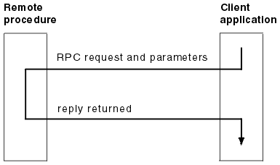
Software Infrastructure: Communication
Uses a RPC based infrastructure called "Stubby"
Often calls to local subroutines are treated as a RPC (supports refactoring and modularity)
GSLB can load balance RPCs
Data is transferred to RPC using protocol buffers
Notes:
All of Google’s services communicate using a Remote Procedure Call (RPC) infrastructure named Stubby; an open source version, gRPC, is available. Often, an RPC call is made even when a call to a subroutine in the local program needs to be performed. This makes it easier to refactor the call into a different server if more modularity is needed, or when a server’s codebase grows. GSLB can load balance RPCs in the same way it load balances externally visible services.
A server receives RPC requests from its frontend and sends RPCs to its backend. In traditional terms, the frontend is called the client and the backend is called the server.

Slide 20
Software Infrastructure: Communication
What are protocol buffers (protobufs)?
Extensible mechanism for serializing structured data
Same goal as XML, but offers several advantages over XML
Smaller (3-10 times smaller)
Faster (20 to 100 times faster)
Less Ambiguous
Similar to Apache Thrift
Specify a schema for messages
Messages are sent in a binary encoded form (small but not human readable!)
See: https://developers.google.com/protocol-buffers/
Notes:
Data is transferred to and from an RPC using protocol buffers, often abbreviated to "protobufs," which are similar to Apache’s Thrift. Protocol buffers have many advantages over XML for serializing structured data: they are simpler to use, 3 to 10 times smaller, 20 to 100 times faster, and less ambiguous.
Protocol buffers are Google's language-neutral, platform-neutral, extensible mechanism for serializing structured data – think XML, but smaller, faster, and simpler. You define how you want your data to be structured once, then you can use special generated source code to easily write and read your structured data to and from a variety of data streams and using a variety of languages.

Slide 21
Development Environment
Version Control
Process

Slide 22
Version Control
Development velocity is very important to Google
A single shared repository is used across google, the reasons being If a problem is found in a component outside of an engineer's project, they can fix the problem and send the proposed changes to the changelist for review
(Note: there are some exceptions, such as the Android and Chrome group work in their own open sourced repositories).
Notes:
Apart from a few groups that have their own open source repositories (e.g., Android and Chrome), Google Software Engineers work from a single shared repository. This means if engineers encounter a problem in a component outside of their project, they can fix the problem, send the proposed changes ("changelist," or CL) to the owner for review, and submit the CL to the mainline.

Slide 23
Process
Changes made/software developed
The code is reviewed
If the review is fine, Build request sent to build servers in a datacentre - Build servers can compile in parallel, so large builds are executed quickly
Tests run on all software that may be impacted by the new code - If any test fails, the owner of the code is notified - If all tests pass, some projects use a "push-on-green" system where new version is automatically pushed to production
Notes:
When software is built, the build request is sent to build servers in a datacenter. Even large builds are executed quickly, as many build servers can compile in parallel. This infrastructure is also used for continuous testing. Each time a CL is submitted, tests run on all software that may depend on that CL, either directly or indirectly. If the framework determines that the change likely broke other parts in the system, it notifies the owner of the submitted change. Some projects use a push-on-green system, where a new version is automatically pushed to production after passing tests.

Slide 24
Putting it all together
An Example

Slide 25
The goal
Suppose we want to offer a service that lets you determine where a given word is used throughout all of Shakespeare’s works.
Notes:
To provide a model of how a service would hypothetically be deployed in the Google production environment, let’s look at an example service that interacts with multiple Google technologies. Suppose we want to offer a service that lets you determine where a given word is used throughout all of Shakespeare’s works.

Slide 26
Can divide the system into two parts
A batch component that reads all of Shakespeare’s texts, creates an index, and writes the index into a Bigtable.
This only needs to be run once, or very infrequently
An application frontend that handles end-user requests. This job is always up, as users in all time zones will want to search in Shakespeare’s books.
Notes:
We can divide this system into two parts:
A batch component that reads all of Shakespeare’s texts, creates an index, and writes the index into a Bigtable. This job need only run once, or perhaps very infrequently (as you never know if a new text might be discovered!).
An application frontend that handles end-user requests. This job is always up, as users in all time zones will want to search in Shakespeare’s books.

Slide 27
Batch Component
MapReduce comprising three phases.
Map phase:: Reads Shakespeare’s texts and splits them into individual words. This is faster if performed in parallel by multiple workers.
Shuffle phase: Sorts the tuples by word.
Reduce phaser: A tuple of (word, list of locations) is created.
Each tuple is written to a row in a Bigtable, using the word as the key.
Notes:
The batch component is a MapReduce comprising three phases.
The mapping phase reads Shakespeare’s texts and splits them into individual words. This is faster if performed in parallel by multiple workers.
The shuffle phase sorts the tuples by word.
In the reduce phase, a tuple of (word, list of locations) is created.
Each tuple is written to a row in a Bigtable, using the word as the key.

Slide 28
Application/Client End (1)
User points their browser to shakespeare.google.com
To get the IP address, the user’s device resolves the address with its DNS server
This request ultimately ends up at Google’s DNS server, which talks to GSLB. GSLB picks which server IP address to send to this user (based on load)
Browser connects to this HTTP server. - Server is a reverse proxy (named google frontend) which looks up the required service: i.e. web search, maps, or shakespeare - Server finds an available shakespeare server (using GSLB) and sends the server a RPC with the HTTP request
Notes:
The user points their browser to shakespeare.google.com. To obtain the corresponding IP address, the user’s device resolves the address with its DNS server (1). This request ultimately ends up at Google’s DNS server, which talks to GSLB. As GSLB keeps track of traffic load among frontend servers across regions, it picks which server IP address to send to this user.
The browser connects to the HTTP server on this IP. This server (named the Google Frontend, or GFE) is a reverse proxy that terminates the TCP connection. The GFE looks up which service is required (web search, maps, or—in this case—Shakespeare). Again using GSLB, the server finds an available Shakespeare frontend server, and sends that server an RPC containing the HTTP request.

Slide 29
Application/Server End (2)
5. Shakespeare server analyzes the HTTP Request, and constructs a protobuf containing the word to lookup.
6. Shakespear front end server now contacts shakespeare backend server (again via GSLB)
7. This backend server now contacts a Bigtable server to obtain the requested data (request and response both via protobufs) 8. Response handed back to front end server (still as a protobuf)
9. Finally, the frontend server assembles the HTML and displays the answer to user
Notes:
The Shakespeare server analyzes the HTTP request and constructs a protobuf containing the word to look up. The Shakespeare frontend server now needs to contact the Shakespeare backend server: the frontend server contacts GSLB to obtain the BNS address of a suitable and unloaded backend server (4). That Shakespeare backend server now contacts a Bigtable server to obtain the requested data (5).
The answer is written to the reply protobuf and returned to the Shakespeare backend server. The backend hands a protobuf containing the results to the Shakespeare frontend server, which assembles the HTML and returns the answer to the user.

Slide 30
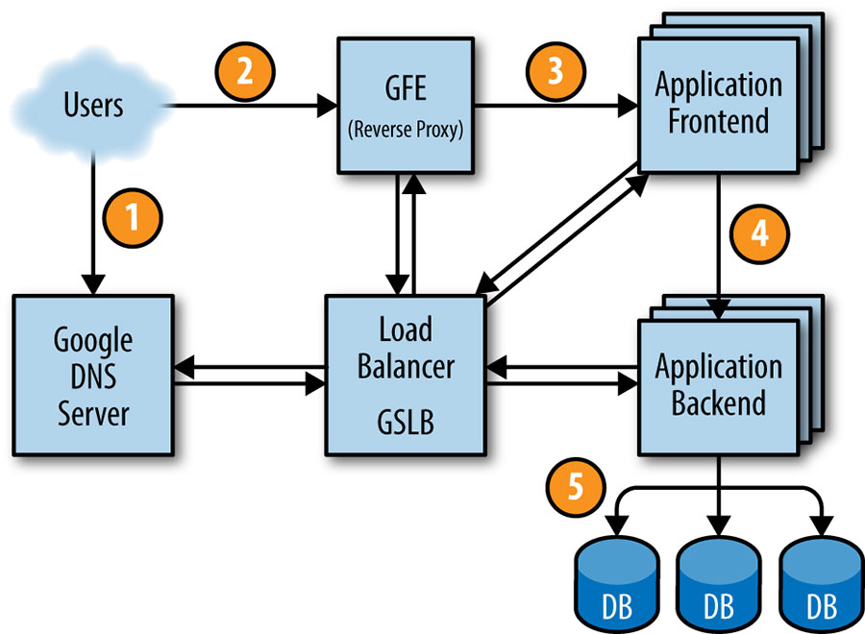
Notes:
The previous steps composed into a picture. Note the numbers here do match the previous slides as additional details were added. This just serves as a visualisation of the general process followed

Slide 31
That seems long! How long does this take?
Only a few hundred milliseconds, to achieve this careful considerations also need to be made to reduce the latency of these requests, since many remote calls are being used.
There are also many potential points of failure, imagine if the GSLB failed. This is why rigorous testing and careful rollout procedures are important to google (as discussed in the Development Environment section)!
Notes:
This entire chain of events is executed in the blink of an eye—just a few hundred milliseconds! Because many moving parts are involved, there are many potential points of failure; in particular, a failing GSLB would wreak havoc. However, Google’s policies of rigorous testing and careful rollout, in addition to our proactive error recovery methods such as graceful degradation, allow us to deliver the reliable service that our users have come to expect.

Slide 32
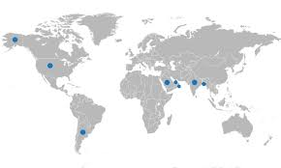
Considerations
Will have clients all over the globe, having all backend servers in a single location can add high amounts of latency for many users!

Slide 33
Considerations
Solution: Distribute these backend servers around the globe, paying attention to the usage rates (which we have thanks to Borgman monitoring from earlier!)
Notes:
Load testing determined that our backend server can handle about 100 queries per second (QPS). Trials performed with a limited set of users lead us to expect a peak load of about 3,470 QPS, so we need at least 35 tasks. However, the following considerations mean that we need at least 37 tasks in the job, or N+2:
During updates, one task at a time will be unavailable, leaving 36 tasks.
A machine failure might occur during a task update, leaving only 35 tasks, just enough to serve peak load.
A closer examination of user traffic shows our peak usage is distributed globally: 1,430 QPS from North America, 290 from South America, 1,400 from Europe and Africa, and 350 from Asia and Australia. Instead of locating all backends at one site, we distribute them across the USA, South America, Europe, and Asia. Allowing for N+2 redundancy per region means that we end up with 17 tasks in the USA, 16 in Europe, and 6 in Asia. However, we decide to use 4 tasks (instead of 5) in South America, to lower the overhead of N+2 to N+1. In this case, we’re willing to tolerate a small risk of higher latency in exchange for lower hardware costs: if GSLB redirects traffic from one continent to another when our South American datacenter is over capacity, we can save 20% of the resources we’d spend on hardware. In the larger regions, we’ll spread tasks across two or three clusters for extra resiliency.

Slide 34
Considerations
Lets not forget the back end servers also need to contact BigTable, so the databases are also replicated in each region.
This reduces latency and increases availability (as if one server fails, the data is replicated elsewhere)
Notes:
Because the backends need to contact the Bigtable holding the data, we need to also design this storage element strategically. A backend in Asia contacting a Bigtable in the USA adds a significant amount of latency, so we replicate the Bigtable in each region. Bigtable replication helps us in two ways: it provides resilience should a Bigtable server fail, and it lowers data-access latency. While Bigtable only offers eventual consistency, it isn’t a major problem because we don’t need to update the contents often.

Slide 35
Thanks!
Any questions?

Slide 36
Question
A cool tool to visualise how large a petabyte is given at: http://www.redcentricplc.com/resources/infographics/byte-size/
Some perspective of 1.3 pbs, as it is a lot:
It is a lot because Google must be able to support this much bandwidth as a lot of users and businesses use Google as a search engine and other cloud functionalities. Google accomplished this by connecting hundreds of Google-built switches in a Clos network fabric name Jupiter, that supports 1.3 pbs bisection bandwidth among servers.

Slide 37
Question
Is SDN fast enough for handling large amount of traffic in the network?
Yes. SDN’s network architecture separates the centralized network control plane from the forwarding plane where the control plane manages multiple forwarding devices such as the switches. The control plane does all the computation and decision making for where to route the packets. This information is then sent to each of the “dumb” switches which forward the packets based on the given rules or routing information. This able to move compute-expensive routing decision away from the routers and use simple switching hardware which makes the operation faster.
In addition, switches only does packet matching on the packet’s information such as the MAC address, source and destination IP addresses to decide where to forward the packet.

Slide 38
Question
Borg relation with Kubernetes
Borg system is a descendant of Kubernetes. Kubernetes is an open source container cluster orchestration framework started by Google in 2014.

Slide 39
Question
Configuration of Monitoring Server:
The question was around how google configures their monitoring servers.
Borgmon is setup to monitor from a set of servers. As the metrics gathered are standardised, Borgmon can also monitor other Borgmon servers, meaning a hierarchical structure can be built around a service offering statistics at any given level for the service.
I think the questioner was also after information about how the HTTP requests were made to retrieve these metrics. However, this has not been made available for Borgman (as Borgman is internal to google)
Prometheus (https://prometheus.io) is an opensource alternative to Borgman, and the page here gives examples for how such queries are made https://prometheus.io/docs/querying/examples/
A good article which goes into more depth around monitoring at google is here: https://landing.google.com/sre/book/chapters/practical-alerting.html

Slide 40
Question
Google’s proprietary Datacenter:
The question was clarifying Google's use of proprietary hardware , and requesting some additional details
Google's resources stored in google-designed data centers ( Unlike "standard" colocation data centers, the compute hardware in a Google-designed datacenter is the same across the board), proprietary hardware includes
Power distribution
Cooling
Networking
More information is given at: https://research.google.com/pubs/pub41606.html
But as much is proprietary, unfortunately not much additional information can be given

Slide 41
Question
Is GSLB part of Borg?
No, these are two separate systems.
Borg manages job resources at a cluster level, e.g finding a machine which has the needed 2GB of RAM.
GSLB occurs at a high level, and provides load balancing for
Geographic load balancing for DNS requests
Load balancing at a user service level (for example, YouTube or Google Maps)
Load balancing at the Remote Procedure Call (RPC) level,
Notes:
For more about borg see: https://research.google.com/pubs/pub43438.html

