Slide 1
The Google File System By: Sanjay Ghemawat, Howard Gobioff, and Shun-Tak Leung Presented By: Miguel Orevillo, David Barnett, Joely Huang

Slide 2
Introduction & Design Overview
With: Miguel Orevillo

Slide 3
Introduction

Slide 4
Background
Distributed File System created by Google to provide efficient and reliable access to data to their applications
Since paper was written, a more up to date version of GFS code named Colossus was released in 2010

Slide 5
GFS Goals
Same goals as every other distributed file system
Meet rapidly growing demands of Google’s data processing needs.
Design has been driven by key observations by both future and anticipated work
Notes:
Same goals of other distributed file systems
Performance
Scalability
Reliability
Availability

Slide 6
Design Choices
Component failures are the norm rather than exception
Constant monitoring, error detection, fault tolerance and auto recovery is key
Files are huge by traditional standards such as multi-GB files.
Notes:
File system consists of hundreds or even thousands of storage machines built from inexpensive commodity parts and is accessed by a comparable number of client machines Need to take into account for this when errors occur
Each file stores many application objects such as web documents Unwieldy to manage billions of KB-sized files

Slide 7
Design Choices cont’d...
3. Appending new data rather than overwriting
Once written, files are only read and sequential
4. Increase in flexibility by co-designing applications and file system API
Example, atomic append operation to let concurrent adding to file
Notes:
3. Some may constitute large repositories that data analysis programs scan through. Some may be data streams continuously generated by running applications. Some may be archival data. Some may be intermediate results produced on one machine and processed on another, whether simultaneously or later in time. Given this access pattern on huge files, appending becomes the focus of performance optimization and atomicity guarantees, while caching data blocks in the client loses its appeal.

Slide 8
Design Overview

Slide 9
Assumptions
Expected for components to fail
Monitor and detect and recover from any failures
Huge storage
Multi-GB files are most common, small files supported but no optimization
Large streaming reads and small random reads
1MB reads vs. few KBs
Notes:
Large streaming reads and small random reads
Performance-conscious applications often sort small reads to advance steadily through file rather than go back and forth

Slide 10
Assumptions cont’d
Large, sequential writes that append to files
Seldom modified after this
Efficiently implement well-defined semantics for concurrent users
Producer-consumer queues, many-way merging
High sustained bandwidth more important than low latency
Notes:
Once written, files are seldom modified again
Small writes supported but dont need to be efficient
Most of our target applications place a premium on processing data in bulk at a high rate, while few have stringent response time requirements for an individual read or write.

Slide 11
Interface
Familiar file system interface and organized hierarchically
Supported operations
Create, delete, open, close, read and write files
Snapshot
Creates copy of file/directory - low costs
Record Append
Multiple clients can add data to same file concurrently

Slide 12
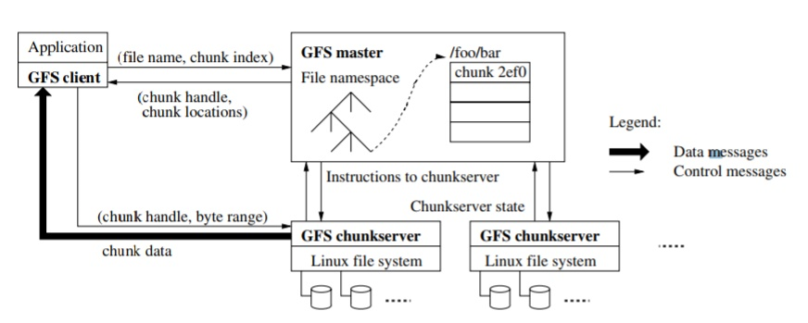
Architecture
Consists of single master and multiple chunk servers accessed by multiple clients
Files divided into fixed-size chunks
Identified as 64 bit chunk handle assigned by master
Notes:
Easy to run both chunkserver and client on same machine as long as machine resources permit and lower reliability caused by running possible flaky application code is acceptable
Stored on local disks
By default store three replicas (user can choose where to store them)

Slide 13
Architecture cont’d...
Master maintains all file system metadata
Namespace, access control info, mapping of files to chunks and location
Master periodically communicates with each chunk (HeatBeat)
Notes:
The master maintains all file system metadata. This includes the namespace, access control information, the mapping from files to chunks, and the current locations of chunks. It also controls system-wide activities such as chunklease management, garbage collection of orphaned chunks, and chunkmigration between chunkservers. The master periodically communicates with each chunkserver in HeartBeat messages to give it instructions and collect its state.

Slide 14
Architecture cont’d...
Clients interact with master for metadata operations
Data-bearing communication goes directly to chunkservers
Client and chunkserver do not cache data
Notes:
Neither the client nor the chunkserver caches file data. Client caches offer little benefit because most applications stream through huge files or have working sets too large to be cached. Not having them simplifies the client and the overall system by eliminating cache coherence issues. (Clients do cache metadata, however.) Chunkservers need not cache file data because chunks are stored as local files and so Linux’s buffer cache already keeps frequently accessed data in memory.

Slide 15
Single Master
Simple design
Helps chunk placement and replication
Minimize involvement in read and write
Bottleneck
Client asks master for chunkserver

Slide 16
Read Example..
Notes:
First, using the fixed chunksize, the client translates the file name and byte offset specified by the application into a chunkindex within the file. Then, it sends the master a request containing the file name and chunk index. The master replies with the corresponding chunk handle and locations of the replicas. The client caches this information using the file name and chunkindex as the key.
The client then sends a request to one of the replicas, most likely the closest one. The request specifies the chunk handle and a byte range within that chunk. Further reads of the same chunkrequire no more client-master interaction until the cached information expires or the file is reopened. In fact, the client typically asks for multiple chunks in the same request and the master can also include the information for chunks immediately following those requested. This extra information sidesteps several future client-master interactions at practically no extra cost.

Slide 17
Chunk Size
64MB - larger than typical
Stored as plain Linux file
Large chunk advantages
Reduces client need to interact with master
Client more likely to perform many operations on given chunk
Reduces network overhead
Reduces size of metadata stored
Notes:
Each replica is extended only as needed tp avoid wasting space due to internal fragmentation
Reduced overhead by keeping persistent TCP connection to the chunkserver over long period of time

Slide 18
Chunk Size cont’d..
Large chunk disadvantages
Small files can create hot spots on chunkservers if many clients access same file
Notes:
In practice, hot spots have not been a major issue as apps mostly read files sequentially
Potential long term solution is to allow clients to read from other clients in situations

Slide 19
Metadata
Master stores three types of metadata
File and chunk namespaces
Mapping from files to chunks
Location of each chunk’s replicas
Stored in memory
Fast operations
Easy and efficient to scan entire state
Notes:
First two are kept persistent by operation log to allow updates to the master state in a simple, reliable way without risking inconsistencies if master crashes
Master asks each chunkserver about its chunks at startup and whenever a chunkserver joins cluster

Slide 20
Metadata cont’d....
Concern
Limited by how much memory master has
Not a serious limitation and if necessary, cost of adding memory to master is small price to pay for enhancement
Regular HeartBeat messages to keep itself up to date
Eliminated synchronisation problems between master and chunkservers
Notes:
Most chunks are full because most files contain many chunks where only last may be partially filled
Price to pay for more memory is small in exchange for simplicity, performance, flexibility
Initially kept chunk location info persistent at master but simpler to request data from chunkservers

Slide 21
Metadata cont’d....
Operational Log
Serves logical timeline of operations
Must be stored reliably and make no changes
Replicate on multiple remote machines
Master checkpoints state when oversize
Recovery
Older checkpoints can be deleted
Notes:
Contains historical record of critical metadata changes
If not stored properly, lose whole file system or recent client operations even if the chunks survive
Replicate on multiple remote machines
Building checkpoints can take a while
Internal state structured in a way that new ones can be created without delay

Slide 22
Consistency Model
Relaxed consistency model
Guarantees
Atomicity and Correctness by namespace locking
State of region depends on mutation
File region consistent if all clients always see same data
Region defined after file data mutation is consistent
Failed makes region inconsistent
Notes:
The state of a file region after a data mutation depends on the type of mutation, whether it succeeds or fails, and whether there are concurrent mutations. Table 1 summarizes the result. A file region is consistent if all clients will always see the same data, regardless of which replicas they read from. A region is defined after a file data mutation if it is consistent and clients will see what the mutation writes in its entirety. When a mutation succeeds without interference from concurrent writers, the affected region is defined (and by implication consistent): all clients will always see what the mutation has written. Concurrent successful mutations leave the region undefined but consistent: all clients see the same data, but it may not reflect what any one mutation has written. Typically, it consists of mingled fragments from multiple mutations. A failed mutation makes the region inconsistent (hence also undefined): different clients may see different data at different times.

Slide 23
Consistency Model cont’d...
Stale replicas never involved in a mutation
Garbaged collected instead
Even with failures, able to be restored
Data becomes unavailable, not corrupted
Notes:
Long after a successful mutation, component failures can of course still corrupt or destroy data. GFS identifies failed chunkservers by regular handshakes between master and all chunkservers and detects data corruption by checksumming (Section 5.2). Once a problem surfaces, the data is restored from valid replicas as soon as possible (Section 4.3). A chunk is lost irreversibly only if all its replicas are lost before GFS can react, typically within minutes. Even in this case, it becomes unavailable, not corrupted: applications receive clear errors rather than corrupt data.

Slide 24
System Interactions & Master Operation With: David Barnett

Slide 25
System Interactions

Slide 26
Lease & Mutation Order
Mutation will change chunk data or metadata
E.g. Record Append, Snapshot, Write
Performed on all replicas
Master grants a replica a lease to become primary
Primary decides order of mutations
Notes:
Leases controls the mutations of GFS files and directories
=====
A mutation is an operation that changes the contents or
metadata of a chunk such as a write or an append opera-
tion. Each mutation is performed at all the chunk’s replicas.
We use leases to maintain a consistent mutation order across
replicas. The master grants a chunk lease to one of the repli-
cas, which we call the primary.
The primary picks a serial
order for all mutations to the chunk. All replicas follow this
order when applying mutations. Thus, the global mutation
order is defined first by the lease grant order chosen by the
master, and within a lease by the serial numbers assigned
by the primary.

Slide 27
Lease & Mutation Order
Designed to minimize Master interaction
A lease times out after 60s
Requests extensions with each heartbeat during operation
Lease can be revoked
If Primary lost, Master waits for timeout before granting new lease
Notes:
====
The lease mechanism is designed to minimize management
overhead at the master. A lease has an initial timeout
of 60 seconds. However, as long as the chun kis being mutated,
the primary can request and typically receive extensions
from the master indefinitely. These extension requests
and grants are piggybacked on the HeartBeat messages
regularly exchanged between the master and all chunk servers.
The master may sometimes try to revoke a lease before it
expires (e.g., when the master wants to disable mutations
on a file that is being renamed). Even if the master loses
communication with a primary, it can safely grant a new
lease to another replica after the old lease expires.

Slide 28
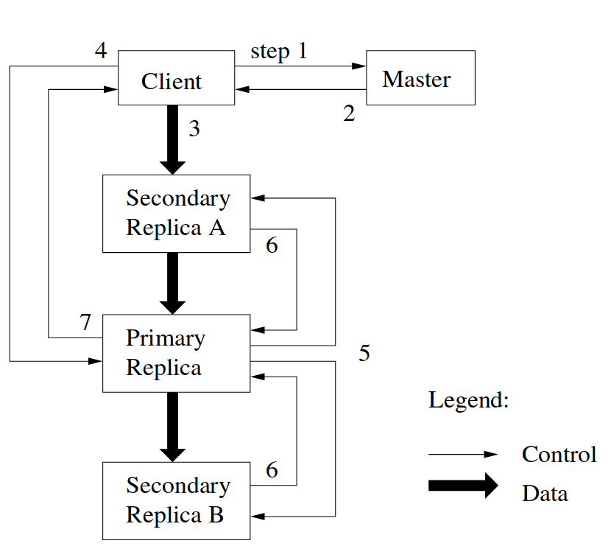
Control Flow of a Write
Step 1
Client ask Master for chunk server with lease
Master may delay this as it grants a lease
Notes:
The client application asks the master for the location of the primary and secondaries of a chunk of data.
The master may delay this due to locks on the chunk, file, namespace or that there is no primary ATM
=====
1. The client asks the master which chunkserver holds
the current lease for the chunk and the locations of
the other replicas. If no one has a lease, the master
grants one to a replica it chooses (not shown).

Slide 29
Control Flow of a Write
Step 2
Master replies with Primary location and its replicas
Client caches locations
Cache expires when Primary loses lease or MIA
Notes:
The client will cache the chunk locations given to it from the master until the primary refuses it
=====
2. The master replies with the identity of the primary and
the locations of the other (secondary) replicas. The
client caches this data for future mutations. It needs
to contact the master again only when the primary

Slide 30
Control Flow of a Write
Step 3
Client pushes data to chunk servers
Data & control decoupled
Data is pipelined from one server to the next
Notes:
The data is pipelined to each replica node, see data flow section
=====
3. The client pushes the data to all the replicas. A client
can do so in any order. Each chunkserver will store
the data in an internal LRU buffer cache until the
data is used or aged out. By decoupling the data flow
from the control flow, we can improve performance by
scheduling the expensive data flow based on the net-
Work topology regardless of which chunk server is the
primary. Section 3.2 discusses this further.

Slide 31
Control Flow of a Write
Step 4
Client sends write to Primary after all replicas receive data
Primary serialize request
Applies to local state
Notes:
The write command is given to the primary since the data is present on the primary and secondaries so the write operation can be applied locally
=====
4. Once all the replicas have acknowledged receiving the
data, the client sends a write request to the primary.
The request identifies the data pushed earlier to all of
the replicas. The primary assigns consecutive serial
numbers to all the mutations it receives, possibly from
multiple clients, which provides the necessary serial-
ization. It applies the mutation to its own local state
in serial number order.

Slide 32
Control Flow of a Write
Step 5
Primary forwards write to all Secondaries
Notes:
Primary tells the secondaries to apply the operation after its completed.
=====
5. The primary forwards the write request to all secondary replicas.
Each secondary replica applies mutations in the same serial
number order assigned by the primary.

Slide 33
Control Flow of a Write
Step 6
Secondaries acknowledge completed mutation
Notes:
Secondaries acknowledge the operating and report any errors
=====
6. The secondaries all reply to the primary indicating
that they have completed the operation.

Slide 34
Control Flow of a Write
Step 7
Primary reports result to Client
Any errors on Secondaries are reported
If failed, Client code handles re-try
Notes:
Informs the user that the operation is complete and reports errors,
If there was an error the user is to re-try the operation again, the corrupted or duplication of data as a result of this is OK since GFS applications are built to handle such errors in data
=====
7. The primary replies to the client. Any errors encoun-
tered at any of the replicas are reported to the client.
In case of errors, the write may have succeeded at the
primary and an arbitrary subset of the secondary repli-
cas. (If it had failed at the primary, it would not
have been assigned a serial number and forwarded.)
The client request is considered to have failed, and the
modified region is left in an inconsistent state. Our
client code handles such errors by retrying the failed
mutation. It will make a few attempts at steps (3)
through (7) before falling back to a retry from the be-
ginning of the write.

Slide 35
Data Flow
Designed to:
Effectively use network
Fully utilise a node’s link
Avoid bottlenecks, crossing routers
Minimize latency, connect to closest
Notes:
Designed to effectively using the network
Use all the throughput of a node to move the data onto the next node
Try not to cross over routers, racks or data centers when pushing data
Push data to the closest replica
=========
We decouple the flow of data from the flow of control to
use the network efficiently. While control flows from the
client to the primary and then to all secondaries, data is
pushed linearly along a carefully picked chain of chunk servers
in a pipelined fashion. Our goals are to fully utilize each
machine’s network bandwidth, avoid network bottlenecks
and high-latency links, and minimize the latency to push
through all the data.
To fully utilize each machine’s network bandwidth, the
data is pushed linearly along a chain of chunk servers rather
than distributed in some other topology (e.g., tree). Thus,
each machine’s full outbound bandwidth is used to trans-
fer the data as fast as possible rather than divided among
multiple recipients

Slide 36
Data Flow
Pipelines data along a chain
Duplexed links, no cost of uploading the download
Chain is picked by “closest” node
Paper leverages knowledge of IP addresses
Notes:
Achieves this by pipelining the data between each replica.
They can upload data as they receive it as each node has a full duplex link, so upload does not affect download throughput
When pushing data a chain of replicas are decided to push through based off how “close” they are
====
To avoid network bottlenecks and high-latency links (e.g.,
inter-switch links are often both) as much as possible, each
machine forwards the data to the “closest” machine in the
Network topology that has not received it. Suppose the
client is pushing data to chunkservers S1 through S4. It
sends the data to the closest chunkserver, say S1. S1 for-
wards it to the closest chunkserver S2 through S4 closest to
S1, say S2. Similarly, S2 forwards it to S3 or S4, whichever
is closer to S2, and so on. Our network topology is simple
enough that “distances” can be accurately estimated from
IP addresses.
Finally, we minimize latency by pipelining the data trans-
fer over TCP connections. Once a chunkserver receives some
data, it starts forwarding immediately. Pipelining is espe-
cially helpful to us because we use a switched network with
full-duplex links

Slide 37
Atomic Record Appends
Most common operation for GFS
Multiple-producer / single-consumer queues
Puts data at end of file
Order decided by Primary
When appends overflows a chunk
Primary pads chunk & tells client to append on new chunk
Size limited to ¼ of chunk size
Minimizes worst case of new chunks
Notes:
The record append is the heavily used file mutation operation for GFS due to the common use of multiple-producer / single-consumer queues.
The primary decides the order, instead of clients, to move all concurrency resolving onto the primary
If the appended data overflows the chunk max size the Primary will pad out the chunk to max and tell the client to append to a new chunk, this a large cost
To minimize this a append is limited to a ¼ of the chunk server so that the appends are less likely to overflow to reduce the worst case of padded chunks & creating new chunks

Slide 38
Atomic Record Appends
Primary applies locally and tells Secondaries to as well
Any failures client needs to retry
Replicas may have duplicate records or differing data
GFS does not guarantee bitwise replicas
Guarantees data is written at least once anatomically
Notes:
As shown in the Write control flow, the write is first competed on the primary then replicas
If there is a failure on any replica the entire operation must be retried by the client
This allows for replicas to have duplicate or corrupted records
GFS is fine with this because client code is built to deals with these errors
GFS does not guarantee that all replicas are bitwise duplicates but that they are all the same length
GFS does however, guarantee that at least one replica is appended with the data

Slide 39
Snapshot
Duplicates a file or a folder tree
Revokes all leases in snapshot
Clones file/directory’s metadata
Uses Copy-on-write to minimize duplicates
Uses chunk has reference count to detect when to copy on write
Notes:
Snapshot duplicates a file or directory tree for almost free
Needs to revoke all leases on the chunks in the snapshot (this can take at least the timeout )
Then clones the metadata of the snapshotted, this has the side effect that chunks now have more than one reference count
There is no writes to chunk servers about a snapshot, all of this is on the master.
When a client then wants to write to the snapshot or source, the master notices that the chunk has more than 1 references.
The chunk is then duplicated and the client is then directed to write to the duplicated chunk (Copy-on-Write)

Slide 40
Master Operation

Slide 41
Namespace Management & Locking
Master operations can take time
Snapshots, renames, delete
Locks over namespaces to ensure ordering
Each directory and file has a Read-Write lock
Prevents moves, renames, deletes on a path already being operating on
Notes:
Master operations can take time, to ensure a correct order of operations locks are used for the path to files
A chain of locks are applied to the path to the resource, everything preceding the target is READ locked, the target is READ or WRITE locked given the client’s request.
The locks are to ensure mutations that affect current operation are not interrupted, e.g. rename, moves, deletes
Example: writing to ‘/data/406/aol/part-0’
/data/406/aol/part-0
R / R / R / W
R - read lock, W - Write lock

Slide 42
Replica Placement
Chunk replication policy ensures,
Data reliability
Data availability
Can be configured per-namespace
Spread across racks ensures,
Resistance to failure of shared resource (rack power, network, etc.)
More aggregate network bandwidth over multiple racks
Notes:
Replicas are placed to maximise the reliability and availability of the data
These settings are can be configured per-namespace, e.g. number of replicas
The main metric used for replica placement is to put data onto different racks, this allows the data to be:
Resistant to failures of shared rack resources, Data reliability
By being over multiple racks the aggregate throughput of the racks can be utilised, Data availability

Slide 43
Chunk Creation
Place new chunks on machines with below average disk usage
Limit “recent” creation of chunks onto a machine
Creating a chunk has an associated write, high network and disk usage
Spread across racks
Notes:
When creating new chunks the Master has three metrics to decide where to place a new chunk
On a machine that is not being used as much as the rest (also re-balances the cluster)
Do not put too much into the same machine because of the associated write of a new chunk, could topple the machine
Spread across the rack, see replica placement

Slide 44
Re-replication
Occurs when replica count falls below target
Prioritizes on:
Chunks with smallest count,
If the chunks are currently in use, “live” chunks,
Chunks the client is waiting on
Master instructs replicas to clone chunks from a valid replica
Throttles clone reads
Notes:
Replicas can go missing, the machine fails the disk gets disable, etc. GFS needs to be able to re-replicate the chunks
This happens when the replica count falls below the user configured value, (this can be per-namespace specific)
The order of replication is prioritized on:
What chunk has the smallest count, ensure reliability
If the chunk use currently in use, ensures availability
If the chunk is blocking a client, ensures performance
The master instructs the replicas to clone from other valid replicas, this is limited like creating a new chunk
The reads for the clones are throttled to minimize the impact on the cluster

Slide 45
Rebalancing
Moves replicas to improve disk and load
Moves from machines with higher than average usage
Gradually fills up new machines
Notes:
The cluster rebalances itself to improve the average load of the machine’s & disks
Moves from machines with higher than average usage to other machines following the creation rules
This allows for new machines added to the cluster to be gradually filled up over time

Slide 46
Garbage Collection
GFS does not immediately reclaim disk space on delete
“Delete” renames to hidden name including a timestamp
Allows to un-“delete” with a rename
Master cleans up files with timestamps that have lapsed
Notes:
Deleting a file in GFS does not necessarily deletes the file when requested, the files renamed to a special name that is hidden and includes a timestamp of the delete
This “deleted” file can be “restored” by renaming it from the special name
The master will go through the tree when idle-ish to find files to remove from the metadata, and files that have timed out from (given their timestamp)
The timeout time can be configured per-namespace

Slide 47
Garbage Collection
Master deletes metadata about deleted files
Scans and identifies orphaned chunks that are also erased
Replicas inform Master what chunks has
Master informs replicas what chunks are no longer needed
Replica lazily deletes orphaned chunks from disk
Notes:
When the master deletes the metadata about a file the chunks associated are checked if they are now orphaned (no file references the chunk)
If they are orphaned they are removed from the metadata
Replicas include a list of chunks they hold during a heartbeat, the master response can include a list of chunks that are no longer needed
The replica now knows it can remove those chunks when it has time, generally as part of its background operations & cleanup

Slide 48
Garbage Collection
Any chunk unknown to Master is garbage
Less errors than commands to delete chunks
Storage reclamation is background operation
Namespaces can be configured for quick deletes, e.g. double “delete”
Notes:
In the system as a whole any chunk that the master does not have a record of in its metadata is considered garbage and can be safely removed
This prevents the possibly erroneous method of the Master sending out commands to delete particular chunks, instead replicas ask if what they have is good and Master tells them what can go
The actual process of reclaiming the disk space on the replicas are a background operation
The timestamps can be configured to be weeks or instantly per-namespace (directory) and a feature of deleting a hidden file will delete it straight away

Slide 49
Stale Replica Detection
Chunks can become stale if it misses mutation while down
Each chunk has a version number
Increments on granting a lease
Maintained in Master metadata and on replica’s disk
Notes:
Chunks can become stale if the replica fails and an operation occurs during downtime
To detect this each chunk has a version number associated with it
The version is incremented with each lease granted
The versions held are reported as a part of the chunk list reporting to the master in the Heartbeat
The version numbers are maintained in the Master’s metadata and on disk of the replicas

Slide 50
Stale Replica Detection
Detecting stale chunks
Is stale if Master’s version is greater
Master accepts greater version than its own, assumes it failed during a write
Stale replicas are garbage collected
Clients are given chunk versions on to verify what chunks it is querying
Notes:
To detect stable replicas the version is compared against the master’s version of the chunk
If the replica is less than, it is considered stale
If the replica is greater, the master accepts that version and assumes it failed during a write
Stale replicas are considered garbage and will be deleted in due course
Clients are given a version number with its chunk list to add a safeguard that the client is accessing the right data (& most up-to-date)

Slide 51
Fault Tolerrance
Joely Huang

Slide 52
High Availability
Fast Recovery
Chunk Replication
Master Replication
Notes:
Fast recovery:
Servers are designed to start in seconds it they are terminated. There is no difference between normal and abnormal termination, servers are routinely shut down just by killing the process.
Chunk Replication
Each chunk is replicated on multiple chunk servers on different racks
The master clones existing replicas as needed to keep each chunk fully replicated as chunkservers go offline or detect corrupted replicas through checksum verification
Future work for Chunk Replication:
Replication is a good solution for high availability, however it uses quite a lot of resources since it is replicating an entire chunk. Two solutions that need to be explored are using parity bits or erasure codes.
The goal of erasure coding is to recover the corrupted data using information about the data stored elsewhere.
Erasure coding lengthens splits the data into chunks, and lengthens each chunk by adding redundant data and stores it across different locations, such as racks, or other server rooms.
Master Replication:
The master state is replicated for reliability. Its operation log and checkpoints are replicated on multiple machines.
For simplicity, one master process remains in charge of all mutations as well as background activities such as garbage collection that change the system internally.
When it fails, it can restart almost instantly. If its machine or diskfails, monitoring infrastructure outside GFS starts a new master process elsewhere with the replicated operation log.
Shadow Masters:
“Shadow” masters provide read-only access to the file system even when the primary master is down. Shadow masters may lag a bit, typically fractions of a second. Because of this, the read availability is restricted to applications that don’t mind getting slightly stale results.
A shadow master reads a replica of the growing operation log and applies the same sequence of changes to its data structures exactly as the primary does.
Like the primary, it polls chunkservers to locate chunk replicas to monitor their status. It depends on the primary master only for replica location updates resulting from the primary’s decisions to create and delete replicas.

Slide 53
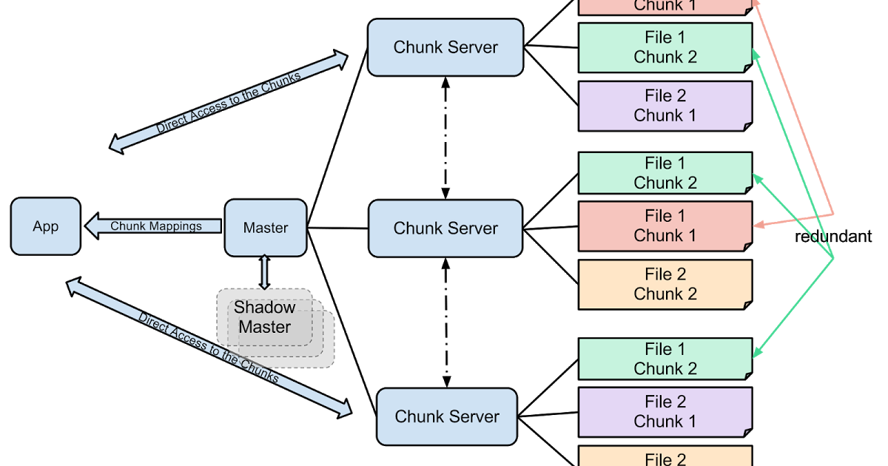
High Availability
Notes:
Fast recovery:
Servers are designed to start in seconds it they are terminated. There is no difference between normal and abnormal termination, servers are routinely shut down just by killing the process.
Chunk Replication
Each chunk is replicated on multiple chunk servers on different racks
The master clones existing replicas as needed to keep each chunk fully replicated as chunkservers go offline or detect corrupted replicas through checksum verification
Future work for Chunk Replication:
Replication is a good solution for high availability, however it uses quite a lot of resources since it is replicating an entire chunk. Two solutions that need to be explored are using parity bits or erasure codes.
The goal of erasure coding is to recover the corrupted data using information about the data stored elsewhere.
Erasure coding lengthens splits the data into chunks, and lengthens each chunk by adding redundant data and stores it across different locations, such as racks, or other server rooms.
Master Replication:
The master state is replicated for reliability. Its operation log and checkpoints are replicated on multiple machines.
For simplicity, one master process remains in charge of all mutations as well as background activities such as garbage collection that change the system internally.
When it fails, it can restart almost instantly. If its machine or diskfails, monitoring infrastructure outside GFS starts a new master process elsewhere with the replicated operation log.
Shadow Masters:
“Shadow” masters provide read-only access to the file system even when the primary master is down. Shadow masters may lag a bit, typically fractions of a second. Because of this, the read availability is restricted to applications that don’t mind getting slightly stale results.
A shadow master reads a replica of the growing operation log and applies the same sequence of changes to its data structures exactly as the primary does.
Like the primary, it polls chunkservers to locate chunk replicas to monitor their status. It depends on the primary master only for replica location updates resulting from the primary’s decisions to create and delete replicas.

Slide 54
Data Integrity
What is Checksumming?
Chunk replicas
Read:
Verify within reading range
Checksum mismatch
Write:
Incremental Update
Idle Chunk servers
Notes:
Each chunkserver uses checksumming to detect corruption of stored data.
There are often disk failures that cause data corruption or loss as there are thousands of disks and hundreds of machines.
Corruption can be recovered through chunk replicas, but detecting corruption is impractical.
As there can’t be identical replicas due to possible errors during replication, each chunkserver needs to independently verify the integrity of its own copy by maintaining checksums.
A chunk is broken up into 64 KB blocks. Each has a corresponding 32 bit checksum.
Read For reading, the chunk server verifies the checksum within the reading range before returning, so that it doesn’t propagate corruptions to other machines.
If checksum doesn’t match, returns an error to the requestor, and reports mismatch to the master.
In response, the requestor will read from other replicas, while the master will clone the chunkfrom another replica. After a valid new replica is in place, the master instructs the chunkserver that reported the mismatch to delete its replica
Checksum doesn’t effect the read performances as checksum lookups are done without any I/O.
Write
Checksum computation is heavily optimized for writes that append to the end of a chunk compared to writes that overwrite existing data)
Incrementally update the checksum for the last partial checksum block, and compute new checksums for any brand new checksum blocks filled by the append.
When idle, chunkservers scan and verify inactive chunks. It helps detect corruption in chunks that are rarely read. If corruption is detected, the master creates a new uncorrupted replica and deleted the corrupted replica. This prevents inactive but corrupted chunk replicas to getaway as valid replicas of a chunk.

Slide 55
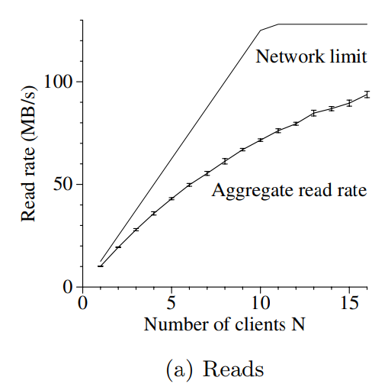
Measurements - Reads
Reads 4MB from a 320GB file set.
Repeated 256 times, totalling to 1GB
Notes:
Tested on one master, two master replicas, 16 chunkservers, and 16 clients.
Read:
The limit peaks at an aggregate of 125 MB/s when the 1 Gbps link
The observed read rate is 10 MB/s, when just one client is reading
The aggregate read rate reaches 94 MB/s, about 75% of the 125 MB/s link limit, for 16 readers
The read rate is less steep as the number of clients increase because as the number of readers increases, so does the probability that multiple readers simultaneously read from the same chunkserver.

Slide 56
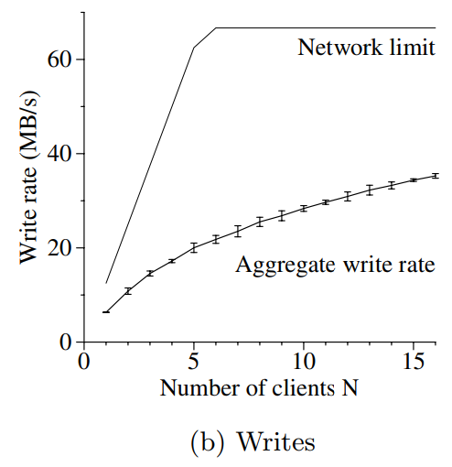
Measurements - Writes
Writes 1GB of data to a new file
Notes:
Tested on one master, two master replicas, 16 chunkservers, and 16 clients.
Read:
The limit plateaus at 67 MB/s because we need to write each byte to 3 of the 16 chunk servers
The write rate for one client is 6.3 MB/s, about half of the limit.
Network stack does not interact very well with the pipelining scheme used for pushing data to chunk replicas.
Delays in propagating data from one replica to another reduce the overall write rate
Aggregate write rate reaches 35 MB/s for 16 clients (or 2.2 MB/s per client), about half the theoretical limit.
As in the case of reads, it becomes more likely that multiple clients write concurrently to the same chunkserver as the number of clients increases.
collision is more likely for 16 writers than for 16 readers because each write involves three different replicas

Slide 57
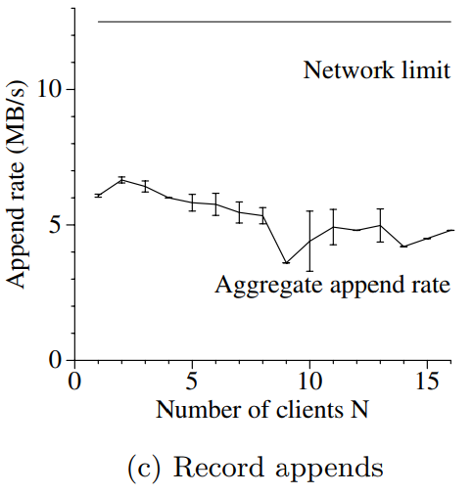
Measurements - Record Append
N clients append simultaneously to a single file
Notes:
Tested on one master, two master replicas, 16 chunkservers, and 16 clients.
Read:
Performance is limited by the networkbandwidth of the chunkservers that store the last chunkof the file, independent of the number of clients
It starts at 6.0 MB/s for one client and drops to 4.8 MB/s for 16 clients, mostly due to congestion and variances in networktransfer rates seen by different clients.

Slide 58
Real World Clusters
Cluster A For R & D by 100+ engineers
Cluster B For production data processing
A task consists of many processes on many machines
Notes:
Cluster A is used regularly for research and development by over a hundred engineers. A typical task is initiated by a human user and runs up to several hours.
It reads through a few MBs to a few TBs of data, transforms or analyzes the data, and writes the results backto the cluster.
Cluster B is primarily used for production data processing. The tasks last much longer and continuously generate and process multi-TB data sets with only occasional human intervention
A single “task” consists of many processes on many machines reading and writing many files simultaneously

Slide 59
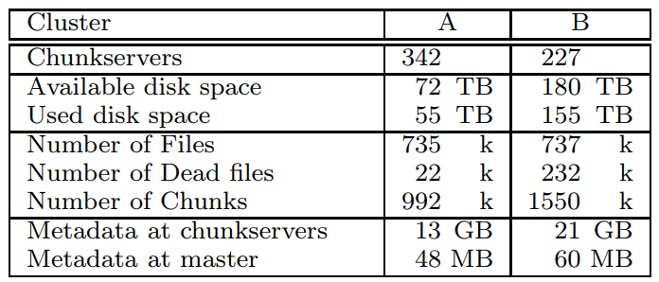
Real World Clusters - Storage
Notes:
Both clusters have hundreds of chunkservers, support many TBs of disk space, and are fairly but not completely full.
“Used space” includes all chunk replicas.
Virtually all files are replicated three times. Therefore, the clusters store 18 TB and 52 TB of file data respectively
The two clusters have similar numbers of files, though B has a larger proportion of dead files, namely files which were deleted or replaced by a new version but whose storage have not yet been reclaimed. It also has more chunks because its files tend to be larger.

Slide 60
Real World Clusters - Metadata
Notes:
Chunkservers store tens of GB of metadata, mostly checksums for 64 KB blocks of user data. Other metadata includes the chunk version number.
The metadata kept at the master is much smaller.
File names stored in a prefix-compressed form
File ownership and permissions
Mapping from files to chunks
Each Chunk’s current version
Each chunk’s replica location and refernce count for implementing copy-on-write
Each individual server, both chunkservers and the master, has only 50 to 100 MB of metadata. Therefore recovery is fast: it takes only a few seconds to read this metadata from diskbefore the server is able to answer queries. However, the master is somewhat hobbled for a period – typically 30 to 60 seconds – until it has fetched chunk location information from all chunkservers.

Slide 61
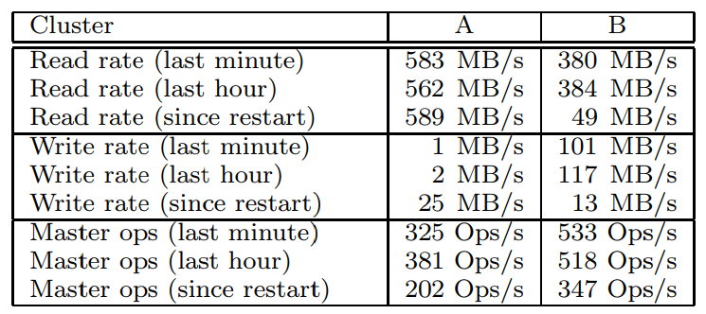
Real World Clusters - Read and Write
Notes:
The read rates were much higher than the write rates
A had been sustaining a read rate of 580 MB/s for the preceding week. Its network con- figuration can support 750 MB/s, so it was using its resources efficiently.
Cluster B can support peakread rates of 1300 MB/s, but its applications were using just 380 MB/s.

Slide 62
Real World Clusters - Master Load
Notes:
the rate of operations sent to the master was around 200 to 500 operations per second
not a bottleneckfor these workloads.
In an earlier version of GFS, the master was occasionally a bottleneckfor some workloads.
It spent most of its time sequentially scanning through large directories (which contained hundreds of thousands of files) looking for particular files
changed the master data structures to allow efficient binary searches through the namespace.
It can now easily support many thousands of file accesses per second.
If necessary, we could speed it up further by placing name lookup caches in front of the namespace data structures.

Slide 63
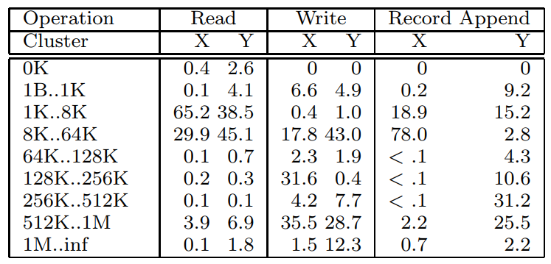
Chunkserver Workload
Notes:
the distribution of operations by size.
The small reads (under 64 KB) come from seek-intensive clients that look up small pieces of data within huge files. The large reads (over 512 KB) come from long sequential reads through entire files.
Read Cluster Y
A significant number of reads return no data at all in cluster Y.
Our applications, especially those in the production systems, often use files as producer-consumer queues
Producers append concurrently to a file while a consumer reads the end of file.
Occasionally, no data is returned when the consumer outpaces the producers.
Read Cluster X
Cluster X shows this less often because it is usually used for short-lived data analysis tasks rather than long-lived distributed applications.

Slide 64
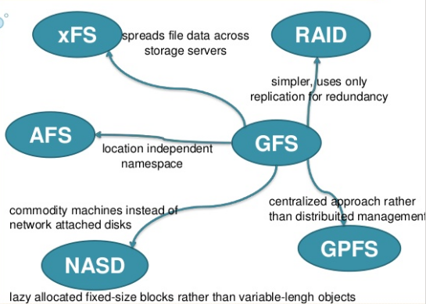
Related Work
Notes:
GFS provides a location independent namespace which enables data to be moved transparently for load balance or fault tolerance. A filesystem is "location independent" if file paths do not reveal the physical location of the file.
Unlike AFS (andrew file system), GFS spreads a file’s data across storage servers in order to deliver aggregate performance and increased fault tolerance.
As disks are relatively cheap and replication is simpler than more sophisticated RAID [9] approaches, GFS currently uses only replication for redundancy and so consumes more raw storage than xFSor Swift
In contrast to systems like AFS, xFS, Frangipani [12], and Intermezzo [6], GFS does not provide any caching below the file system interface. Our target workloads have little reuse within a single application run because they either stream through a large data set or randomly seek within it and read small amounts of data each time.
Some distributed file systems like Frangipani, xFS, Minnesota’s GFS[11] and GPFS [10] remove the centralized server and rely on distributed algorithms for consistency and management.
GFS uses centralised approach as it simplies the design, increases reliability and gains flexibility.
a centralized master makes it much easier to implement sophisticated chunkplacement and replication policies since the master already has most of the relevant information and controls how it changes
Fault tolerance is addressed by keeping the master state small and fully replicated.
Scalability and high availability are provided by shadow masters.
GFS closely resembles NASD (Network attached secure disk) architecture. NASD is based on network-attached disk drives (are hard disk storage devices which you can connect to your home or office network. They enable multiple computers in a network to share the same storage space at once.), while GFS uses commodity machines as chunkservers.

Slide 65
Conclusion
GFS demonstrates the qualities essential for supporting large-scale data processing workloads on commodity hardware
The system provides fault tolerance
GFS has successfully met their storage needs and is widely used within Google
Notes:
The Google File System demonstrates the qualities essential for supporting large-scale data processing workloads on commodity hardware
The system provides fault tolerance by constant monitoring, replicating crucial data, and fast and automatic recovery. Chunkreplication helps tolerate chunkserver failures. Additionally, checksumming was used to detect data corruption at the disk
GFS has successfully met their storage needs and is widely used within Google as the storage platform for research and development as well as production data processing. It is an important tool that enables them to continue to innovate and attack problems on the scale of the entire web.

Slide 66
Questions?
🤔🤔🤔🤔🤔🤔🤔🤔

Slide 67
What if I need to delete a file for Legal Compliance
A “double delete” will begin the process to delete the file from the servers

Slide 68
Why are chunks mutable?
To ensure that the entire block size is utilised
The cost of mutating them is mitigated by using a Primary replica

Slide 69
Undeleting Metadata
Restore from a master checkpoint

Slide 70
Multiple writes with one server going down, high version number
Master trusts highest version number, either from itself or a replica
Replicas do not attempt to merge data

Slide 71
Isn’t the master process massive?
No, the measurements show it only uses 60MiB of RAM in production operation
Compresses file names with prefix-compression

Slide 72
Extra

Slide 73
Hadoop Distributed File Systems (HDFS)
HDFS has multiple name servers which acts as masters (distributed)
GFS has only one (centralised, single point of failure)
GFS built for general files
HDFS built for just Hadoop’s MapReduce
HDFS uses 128MiB blocks with data and checksum in separate files
Notes:
Source: https://www.slideshare.net/YuvalCarmel/gfs-vs-hdfs

Slide 74
Colossus File System
Next-generation cluster-level file system
Automatically sharded metadata layer
Data typically written using Reed-Solomon (1.5x)
Client-driven replication, encoding and replication
Metadata space has enabled availability analyses
Notes:
source : https://www.systutorials.com/3202/colossus-successor-to-google-file-system-gfs/
http://web.archive.org/web/20160324185413/http://static.googleusercontent.com/media/research.google.com/en/us/university/relations/facultysummit2010/storage_architecture_and_challenges.pdf

Slide 75
Colossus vs. GFS
GFS built for batch operations
Operations that happen in the background before they apply
Colossus is built for real-time
Occurs almost instantly
Colossus removes Single point of failure of GFS
Has multiple masters than a single one
Reduce chunk size from 64MiB to 1MiB
Notes:
Source: https://www.wired.com/2012/07/google-colossus/

