Slide 1
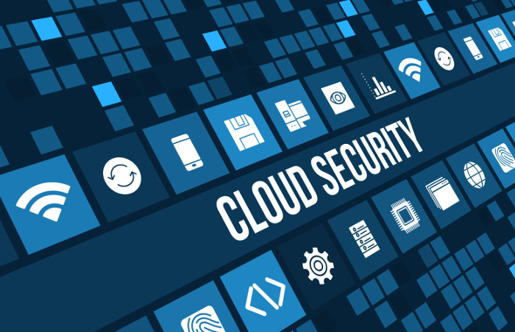
What’s New About Cloud Computing Security?
Adrian (Songbo Wu), Mohsen
25/09/2017
Notes:
https://jsfiddle.net/1uwvave3/
Pub sub demo by Moshen to refresh your memory
https://www.itgct.com/why-access-control-is-extremely-important-for-cloud-security/

Slide 2

Introduction
Brief description of cloud computing security issues.
Motivations of writing this cloud computing security article.
Related work based on the cloud computing security topic.
Four Important points which have been mentioned in cloud computing security article.
Future work based on this topic.
Notes:
Mohsen
Throughout this presentation we will be covering these points:
First Paragraph:
When I am talking about the cloud computing security issues. I mean issues such as:
Data breach requiring disclosure and notification to victims.
Compliance violations and regulatory actions.
Loss of control over end user actions.
Hijacking of Accounts.
Abuse of Cloud Services.
Malware infections that unleash a targeted attack.
Second Paragraph:
cloud computing threat model includes several novel elements. data processors must deploy security controls for their ICT infrastructure to protect it against external as well as internal attackers.
data and software are not the only assets worth protecting. Activity patterns also need to be protected. Sharing of resources means that the activity of one cloud user might appear visible to other cloud users using the same resources, potentially leading to the construction of covert and side channels.
Third Paragraph:
Fourth Paragraph:
The four important points are worth mentioning here are the clarification of the definition, the new assessment nowadays, and the new challenge and the issue already exists.
Fifth Paragraph:
The further work includes security primitives, different level of isolation, mutual audibility, and ecosystem and the ethical issue related to cloud.
http://www.datacenterjournal.com/top-cloud-security-trends-for-2016/

Slide 3
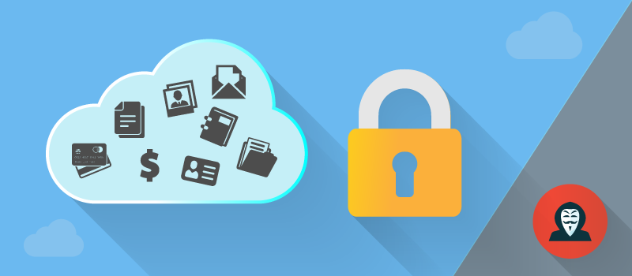
Main idea of industry paper: Cloud Computing security
In this work we strive to frame the full space of cloud-computing security issues, attempting to separate justified concerns from possible over-reactions. Mutual auditability
We argue that few cloud computing security issues are fundamentally new or fundamentally intractable.Most of the computing security issues are old or tractable
we argue that two facets are to some degree new and fundamental to cloud computing: the complexities of multi-party trust considerations, and the ensuing need for mutual auditability. Complexities of multi party trust consideration
Notes:
Mohsen
First Paragraph: Multi party trust consideration happen when it comes to the situation that different business entities share the same cloud utilities.
Mutual-auditability :
“What this means is that as an administrator, you can verify to the user that their actions are their actions, and that you didn’t complete any actions yourself. As a user, I can also verify that my actions are my actions -- I can see that I’m the one that performed them. Most importantly, an auditor (or any other 3rd party for that matter) can go in and determine which actions were completed by which parties. “
https://www.joyent.com/blog/the-four-keys-of-cloud-security-mutual-auditability
such as -> Data Breaches: overall data breaching was three times more likely to occur for businesses that utilize the cloud than those that don’t. The simple conclusion is that the cloud comes with a unique set of characteristics that make it more vulnerable.
Such as -> Compliance violations and regulatory actions: most companies operate under some sort of regulatory control of their information, whether it’s HIPAA (Health Insurance Portability and Accountability Act of 1996) for private health information, FERPA The Family Educational Rights and Privacy Act for confidential student records, or one of many other government and industry regulations. Under these mandates, companies must know where their data is, who is able to access it, and how it is being protected. BYOC often violates every one of these tenets, putting the organization in a state of non-compliance, which can have serious repercussions.
Second Paragraph: Four security issues that are important for Cloud Service Providers (CSPs) : Confidentiality, Integrity, Availability, Mutual-auditability.
such as -> Loss of control over end user actions: When companies are in the dark about workers using cloud services, those employees can be doing just about anything and no one would know—until it’s too late. For instance, a salesperson who is about to resign from the company could download a report of all customer contacts, upload the data to a personal cloud storage service, and then access that information once she is employed by a competitor. The preceding example is actually one of the more common insider threats today.
such as -> Hijacking of Accounts: The growth and implementation of the cloud in many organizations has opened a whole new set of issues in account hijacking.Attackers now have the ability to use your (or your employees’) login information to remotely access sensitive data stored on the cloud; additionally, attackers can falsify and manipulate information through hijacked credentials.
Third Paragraph:
such as -> Abuse of Cloud Services: Application Programming Interfaces (API) give users the opportunity to customize their cloud experience. However, APIs can be a threat to cloud security because of their very nature. Not only do they give companies the ability to customize features of their cloud services to fit business needs, but they also authenticate, provide access, and effect encryption.
such as -> Malware infections that unleash a targeted attack: cloud services can be used as a vector of data exfiltration. Skyhigh uncovered a novel data exfiltration technique whereby attackers encoded sensitive data into video files and uploaded them to YouTube. We’ve also detected malware that infiltrates sensitive data via a private Twitter account 140 characters at a time. In the case of the Dyre malware variant, cyber criminals used file sharing services to deliver the malware to targets using phishing attacks.
http://www.papertracer.com/blog/cloud-computing-security-make-your-data-more-secure

Slide 4
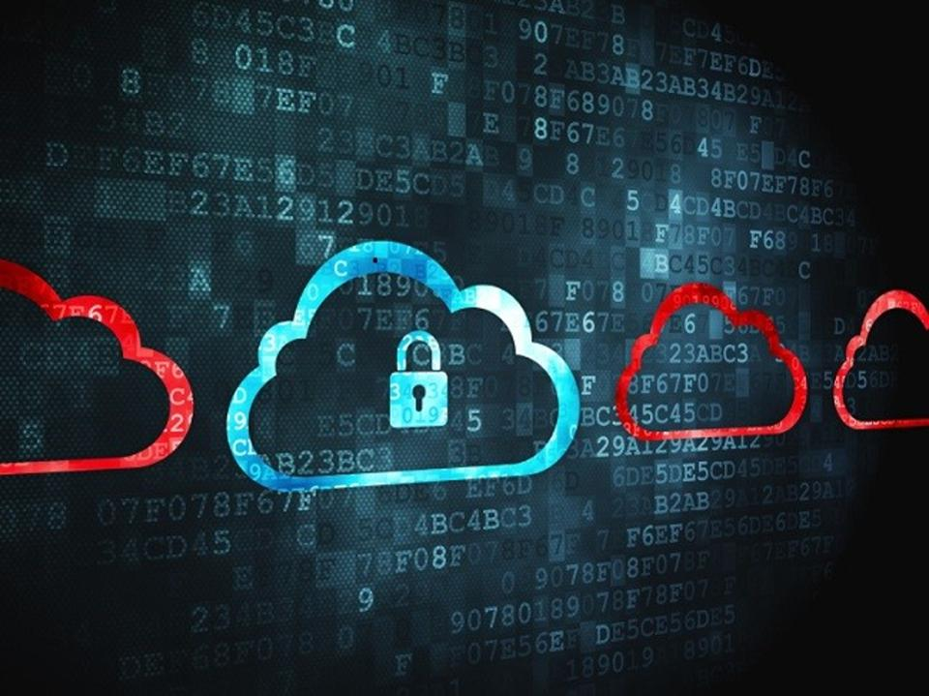
Motivation
Security becomes the most significant barrier to faster and more widespread popularity of cloud computing
The ambiguousness of the term “cloud computing”
Sort out what is new in security issue in a broader vision
Notes:
Mohsen
First Paragraph:
As cloud computing providers can provide the clients with scalable and dynamic computing resource at a low cost, security issue has become the most widespread issue which involve academia researchers. Industry decision makers and government organizations.
Second Paragraph:
Cloud computing are not the safe solution for some business scenarios because of its issues like service availability, data confidentiality, reputation fate sharing.
Third Paragraph:
The vague term of cloud computing has been changed from time to time which make the discussion of the cloud computing security lack of consistence.
https://www.forbes.com/sites/oracle/2016/04/19/how-to-determine-if-you-can-trust-cloud-security/#1f816cc722ce

Slide 5
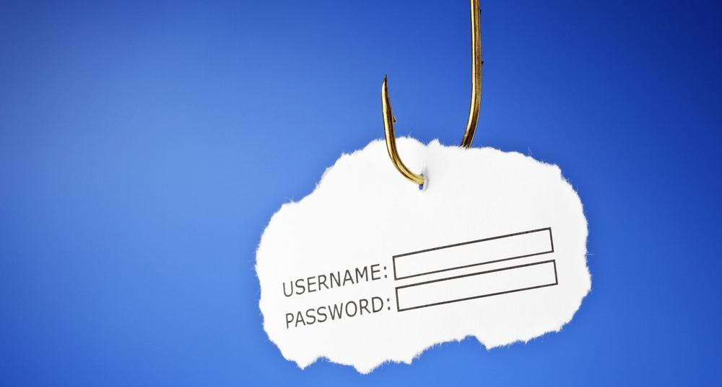
Related work
Phishing , downtime, data loss, password weakness ,host running botnets are not new
Academia area like ACM cloud computing Security workshop
The black hat community makes the cloud platform as their crimes scene.
Notes:
Mohsen
“Related work” is referring to the “3.1 What is not new” of the paper.
First Paragraph:
phishing is the attempt to get sensitive information like usernames , passwords, and credit card details for vicious reasons through pretending a trustworthy entity in an electronic environment.
downtime is referring to the periods when a computer system is not available.
Second Paragraph:
data loss is an error condition in information system whose data is compromised by failures or neglect in storage, transmission and processing.
password weaknesses is referring to the degree of the complexity of the password combination is so shallow that other people can figure it out easily.
Botnet is a combination of the words robot and network which can be used to perform distributed DDoS attack or steal data and other malicious purpose.
Third Paragraph:
ACM(Association for Computing Machinery) Conference on Computer and Communications Security is under dedicated tracks from various sources.
Black hat hacker is a hacker who uses his knowledge to penetrate computer security network system for unjustified reason .
EC2 users are being used by the black hat without notice to perform cyber crimes.
EC2 is a virtual computing environment, that enables customers to use Web service interfaces to launch instances with a variety of operating systems, load them with your custom applications, manage your network's access permissions, and run your image using as many or few systems as you need.
https://www.tripwire.com/state-of-security/security-awareness/6-common-phishing-attacks-and-how-to-protect-against-them/

Slide 6
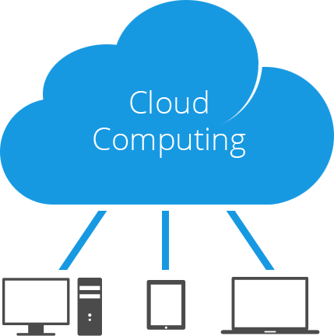
Point one: Distracted by definition
The term of cloud computing keep changing
Key features including the illusion and no up front commitment and pay as you go.
NIST definition which is the spirit of this paper
SaaS VS PaaS VS IaaS
Public clouds VS community clouds VS private clouds VS hybrid clouds
Notes:
Mohsen
“Point one: Distracted by definition” is referring to the “2. DISTRACTED BY DEFINITIONS” of the paper.
First & Second Paragraph:
The meaning of the term cloud computing changes from time to time that it is defined more by usage than the official documentation .
“Above the Clouds: A Berkeley View of Cloud Computing,” article points out the definition that “cloud computing to include application software delivered as services over the Internet, and the hardware and systems software in the datacenters that facilitate these services “
Third & Fourth Paragraph:
The more clear definition is from by the e U.S. National Institute of Standards and Technology which defines the cloud computing should include feature like on demand services broad network access, resource pooling ,rapid elasticity and metered service which is similar to a utility.
Fifth Paragraph:
public clouds is accessible to the general public or a large industry group.
community clouds is serving several organizations.
private clouds is limited to a single organization.
hybrid clouds is a mix of the others.
http://www.tech-cave.com/cloud-computing-10-popular-cloud-based-apps/

Slide 7
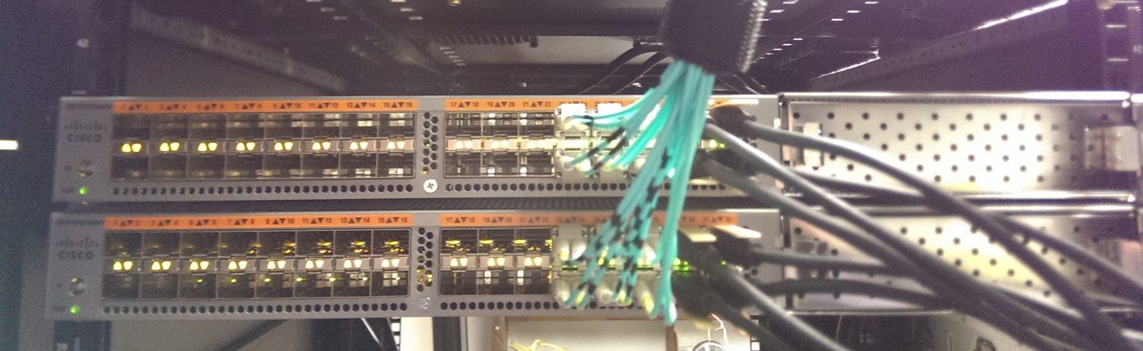
Point two : New assessment
Cloud computing is more trustworthy than botnets
Vulnerabilities like Shared resource environment and unexpected side channels and covert channels
Fate-sharing consequences
Notes:
Adrian starts here :
“Point two : New assessment” is referring to the “3.2 What is new” of the paper.
The bad hackers can use cloud computing resource to perform the DDos(distributed denial-of-service) attack in a more reliable service than traditional botnets even if the price will be costly.
The shared resource environment in cloud computing raises the side channels for passively observing information and the covert channels for actively sending data. These exposed channels will be used by the attacker to place VM on the same physical machine to the target machine to build a side channel between VM to enable SSH keystroke timing attack.
“Fate-sharing is an engineering design philosophy where related parts of a system are yoked together, so that they either fail together or not at all. Fate-sharing is an example of the end-to-end principle.”
Fate sharing has two sides :
The pro is that it can let the cloud tenants to benefit from the concentration of the security expertise which uses best practices for securing.
The con is that some individual subverter can disrupt other users via using cloud provider's IP address for spamming which will make the IP address of the provider blacklisted.
https://networkphil.com/2016/03/18/fate-sharing-in-the-network-core/

Slide 8

Point three: Novelties in the cloud threat model
Protection of the activity pattern
Business reputation
Longer trust chain
Subverters among participants
Business competitors sharing the same cloud
Auditability in cloud computing
Misunderstanding of the availability
Notes:
“Point three: Novelties in the cloud threat model” is referring to the “3.3 Novelties in the cloud threat model” in the paper.
The covert and side channels can be constructed via sharing the resources which exposes the visibility of the activity of the users. Activity patterns also contains sensitive info which will compromise the business info of the customer.
The instinct of the shared environment in the cloud makes it hard to track illegal use of the system thus will put the reputation of the company to a danger position.
Longer trust chain can be like SAAS to PAAS to IAAS instead of just simply provider/user model.
The latent subverters can be among the cloud user with disguising them well which will run botnet and spam under the cloud.
Cloud providers can also sell the user data to other bidders.
Competitive business can use the same cloud facilities in which causes strong conflict of interest and even incurs to access each other’s confidential information within the same cloud environment.
The cloud stakeholders with conflicts need to use mutual auditability for reassurance to protect their business in the cloud.
Auditability allows the attribution of blame in search and capture evidence for the incidents inside the cloud which will be useful for the lawsuit and law enforcement department.
The misconception of the overestimate the availability of the cloud environment leads to inadequate security good practices like backup across many cloud providers.
https://blog.cloudhq.net/top-10-cloud-security-threats-in-2013/

Slide 9
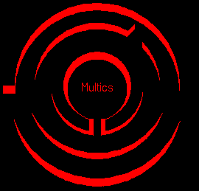
Point four: Already seen
4.1 Multics (1969-2016)
Introduce the Concept of the computing utility
Based on the permission instead of exclusion
Open design for mechanism with protection key secret
Least privilege
Human usability
Notes:
“Point four: Already seen ” is referring to the “4. SOME DEJA VU” of the paper
Multics (Multiplexed Information and Computing Service) is an influential early time-sharing OS which is based around the idea of a single-level memory. Essentially all modern OS are heavily influenced by Multics. It introduces the concept of computing utility.
http://www.multicians.org/
First, Multics implemented permission based protection mechanisms instead of exclusion-based in which means all the access to every object checked current authority in advanced.
Second, Multics embraced a format of Kerckhoffs’ principle which is for maintaining open design for its mechanisms with only the protection keys secret.
Third, the system operates at least privilege.
Finally, the design of Multics explicitly realized the importance of human usability.
http://www.multicians.org/myths.html#aim

Slide 10
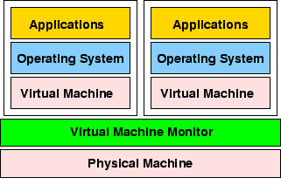
Point four: Already seen
4.2 VMMs
Lower risks of security failures
Easier to debug
Security isolation (k×n > k*n)
Independency of the failure of the programmes
Notes:
1. concurrent execution in lower level comes with lower risks of security failures for example a single programming OS has a much lower security risk than an OS running many concurrent programs simultaneously.
2. In the same level of multiprogramming, VMMs are simpler and easier to debug thus they are more secure because admins have more control.
3,Security violation will be triggered when both the guest OS and the VMM fail simultaneously. In other words, a VMM hosting k guest OSs in each VM OS running n programs has less failure rate than a single host OS running k×n programs.
4, the downtime of each application is independent so that the overall failure probability is multiplicative which means will become smaller when the number of independent programs increase (Joint probability distribution).
https://www.usenix.org/legacy/publications/library/proceedings/usenix01/sugerman/sugerman_html/node1.html

Slide 11
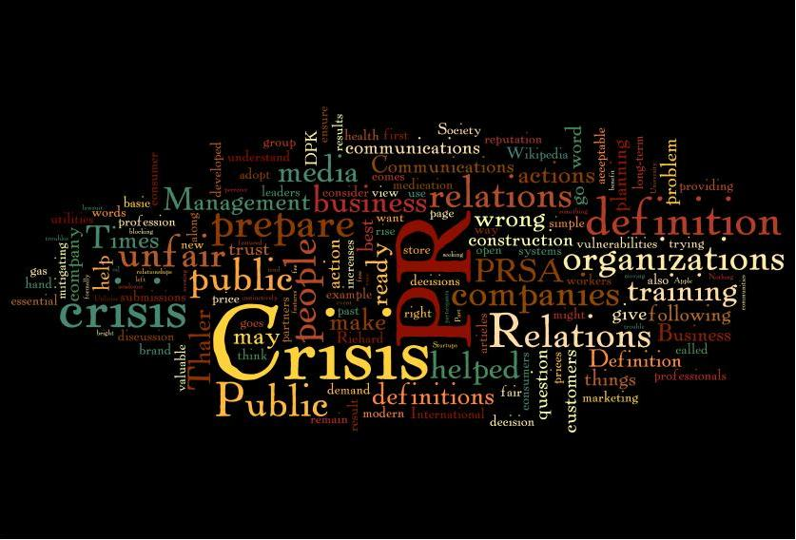
Point four: Already seen
4.3 National CSS
Negative incident leads to the negative public image
Honestness to the failure and support win client trust
Security risks management influences partnership
Notes:
National CSS(Computer Software Systems) was a time sharing company in 1960 to 1980s and it was acquired by Dun&Bradstreet in 1979. It had data centers over the States and UK.
The first incident of leaking password directory led to security of all its customers being compromised. Its passive response to its clients while hiding some information made a negative public relation crisis even if it warned its clients.
The second incident help the CSS to win clients appreciation due to its active response to the hardware failure. This time CSS was being honest to its fault and took the initiative to help its client Bell Labs to recover the data via typing data from stacks of printouts.
http://danielkeeney.com/teaching-crisis-pr/

Slide 12
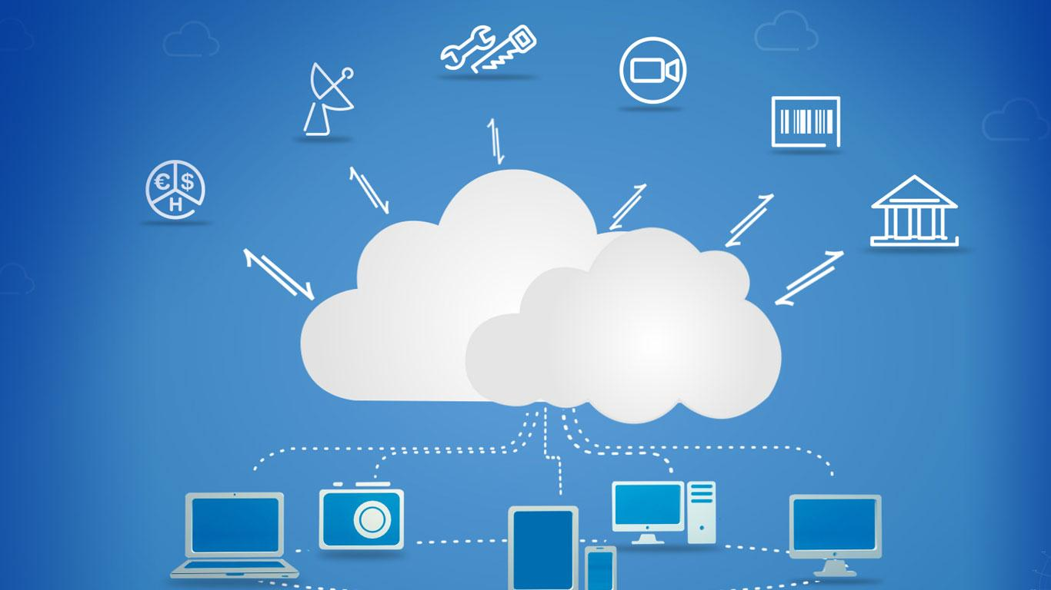
Future work
Security primitives with well design defaults
Different granularities of isolation
Side channels and covert channels
Mutual audibility requires much more works but strong security feature.
Ecosystem of threats
Ethical issues
Notes:
“Future work” is “5. NEW OPPORTUNITIES” in the paper.
Security primitives with some defaults feature can let the users to choose from a spectrum of security level. Cloud provides can provide a plug and play model which is like a specification that facilitates the discovery of a hardware component in a system without physical device configuration. This model can comply with both HIPAA (Healthcare Information Portability and Accountability Act) and the PCI DSS (Payment Card Industry Data Security Standard)
http://blog.securitymetrics.com/2014/05/hipaa-vs-pci-dss.html
Isolating by virtual or physical machines, LANs, clouds, or datacenters and other level can provide more trade off option between security and performance for users to choose to increase the diversity of the service.
http://www.sigops.org/sosp/sosp09/papers/castro-sosp09.pdf
Analysis of quantification and assessment of channel bit rates can help to monitor side channels and covert channels.
http://bristolcrypto.blogspot.co.nz/2015/06/52-things-number-38-what-is-difference.html
Mutual audibility is necessary to demonstrate mutual trustworthiness among providers and users but it may influence the performance. More works like third party setup and audit logs need to be managed.
High dimensional factors need to be considered in the ecosystem, such as worms, bots, scams, spam, phishing, active content, browsers, usability, and other human factors.
Ethical issue is common in cloud providers, for example, the EC2 information leak study in triggered a highly visible security effort by Amazon Web Services.
https://cseweb.ucsd.edu/~hovav/dist/cloudsec.pdf
https://knowtechie.com/cloud-security-what-financial-institutions-should-know/
This video helps you guys to have a better understanding of the presentation:
https://www.youtube.com/watch?v=L-cC-JjYos0

Slide 13

Questions?
Notes:
http://cloudnewsdaily.com/cloud-security/
https://jsfiddle.net/1uwvave3/
https://www2.eecs.berkeley.edu/Pubs/TechRpts/2010/EECS-2010-5.pdf

Slide 14
Question : Does AWS need to follow the local law in EU regarding the situation that governments need to reveal the data of customers ?
Answer : AWS does not disclose customer content unless they are required to do so to comply with the law or a valid and binding order of a governmental or regulatory body. Unless prohibited from doing so or there is clear indication of illegal conduct in connection with the use of Amazon products or services, Amazon notifies customers before disclosing customer content so they can seek protection from disclosure.
Question : How does the user reduce the risk from side channel and convert channel ?
Answer : Dedicated cloud hosting can help the cloud users to isolate their data centers from subverter hacking via those two channels to some extent.
Notes:
https://aws.amazon.com/compliance/eu-data-protection/
https://en.wikipedia.org/wiki/Dedicated_hosting_service

