Slide 1
NWEN405: Security Engineering
Usability and Psychology
(chapter 2 of Anderson’s book) Ian Welch

Slide 2
Project 2.
Officially due 16th October but no late penalty.
TCP/IP attacks using VirtualBox.
Write up a report explaining the attacks explaining why they work (or don’t work).
Radek has setup VirtualBox images with copies on scratch drive in CO246.
Propose two helpdesks:
Wednesday 3-4pm
Friday 3-4pm
Aim is to get them everything up and running.

Slide 3
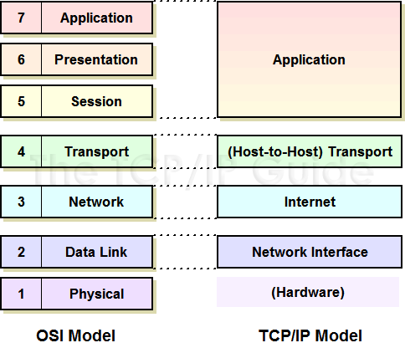
What’s the missing layer?

Slide 4
Layer 8 – people.
Amateurs hack systems, professionals hack people. — Bruce Schneier

Slide 5
Why worry about people?

Slide 6
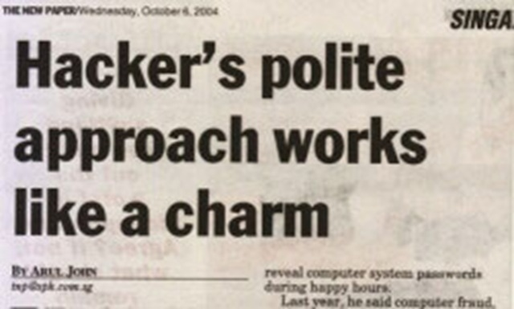
Problem -
We build systems that are vulnerable to social engineering attacks.
Notes:
http://www.grtcorp.com/content/social-engineering-trumps-rocket-science
Social engineering –manipulate people into performing actions or divulging confidential information even if these actions might be against the best interests of that person.
Social engineering is just one part of a scheme with a larger perhaps longer term goal.
For example, the attacker wants the subject to divulge a password that can be used in a bigger scheme to attack a system.

Slide 7
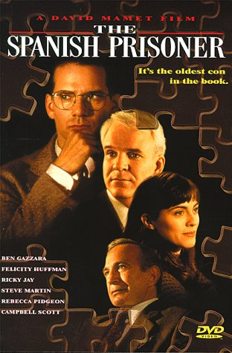
Example: Spanish Prisoner Scam
Social engineering isn’t new.
Notes:
Some social engineering attacks are just updated versions of cons or scams.
The scam typically involves promising the victim a significant share of a large sum of money, which the fraudster requires a small up-front payment to obtain. If a victim makes the payment, the fraudster either invents a series of further fees for the victim, or simply disappears.
Spanish Prisoner – 16th century – the victim (mark) is told that he is in correspondence with a wealthy person imprisoned in Spain under a false identity.
Unfortunately money is required for this release but larger funds can be provided as reward once the person is released and as a bonus the prisoner has a beautiful daughter who would look favorably upon the man who rescued her father.
This was an expensive scam to run and high chance of failure.
Modern example are 419 scams (Nigerian bank scam) allows mass marketing of the idea, doesn’t matter that is risky.

Slide 8
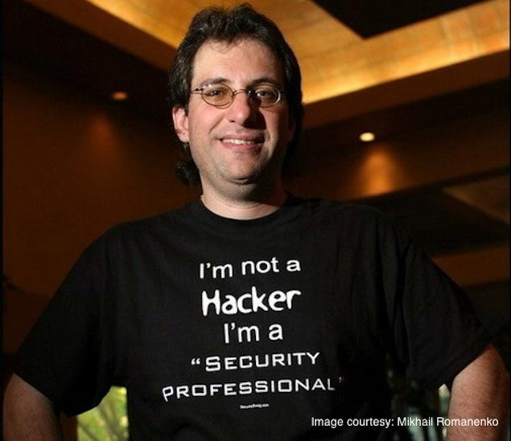
Example: Pre-texting.
Gain information by pretending to be someone authorised to be told it and add urgency.
Notes:
Phone someone who has the information you need under a false pretext, usually by pretending to be someone authorised to be told it.
Pre-computer, used by private investigators and spies.
Some examples, Kevin Mitnick, computer hacker would pretend to be an employee and solicit “help” such as a password.
Another technique is to create false urgency (much beloved of con men, buy now!). For example, cut the power or fabricate a crisis that requires you to be given information such as passwords or access details to solve the crisis you created.

Slide 9
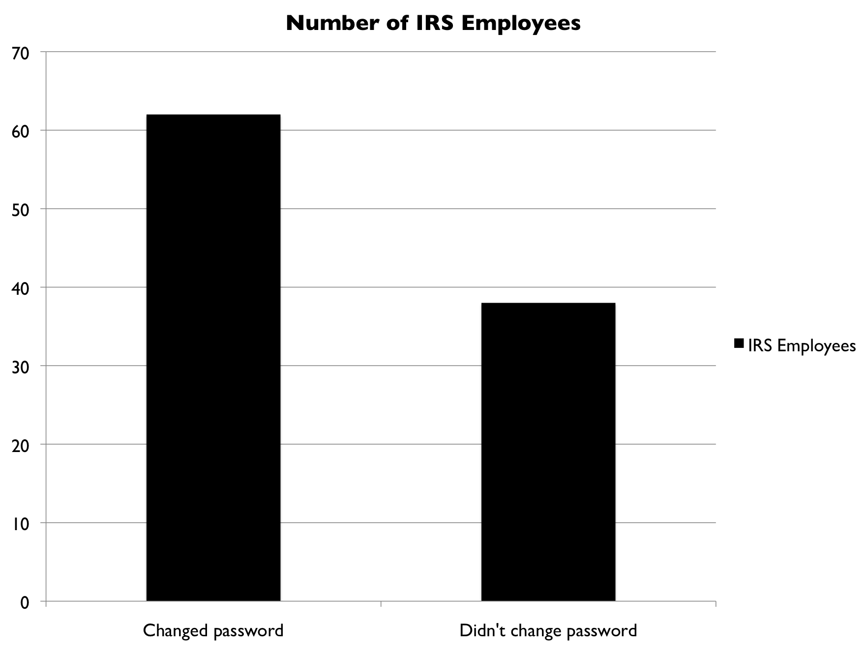
Notes:
How big a problem?
Case studies, IRS audit in 2007. Staff called 203 IRS employees at all levels, asked for their user ids, and told them to change their passwords to a known value. 62 of them did so. Assume 100,000 IRS employees and maybe you can fool 60,000 of them into giving you access.

Slide 10
Pre-texting targets organisations.
Phishing targets customers of organisations.
Notes:
Pretexting attacks organisation (in general, see notes). Phishing attacks individual.
Here target is your customers who are tricked into revealing sensitive information such as bank ids, passwords etc. Variant on the work “fishing”.
Began 2003 with fake bank sites or sites such as PayPal.
Basic idea. Send email or IM with link to the “offical site”. Link sends you to a fake site.
Success based on flooding range of customers. Many customers noticed odd use of English in the emails sent to lure people to fake sites. Not necessarily the case nowadays.
Losses in 2006. USA $US 200 million 2006, UK $US 70 million. Hard to get accurate figures.

Slide 11
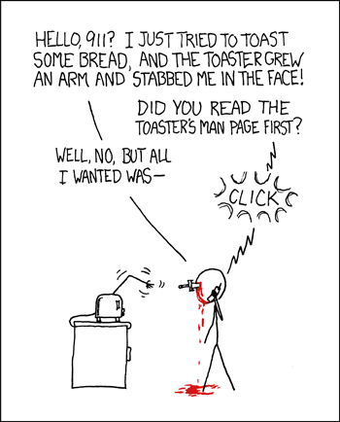
Social engineering doesn’t work because people are stupid or just follow the instructions.
Notes:
Social engineering involves manipulating people by exploiting aspects of human psychology – both cognitive (individual) and social (how we act in groups) psychology.

Slide 12
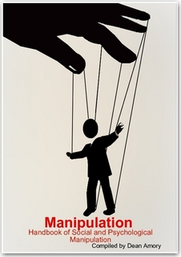
(1) Attackers exploit cognitive and social biases that are part of human nature.
Notes:
Social engineering involves manipulating people by exploiting aspects of human psychology – both cognitive (individual) and social (how we act in groups) psychology.
These biases stood us in good stead on the primeval savannah but the online environment can lack the cues that would protect us against manipulation.

Slide 13
Understanding the biases can help us design mechanism to protect the system.
People are trusting requiring the need for:
Operational security controls.
i.e. how do you counter natural human impulses to be helpful
Variant on idea of educating users, works in highly structured organisations.
Design of controls – insights from decision science and social psychology
Notes:
Countering such attacks requires both controlling risk but also trying to counter natural human impulses to be helpful. Sort of social engineering to prevent social engineering.
The military have a word for this called Operational security. System = computers + people.
- limit access to information.
- controls on who I discuss things with.
- controls that specify that they have to prove who they are.
- controls on how I can talk to them (means of communication)
- controls on the protocol for responding to queries.
- control the flow/disposal of information.
Explain the rules and also explain why they are there. Has to be explained to everyone. Can't just assume people will do the right thing.

Slide 14
Idea originated with the military.
Operational security … miminize risk (limiting who knows) and control access (via training about the rules and explaining the reasons for the rules).
Some measures:
1. limit access to information.
2. controls on who I discuss things with.
3. controls that specify that they have to prove who they are.
4. controls on how I can talk to them (means of communication)
5. controls on the protocol for responding to queries.
6, control the flow/disposal of information.
Notes:
Countering such attacks requires both controlling risk but also trying to counter natural human impulses to be helpful. Sort of social engineering to prevent social engineering.
The military have a word for this called Operational security. System = computers + people.
- limit access to information.
- controls on who I discuss things with.
- controls that specify that they have to prove who they are.
- controls on how I can talk to them (means of communication)
- controls on the protocol for responding to queries.
- control the flow/disposal of information.
Explain the rules and also explain why they are there. Has to be explained to everyone. Can't just assume people will do the right thing.

Slide 15
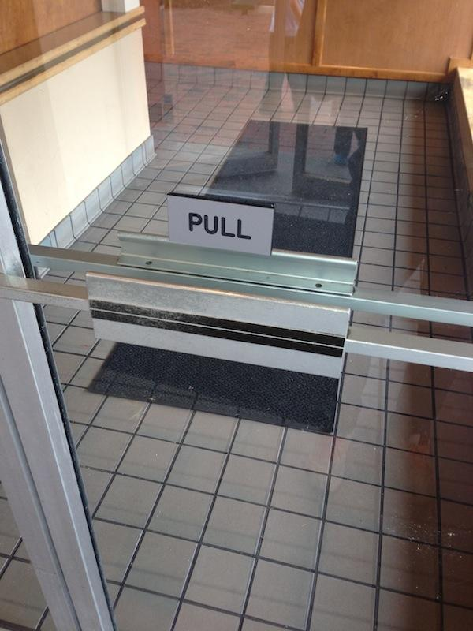
(2) Security interfaces lack usability and get in the way.
Notes:
Get in the way – people are driven to complete tasks, they will bypass security.

Slide 16
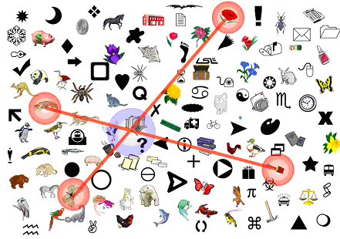
Understanding the biases can help us design interfaces that support better decision making.
Example: Replace hard to remember passwords with easy to recognise images.
Apply cognitive psychology.
Notes:
Example – passwords really bad technology, the best ones are the worst to remember (cognitive psychology finding).
Example system – secret image, don’t reveal it by touching, find four other images that if you draw lines will cross.
Randomise selections. Previous studies show good memorability but still problems – for example, people pick common colours.

Slide 17
Cognitive psychology =
experimentally based and field based insights into how individuals think, remember, make decisions and daydream
“To err is human”
Notes:
Cognitive psychology: what we think, remember, make decisions and daydream.
Much understanding from ergonomics. Flight systems and more lately user interfaces in the field of HCI.
Security should design systems that take into account what is known about common error modes for humans. There are three main types of errors observed in studies of operators of equipment (next slide).

Slide 18
Insights from studies of machine operators:
1. Slips and lapses at the level of skills.
2. Mistakes at the level of rules.
3. Mistakes at the cognitive level.
Notes:
Human errors made while operating equipment fall into three main categories:
1. Slips and lapses at the level of skills (capture and post-completion errors).
2. Mistakes at the level of rules (following the wrong one).
3. Mistakes at the cognitive level (wrong mental model).
You should be able to define each of the above and give examples.

Slide 19
Class 1 errors when we don’t need to think about practiced skills. Handy!
Downside. Inattention leads to a practiced action to performed instead of intended one.
We get are prone to capture errors and post-completion errors.
Notes:
Think about riding a bike. It becomes automatic.
Example. Intend to go to supermarket on way home but end up following more usual habit of going straight home.
Example. Clicking OK on dialog boxes.
Post completion variant. Leaving card in ATM should it dispense money first.

Slide 20
Class 2 errors when operator has to follow rules.
Downside. When overlapping rules and under pressure, may not choose best rule.
Notes:
We may choose the one that is the one uppermost in our mind (easiest to remember), the strongest or most general rule.
Example. End users told many rules to follow for safe Internet usage.
1. https instead of http.
2. check the URL contains the name of the site you trust.
We now have a user who has to buy a plane ticket at the end of their working day.

Slide 21
Class 3 errors when operator has to apply a mental model to choose what to do.
Downside. When the mental model is wrong!
Notes:
The designer and the user may have very different mental models.
Example. Canadian bank had an embedded video showing a Bear catching a salmon.
Users were sent to a copy of the site.
Many claimed it couldn’t be a copy because it would be too difficult to create a video from scratch.

Slide 22
Why do we ignore security warnings?
One aspect might be selective inattention.
http://youtu.be/vJG698U2Mvo
Notes:
A type of attention which involves focusing on a specific aspect of a scene while ignoring other aspects. Selective attention can be conscious (as when one chooses to attend to an interesting object, like a tv, instead of a less interesting one, like a coffee table) or unconscious (as in a scene of a green field with a single red tulip - the tulip will receive attention initially). Often, we think we have taken in an entire scene when, in reality, we have processed only the area we are attending to and only have a general "gist" of the rest of the scene (see links for examples, where you can watch this happen to you).
Could be where attacker constructs page or similar to distract you from what is going on. Relates to our rules rule.

Slide 23
Behavioural economics/decision science =
investigates decision making
We use heuristics, not completely rational beings
Notes:
Perceptual Bias and Behavioural Economics
Cross over with economics “behavioural economics”.
Economics has notion of the rational actor who will carefully weigh up every decision.
Developers of security systems sometimes have the same actor in mind.
But people are not always rational. That said can we say anything about how they may act?
.

Slide 24
Behavioural economics/decision science =
investigates decision making
We use heuristics, not completely rational beings
Notes:
Perceptual Bias and Behavioural Economics
Cross over with economics “behavioural economics”.
Economics has notion of the rational actor who will carefully weigh up every decision.
Developers of security systems sometimes have the same actor in mind.
But people are not always rational. That said can we say anything about how they may act?
.

Slide 25
Prospect Theory
X avoids losing $100, Y wins $100.
X is twice as happy as Y.
(Kahneman and Tversky)
Notes:
Prospect theory that models risk aversion.
Kahneman and Tversky did experiments and found that people lose more satisfaction by losing $100 than they gain by winning $100.
Some studies suggest twice as much.

Slide 26


More likely to take an action if it is framed as a gain rather than a loss.
Don’t tell me how much it costs, tell me how much I save!
Notes:
An everyday example is a trial period, after you have used X for a while you will perceive its loss worse than paying for it.
Another example is persuasion by framing one action as a loss as opposed to a gain.
how marketers talk about making savings or about a discount rather than the cost of an item.
We are see gaining a discount as making money even if buying something we really do not need.
Attackers can use this knowledge to push someone in a desired direction.
Perhaps by framing a decision to click a link in a phishing email by emphasising potential loss unless you do so.

Slide 27
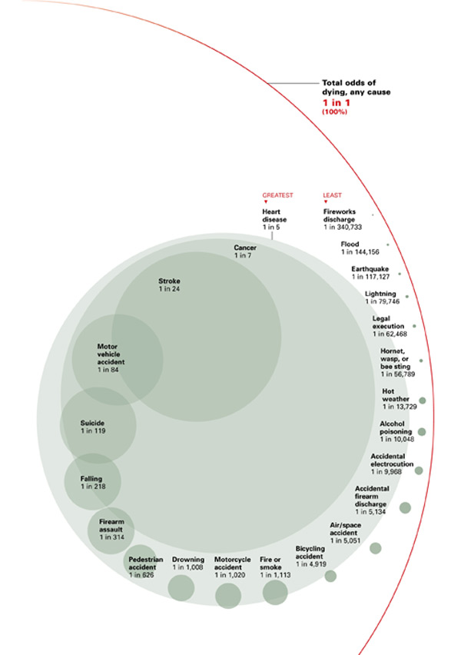
Risk Assessment
Notes:
Risk assessment.
Related to this is our inability to estimate risk.
Attackers want us to misjudge potential risks and also misjudging potential risks can stop us from doing “sensible” things.
We can can overstate risks to which we have been sensitised or where we believe we do not have more control.
For example, many people believe it is safer to drive a car (control) versus be a passenger in a plane (no control, plan crashes make the evening news).
Image from http://www.kriha.de/blog6.html

Slide 28

Satisficing
Notes:
When we are faced with a choice where the risks are hard to assess accurately we tend to go for the “good enough”. This is because we don’t see the cognitive strain as worth it, especially if it is a small transaction. This is called satisficing.
An aspect of this is that we might stick to default security settings especially if we don’t really understand security because it requires less cognitive energy to be expended.
Another aspect might be that if the transaction is small (or we perceive it to have a small cost) we might go for the familiar action rather than do anything new or spend time considering the real risk.

Slide 29
Different aspects of mental processing
Minds composed of affective (“heart”) and cognitive (“head”) components.
Social decision making uses heart and other decision making uses head.

Slide 30
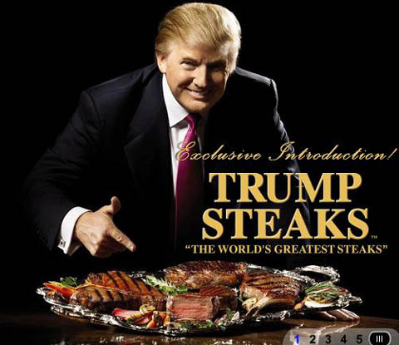
Affect heuristic
Notes:
Affect heuristic.
Paul Slovic and colleagues propose emotion as an influencer.
By asking an emotional question (“How many dates did you have last month?”) you can get people to answer subsequent questions using their hearts rather than their minds.
For example, misunderstimate probabilities.
Cognitive overload (mentioned in the last lecture) can enhance this effect.
Use by attackers who include images of celebrities in phishing emails or have them purport to come from someone you know and trust.

Slide 31
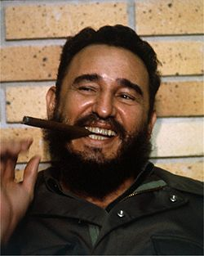
Fundamental Attribution Error
Notes:
Fundamental attribution error.
People try to explain things by intentionality rather than by situation.
Jones and Harris hypothesized that people would attribute apparently freely-chosen behaviors to disposition, and apparently chance-directed behaviors to situation.

Slide 32
Fundamental Attribution Error
Notes:
Jones, E.E. & Harris, V.A. (1967). The attribution of attitudes. Journal of Experimental Social Psychology, 3, 1–24.
Subjects read pro- and anti-Fidel Castro essays. Subjects were asked to rate the pro-Castro attitudes of the writers.
When the subjects believed that the writers freely chose the positions they took (for or against Castro), they naturally rated the people who spoke in favor of Castro as having a more positive attitude towards Castro.

Slide 33
Fundamental Attribution Error
Notes:
The interesting thing was that when the subjects were told that the writer's positions were determined by a coin toss, they still rated writers who spoke in favor of Castro as having, on average, a more positive attitude towards Castro than those who spoke against him.
In other words, the subjects were unable to see the influence of the situational constraints placed upon the writers; they could not refrain from attributing sincere belief to the writers.

Slide 34
Fundamental Attribution Error
Notes:
In other words, the subjects were unable to see the influence of the situational constraints placed upon the writers; they could not refrain from attributing sincere belief to the writers.
They had to explain what was going on in terms of intention of the writers rather than other factors.

Slide 35
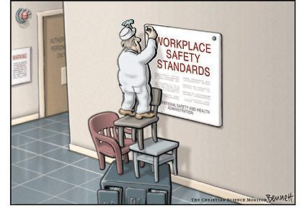
Notes:
Another variance on this is the “just world” hypothesis.
It could never happen to X because they are good person.
I don’t need to have X protection for my system because I am a good person, or I do not need to check X’s credentials because they are a good person. That is they will act in a certain way irrespective of the impact of situation.

Slide 36
Social psychology =
explains the thoughts, feelings and behaviours influenced by the actual, imagined, or implied presence of others.
Persuasion, prejudice, conformity!
With rise of social systems, attack vector.
Notes:
Social Psychology. Attempts to explain how the thoughts, feelings and behaviour of individuals influenced by the actual, imagined, or implied presence of others. Useful in understanding persuasion.

Slide 37
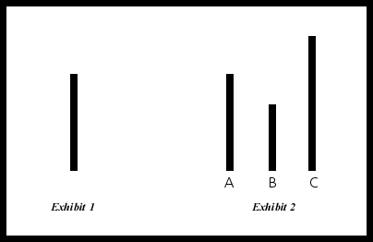
Solomon Asch (1951).
People can be induced to deny the evidence of their senses in order to conform to a group.
Choose closest matching length of the right.
Notes:
How powerful is social pressure?
Some evidence from Solomon Asch (1951). People could be induced to deny the evidence of their own eyes in order to conform to a group.

Slide 38
Solomon Asch (1951).
People can be induced to deny the evidence of their senses in order to conform to a group.
Choose closest matching length of the right.
Notes:
Asch showed bars like those in the Figure to college students in groups of 8 to 10.
He told them he was studying visual perception and that their task was to decide which of the bars on the right was the same length as the one on the left.
What’s the correct answer? A.
Asch asked the students to give their answers aloud. He repeated the procedure with 18 sets of bars.
Only one student in each group was a real subject. All the others were confederates who had been instructed to give two correct answers and then to some incorrect answers on the remaining 'staged' trials.
Asch arranged for the real subject to be the next-to-the-last person in each group to announce his answer so that he would hear most of the confederates incorrect responses before giving his own. Would he go along with the crowd?

Slide 39
Solomon Asch (1951).
People can be induced to deny the evidence of their senses in order to conform to a group.
Choose closest matching length of the right.
Notes:
71% would change their estimate of length of a line to fit in with other group members.
Why important? Explains why people will ignore security warnings if their friends also do it. Phishing emails can exploit this if the request comes from a group of friends.

Slide 40
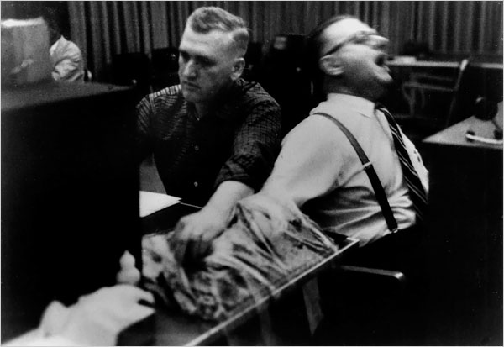
Stanley Milgram (1960s).
People will do immoral things and obey authority rather than their conscience.
Notes:
(2) Stanley Milgram (1960s). People prepared to administer severe electric shocks to people under instruction by people who appear to represent authority.
Stanley Milgram's obedience experiments in the early 1960s are some of the most famous in all of psychology. In them, Milgram tested how far people would go in delivering painful shocks to a peer, when instructed to do so by an authority figure -- the experimenter, or scientist. The scientist told the volunteers they were participating in a learning experiment, to test how shocks might improve recall of word associations; and he encouraged them to continue raising the voltage of the shocks when the learner gave wrong answers. The "learner" was in fact an actor, giving many wrong answers, and pretending to be receiving shocks. Most of the study participants went to what they thought was the maximum shock level -- 450 volts on the machine -- despite loud protests and shouts of pain from the learner.
Basic of pre-texting attacks.

Slide 41
Stanley Milgram (1960s).
People will do immoral things and obey authority rather than their conscience.
Notes:
Before conducting the experiment, Milgram polled fourteen Yale University senior-year psychology majors to predict the behavior of 100 hypothetical teachers. All of the poll respondents believed that only a very small fraction of teachers (the range was from zero to 3 out of 100, with an average of 1.2) would be prepared to inflict the maximum voltage. Milgram also informally polled his colleagues and found that they, too, believed very few subjects would progress beyond a very strong shock.[1]
In Milgram's first set of experiments, 65 percent (26 of 40)[1] of experiment participants administered the experiment's final massive 450-volt shock, though many were very uncomfortable doing so; at some point, every participant paused and questioned the experiment, some said they would refund the money they were paid for participating in the experiment.
60% administered severe electric shocks.
Basic of pre-texting attacks.

Slide 42
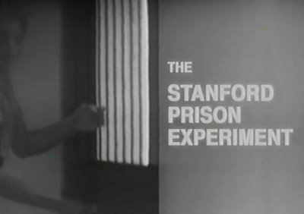
Philip Zimbardo (1971).
Normal people can behave wickedly in the absence of orders.
Experiment halted after six days.
Notes:
Example of situation.
Philip Zimbardo (1971). Normal people can behave wickedly even in the absence of orders.
The Stanford Prisoner Experiment. Zimbardo set up a ‘prison’ at Stanford where 24 students were randomly assigned to the roles of 12 warders and 12 inmates.
The aim of the experiment was to discover whether prison abuses occurred because warders (and possibly prisoners) were self-selecting.
The students playing the warders became sadistic authoritarians and the experiment was halted after six days on ethical grounds.
Maybe this can be exploited by an attacker who exploits people desire to conform to a role?

Slide 43
Once started why don’t people stop?
Cognitive dissonance theory.
Basically hoaxers know no-one wants to look like a dupe, most people are optimistic and most people follow social norms.
Notes:
Another interesting aspect of social psychology is the insight that people are uncomfortable holding conflicting views (cognitive dissonance). Therefore people often continue in wrong course of action in spite of evidence against it. No one wants to admit they were duped.
Also people don’t like to go against social norms and stop interaction, hustlers make use of this. Security professionals should be trained to notice when being placed under pressure by social cues to “just do it” and step back to evaluate whether it is a sensible course of action. Note that this behaviour might explain why people who have made contact with fraudsters like the Bank Advance or Nigerian scams continue to get further into debt.

Slide 44
Perhaps you can see now why social engineering is so powerful!
Book has an unsettling example involving McDonalds.
Combating these problems could rely upon creating strong social norms amongst security professionals.

