Slide 1
The Grid: Computing without Bounds
Joely Huang
31/7/2017

Slide 2
Early humans ate only the food they caught and used only the tools they made.

Slide 3
Imagine being in a Cafe
Turning on the tap is like turning on a bottomless barrel
Plugging your laptop charger into a wall socket
Virtualization
“It hides useful functions behind an interface that conceals the details of how they are implemented.”
Notes:
Imaging being in a cafe. The cafe barista turns on the tap as if it was tapping on a bottomless barrel. Plugging your laptop charger into the wall socket is the same phenomenon. You can’t see how the the wiring occurs behind the wall, and which company is generating the power. Its all hidden. This is the concept of virtualization. “It hides useful functions behind an interface that conceals the details of how they are implemented.”

Slide 4
Computing itself, however, is anything but virtualized.
Notes:
Any computer, laptop, data center, they are all running local software programs. If we can’t accept a situation where every home and business had to operate its own power plant, water reservoir, why should we do so for computers? Because of this, computer scientists have been motivated to look for more efficient alternatives. The increasing network speed should be utilized to handle computers that are assembled dynamically from distributed pieces. With this, resources such as processing, storage, data and software can be requested at any point in time, anywhere and from any suitable supplier. This is the computing grid, just like the electric grid.

Slide 5

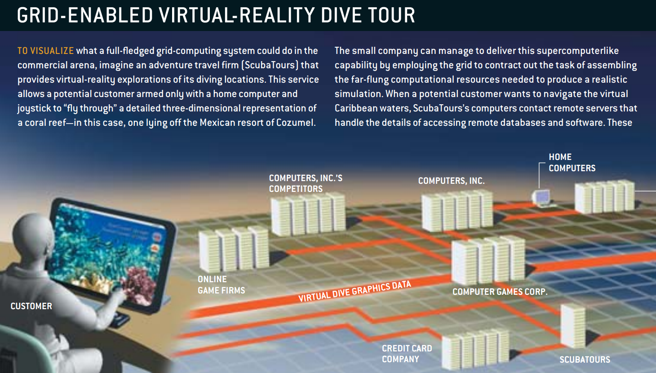
Notes:
Imagine a travel agency that provides virtual-reality explorations of different diving locations. The customer navigates the virtual waters off Cozumel. In order to virtualize this diving location, the company will need access to databases and software in order to obtain relevant geographic information which then gets rendered to 3D graphics, lay over the commercial information and integrate real-time video from on-site cameras. This is a huge investment. No travel agency will probably be able to afford to do this.

Slide 6
Grid Business
Necessary resources assembled from multiple suppliers
Achieves favourable economies of scale
Grid systems are also used in the medical industry
Access to X-rays of a million other patients allows issues to be identified earlier
Notes:
This is where grid technologies come in. With this, the necessary resources can be assembled from multiple suppliers, where they share the resources required to build the virtualization. This achieves a favourable economies of scale.
KINDA IMPORTANT (MOTIVATION)
Another example of where grid systems are used is in the medical industry. X-rays are stored in databases, and viewed on computers. With grid systems, having access to X-rays of a million other patients would possibly allow a physician to identify any issues early, allow biochemists screen 10,000 drug candidates in an hour rather than a year.

Slide 7
Globally Virtualized Grid Computing
Extension of today’s Internet
Allowing anyone or device to talk to any other person or device anywhere.
The goal is to virtualize computing and information
Software services are provided securely and reliably
Notes:
Putting the previous examples describe the concept of globally virtualized grid computing. It is basically an extension to today’s Internet. The Internet already virtualizes communication by allowing anyone or device to talk to any other person or device anywhere.
The goal of developing the grid is to virtualize computing and information, just like how communication is virtualized. This means any person or device can provide software services to any other person or device, securely and reliably.

Slide 8
Motivation
Lack of technologies that allowed scientific communities to collaborate together
Share resources in a controlled and well-managed manner
Integrating software that would enable sharing by linking them into a VO structure
The software authenticates identity, authorizing a requested activity, defines and accesses available resources, controls movement of data
Notes:
MOTIVATION
The idea of globally virtualized computing came from the lack of technologies that allowed scientific communities to collaborate together at different institutions in order to share resources in a controlled and well-managed manner. Bringing together different groups from different institutions is called virtual organizations.
Like how a national soccer team is formed, it gathers professional players across the nation to train and compete in the World Cup. These scientific groups will be formed from different institutions across the nation. They will share information, computers, storage and software in order to engage in collaborative work. Unlike soccer players, they might not wear the same uniforms, speak the same language, follow the same rules or even play the same game.
Without replacing systems at participating sites, Kesselman, Tuecke and Foster envisioned a new class of integrating software that would enable this sharing by linking them into a VO structure. A VO is made up of members who work together, appearing to be in the same physical location, but however are actually working apart, in different location across possibly the world. The software would enable sharing by authenticating identity, authorizing a requested activity, defining and accessing available resources, and controlling the movement of data. These functions will all be standardized, and most importantly will operate at an acceptable cost as it is built on top of existing computation structures.

Slide 9
Previous Work
Establish temporary links among 11 high-speed research computer networks
Software knitting 17 participating I-WAY sites
Allowed users to run applications on computers across the country
Users could log on once, locate suitable computers, reserve time, load application codes and monitor execution
Notes:
PREVIOUS WORK
In late 1994, Stevens and DeFanti proposed establishing temporary links among 11 high-speed research computer networks to create a national grid called the “I-WAY”. Stevens and DeFanti then gathered a team including Foster to develop the software that knitted the 17 participating I-WAY sites into a single virtual system. These protocols allowed users to run applications on computers across the country. Users could log on once, locate suitable computers, reserve time, load application codes, and then monitor their execution. In one example, a network was constructed to allow combustion engineers across the U.S. to work collaboratively on improvements to industrial incinerators.
???
In 1997 we unveiled the first version of our grid software system, the Globus Toolkit, and demonstrated its operation across 80 sites worldwide. Meanwhile the National Science Foundation funded the creation of the National Technology Grid to connect university scientists with highend computers, NASA started work on its Information Power Grid (which had similar goals), and the DOE initiated pioneering work on applying grids to science research.
The remainder of the 1990s saw growing implementation of grid concepts and technology. The high-energy physicists designing the Large Hadron Collider at CERN, the European organization for nuclear research, for instance, recognized that a grid system would be essential to their analysis of the huge quantities of data the new accelerator was to produce. Projects were subsequently established to develop the needed grid technologies, notably the European DataGrid, as well as the U.S. Grid Physics Network and Particle Physics Data Grid efforts. These and similar undertakings spurred the development of grid-related infrastructure, user communities and new software applications.

Slide 10
Applying Grid Technologies
Analyse data from the Sloan Digital Sky Survey
Computational resources placed in labs spread across the nation
Also applied in clinical medicine
Digital imaging library stores mammograms and other body scans
Physicians can be linked with advanced analytical tools for automated diagnosis
Notes:
APPLYING GRID TECHNOLOGIES
A team at the University of Chicago have applied grid technologies to analyse the data from the Sloan Digital Sky Survey. It requires a great amount of effort to map a quarter of the night sky to determine the positions and absolute brightnesses of more than 100 million celestial objects. With grid technologies, computational resources are placed in labs spread across the nation. This reduces the time it takes to perform scans, from possibly weeklong scans to the time it takes to brew a cup of coffee.
Grid technologies are also applied in clinical medicine. With digital imaging, it is easier to compare mammograms and other body scans both across time for individual patients and across case populations. These mammograms and body scans will be stored in a digital imaging library. It ensures the images will be stored securely, keeping the information well organized. With this library, physicians and researchers will be able to access an entire imaging library of mammograms and body scans. With the grid system, physicians can also be linked with advanced analytical tools for automated diagnosis, and also permit researchers to conduct in-depth studies to determine the effects of environment and lifestyle choices on disease.

Slide 11
Applying the Grid
Turning on the tap is like turning on a bottomless barrel
Plugging your laptop charger into a wall socket
Virtualization
“It hides useful functions behind an interface that conceals the details of how they are implemented.”
Notes:
APPLYING THE GRID
Let’s return to the travle agency scenario. What happens when a customer asks for a virtual dive off Cozumel? The travel agency first establishes that the customer has Internet connection and determines what they want to see. It hands off this request to a specialized virtual-reality service provider, Computer Games Corp. (Computer Games Corp. also supports multiparticipant Internet gaming companies, hence its name.) Computer Games Corp. assembles the data and software required to deliver the streaming video generated in response to the user’s navigational commands. Its computers reach out into the grid to locate the most attractive supplier of computational cycles for the rendering of the video stream. Computer Games Corp. then installs this software, and the virtual dive gets under way. In effect, Computer Games Corp. acts as a middleman, aggregating services from several sources to afford a specialized capability to the user

Slide 12
Future Work
Expanding to larger communities
Establish the basis for a global grid system
Manage large, distributed infrastructures
Enable users to exploit the availability of on-demand resources and services
Research evolution of grid concepts and technologies
Notes:
Grid technologies are expanding to larger communities, including those based on purely commercial relationships. [Standardization is spurring investment and innovation.] During the next few years, the aim will be to establish the basis for a global grid system. It will manage large, distributed infrastructures to deliver reliable service in the face of failures, enable users to exploit the availability of on-demand resources and services. And lastly, the evolution of grid concepts and technologies will also be researched due to the increasing number and power of computers by orders of magnitude. The basis of the global grid system will be formed from both research and practical experience, targeting fields related to autonomic, ubiquitous and peer-to-peer computing.

