Slide 1
Apache Spark: A Unified Engine for Big Data Processing
Generality, Ongoing Work and Conclusions
Ben Evans
Notes:
Paper available at: http://dl.acm.org/citation.cfm?id=2934664

Slide 2
Outline
Big data requirements
Problems with specialization
Benefits of sparks generality
How spark achieves generality
Ongoing work on spark platform
Conclusions

Slide 3
"Big Data"
Big data is diverse and messy.
A typical big data pipeline often requires several components i.e.
MapReduce-like code for data loading
SQL-like queries
Iterative machine learning.
Notes:
The very nature of “big data” is that it is diverse and messy;
which means most big data applications need to combine many different processing types. A typical pipeline will need MapReduce-like code for loading data, SQL-like queries, and iterative machine learning.

Slide 4
Problem with Specialized Engines
Must stitch together disparate systems, this creates complexity
Often need to write data to storage before passing it to next system, this creates inefficiency
Notes:
Having a separate (specialized) engine for each task can create both complexity and inefficiency as users must piece together disparate systems, and some applications simply cannot be expressed efficiently in any engine.

Slide 5
Generality

Slide 6

Generality Analogy
Spark offers a unified engine, eliminating the need for several disparate specialized engines
Notes:
An analogy used in the paper for the value of generality is comparing smartphones to the separate portable devices that existed before them (i.e. cameras, GPS, cellphones).
Spark offers a unified engine, eliminating the need for several disparate specialized engines similar to how a smartphone eleminated the need for the seperate gadgets.

Slide 7
Benefits of Sparks Generality
Unified API
Efficiency - no need to write to disk, can often do processes in memory
Enables new applications not previously possible (i.e. Interactive queries on a graph)
Notes:
Spark’s generality has several important benefits.
Applications are easier to develop because they use a unified API.
It is more efficient to combine processing tasks, as you can use in memory storage rather than writing to disk between each task
Also enables new applications (such as interactive queries on a graph and streaming machine learning) that were not possible with previous systems.

Slide 8
How does spark offer this Generality?
Resilient Distributed Datasets (RDDs) - Data sharing abstraction
RDDs can emulate any distributed computation, and will do so efficiently in many cases
Notes:
Similar programming model MapReduce however key point is Spark extends this with a data-sharing abstraction called “Resilient Distributed Datasets,” or RDDs. Using RDDs, Spark can capture a wide range of processing workloads that previously needed separate engines, including SQL, streaming, machine learning, and graph processing.

Slide 9
How do RDDs help efficiency?
 | MapReduce | Spark
Replication | Must replicate data | Avoids replication, instead uses "lineage graph"
Serialization | MapReduce serializes the data, making operations such as sorting/shuffling inefficient | Since spark is largely in memory this can often be avoided (but is still supported)
Disk IO | DIsk IO at every stage | Primarily in memory
Lazy Evaluation | Not supported | Content in dataframe not computed until user requests it
Notes:
RDDs give applications control over the most common bottleneck resources in clusters (network and storage I/O). RDDs make data sharing fast by avoiding replication of intermediate data and can closely emulate the in-memory “data sharing” across time that would happen in a system composed of long-running processes.

Slide 10
Limitations of Hardware for Efficiency
Local storage: Each node has local memory with approx 50GB/s bandwidth, as well as 10-20 local disks for approximately 1GB/s to 2GB/s of disk bandwidth
- Links: Each node has a 10GBps link, approx 40x less than its memory bandwidth, and 2x less than its aggregate disk bandwidth
- Racks: Nodes are organized into racks of 20-40 machines, with 40GBps - 80 GBps bandwidth out of each rack, or 2-5x lower than in-rack network performance.
The most important performance concern (related to hardware) is therefor the placement of data and computation in the network

Slide 11
RDD Placement
RDDs provide facilities to control placement (place computations near input data)
RDDs provide control over data partitioning and colocation (such as specifying that data be hashed by a given key).
Notes:
RDDs provide facilities to control placement, lets applications place computations near input data (through an API for “preferred locations” for input sources), and RDDs provide control over data partitioning and colocation (such as specifying that data be hashed by a given key).

Slide 12
Ongoing work

Slide 13
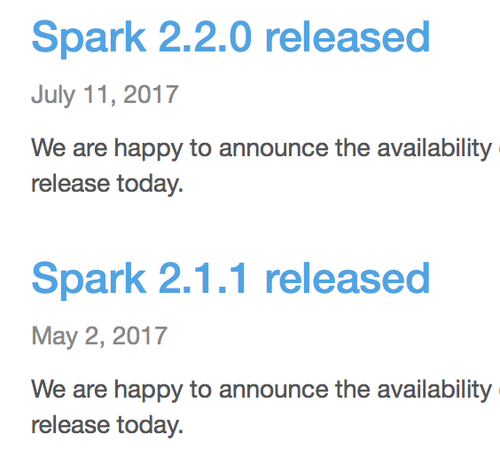
Contributors
Many contributors from both industry and research
https://spark.apache.org/committers.html
Very active and ongoing!

Slide 14
Data Frames
Spark extended in 2015 to add a more declarative API called DataFrame - based on relational algebra
Offers optimizations not seen with sparks traditional functional API (Predictive pushdown, operator reordering, join algorithm selection).
Notes:
A data frame is a set of records with a known schema (analogous to a database table), based around relational algebra.
Dataframes supports operations like filtering and aggregation using an API.
While Data Frames are still new, they have quickly become a popular API. In a July 2015 survey by Apache, 60% of respondents reported using them.

Slide 15
Performance Optimizations
- Focusing on optimising sparks network and IO primitives. Allowed spark to set a new record at Daytona GraySort challenge (100tb of data 3x faster than previous record using 10x fewer machines)
- Removing JVM overhead from much of sparks code
Notes:
Databricks Team (2010) - Focused on Spark’s network and I/O primitives. Allowed Spark to jointly set a new record for the Daytona GraySort challenge. Spark sorted 100TB of data 3× faster than the previous record holder which was based on Hadoop MapReduce using 10× fewer machines. This benchmark was not executed in memory but rather on (solid- state) disks.
Project Tungsten (2015) - Aimed to remove Java Virtual Machine overhead from many of Spark’s code paths by using code generation and non-garbage-collected memory. One benenefit of doing these optimizations in a general engine is that they simultaneously affect all of Spark’s libraries; machine learning, streaming, and SQL all became faster from each change.

Slide 16
Added support for R
SparkR project merged into Spark in 2015 to add support for the R programming language
Notes:
The SparkR project was merged into Spark in 2015 to provide a programming interface in R. The R interface is based on DataFrames and uses almost identical syntax to R’s built-in data frames.

Slide 17
Much more!
This paper was only released in 2016, but viewing the release notes (https://spark.apache.org/releases/) for each release we can see there is still lots of ongoing work
Notes:
Can also view Sparks JIRA at: https://issues.apache.org/jira/browse/SPARK to see open issues and notes.

Slide 18
Conclusions

Slide 19

Scalability
Scalable data processing will be essential for next generation of computer applications
Typically this involves a complex sequences of compressing steps on different computing systems, spark aims to simplify this!
https://spark.apache.org
Notes:
Scalable data processing will be essential for the next generation of computer applications, however this typically involves multiple complex processing steps on various computing systems. To simplify this task, the Spark project introduced a unified programming model and engine for big data applications.

Slide 20
Thank You,
Any questions?
EDIT: Questions/Answers added to next slides

Slide 21
Questions
- Why would removing reliance on JVM speed up spark?
- Data frame optimization in Spark?
- How is Spark run?

Slide 22
Why would removing reliance on JVM speed up spark?
Because java is slow to startup, as the JVM must be loaded before doing any processing (although with newer versions of java this is becoming less of a problem). Code generation was used to skip java's intermediate step of JVM code, and instead go straight to a machine form.
There is also a cost associated with garbage collection (proportional to the number of java objects), so manual memory management can help optimise this.
More information available at: https://databricks.com/blog/2015/04/28/project-tungsten-bringing-spark-closer-to-bare-metal.html

Slide 23
How are data frames optimized in Spark?
The computation is optimised with Spark SQL's query planner, so offers the same optimizations as seen with typical RDBMS (join ordering, predictive pushdown).
The key to these optimizations is since the data is represented in relational algebra we can use algebraic rules to make substitutions based on equivalence, a comprehensive list of some of the relational algebra rules used for optimization can be viewed here: https://www.postgresql.org/message-id/attachment/32513/EquivalenceRules.pdf

Slide 24
How is Spark Run?
Several ways,
Standalone mode (Spark just needs to be installed on each cluster): With this setup we havew a master node, and worker nodes who connect to the master https://spark.apache.org/docs/latest/spark-standalone.html
With Apache Mesos (similar to above, but spark master replaced with a Mesos master) https://spark.apache.org/docs/latest/running-on-mesos.html
With YARN (Security, Scheduling and Resource management controlled by YARN) https://spark.apache.org/docs/latest/running-on-yarn.html

