Slide 1
Controlling Data in the Clouds Outsourcing Computation without Outsourcing Control
NWEN 406: Shusen Yi & Jinsu(Jessie) Li
2017/9/26
Notes:
Today we will talk a paper called “Controlling Data in the Clouds Outsourcing Computation without Outsourcing Control”. You can see the main idea is “control”
Cybersecurity is always important no mater is in traditional inhouse or in the cloud.
Let’s some real example before Jessie starts her talk on the paper.

Slide 2
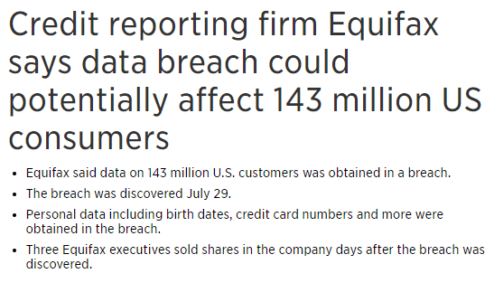
Notes:
This happened recently affect 143 million us consumers
https://www.cnbc.com/2017/09/07/credit-reporting-firm-equifax-says-cybersecurity-incident-could-potentially-affect-143-million-us-consumers.html
.

Slide 3
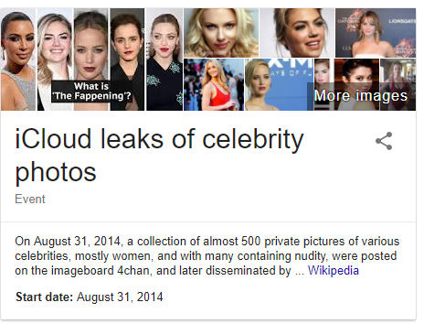
Notes:
Remember this? iCloud leaks of celebrity photos. In 2014.

Slide 4
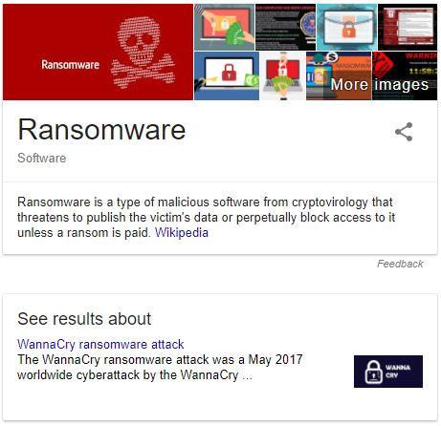
Notes:
Ransomware May 2017. you have you have to pay around US$300 to unlock your computer. US health sector was surffed the most.

Slide 5
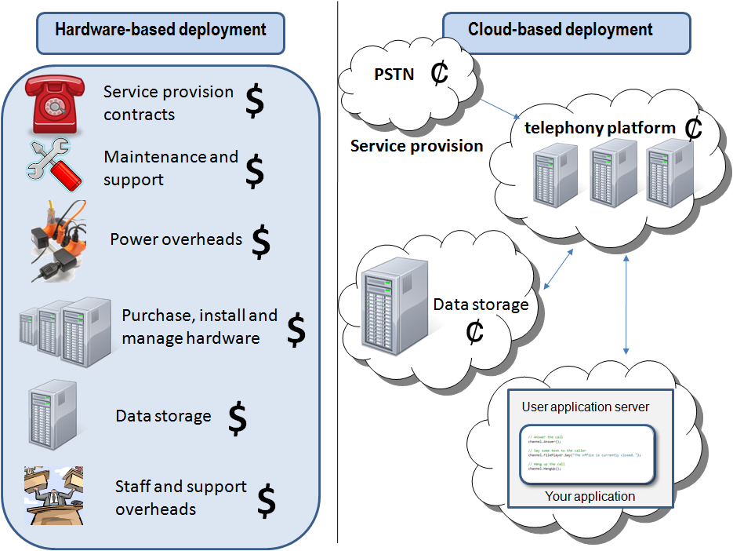
Notes:
http://blog.tmcnet.com/voice-of-ip/assets_c/2012/01/Traditional_vs_cloud_based_deployments-10587.html
We want control our data in the same way even in the cloud as in house.
But do you really need the same way?

Slide 6

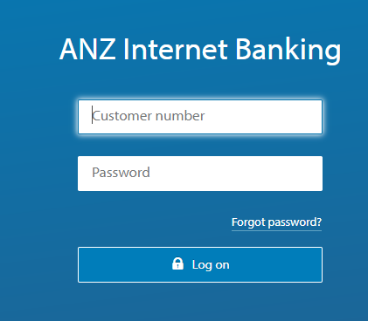
Banks past and Now
Notes:
Think of in the case of banking. In the old days, people don’t use the bank as nowadays. People put their money in the safe cases that banks provided. Banks gave the keys to customers. Customers in full “control” of their money.
Nowadays, you give your money to the bank, you don’t care where or how the bank put your money away. What you really care are: 1, you won’t lost any money, you can access whenever you want.

Slide 7
Contents
Introduction
Motivation and Main idea
Fear of the Cloud
New Problems
New Directions
Conclusion
Notes:
There are 6 parts in the topic Jessie will talk the first three and Shusen will talk the last three topics.
Jessie: Introduction
Motivation and Main idea
Fear of the Cloud
Shusen: New Problems
New Directions
Conclusion

Slide 8
Introduction
Benefits of Could computing
Flexibility
Scaling services, Customizing applications, Accessing from anywhere using various devices etc.
Efficiency
Quickly deployed, Easily upgraded, Lower costs of maintenance and infrastructure, etc.
Notes:
Benefits of cloud computing:
It is a disruptive technology that has the potential to enhance collaboration, agility, scaling, and availability, as well as providing the opportunities for cost reduction through optimized and efficient computing.
1.Flexibility
Users can scale services to fit their needs, customize applications, and access cloud services from anywhere with an Internet connection.
2.Efficiency
Enterprise users can get applications to market quickly without worrying about underlying infrastructure costs or maintenance.

Slide 9
Introduction
Situation(2009)
Some companies operates almost entirely in the cloud.
E.g. Salesforce.com – the 14 largest company
The top five software companies all have major cloud offerings.
However,
Many potential cloud users have yet to join the cloud.
Major cloud users are for the most part testing the waters with smaller project and putting only their less sensitive data in the cloud.
Notes:
Today, the 14th largest software company by market capitalization (Salesforce.com) operates almost entirely in the cloud, the top five software companies by sales revenue all have major cloud offerings, and the market as a whole is predicted to grow to $160B by 2011 (source: Merrill Lynch).
Many potential cloud users have yet to join the cloud
Major cloud users are for the most part testing the waters with smaller project and putting only their less sensitive data in the cloud

Slide 10
Introduction
Security
Why?
Notes:
Why? What do they worry about?
The answer is security.
Lack of control in the cloud is the major worry.
Transparency in the cloud implementation is one aspect of control.
For instance,
Be possible or easier attacked
Be easier to lock down information

Slide 11
Motivation and Main idea
Motivation
Help people to overcome fears of the cloud.
Main idea
Present concerns/problems and their impacts.
Provide some possible solution to mitigate these concerns and problems.
Notes:
Authors present the security issues that people concern, in order to overcome their fears.
The main ideas:
Present concerns and their impacts
Provide some possible solution to solve these concerns

Slide 12
Fear of the cloud
What are the “security ”concerns that are preventing companies from taking advantage of the cloud?
Traditional security
Availability
Third-party data control
CSA Security Guidance for Critical Areas of Focus in Cloud Computing v4.0
https://cloudsecurityalliance.org/guidance/#_overview
Notes:
Here the authors classify the security concerns as:
Traditional security
Availability
Third-party data control
The latest Cloud Security Alliance’s report contains a different sort of classifying based on 14 different security domains.

Slide 13
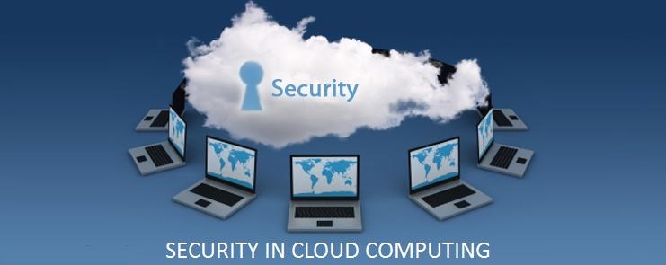
Fear of the cloud
Traditional security
Be possible or more vulnerable to attack
Be easier to lock down information
Be easier to enforce security via contracts
Notes:
These concerns involve computer and network intrusions or attacks that will be made possible or at least easier by moving to the cloud.
It could be easier to lock down information if it's administered by a third party rather than in-house, if companies are worried about insider threats
In addition, it may be easier to enforce security via contracts with online services providers than via internal controls.

Slide 14
Fear of the cloud
Traditional security
VM-level attacks.
Vulnerabilities are a potential problem in multi-tenant architectures.
Vulnerabilities have appeared in VMWare, Microsoft’s Virtual PC and Virtual Server.
e.g. Third Brigade mitigate potential VM-level vulnerabilities through monitoring and firewalls.
(Third Brigade, Inc. develops Web based security software for servers and virtual machines.)
Notes:
TS1. VM-level attacks. Potential vulnerabilities in the hypervisor or VM technology used by cloud vendors are a potential problem in multi-tenant architectures. Vulnerabilities have appeared in VMWare, Xen, and Microsoft’s Virtual PC and Virtual Server. Vendors such as Third Brigade mitigate potential VM-level vulnerabilities through monitoring and firewalls.

Slide 15
Fear of the cloud
Traditional security
Cloud provider vulnerabilities.
These could be platform level, such as an SQL-injection or cross-site scripting vulnerability
e.g.
Google Docs Glitch Exposes Private Files (2009)
https://www.pcworld.com/article/160927/google_docs_glitch_exposes_private_files.html
Notes:
Google Docs Glitch Exposes Private Files
In 2009, a glitch within Google's free Google Docs utility caused some private documents to be exposed, the company has confirmed.
https://www.pcworld.com/article/160927/google_docs_glitch_exposes_private_files.html
Security issues with Google Docs.
https://peekay.org/2009/03/26/security-issues-with-google-docs/

Slide 16
Fear of the cloud
Traditional security
Phishing cloud provider.
Phishers and other social engineers have a new attack vector.
e.g.
The Salesforce phishing incident (2007)
https://www.pcworld.com/article/160927/google_docs_glitch_exposes_private_files.html
Notes:
the Salesforce phishing incident
In 2007, Salesforce warned customers that they may be the targets of malicious software or phishing scams, after one of its employees was tricked into divulging a corporate password.
https://www.pcworld.com/article/139353/article.html

Slide 17
Fear of the cloud
Traditional security
Expanded network attack surface.
The cloud user must protect the infrastructure used to connect and interact with the cloud, a task complicated by the cloud being outside the firewall in many cases.
Notes:
For instance, Security Evaluation of Grid Environments(https://hpcrd.lbl.gov/HEPCybersecurity/HEP-Sec-MillerMar2005.ppt)
shows an example of how the cloud might attack the machine connecting to it.

Slide 18
Fear of the cloud
Traditional security
Authentication and Authorization.
The enterprise authentication and authorization framework does not naturally extend into the cloud.
Enterprise Authentication &
Authorization
Cloud resources (security data)
Notes:
How does a company meld its existing framework to include cloud resources?
Furthermore, how does an enterprise merge cloud security data (if even available) with its own security metrics and policies?

Slide 19
Fear of the cloud
Traditional security
Forensics in the cloud.
Traditional forensic permit investigators to seize equipment and perform detailed analysis on the media and data recovered.
However, cloud forensics are not as easy as traditional ones, it depends on cloud providers or their attitude toward forensics.
Notes:
Unlike cloud forensics, a traditional setup would require backup of all the data on physical entities such as DVDs, portable HDDs, etc. for use by people involved in forensics. A normal, traditional setup may also be asked to stop functioning so that records are not changed while forensics is being completed.
For cloud forensics, one can easily replicate the entire process on the backup servers as clouds are always on-demand services. These backup servers can be used by investigators to reconstruct crime and for investigation while the normal business is carried out using main servers. Some additional expenses may be incurred but that is better than the costs of backing up entire data onto physical entities or stopping activities altogether.
However, cloud forensics are not as easy as they seem; the reason being the ignorance of cloud providers or their attitude toward forensics. Different cloud providers use different approaches and cannot easily identify the information that needs to be provided to the people involved in forensics. They may or may not offer all the required data to the investigators.
Traditional digital forensic methodologies permit investigators to seize equipment and perform detailed analysis on the media and data recovered. The likelihood therefore, of the data being removed, overwritten, deleted or destroyed by the perpetrator in this case is low. More closely linked to a CC environment would be businesses that own and maintain their own multi-server type infrastructure, though this would be on a far smaller scale in comparison.
However, the scale of the cloud and the rate at which data is overwritten is of concern.

Slide 20
Fear of the cloud
Availability
These concerns center on critical applications and data being available.
e.g.
Google – one-day outage in October, 2008
Amazon S3 – over seven-hours downtime in July, 2008
FlexiScale – 18 hours outage in October, 2008
Google App Engine and Amazon both outage in October, 2012
Notes:
Amazon EC2 - permanently destroyed some data in April, 2011
Amazon's Cloud Crash Disaster Permanently Destroyed Many Customers' Data
https://www.businessinsider.com.au/amazon-lost-data-2011-4?r=US&IR=T

Slide 21
Fear of the cloud
Availability
Uptime.
Can a cloud provider’s server uptime compares well with user’s own data?
Single point of failure and attack.
More single points may lead to more failures and attacks.
Assurance of computational integrity.
Can a cloud provider be faithfully running a hosted application and give valid results?
Notes:
A1. Uptime. As with the Traditional Security concerns, cloud providers argue that their server uptime compares well with the availability of the cloud user’s own data centres. Besides just services and applications being down, this includes the concern that a third-party cloud would not scale well enough to handle certain applications.
A2. Single point of failure. Cloud services are thought of as providing more availability, but perhaps not – there are more single points of failure and attack.
A3. Assurance of computational integrity. Can an enterprise be assured that a cloud provider is faithfully running a hosted application and giving valid results? For example, Stanford's Folding@Home project gives the same task to multiple clients to reach a consensus on the correct result.

Slide 22
Fear of the cloud
Third-party data control
The legal implications of data and applications being held by a third party are complex and not well understood.
There is also a potential lack of control and transparency when a third party holds the data.
Notes:
Part of the hype of cloud computing is that the cloud can be implementation independent,
but in reality regulatory compliance requires transparency into the cloud.

Slide 23
Fear of the cloud
Third-party data control
Due diligence.
If a cloud user do a legal action, such as selection or deletion, can a cloud user compel the cloud provider to respond in the required time-frame?
how can a cloud user be guaranteed that data has been deleted by the cloud provider?
Notes:
This is about if a cloud provider can respond in the required time-frame.
or
whether a cloud provide can perform the functions that a cloud user expected.

Slide 24
Fear of the cloud
Third-party data control
Auditability.
Audit difficulty is another side effect of the lack of control in the cloud.
How do you perform an on-site audit when you have a distributed and dynamic multi-tenant computing environment spread all over the globe?
It may be very difficult to satisfy auditors that your data is properly isolated and cannot be viewed by other customers
Notes:
Is there sufficient transparency in the operations of the cloud provider for auditing purposes?
Currently, this transparency is provided by documentation and manual audits.
A related concern is proper governance of cloud-related activity. It’s easy, perhaps too easy, to start using a cloud service .
One popular auditing guideline is the SAS 70, which defines guidelines for auditors to assess internal controls, for instance controls over the processing of sensitive information. SOX and HIPAA are other well-known regulations.
US government agencies generally need to follow guidelines from FISMA, NIST, and FIPS.
Certain regulations require data and operations to remain in certain geographic locations.
Cloud providers are beginning to respond with geo-targeted offerings.

Slide 25
Fear of the cloud
Third-party data control
Contractual obligations.
There are uncertainties with using another company's infrastructure, but any uncertainty is bad for business.
e.g.
Amazon AWS’s terms: 1.5 Program Changes.
“We may change or discontinue the Program or any aspect of it, including these Terms at any time in our sole discretion (with or without prior notice to you), including without limitation, changing or discontinuing any benefits offered under the Program.”
Notes:
One problem with using another company's infrastructure besides the uncertain alignment of interests is that there might be surprising legal implications. For instance, here is a passage from Amazon’s terms of use : 10.4. Non-Assertion. During and after the term of the Agreement, with respect to any of the Services that you elect to use, you will not assert, nor will you authorize, assist, or encourage any third party to assert, against us or any of our customers, end users, vendors, business partners (including third party sellers on websites operated by or on behalf of us), licensors, sublicensees or transferees, any patent infringement or other intellectual property infringement claim with respect to such Services. This could be interpreted as implying that after you use EC2, you cannot file infringement claims against Amazon or its customers suggesting that EC2 itself violates any of your patents. It's not clear whether this non-assert would be upheld by the courts, but any uncertainty is bad for business. (This passage cannot be found on the Amazon web site.)

Slide 26
Fear of the cloud
Third-party data control
Cloud Provider Espionage.
This is the worry of theft of company proprietary information by the cloud provider.
Notes:
For example, Google Gmail and Google Apps are examples of services supported by a private cloud infrastructure. Corporate users of these services are concerned about confidentiality and availability of their data. According to a CNN article [50]: For Shoukry Tiab, the vice president of IT at Jenny Craig, which uses Postini and Google Maps, the primary concern is security and confidentiality. "Am I nervous to host corporate information on someone else's server? Yes, even if it's Google." Note that for consumers, there were initially widespread confidentiality concerns about Gmail, but now those concerns seem to have faded. We believe this is an example of the Privacy Hump: Early on in the life cycle of a technology, there are many concerns about how these technologies will be used. These concerns are lumped together forming a “privacy hump” that represents a barrier to the acceptance of a potentially intrusive technology…. Over time, however, the concerns fade, especially if the value proposition is strong enough. Consumers at least seem to have decided that, in this case, the dangers of placing their data in the cloud were outweighed by the value they received.

Slide 27
Fear of the cloud
Third-party data control
Data Lock-in.
How does a cloud user avoid lock-in to a cloud-computing vendor?
e.g.
A cloud platform shuts down so that customers have to rewrite their applications to run on different platforms.
Notes:
The data might itself be locked in a proprietary format, and there are also issues with training and processes.
There is also the problem of the cloud user having no control over frequent changes in cloud-based services.
Coghead is one example of a cloud platform whose shutdown left customers scrambling to rewrite their applications to run on a different platform.
Of course, one answer to lock-in is standardization, for instance GoGrid API.(http://www.gogrid.com/company/pressreleases/gogrid-moves-api-specification-tocreativecommons.php)

Slide 28
Fear of the cloud
Third-party data control
Transitive nature.
The contracted cloud provider might itself use subcontractors, over whom the cloud user has even less control.
e.g.
In 2008, the online storage service called The Linkup which in turn used Nirvanix, The Linkup shutdown after losing loads of customer data, which some say was the fault of Nirvanix.
Notes:
Another possible concern is ….
Another example is Carbonite, who is suing its hardware providers for faulty equipment causing loss of customer data.

Slide 29
3. NEW PROBLEMS Cheap data and data analysis Cost-effective defense of availability Increased authentication demands Mash-up authorization 4. NEW DIRECTIONS Information-centric security High-Assurance Remote Server Attestation Privacy-Enhanced Business Intelligence 5. CONCLUSION
Notes:
My parts are as the following:
The section will highlight the “new” security problems when cloud computing becomes maturation and widely used.
3,new problems,
Cheap data and data analysis Cost-effective defense of availability Increased authentication demands Mash-up authorization
4. new directions, and 5. conclusion
Information-centric security High-Assurance Remote Server Attestation Privacy-Enhanced Business Intelligence
Attestation=authentication, certification

Slide 30
Cheap data and data analysis
Enormous data sets in the cloud can be commercialized for advertising
Google
Possible for no Google
Impact on privacy
Potentially massive attack
Privacy- Have you been googled?
18 month to keep your data then anonymised
Anonymizing Data
A difficult problem
Netflix
Massachusetts General Hospital
Notes:
The section will highlight the “new” security problems when cloud computing becomes maturation and widely used.
The first new problem is “Cheap data and data analysis”. When there are huge amount of data that can be used to analyse
for the purpose of advertisement. Google is an example. It collect and analyse customer data for its advertising network. Because of the data is so cheap even companies without Google's recourses and do the same thing.
The impact on privacy:
Because of the cloud, attackers potentially have massive, centralized databases available for analysis and also the raw computing power to mine these databases. For example, Google is essentially doing cheap data mining when it returns search results. How much more privacy did one have before one could be Googled?
Anonymizing Data
Because of privacy concerns, enterprises running clouds collecting data have felt increasing pressure to anonymize their data.
18 month to kep your data then anonymised.
Anonymizing data is a difficult problem.

Slide 31
Cost-effective defense of availability
Availability is still important even for adversary
Lithuania cyber attack
losses of productivity
degraded trust in the infrastructure
potentially costly backup measures
operate on the basis of minimization of losses, required service levels, or similar measures.
Notes:
This is just one paragraph-Cost-effective defense of availability
Availability is still important even for adversary
operate on the basis of minimization of losses, required service levels, or similar measures.
Availability also needs to be considered in the context of an adversary whose goals are simply to sabotage activities. Increasingly, such adversaries are becoming realistic as political conflict is taken onto the web, and as the recent cyber attacks on Lithuania confirm [31]. The damages are not only related to the losses of productivity, but extend to losses due to the degraded trust in the infrastructure, and potentially costly backup measures. The cloud computing model encourages single points of failure. It is therefore important to develop methods for sustained availability (in the context of attack), and for recovery from attack. The latter could operate on the basis of minimization of losses, required service levels, or similar measures.

Slide 32
Increased authentication demands
Thin clients no software installed on client side
Advantage: making software piracy more difficult and giving the ability to centralize monitoring
May help prevent the spread of sensitive data on untrustworthy clients.
opportunities related to security
Users do not have to worry about the risks of any actions
Their security is managed by the cloud
Stimulates mobility of users, but increases the need to address authentication in a secure manner
Threat of phishing and other abusive technologies
Notes:
Thin clients no software installed on client side
Advantage: making software piracy more difficult and giving the ability to centralize monitorin
May help prevent the spread of sensitive data on untrustworthy clients.
opportunities related to security
Users do not have to worry about the risks of any actions
Their security is managed by the cloud
Stimulates mobility of users, but increases the need to address authentication in a secure manner
Threat of phishing and other abusive technologies

Slide 33
Mash-up authorization
As adoption of cloud computing grows, we are likely to see more and more services performing mash-ups of data. This development has potential security implications
Data leaks
requirements on how access is authorized for reasons of usability
centralized access control
Facebook user can upload both sensitive and non-sensitive data
utilized by third party applications
Notes:
The Last new problems of the four is “ Mash-up authorization”
As adoption of cloud computing grows, we are likely to see more and more services performing mash-ups of data. This development has potential security implications
Data leaks
requirements on how access is authorized for reasons of usability
centralized access control
Facebook user can upload both sensitive and non-sensitive data
utilized by third party applications

Slide 34
Information-centric security
self-protection-- self-describing and defending
encrypted and packaged with a usage policy
secure environment using virtualization
Information-centric security is a natural extension of the trend toward finer, stronger, and more usable data protection.
Notes:
The fist of new direction is “Information-centric security”
self-protection-- self-describing and defending
encrypted and packaged with a usage policy
secure environment using virtualization
Information-centric security is a natural extension of the trend toward finer, stronger, and more usable data protection.

Slide 35
High-Assurance Remote Server Attestation
lack of transparency
Data owners wish to audit how their data is being handled at the cloud, and in particular, ensure that their data is not being abused or leaked,
or at least have an unalterable audit trail when it does happen.
Trusted Computing
a trusted monitor installed at the cloud server that can monitor or audit the operations of the cloud server
When the data owner receives this proof of compliance, it can verify that the correct monitor code is run, and that the cloud server has complied with access control policies.
Notes:
The second new direction
Attestation=authantication + certification?

Slide 36
Privacy-Enhanced Business Intelligence
Encryption of all cloud data
Searching and indexing the data
State-of-the-art cryptography
Versatile encryption schemeson
homomorphic encryption
even encrypted data can enable anomaly detection that is valuable from a business intelligence standpoint
potentially enable better insider threat detection
Apart from ensuring privacy, applied cryptography may also offer tools to address other security problem
storage server can show a compact proof that it is correctly storing all of the client’s data.
Notes:
Privacy-Enhanced Business Intelligence
Encryption of all cloud data
even encrypted data can enable anomaly detection that is valuable from a business intelligence standpoint
potentially enable better insider threat detection
Apart from ensuring privacy, applied cryptography may also offer tools to address other security problem
storage server can show a compact proof that it is correctly storing all of the client’s data.

Slide 37
CONCLUSION
“Cloud Computing is likely to have the same impact on software that foundries have had on the hardware industry.”
Cloud fears largely stem from the perceived loss of control of sensitive data
the new threats require new constructions to maintain and improve security
these are tools to control and understand privacy leaks, perform authentication, and guarantee availability in the face of cloud denial-of-service attacks
Notes:
The Conclusion :
Overcome the fear of cloud. Whether adoption becomes as prevalent and deep as some forecast will depend largely on overcoming fears of the cloud.
Cloud fears largely stem from the perceived loss of control of sensitive data. we propose to extend control measures from the enterprise into the cloud through the use of Trusted Computing and applied cryptographic techniques.
Our vision also relates to likely problems and abuses arising from a greater reliance on cloud computing, and how to maintain security in the face of such attacks
these are tools to control and understand privacy leaks, perform authentication, and guarantee availability in the face of cloud denial-of-service attacks.
Thank you!

Slide 38
Question and Answer
Q: Why does the enterprise authentication and authorization framework not naturally extend into the cloud?
A:
The cloud provider might not have implemented a framework that can extend the enterprise authentication and authorization framework such as crossover security groups.
The client company might not be able to melt its existing authentication and authorization framework into cloud resources.
It’s hard for the enterprise to merge cloud security data with its own security metrics and policies.

